Slide 1
Education at a Time of Crisis
Stephen Scoffham
Visiting Reader in Sustainability and Education, Canterbury Christ Church University
March 2022
Notes:
We now know beyond all reasonable doubt that we are living at a time of environmental crisis. Forest fires, droughts, floods storms and other disasters are reported with increasing regularity from around the globe. Climate change has taken centre stage in recent years, but pollution and biodiversity loss are also major threats.
Education is widely seen as having a part to play in addressing the challenges that lie ahead. This power point considers some of the issues. The image on this opening slide hints at the need to respect nature and value indigenous wisdom.
How do you think learning from nature might change the way that we live our lives?

Slide 2
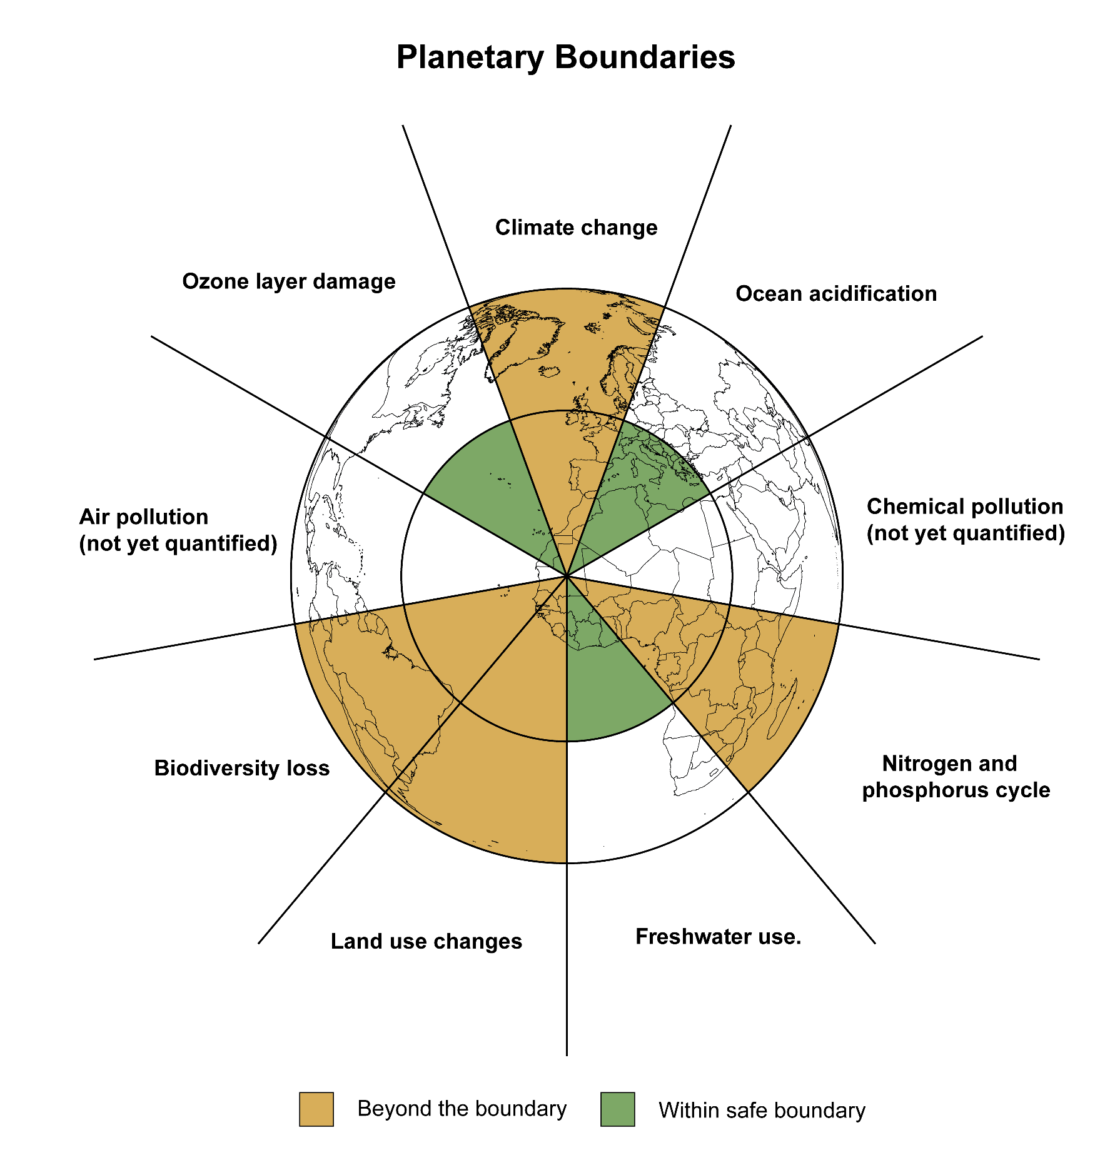
After Rockstrom and Klum 2015 and Raworth 2017
Notes:
The notion of planetary boundaries was developed by Johan Rockstrom and colleagues at the Stockholm Resilience Centre.
It draws on ecological notions such as carrying capacity, feedback and resilience to identify essential Earth systems and to assess points at which they might become dangerously destablised.
Their research indicates that several key breached have already been breached, whilst others are reaching their critical threshold.
An informed understanding of environmental problems is an essential basis for future action.
Does this model help you to understand how different aspects of sustainability are linked together? Does anything in the model surprise you?

Slide 3
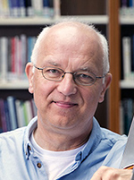
Purpose of education
The educational task consists in arousing the desire in another human being for living in the world in a grown-up way (Biesta 2017 p7)
We have to ask of everything that is potentially there whether it is desirable for the life of the child, for the life of the child that lives with others, and for the life we live together on a vulnerable planet with limited capacity (Biesta 2015 p8)
Three enduring challenges:
Democracy – how to live together
Ecology – how to manage and sustain our lives on a finite planet
Care – how we ‘carry’ others, particularly those who cant care for themselves
A shift away from competition towards co-operation
A shift away from survival towards life
Notes:
How can education contribute to addressing the environmental crisis? In order to answer this question we need to consider what education is for and to recognise its fundamental characteristics.
Educational philosopher, Gert Biesta, argues that education has multiple purposes one of which is the cultivation of personal qualities or desires. This is necessarily an uncertain process which cannot be guaranteed.
Asking whether what we desire is actually desirable for ourselves, others or the planet is one way of encapsulating both the fundamental aim of education and the challenges of the times in which we live.
What criteria might be used to assess what we think is desirable?

Slide 4
Ecological and environmental crisis
Climate change, biodiversity, population growth
Current context
Economic system
Social structures
Human-nature relationship
Innovations
Technology and
‘green initiatives’
Action
International agreements and accords (SDGs)
Role of education
Disciplinary knowledge
Conceptual understanding
Self understanding
Identity and belonging
Emotional learning
Global perspectives
Wisdom and values
Sustainability Education
Foundational narratives
Deeply held assumptions and beliefs
Notes:
What happens in the classroom and other formal educational settings may seem relatively straightforward but it is actually a synthesis of a complex range of forces.
To begin with there is the need to abide by curriculum requirements which are themselves based on a deeper ideas about the theory and practice of education. At the same time, the economic, social, cultural and political context colours the way that education is practiced and perceived.
Hidden assumptions about what we value both as individuals and as a society also underpin our actions. The current environmental crisis is an additional factor. The way that these different forces interact is constantly changing and evolving.
When you in the classroom d o you feel that you have reasonable degree of autonomy to exercise your professional judgement? How are you able to overcome any barriers you encounter?

Slide 5
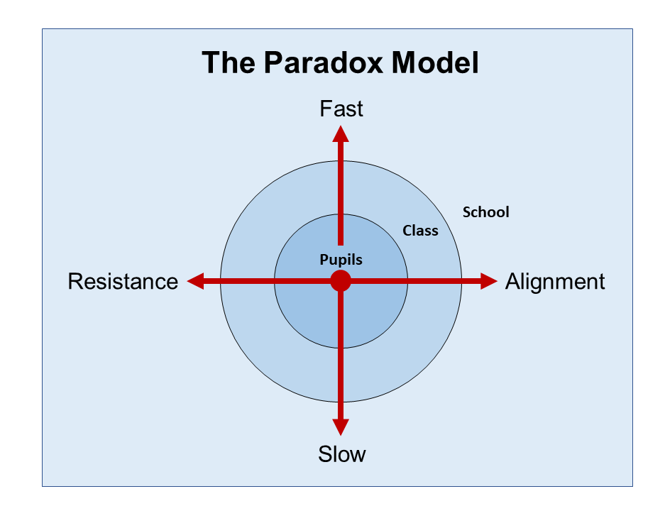
Kemp and Scoffham 2022
Kamp and Scoffham 2022
Notes:
The paradox model is one way to make sense of different responses to the current environmental emergency. It is structured around two axes.
The horizontal (x) axis refers to the extent to which practice either aligns with or resists current thinking. The vertical (y) axis relates to the speed of the response – fast or slow.
Education is necessarily a slow process which reflects the norms of society. This places it in ‘slow-alignment’ quadrant. Political campaigning and direct action generally fall into the ‘fast-resistance’ quadrant.
One of the key points about the paradox model is that it provides an inclusive framework. It also recognises that responses operate at different scales and acknowledges that they can all be legitimate.
Are there any circumstances in which you think that teachers should encourage children to take political action? Have you ever felt the need to this and, if so, what was the result.

Slide 6
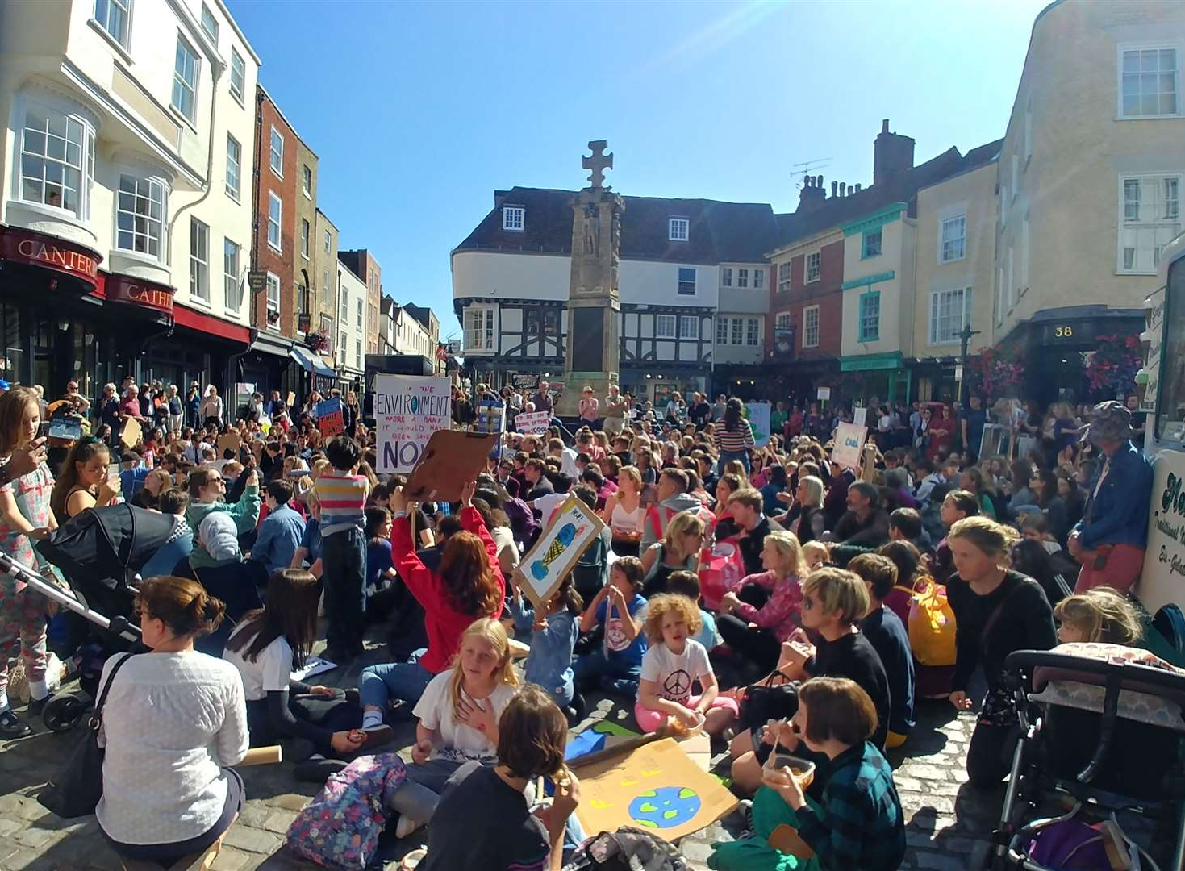
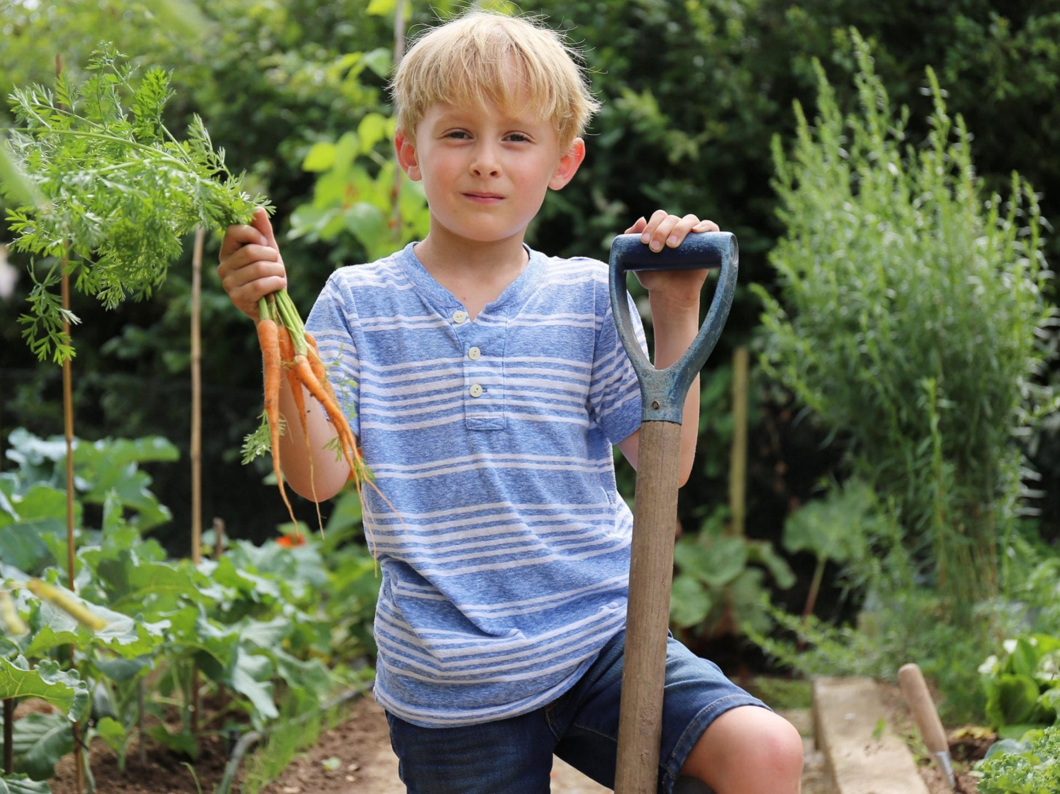
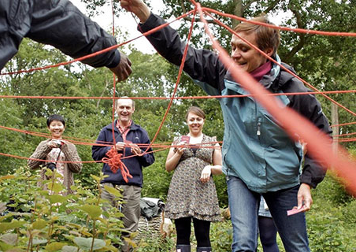
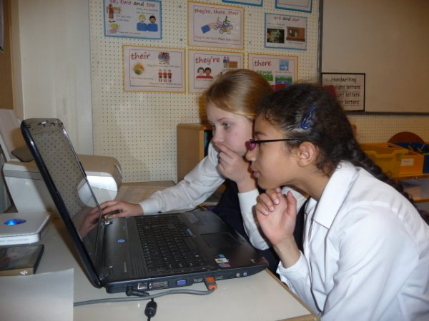
Fast resistance
Fast alignment
Slow resistance
Slow alignment
Notes:
Schools and children all over the world are engaging with sustainability education. These four images illustrate different approaches.
Fast-resistance School strikes and protests which raise the profile of
sustainability in democratic/political decision making
Fast-alignment Gardening and practical activities in the natural
environment which engage with sustainability in a
practical way
Slow-resistance New thinking about the sustainability education and
how it can be delivered in formal and informal settings
Slow alignment Classroom activities and investigations which deepen
pupils’ thinking and understanding of sustainability
issues.
In which of these four groups does the work that you have done with children seem to fit best?

Slide 7
Hope
Despair
We stand at a critical time in Earth’s history …… As the world becomes increasingly interdependent and fragile, the future at once holds great peril and great promise.
Earth Charter (2000)
Notes:
Teaching pupils about sustainability is a delicate balancing act.
It is important to be truthful about the current crisis and its implications. However, there is a danger of triggering anxiety and denial responses.
Celebrating the wonders of the world around us is often an effective starting point . Empowering children and helping them to do something positive about environmental problems (however small) is another valuable approach.
Ultimately, education needs to be conducted in spirit of hope – gloom and despair don’t provide a context in which learning is likely to thrive.
Do you think it is genuinely possible to be both hopeful and truthful about the current environmental crisis? How do you personally try to harness the optimism and passion of the younger generation?

Slide 8
References
Biesta, G. (2015) ‘The Duty to Resist: Redefining the Basics of Today’s
Schools’, Research on Steiner Education, 6: 1-11..
Biesta, G. (2017) The Rediscovery of Teaching, London: Routledge.
Earth Charter (2000) Available online at https://earthcharter.org/library/the-earth-charter-text/
Kemp, N. and Scoffham, S. (2022) ‘The Paradox Model: Towards a
Conceptual Framework for Engaging with Sustainability in Higher
Education’ in International Journal of Sustainability in Higher Education.
RockstrÖm, J., and Klum, M. (2015) Big World Small Planet, Stockholm: Max StrÖm Publishing
Rockstrom, J. (2020) ‘Ten years to transform the future of humanity – or
destabilize the planet’, TED talk
Solnit, R. (2020) ‘Hope in a Time of Crisis’ The Guardian 7th April pp5-9

