Slide 1
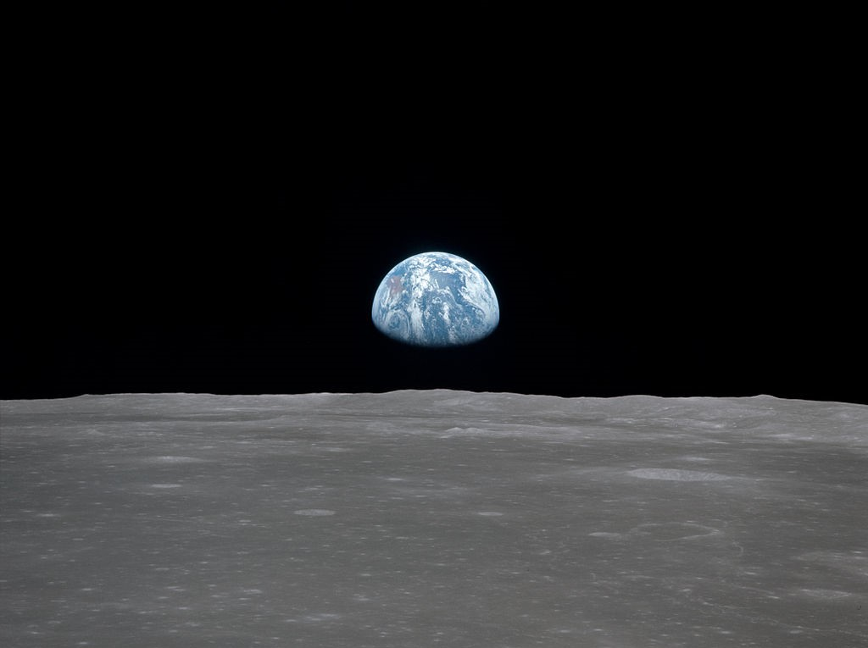
Making Sense of the SDGs
Stephen Scoffham
5th January 2022
Source: WikiCommons
Notes:
Sustainability is a way of looking at the world and our lives.
It recognises that we have to live within planetary limits.
And it is sensitive to the extraordinary beauty and fragility of the Earth.
What makes sustainability such an urgent issue at the current time?

Slide 2
1-6
Goal 1: End poverty in all its forms
Goal 2: Zero Hunger
Goal 3: Health
Goal 4: Education
Goal 5: Gender equality and women’s empowerment
Goal 6: Water and Sanitation
7-12
Goal 7: Energy
Goal 8: Economic Growth
Goal 9: Infrastructure, industrialization
Goal 10: Inequality
Goal 11: Cities
Goal 12: Sustainable consumption and production
13-17
Goal 13: Climate Change
Goal 14: Oceans
Goal 15: Biodiversity, forests, desertification
Goal 16: Peace, justice and strong institutions
Goal 17: Partnerships
7-12
13-17
Search SDG Site
A-Z Site Index
17 Goals to Transform Our World
The Sustainable Development Goals are a call for action by all countries – poor, rich and middle-income – to promote prosperity while protecting the planet. They acknowledge that ending poverty must go hand-in-hand with strategies that build economic growth and addresses a range of social needs including education, health, social protection, and job opportunities, while tackling climate change and environmental protection.
Notes:
There are 17 SDGs and they are designed to provide a vision of a better world. Each goal is supported by a number of targets which provide an accountability framework.
They SDGs apply for the period 2015-30 and extend and develop the Millennium Development Goals (MDGs) which applied from 2000-2015.
The SDGs were agreed by every member state of the United Nations. They are intended for local communities as well as national governments.
Do you think the goals are clear, appropriate and attainable? Can you think of any additional goal that you would add?

Slide 3
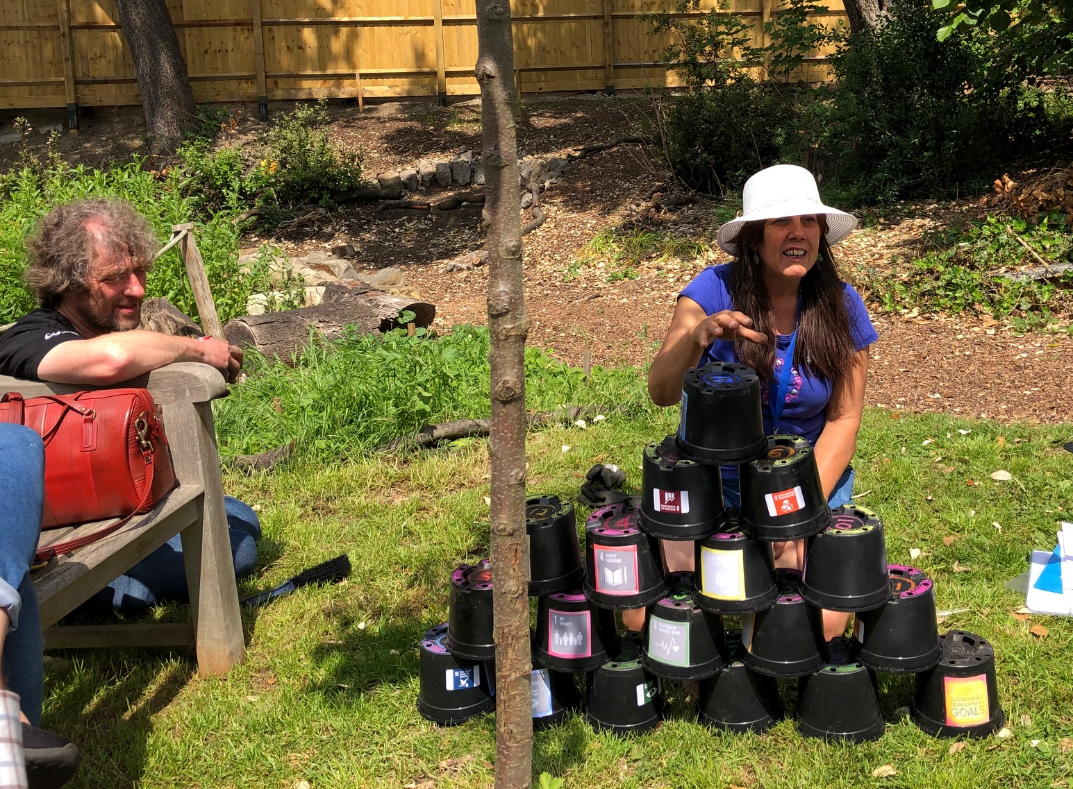
© Stephen Scoffham
Notes:
The SDGs can be grouped in many different ways.
Some people see the ecological goals as fundamental because all life depends on the environment.
The goal which focuses on partnership (goal 17) is sometimes seen as a key.
It is instructive to experiment with different arrangements, as in this activity, using labelled flower pots.
What way of grouping the SDGs makes best sense to you? How does this differ from how other people arrange them?

Slide 4
SDG Pyramid
Notes:
This SDG pyramid emphasises how all the goals depend on each other. It also illustrates how social, economic and environmental factors all play a part in our lives.
Sustainable living is about finding a balance.
Given that the goals all inter-relate, does it make sense to try to implement them individually?

Slide 5
Sustainable development involves integrating economic, social and environmental aspects at all levels.
UNGA 2012
Economic
Social
Environmental
The goals are actively dangerous: they lock in the global development agenda for the next 15 years around a failing economic model that requires urgent and deep structural changes.
Hickel 2015
Social
Economic
Environmental
Business as usual?
Notes:
The SDGs appear to give equal weight to environmental, social and economic factors.
However, in practice, economics and business dominate.
It is also clear that the SDGs reflect the interests of the world’s most powerful countries.
Furthermore, the SDGs do not attempt to analyse why so many people remain hungry when there is enough food for everyone, or why some countries are so much richer than others.
To what extent do you think the SDGs reflect the legacy of colonialism?

Slide 6
Other critiques
The SDGs fail to take proper account of heritage, culture, politics and power relations
They rely on technology and ‘progress’ to solve problems
They focus on gender but not racial equality
They make no effort to explain the causes of poverty and global inequalities
But
The SDGs set out a vision for the future
They bring together social, environmental and economic issues
They provide a framework that been agreed by all nations
Notes:
Despite their weaknesses the SDGs have gained considerable support from many sections of society.
Do you know of any groups or organisations in your area which are using the SDGs in their work? Have you used them in your teaching? If so, how?

Slide 7
Ecological
overshoot
Human
deprivation
After Raworth 2017
Notes:
The challenge which confronts us today is to find a way for humanity flourish within environmental limits.
Many people argue that we need a new vision of prosperity that isn’t based on ever increasing consumption.
Kate Raworth proposes the notion of ‘doughnut economics’. In her model the ring of the doughnut represents what she calls ‘a safe and just place for humanity’. This space is bounded by ecological overshoot on the one hand and social deprivation on the other.
Do you think the SDGs can been seen as providing a similar framework? How else might we model this fundamental and complex challenge?

Slide 8
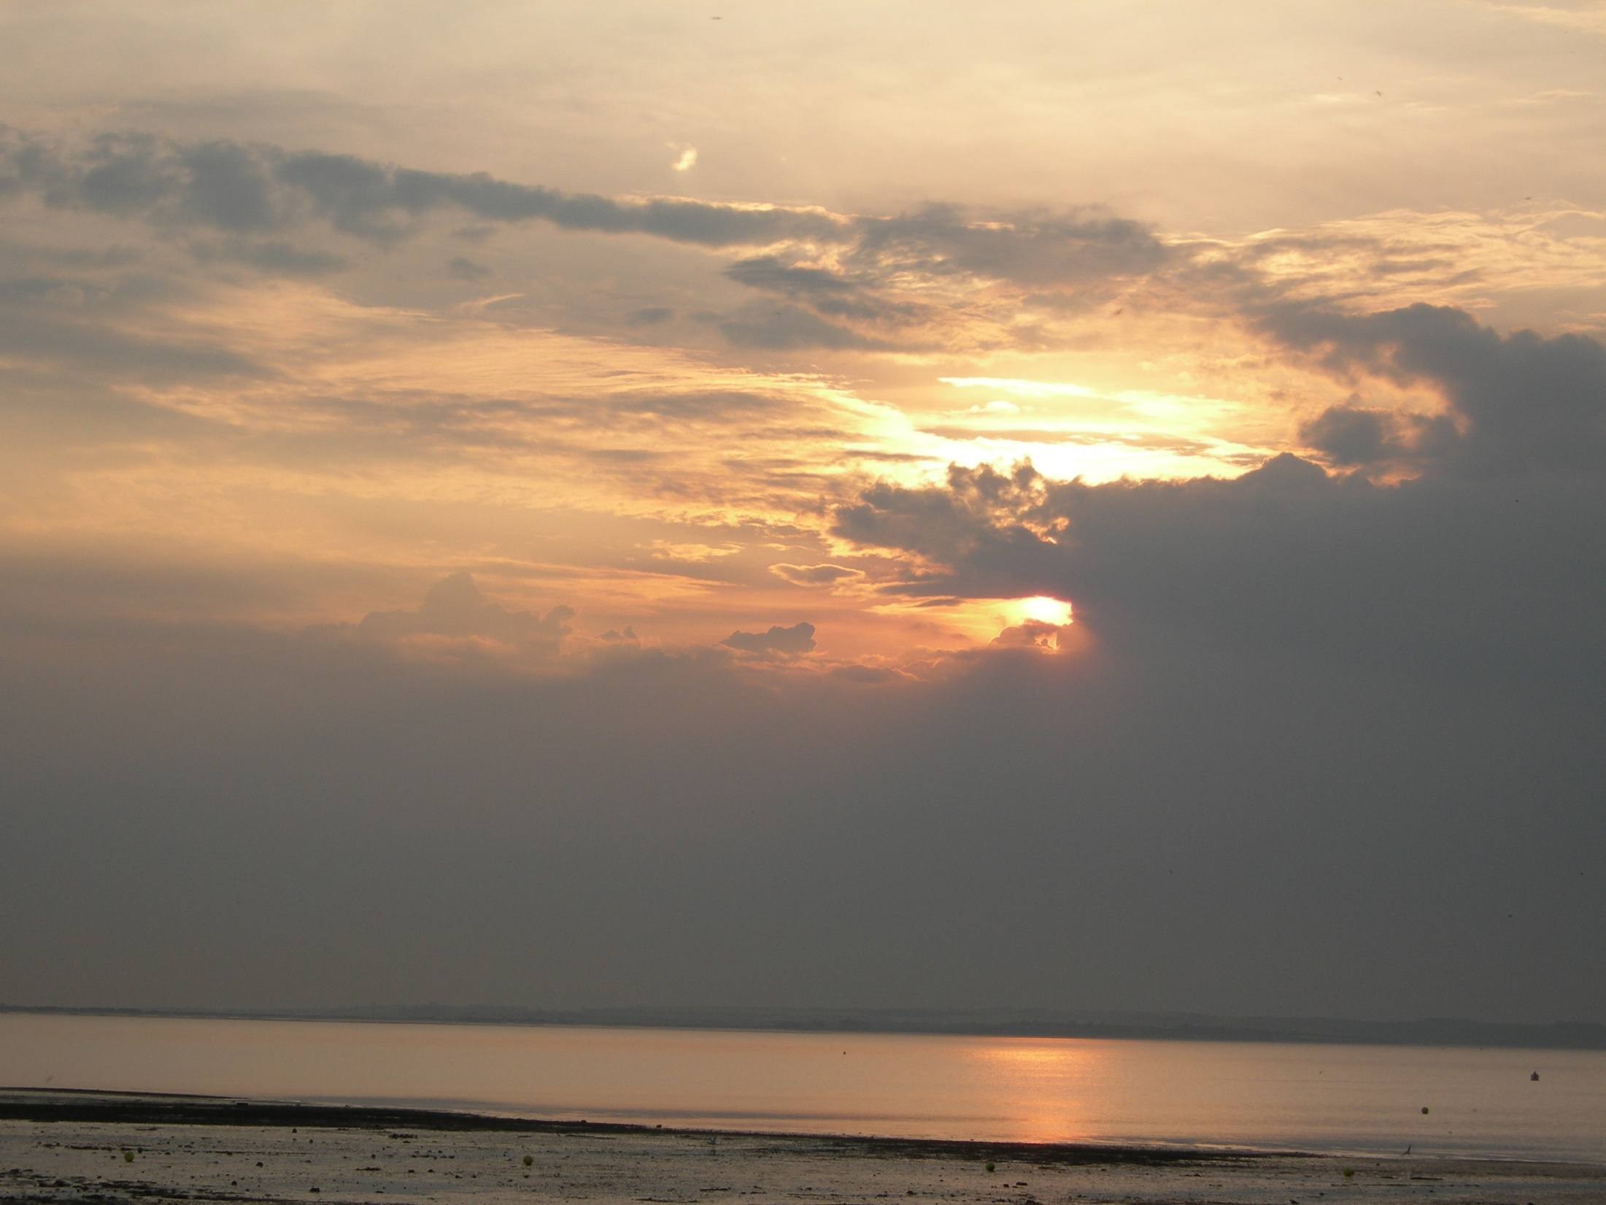
A Vision for the Future
Does the vision have to be attainable or does it simply serve as an inspiration which draws us forward?
© Stephen Scoffham
Notes:
As we head into troubled times, we need both a vision for the future and a strategy for getting there.
Are you hopeful or pessimistic about the future, both in your own life and for the wider world? How do you think children view the future?

