Slide 1
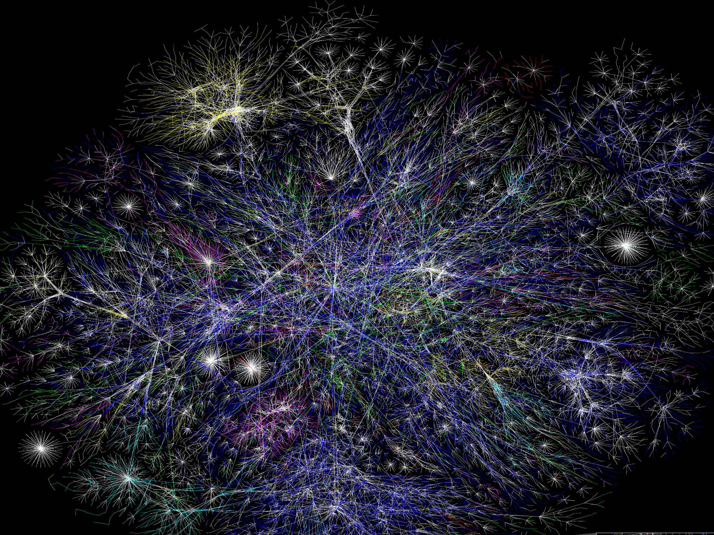
Sustainability:
A Global Challenge
Dr Stephen Scoffham
Visiting Reader in Sustainability and Education
Canterbury Christ Church University
January 2022
Photo: Wikimedia Commons
Notes:
This Power Point provides a brief overview of the world today, highlighting ten key aspects of sustainability.
The image which provides the title background shows a partial
map of the internet. Perhaps unsurprisingly, the map highlights
interconnections.
Interconnectivity is not only a central feature of the human brain, it is also fundamental to a sustainability mindset.
This Power Point is an introduction to the fascinating and urgent challenges that confront us all. As you engage with it you might want consider what has been left out and whether you agree with the argument that is presented.

Slide 2
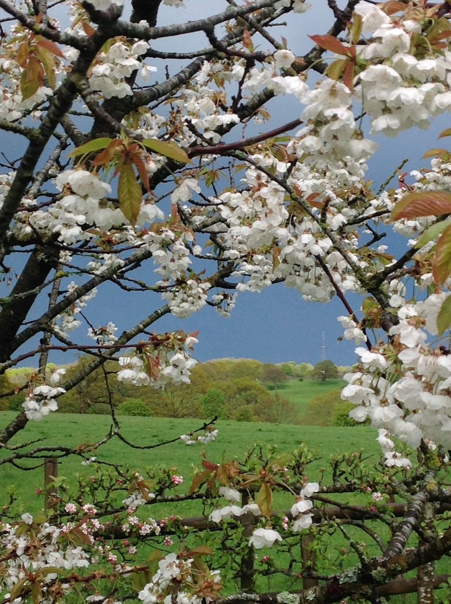
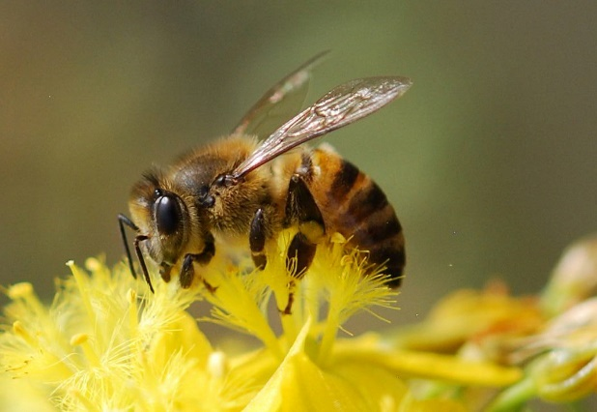
1. We live on a remarkable planet
Photo: Ingrid Schudel
Photo: Stephen Scoffham
Photo Stephen Scoffham
Notes:
We live on a remarkable planet
The way that plants and creatures interact to create habitats is one of a number of key understandings to have emerged from ecology.
Studying the web of life reveals the importance of harmony, balance and co-operation. Nature may be ‘red in tooth and claw’ but it is also finely balanced and carefully attuned.
The interconnections between different forms of life creates resilience and enables plants and creatures to bounce back from surprise events.
Can you identify some of the interconnections in a habitat/environment near you?

Slide 3
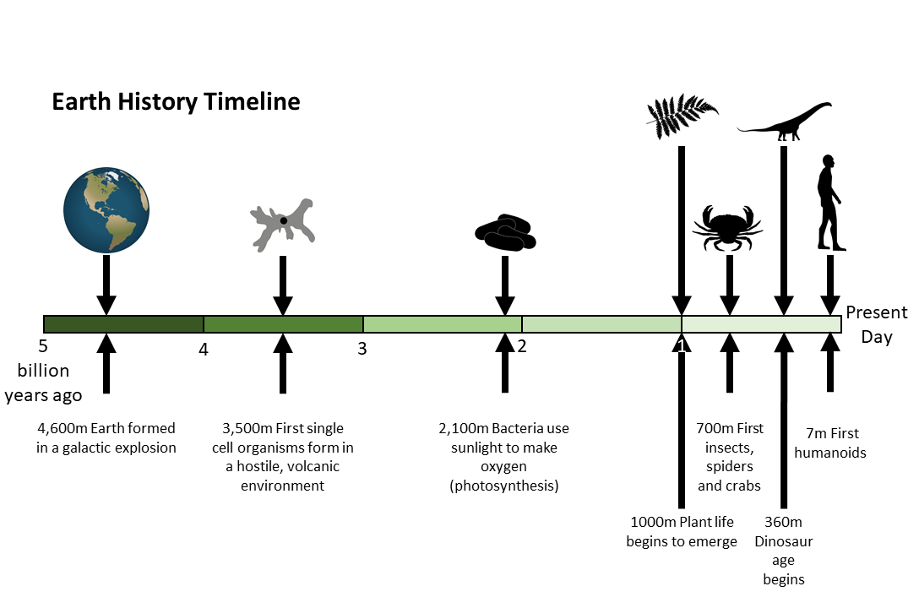
Notes:
When human beings first emerged on the Earth, they inherited a world that was richer in biodiversity than at any previous time in geological history.
People are newcomers to the pantheon of creation but in a remarkably short time they have come to dominate all other forms of life.
Human impact is now regarded as geologically significant. A new term, the ‘Anthropocene’, has been coined to describe the current era.

Slide 4
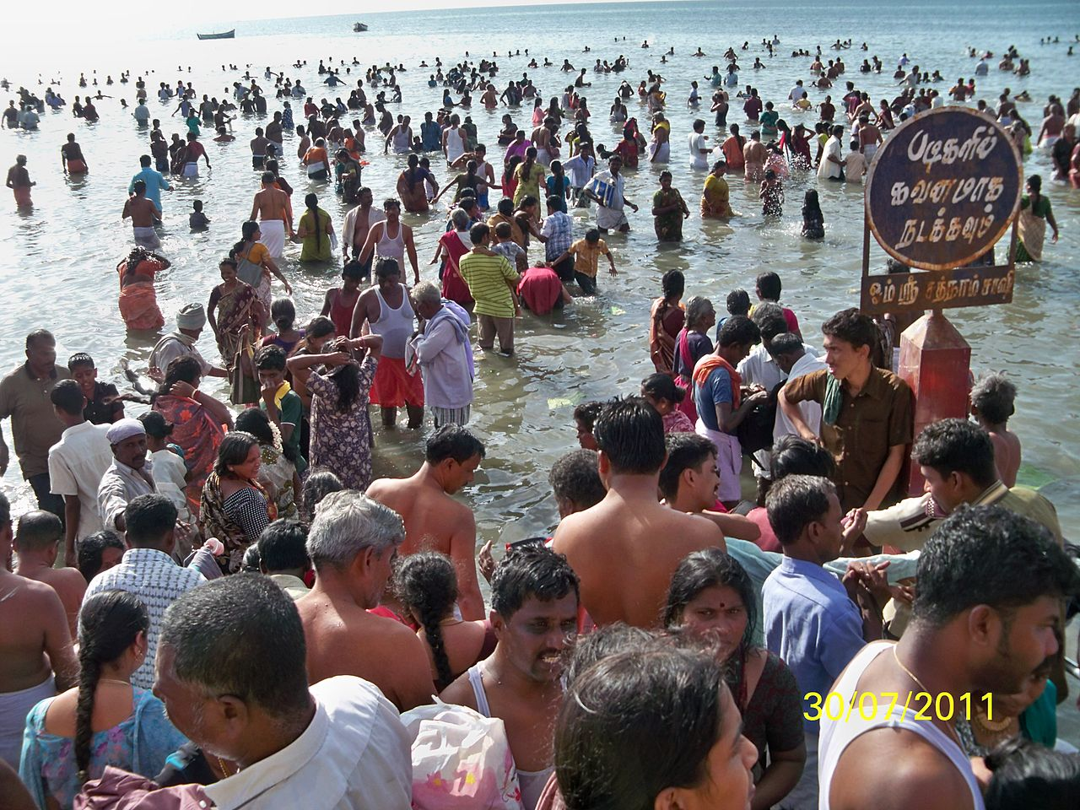
2. We live on a crowded planet
Photo: Wikimedia Commons
Notes:
2. We live on a crowded planet
For nearly all of human history there have been less than 1.000 million people on the planet. However, the last few centuries have seen exponential growth.
Old people today have witnessed human numbers treble in their life time. This has had profound consequences both for society and economic life. However, in some countries the population is actually starting to decline.
What are the consequences of a population that is
(a) increasing or (b) declining?

Slide 5
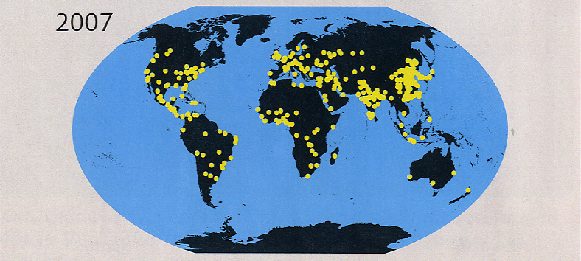
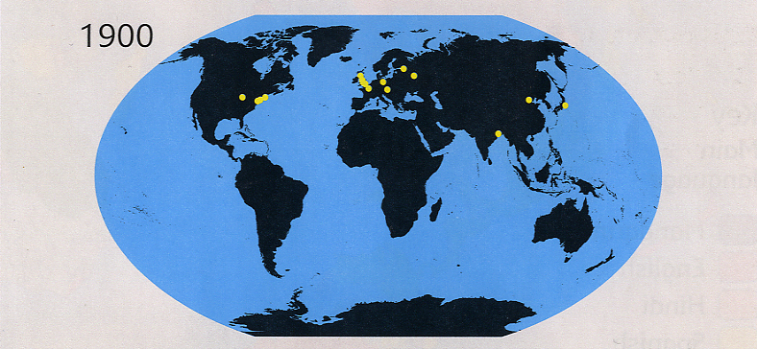
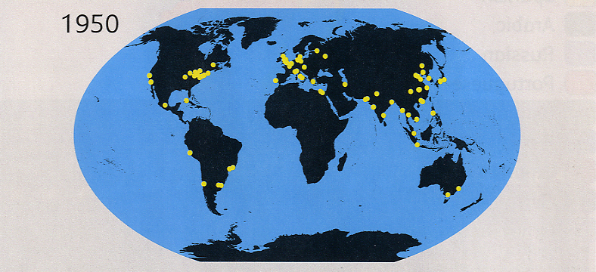
Cities with a population of over a million people
Notes:
One of the most remarkable developments in recent times has been the growth of cities.
Even in Victorian times, there were no more than a handful of cities with a million or more inhabitants. Today, massive urban centres are scattered across every continent apart from Antarctica.
It is estimated that by 2050 around three quarters of the human population will be city dwellers. This makes ensuring the quality of life in urban settings particularly important.
Why do you think cities have grown so much and so fast?

Slide 6
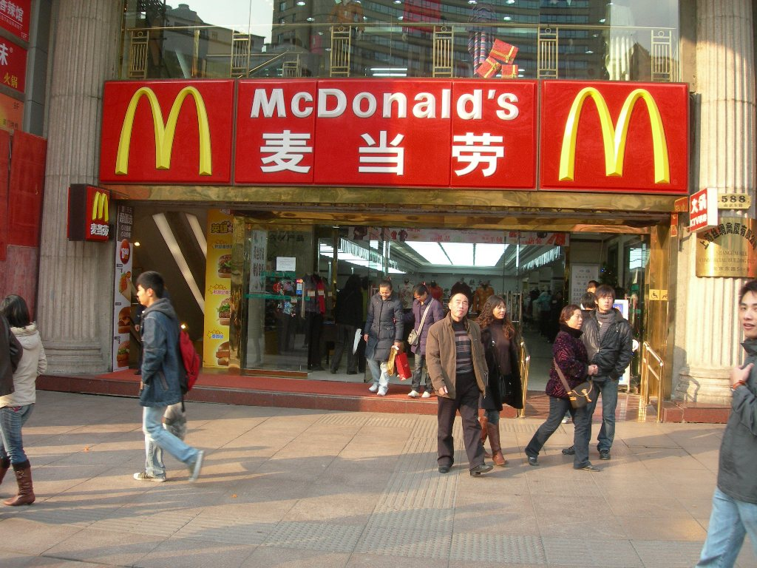
3. We live in a globalised world
Photo: Stephen Scoffham
Notes:
3. We live in a globalised world
In the last 100 years modern transport and communications have linked people together as never before.
From a business perspective, multi-national companies have outlets which provide standardised products to people wherever they live, creating mass markets. We can also now send messages wherever we want at the press of a button, thereby eliminating geographical distance.
These god-like abilities would have completely transformed the course of history had they been available to the monarchs and emperors of the past. They are having a massive impact on the way that we live our lives at the present.
Are there any examples of how your own family or group is scattered around the world?

Slide 7
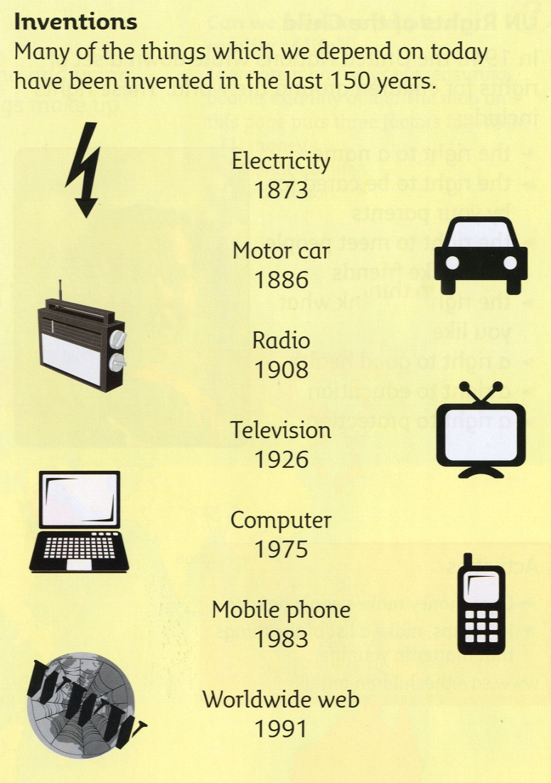
Life styles are changing rapidly as traditional barriers and boundaries become blurred and breakdown
Notes:
Reflecting on modern inventions reveals just how people’s lives have been transformed in the last 150 years. The early pioneers were uncertain how it could be used. Nowadays we depend on it for just about everything that we do.
for m
What other inventions and discoveries aren’t listed on this slide? There are plenty of them!

Slide 8
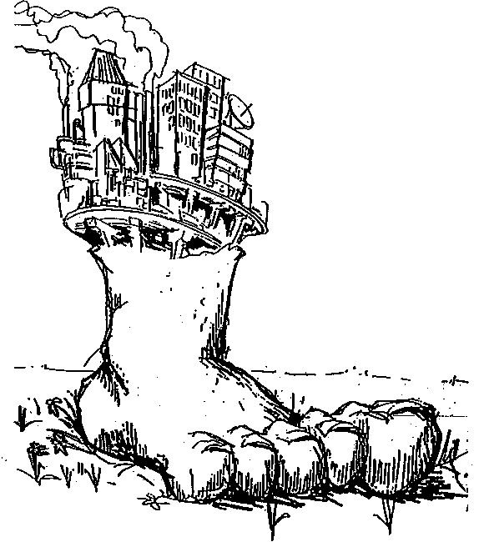
Ecological footprints are one way of showing the carrying capacity of an environment or ecosystem
4. We live in a world that has ecological limits
Notes:
4. We live in a world that has ecological limits
The demands that people make on the environment varies. Generally speaking, people in Industrialised nations use more resources and create much more pollution that people in countries which are less economically developed.
It is now recognised that we need to ‘tread’ less heavily on the Earth. The ecological footprint is a graphic way to represent our environmental impact. And it shows quite clearly that humanity’s demand for ecological services exceeds Earth’s capacity to provide them. Quite simply, we are living beyond our means.
Do you think most people would happy to consume less if others were doing the same? Can you think of ways this might be brought about?

Slide 9
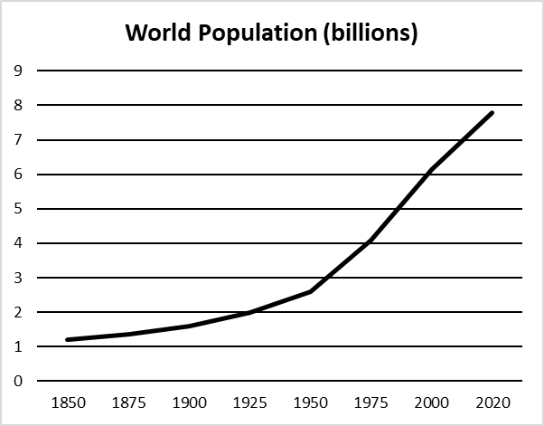
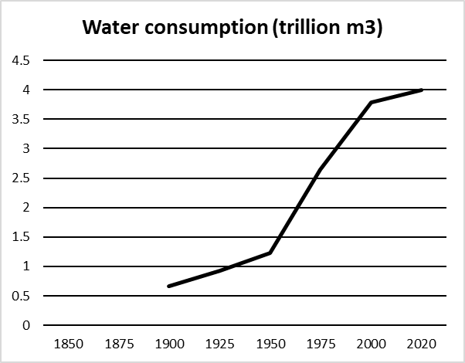
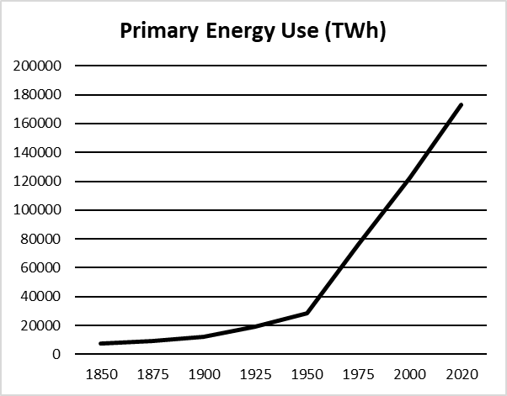
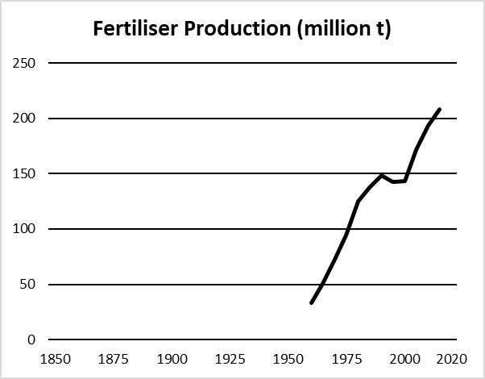
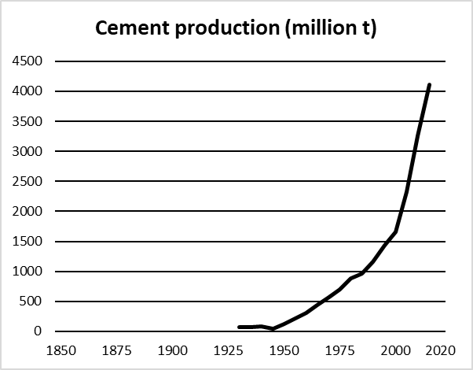
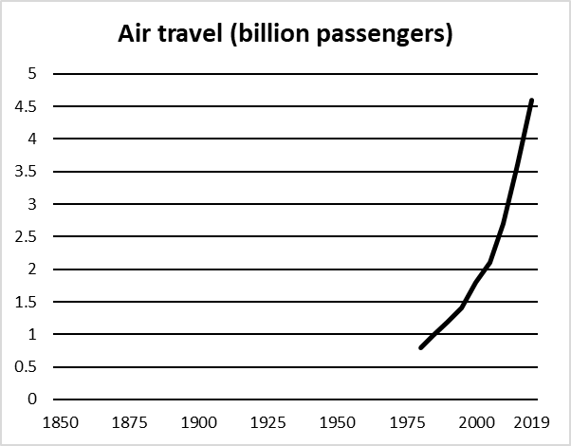
The Great Acceleration
Since the 1950s there has been a huge growth in economic activity
Notes:
Innovations and technological progress have brought huge benefits and improved living conditions beyond recognition for large numbers of people. However, economic activity has come at a cost.
These graphs show how just about every indicator shows a similar upward trend. This is known as the Great Acceleration.
Will activity continue to expand at a similar rate in the years to come? Our economic system is based on growth but it simply cannot be maintained indefinitely.

Slide 10
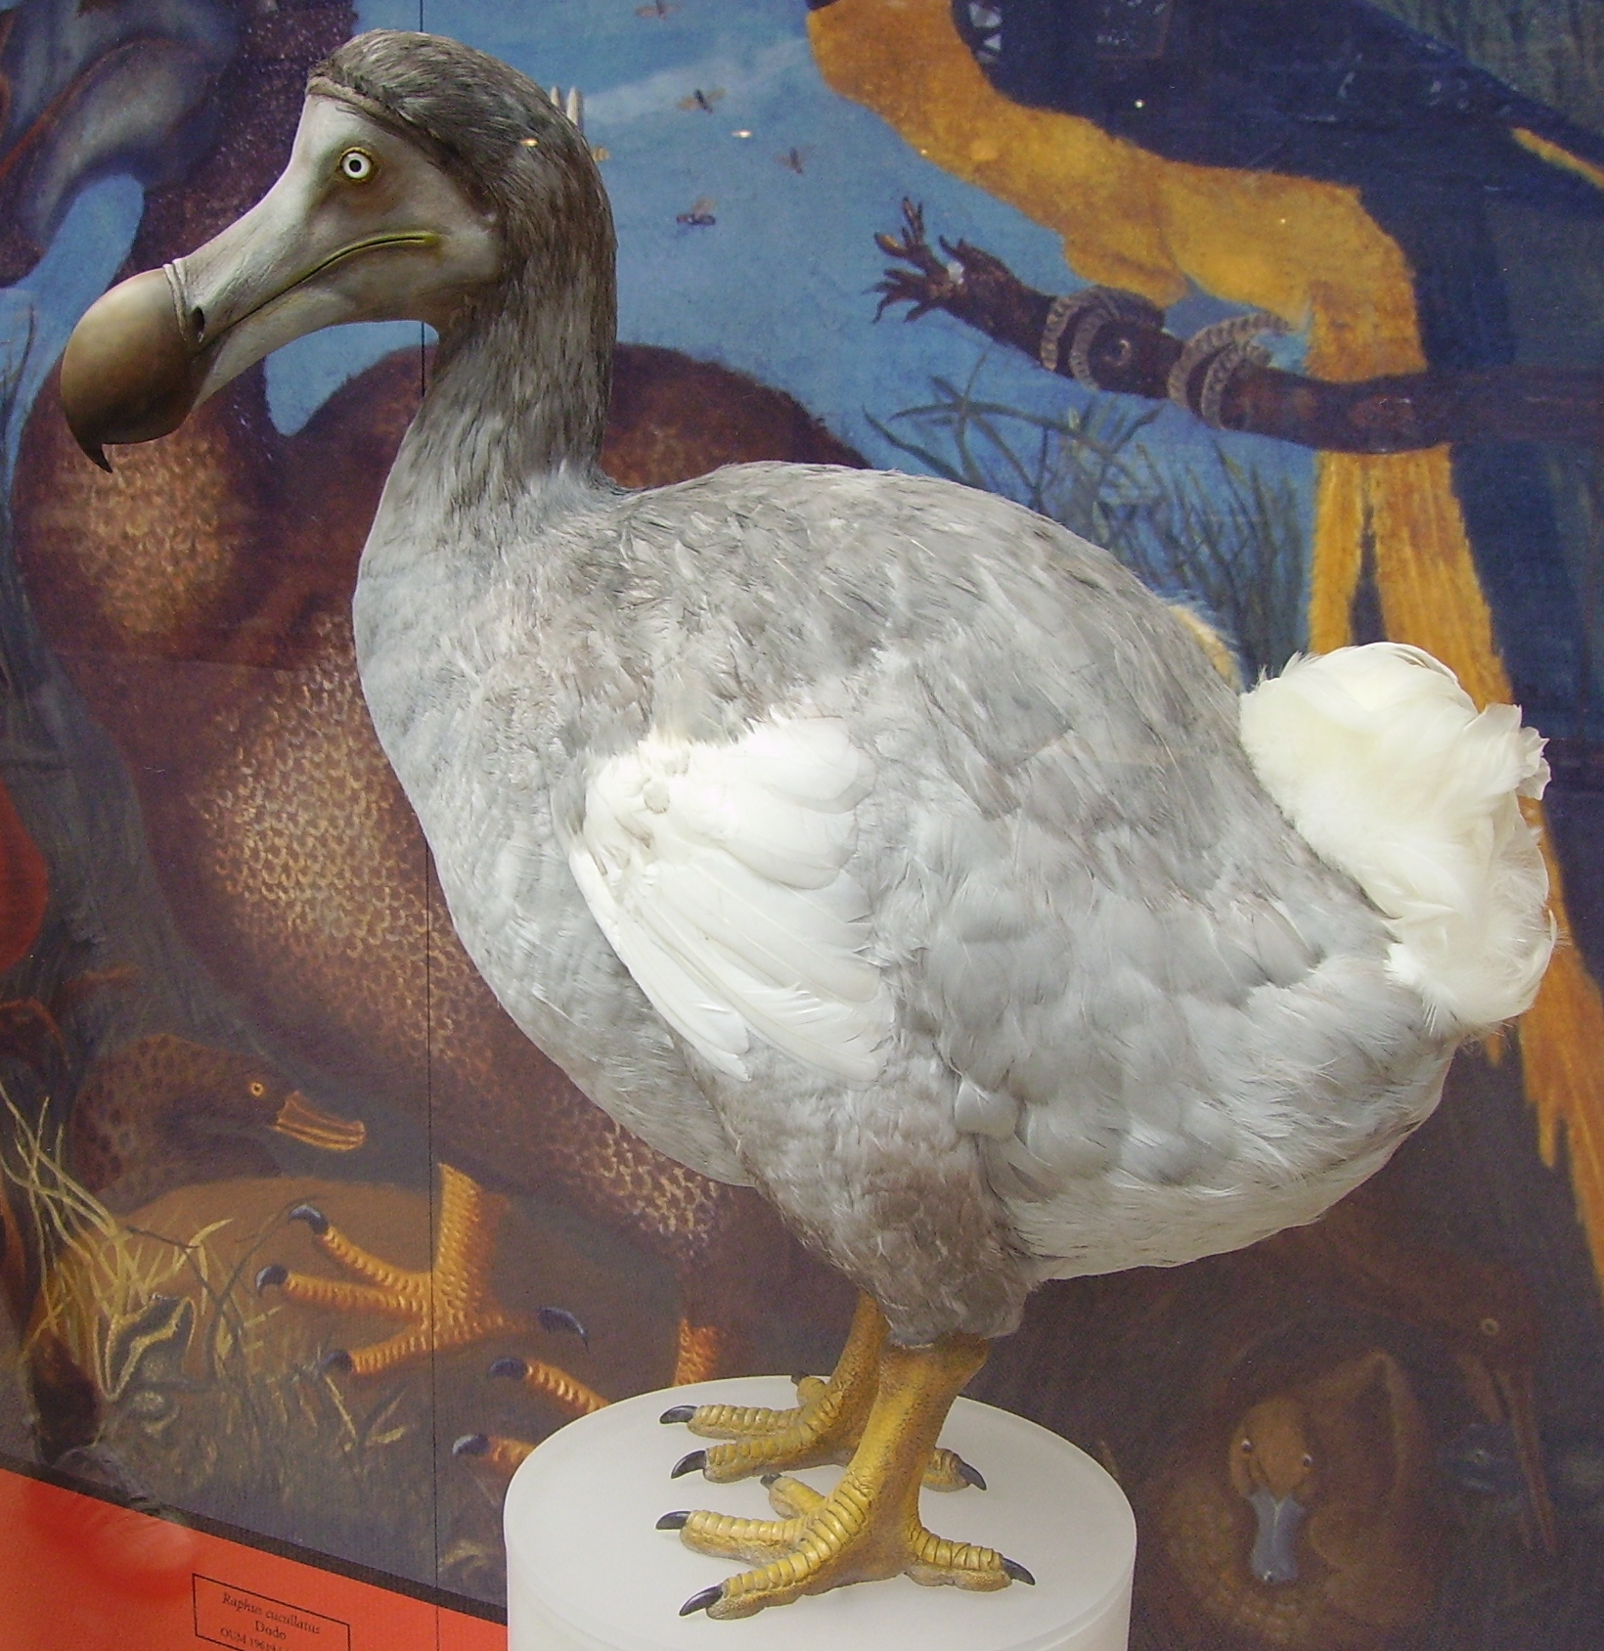
5. We are living at a time of mass extinction
Photo: Wikimedia Commons
Notes:
5. We are living at a time of mass extinction
The decline in wildlife around the world has happened at an alarming rate. The dodo, which was hunted to extinction in the seventeenth century, has come to symbolise the extinction of a species. We now know that global wildlife populations have dropped by around two thirds in the last 50 years.
Biodiversity loss raises fundamental questions about how human beings relate to nature. What is at stake here is not only the survival of plants and creatures, but our own future as a human race. We depend on nature in multiple ways for our food and well-being. As natural world becomes increasingly degraded, we are kicking away our own life support systems.
What countries or regions of the world do you think supplied the food you have eaten recently?

Slide 11
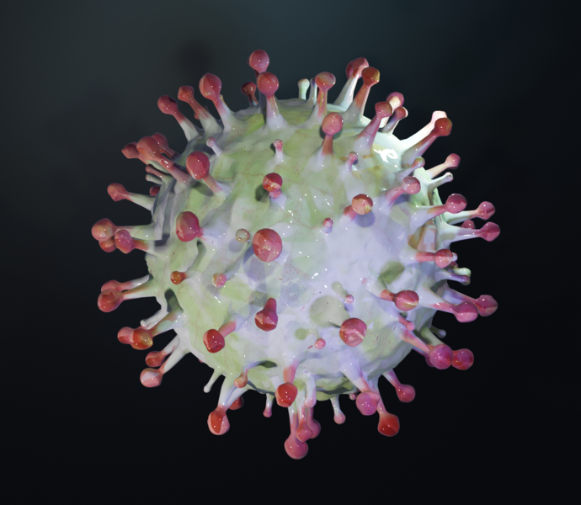
Pandemics
and health disasters are becoming increasingly common.
Photo: Wikimedia Commons
Notes:
Human health is another dimension of sustainability. There has been a significant increase in pandemics in recent years. The causes are complex but it is widely recognised that habitat loss is a significant underlying factor.
Not only is the catastrophic collapse of wildlife undermining the resilience and diversity of natural systems, it is also concentrating diseases in smaller and smaller area.
The Covid-19 pandemic is just one example of how altering nature too fast or in the wrong way can have devastating human consequences. It has also illustrated how vulnerable we are to unexpected events.

Slide 12
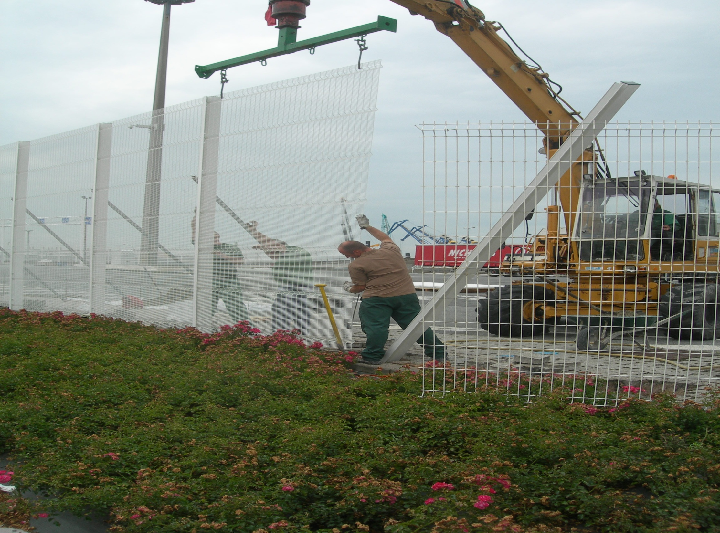
6. We live in a world of great inequalities
Photo: Stephen Scoffham
Notes:
6. We live in a world of great inequalities
Disparities of income, education and health are one of the features of the contemporary world. The fences and barriers which have been erected to protect national borders are one manifestation of these inequalities.
This image, taken a few years ago, shows the fence around Calais in France being strengthened in an attempt to prevent illegal immigration to the UK. It is salutary to reflect that like so many barriers people often find ways of getting round the edges.
What famous walls and barriers around the world can you think of both past and present? What was the impact of their construction/destruction?

Slide 13
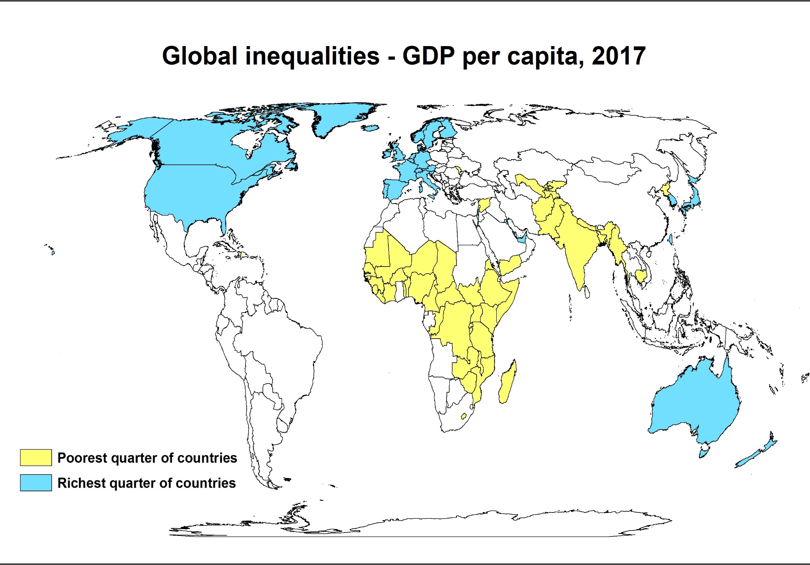
Source: World in data
Notes:
Inequalities in GDP –Gross Domestic Product- reveal a global pattern that dates back to the colonial era.
Countries in Europe, North America and Australasia are shown in blue on this map. These are the world’s richest countries. Countries shown in yellow are poorest.
It is no co-incldence that the division between rich and poor corresponds with the European colonial empires of the past.
Although most countries have gained political independence, the world economic system continues to maintain massive inequalities of wealth.

Slide 14
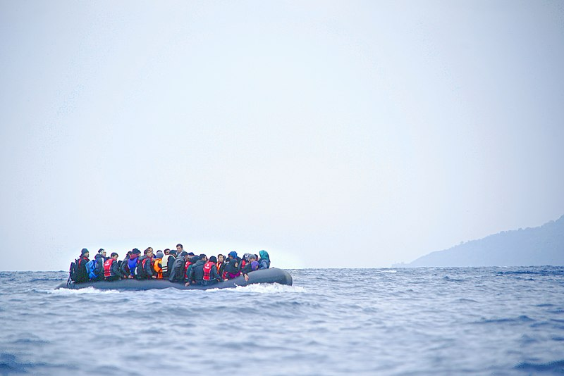
7. We live in a world where there are many serious conflicts
Photo: Wikimedia Commons
Notes:
7. We live in a world where are many serious conflicts
Wars both between and within states are a feature of modern life. In many parts of the world people have been forced to leave their homes, triggering a crisis which politicians in host countries find difficult to resolve.
Environmental stress and competition for scarce resources
often lies beneath the surface of ethnic, ideological and national conflict.
If climate change goes on driving more and more people out of their homes how do you think we should respond?

Slide 15
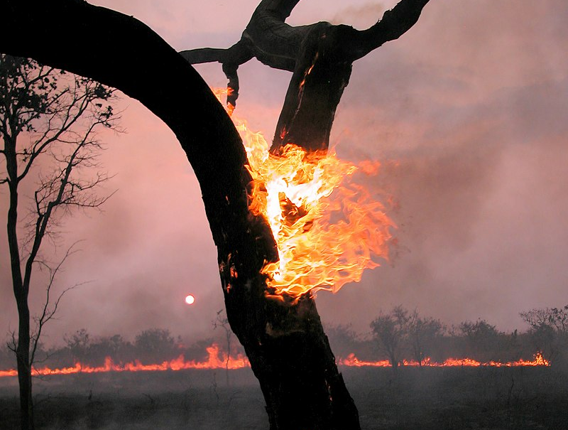
8. We live in a world that is getting dangerously warm.
By Barroso2501 - Own work, CC BY-SA 4.0, https://commons.wikimedia.org/w/index.php?curid=106418618
Notes:
8. We live in a world that is getting dangerously warm
Droughts, storms and floods are affecting many countries and are set to get more severe in decades to come.
Scientists have been warning about the risks of global warming for decades – now the evidence of dangerous climate change is all around us. The reports from the IPCC are getting increasingly bleak and it is clear that window for opportunity is rapidly closing.
Given that we know what is happening, why do think we are being so slow to respond both globally and nationally?

Slide 16
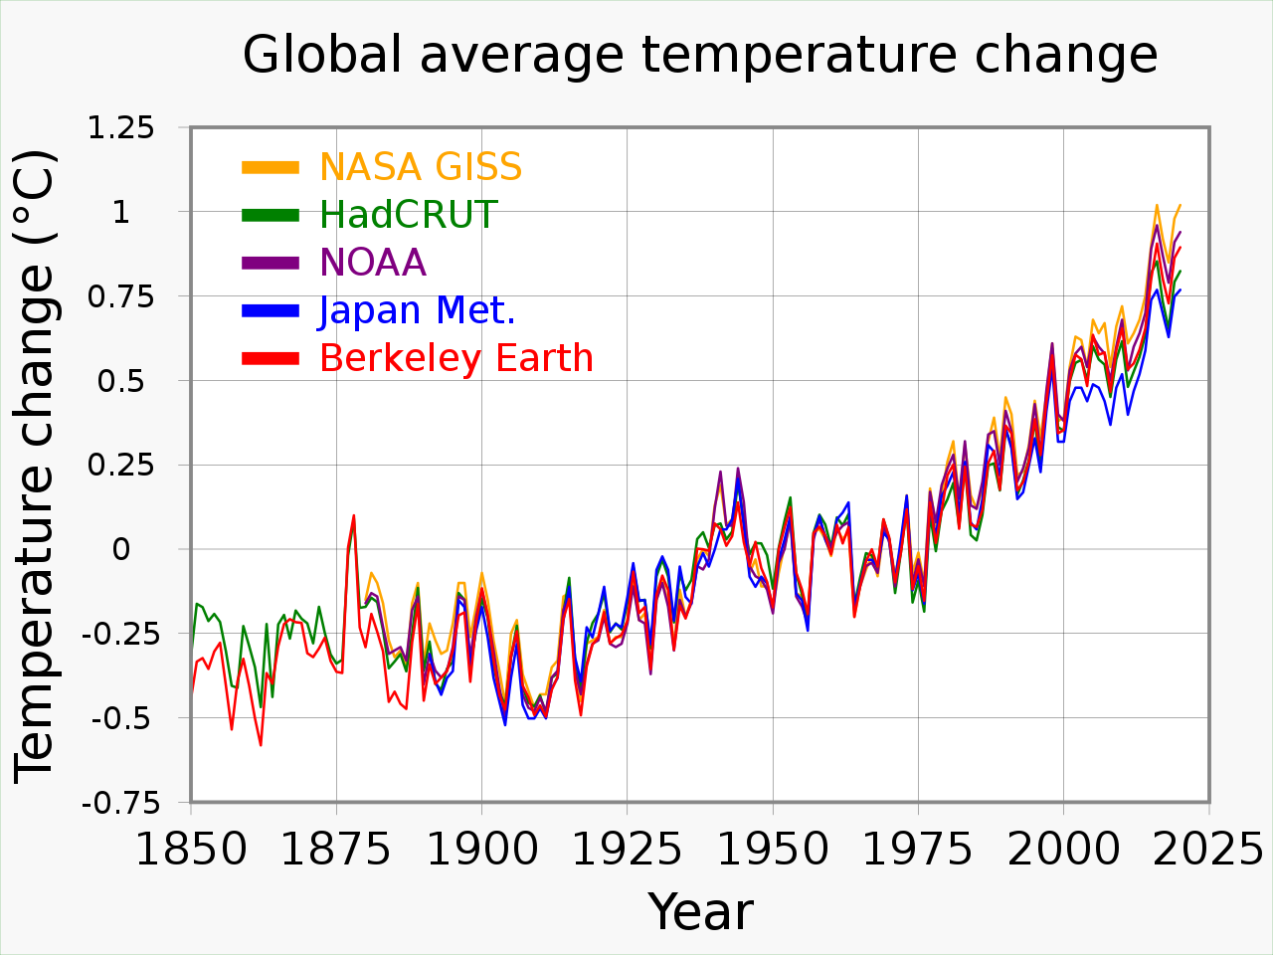
By RCraig09 - Own work, CC BY-SA 4.0, https://commons.wikimedia.org/w/index.php?curid=88535596
Notes:
The world is warmer today than it has been at any time in the last 10,000 years. This graph shows changes since 1850.
It is now established that burning fossil fuels is one of the key causes of climate change.
So far the impact of emissions has been masked by the ability of the oceans to absorb carbon dioxide. However, this will not continue indefinitely.
At some point in the future, planetary weather systems will reach a ‘tipping point’ beyond which runaway feedback seems likely.

Slide 17
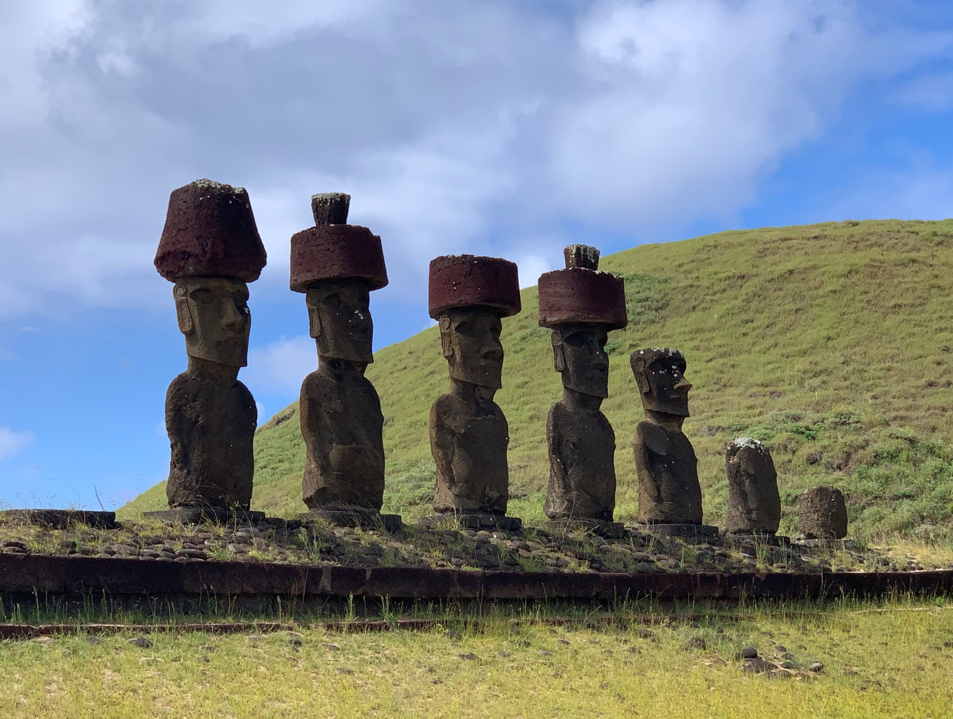
9. We can make decisions about how we live our lives.
Photo; Richard Hatwood
Notes:
9. We can make decisions about how we live our lives
The future is not ordained. The choices we make today have the potential to change what happens next.
These stone statues on Easter Island are a memento to a lost civilization. We don’t know exactly what caused it to collapse but the statues are reminder that societies are vulnerable to collapse.
If we undermine our ecological base, as may have happened on Easter Island, we are taking risks that we have no way of evaluating and which may ultimately destroy us.
Who takes the decisions about how we live our lives? Do you feel you have sufficient say in this? In what different ways can you express your views?

Slide 18
10 What we do depends on our beliefs and values
Two key ideas
Business as usual is not an option – planetary systems can no longer absorb the impact of ever increasing human activity.
Sustainability development is about achieving prosperity within planetary limits – its not a threat but an opportunity which will encourage innovation and lead to a better world.
Notes:
10 What we do depends on our beliefs and values
Getting to grips with sustainability involves many different
dimensions. This Power Point pivots around just two key ideas:
Continuing as we are is no longer a viable option
We have to live within planetary limits
The beliefs and values which underpin our actions often go unacknowledged. Education, in all its different guises, has an important part to play in developing new ideas and addressing the challenges that lie ahead.
Developing a new and hopeful vision of the future is an urgent task which cannot be ignored. And it begs many fundamental questions.
When we talk about sustainability, what is it that we are seeking to sustain?

Slide 19
Further reading
Jackson, T. (2017) (2nd edn.) Prosperity without Growth, London: Routledge.
Klein, N. (2015) This Changes Everything, London: Penguin.
Maxton, G. and Randers, J. (2016) Reinventing Prosperity, Vancouver: Greystone Books.
Raworth, K. (2017) Doughnut Economics, London: Random House.
Read, R. and Alexander, S. (2019) This Civilization is Finished, Melbourne: Simplicity Institute.
Rockstrom, J. and Klum, M. (2015) Big World Small Planet, Max Strom Publishing.
Sachs, J.S. (2015) The Age of Sustainable Development, New York: Columbia University Press.

