Slide 1
Mission to China
Inculturating the Gospel

Slide 2
Outline
Alopen’s mission to China from Persia, 7th C
Matteo Ricci’s mission to China from Europe, 16th C
Debating inculturation

Slide 3
Alopen’s mission to China from Persia, 7th C

Slide 4
Church of the East
The Church of the East (Assyrian; East Syrian; Persian; ‘Nestorian’)
Christian cities/states at end of 2nd century: Edessa (Osrhoene; modern Turkey) and Adiabene (modern Iraq)
Persian Empire (centred in modern Iran)
Theodore of Mopsuestia, Antiochene School: emphasised the distinctiveness of the two natures of Christ
Nestorius, pupil of Theodore. Went further in separating the natures and argued that Mary was Christotokos but not Theotokos. Condemned at Ephesus in 431

Slide 5
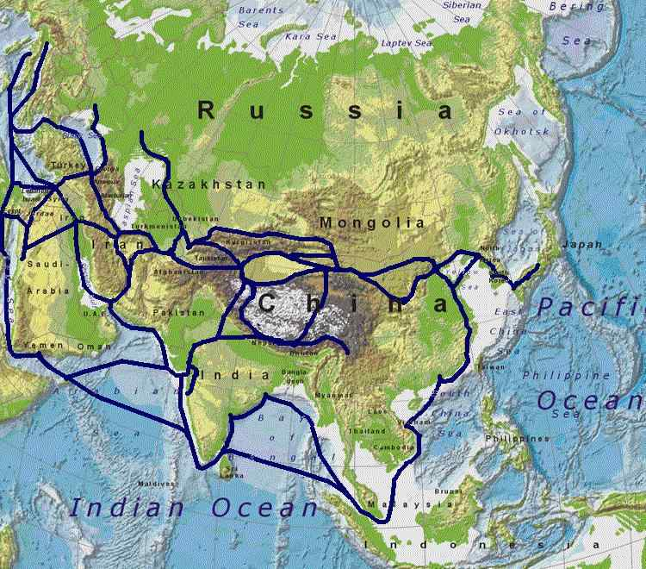
The Silk Road
Notes:
Wikicommons

Slide 6
Church of the East 1
Spread through trade along the Silk Road
Persian Christian diaspora due to persecution by Zoroastrian rulers
Central Asia, China
India, South-east Asia

Slide 7
Church of the East 2
‘The extensive evidence shows that for many centuries the Church of the East included greater numbers over vastly greater distances than the churches of Rome or Byzantium, and this without imperial domination’
John C. England, The Hidden History of Christianity in Asia: The Churches of the East before 1500 (Delhi: ISPCK, 1996), 2.

Slide 8
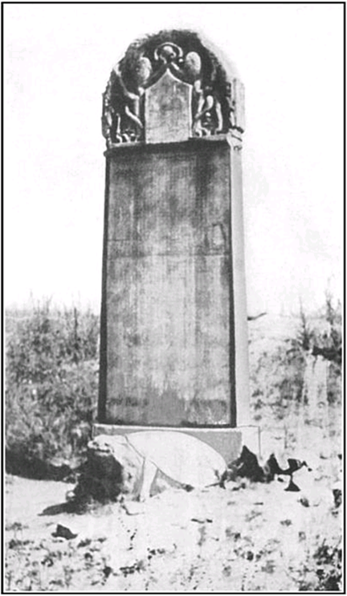
Church of the East in China
Nestorian monument (stele; tablet)
Dug up in 1625 near Xi’an (Chang-an)
3 metres high
Chinese characters and some Syriac
Composed by a Nestorian monk, metropolitan
Mission of Alopen (Olopun) from Persia to China, 635
Text on handout
Notes:
Wikipedia

Slide 9
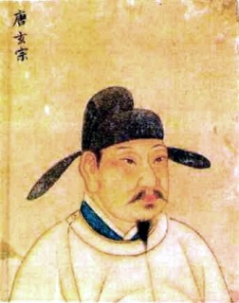
7th C Chinese context
Tang Dynasty (618-907)
Open to practical innovations and new technologies
Buddhism dominant
Other Christian documents including the Jesus Sutras
Found in cave at Mogao near Dunhuang
Date from between 635 and 1000
Notes:
Wikipedia

Slide 10
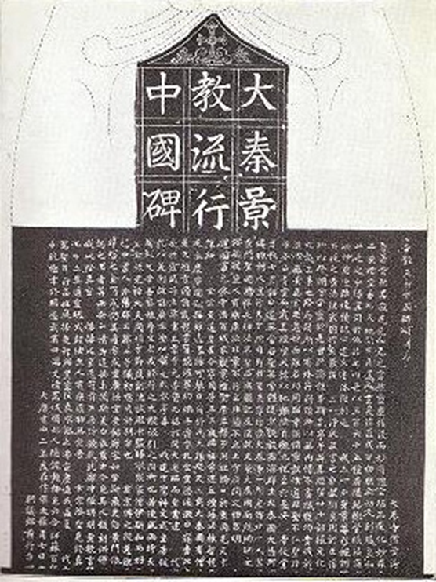
History of the Church of the East in China
According to the inscription (‘history’ section), Christianity flourished in China at first
But from 699 Buddhists caused controversy and violence against Christians
In 742 Christianity was restored by the emperor
Monument was erected 781
Christians hoped to continue to influence China in the ‘illustrious way’ or ‘path’.
Notes:
Wikipedia

Slide 11
Doctrine of the monument 1
Activity
Read the ‘doctrine’ section.
What is Christian about this text?
What is unfamiliar or strange?

Slide 12
Doctrine of the monument 2
God, or Alaha – the Syriac word
God as ‘Three-One’ (Trinity) – Creator
Humankind, tempted by Satan and ‘lost their path’.
‘ancient dispensation’ of the ‘twenty-four holy men’ – Old Testament (24 books in Syriac Bible)
Incarnation of the second person of the Trinity as a holy one, born of a virgin in Syria, visited by wise men (from Persia, Magi)
Death?, resurrection and ascension of Christ
The divine and human nature of Jesus separated (as Nestorius): ‘Divided in nature, he entered the world’ (Ode)

Slide 13
Doctrine of the monument 3
Religion of ‘holy men’ and ‘right principles’
Descriptions of ‘The Illustrious Religion’:
  The New Testament (27 books)
  Baptism
  Cross (wood)?
  Monastic practice
  Community life – equality, sharing, restraint
  Christian worship and Eucharist (sacrifice)

Slide 14
Inculturation 1
How is the gospel expressed in cultural terms?
Beautifully written in Chinese
Translation of the gospel
Deference to the emperor and Chinese authorities
Uses Chinese terms familiar in Buddhism and Daoism
Use of ‘the Way’ (dao as in Daoism). Cf. Acts 9:2
Use ‘illustrious’ (enlightened) as in Buddhism
No mention of the death of Christ (offensive to Chinese?)

Slide 15
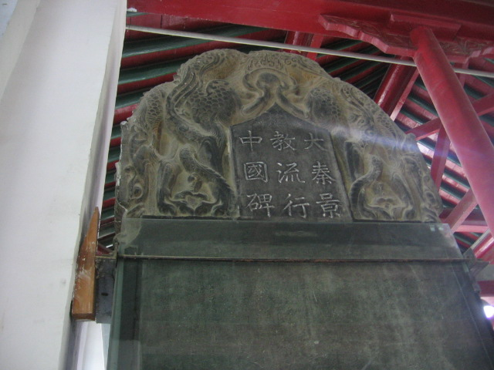
Inculturation 2
Dragons (China) holding a pearl (of great price?)
Symbols of Daoism (clouds) and Buddhism (lotus)
Notes:
By Dirrival (Own work) [CC BY-SA 2.5 (http://creativecommons.org/licenses/by-sa/2.5)], via Wikimedia Commons

Slide 16
Reasons for the demise of Persian Christianity in China after 845
Relied too heavily on imperial favour?
Community remained dominated by foreigners?
Use of Chinese phonetizations of Syriac terms for the essential concepts rather than Chinese terms?
With the rise of Islam cut these Christians off from home support?
Syncretistic tendencies in later writings weakened their message and distinctiveness?
Did the Syrians inculturate too much? Not enough? With respect to the wrong things?

Slide 17
Sources and commentary on Alopen’s mission
East Asian History Sourcebook: Ch'ing-Tsing: Nestorian Tablet http://legacy.fordham.edu/halsall/eastasia/781nestorian.asp
Yves Raguin SJ, ‘Jesus-Messiah of Xi’an’, Tripod 22/124 (Spring 2002). Translated from the French by Betty Ann Maheu MM. http://www.hsstudyc.org.hk/en/tripod_en/en_tripod_124_05.html
John R. Lawton, ‘Description and Significance of the Nestorian Stele’ (no date), http://www.aina.org/articles/dasotns.pdf
D.T. Irvin & S.W. Sunquist, History of the World Christian Movement. Vol I (Maryknoll, NY: Orbis, 2001), pp. 57-65, 195-208, 271-88
Moffett, Samuel Hugh, A History of Christianity in Asia, Vol I (Maryknoll, NY: Orbis Books, 1998), pp. 287-323
Philip Jenkins, The Lost History of Christianity (Oxford: Lion, 2008), pp. 45-70

Slide 18
Matteo Ricci’s mission to China from Europe, 16th C

Slide 19
Jesuits, Society of Jesus
Founded 1540 by St Ignatius of Loyola
Spiritual exercises
Inwardness for outgoing
Military-style organisation and commitment
Responsible to the pope
Evangelization through education
Pioneered ‘inculturation’

Slide 20
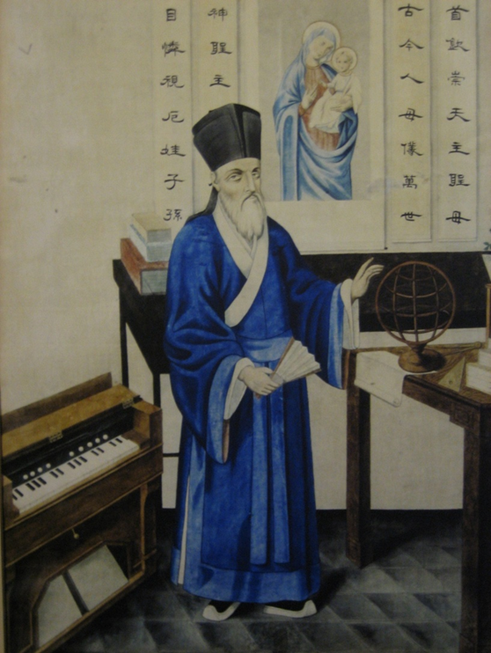
Matteo Ricci
Italian Jesuit
1552-1610
Entered China from Macau in 1583
2-order universe of Aquinas
Humanist regard for cultures
Introduced Western mathematics and technology
Notes:
Wikicommons

Slide 21
‘Accommodation’
Ricci first identified as a Buddhist monk
Switched to Confucian scholar to penetrate Beijing
1601 invited into the Forbidden City
Served the emperor as a scientist
Wrote texts in Chinese introducing Western thought

Slide 22
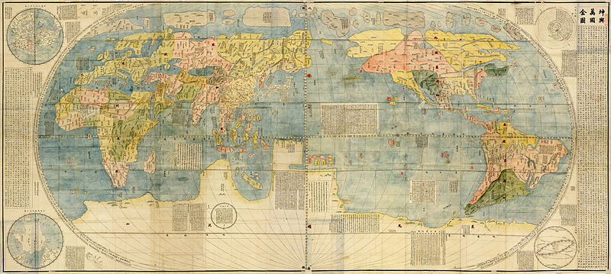
1602 map created by Matteo Ricci at the request of the emperor

Slide 23
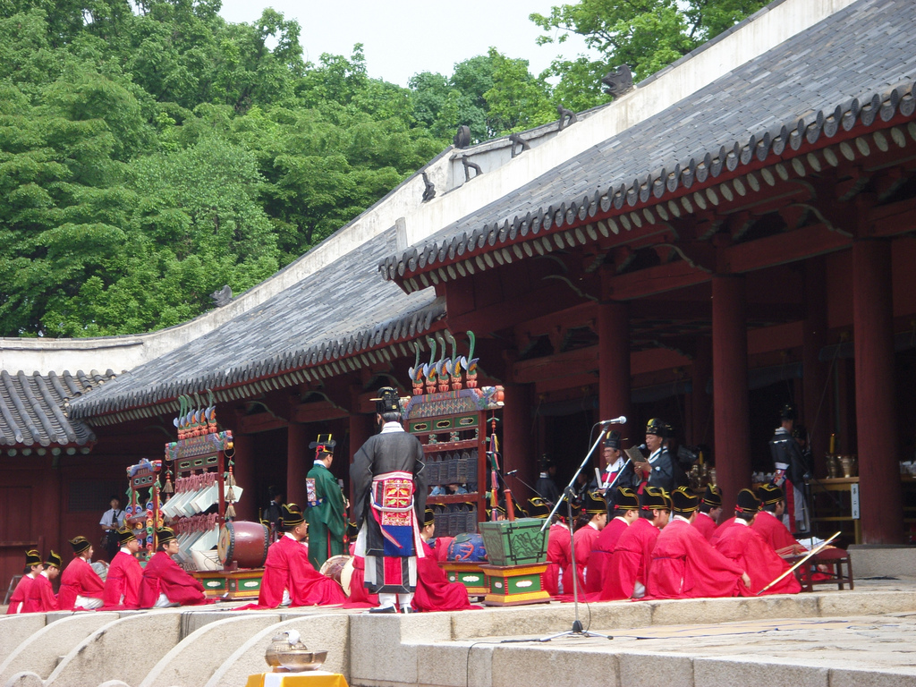
Confucian ritual
Notes:
Wikicommons. by joonghijung at Flickr
An elaborate performance of Korean ancient court music (with accompanying dance) known as Jongmyo jeryeak (hangul: 종묘제례악; hanja: 宗廟祭禮樂) is performed there each year in May. Musicians, dancers, and scholars would perform Confucian rituals, such as the Jongmyo Daeje (Royal Shrine Ritual) in the courtyard five times a year. Today the rituals have been reconstructed and revived. The Jongmyo Daeje has been designated as Important Intangible Cultural Property No. 56.

Slide 24
Matteo Ricci, The True Meaning of the Lord of Heaven (1603)
Introduced Catholic philosophy into Confucian culture
Defined the theological terminology for Confucian-Christian debate for several centuries
Added a new tier to Confucianism: relationship to a personal creator God, membership of a global community and revealed understanding of the mysteries of the universe
Christological doctrines of the Catholic Church only alluded to in the last section of the book
No mention of the suffering and death of Christ

Slide 25
Ricci’s approach
Emphasised common ground between Christianity and Confucianism
Translated Chinese classics into Latin
Gave God a Chinese name: ‘Lord of Heaven’ (Tiānzhǔ)
Allowed Chinese Catholics to continue most Confucian practice
Included a modified version of ancestor veneration and veneration of Confucius

Slide 26
Sources and commentary on Ricci
Modern History Sourcebook: The Chinese Rites Controversy, 1715 http://legacy.fordham.edu/halsall/mod/1715chineserites.asp
Georgetown University, Inculturation: The Legacy of Matteo Ricci http://www.georgetown.edu/inculturation.html
Ricci Center, http://www.riccicenter.com/
Ignation Spirituality (Loyola Press), Matteo Ricci http://www.ignatianspirituality.com/ignatian-voices/16th-and-17th-century-ignatian-voices/matteo-ricci-sj/
D.T. Irvin & S.W. Sunquist, History of the World Christian Movement. Vol II (Maryknoll, NY: Orbis, 2012), pp. 167-78
Moffett, Samuel Hugh, A History of Christianity in Asia, Vol II (Maryknoll, NY: Orbis Books, 1998, 2005), pp. 105-42
Mary Laven, Mission to China: Matteo Ricci and the Jesuit Encounter with the East (London: Faber and Faber, 2011)

Slide 27
Debating inculturation

Slide 28
Ricci’s ‘accommodation’ approach questioned
Discussion
Why did Ricci practise ‘accommodation’ or inculturation?
Why might other missionaries challenge his approach?

Slide 29
Chinese rites controversy
Rites controversy: Portuguese Jesuits versus French Dominicans and Franciscans
Disputed
  Ricci’s name for God
  Veneration of Confucius
  Religious meaning of ancestor veneration
1715 Pope Clement XI decided against the rites
1773-1814 Suppression of the whole Jesuit order worldwide
Chinese rites were permitted by Pope Pius XI in 1935
Second Vatican Council (1962-1965) encouraged engagement with modern culture
Notes:
Centralized power and high levels of social control in China made missionaries more reliant on permission of the authorities
The Franciscans and Dominicans tended to work in the countryside where there was less control and with peasants whose understanding of the ancestors may have been more superstitious

Slide 30
Inculturation since Vatican II
Pope Paul VI insisted on a ‘synthesis between faith and culture’
‘Inculturation’ came into common currency among Jesuits in the 1970s to describe this
In the encyclical Redemptoris Missio (1990), John Paul II defined inculturation as a dual activity of ‘the intimate transformation of authentic cultural values through their integration in Christianity and the insertion of Christianity in the various human cultures’.
Inculturation is a ‘slow journey’, or ‘incubation’, bringing about a new form of life that is marked by both ‘compatibility with the gospel and communion with the universal Church’.

Slide 31
Further discussion
Are Paul VI and John Paul II talking about the same thing?
Can/should the gospel be changed by culture or only the other way round?
How has the gospel been inculturated in your home country?
Whose culture should you inculturate with respect to?

Slide 32
Mission to China
Inculturating the Gospel

