Slide 1
Do Now!
4. What is primary data?
a) Data that you collected
b) Data from the internet
c) Data from last year’s fieldwork
5. What is the mean in a set of data?
a) Taking the lowest value from the highest value.
b) The average
c) The most common value
d) The middle value
6. Which measure is the middle value?
a) Mean
b) Mode
c) Median
d) Range
7. What is the most common number in a set of data called?
a) Mode
b) Median
c) Range
d) Inter-quartile range
8. Which is an example of a qualitative piece of data?
a) River depth measurements
b) Likert survey
c) Traffic count
d) Pedestrian count
9. Select two examples of secondary data.
a) Newspaper Report
b) Environmental quality survey
c) Census information from 2011
d) Traffic Count
1. Which of the following is a primary data collection method?
a) Photo analysis
b) Checking an OS map
c) Bar chart
d) Environmental Quality Survey
2. What is an advantage of primary data?
a) It is time consuming and may not give accurate enough information
b) It gives you data from the past
c) It will be up to date information
3. What is an advantage of secondary data?
a) It can be more trustworthy
b) It is easy to collect
c) It requires co-operation from other people

Slide 2
Title: Fieldwork Data Collection
LO: To prepare and collect fieldwork data and to analyse our results.

Slide 3
Can we make our school more sustainable?
Today we are going to practice some fieldwork techniques around our school site.
This will involve you working together in groups and collecting data as we move around the school site.
Our enquiry question is: Can our school site be improved to make it more sustainable?
We will then evaluate our findings and present the information to the Senior Leadership Team.

Slide 4
Recap: What does sustainable mean?
Very simply, if something is sustainable it does not consume or destroy resources or the environment.
It is being environmentally friendly and looking after our environment for future use.
It is meeting our own needs without compromising the ability of future generations to mee their own needs.
Is our school sustainable? How could we become more sustainable? What will we find out as we move around our school site?

Slide 5
How could we make our school site more sustainable?

Slide 6
What are we going to do today?
Bi-polar survey/Environmental quality survey
Facilities count
Emotions survey
Observations
Are these qualitative or quantitative methods?
Is this primary or secondary data?
Before we go outside we will go through each data collection method.

Slide 7
Recap: What is Qualitative and Quantitative Data
Qualitative Data
Quantitative Data
Qualitative data is non-numerical data. It is about the qualities of a location.
Quantitative data is numerical data. It is data that can be counted.
Some examples are:
Field sketches
Photographs
Use of Powers Roundness Scale
Written descriptions
Poems and stories
Some examples are:
Measuring velocity
Measuring the build up of sediment
Measuring the gradient – beach profile
Pedestrian count
Measuring waves per minute

Slide 8
What do we call this type of survey?
Negative Evaluation | Bipolar Score |  |  |  |  |  |  | Positive Evaluation
 | -3 | -2 | -1 | 0 | +1 | +2 | +3
Pavements and other concrete surfaces are in poor working order |  |  |  |  |  |  |  | Pavements and other concrete surfaces in a good state of repair
Lots of litter and no visible bins |  |  |  |  |  |  |  | No obvious litter and lots of bins.
Buildings are in a bad state of repair. |  |  |  |  |  |  |  | Buildings are in a good state of repair.
Lots of vandalism and graffiti |  |  |  |  |  |  |  | No evidence of vandalism or graffiti
Unattractive location |  |  |  |  |  |  |  | Attractive location
Not much green space |  |  |  |  |  |  |  | Lots of green space

Slide 9
Bi-polar / Environmental Quality Survey
An environmental quality survey uses an observer’s judgements to assess environmental quality against a range of indicators. Often they work on a sliding scale of quality (like 1 to 5) to represent less good to good. Alternatively you can use a Bi-polar scale (like -5 to +5) to indicate a negative assessment through to a positive assessment, with 0 representing neither good or bad.
As it is based on personal judgements the data collected using environmental quality surveys is subjective.
Example of a bi-polar survey

Slide 10
Facilities count
At each site we are going to count the following:
Litter bins
Recycling bins
Benches
Other notable facilities in that area e.g. bike racks and recreational activities.

Slide 11
Emotions Mapping – proportional circles
As we move around the school site you are going to note down how you feel in different areas of the school.
You are then going to locate these on your school map using coloured circles. The bigger the circle the bigger the emotion you feel.
RED: Emotions are unpleasant, angry frustrated and anxious
YELLOW: Emotions are excitement, joy and elation
BLUE: Emotions are boredom, sadness and despair
GREEN: Emotions are tranquil, satisfied, generally ok with that location.

Slide 12
Observations
What to record |  | Notes
Facts | Date and time, location, weather
Physical environment | What is the layout of the environment
 | What is the green space used for?
Social environment | How are people using this area?
 | Are there any suggestions of diversity in this area?
 | What sustainable features do you notice in this area?
How does area make you feel? What impression do you get?
As we move around the school site we are also going to write down our observations.
Complete the table in your handout. What do you notice in each location?
Could our school site be made more sustainable? What would your recommendations be?
Use your weather equipment to measure wind speed and temperature.

Slide 13
Whilst we are outside…
Complete each of the worksheets, collecting data as we move around the site.
Don’t just copy from each other – some of this data is subjective, therefore it is YOUR opinion.
Behave responsibly.
Be good geographers.
Our four sites are:
1.
2.
3.
4.

Slide 14
Data Presentation
How can we present our data?

Slide 15
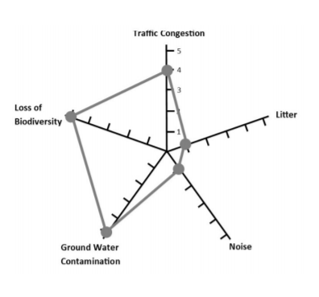
How can we present our results?
Success Criteria
Drawn with a pencil and ruler
Title
Labelled axis
NEAT
Data is clearly drawn
This is a radial diagram. It is a more sophisticated data presentation technique than a bar chart.
We are going to use one to show the results of our bi-polar survey.

Slide 16
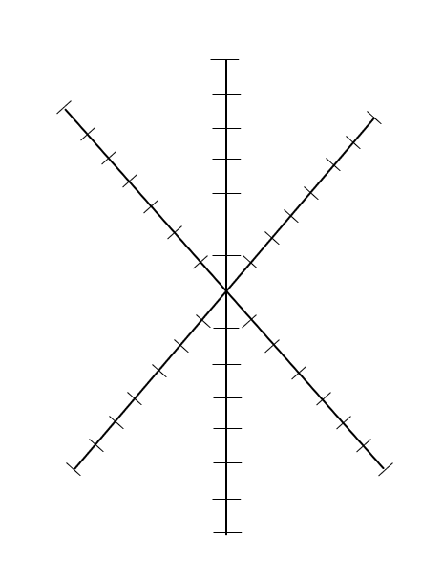
How to draw a radial diagram
Label the end of each of the points of the star with a title e.g. pavements, litter, green spaces.
Label the markers going down each point – the highest number is at the top e.g. +3, +2, +1, 0, -1, -2, -3
Put a cross on each marker to record your data.
Join up each of the dots.
Do this for each site – each radial diagram should be a different colour.
Provide a key to show what each colour means.
Pavements
+3
0

Slide 17
Answering our enquiry question
Can our school site be improved to make it more sustainable?
What data have we collected?
Does the data suggest that our school is sustainable?
Does the data suggest that our school is not sustainable, and needs improving?
Has our data collection been accurate and reliable?
How could we improve our investigation?
What other data could we collect? How would it aid our investigation?

Slide 18
Letter to SLT
Dear Senior Leadership Team,
I am writing to you to make some suggestions for our school. I have recently completed some fieldwork in my geography lessons and I have been investigating the sustainability of our school.
Our class would like to invite you to our lesson to see our work on sustainability and to discuss how we think we could make our school more sustainable.
In conclusion we have made the following recommendations and would welcome your thoughts as to how we could achieve these:

