Slide 1
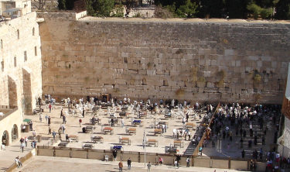
Archaeology in the New Testament

Slide 2

Prove to Me that God Exists
Archaeology in the New Testament
The New Testament covers the years from 7BC-96AD.
Many cities, places and things that relate to the time of Jesus have been found.
Things like Peter’s house in Capernaum, Caesarea-the Roman capital of Palestine, the Mount of Olives, the Jerusalem Temple, the Garden of Gethsemane, Ephesus, Thessalonica, Tyre, etc.

Slide 3

Prove to Me that God Exists
Archaeology in the New Testament
In 1990, workers broke thru a burial cave and found an ossuary with Caiaphas’ name on it.

Slide 4
Prove to Me that God Exists
Archaeology in the New Testament
In 1945, archaeologists found 2 ossuaries outside Jerusalem, marked with crosses with the inscriptions “Jesus, help” and “Jesus, let him arise”. These ossuaries were dated to around 50AD.
For more archaeological proof of the bible, read http://BSSSB-LLC.com/ archaeological-confirmations-of-the-bible/. Also check out the website and book references. Also, see the handouts.

Slide 5
Prove to Me that God Exists
Archaeology in the New Testament
Were you aware of all of the archaeological discoveries made that confirm what the bible says?
What would you say to someone who says Harry Potter mentions London too? Would this defeat your argument?

Slide 6
Archaeology in the New Testament

