Slide 1
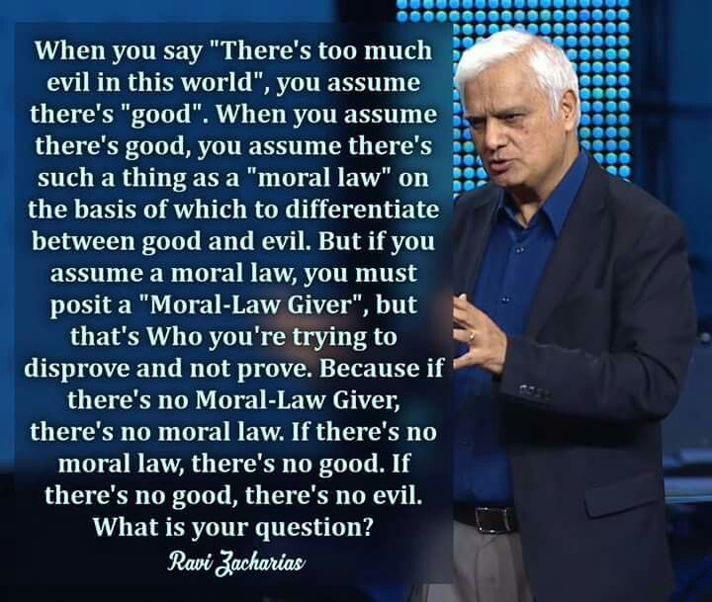

Slide 2

Prove to Me that God Exists
The Moral Argument
1) If objective/absolute moral values exist, then God must exist.
2) Objective/absolute moral values do exist.
3) Therefore, God must exist.

Slide 3
Prove to Me that God Exists
The Moral Argument
Some people would say that our morality evolved like we evolved from a single cell. They are saying that morality has its origins in chemicals and blind chance.
But morality tells you what you ought to do, not what your genes or survival instincts tell you to.
Atheist philosopher William Provine said, “There is no ultimate foundation for ethics, no ultimate meaning to life, and no free will for humans either (because our genes tell us what to do).

Slide 4
Prove to Me that God Exists
The Moral Argument
You either believe that morals are absolute (the same for everybody) or relative (not the same for everybody)
If they’re relative, what do we do when my morals interact with yours?
If they’re absolute, whose absolutes do we use?

Slide 5
Prove to Me that God Exists
The Moral Argument
It’s a suicide statement to say, “I can absolutely say that there are no absolutes.”
Morals don’t change much from one culture to another, but they’re expressions do.

Slide 6
Prove to Me that God Exists
The Moral Argument
Where did you previously believe your morals came from?
Without godly view of morality, do you believe you could justify anything?
How would you respond to someone who said that rape was OK?

Slide 7
Prove to Me that God Exists
The Moral Argument
There are some moral systems that are inferior to others, like polygamy or cannibalism.
A nation that believes in relative morality will never produce a social reformer like Mother Teresa or Martin Luther King, Jr.

Slide 8
Prove to Me that God Exists
The Moral Argument
Sincerity of belief doesn’t make your belief true. You can be sincerely wrong.
Most people who claim to live by relative morality, don’t! They just live by another set of absolutes. Try disagreeing with them and see what their response is.

Slide 9
Prove to Me that God Exists
The Moral Argument
Consider the following points:
A) Don’t confuse morals with their expressions
B) Without an objective moral standard, you can’t say that murder or rape is wrong. You can only say it’s not your preference or it’s against agreed upon rules for the people group that you’re living with.

Slide 10
Prove to Me that God Exists
The Moral Argument
Consider the following points:
C) We shouldn’t deny moral absolutes just because we have trouble knowing the answer in a few difficult situations.
D) In real life, most people believe in objective, absolute moral standards They just haven’t thought it thru enough to realize this.

Slide 11
Prove to Me that God Exists
The Moral Argument
Why do some people disagree with absolute morality?
How would belief in an absolute morality affect your beliefs now?
Explain why there is no absolute morality in atheism

