Slide 1

The Science Argument

Slide 2

Prove to Me that God Exists
The Science Argument
There are two methods of proving something:
The scientific method…
The legal/historical method…
Scientism – the belief that nothing exists but our 4 dimensional world of 3 spatial & one time dimension. It believes that everything can be explained by the natural laws of physics, chemistry, etc.. It doesn’t believe in anything supernatural.

Slide 3
Prove to Me that God Exists
The Prophecy Probability Argument
10 = 10¹ ten
10 x 10 = 10¹ x 10¹ = 10¹⁺¹ = 10² = one hundred or the number 1 followed by 2 zero’s (100) or 10².
10 x 10 x 10 = 10¹ x 10¹ x 10¹ = 10¹⁺¹⁺¹ = 10³ = one thousand or the number 1 followed by 3 zero’s (1,000) or 10³

Slide 4
Prove to Me that God Exists
The Prophecy Probability Argument
10 x 10 x 10 x 10 x 10 x 10 = 10¹ x 10¹ x 10¹ x 10¹ x 10¹ x 10¹ = 1,000,000 = one million or the number 1 followed by 6 zero’s (1,000,000) or 10⁶
1 chance in 10⁵³ power = zero chance, it’ll never happen
That’s 1 followed by 53 zeros.
Great, now you’re an expert in exponents

Slide 5
Prove to Me that God Exists
The Science Argument
Let’s look at three lines of reasoning:
1) The fine-tuned universe perfectly suited for our type of life.
A) There are at least 152 physical constants necessary for life.
The probability of all of these physical constants being exactly accurate to produce & sustain our type of life is 1 in 10²⁸² power. That’s 1 followed by 282 zeros. Remember 1 chance in 10⁵³ power is defined as NEVER happening.

Slide 6
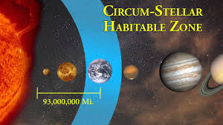
Prove to Me that God Exists
The Science Argument

Slide 7
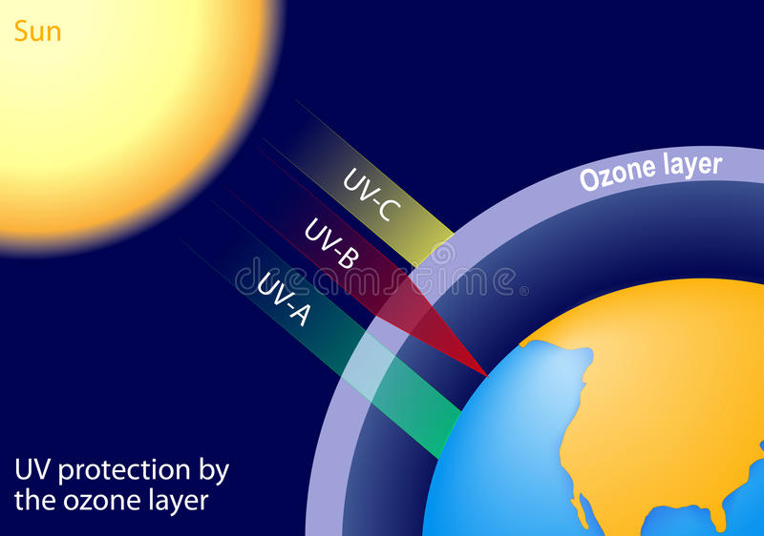
Prove to Me that God Exists
The Science Argument

Slide 8
Prove to Me that God Exists
The Science Argument
Do you think all of these constants could have happened by chance?
How does this affect your view of who or what created our universe?

Slide 9
Prove to Me that God Exists
The Science Argument
Let’s look at three lines of reasoning:
2) The incredible design of our bodily cells and DNA
A) The ATP example

Slide 10
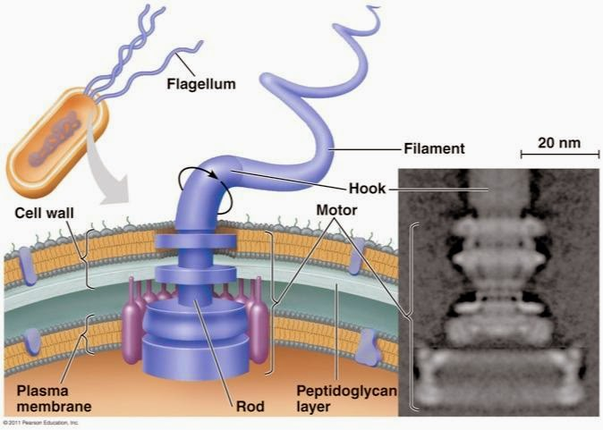
Prove to Me that God Exists
The Science Argument

Slide 11
Prove to Me that God Exists
The Science Argument
Let’s look at three lines of reasoning:
2) The incredible design of our bodily cells and DNA
B) The cell examples

Slide 12
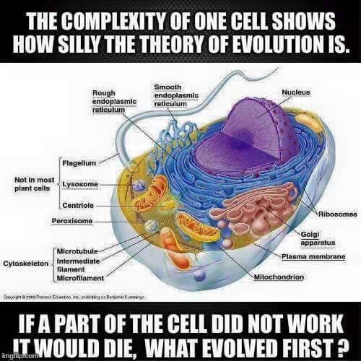
Prove to Me that God Exists
The Science Argument

Slide 13
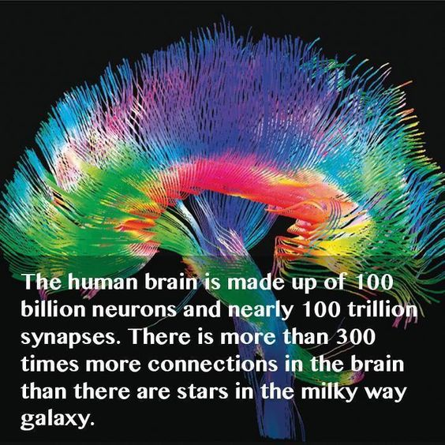
Prove to Me that God Exists
The Science Argument

Slide 14
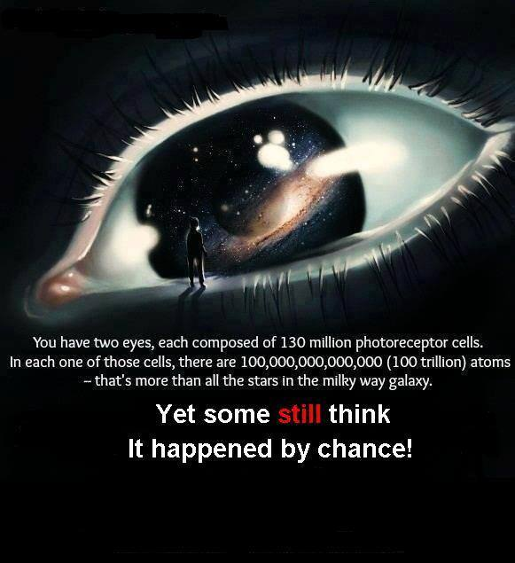
Prove to Me that God Exists
The Science Argument

Slide 15
Prove to Me that God Exists
The Science Argument
3) Quotes from famous scientists

Slide 16

Prove to Me that God Exists
The Science Argument
How does this affect your views of the theory of evolution, that atoms and chemicals randomly arranged themselves thru trillions of mutations to produce human?
Do you think these types of arguments should be taught in the public school system?

Slide 17
The Science Argument

