Slide 1
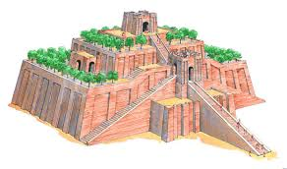
Archaeology in the Old Testament

Slide 2

Prove to Me that God Exists
Archaeology in the Old Testament
Archaeology verifies the existence of some people, cities, culture and other things on the Old Testament.
While archaeologists have not found everything mentioned in the bible, they have found a lot.

Slide 3
Prove to Me that God Exists
Archaeology in the Old Testament
Nelson Glueck, the late, great 20th century archaeologist, has stated that no archaeological discovery has ever disagreed with the bible.
God has said to test everything to know what is really from Him – 1st Thessalonians 5:21.

Slide 4
Prove to Me that God Exists
Archaeology in the Old Testament
An example of this was the Hittite nation….
Another example was King David….
Archaeological evidence has been found in cities like Jericho, Nineveh, Ur, Mari, Babylon, Elba, Megiddo, Susa, the Qumran caves, etc.

Slide 5
Prove to Me that God Exists
Archaeology in the Old Testament
Archaeologists have found towers (ziggurats) in the region where the Tower of Babel is believed to have been.
In Isaiah 20:1, it mentions Sargon, King of Assyria. Scholars doubted his existence until his palace was found.

Slide 6
Archaeology in the Old Testament

