Slide 1
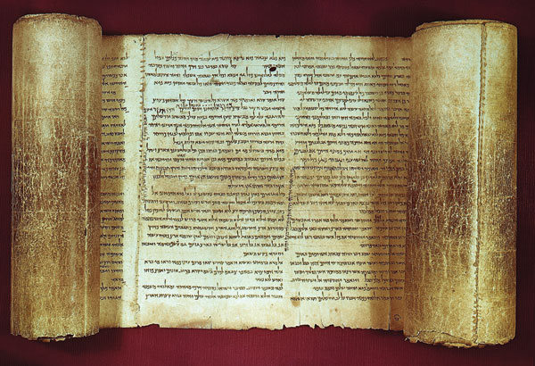
Are the bible manuscripts reliable?

Slide 2

Prove to Me that God Exists
Are the Bible manuscripts are reliable
Bibliographic test…(see handouts), how many manuscripts to we have and what is the time interval between the original and the earliest copies.
Internal evidence…are there contradictions or known historical errors in the copies? Did the events described really happen?
External evidence…do other historical documents confirm or deny them?
By using the same manuscript tests that other reliable historical documents use, the bible is more reliable than all of them.

Slide 3
Author | Book | Datw Written | Earliest Copies | Time Gap | # of copies
Homer | Iliad | 800 B.C. | 400 B.C. | 400 yrs | 643
Herodotus | History | 480-425 B.C. | 900 A.D. | 1,350 yrs | 8
Thucydides | History | 460-400 B.C. | 900 A.D. | 1,300 yrs | 8
Plato |  | 400 B.C. | 900 A.D. | 1,300 yrs | 7
Demosthenes |  | 300 B.C. | 1100 A.D. | 1,400 yrs | 200
Caesar | Gallic Wars | 100-44 B.C. | 900 A.D. | 1,000 yrs | 10
Livy | History of Rome | 59 B.C.-17 A.D. | 4th century partial | 400 yrs | 1 partial
 |  |  | mostly 10th century | 1,000 yrs | 19
Tacitus | Annals | 100 A.D. | 1100 A.D. | 1,000 yrs | 20
Pliny Secundus | Natural History | 61-113 A.D. | 850 A.D. | 750 yrs | 7
New Testament | Greek manuscripts | 50-100 A.D. | 114 A.D.(fragment) | 50 yrs | 5,686
 |  |  | 200 A.D.(books) | 100 yrs
 |  |  | 250 A.D.(most of NT) | 150 yrs
 |  |  | 325 A.D.(complete NT) | 225 yrs
New Testament | Non-Greek manuscripts |  |  |  | 19,284
New Testament | Total manuscripts |  |  |  | 24,970

Slide 4
Early Church Father Quotations of the New Testament
Column1 | Column2 | Column3 | Column4 | Column5 | Column6 | Column7
Writer | Gospels | Acts | Pauline letters | General letters | Revelation | Totals
Justin Martyr | 268 | 10 | 43 | 6 | 3 | 330
Irenaeus | 1,038 | 194 | 499 | 23 | 65 | 1,819
Clement | 1,107 | 44 | 1,127 | 207 | 11 | 2,406
Origen | 9,231 | 349 | 7,778 | 399 | 165 | 17,992
Tertullian | 3,822 | 502 | 2,609 | 120 | 205 | 7,258
Hippolytus | 734 | 42 | 387 | 27 | 188 | 1,378
Eusebius | 3,258 | 211 | 1,592 | 88 | 27 | 5,176
Grand Totals | 19,368 | 1,352 | 14,035 | 870 | 664 | 36,289

Slide 5
Prove to Me that God Exists
- Did you know of this first test in showing how accurate the bible is?
- Has your view of the bible been strengthened or weakened by this first test?

Slide 6
Prove to Me that God Exists
Regarding test#2 – the internal test:
- The disciples couldn’t afford to risk inaccuracies
- The disciples appealed to common events that the average person knew about
- despite popular rumors, there are no erros or contradictions in the bible

Slide 7
Prove to Me that God Exists
Regarding test#2 – there are usually 3 types of errors
- Spelling or word order errors…more than 99% of the variants fall into this category.
- Numerical errors…about a handful
- Interpretation errors…these are easily answered by looking at a commentary, a bible difficulty book or knowing a bit about translating from one language to another

Slide 8
Prove to Me that God Exists
- Did you know of this 2nd test in showing how accurate the bible is?
- Do you think that this answers the criticisms that there are errors/contradictions in the bible effectively?
- Has your view of the bible been strengthened or weakened by this 2nd test?

Slide 9
Prove to Me that God Exists
Regarding test#3 – the external test:
Tacitus
Suetonius
Josephus
Thallus
Pliny, the Younger
Jewish Talmud
Lucian of Samosata
Mara Bar-Serapion
Trajan, a Roman Emperor
The Gospel of Truth
The Acts of Pontius Pilate
Dead Sea Scrolls
All the gnostic, pseudepigraphon & apocryphal writings

Slide 10
Prove to Me that God Exists
Regarding test#3 – the external test:
The many early church fathers who kept very detailed records which are verified by other ancient documents. Most of these early church fathers were killed for their belief. Who would die for a lie, knowing it was a lie?

Slide 11
Prove to Me that God Exists
- Did anything surprise you about this 3rd test?
- Do you feel that these 3 tests make a strong argument for the accuracy of the bible?
- If someone said that the bible is just an old wives tale or an old book about sheep herders, how would you respond?

Slide 12
Are the bible manuscripts reliable?

