Slide 1

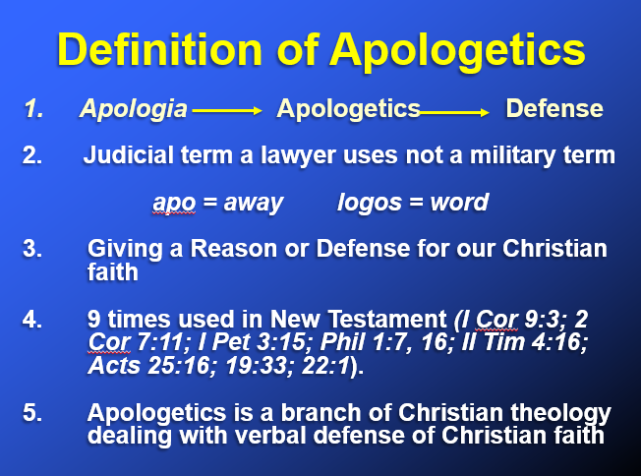

Slide 2
Prove to Me that God Exists
Introduction to Apologetics
Apologetics mean “a defense of the faith”
1st – why should we even answer this question?
1st Peter 3:15…”Always be prepared to give an answer to everyone who asks you to give the reason for the hope that you have.”
Isaiah 1:18 says, “Come, let us reason together”

Slide 3
Prove to Me that God Exists
Introduction to Apologetics
Apologetics mean “a defense of the faith”
2nd – does the person really want to hear your answer?
The goal in most disagreements is to destroy your opponent.
The goal in apologetics is to win your opponent.
The heart cannot delight in what the mind rejects as false.

Slide 4
Prove to Me that God Exists
Introduction to Apologetics
Two methods of determining the truth:
1) The scientific method;
A) Observe an event
B) Measure that event
C) Repeat A & B many times

Slide 5
Prove to Me that God Exists
Introduction to Apologetics
Two methods of determining the truth:
2) The legal/historical method;
A) This method is used to determine the validity of an event that cannot be repeated.
B) This method is not 100% accurate but depends on proving the reality of an event beyond a reasonable doubt, not beyond any doubt.
C) Repeat A & B

Slide 6
Prove to Me that God Exists
Introduction to Apologetics
Two methods of determining the truth:
When we’re talking about proving the existence of God or how the universe was started or how human beings were created, what method do you think we’ll use?
What would you say to someone who says, “Prove to me scientifically that God exists?”

Slide 7
Prove to Me that God Exists
Introduction to Apologetics
What subject area do they want proof in? Is it historical, archaeological, cosmological, teleological, moral, prophetic probability, scientific, philosophical or sociological/psychological?
Don’t worry if you don’t have all the answers. No one does. But you can lead them to places that do have answers. Just tell them you’ll have to get back to them on it.

Slide 8
Prove to Me that God Exists
Introduction to Apologetics
Do you think most people are aware of these 2 types of proof?
What would you say to someone who says to you, “Prove to Me that God Exists?”
What did you learn anything from this lesson?

