Slide 1
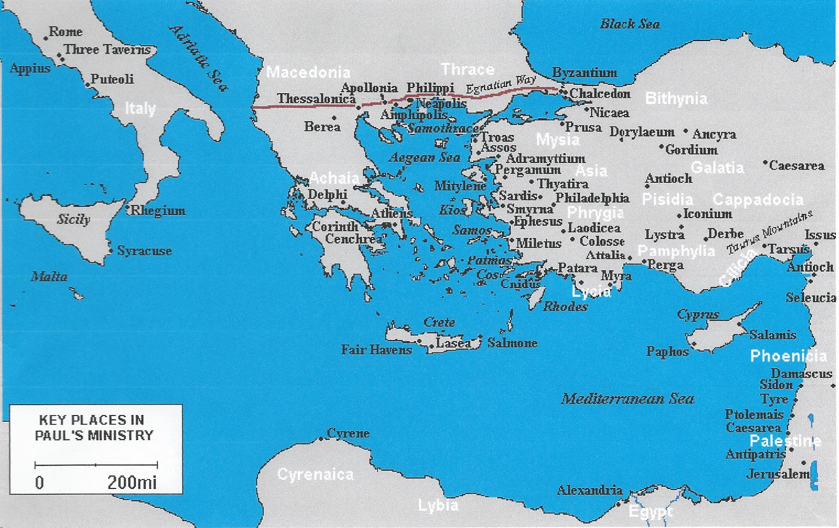
How to Read Colossians

Slide 3
How to Read Colossians
Section 1 and 2 ~ Intro and c1v1-14 (thanksgiving and prayer)
Section 3 ~ c1v15-c2v5 (supremacy of Christ)
Section 4 ~ c2v6-23 (freedom from regulations through Christ)
Section 5 ~ c3v1-17 (rules for holy living; the principles)
Section 6 ~ c3v18-c4v6 (rules for holy living; the people)
Section 7 ~ c4v7-18 (final greetings)

Slide 4
How to Read Colossians
Structure of the passage:
Interpret what Paul is saying to the 1st century Colossians, or what is the original meaning
Bridge the context:
This section bridges the meaning between the 1st century Colossians and what it means to us today by focusing on the timely and timeless aspects of the text

Slide 5
How to Read Colossians
Contemporary significance:
How can we apply the eternal truths meant for the 1st century Colossians, spoken in a different time and culture, and apply them to the similar yet different needs of our culture today

Slide 6
How to Read Colossians
Weather:
Temperate in winter; hot in summer
Ethnicity:
Three branches of Turks:
Turks in Mongolia are pure Asiatic Turks
Turks in mid-Asia areas (like Turkmenistan) are a combination
Turks in Turkey are more European in appearance; they consider themselves European, not Middle-Eastern

Slide 7
How to Read Colossians
Terrain:
Southern bank of Lycus River, near the cities of Laodicea and Hierapolis
Main industries were wool and cloth dyeing
In an earthquake-prone region; Colossae was destroyed by an earthquake in 61-62A.D.

Slide 8
How to Read Colossians
Terrain:
Rebuilt as a much smaller city, Colossae was completely destroyed by 12th century Muslims
Lycus River water had chalk in it, which was fatal to vegetation
In other areas, there was volcanic dirt, which was excellent for sheep-grazing

Slide 9
How to Read Colossians
Religiosity:
A Gentile church that Epaphras (not Paul) founded c1v7 and c4v12
The Mother-goddess cult of ‘Cybele’ and many other “mystery” religions were there
Large Jewish population that was influenced by these “mystery” religions

Slide 10
How to Read Colossians
The Colossian heresy:
No one can say for sure what it was
It attacked the total and unique supremacy of Christ
Christ + nothing
The heresy emphasizes the power of demonic spirits
There was an ascetic element to this heresy

Slide 11
How to Read Colossians
The Colossian heresy:
The most probable candidate for this heresy was “Gnosticism”
Gnosticism thought rivaled Christianity in the 2nd to 4th centuries
The “Lost Gospels” are all Gnostic gospels
Christian thinkers so soundly defeated Gnosticism, only remnants of it are alive in other religions today

Slide 12
How to Read Colossians
In all of Paul’s letters, there is a pattern:
In Colossians, the first half (c1 and c2) he talks about doctrine or principle
the second half (c3 and c4) he talks about duty or practice

Slide 13
How to Read Colossians

Slide 14
How to Read Colossians
Who wrote Colossians?
c1v1 ~ Paul, the Apostle
To whom was it written?
c1v2 ~ the believers at Colossae
What was his purpose in writing it?
c2v4,8 ~ to combat some philosophy

Slide 15
How to Read Colossians
Do people try to do this today?
What are some examples of this?
All cults lower the true position of Christ
They all say He is not God, not a part of the Trinity, etc., etc.

Slide 16
How to Read Colossians
Original Meaning:
c1v3 ~ Paul thanks the Colossians for what two things?
Faith is not a mental assent ~ Hebrews 11:1
Faith is NOT blind faith ~ 2nd Timothy 1:12
Faith acts on what it believes ~ James 2:14-17

Slide 17
How to Read Colossians
Original Meaning:
c1v3 ~ Paul thanks the Colossians for what two things?
Love is an action that improves the welfare of others ~ Romans 5:8
Love is an action, not just an emotion Matthew 25:31-46

Slide 18
How to Read Colossians
Original Meaning:
Chiasm / chiasmus (a pattern): c1v4-8
A. v4 “we have heard of your FAITH…LOVE”
B. v5 “the faith and love…HEARD…TRUTH”
C. v6a “All over the world this gospel is bearing fruit and growing”
B’ v6b “just as it has been…HEARD…TRUTH”
A’ v7-8 “FAITHFUL minister…LOVE in the Spirit”

Slide 19
How to Read Colossians
Bridging the context:
c1v6 ~ Truth in an age of relativism
Christians were called atheists
Christians were considered unpatriotic

Slide 20
How to Read Colossians

Slide 21
How to Read Colossians
Contemporary significance: c1v1-8
1. The gospel is good news
2. The gospel is truth v5-6
3. The gospel is universal John 3:16; Revelation 7:9
4. The gospel is productive v6
5. The gospel tells us of grace v6

Slide 22
How to Read Colossians
Contemporary significance: c1v1-8
6. The gospel is humanly transmitted v7
7. We must live life with thanksgiving and joy to God v3
8. “Hope” refers to a confident expectation that God will fulfill His promises, not our personal dreams
9. Paul lays great importance on prayer v3

Slide 23
How to Read Colossians
Original Meaning: c1v9-14
Knowledge, wisdom and understanding are often used partially or fully together Exodus 31:3, 35:31 Isaiah 11:2 Ephesians 1:7 Philippians 1:9 Philemon 6
Knowledge ~ to intimately know (Hebrew word ‘yada’) see Genesis 4:1 (Adam ‘knew’ Eve)

Slide 24
How to Read Colossians
Original Meaning: c1v9-14
Knowledge, wisdom and understanding are often used partially or fully together Exodus 31:3, 35:31 Isaiah 11:2 Ephesians 1:7 Philippians 1:9 Philemon 6
Wisdom ~ to the Hebrews it meant “practical skill in living”

Slide 25
How to Read Colossians
Original Meaning: c1v9-14
Knowledge, wisdom and understanding are often used partially or fully together Exodus 31:3, 35:31 Isaiah 11:2 Ephesians 1:7 Philippians 1:9 Philemon 6
Understanding ~ to gain insight into something
The more intimately we KNOW God, the more we UNDERSTAND His ways, making WISER choices in our lives

Slide 26
How to Read Colossians
Original Meaning: c1v9-14
A structural marker is a word or words that alert the reader that what is about to follow is important
“For this reason…” c1v9
“…in order that…” c1v10
“…so that…” c1v11

Slide 27
How to Read Colossians
Original Meaning: c1v9-14
For this reason… 1. 2. …in order that… 1.
2.
3.
4. …so that… 1. 2. A. B. C.

Slide 28
How to Read Colossians
Original Meaning: c1v9-14
For this reason…
1.
2.
we’re praying for you
asking God to fill you with all spiritual wisdom and understanding

Slide 29
How to Read Colossians
Original Meaning: c1v9-14
…in order that…
1.
2.
3.
4.
you may live a life worthy of the Lord and may please Him in every way
bearing fruit in every good work
growing in the knowledge of God
being strengthened by His power

Slide 30
How to Read Colossians
Original Meaning: c1v9-14
…so that…
1.
2.
you will have great endurance and patience
you will joyfully give thanks to the Father because
A.
B.
C.
we share in the inheritance
He has rescued us from the power of darkness to
the kingdom of the Son He loves

Slide 31
How to Read Colossians
Bridging the Contexts: c1v9-14
Knowledge of God + understanding + wisdom = a life pleasing to God
Bearing fruit in every good work:
1. Refers to our obedience to Jesus’ commands
2. We aren’t saved by “works”, but we are created for them Ephesians 2:8-10
3. Romans 2:13 says it is not ‘hearers’ of the Word who are righteous, but ‘doers’

Slide 32
How to Read Colossians
Bridging the Contexts: c1v9-14
Knowledge of God + understanding + wisdom = a life pleasing to God
Bearing fruit in every good work:
4. In Matthew 7:19 trees that don’t bear good fruit will be cut down and thrown into the fire
A. 1st Corinthians 3:11-15 says we won’t lose our salvation, but we will lose some heavenly rewards

Slide 33
How to Read Colossians
Contemporary Significance: c1v9-14
The significance of prayer:
Regularly v9
For others v9,10
For our spiritual development v9,10
With praise and thanksgiving v12

Slide 34
How to Read Colossians
Contemporary Significance: c1v9-14
Pleasing God:
1. Growing in the knowledge of God…
2. Bearing fruit…
3. Being strengthened by God’s power will produce patience and endurance
Patience is…
Endurance is… Philippians 4:11-13
Joyfully giving thanks…
4. The forgiveness of sins… Sin cripples; God’s forgiveness frees

Slide 35
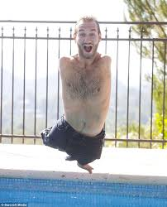
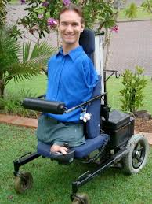

Slide 36
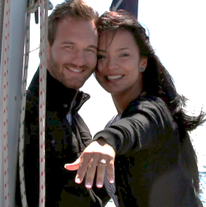

Slide 37
How to Read Colossians
Original Meaning: c2v6-23
1. Paul’s wishes for the Colossians ~ v6,7
2. Paul’s warning to the Colossians
A. v8-10 ~ Gnosticism
B. v11-17 ~ Legalism
C. v18,19 ~ Mysticism
D. v20-23 ~ Asceticism
3. How many times does Paul say “with” or “in Christ” in this section?

Slide 38
How to Read Colossians
Original Meaning: c2v6-23
4. Paul’s wishes for the Colossians ~ v6,7
A. “rooted” ~ Jeremiah 17:8
B. “being built up”
C. “strengthened in the faith”
D. “overflowing with thankfulness”

Slide 39
How to Read Colossians
Original Meaning: c2v6-23
5. Paul’s warnings to the Colossians ~ v8-23
A. Truth vs. Deception ~ c1v5,6
B. Liberation vs. Captivity ~ c1v13
6. This philosophy depends on… v8
A. Human traditions
B. The basic / elemental ~ principles / spirits of this world

Slide 40
How to Read Colossians
Original Meaning: c2v6-23
7. Paul’s warning to the Colossians
A. v8-10 ~ Gnosticism
the fiction…
the fact…
B. v11-17 ~ Legalism
the love of Christ ~ v11-15
the liberty in Christ ~ v16,17
C. v18,19 ~ Mysticism
the fiction…
the fact…
D. v20-23 ~ Asceticism
the fiction…
the fact…

Slide 41
How to Read Colossians
Original Meaning: c2v16-23
There are three parts to this section:
1. A 2nd warning ~ v16,17 (see 1st warning in c2v8)
2. A 3rd warning ~ v18,19
3. A rhetorical question ~ v20-23
1. The 2nd warning ~ see Hebrews 10:1
2. The 3rd warning
3. Rhetorical question ~ see Mark 7:19

Slide 42
How to Read Colossians
Bridging the Contexts: c2v6-23
Paul stresses three vital theological issues:
1. The all-sufficiency of Christ ~ c2v9,10
2. God has provided complete forgiveness and fullness in Christ ~ c2v10,13-14
3. Christ has completely disarmed any threatening power against us (Satan and his demons) c2v15

Slide 43
How to Read Colossians
Bridging the Contexts: c2v6-23
There are four points to consider:
1. “just as you received Christ as Lord… continue to live in Him” ~ c2v6
2. The circumcision of Christ ~ c2v11,13
3. False philosophies ~ c2v8
4. Basic principles of this world / elemental spirits of this world ~ c2v8

Slide 44
How to Read Colossians

Slide 45
How to Read Colossians
Bridging the Contexts: c2v16-23
Philosophies / religions that challenge / contaminate Christianity take on the following characteristics:
1. It judges, excludes or disqualifies people according to arbitrary, human criteria
2. It engenders religious tyranny over people based on these criteria
3. It panders to human pride and results in puffing people up by promoting things like…

Slide 46
How to Read Colossians
Bridging the Contexts: c2v16-23
Philosophies / religions that challenge / contaminate Christianity take on the following characteristics:
4. It attaches too much importance to temporal things or to the heavenly realm
5. It cuts people off from other believers
6. It lessons our view of, and dependence on, Christ

Slide 47
How to Read Colossians
Bridging the Contexts: c2v16-23
Philosophies / religions that challenge / contaminate Christianity take on the following characteristics:
7. It pretends to offer greater wisdom / knowledge than is found in the cross of Christ. Its wisdom focuses on fulfilling ourselves, rather than being filled by the Holy Spirit.
8. You wind up working for your salvation and not trusting Christ alone

Slide 48
How to Read Colossians
Contemporary Significance: c2v6-23
Every generation of Christians have faced threats like the Colossians faced:
1. Paul reiterates the Truth of the Gospel
a. …continue to live in Christ… v6
b. …be thankful… v7
2. He wants us to be aware of false ideologies
3. He wants is to be free from controlling forces

Slide 49
How to Read Colossians
Contemporary Significance: c2v6-23
Every generation of Christians have faced threats like the Colossians faced:
4. What are some of the false beliefs or statements you have encountered?
5. A list of rules may give us a greater sense of security or lead us to regard our obligations to God as a checklist… (and if we do them, God will love us more)
a. Name some “false” Christian rules

Slide 50
How to Read Colossians
Contemporary Significance: c2v6-23
Every generation of Christians have faced threats like the Colossians faced:
6. The danger of mystical experiences
7. The danger of someone or something else filling the gap between us and God… Revelations 19:10, 22:8-9 Psalms 34:7 Hebrews 13:2 Genesis 3:24 2 Corinthians 11:13-15
8. The danger of losing connection with the Head… Hebrews 10:23-25

Slide 51
How to Read Colossians

Slide 52
How to Read Colossians
Original Meaning: c3v18-c4v1
c3v1-17 ~ Principles
c3v18-c4v1 ~ These principles worked out in everyday relationships
History of Greco-Roman life
v18-19 All privileges belonged to the husband All duties belonged to the wife
v20-21 All privileges belonged to the parents All duties belonged to the child
v22-c4v1 All privileges belonged to the master All duties belonged to the slave

Slide 53
How to Read Colossians
Original Meaning: c3v18-c4v1
In Christianity, the privileges and rights fall into the background, and the duty and obligations come to the forefront
v18-19 To submit (hypotasso) is not to be subservient
This directive is not one-sided; demands are also made of the husband
This submission is qualified with the phrase,
“as is fitting in the Lord”

Slide 54
How to Read Colossians
Original Meaning: c3v18-c4v1
v20-21 1st Corinthians 4:21 Colossians 3:12
v20-c4v1 Slavery was an entrenched reality. Paul subtly undermines its premise.

Slide 55
How to Read Colossians
Bridging the context: c3v18-c4v1
Paul focused on how to live within one’s cultural framework in obedience to Christ.
We can see how Christ’s lordship subtly deconstructs the old habits of domination and exploitation.
If others did not perceive Christianity to be disruptive of society, they might be more willing to listen to the gospel. Titus 2:9-10

Slide 56
How to Read Colossians
Bridging the context: c3v18-c4v1
The commands recognize that reciprocity exists, so that the entitlements are not all on one side and the obligations on the other. (this was radical for its time)
The term “the Lord” appears seven times in these passages.
Paul assumed the role of “paterfamilias” (1 Cor 4:15) but he did not lord it over them (2 Cor 1:24)

Slide 57
How to Read Colossians
Contemporary significance: c3v18-c4v1
Proverbs assumes the house is the primary place of moral foundation and social duty.
We are buying into the modern marketing mantra to continually upgrade to new and improved versions
We are too devoted to self-fulfillment to appreciate the concept of servant-hood and its very different joys

Slide 58
How to Read Colossians

