Slide 1
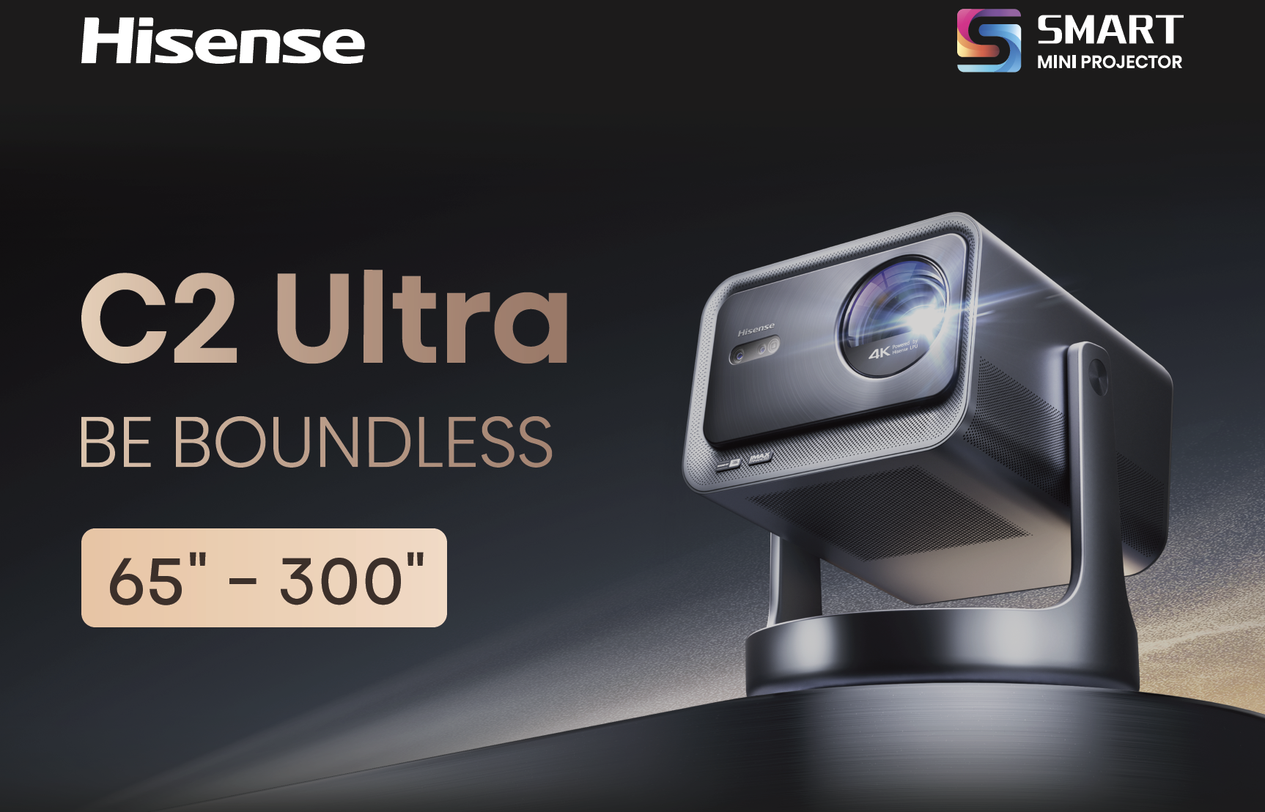
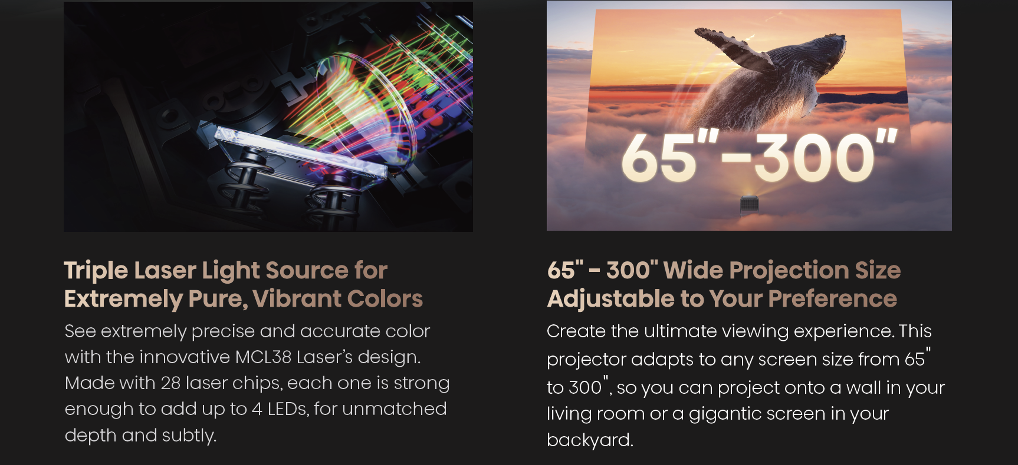

C1 Laser Mini Projector

Slide 2
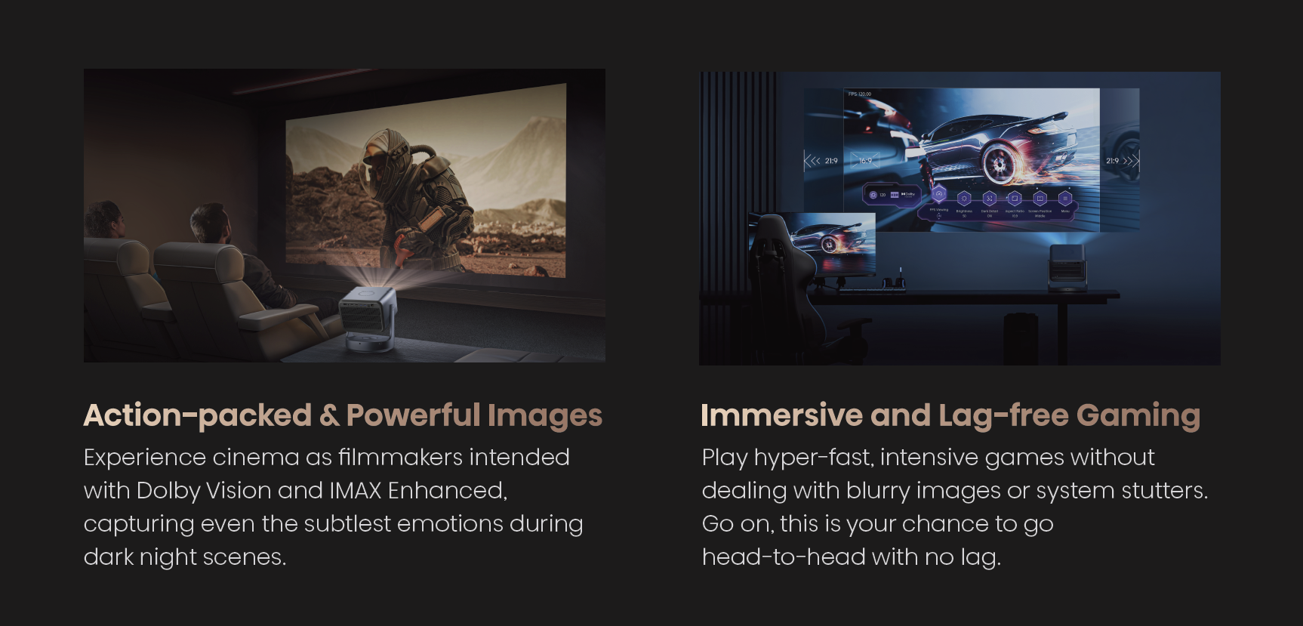
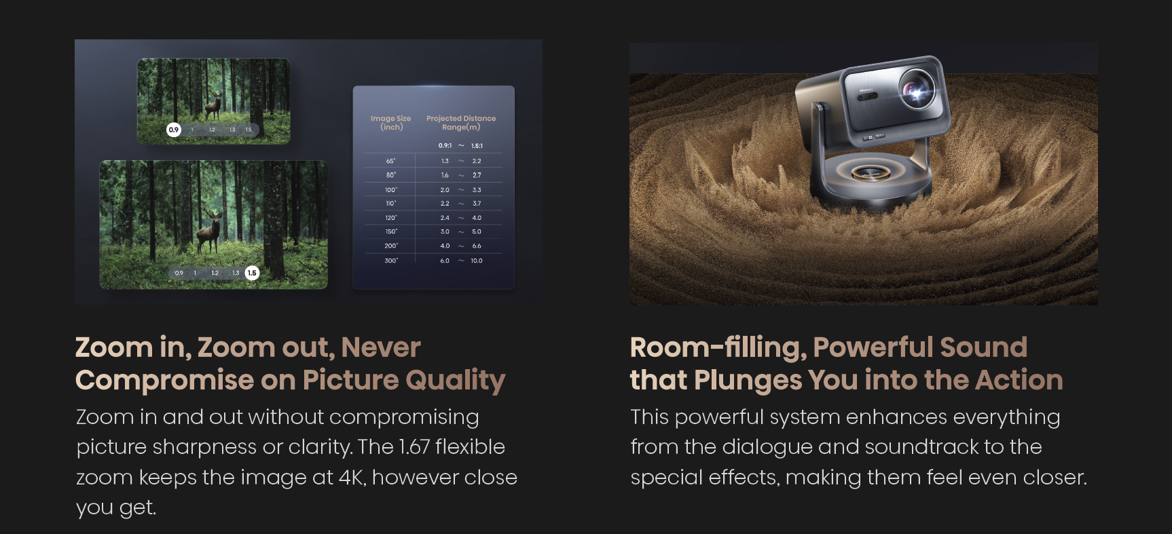
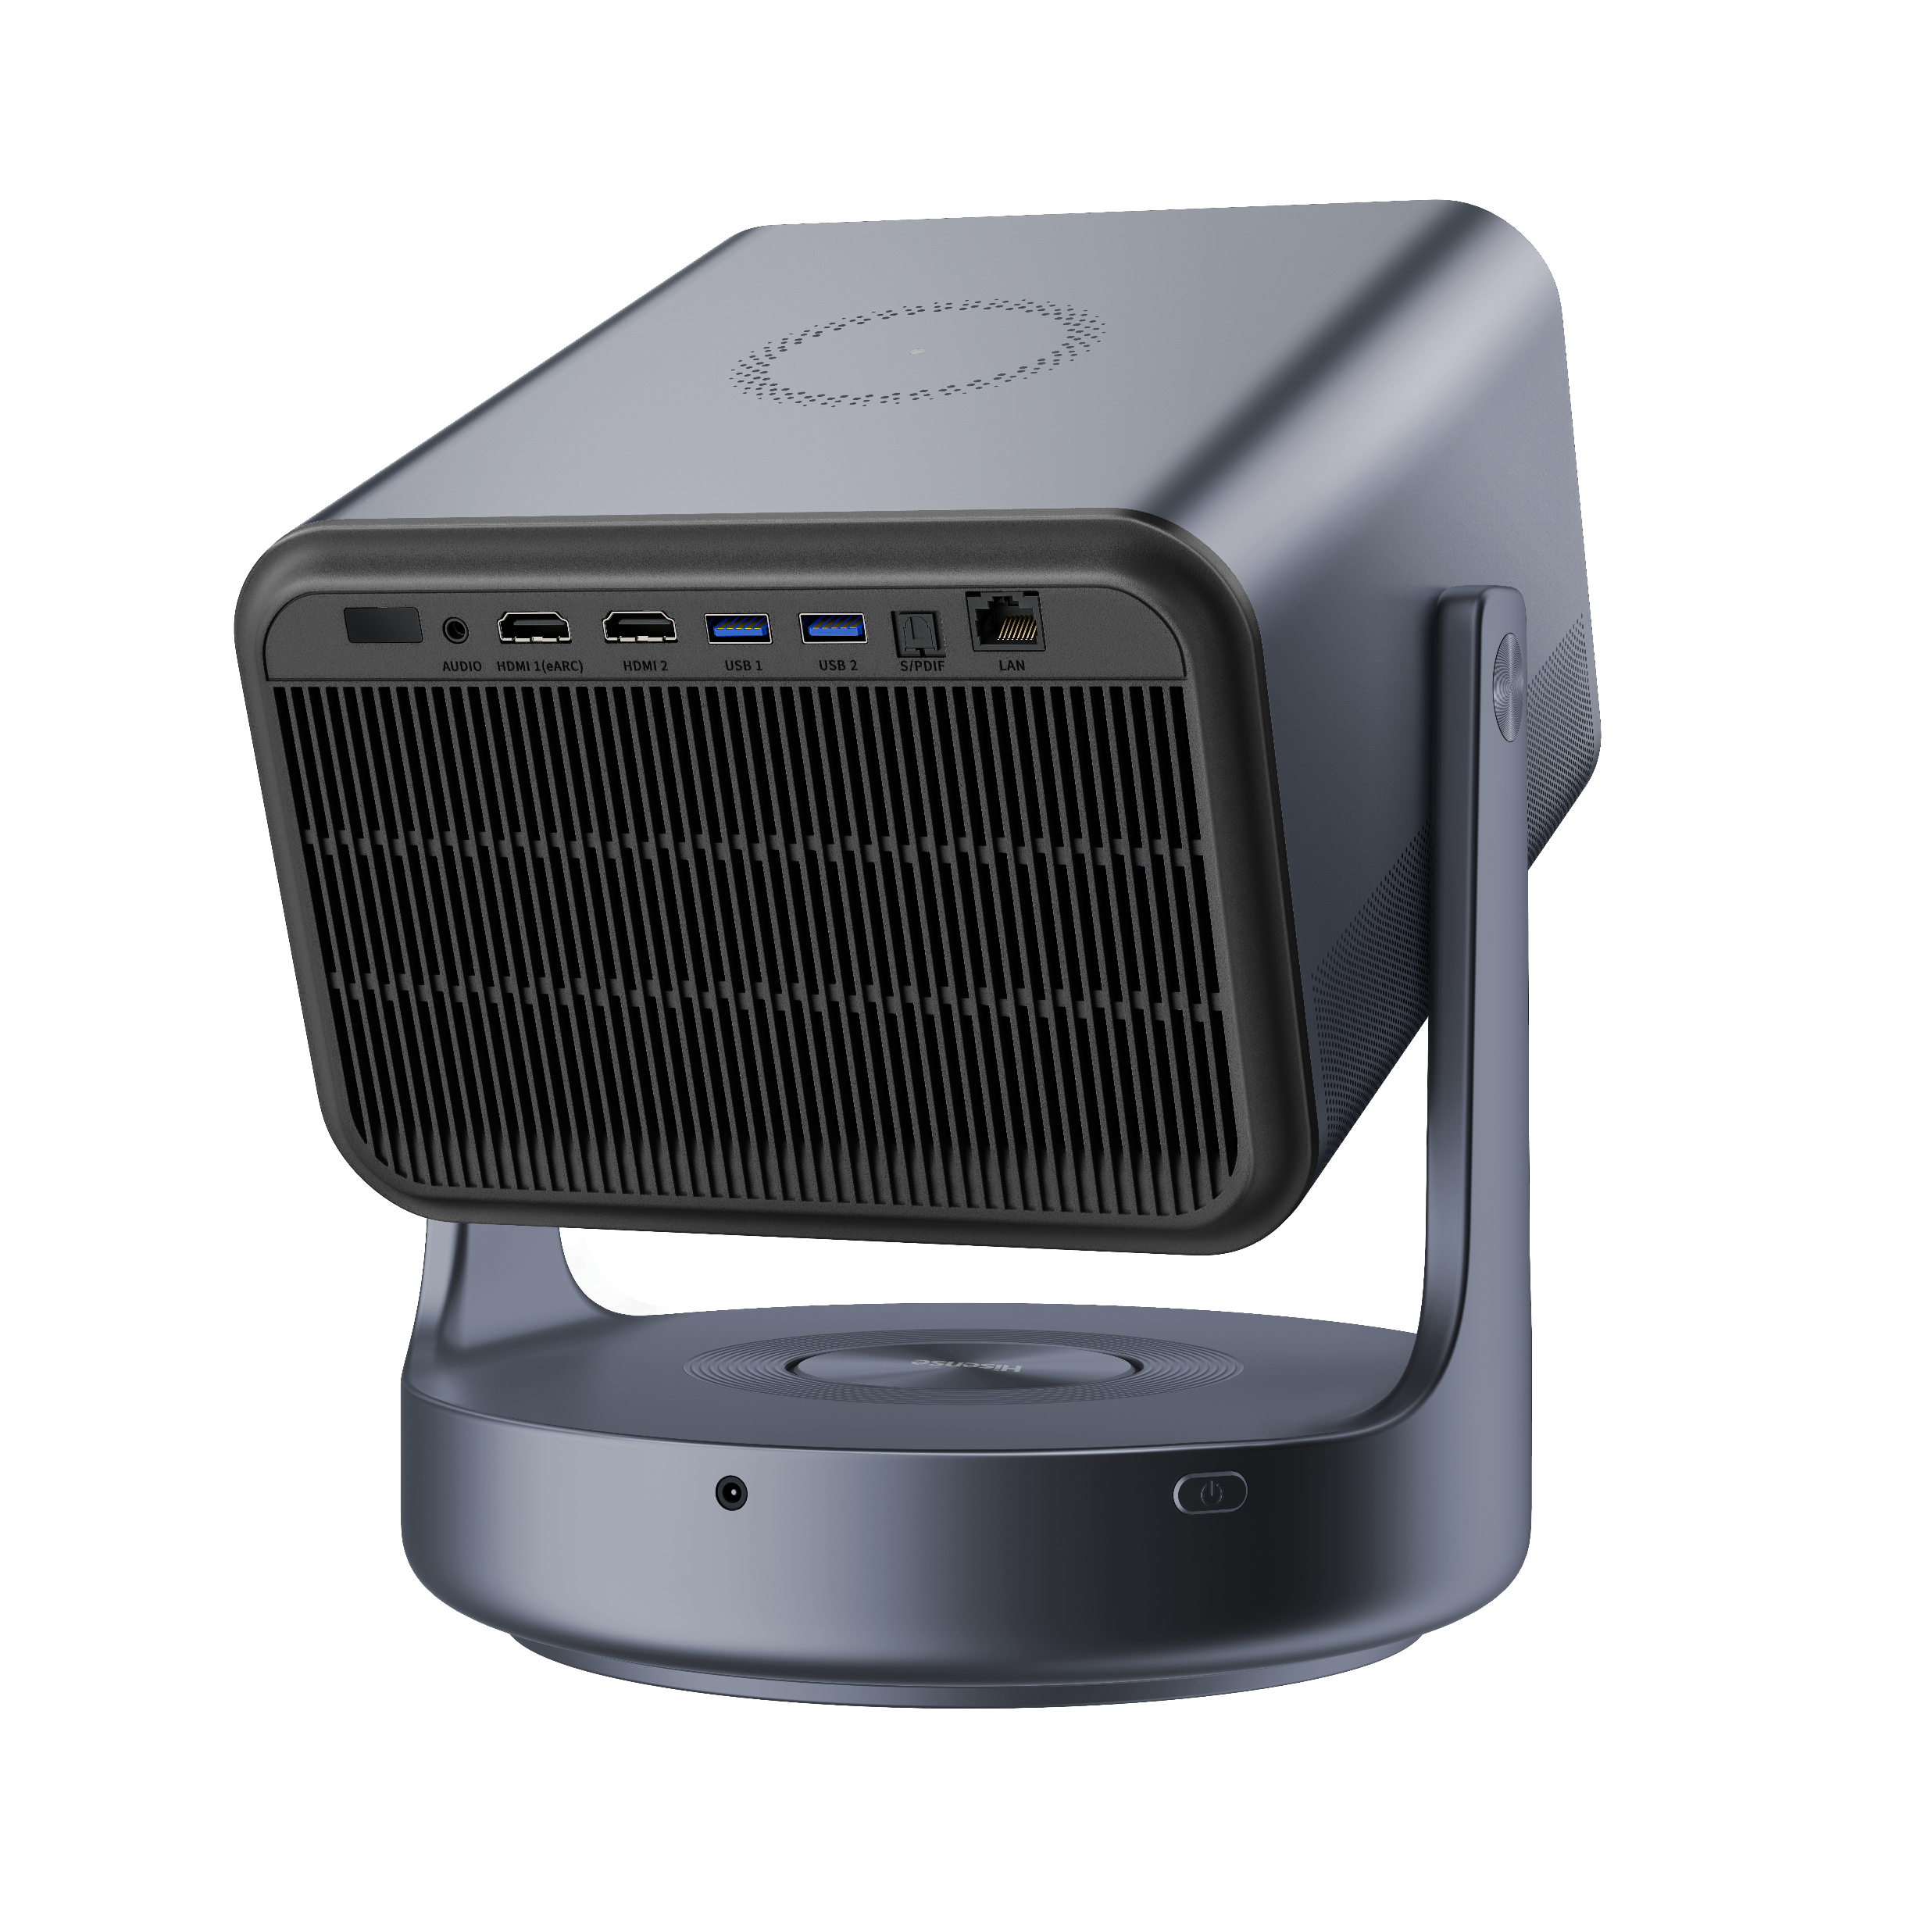
Up to 130” Projection
Ports & Connectivity
2x
2x
USB 3.0
Ultra High-Speed HDMI
(1 with eARC)
1x
1x
LAN Ethernet
Digital Audio Out

Slide 3
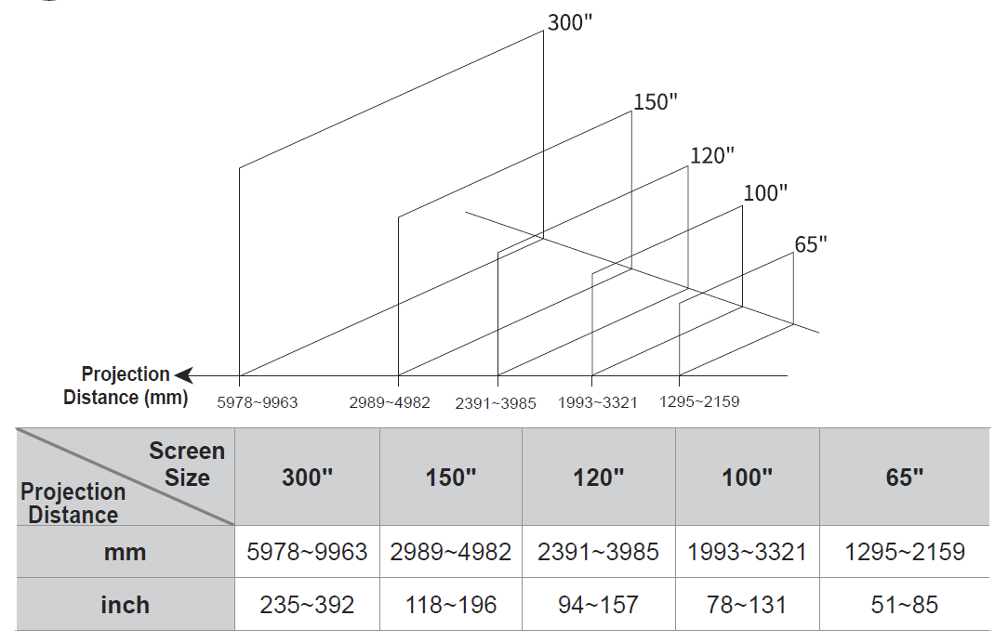
Tech Specs C2 Ultra
Physical | Dimensions(W x H x D) | 9.7’’ × 11.3’’ × 9.7’
 | Weight | 13.9 lbs
 | Packaged Dimensions (W x H x D) | 15.8” x 13.3” x 15.6”
 | Packaged Weight | 21.4 lbs
Picture | Projection Size | 65”-300”
 | Brightness | 3000 ANSI Lumens
 | Color Space | 110%BT.2020
 | Native Contrast Ratio | 2,000:1
 | HDR | HDR10+, HDR10，Dolby Vision, HLG
 | Light Source | R+G+B Triple Laser
 | Laser Life | 25,000+ Hours
 | Throw Ratio | 0.9-1.5：1
 | Chipset | 0.47” DMD
Audio | Audio Output Power | 2*10W+20W Powered by JBL
 | Surround Sound | Dolby Digital, DTS Virtual:X
Smart Features | Smart TV Platform | VIDAA OS
 | App Store | VIDAA App Store
 | Streaming Services | Netflix, Amazon Prime Video, YouTube，Disney+
 | Voice Assistant | Amazon Alexa，VIDAA Voice
 | Screen Mirroring | Airplay2(will be available through OTA)，Miracast
Connectivity | Wi-Fi | 802.11a/b/g/n/ac/ax，WiFi 6e
 | Bluetooth | Yes
 | Wired Ethernet | Yes
Power | Power Consumption | 180W
 | Standby Consumption | <0.5W
 | Power Supply | 100-240V~ 60/50Hz Max 2.5A
Ports | HDMI | 2xHDMI2.1(ALLM)
 | HDMI ARC, CEC | Yes
 | USB | 2x USB 3.0
 | RF Antenna | No
 | Ethernet (LAN) | 1x
 | Digital Audio Output | 1x Optical
 | Analog Audio Output | 1x
Ohter Features | Console Color | Gun metal grey
 | Eye Protection | Yes
 | HSR240 | Yes
 | Remote Finder | Yes
 | Sound Send | Yes
 | IMAX Enhanced | Yes
 | Control4 Compatible | Yes
 | 3D Ready | Active
 | TOF Type | 3D TOF
 | Zoom | Optical and Digital
 | Auto focus | Yes, seamless
 | Auto Screen Fit | Yes
 | Auto Keystone correction | Yes, seamless
 | Auto Obstacle Avoidance | Yes
Accessories | Remote | Yes, voice remote with backlight
 | Quick Start Guide / Manual | QSG in box, Manual online
 | Power Cable | Yes
 | Cleaning Kit | Yes
 | Warranty | 1 Year limited Warranty
 | UPC / EAN | UPC:888143020563 EAN:6942351409405
NOTE:
When the projection size is greater than 150 inches, Auto Shift Correction may be unavailable, Manual Focus and Screen Alignment are required.
The projection distances are provided for reference, and the actual distance varies with the selection of optical zoom.
A 5% deviation is considered acceptable for the measurements about the projection distance.
All product, product specifications, and data are subject to change without notice to improve reliability, function, design or otherwise. Release 120321.
All trademarks and logos used herein are the property of their respective owners. Copyright © 2022 USA, All rights reserved.
Hisense USA Corporation | 7310 McGinnis Ferry Road, Suwanee, GA 30024 | 1-888-935-8880 | www.hisense-usa.com

