Slide 1

2025 Annual EPP Accreditation Reporting Measures (2023-2024 Completer Data)
Christian Brothers University
Department of Education

Slide 2
Performance Measures

Slide 3

CAEP Measure 1: Completer Effectiveness
Measure 1 - Section A: Data that addresses completer impact in contributing to P-12 student learning growth (TVAAS)
% Cohort Members w/ TVAAS Scores Level 3 or Above (3-Year Average)*
State Average | CBU Average
59.1% | 94.4%
The Tennessee Value-Added Assessment System (TVAAS) measures student growth year over year, regardless of whether the student is proficient on the state assessment. This tool measures how much students grow in a year, relative to other students across the state that took the same assessment that year.
% Cohort Members w/ TVAAS Scores Level 4 or Above (3-Year Average)*
State Average | CBU Average
24.5% | 38.9%

Slide 4
CAEP Measure 1: Completer Effectiveness
Measure 1 - Section B: Data that addresses completer effectiveness in applying professional knowledge, skills, and dispositions
% Cohort Members with LOE scores Level 3 or Above*
State Average | CBU Average
89.4% | 97.6%
Tennessee State Department of Education (TDOE) uses specific data to calculate teachers' final evaluation score, the Level of Effectiveness (LOE) score. The LOE score for public school teachers including qualitative measures, student growth measures, and student achievement measures. TDOE recognizes a score of '3' as 'Meeting/At Expectations' and a score of '4' or higher as 'Significantly Above Expectations'.
% Cohort Members with LOE scores Level 4 or Above*
State Average | CBU Average
61.6% | 73.2%

Slide 5
CAEP Measure 1: Completer Effectiveness
Measure 1: Section B: Data that addresses completer effectiveness in applying professional knowledge, skills, and dispositions
% Cohort Members with Classroom Observation Scores of Level 3 or Above
State Average | CBU Average
96% | 97.8%
CBU Completer
Teaching Effectiveness*
Instructional practices implemented in Tennessee public school are evaluated using the evaluation rubric. Made up of eleven indicators, the TEAM rubric is used to identify an educator's level of effectiveness in classroom instruction.
% Cohort Members with Classroom Observation Scores of Level 4 or Above
State Average | CBU Average
63.9% | 76.1%
Notes:
Level 3 97.8 Average – 91.7 Early Childhood Education
100% Elementary Education
Level 4 – 76.1% avg based on 66.7% Early Childhood Ed
69.2% Elementary Education

Slide 6
CAEP Measure 1: Completer Effectiveness
Measure 1: Section B: Data that addresses completer effectiveness in applying professional knowledge, skills, and dispositions
The Candidate Assessment domain evaluates a provider's performance in preparing candidates to pass the pedagogical and content-area assessments required to obtain a Tennessee teaching license.
Data Cycle | Domain Performance | Praxis PLT Pass Rate | EdTPA Pass Rate | Praxis Content Area Pass Rate | Leadership Praxis Pass Rate | Praxis Literacy Pass Rate
2023-24 EPP Report Card | Exceeds Expectations | n/a | 100% | 93.8% | 100% | 95.5%
2022-23 EPP Report Card | Meets Expectations | 96.8% | 95% | 89.8% | 100% | 78.3%
2021-22 EPP Report Card | Meets Expectations | 97% | 100% | 91.7% | 100% | 82.6%

Slide 7
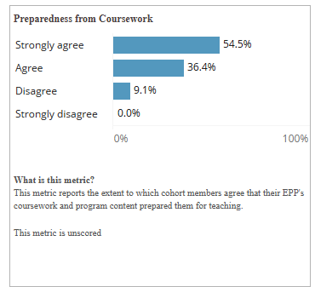
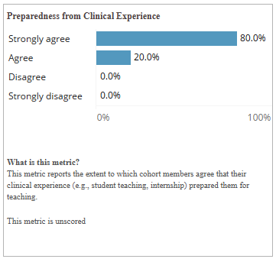
CAEP Measure 2: Satisfaction of Employers and Stakeholder Involvement (Initial)
The metrics below report to the extent which cohort members agree that their EPP coursework and clinical experiences (e.g. student teaching, job-embedded, internships, etc.) prepared them for teaching.

Slide 8
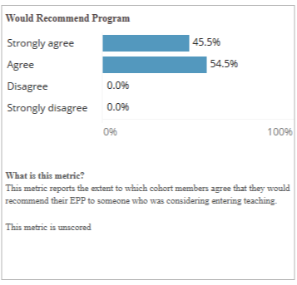
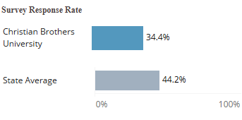
CAEP Measure 2: Satisfaction of Employers and Stakeholder Involvement(Initial)
The metrics below report to the extent which cohort members agree that they would recommend the EPP to someone considering teaching. Additionally the survey response rate identifies cohort members who were employed in a Tennessee public school at the time the survey was administered.

Slide 9
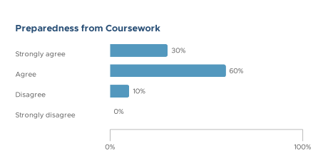
CAEP Measure 3: Candidacy Competency at Completion (Initial)
Documented responders were asked to rate their satisfaction with level of preparation from the EPP program for the teaching profession.

Slide 10
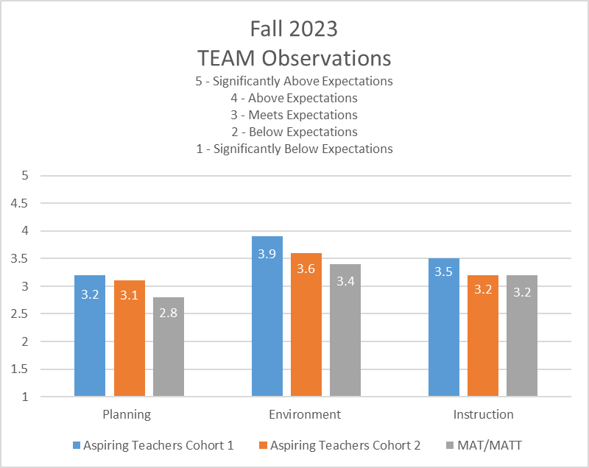
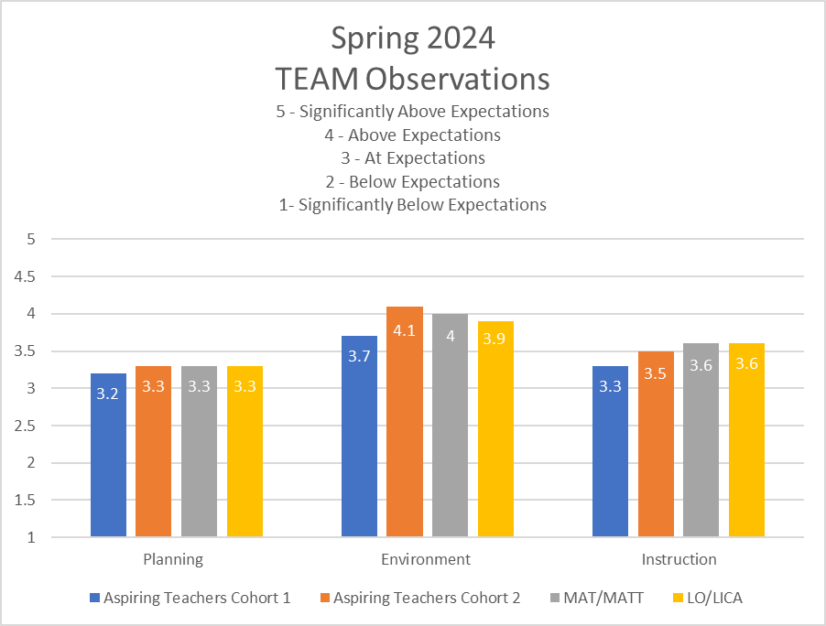
CAEP Measure 3: Candidacy Competency at Completion (Initial)
TEAM Observation Data
The purpose of the TEAM evaluation process is to provide educators with a model that helps them continuously improve their practice based on indicators in the following three areas:
Planning
Environment
Instruction

Slide 11
CAEP Measure 3: Candidacy Competency at Completion (Advanced)
Candidates must pass the Praxis Leadership assessment to gain administrative licensure for the state of Tennessee.
CBU Praxis Leadership pass rates for SY 2023-24 is 100%
(n-size 25)
100%

Slide 12
CAEP Measure 4: Ability of Completers to Be Hired (Initial)
Data Cycle | Overall Domain Performance | Rate of First Year Employment in TN Public Schools | Second Year Retention Rate | Third Year Retention Rate
TN Average | Meets Expectations | 82.7% | 89.5% | 82.6%
CBU (2023-24) |  | 79.1% | 93.6% | 90.0%
Based on the TN EPP Report Card, the Employment domain evaluates a provider's performance in preparing educators to begin and remain teaching in Tennessee public schools. Over a three-year range, CBU completers have surpassed state hiring and retention averages in Tennessee public schools, earning 'Exceeds Expectations' performance rating.
Data Cycle | Overall Domain Performance | Rate of First Year Employment in TN Public Schools | Second Year Retention Rate | Third Year Retention Rate
TN Average | Exceeds Expectations | 80.3% | 93.6% | 78.8%
CBU (2022-23) |  | 82.5% | 96.6% | 77.8%
Data Cycle | Overall Domain Performance | Rate of First Year Employment in TN Public Schools | Second Year Retention Rate | Third Year Retention Rate
TN Average | Exceeds Expectations | 79.1% | 94.2% | 82.6%
CBU (2021-22) |  | 84.4% | 96.6% | 91.7%

Slide 13
CAEP Measure 4: Ability of Completers to Be Hired (Advanced)
Based on the TN EPP Report Card for Leader Preparation Completers, the percentage of educators employed as administrators in the state has been averaged over a 3-year period.
Number of Completers in 3-Year Cohort | Percentage Ever Employed as Administrator
30 | 23.3%

