Slide 1

2025 Annual EPP Reporting Measures
(2024-2025 Completer Data)
Christian Brothers University
Department of Education

Slide 2
Candidate Demographics

Slide 3
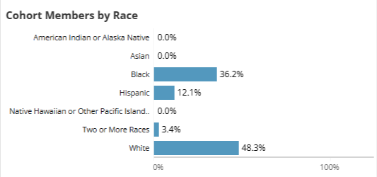
Candidate Demographics (Initial Programs)
The metrics below show the racial and ethnic composition of CBU candidates in Initial programs.

Slide 4
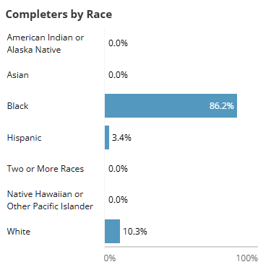
Candidate Demographics (Advanced Programs)
The metrics below show the racial and ethnic composition of CBU candidates in Initial programs.

Slide 5
Performance Measures

Slide 6

Measure 1 - Completer Effectiveness
Measure 1 - Section A: Data that addresses completer impact in contributing to P-12 student learning growth (TVAAS)
% Cohort Members w/ TVAAS Scores Level 3 or Above (3-Year Average)*
State Average | CBU Average
58.9% | 84.6%
The Tennessee Value-Added Assessment System (TVAAS) measures student growth year over year, regardless of whether the student is proficient on the state assessment. This tool measures how much students grow in a year, relative to other students across the state that took the same assessment that year.
% Cohort Members w/ TVAAS Scores Level 4 or Above (3-Year Average)*
State Average | CBU Average
23.4% | 46.2%
Notes:
It’s important to note that last year, the EPP did not meet the state average in both areas (L3 by 2% L4 by 16%), so significant gains were made this year.

Slide 7
Measure 1 - Completer Effectiveness
Measure 1 - Section B: Data that addresses completer effectiveness in applying professional knowledge, skills, and dispositions
% Cohort Members with LOE scores Level 3 or Above*
State Average | CBU Average
90.5% | 95.8%
Tennessee State Department of Education (TDOE) uses specific data to calculate teachers' final evaluation score, the Level of Effectiveness (LOE) score. The LOE score for public school teachers including qualitative measures, student growth measures, and student achievement measures. TDOE recognizes a score of '3' as 'Meeting/At Expectations' and a score of '4' or higher as 'Significantly Above Expectations'.
% Cohort Members with LOE scores Level 4 or Above*
State Average | CBU Average
63.1% | 84.7%

Slide 8
Measure 1 - Completer Effectiveness
Measure 1: Section B: Data that addresses completer effectiveness in applying professional knowledge, skills, and dispositions
% Cohort Members with Classroom Observation Scores of Level 3 or Above
State Average | CBU Average
95% | 98.7%
CBU Completer
Teaching Effectiveness*
Instructional practices implemented in Tennessee public school are evaluated using the evaluation rubric. Made up of eleven indicators, the TEAM rubric is used to identify an educator's level of effectiveness in classroom instruction.
% Cohort Members with Classroom Observation Scores of Level 4 or Above
State Average | CBU Average
63.2% | 82.7%
Notes:
Level 3 97.8 Average – 91.7 Early Childhood Education
100% Elementary Education
Level 4 – 76.1% avg based on 66.7% Early Childhood Ed
69.2% Elementary Education

Slide 9
Measure 1 - Completer Effectiveness
Measure 1: Section B: Data that addresses completer effectiveness in applying professional knowledge, skills, and dispositions
The Candidate Assessment domain evaluates a provider's performance in preparing candidates to pass the pedagogical and content-area assessments required to obtain a Tennessee teaching license.
Data Cycle | Domain Performance | Praxis PLT Pass Rate | EdTPA Pass Rate | Praxis Content Area Pass Rate | Leadership Praxis Pass Rate | Praxis Literacy Pass Rate
2024-2025 EPP Report Card | Meets Expectations | n/a | 100% | 89.2% | 100% | 89.7%
2023-24 EPP Report Card | Exceeds Expectations | n/a | 100% | 93.8% | 100% | 95.5%
2022-23 EPP Report Card | Meets Expectations | 96.8% | 95% | 89.8% | 100% | 78.3%
2021-22 EPP Report Card | Meets Expectations | 97% | 100% | 91.7% | 100% | 82.6%

Slide 10
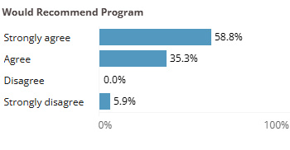
Measure 2 - Satisfaction of Employers and Stakeholder Involvement
The metrics below report to the extent which cohort members agree that they would recommend the EPP to someone considering teaching.

Slide 11
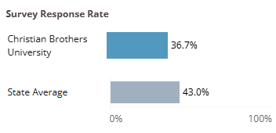
Measure 2 - Satisfaction of Employers and Stakeholder Involvement
This metric shows the survey response rate for cohort members who were employed in a Tennessee public school at the time the survey was administered.
Notes:
Increase in participation from 2024 by 2.3%

Slide 12
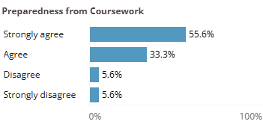
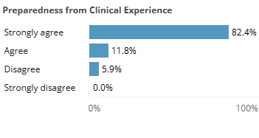
Measure 3 – Candidacy Competency at Completion
The metrics below report to the extent which cohort members agree that their EPP coursework and clinical experiences (e.g. student teaching, job-embedded, internships, etc.) prepared them for teaching.

Slide 13
CAEP Measure 3: Candidacy Competency at Completion (Advanced)
Candidates must pass the Praxis Leadership assessment to gain administrative licensure for the state of Tennessee.
CBU Praxis Leadership pass rates for SY 2024-25 is 100%
(n-size 24)
100%

Slide 14
CAEP Measure 4: Ability of Completers to Be Hired
Data Cycle | Overall Domain Performance | Rate of First Year Employment in TN Public Schools | Second Year Retention Rate | Third Year Retention Rate
TN Average | Meets Expectations | 84.6% | 94.2% | 85.1%
CBU (2024-25) |  | 83.1% | 100% | 70%
Based on the TN EPP Report Card, the Employment domain evaluates a provider's performance in preparing educators to begin and remain teaching in Tennessee public schools. Over a three-year range, CBU completers have surpassed state hiring and retention averages in Tennessee public schools, earning the ‘Meets Expectations' performance rating.
Data Cycle | Overall Domain Performance | Rate of First Year Employment in TN Public Schools | Second Year Retention Rate | Third Year Retention Rate
TN Average | Meets Expectations | 82.7% | 89.5% | 82.6%
CBU (2023-24) |  | 79.1% | 93.6% | 90.0%
Data Cycle | Overall Domain Performance | Rate of First Year Employment in TN Public Schools | Second Year Retention Rate | Third Year Retention Rate
TN Average | Exceeds Expectations | 80.3% | 93.6% | 78.8%
CBU (2022-23) |  | 82.5% | 96.6% | 77.8%

Slide 15
CAEP Measure 4: Ability of Completers to Be Hired (Advanced)
Based on the TN EPP Report Card for Leader Preparation Completers, the percentage of educators employed as administrators in the state has been averaged over a 3-year period.
Number of Completers in 3-Year Cohort | Percentage Ever Employed as Administrator
29 | 10.3%

