Slide 1
The Urban Rat Project
Household Trap Reminder Service

Slide 2
The Problem
1 in 5 suburban households need to be trapping or baiting to rid NZ of rats and other pests.
They need to check their stations regularly, year after year.
We need to gather all that data…
AND KEEP PEOPLE MOTIVATED!
343,700
households
17.9M
checks/year if done weekly

Slide 3
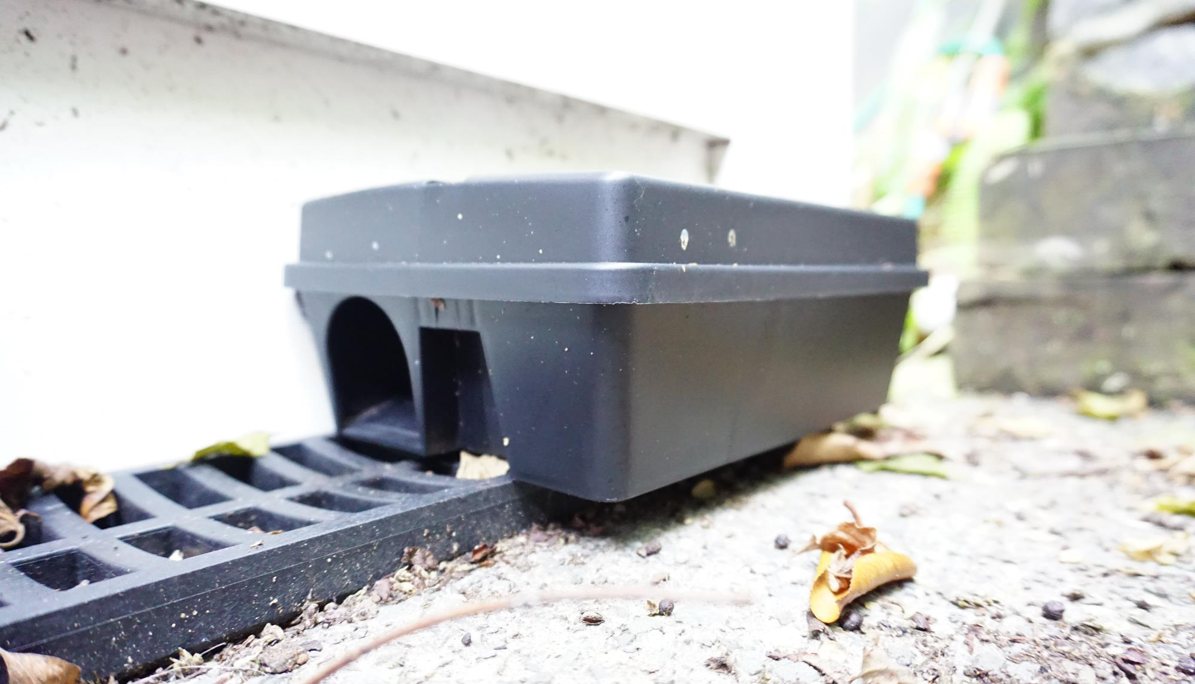
We use Behavioural Science to Lift & maintain Householder engagement…
… while gathering data with minimal friction

Slide 4
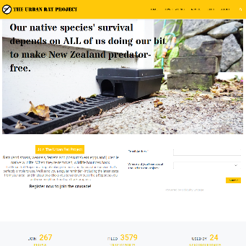
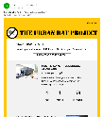
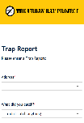
Our Solution
1
Household joins or hears about community group
2
Sign up at ratproject.org
3
Receive regular email reminder
4
Check trap and file Report

Slide 5
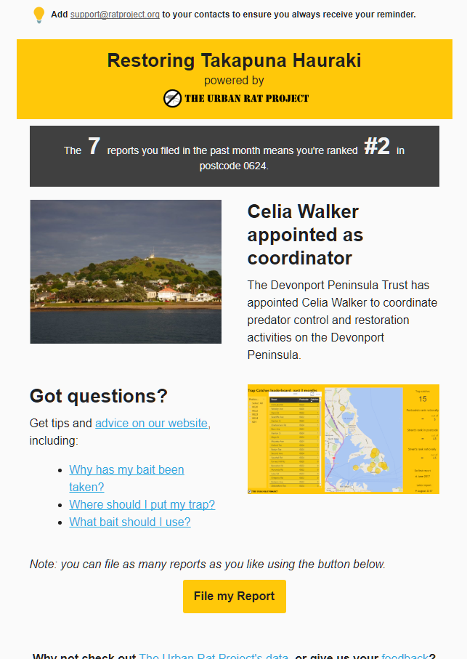
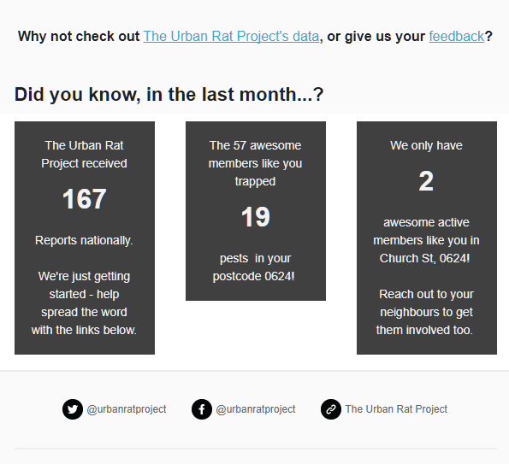
Reminder
Co-branded with community group
Personal ranking in postcode
Locally-relevant content
Helpful tips
File a report, pre-populated with user’s last answers
Stats
More stats!

Slide 6
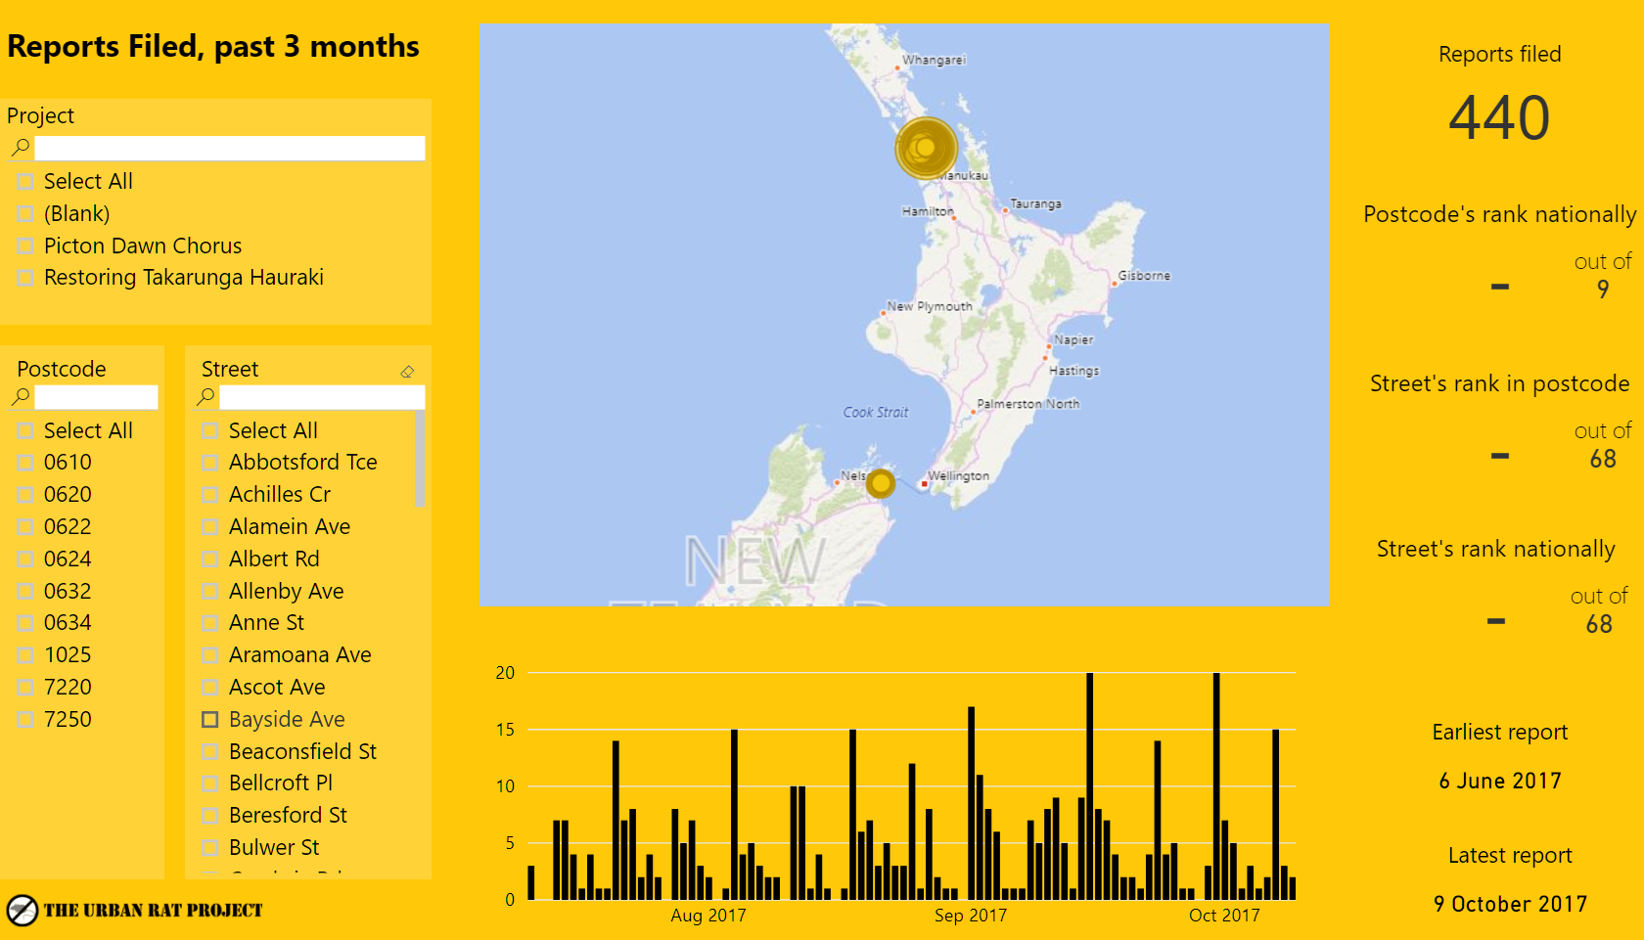
Interactive Dashboard

Slide 7
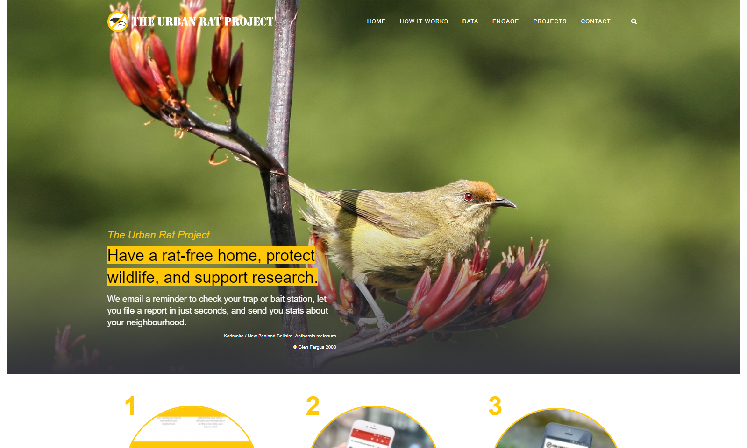
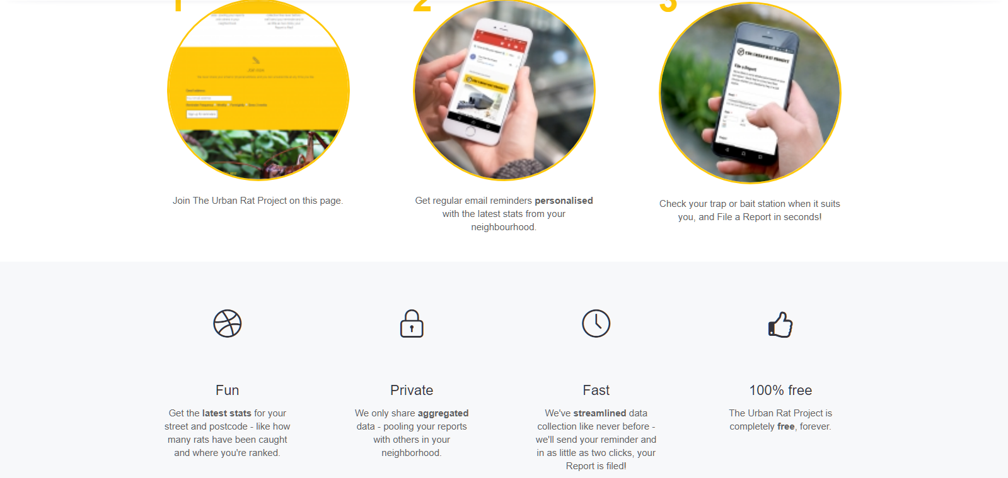
Website

