Slide 1
A vision prepared by the Tui Nature Reserve Wildlife Charitable Trust
Wild about NZ Wildlife

Slide 2
The Trust made a commitment to reverse the decline of our wildlife in New Zealand
Ecological restoration programmes
Captive native breeding programmes
Innovative new aviary design
Soft release programmes for other projects

Slide 3
Why?
80% of all remaining NZ Birds
88% our skinks and geckos
100% of our frogs
Are facing extinction (Environment Aotearoa Report, Oct.2015)
Predation is the main cause of the decline of NZ native species

Slide 4
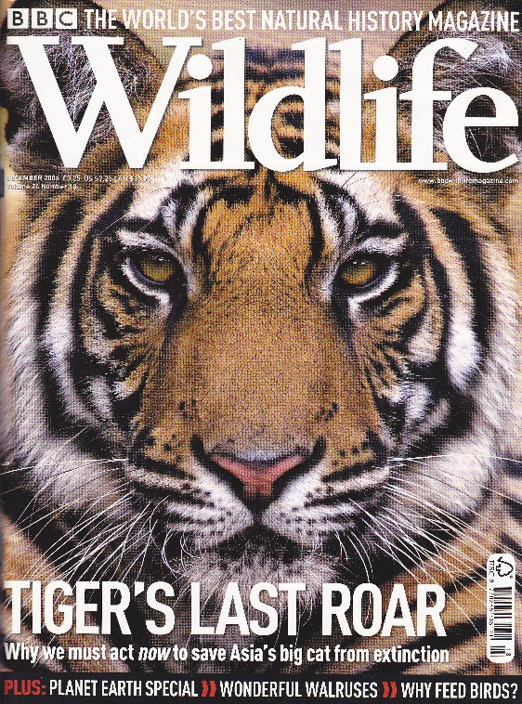
The Trust has restored 80 hectares of prime native forest in the Marlborough Sounds

Slide 5
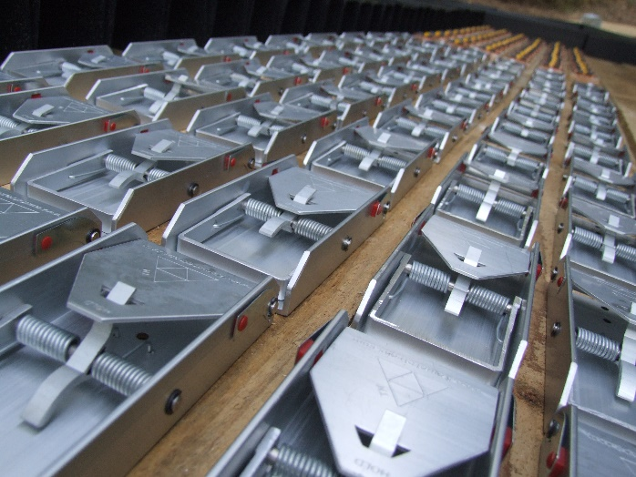
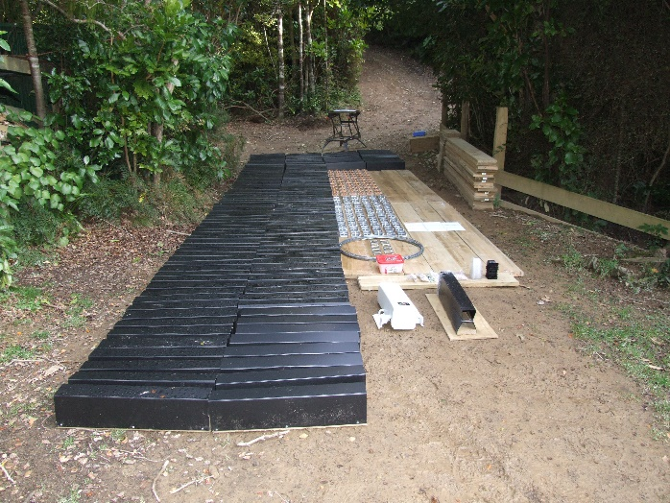
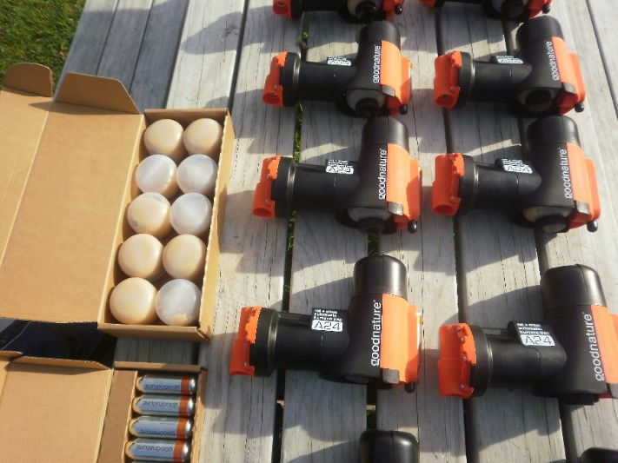
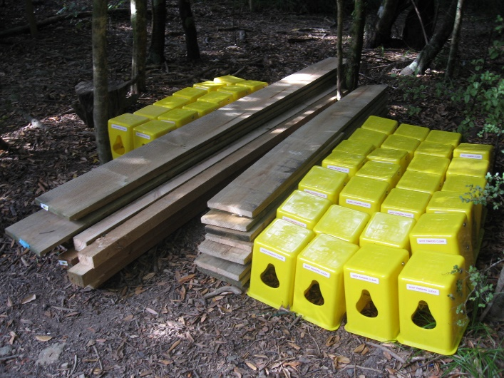
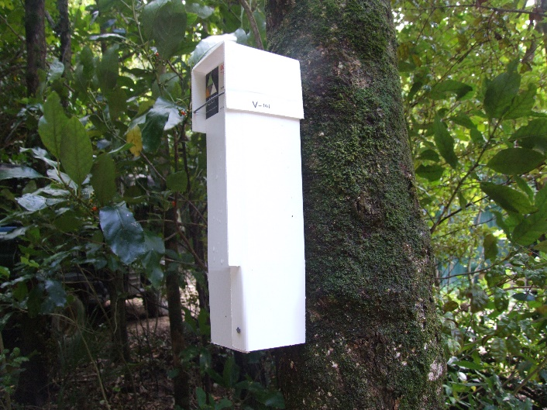
The sanctuary has only used toxin free methods since it began in 1994

Slide 6
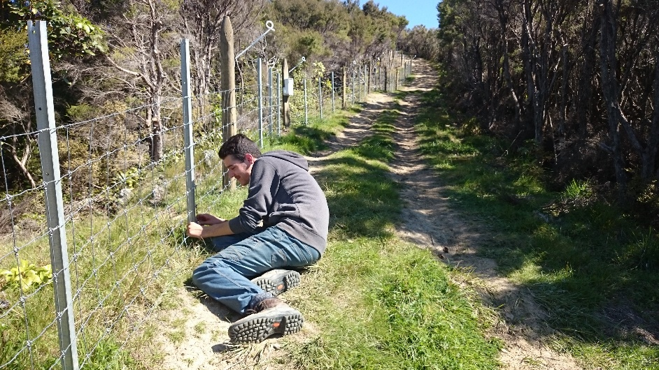
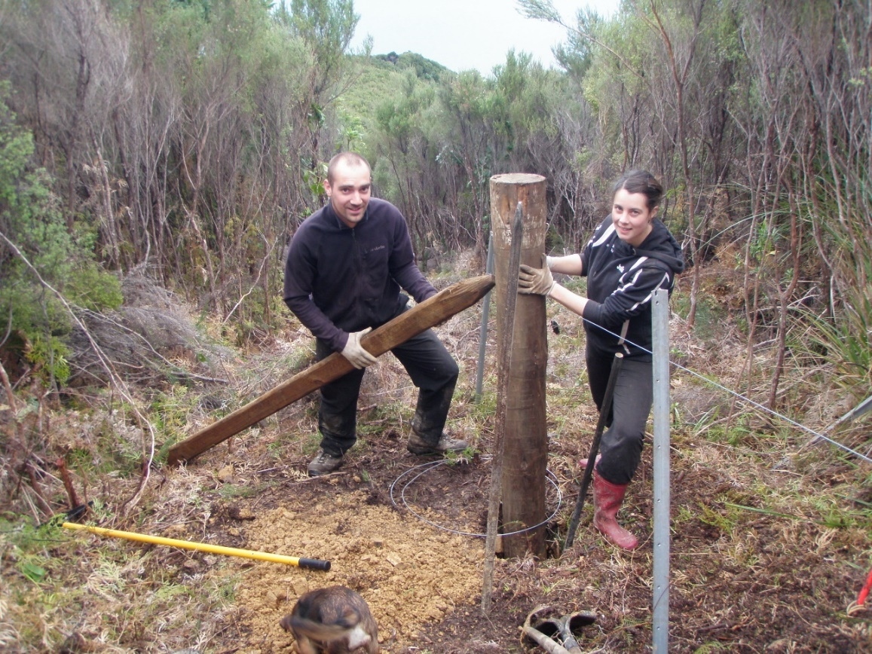
3000 Meter ungulate-proof fence almost completed

Slide 7
Monitoring is done by tunnels, chew cards and our certified rodent detection dogs

Slide 8
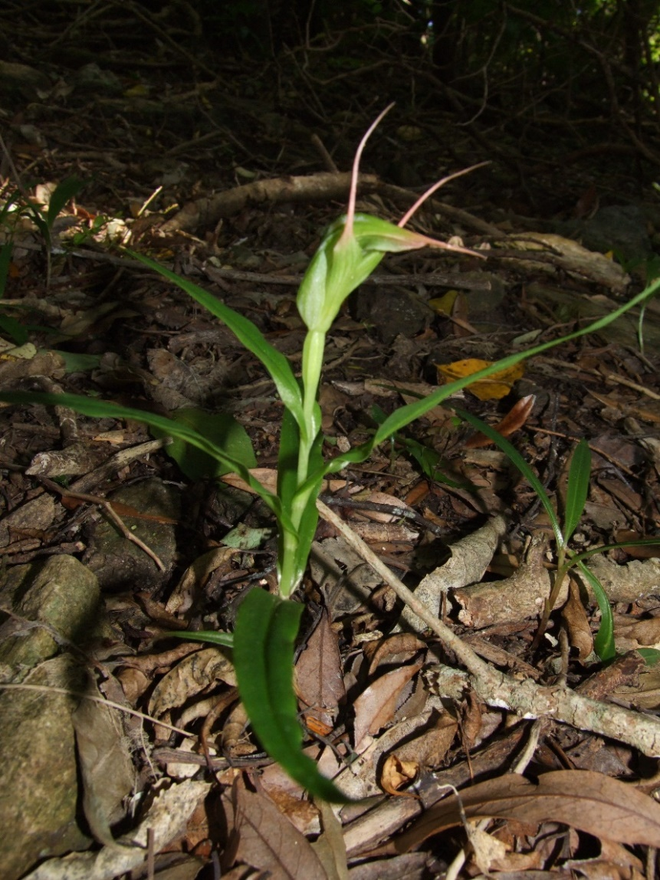
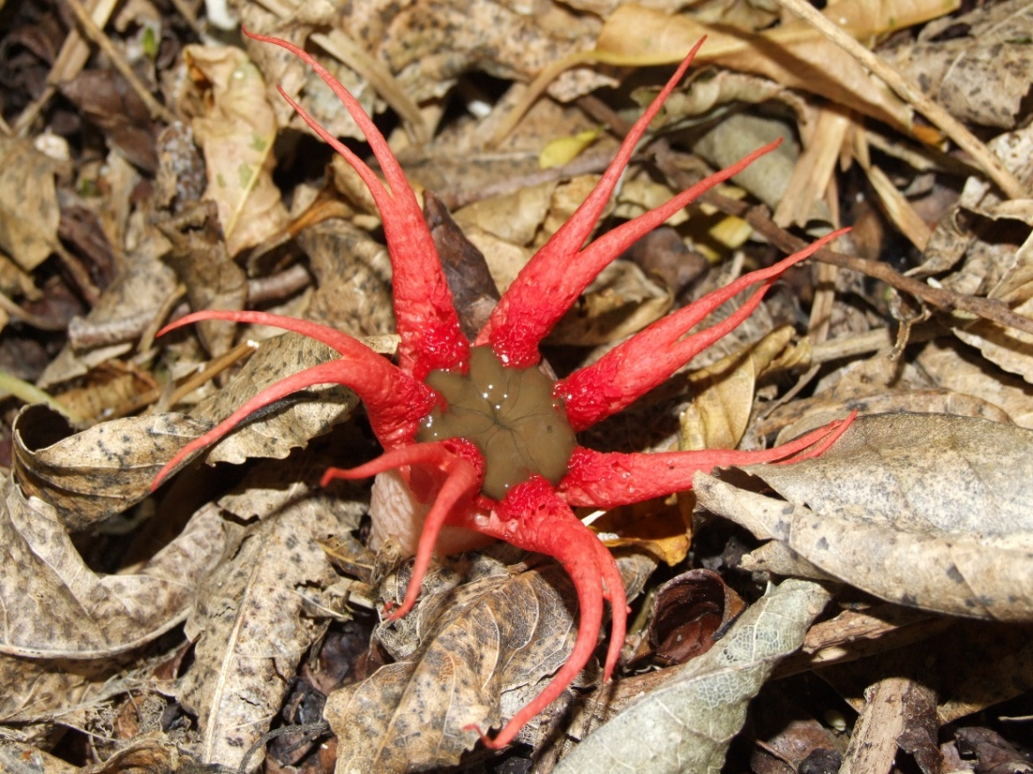
Restoration process is showing the results

Slide 9
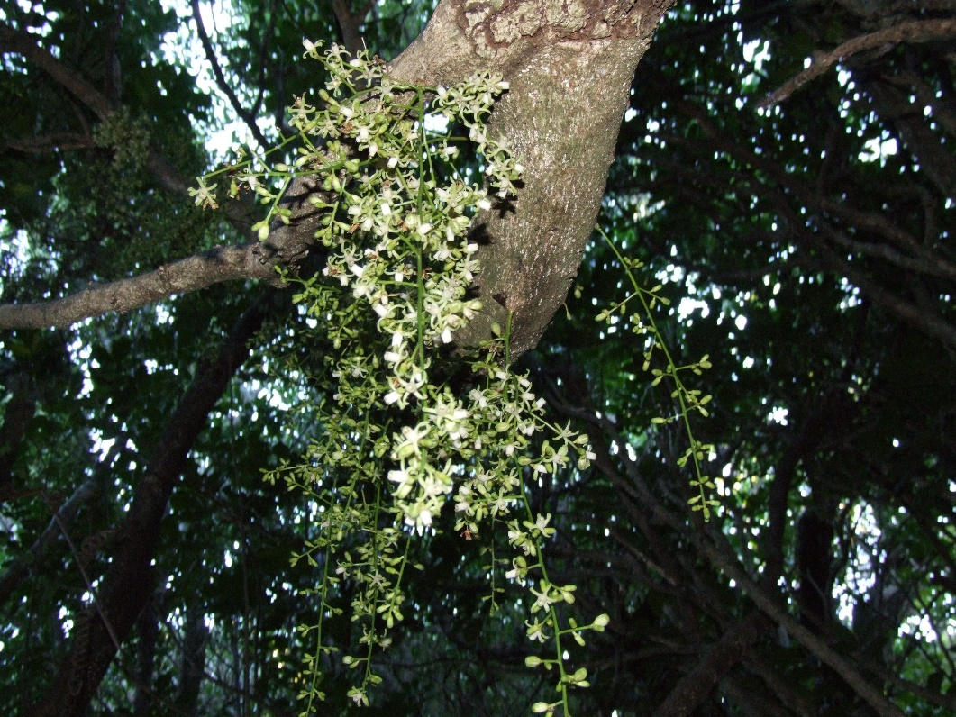
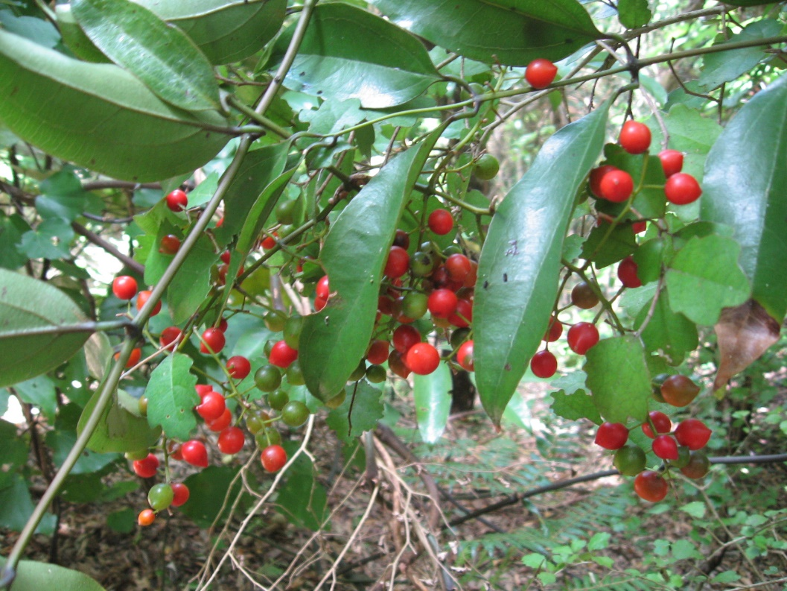
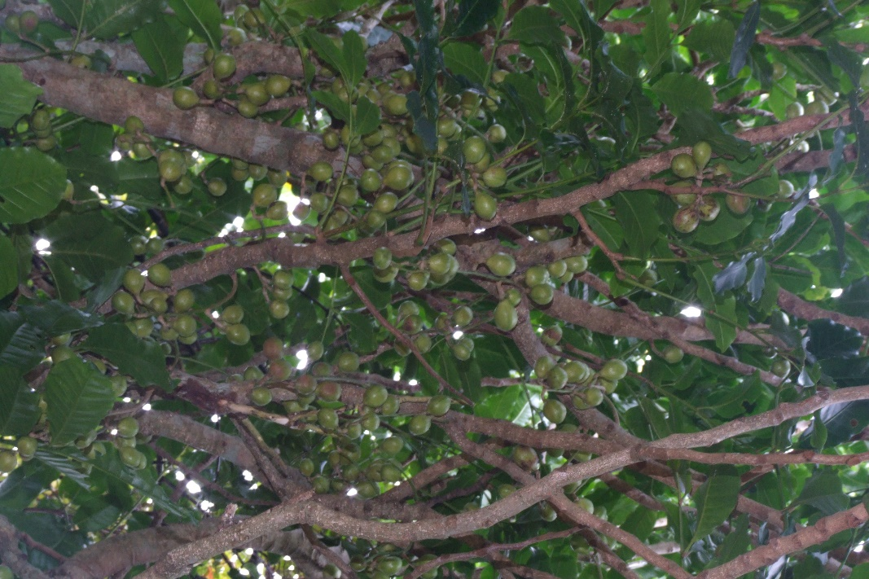
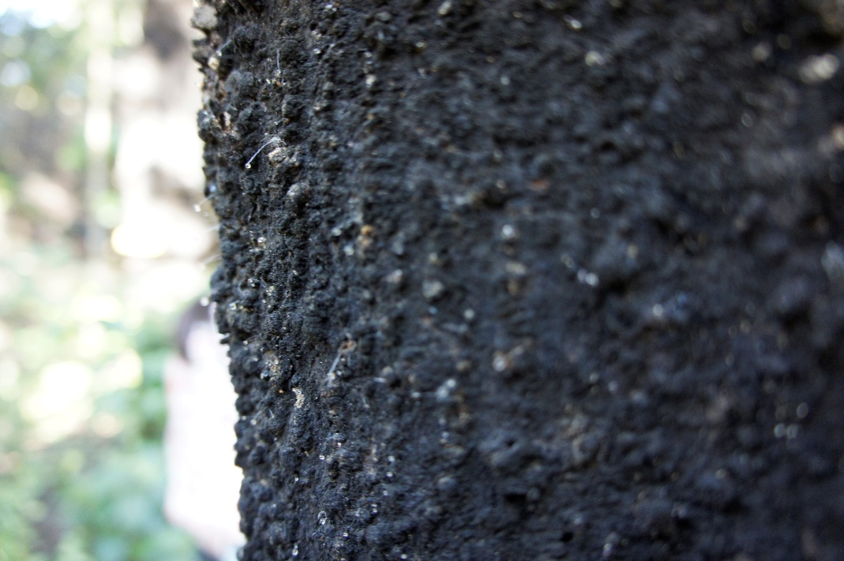

Slide 10
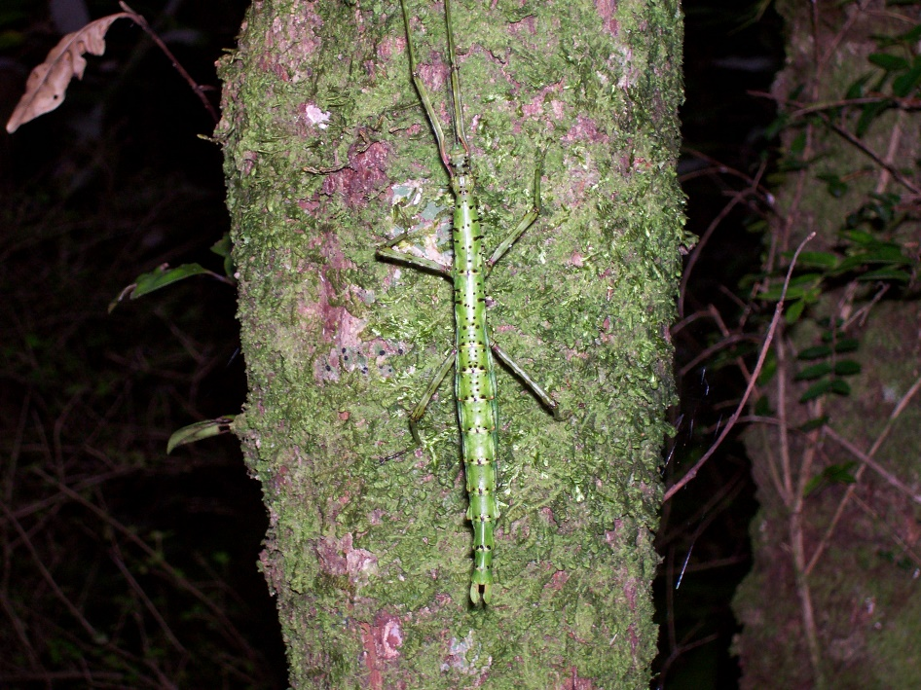
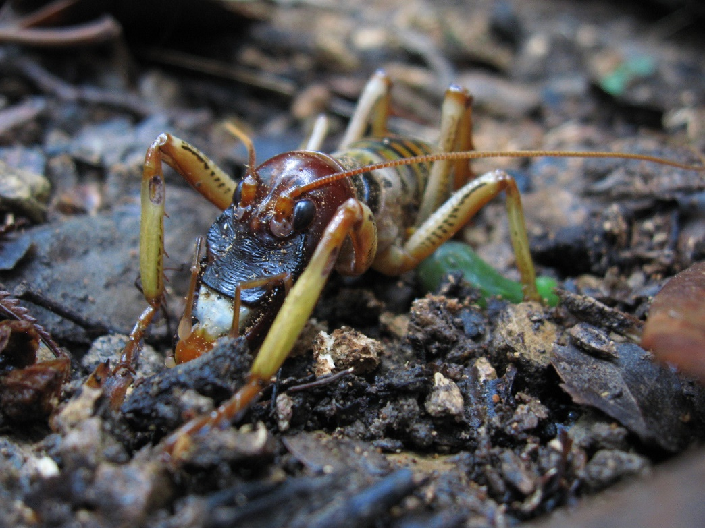
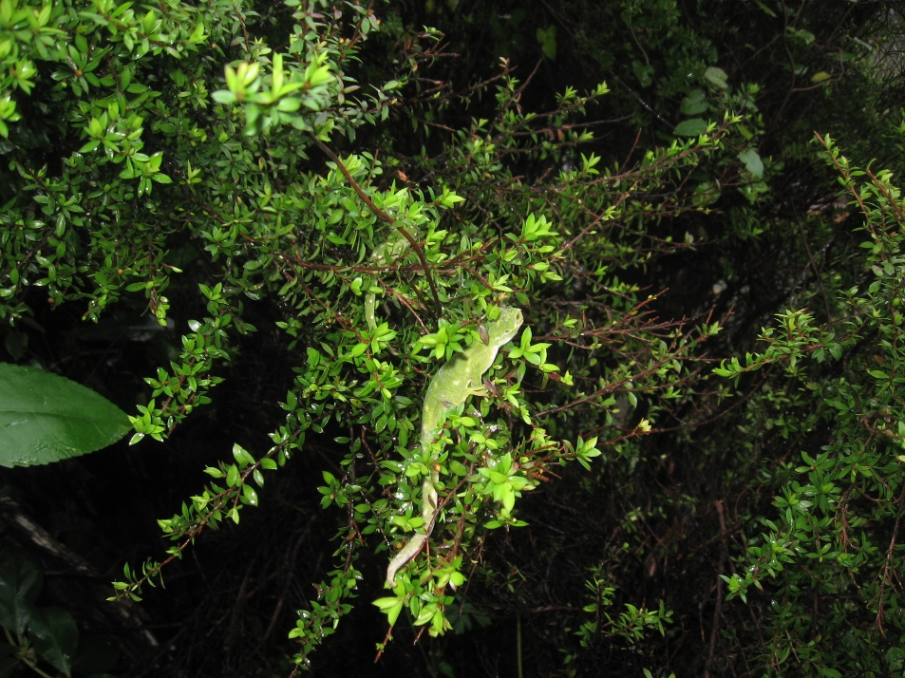
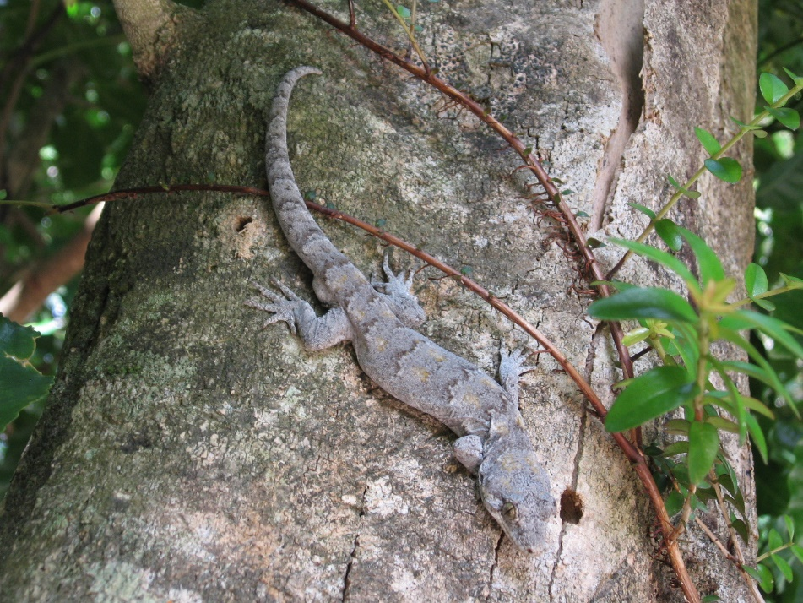

Slide 11
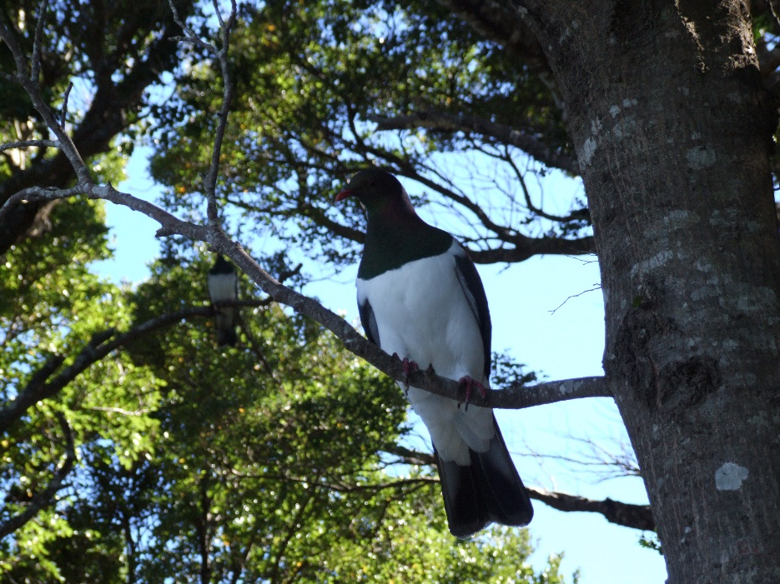
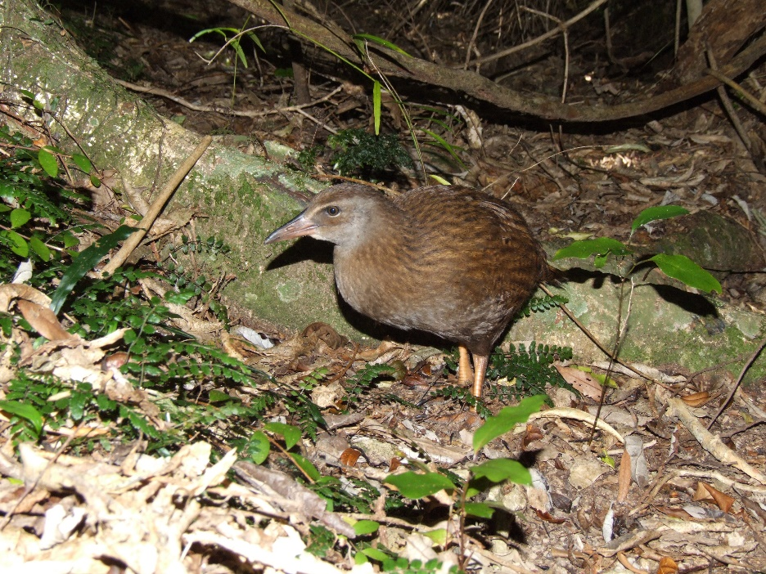
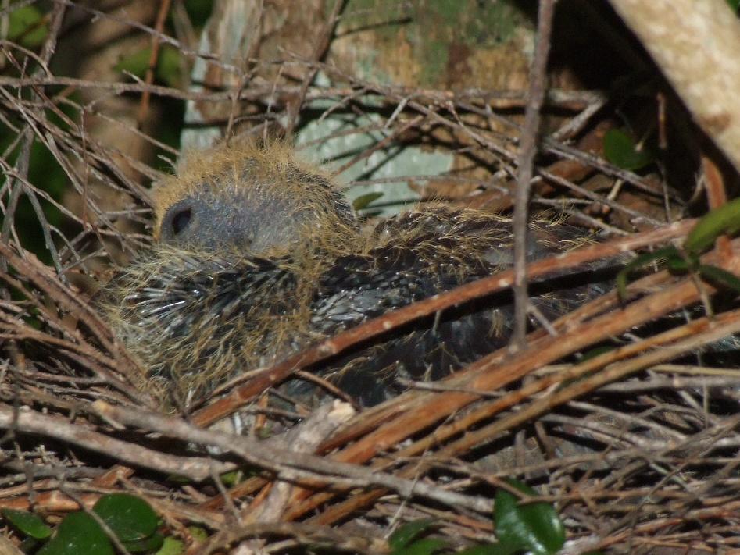
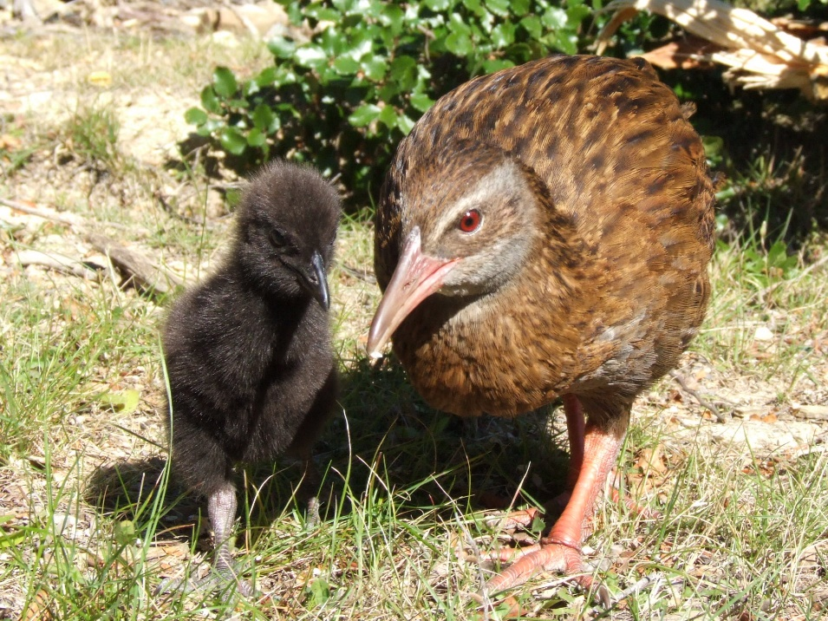

Slide 12
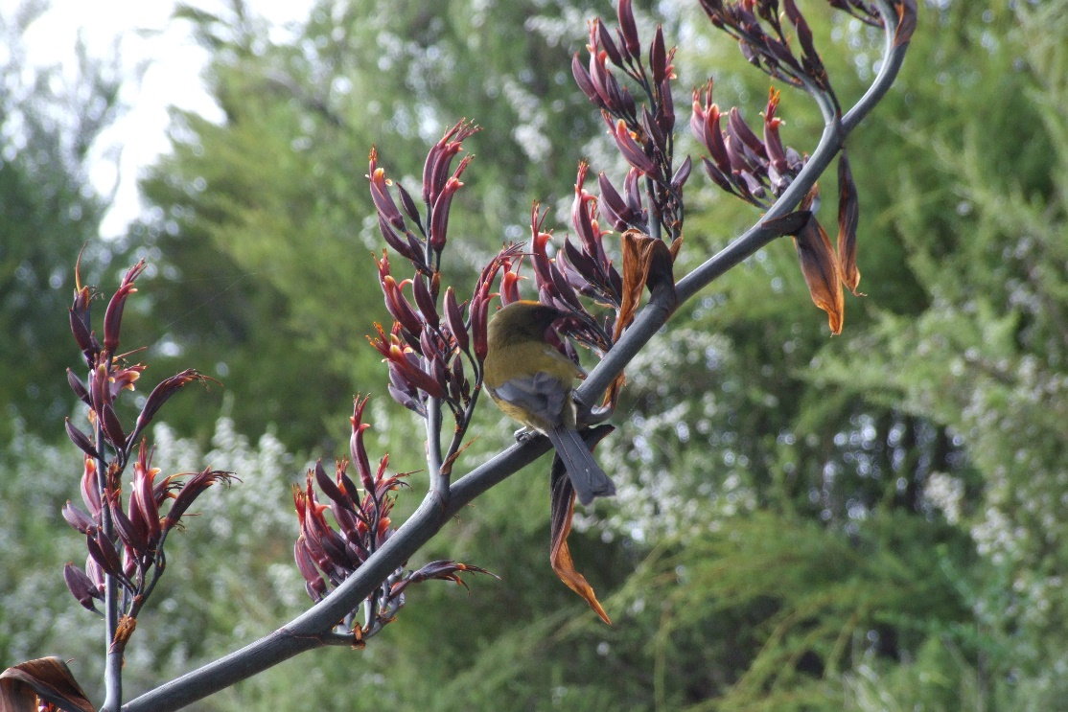
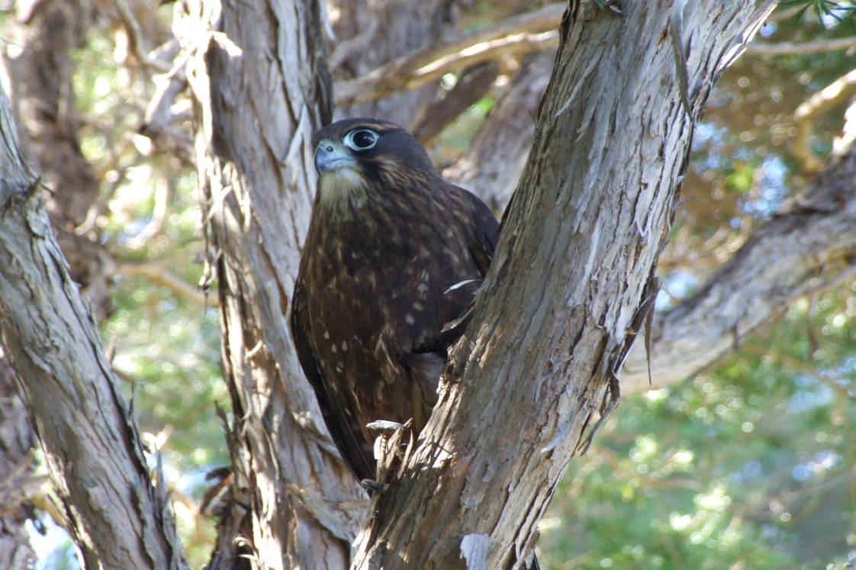
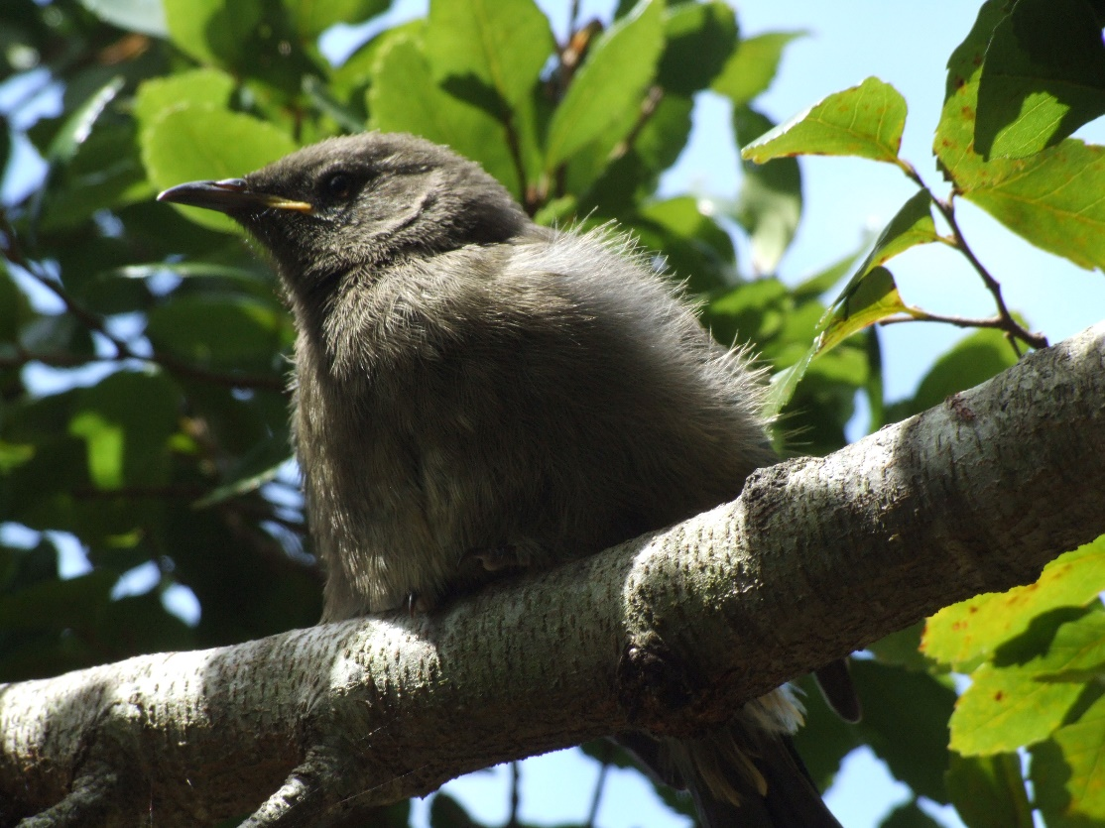
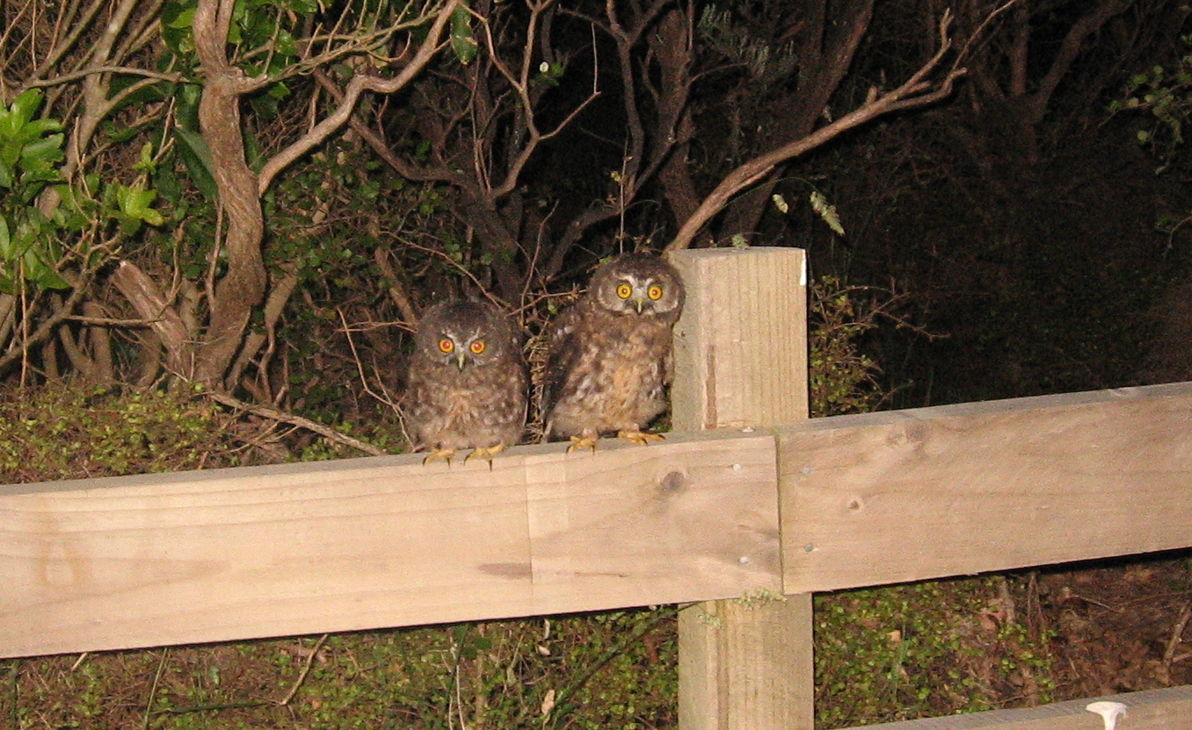

Slide 13
Growing demand to re-introduce native species into restored predator free areas
Wild species are needed to release in predator free areas (PFNZ 2050)
Limited collection from offshore sanctuaries (Wildlife Act 1.5, 2.25)
Soft release programmes will increase the success rate
The usage of the re-locatable aviaries will not add cost to other projects

Slide 14
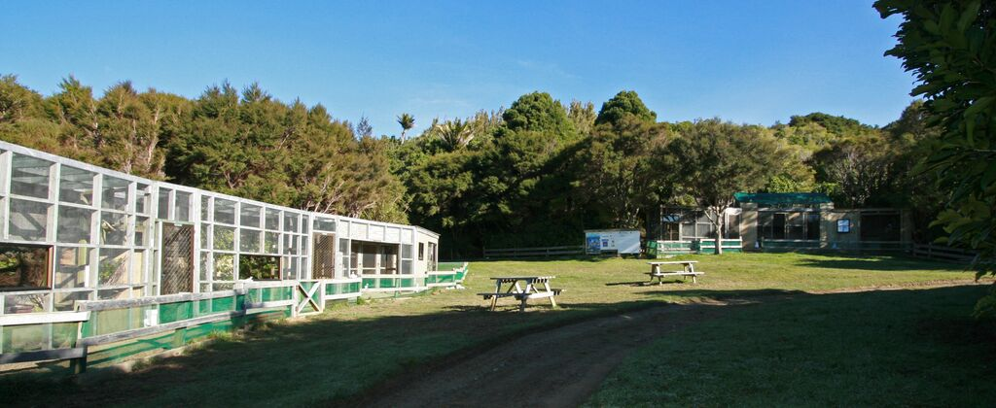
Existing facilities “breeding for release” programme at Tui

Slide 15
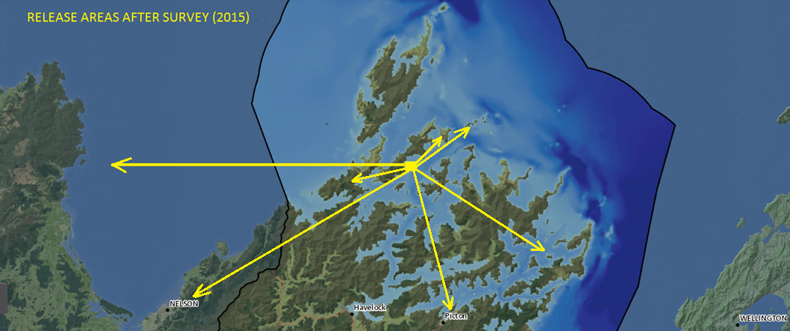
A survey in 2015 identified potential release areas into other community projects

Slide 16
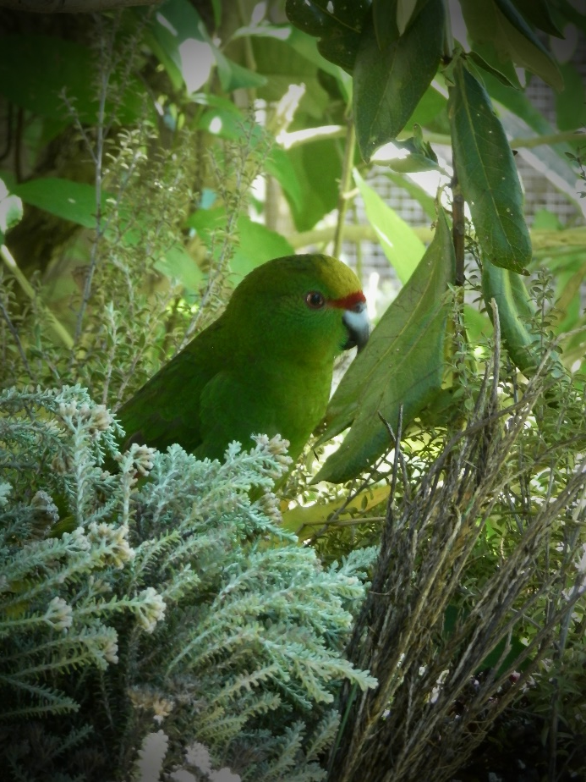
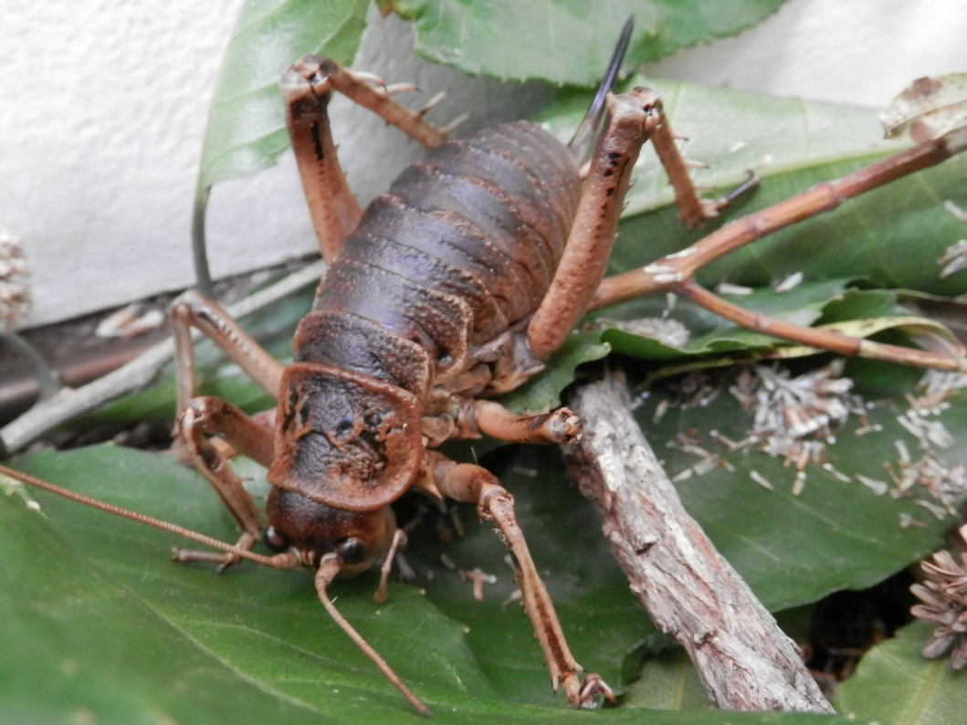
First native species released from our facilities
Yellow Crowned Kakariki in the Abel Tasman (Project Janszoon)
Giant Weta on Puangiangi Island Marlborough Sounds

Slide 17
Partnerships are formed to protect the gene pool
PRESERVING THE GENE POOL
Tui Reserve
Eco
World
Natureland
Lochmara

Slide 18
Cost effective re-locatable aviaries are professionally designed with local support
Design and support from local company
First funding towards expansion (running cost)

Slide 19
The new modular system design has huge benefits
The panels are inter-exchangeable to adopt to summer and winter seasons (sun direction, shelter etc.)
The aviaries can be adjusted to the need of the species like living space and flight path
Can be easily assembled, transported and relocated
The soft release approach will increase the success of the release
One off investment will benefits many other community projects

Slide 20
Other benefits of this unique project
Creating awareness for the wider public by visitors days at multiple locations
To gain more knowledge regarding the species involved
Study and research opportunities
Linking to other projects to build knowledge and expertise to increase the success and survival rate of the released species

Slide 21
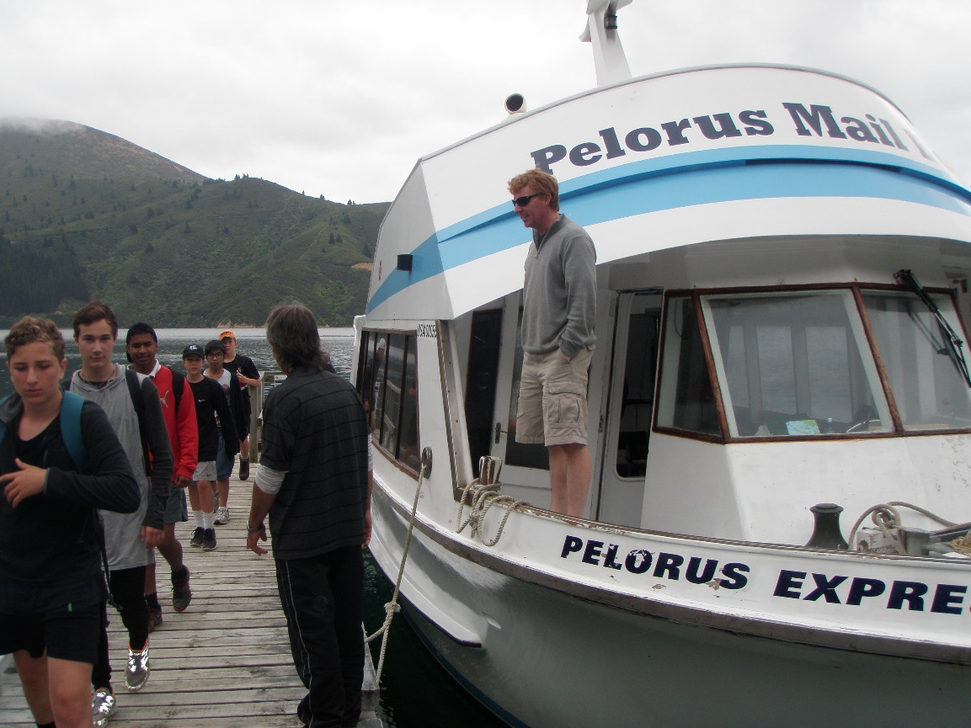
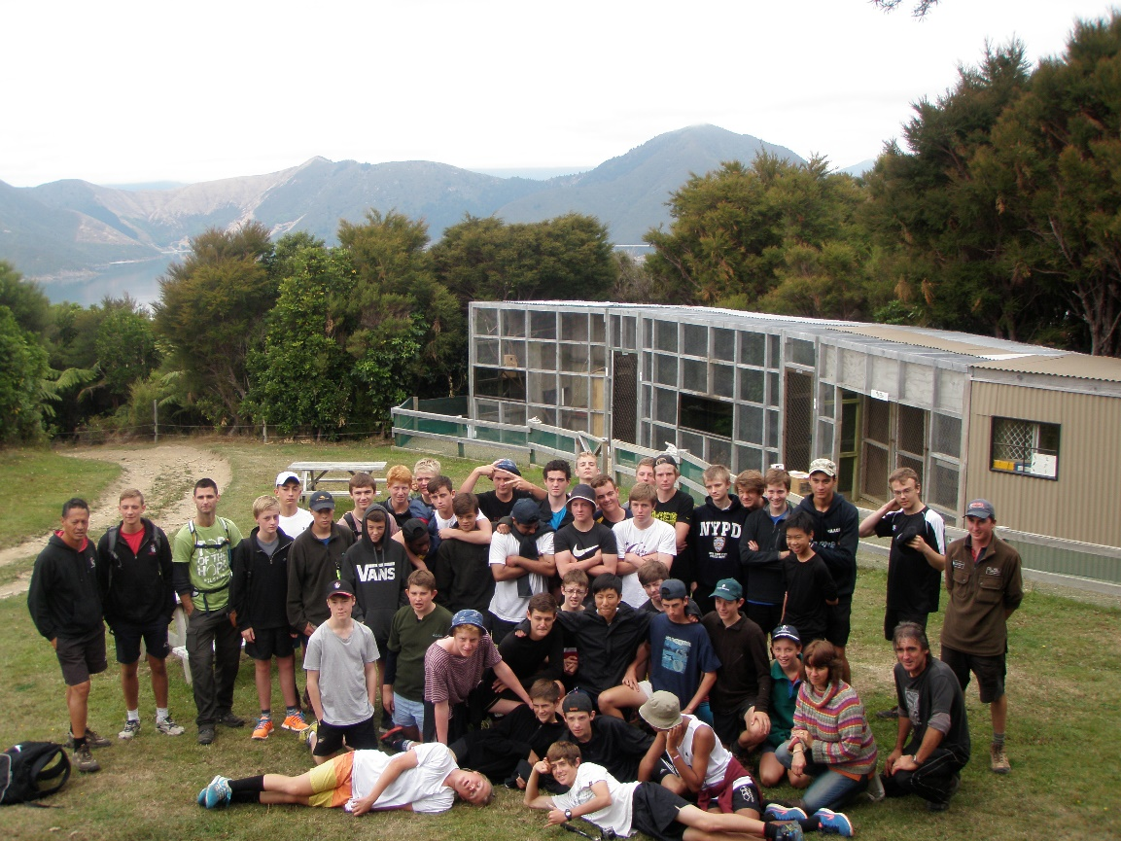
Promoting and creating awareness

Slide 22
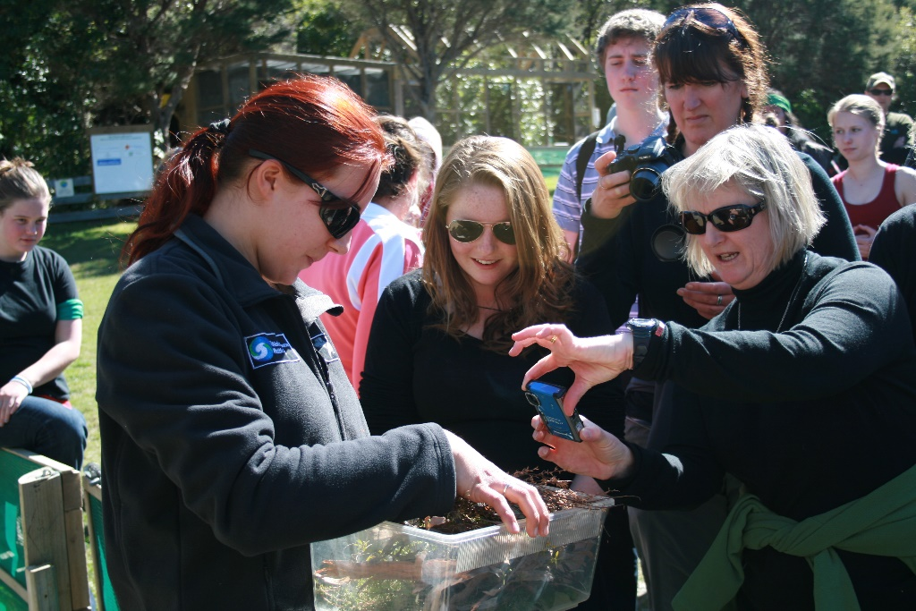
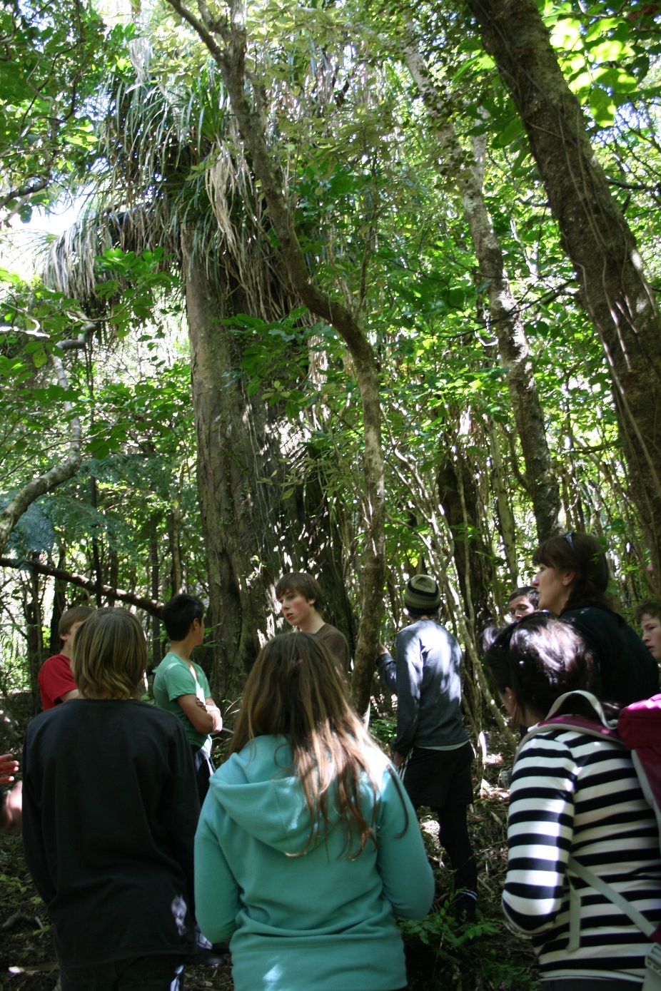
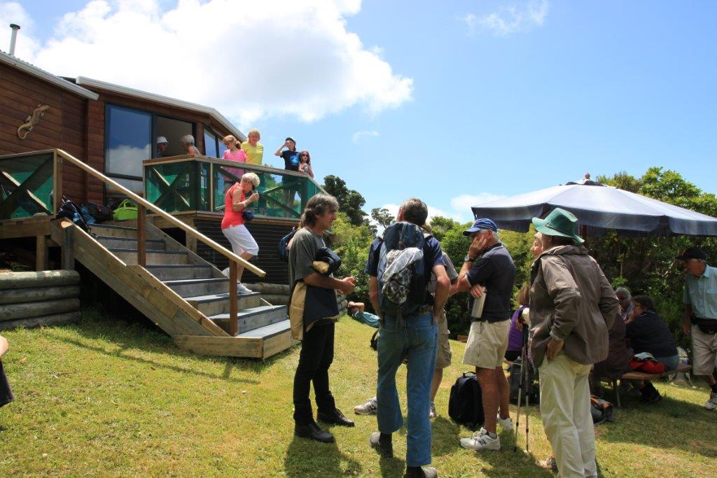

Slide 23
Involving young people is vital for the future

Slide 24
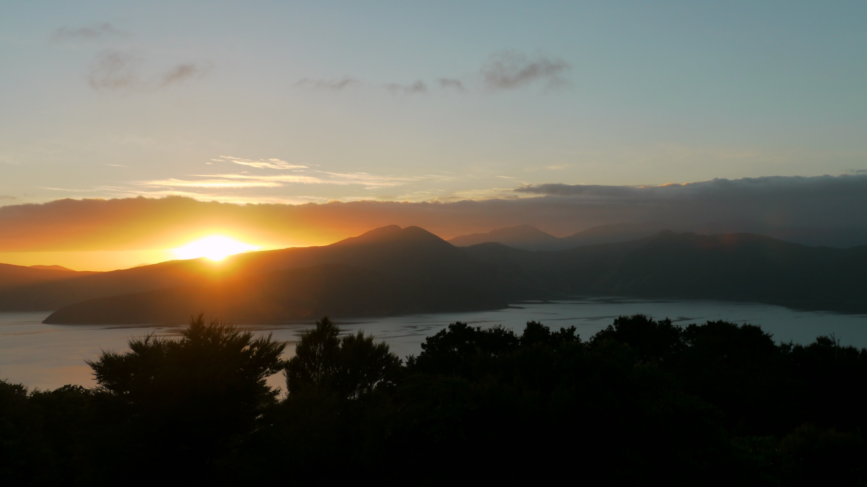
t
TUI NATURE RESERVE

