Slide 1
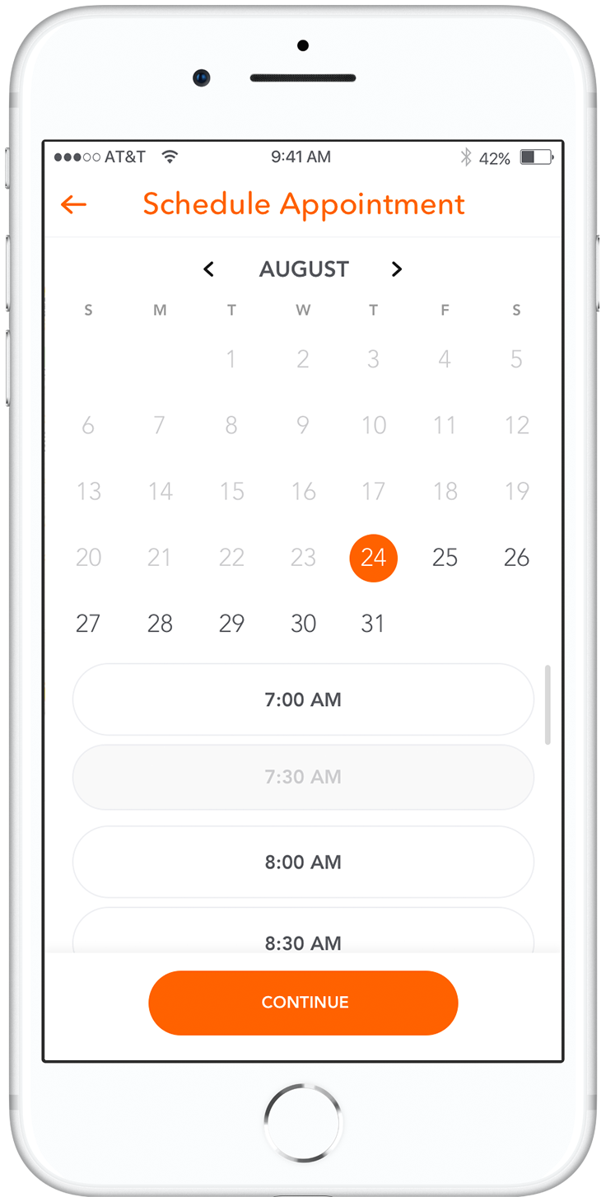
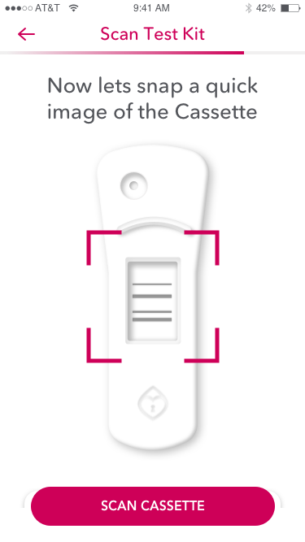
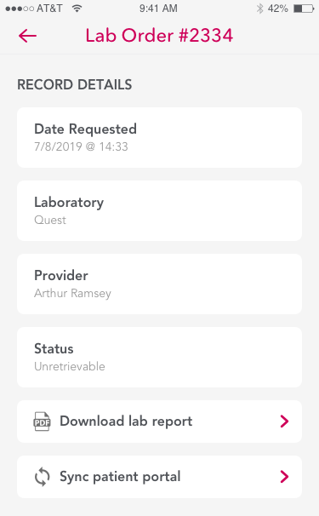
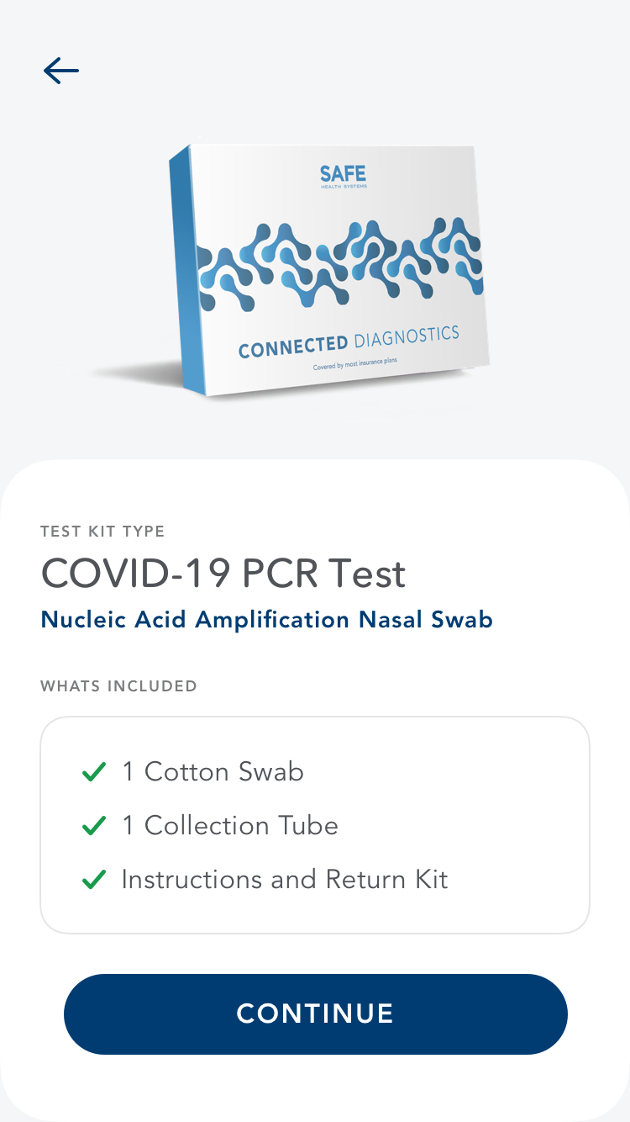
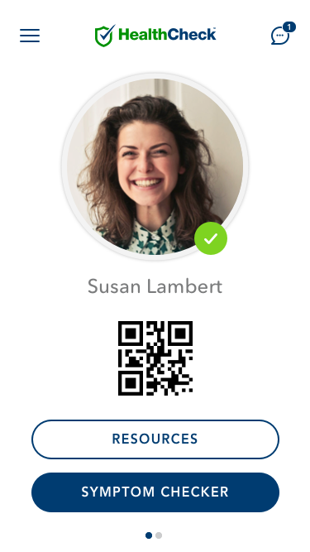
Turnkey Testing and Health Status Verification
COVID-19 cost avoidance and risk mitigation solution
The current COVID-19 outbreak illustrates how disruptive and costly novel pathogens can be to companies and employees. HealthCheck is a turnkey solution for employers to manage ongoing employee testing and health status verification.
Pandemic Response System
Adequate testing and rapid coordinated response is key to containment and cost avoidance. HealthCheck coordinates testing, surveillance, and enables efficient remote triage of consumers who test positive.
Integrated Testing
Integrated testing options include test kit delivery, integrations with Quest and LabCorp, thousands of affiliated collection sites, and remote point-of-care
rapid tests with results scanned using a cell phone.
Remote Triage
Positive cases are triaged remotely with conditional response protocols configured to meet occupation health guidelines, including additional diagnostics, telehealth consult, or prescription.
Private Health Status Verification
Digital passports use QR code technology and ‘ready to work’ / ‘not ready for work’ health record abstraction to provide maximum privacy while mitigating risk.
POWERED BY
SAFE HEALTH SYSTEMS, INC.
5455 Wilshire Blvd., 12th Floor
Los Angeles, CA 90036
310-464-9213 | safehealth.me

Slide 2
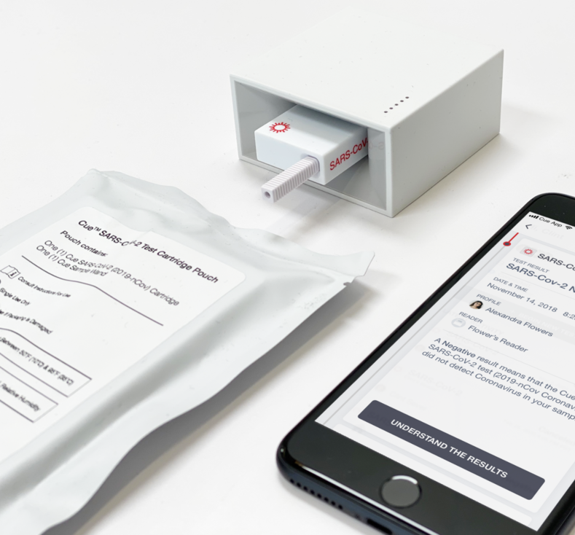
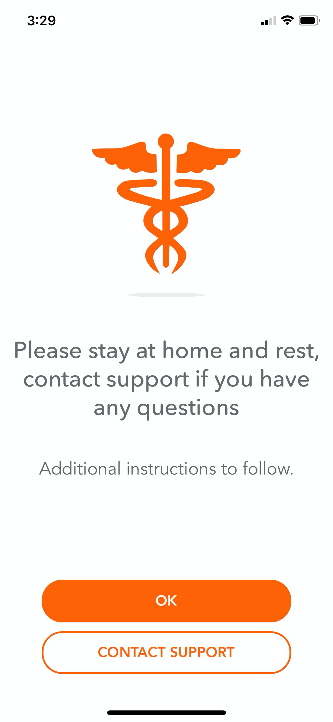
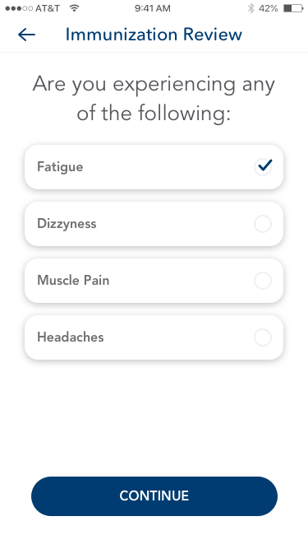
Connected Diagnostics enables early detection and cost avoidance
Onsite real-time molecular testing for early pre-symptom infections with results in 20 minutes
Integrated test kit delivery workflow provides safe and convenient testing for students and faculty
Integrations with Quest, LabCorp, Mayo Clinic Labs and thousands of brick and mortar collection facilities
Optional telehealth triage and seamless e-prescribing
Here’s how it works
You may have an active COVID-19 infection. Please self quarantine, a test kit is in route to you.
Symptom Checker
Users are prompted to take the symptom checker at predefined intervals and self report any symptoms.
Conditional Response
Users are instructed on next steps based on the results of the daily symptom checker, including testing as needed.
Integrated Testing
Multiple integrated testing options, including home test kits, onsite rapid testing, and over 5,000 collection sites
Digital Passport
Health status passport tied to symptom checker self-reporting and testing protocol enables cohesive access control
SAFE HEALTH SYSTEMS, INC.
5455 Wilshire Blvd., 12th Floor
Los Angeles, CA 90036
310-464-9213 | safehealth.me

Slide 3
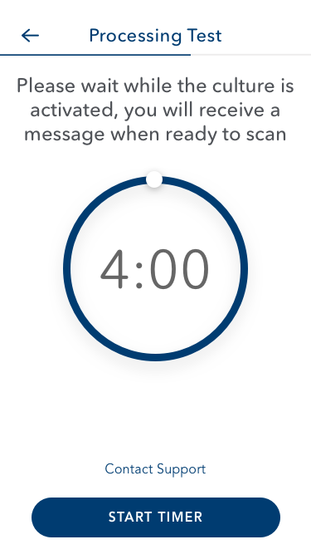
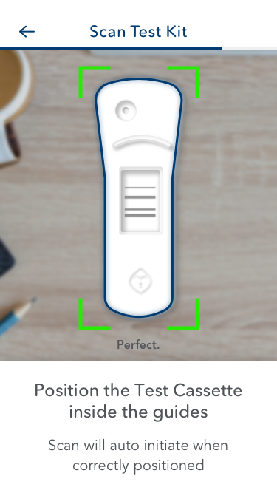
About Us
SAFE HEALTH is a partnership with Mayo Clinic on a mission to empower the private sector and world governments with technology that makes healthcare more accessible and reduces the cost of care at scale. We are inspired to create tools that help people play a more active role in their personal healthcare and live happier, healthier lives.
SAFE is developing next-generation systems that reduce healthcare costs and increase accessibility at scale
Digital Care Platform
The Digital Health Connected Diagnostics Platform enables rapid implementation of specialized population health applications that combine virtualized provider services and care automation, integrated diagnostics, health record interoperability, and seamless Rx delivery.
Connected Diagnostics
Integrated diagnostic testing capabilities, including home test kit delivery, integrations with Quest, LabCorp, MCL, thousands of affiliated collection sites, and remote point- of-care testing platform using inexpensive LFIA-based rapid tests with results scanned using a mobile phone.
Virtual Health Services
Assisted care automation and crowd sourced provider services enable efficient remote care delivery with seamless e-prescribing and Rx home delivery.
Solutions Provider
We strive to build solutions that improving outcomes and reduce costs at scale.
COVID-19
SAFE HEALTH SYSTEMS, INC.
5455 Wilshire Blvd., 12th Floor
Los Angeles, CA 90036
310-464-9213 | safehealth.me

