Slide 1
Artificial intelligence/ machine learning MEDICAL DEVICE software Action Plan
Anindita Saha, Assistant Director
CDRH Digital Health Center of Excellence, FDA
February 10, 2021

Slide 2
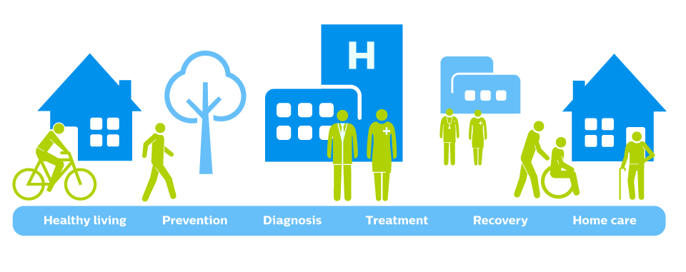


Digital Health
The convergence of connectivity, data and computing power for healthcare and related uses across the life of an individual or a patient.
Healthy living Prevention Diagnosis Treatment Recovery Home care
Moving health care from the Clinic to the
Patient
Understanding patient’s behavior and physiology
“In the wild”
Focusing on prevention for early/smaller
interventions
Leveraging computing power, sensors, connectivity and software
Notes:
Digital health can be considered as the convergence of connectivity, data, and computing power for healthcare and related uses across the life of an individual or patient.
Digital health is moving healthcare from the clinic to patient, understanding the behavior and physiology in the wild, and enables early and smaller interventions.

Slide 3

Digital Health Technology
Healthy living Prevention Diagnosis Treatment Recovery Home care Management
Convergence of computing power, connectivity, sensors,
and software used in healthcare.
Used as a medical product
Incorporated into a medical product
(include a pharmacologic product)
Used to develop a medical product
Used to study a medical product
Used as a companion or adjunct to a medical product,
including diagnostics and therapeutics.

Slide 4
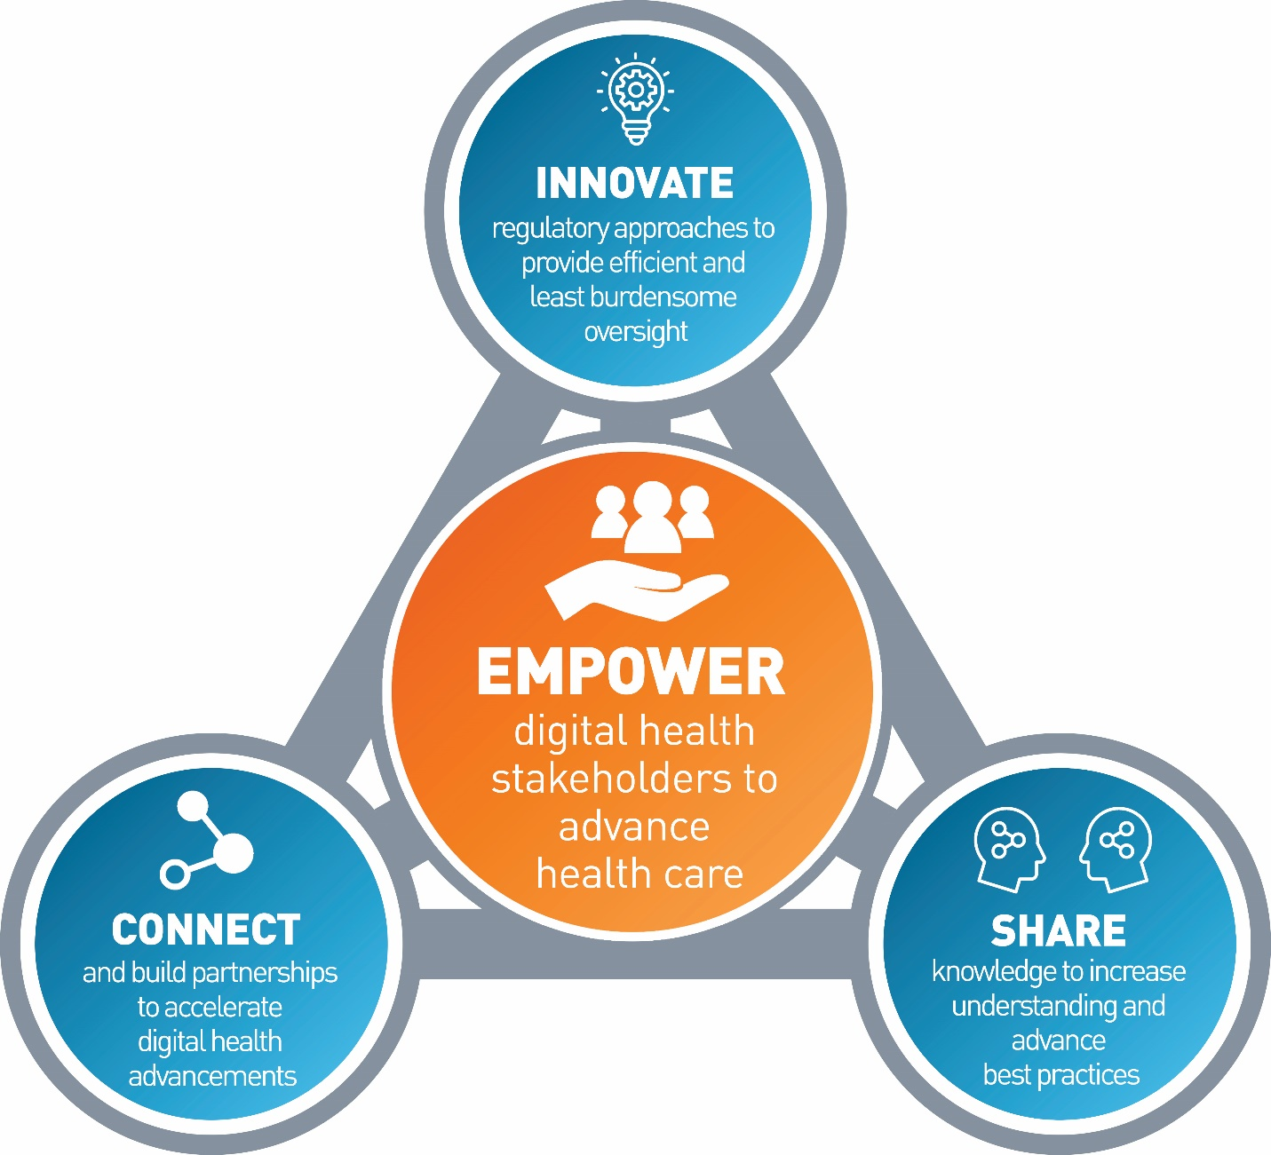



Digital Health Center of Excellence
Empowering All to Advance Healthcare
Our goal: Empower stakeholders to advance health care by fostering responsible and high-quality digital health innovation that meets FDA standards of safety and effectiveness.
The Digital Health Center of Excellence aims to:
Connect and build partnerships to accelerate digital health advancements.
Share knowledge to increase awareness and understanding, drive synergy, and advance best practices.
Innovate regulatory approaches to provide efficient and least burdensome oversight .
Develop novel, efficient regulatory approaches that are least burdensome
Connect
Share
Build partnerships, new networks to accelerate and scale
Gather, simplify, and share information to increase awareness and understanding

Slide 5
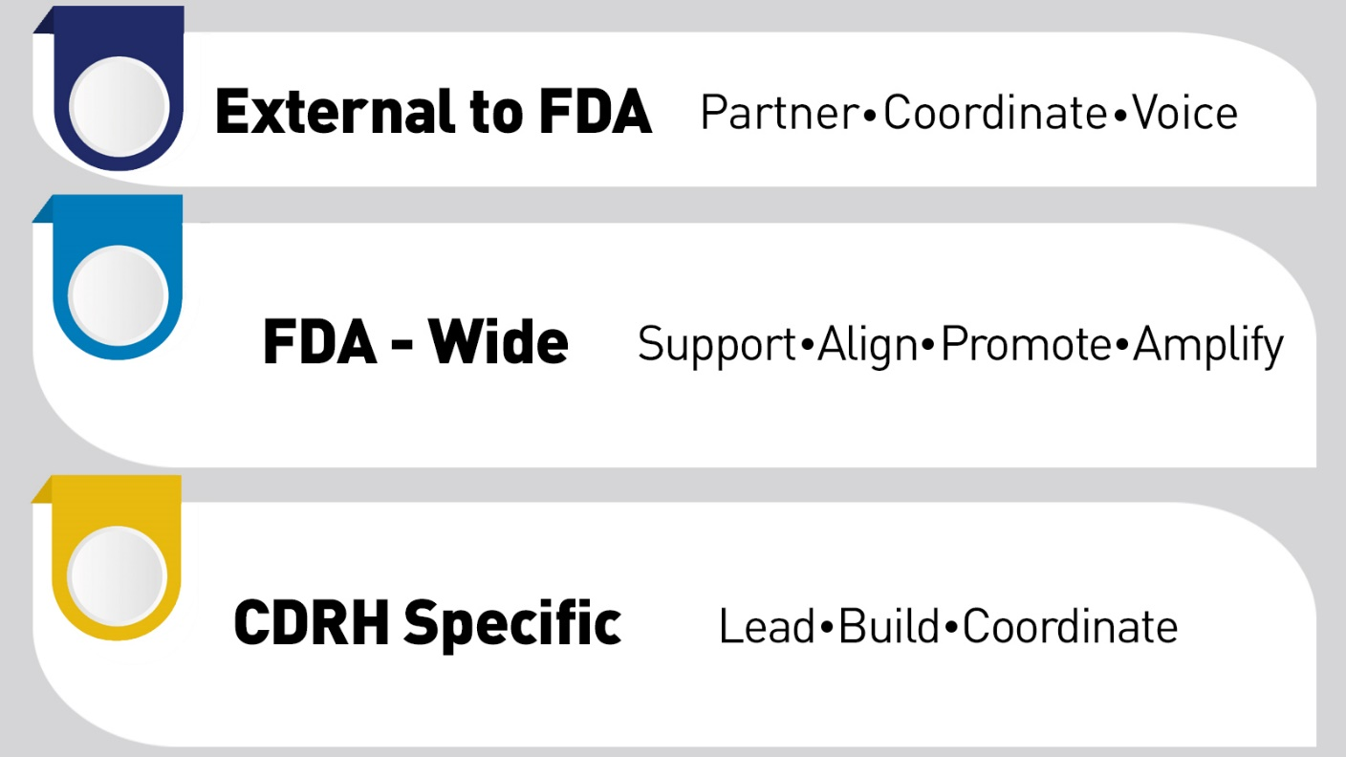
DHCoE Services
Notes:
External to FDA: Partner, Coordinate, Promote
Provide clarity on regulation
Advance international harmonization on policy
Facilitate and build strategic partnerships
Communicate FDA research interests
FDA-wide: Support, Align, Amplify
Provide training opportunities for FDA staff
Foster collaboration on common interest areas
Identify and prioritize regulatory science needs for digital health topics
Coordination: Leverage, share, and avoid duplication of work
Promote, showcase, and amplify existing work at the centers
Disseminate shared resources
Provide scientific expertise across the Agency
CDRH Specific: Lead, Build, Enable
Set and lead strategic direction in digital health
Launch strategic Initiatives
Establish and promote best practices
Enable efficient, transparent, and predictable product review with consistent evaluation quality
Build new capacity to oversee and leverage DH technologies
Create more shared resources
Coordinate the development of cross cutting DH policies

Slide 6

DHCoE Functional Areas
Coordinated by Digital Health Center of Excellence
Dedicated functions + Virtual functions
DH Policy Development/ Support
Policy development and support
DH Technology Support
Submission policy support
Regulatory Innovation/Strategic Initiatives
Pre-Cert
DH inquiries
Submission support
Guidance/Policy development
Wearables
Software development practices
Software and digital health standards
Wearables
Interoperability
Digital Biomarkers
DHCoE Operations & Coordination/Partnerships
AI/ML in Medical Products
Internal: Steering Committee, Advisory Group
Policy development and support
IMDRF collaborations
External engagement/ collaboration
External: collaborations and partnerships
Medical Device Cybersecurity
Policy development and support
IMDRF collaborations
External engagement/ collaboration
Advancing Regulatory Science
Regulatory Review Support
Advanced Manufacturing
Advanced Clinical Studies and RWE
Digital Pathology
Day – day review support for OHTs
Case for Quality (Software in Manufacturing)
In silico modeling
Use of RWE in DH devices
RWE from digital health technology
Software used to manufacture medical device
Digital twin for manufacturing
Implement DH policies
Patient-Generated Data
Virtual Reality/Augmented Reality
Training for reviewers
Implement competency tiers
6

Slide 7
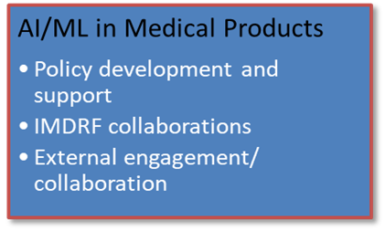
DHCoE Functional Areas
Coordinated by Digital Health Center of Excellence
Dedicated functions + Virtual functions
DH Policy Development/ Support
Policy development and support
DH Technology Support
Submission policy support
Regulatory Innovation/Strategic Initiatives
Pre-Cert
DH inquiries
Submission support
Guidance/Policy development
Wearables
Software development practices
Software and digital health standards
Wearables
Interoperability
DHCoE Operations & Coordination/Partnerships
AI/ML in Medical Products
Internal: Steering Committee, Advisory Group
Policy development and support
IMDRF collaborations
External engagement/ collaboration
External: collaborations and partnerships
Medical Device Cybersecurity
Policy development and support
IMDRF collaborations
External engagement/ collaboration
Advancing Regulatory Science
Regulatory Review Support
Advanced Manufacturing
Advanced Clinical Studies and RWE
Digital Pathology
Day – day review support for OHTs
Case for Quality (Software in Manufacturing)
In silico modeling
Use of RWE in DH devices
RWE from digital health technology
Software used to manufacture medical device
Digital twin for manufacturing
Implement DH policies
Patient-Generated Data
Virtual Reality/Augmented Reality
Training for reviewers
Implement competency tiers
7

Slide 8
AI/ML Medical Device Software Action Plan

Slide 9
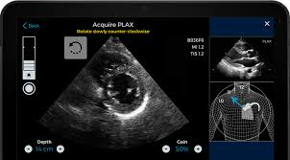
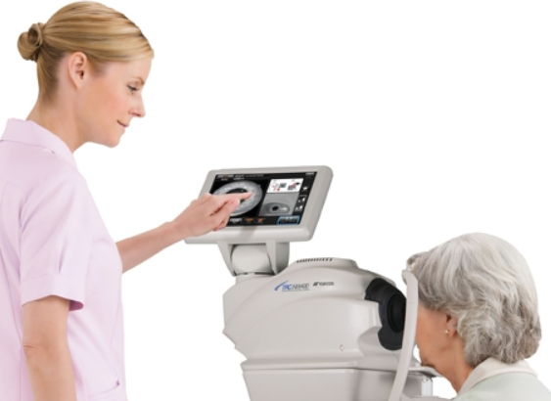
Background: Examples of AI/ML-Based Software
FDA News Release
FDA Authorizes Marketing of First Cardiac Ultrasound Software That Uses Artificial Intelligence to Guide User
February 7, 2020
Caption Health
FDA News Release
FDA Permits Marketing of Artificial Intelligence-Based Device to Detect Certain Diabetes-Related Eye Problems
April 11, 2018
IDx-DR

Slide 10


AI/ML-Based Medical Devices: Opportunities
Fundamentally transform the delivery of healthcare
    Earlier disease detection
    More accurate diagnosis
    New insights into human physiology
    Personalized diagnostics and therapeutics
Across all medical fields
Ability to learn from the wealth of real world data and improve performance of AI/ML Systems
www.fda.gov/digitalhealth

Slide 11
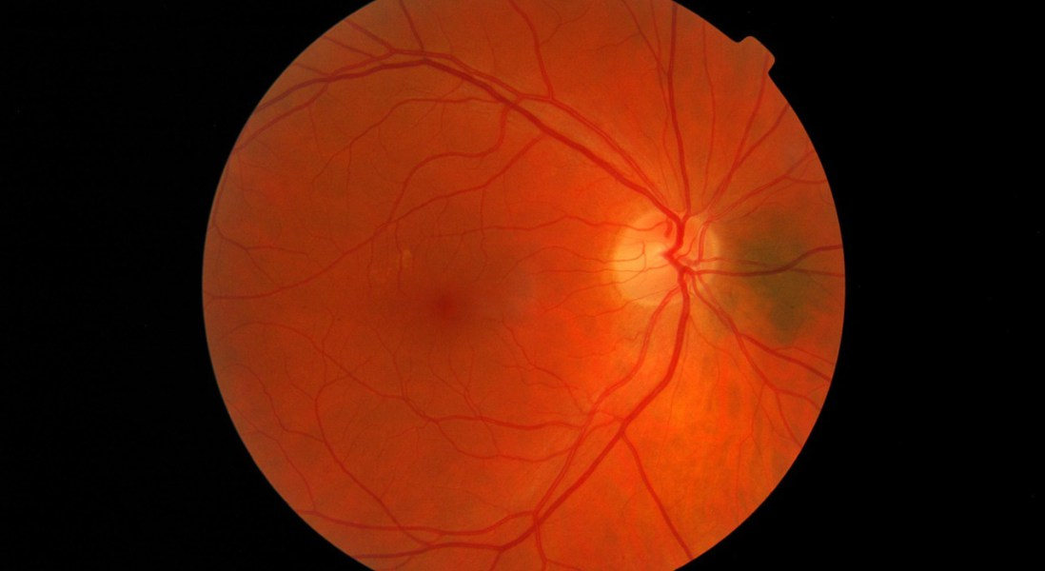
AI/ML-Based Medical Devices: Challenges
Need for large, high-quality, well-curated data sets
Explainability of “black box” approaches
Identification and minimization of bias
Providing oversight for an evolving system
Ensuring transparency to users

Slide 12
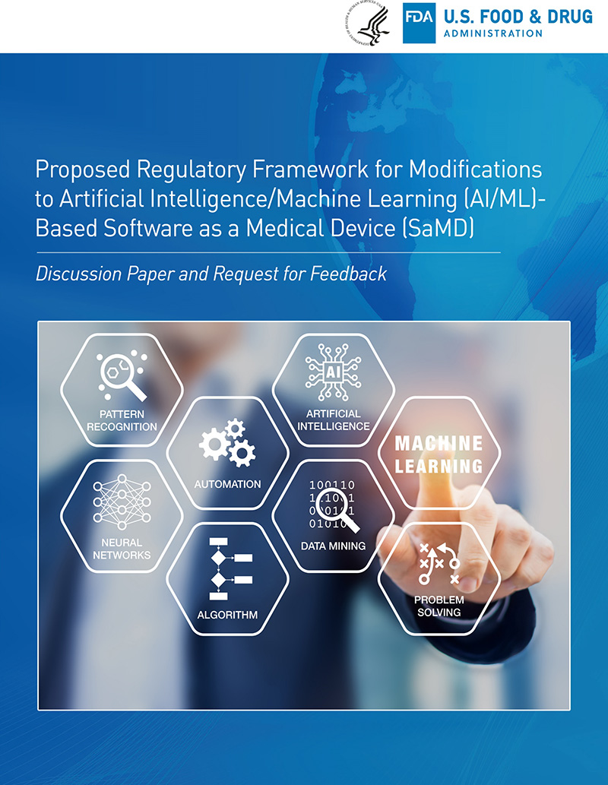
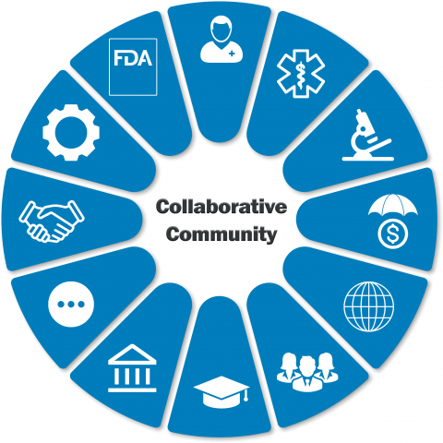
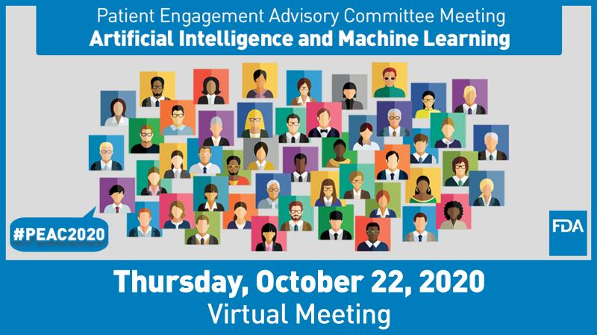
Digital Health Center of Excellence
Artificial Intelligence/ Machine Learning (AI/ML) Recent Milestones
Recent Milestones
    April 2019: Published AI/ML-SaMD - Discussion Paper
    Sept 2019: Initiated participation in Collaborative Community related to AI/ML
    Feb 2020: Public Workshop on the Evolving Role of AI in Radiological Imaging
    Oct 2020: Patient Engagement Advisory Committee (PEAC) Meeting
    on patient trust in AI/ML technologies
.
WORKSHOP
Evolving Role of AI in Radiological Imaging
February 28-28, 2020

Slide 13

Proposed Regulatory Framework for AI/ML-Based SaMD:
Discussion Paper & Request for Feedback
Since publishing in April 2019 FDA’s Proposed Regulatory Framework for Modifications to AI/ML-Based SaMD, we’ve received stakeholder feedback through:
> 1,000 comments on public docket from a diverse community of stakeholders
> 30 publications in peer-reviewed journals
Pre-submission meetings on AI/ML devices
Patient Engagement Advisory Committee Meeting (PEAC)
Notes:
Matthew starts

Slide 14
Stakeholder Feedback on AI/ML Approach
What we heard from stakeholders:
Regulatory Framework: Requested further development of proposed regulatory framework for AI/ML-based SaMD
Good Machine Learning Practices (GMLP):
Supported the idea of GMLP and the need for
harmonization of its efforts
3. Transparency: Asked for further discussion
with FDA on how these technologies interact
with people, including transparency to users
Regulatory Science: Described need for improved methods related to algorithmic bias and robustness.
Real-World Performance (RWP): Sought clarity on RWP monitoring for AI/ML software.

Slide 15
Stakeholder Feedback on AI/ML Approach
What we heard, and what we’ll do
What we heard from stakeholders:
Regulatory Framework: Requested further development of proposed regulatory framework for AI/ML-based SaMD
Good Machine Learning Practices (GMLP):
Supported the idea of GMLP and the need for
harmonization of its efforts
3. Transparency: Asked for further discussion
with FDA on how these technologies interact
with people, including transparency to users
Regulatory Science: Described need for improved methods related to algorithmic bias and robustness.
Real-World Performance (RWP): Sought clarity on RWP monitoring for AI/ML software.
What we’ll do -- The AI/ML Action Plan:
Update the proposed AI/ML framework,
including through Guidance
Strengthen FDA’s role in harmonizing GMLP
through standards development & other initiatives
Foster a patient-centered approach,
starting with a workshop on transparency to users
4. Support development of regulatory science methods
related to algorithm bias and robustness
Advance real-world performance pilots
in coordination with stakeholders and other programs

Slide 16
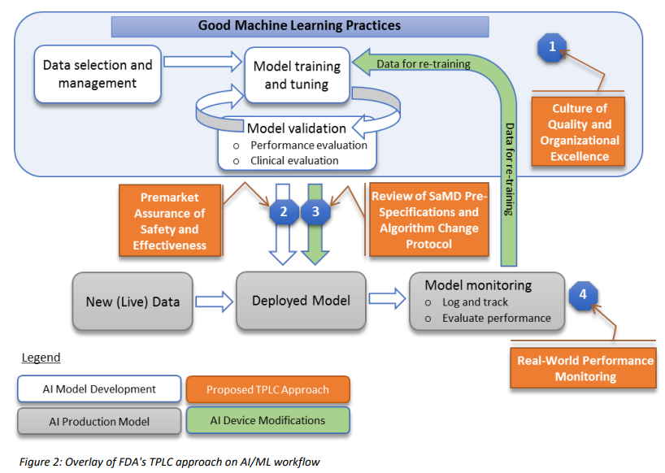
Tailoring a Regulatory Framework for AI/ML-based SaMD
Part 1: Regulatory Framework
Part 2: GMLP and
Harmonization
Part 3: Pt-Centered Transparency
Part 4: Regulatory Science Methods
Part 5: RWP
Considerations
A strength of AI/ML systems is their ability to learn from real world data and improve performance over time
Predetermined Change Control Plan includes:
  SaMD Pre-Specifications (SPS): describes "what" aspects the manufacturer intends to change through learning,
  Algorithm Change Protocol (ACP): explains "how" the algorithm will learn and change while remaining safe and effective
Goal is to issue a Draft Guidance on the Predetermined Change Control Plan in 2021

Slide 17




Part 1: Regulatory Framework
Part 2: GMLP and
Harmonization
Part 3: Pt-Centered Transparency
Part 4: Regulatory Science Methods
Part 5: RWP
Considerations
Tailoring a Regulatory Framework for AI/ML-based SaMD
Enhance patient access to high quality digital medical products
Maintain a reasonable
assurance of safety and effectiveness
Enable manufacturers to rapidly improve software products with minor changes
Least burdensome

Slide 18
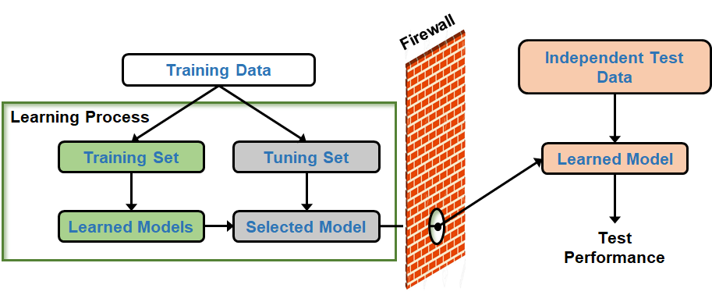
Good Machine Learning Practices (GMLP)
Part 1: Regulatory Framework
Part 2: GMLP and
Harmonization
Part 3: Pt-Centered Transparency
Part 4: Regulatory Science Methods
Part 5: RWP
Considerations
Accepted practices in ML/AI algorithm design, development, training, and testing that facilitate the quality development and assessment of ML/AI-based algorithms
Based on concepts from quality systems, software reliability, machine learning, and data analysis

Slide 19



Part 1: Regulatory Framework
Part 2: GMLP and
Harmonization
Part 3: Pt-Centered Transparency
Part 4: Regulatory Science Methods
Part 5: RWP
Considerations
Good Machine Learning Practices (GMLP)
Standards Development:
  IEEE AI Medical Device Working Group P2801
  ISO/IEC SubCommittee on AI 42 (ISO/ IEC JTC 1/SC 42)
  AAMI/ BSI Initiative on AI in Medical Technology
Collaborative Communities:
  Xavier AI World Consortium Collaborative Community
  Collaborative Community on Ophthalmic Imaging
  Pathology Innovation Collaborative Community
Other Collaborations:
  IMDRF AI Medical Devices WG
  Xavier AI World Consortium
  Collaborative Community
  Collaborative Community
  on Ophthalmic Imaging
  Pathology Innovation
  Collaborative Community

Slide 20
Patient-Centered Approach Incorporating Transparency to Users
Part 1: Regulatory Framework
Part 2: GMLP and
Harmonization
Part 3: Pt-Centered Transparency
Part 4: Regulatory Science Methods
Part 5: RWP
Considerations
AI/ML-based devices have unique considerations that necessitate a proactive patient-centered approach:
that takes into account issues including usability, equity, trust, and accountability
Promotes transparency to all users and to patients more broadly
Patient Engagement Advisory Committee (PEAC) Meeting held Oct 2020
Next Step: Workshop on Transparency planned for 2021

Slide 21
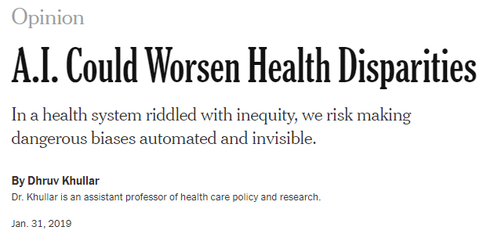
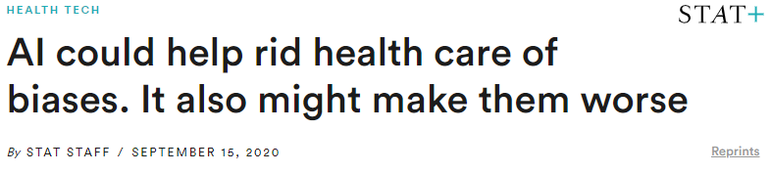
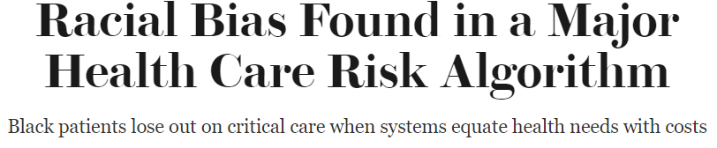
Regulatory Science Methods Related to Algorithm Bias & Robustness
Part 1: Regulatory Framework
Part 2: GMLP and
Harmonization
Part 3: Pt-Centered Transparency
Part 4: Regulatory Science Methods
Part 5: RWP
Considerations
Need for improved methodologies for the evaluation and improvement of machine learning algorithms
Includes methods for the identification and elimination of bias, and on the robustness and resilience of these algorithms to withstand changing clinical inputs and conditions.

Slide 22



Regulatory Science Methods Related to Algorithm Bias & Robustness
Part 1: Regulatory Framework
Part 2: GMLP and
Harmonization
Part 3: Pt-Centered Transparency
Part 4: Regulatory Science Methods
Part 5: RWP
Considerations
Regulatory science research efforts to develop these methods to evaluate AI/ML-based medical software.
Ongoing research being conducting in collaboration with Centers for Excellence in Regulatory Science and Innovation (CERSIs) at:
    University of California San Francisco (UCSF)/ Stanford University;
    Johns Hopkins University.
These collaborations complement the ongoing research efforts and the AI/ML program charter at OSEL.

Slide 23
Part 1: Regulatory Framework
Part 2: GMLP and
Harmonization
Part 3: Pt-Centered Transparency
Part 4: Regulatory Science Methods
Part 5: RWP
Considerations
Real World Performance
Collection and monitoring of real-world data will support a total product lifecycle (TPLC) approach to the oversight of AI/ML-based SaMD
By gathering data on real-world use and performance of SaMD, manufacturers can:
  Improve their understanding of how their products are being used
  Identify opportunities for improvements, and
  Respond proactively to safety or usability concerns

Slide 24
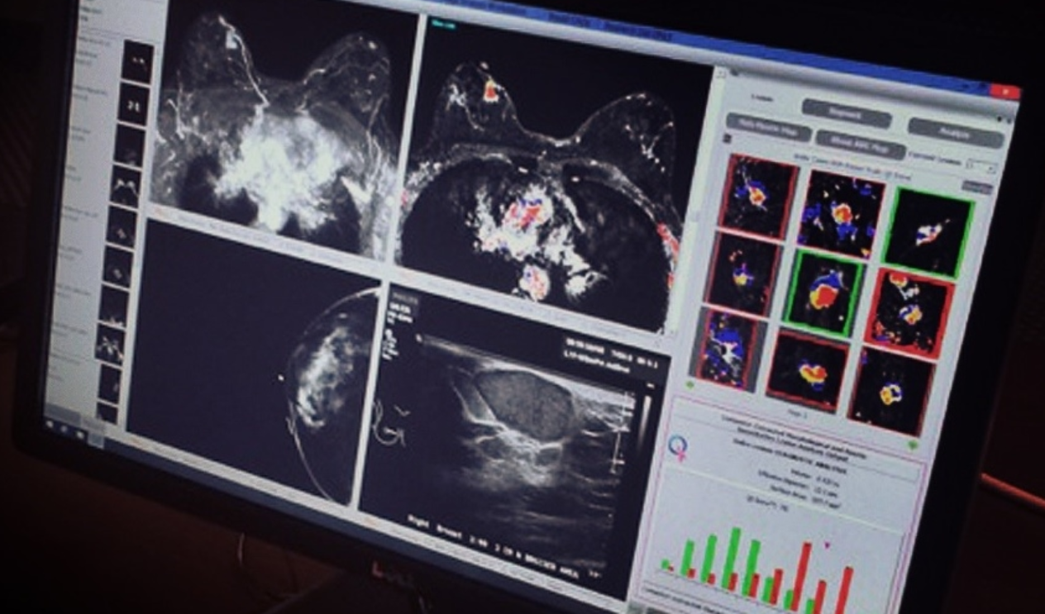
Part 1: Regulatory Framework
Part 2: GMLP and
Harmonization
Part 3: Pt-Centered Transparency
Part 4: Regulatory Science Methods
Part 5: RWP
Considerations
Real World Performance
What type of reference data are appropriate to utilize in measuring the performance of AI/ML software devices in the field?
How much of the oversight should be performed by each stakeholder?
How much data should be provided to the Agency, and how often?
How can the algorithms, models, and claims be validated and tested?
How can feedback from end-users be incorporated into the training and evaluation of AI/ML-based SaMD?
https://angel.co/quantitative-insights

Slide 25
Part 1: Regulatory Framework
Part 2: GMLP and
Harmonization
Part 3: Pt-Centered Transparency
Part 4: Regulatory Science Methods
Part 5: RWP
Considerations
Real World Performance
Actions:
Support the piloting of real-world performance monitoring by working with stakeholders on a voluntary basis
Coordination with other ongoing FDA programs focused on the use of real-world data
Develop a framework for seamless gathering, validation, and evaluation of relevant real-world performance metrics
Continued stakeholder and public engagement
https://angel.co/quantitative-insights

Slide 26
Digital Health Center of Excellence
AI/ML-Related Activities
Update the proposed AI/ML framework, including through Guidance
Strengthen FDA’s role in harmonizing GMLP through standards development & other initiatives
Foster a patient-centered approach, starting with a workshop on transparency to users
Support development of regulatory science methods related to algorithm bias and robustness
Advance real-world performance pilots in coordination with stakeholders and other programs
Recent Milestones
    April 2019– Published AI/ML-SaMD - Discussion Paper
    Sept 2019– First joined Collaborative Community related to AI/ML
    Feb 2020- Public Workshop on the Evolving Role of AI in Radiological Imaging
    Oct 2020- Patient Engagement Advisory Committee (PEAC) Meeting on patient trust in AI/ML technologies
.
Future Plans (2021+)
AI/ML Medical Device Software Action Plan
WORKSHOP
Evolving Role of AI in Radiological Imaging
February 28-28, 2020

Slide 27


Further Questions or Feedback
www.fda.gov/digitalhealth
DigitalHealth@fda.hhs.gov
Anindita Saha
Assistant Director, CDRH Digital Health Center of Excellence
Office of Strategic Partnerships & Technology Innovation (OST)
Center for Devices and Radiological Health (CDRH)
U.S. Food and Drug Administration
Anindita.Saha@fda.hhs.gov

