Slide 1
July, 2020

Slide 2
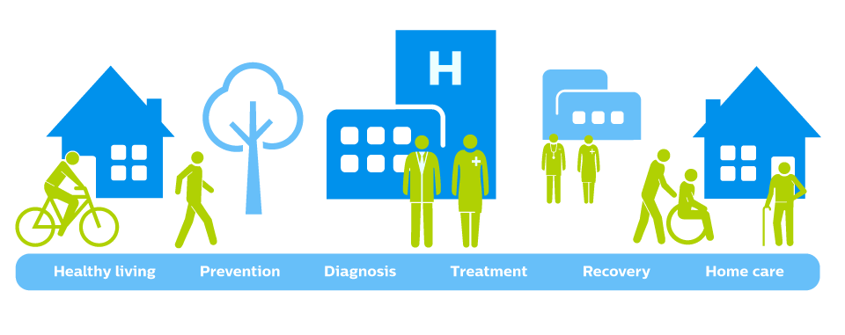
Digital Health
The convergence of connectivity, data and computing power for healthcare and related uses across the life of an individual or a patient.
Healthy living Prevention Diagnosis Treatment Recovery Home care
Moving health care from the Clinic to the Patient
Understanding patient’s behavior and physiology “In the wild”
Focusing on prevention for early/smaller interventions
Leveraging computing power, sensors, connectivity and software
Notes:
Digital health can be considered as the convergence of connectivity, data, and computing power for healthcare and related uses across the life of an individual or patient.
Digital health is moving healthcare from the clinic to patient, understanding the behavior and physiology in the wild, and enables early and smaller interventions.

Slide 3
Digital Health Technology
Healthy living Prevention Diagnosis Treatment Recovery Home care Management
Convergence of computing power, connectivity, sensors, and software used in healthcare.
Used as a medical product
Incorporated into a medical product (include a pharmacologic product)
Used to develop a medical product
Used to study a medical product
Used as a companion or adjunct to a medical product, including diagnostics and therapeutics.

Slide 4
Why a Digital Health Center of Excellence?
Part of the planned evolution of the digital health program
Intent to
Drive synergy for digital health efforts
Align strategy with implementation
Prepare the FDA for the digital health future
Notes:
Slide Purpose: Answer - Why and What has brought us to building the COE

Slide 5
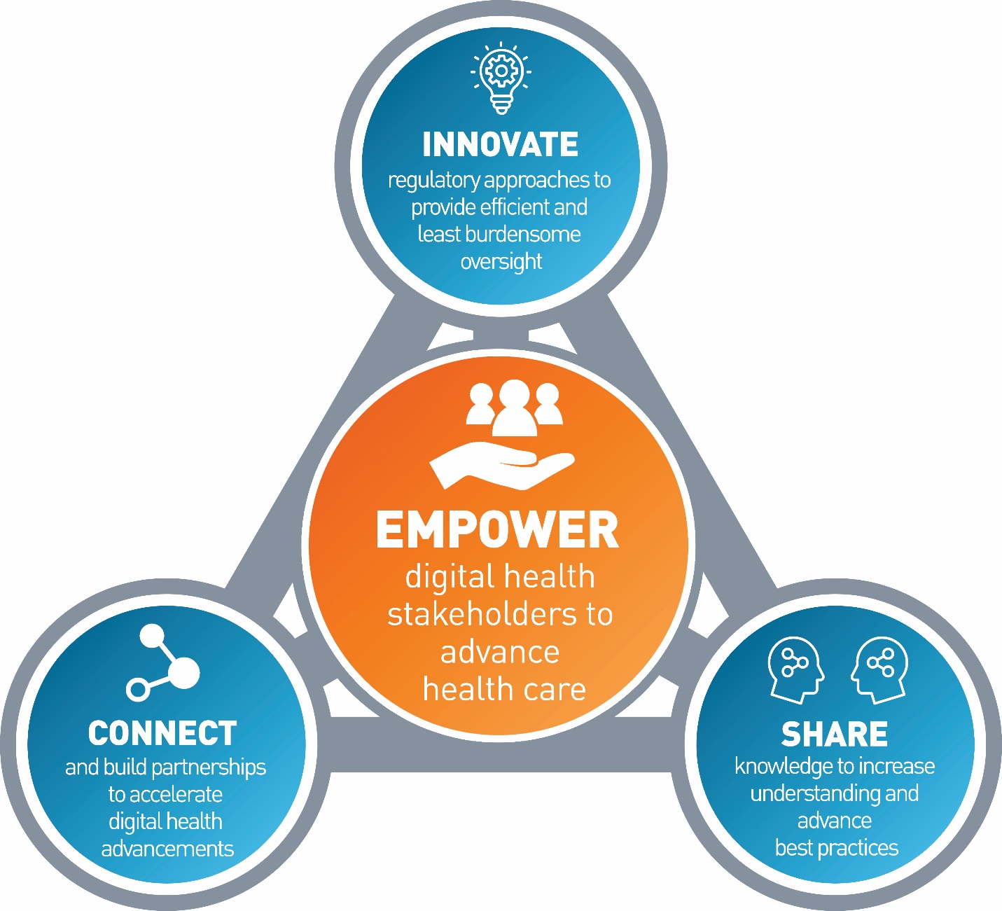
FDA’s
Digital Health Center of Excellence
Empowering All to Advance Healthcare
Our goal: Empower stakeholders to advance health care by fostering responsible and high-quality digital health innovation.
The Digital Health Center of Excellence aims to:
Connect and build partnerships to accelerate digital health advancements.
Share knowledge to increase awareness and understanding, drive synergy, and advance best practices.
Innovate regulatory approaches to provide efficient and least burdensome oversight .
Develop novel, efficient regulatory approaches that are least burdensome
Connect
Share
Build partnerships, new networks to accelerate and scale
Gather, simplify, and share information to increase awareness and understanding

Slide 6
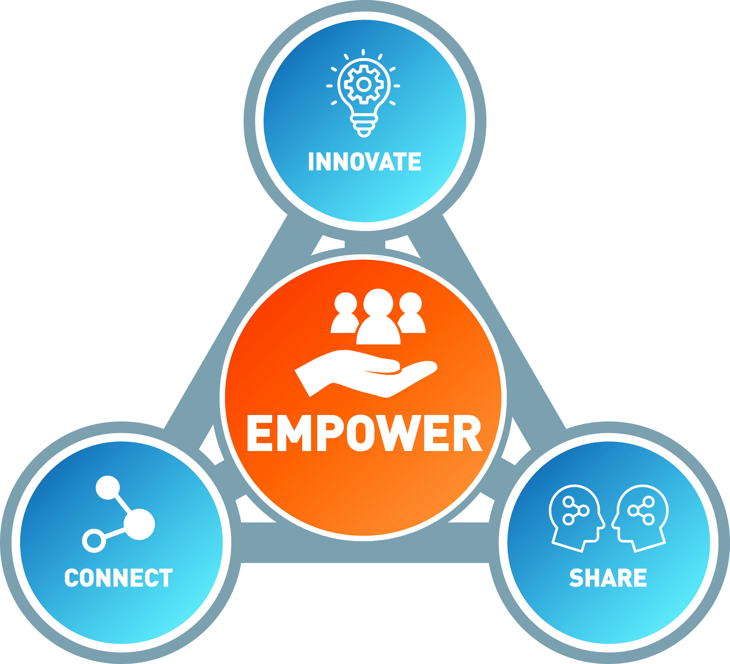
Anticipated Outcomes
Strategically advance science and evidence for digital health technologies that meets the needs of stakeholders.
Efficient access to a highly specialized expertise, knowledge, and tools to accelerate access to digital health technology.
Aligned regulatory approach to harmonize international regulatory expectations and industry standards.
Increased awareness and understanding of digital health trends.
Consistent application of digital health technology policy and oversight approaches.
Reimagined medical device regulatory paradigm tailored for digital health technologies.

Slide 7
DHCoE Functional Areas
Coordinated by Digital Health Center of Excellence
Dedicated functions + Virtual functions
DH Policy Development/ Support
Policy development and support
DH Technology Support
Submission policy support
Regulatory Innovation/Strategic Initiatives
Pre-Cert
DH inquiries
Submission support
Guidance/Policy development
Wearables
Software development practices
Software and digital health standards
Wearables
Interoperability
Digital Biomarkers
DHCoE Operations & Coordination/Partnerships
AI/ML in Medical Products
Internal: Steering Committee, Advisory Group
Policy development and support
IMDRF collaborations
External engagement/ collaboration
External: collaborations and partnerships
Medical Device Cybersecurity
Policy development and support
IMDRF collaborations
External engagement/ collaboration
Advancing Regulatory Science
Regulatory Review Support
Advanced Manufacturing
Advanced Clinical Studies and RWE
Digital Pathology
Day – day review support for OHTs
Case for Quality (Software in Manufacturing)
In silico modeling
Use of RWE in DH devices
RWE from digital health technology
Software used to manufacture medical device
Digital twin for manufacturing
Implement DH policies
Patient-Generated Data
Virtual Reality/Augmented Reality
Training for reviewers
Implement competency tiers
7

Slide 8
DHCoE Services
Notes:
External to FDA: Partner, Coordinate, Promote
Provide clarity on regulation
Advance international harmonization on policy
Facilitate and build strategic partnerships
Communicate FDA research interests
FDA-wide: Support, Align, Amplify
Provide training opportunities for FDA staff
Foster collaboration on common interest areas
Identify and prioritize regulatory science needs for digital health topics
Coordination: Leverage, share, and avoid duplication of work
Promote, showcase, and amplify existing work at the centers
Disseminate shared resources
Provide scientific expertise across the Agency
CDRH Specific: Lead, Build, Enable
Set and lead strategic direction in digital health
Launch strategic Initiatives
Establish and promote best practices
Enable efficient, transparent, and predictable product review with consistent evaluation quality
Build new capacity to oversee and leverage DH technologies
Create more shared resources
Coordinate the development of cross cutting DH policies

Slide 9
DHCoE Services
Provide clarity on regulation
Advance international harmonization on device regulatory policy
Facilitate and build strategic partnerships
Communicate FDA research interests
Advance digital health device international standards
Provide DH expertise across the Agency
Offer training opportunities for FDA staff
Disseminate shared resources
Foster collaboration across FDA in common interest areas
Facilitate synergies in regulatory science research in digital health
Leverage, share, and avoid duplication of work
Promote and showcase existing work at the Centers
Notes:
Hold for panel discussion:
What additional services would stakeholders like to see that are not listed here?
How can the DHCoE best collaborate/engage with stakeholders on these services?

Slide 10
DHCoE Services
Set and lead strategic direction in digital health
Identify and coordinate regulatory science priorities for CDRH
Establish and promote best practices
Enable efficient, transparent, and predictable product review with consistent evaluation quality
Build new capacity to oversee and leverage DH technologies
Create more shared resources
Coordinate the development of cross cutting DH policies

Slide 11
DHCoE Roadmap
Following is our initial roadmap for bringing the benefits of digital health to all Americans, efficiently and collaboratively:
Build and Sustain Capacity
Phase I: Communication
Fall 2020
Phase II: Coordinate
Fall and Winter 2020
Phase III: Amplify
Winter 2021 onwards
Continued strategic partnership building and communication
Build strategic partnerships for policy, regulatory science, and fellowships
Update and implement regulatory framework for digital health
Develop resources for external stakeholders
Harmonization with other regulators
Create a digital health community of practice
Assemble FDA and CDRH advisory groups
Begin operationalizing the DHCoE and outcome measurement
Update and develop resources for FDA staff
Stakeholder Listening Sessions
Amplify current work being done at FDA in digital health
Build Partnerships
Raise Awareness and Engage Stakeholders
Notes:
Hold for panel discussion:
Of the DHCoE priorities identified today: What is the most urgent? What is the low-hanging fruit?

Slide 12
Stakeholder Feedback on AI/ML Approach
Since publishing in April 2019 FDA’s Proposed Regulatory Framework for Modifications to AI/ML-Based SaMD, we’ve received stakeholder feedback through:
> 1,000 comments on public docket from a diverse community of stakeholders
> 30 publications in peer-reviewed journals
Pre-submission meetings on AI/ML devices
Patient Engagement Advisory Committee Mtg (PEAC)

Slide 13
Stakeholder Feedback on AI/ML Approach
What we heard from stakeholders:
Regulatory Framework: Requested further development of proposed regulatory framework for AI/ML-based SaMD
Good Machine Learning Practices (GMLP):
Supported the idea of GMLP and the need for
harmonization of its efforts
3. Transparency: Asked for further discussion
with FDA on how these technologies interact
with people, including transparency to users
Regulatory Science: Described need for improved methods related to algorithmic bias and robustness.
Real-World Performance (RWP): Sought clarity on RWP monitoring for AI/ML software.

Slide 14
Stakeholder Feedback on AI/ML Approach
What we heard from stakeholders:
Regulatory Framework: Requested further development of proposed regulatory framework for AI/ML-based SaMD
Good Machine Learning Practices (GMLP):
Supported the idea of GMLP and the need for
harmonization of its efforts
3. Transparency: Asked for further discussion
with FDA on how these technologies interact
with people, including transparency to users
Regulatory Science: Described need for improved methods related to algorithmic bias and robustness.
Real-World Performance (RWP): Sought clarity on RWP monitoring for AI/ML software.
What we’ll do -- The AI/ML Action Plan:
Update the proposed AI/ML framework,
including through Guidance
Strengthen FDA’s role in harmonizing GMLP
through standards development & other initiatives
Foster a patient-centered approach,
starting with a workshop on transparency to users
4. Support development of regulatory science methods
related to algorithm bias and robustness
Advance real-world performance pilots
in coordination with stakeholders and other programs

Slide 15
Further Questions or Feedback
www.fda.gov/digitalhealth
DigitalHealth@fda.hhs.gov
Bakul Patel, (Bakul.Patel@fda.hhs.gov)
Director, Digital Health Center of Excellence

