Slide 1




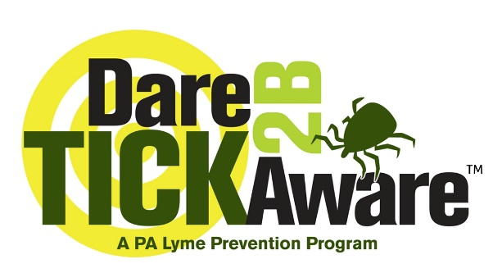

Partnering Up to Raise Awareness
We’re on a mission.
Education. Prevention. Patient Support. Advocacy.

Slide 2
Numbers are Climbing
476,000+ U.S. residents diagnosed annually.
Many are children.
326 children a day!

Slide 3
Risk is High. Prevention is Low.
Only 12% of 1,500+ elementary school kids regularly perform tick checks.
Does a child …
Live near the woods?
Go to camp?
Have a dog or cat?
Play or watch sports in a grassy field?
Enjoy outdoor recess?
Play outside near grass or trees?
That child is at a significantly increased risk.

Slide 4
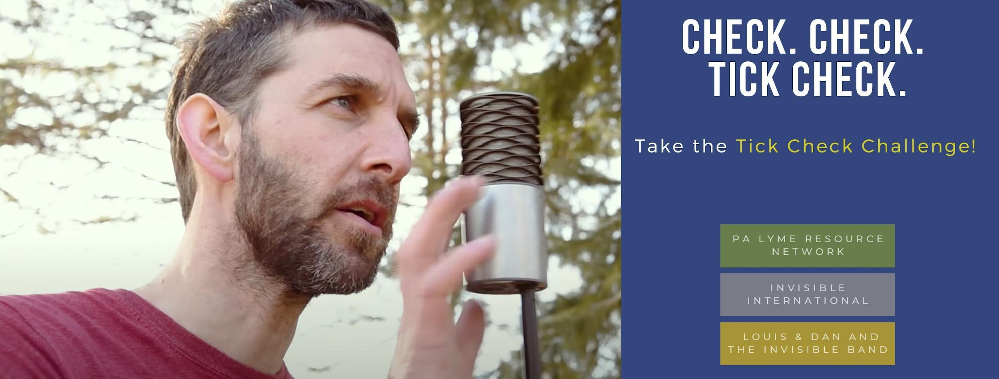
Solution?
The Tick Check Song & Challenge
An interactive challenge created to help educate and protect kids (and adults!) from Lyme Disease and other debilitating tick-borne diseases.
Visit the official online home of the Tick Check Challenge!
Click!

Slide 5
The Song
Educational / evidence-based prevention steps in lyrics - adapted from PA Lyme’s Dare 2B Tick AwareTM Program.
Lyrics
When you go for a walk
In the grass or the woods
You’re strolling by ticks
Who think you taste real good
A bite from a tick
Can make you sick pretty quick
But you can make sure
their diseases don’t stick
Check for ticks - tick check!
Check for ticks - tick check!
Check for ticks - tick check!
Don’t get sick - tick check!
Ticks are like vampires
Your blood helps them grow
They’re drawn to damp places
On your body (eww gross)
So when you come in
From where ever you’ve been
Put your clothes in the dryer
And check for ticks on…your skin!
Check for ticks – tick check!
Check for ticks – tick check!
Check fo ticks – tick check!
Don’t get sick – tick check!
Break it down.
2x
Check your head
Check your hair
Check your armpits
And underwear
Check your knees
Check your feet
Elbows and toes
Are places ticks will go
Check for ticks - tick check!
Check for ticks - tick check!
Check for ticks - tick check!
Don’t get sick - tick check!
Head, hair, armpit, underwear
Knees, feet, elbows, toes
Those are places
Ticks will go…tick check!
Prevention Information
Where ticks hide/habitat
Tick bites can transmit disease/make us sick
Where ticks bite
Put clothes in dryer
Do a tick check
Where to check on body

Slide 6

#TickCheckChallenge
Passion, collaboration and funding coming together to protect lives.
CLICK IMAGES TO WATCH/LISTEN
Steps 3, 4

Slide 7
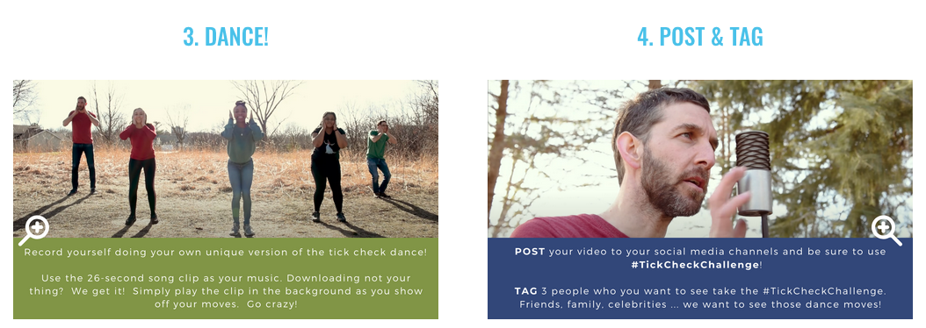
#TickCheckChallenge
Passion, collaboration and funding coming together to protect lives.

Slide 8
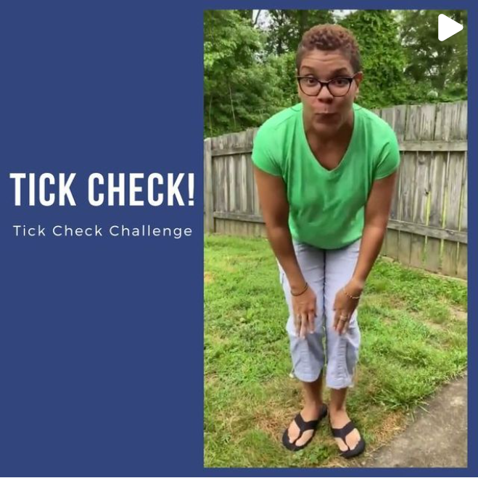
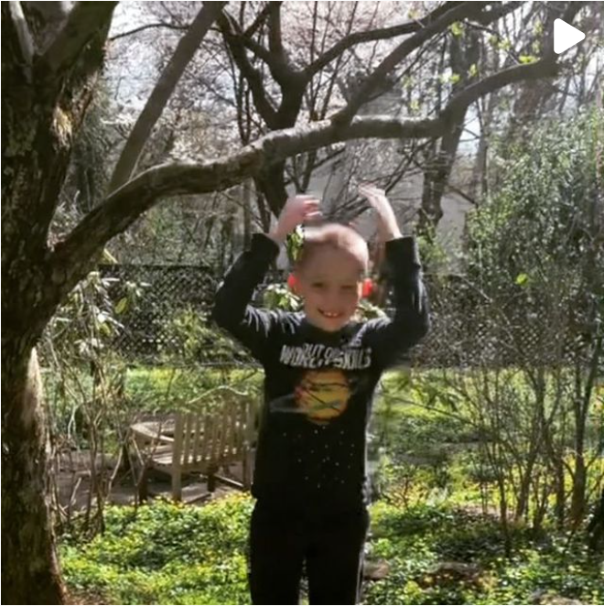
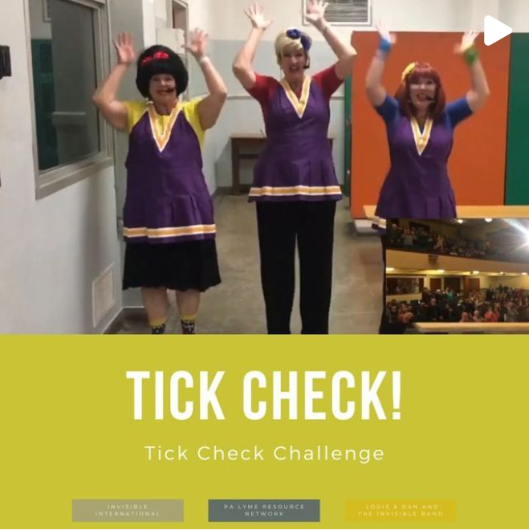
Challenge Videos
CLICK IMAGES TO WATCH

Slide 9
The Path To Prevention
Incubation & Mentorship
PA Lyme Resource Network +
Invisible International’s Hackathon Team
Partnered with
Louis & Dan and the Invisible Band
Social Media
Facebook - Reach 30,835+
Video Minutes Viewed 10.3k
Video 3-second views 12.53k
Instagram – Reach 4,022+
Twitter –Impressions 26,514+
Media
Blogs, Newsletters, Radio,
Podcasts, E News Nationwide
Awareness of ticks & tick checks
Earlier recognition/reduce # of tick bites
Tick check song as awareness tool
Annual May Lyme Awareness Month #TickCheckChallenge
Alternate song versions i.e. choral arrangement
Ongoing campaigns/promotion of song/challenge seasonally
COLLABORATION
IMPACT
GOALS & SUSTAINABILITY

Slide 10
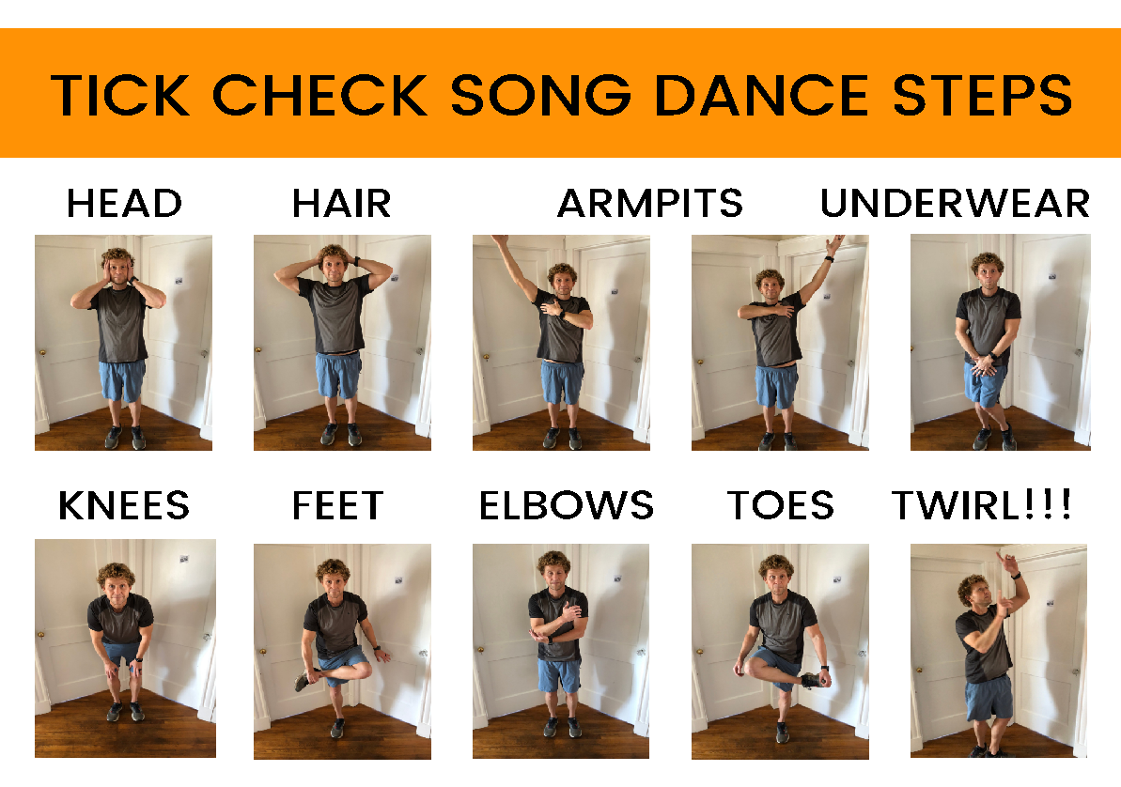
Take the Challenge
Click!

Slide 11
Thank You!
We’re on a mission.
Education. Prevention. Patient Support. Advocacy.

