Slide 1
Hope
“Always be ready to give an explanation to anyone
who asks for a reason for your hope, but do it with
gentleness and reverence, so that, when you are maligned,
those who defame your good conduct in Christ may
themselves be put to shame.”
1 Peter 3:15
Determine which mountain you are climbing. Shift your focus as needed.
Build a personal, convincing case for belief in Jesus, the reason for your hope.
Define lasting happiness / fulfillment. Cultivate a desire for it.
Realign your priorities to pursue and attain it. Stay the course.
Do this on your retreat.

Slide 2
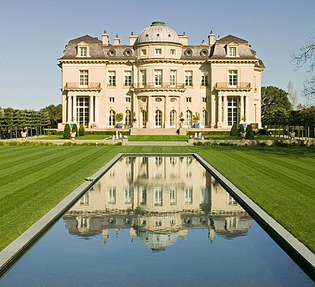
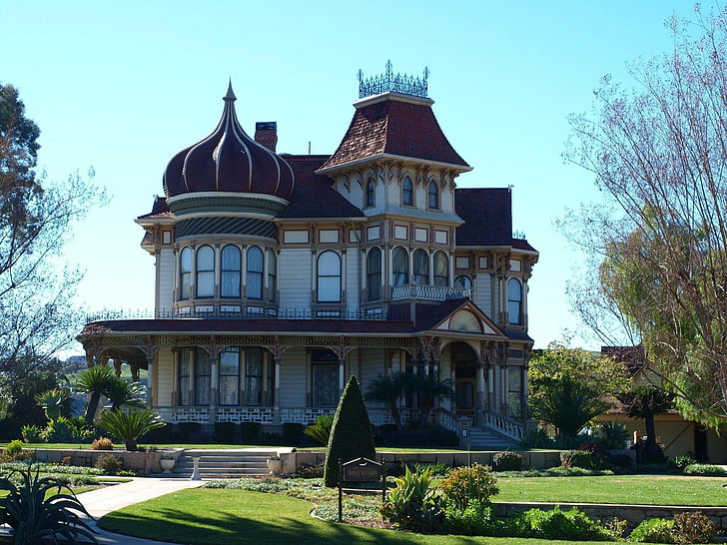
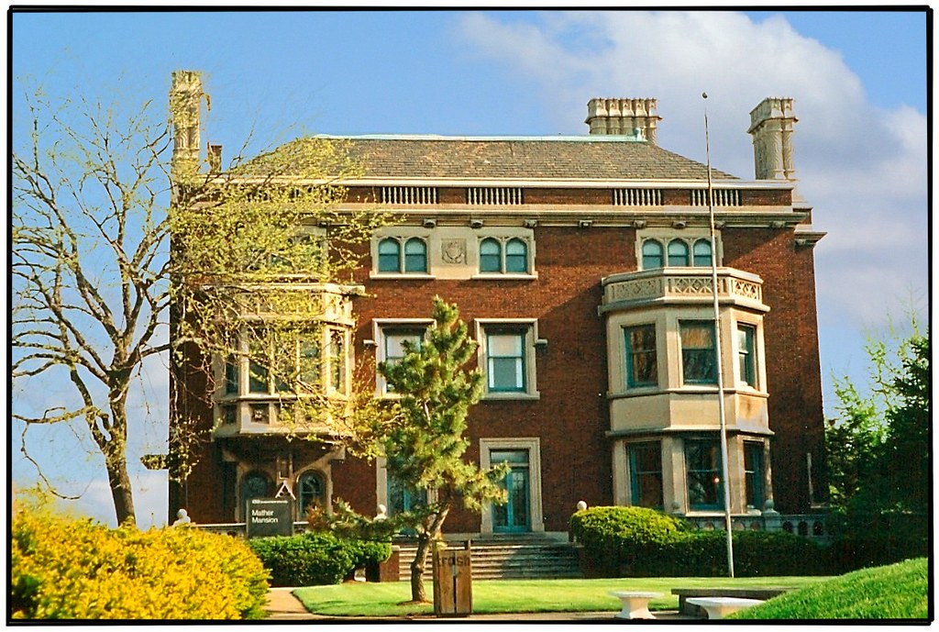
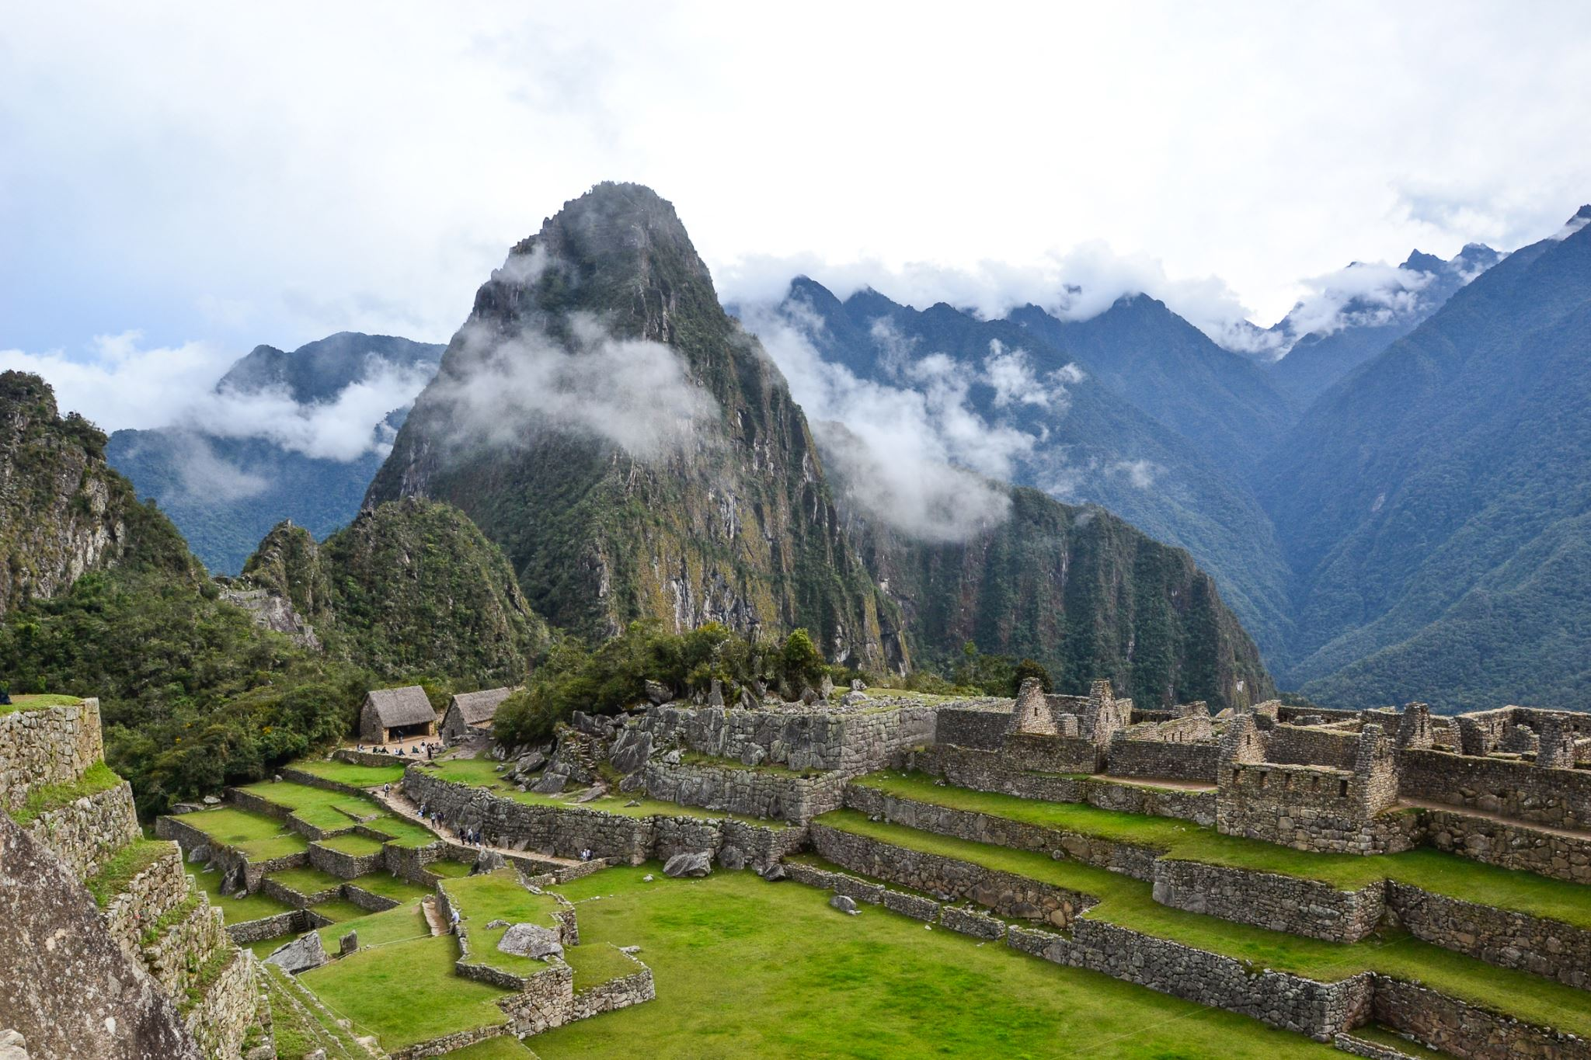
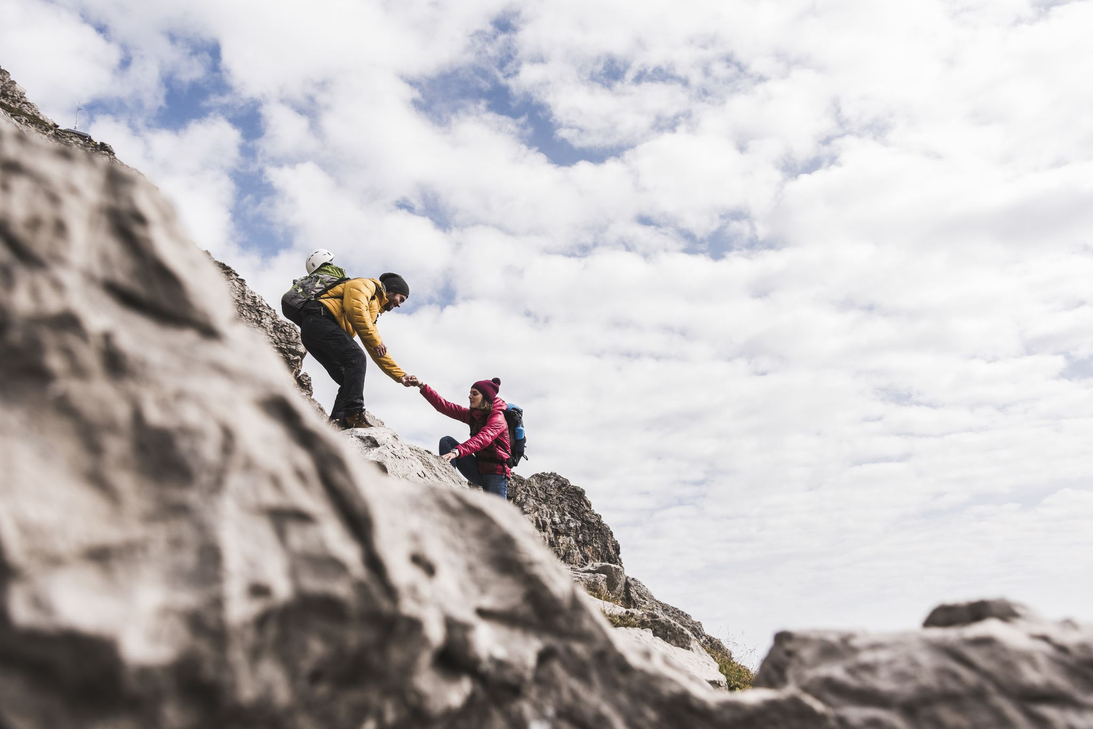
We reveal what we hope for by the mountains we choose to climb.
Death stops these mountains.
In my father’s house there are many mansions.
The path is arduous, but worthwhile.
Self Sufficiency
Wealth
Power
Fame / Respect
Eternal life & Joy
Political domination.
Enrichment wars.
Cultural influence.
Educational change.
Be worshipped.
Win 3 Super Bowls in a row.
Become the richest man
in the world.
Be honored and respected
by everyone.
Focus on the Word/Revelation.
Develop & execute a plan.
Be patient and resilient.
Bring others along.
Live at the level of the spirit.
Be your own boss!
Become a billionaire.
The rich young man and the rich fool.
Christ’s first temptation.
Solve world hunger.
Christ’s second temptation.
Worship me for power…
Christ’s third temptation.
Make yourself a spectacle.

Slide 3
Hope is a confident expectation of receiving God’s promises in the future.
To have hope means to be in “status viatoris”, to be on one’s way.
We are sinners and pilgrims on the way to eternal life.
2025 is a Jubilee Year. The theme is “Pilgrims of hope.”
We are not yet in “status comprehensoris”, to have arrived. Hence arduousness is part of our path forward.
Jesus undergoes the passion and carries his cross to show us how to deal with our arduousness.
What are the reasons for hope? Christ is the one reason. Why?
He heals our infirmities:
1. Spiritual blindness. An inability to experience transcendence.
We need to be born again of water and the spirit.
-Nicodemus. John 3.
-Samaritan woman. John 4.
-Man born blind sees. Pharisees remain blind. John 9.
2. Ignorance of who he is and how everything would unfold.
-Emmaus. Luke 24.
-He opens up their minds. Luke 24.
3. Pain and suffering when it fits the divine plan.
-Leper defers to God’s will. Matthew 8.
-Paralytic comes through friends. Matthew 9.
-Bartimaeus cries out. Mark 10.
-Woman with hemorrhage reaches out. Matthew 9.
He has overcome death:
Widow of Nain’s son. Luke 7.
Jarius’ daughter. Mark 5.
Lazarus. John 11.
Himself. Matthew 28.
He gives us justice and a destination.
1. In my father’s house there are many mansions.
I go to prepare a place for you. John 14.
2. When the Son of man comes in his glory
With all his angels with him. Matthew 25.
3. And everyone who has given up houses or brothers
or sisters…for me will receive hundredfold and
eternal life. Matthew 19.
4. It is you who have stood by me in my trials.
and I confer a kingdom upon you. Luke 22.

Slide 4
We hope for happiness, but are we searching in the right places?
This is typically where we place our hope.
"One must relinquish the customary criteria --"happiness is wealth, possession, power."
For precisely when one makes these things the measure, one is on the wrong path.
So, Catholics are not promised an "exterior" happiness but rather a deep interior security
through communion with the Lord. That He is an ultimate light of happiness in one’s
life is in fact a part of all of this.“ Salt of the Earth pp. 29-30
“What we really need are people who are inwardly seized by Christianity and experience it as
joy and hope, who have become lovers. And these we call saints….Reforms will come
from convincing personalities whom we may call saints.” SOTE Pp. 269-270
Two threats to hope:
1. Despair – Judas. Small infidelities unrepented for lead to larger ones.
Hope helps us seek repentance so our continual small infidelities do not
snowball into an avalanche that destroys us.
2. Presumption – Peter. Excessive self-reliance. Ignorance of one’s weak state.
Read parts of two books:
Josef Pieper - Faith, Hope & Love. Chapter on hope.
Peter Seewald and Cardinal Ratzinger – Salt of the Earth. Sections on Words and Signs, pp. 9-37,
and The Future of the Church, pp. 254-275.

Slide 5
Hope is reflected in what you spend your time doing.
Most
Important
Work/
Housing/
Cars/
Tuitions
Faith/
Prayer/
Service
Faith/
Prayer/
Service
Family/
Culture/
Traditions
Family/
Culture/
Traditions
Hobbies/
Reading
Your prayer life should
influence every other
aspect of your life.
This is known as
“unity of life.”
Hobbies/
Reading
Work
Work/
Friendships/
Apostolate
Family
Hobbies/
Sports
Least
Important
Faith/
Prayer
Hope can help you realign your priorities. This will lead to greater happiness over time.

