Slide 2
Insights from PAI’s Funded Partners
We lead with the following questions:
What do you need?
How can PAI help?
Learning from each other – technical and strategic support and peer-to-peer engagement
Investment in institutional capacity building
Communications and storytelling to elevate and enhance their visibility
Access to the global stage
Influencing/informing donor investments and global policy to advance sexual and reproductive health and rights (SRHR)
Engagement with donors to diversify their own funding and present their work
Co-creating new programs and initiatives
Multiyear, flexible funding for advocacy and accountability

Slide 3
PAI’s Value Add
Share our strengths and embrace the strengths of others
Translate and amplify data, research and policies to enable advocacy action
Convening power of diverse voices and perspectives
Connect progress for SRHR to progress for other development outcomes
Positionality and connectivity between global and local
Network of local, indigenous civil society partners
Enabler of coordinated SRHR advocacy at global, regional, national and subnational levels
57 years as a civil society organization (CSO) 120 funded partners in 36 countries Advocates to our own government in the United States and global institutions Advocacy informed and fueled by needs and opportunities at local and national levels

Slide 4
Our Vision
Our Mission
A just and equitable world where everyone can fully realize their sexual and reproductive health and rights to contribute to health equity, economic well-being and gender equality.
Advance universal access to sexual and reproductive health and rights through advocacy, partnerships and funding of changemakers.

Slide 5
Vision 2025 Goals
Together with local civil society partners, PAI aspires to achieve critical goals related to policy, financing, access and accountability by 2025:
Commitment. Mobilize global, regional and national political will, funding and additional resources to guarantee universal access to SRHR.
Access. Advocate for increased equitable access to quality sexual and reproductive health (SRH) care through universal health coverage, primary health care and other diverse channels.
Movement. Elevate a diversity of voices, evidence and insights to accelerate the global SRHR movement.

Slide 6
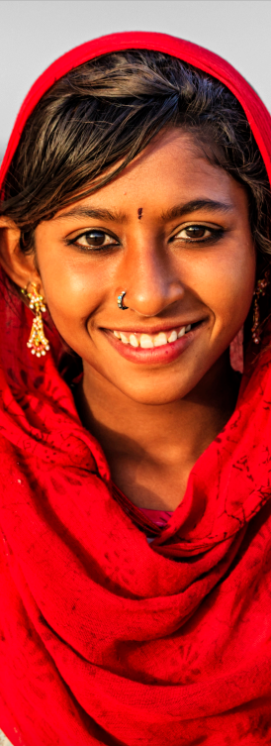
Strategic Pillars
Pillar 1 | Pillar 2 | Pillar 3 | Pillar 4
CULTURE | EQUITABLE PARTNERSHIPS | MAXIMIZE PAI PROGRAM PORTFOLIOS | CASE MAKING
Build an agile, equitable, creative and accountable culture where we thrive and achieve our aspirations. | Expand and deepen partnerships to enhance policy, funding and program impact, and foster a partnership journey that prioritizes the mutual sharing of strengths and shifting of power. | Leverage PAI assets, expertise and voice to accelerate progress toward universal access to SRHR through the lens of four program portfolios: Health financing and systems strengthening (ensuring supply) SRH access and equity (driving demand) Civic engagement (supporting the CSO ecosystem) U.S. and global policy advocacy and accountability (speaking truth to power). | Shape and lead a compelling evidence-informed, country-grounded narrative that fuels our mission and the SRHR movement.

Slide 7
Key Performance Indicators (KPIs) | Pillar 1: Equity, Accountability and Culture | Pillar 2: Partnerships | Pillar 3: Program Portfolios | Pillar 4: Evidence-Informed Case Making
KPI 1: Support a fully engaged, high-quality workforce through an organizational culture defined by kindness, compassion and respect that attracts, retains and develops a diverse staff.
KPI 2: Elevate PAI’s voice and the leadership role of our funded partners by 50% between 2021 and 2025 through media coverage, conferences, stakeholder engagement and policy maker briefings.
KPI 3: Sustain the influence and impact of SRHR advocacy through ongoing engagement with at least 75% of CSOs that have received funding from PAI between 2021-2025.
KPI 4: Increase the share of CSO partners receiving advocacy funding and/or strategic and technical support by a minimum of 50% by 2025 from 96 CSOs in 2021 to 144 by 2025: (90%) of CSO partners receiving funding are local Indigenous groups. (50%) of CSO partners receive multiyear financial and strategic support. (30%) of CSO partners are youth, women, LGBTQI+ and minority-led organizations.
KPI 5: Achieve annual revenue growth targets to enable expansion and strengthening of USG and global advocacy efforts and CSO funding by 2025.

Slide 8
Expansion of Civic Space for SRHR Advocacy
To achieve our mission and global commitments to advance SRHR:
Invest in and sustain a vibrant ecosystem of civil society advocates
Amplify PAI and peer CSO voices, achievements and calls to action –visibility and demand for SRHR
Strengths are shared, power is shifted and new partners are supported

Slide 9
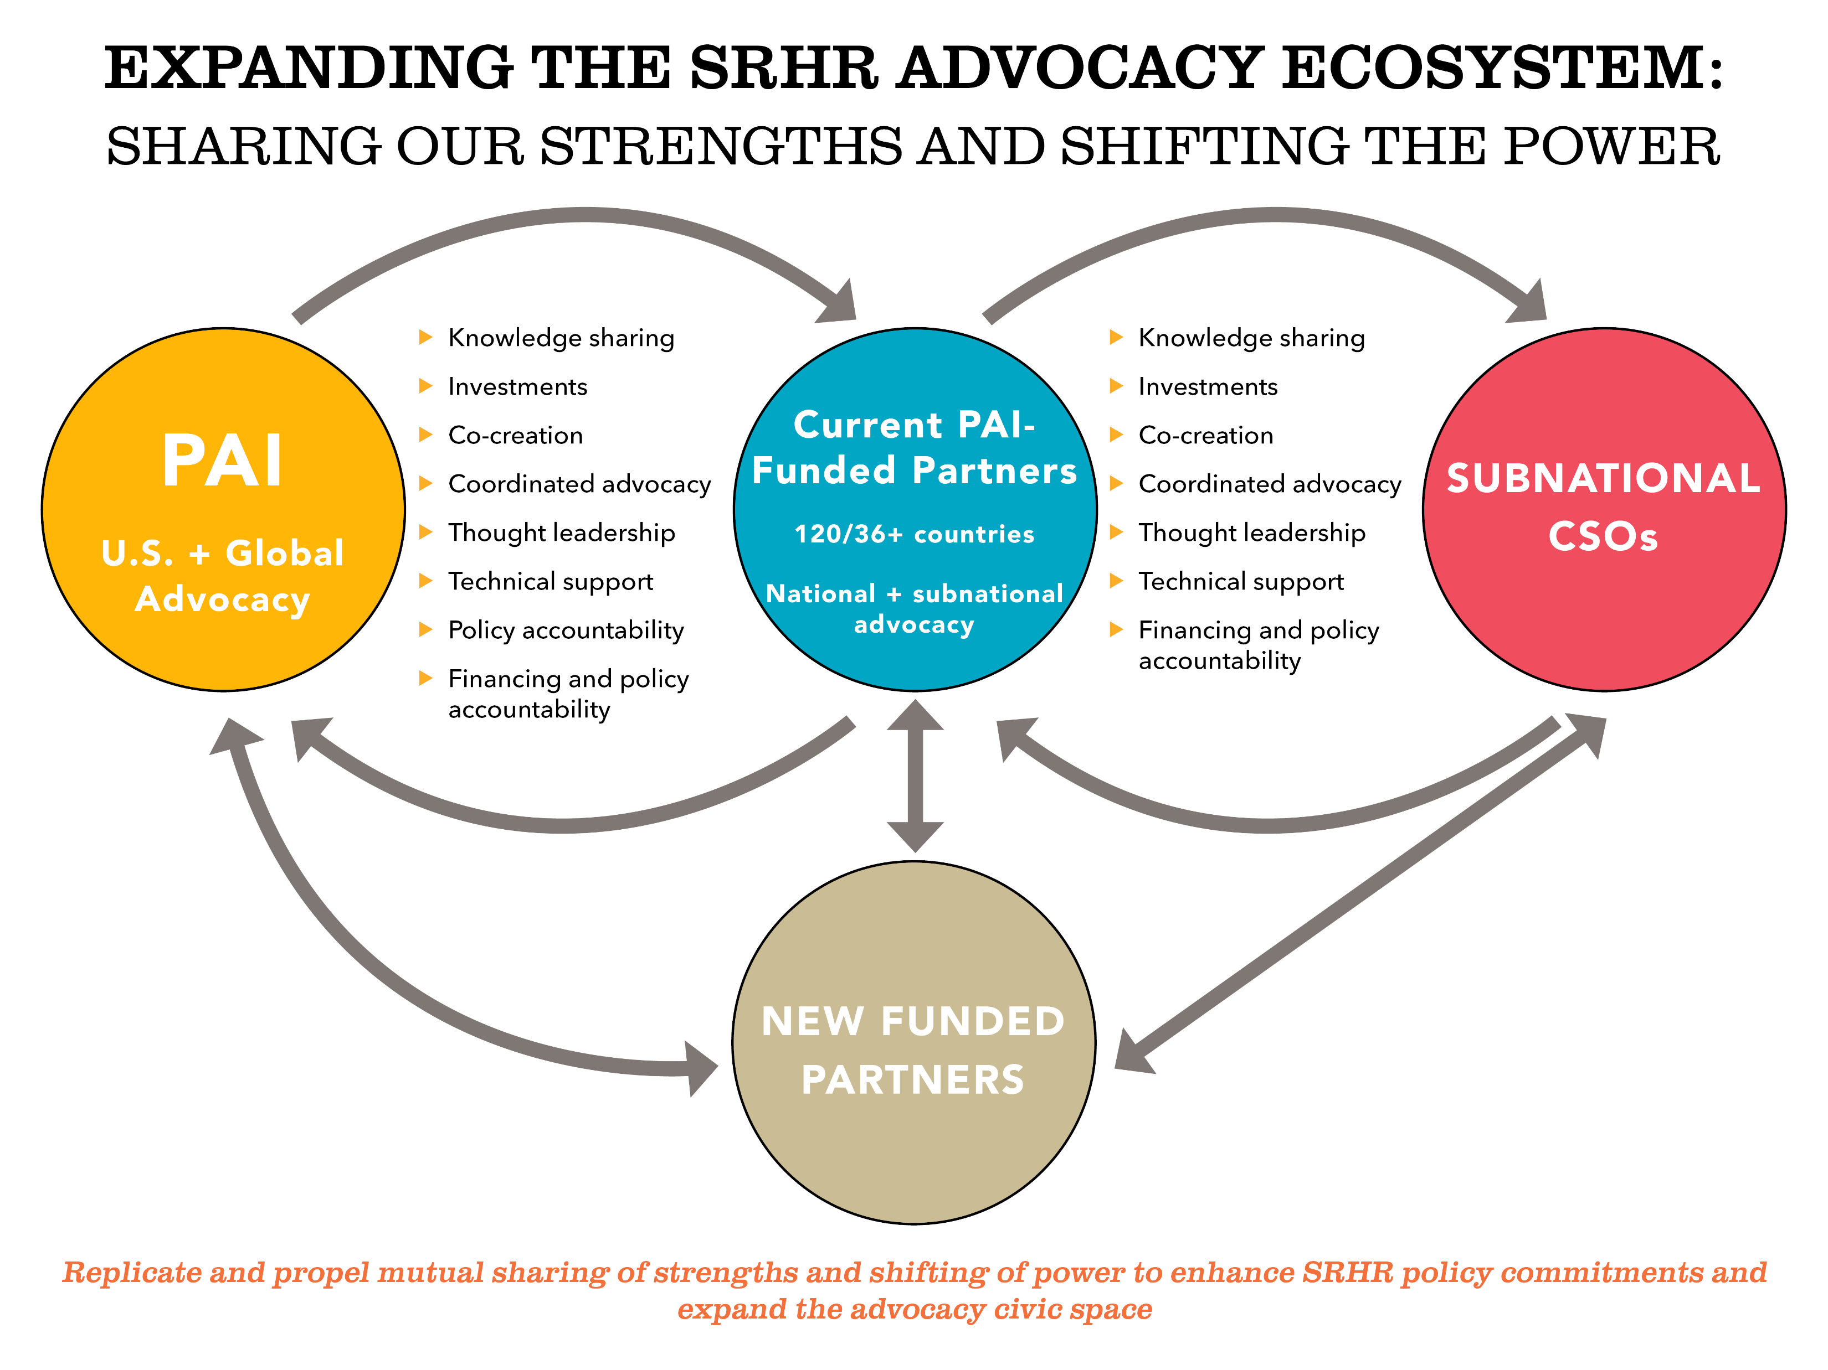

Slide 10
And, to sustain our voice and a vibrant civic space, we also must:
Ensure our identity and intentions are clear
Demonstrate the centrality of SRHR in achieving global development goals
Measure and amplify the impact of advocacy and achievements
Mission aligned, multiyear funding for PAI and funded partners’ advocacy
Flexible and unrestricted investment in both PAI and funded partner institutional capacity development and advocacy agendas
Creation of spaces for shared learning and peer-to-peer exchange among and beyond PAI’s network of peer CSOs

Slide 11
Acknowledgments

Slide 12
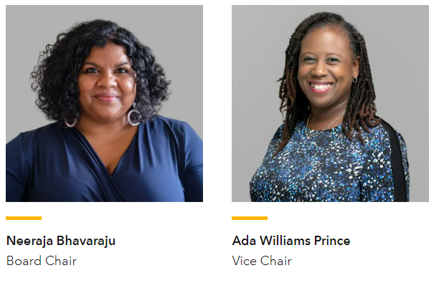
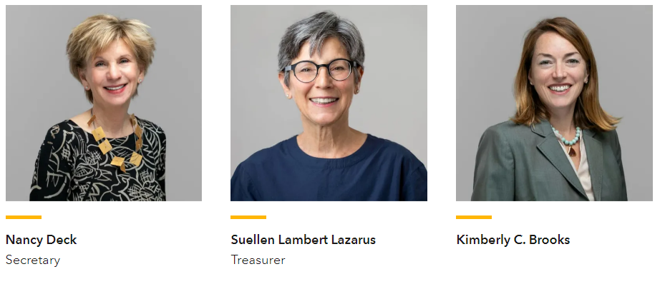
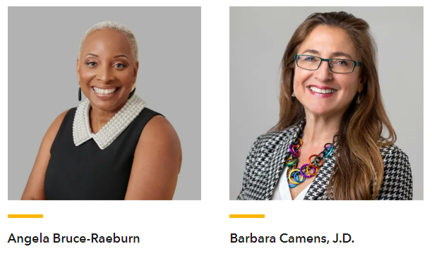
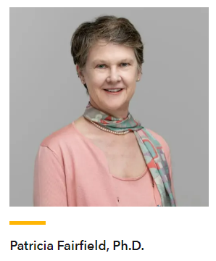
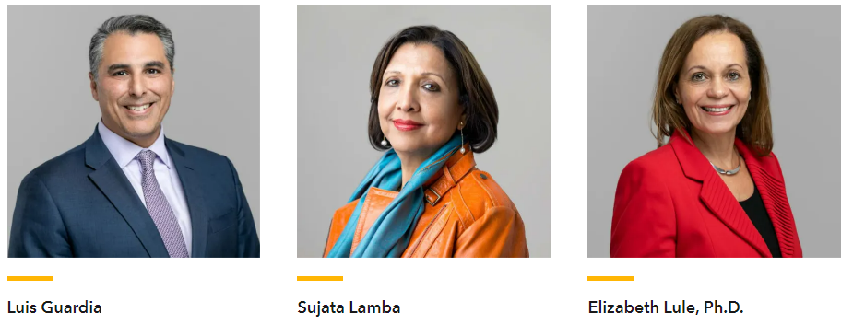
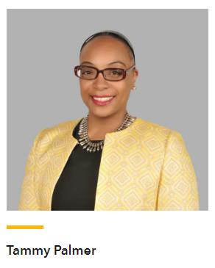
PAI Board of Directors

Slide 13
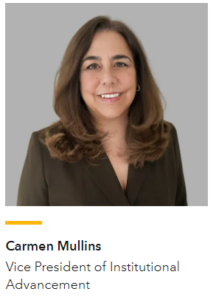
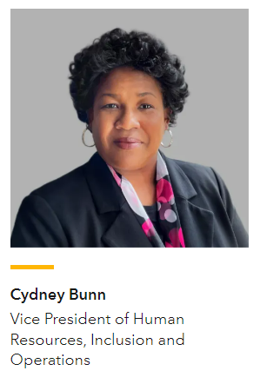
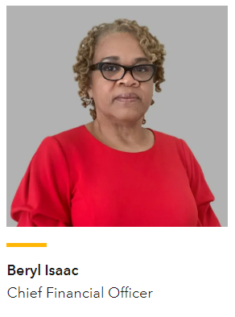
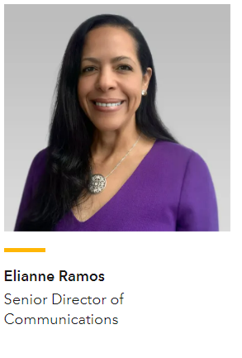
PAI Department Leadership
Christina Wegs
Incoming Vice President of Global Programs and Advocacy

Slide 14
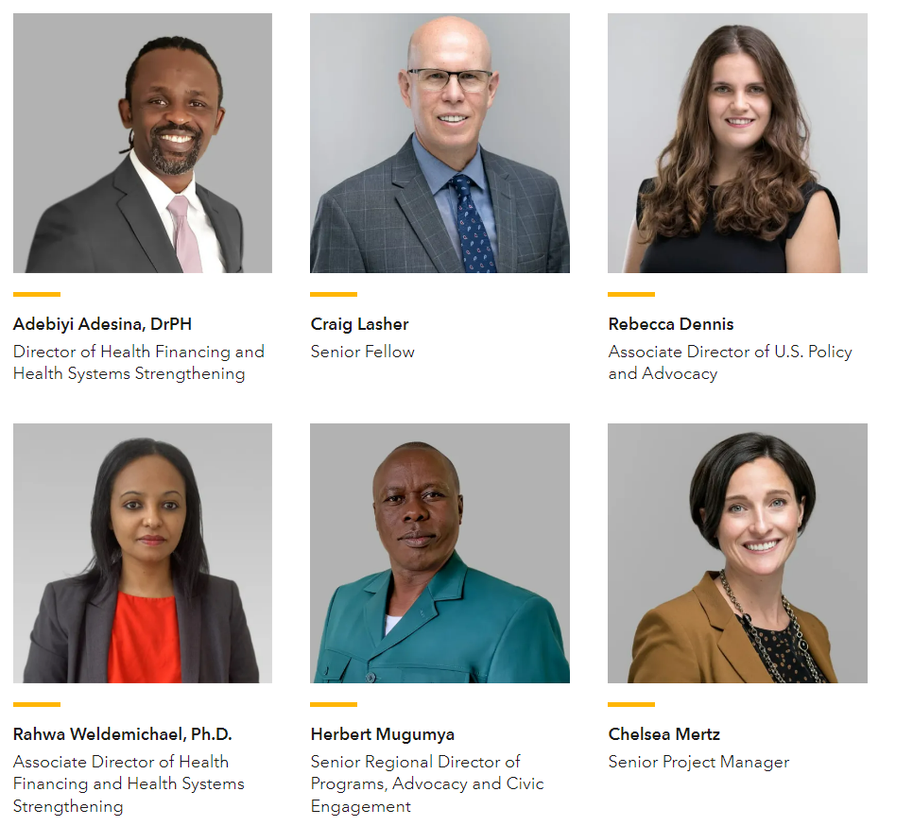
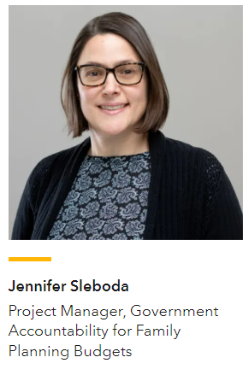
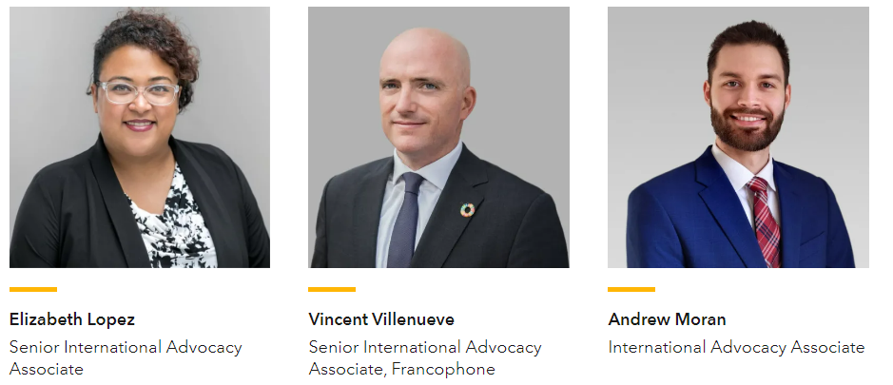
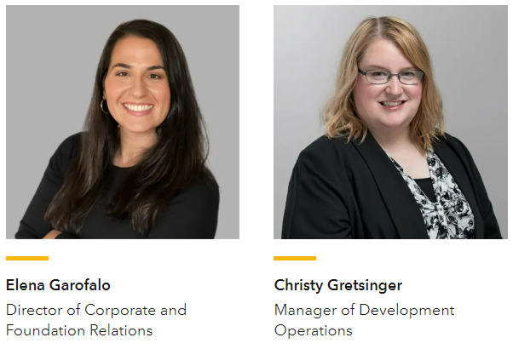
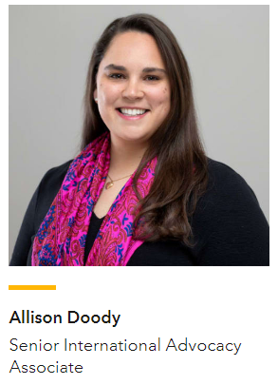
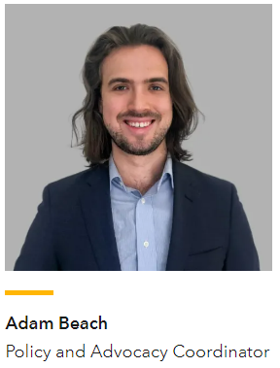
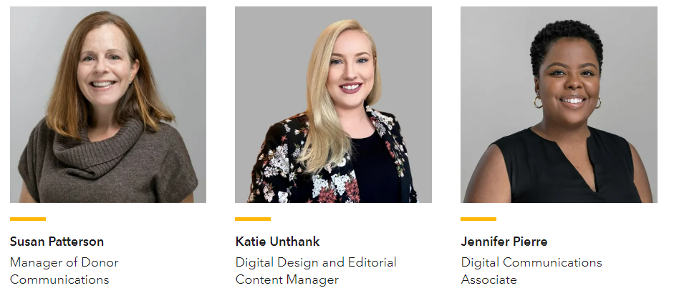
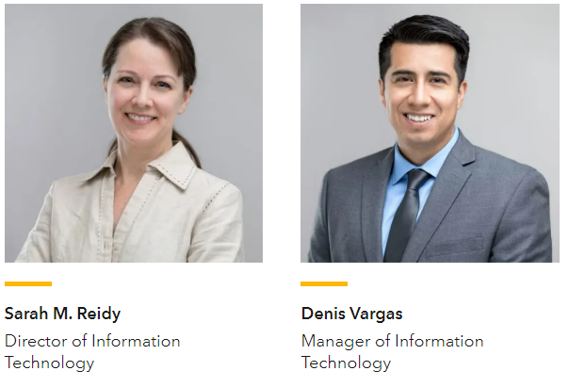
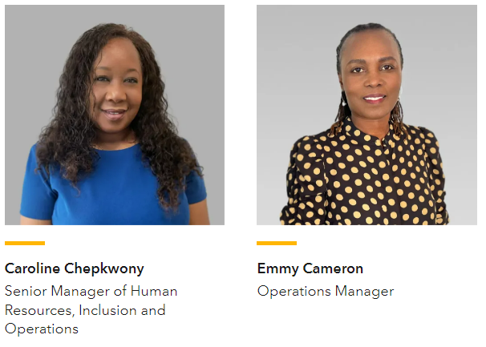
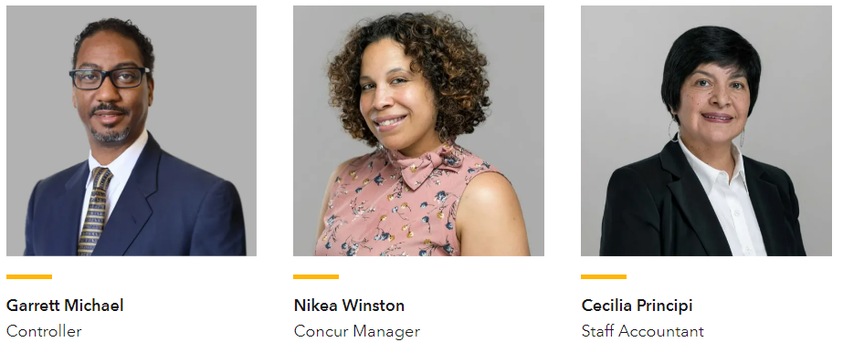
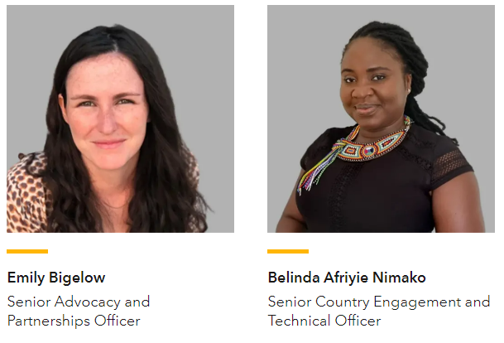
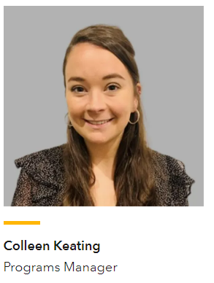
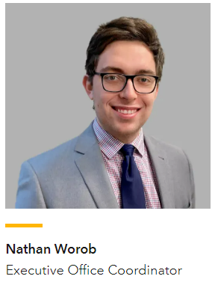
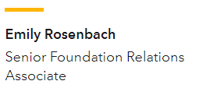
PAI Staff

Slide 15
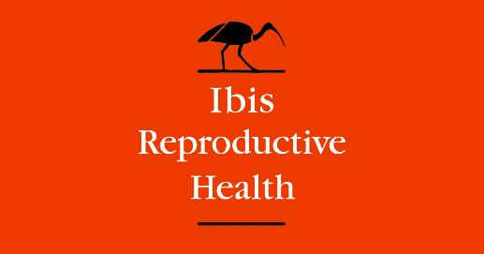
Peers, Partners, Friends

Slide 16
Thank you

