Slide 1



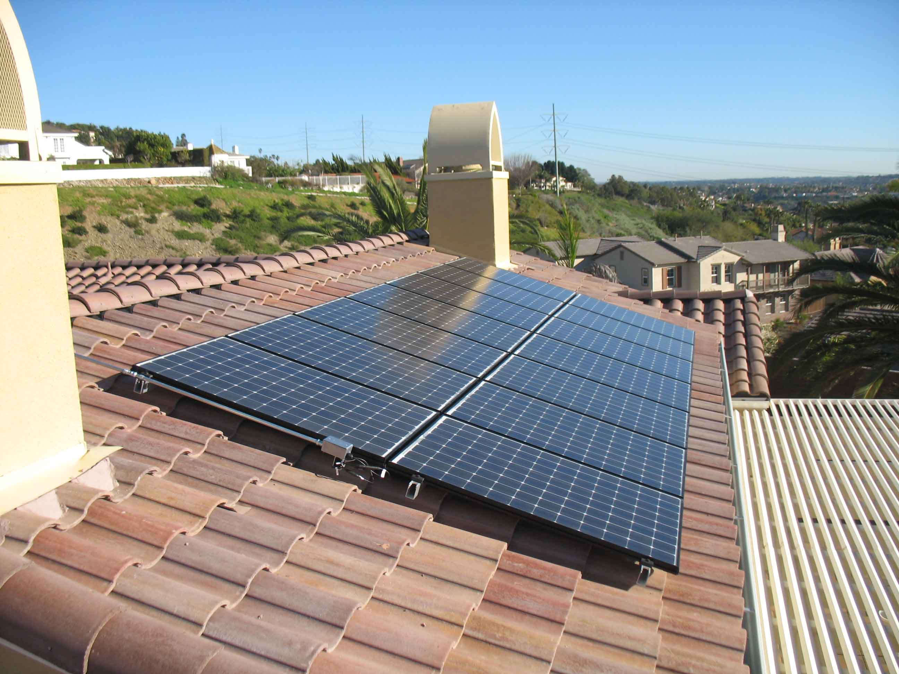
Marketing, Communications & Outreach Plan
EBCE Board of Directors
May 17, 2017

Slide 2

Goals & Objectives
  Provide clear, accurate, and easily accessible program information
  Establish the brand as trustworthy source with household recognition
  Maintain an opt-out rate below 10%
  Maximize opt-up rate
  Build brand awareness prior to program launch
  Deliver clear and transparent messaging regarding electricity rates

Slide 3

Key Challenges & Issues
  Key Challenges
    Undefined costs and rates
    Local job growth
    Lack of brand recognition
  Key Issues
    Trust
    Cost
    Value
Notes:
Undefined Costs and Rates: A program without final product rates will be more difficult to market versus a program with set rates. While estimated rates provide customers with an idea of cost savings, sets rates are more advantageous and transparent, especially since rates may only be slightly cheaper than PG&E at the launch of the program.
Local Job Growth: The term, “local job creation” gives the impression that EBCE will directly contribute to employment growth in the region. In reality, the program will contribute to indirect job growth through cost savings being absorbed back into the local economy and only a few thousand local renewable jobs. Being mindful not to oversell this benefit is important to maintain public expectations.
Lack of Brand Recognition: EBCE is a new program with no brand recognition within the area it will serve. Establishing the EBCE brand, and casting the brand in a positive light, will be a key challenge leading up to the launch of the program.
Our work with other operational CCAs has shown that additional concerns for many electricity customers include:
Trust—“What’s a government agency doing in the electricity business?” Focusing on the aspect of not-for-profit and community control has proven to be key to developing trust and surmounting initial suspicion.
Cost—“How much more will it cost me to buy greener electricity?” Looking issues of cost directly in the eye, even when it’s not necessarily to the program’s advantage (as may sometimes be the case) is always the best policy. Ultimately, honesty about these issues will earn trust in the brand.
Value—“I know that renewable electricity is better than fossil-fuel-based electricity, but if it costs more I’m not sure it’s worth it to me.” Addressing bigger-picture issues of the true cost of fossil fuels, while retaining relevance to the everyday concerns of people, requires a balanced strategic approach to communication.

Slide 4
Brand Evolution
  Develop a complete brand based on the existing logo
  Brand development will include:
    Brand story
    Guidelines for use
    Messaging framework
    Sub-branding naming options
      Sub-brands will convey appropriate “levels” per product

Slide 5

Target Audiences
General customers-at-large/existing PG&E customers
Multicultural audiences:
  Speakers of Spanish, Chinese, Hindi, and Tagalog languages*
Advocates, champions, and early adopters
*According to Data USA, nearly half (44.1%) of Alameda County’s residents speak a language other than English at home.
Seniors
Low-income residents
Solar customers
Commercial/business/industrial
Cities and chambers of commerce
Unincorporated areas
Neighborhood groups and HOA

Slide 6

Messaging
Overarching Messages
  Build trust for EBCE
  Focus on cost, value, and reliability
  Emphasize community, local control, and choice
  Feature environmental impacts and sustainability
Sub Messages
  Tailor messages for each target audience
  Develop messages in-language

Slide 7
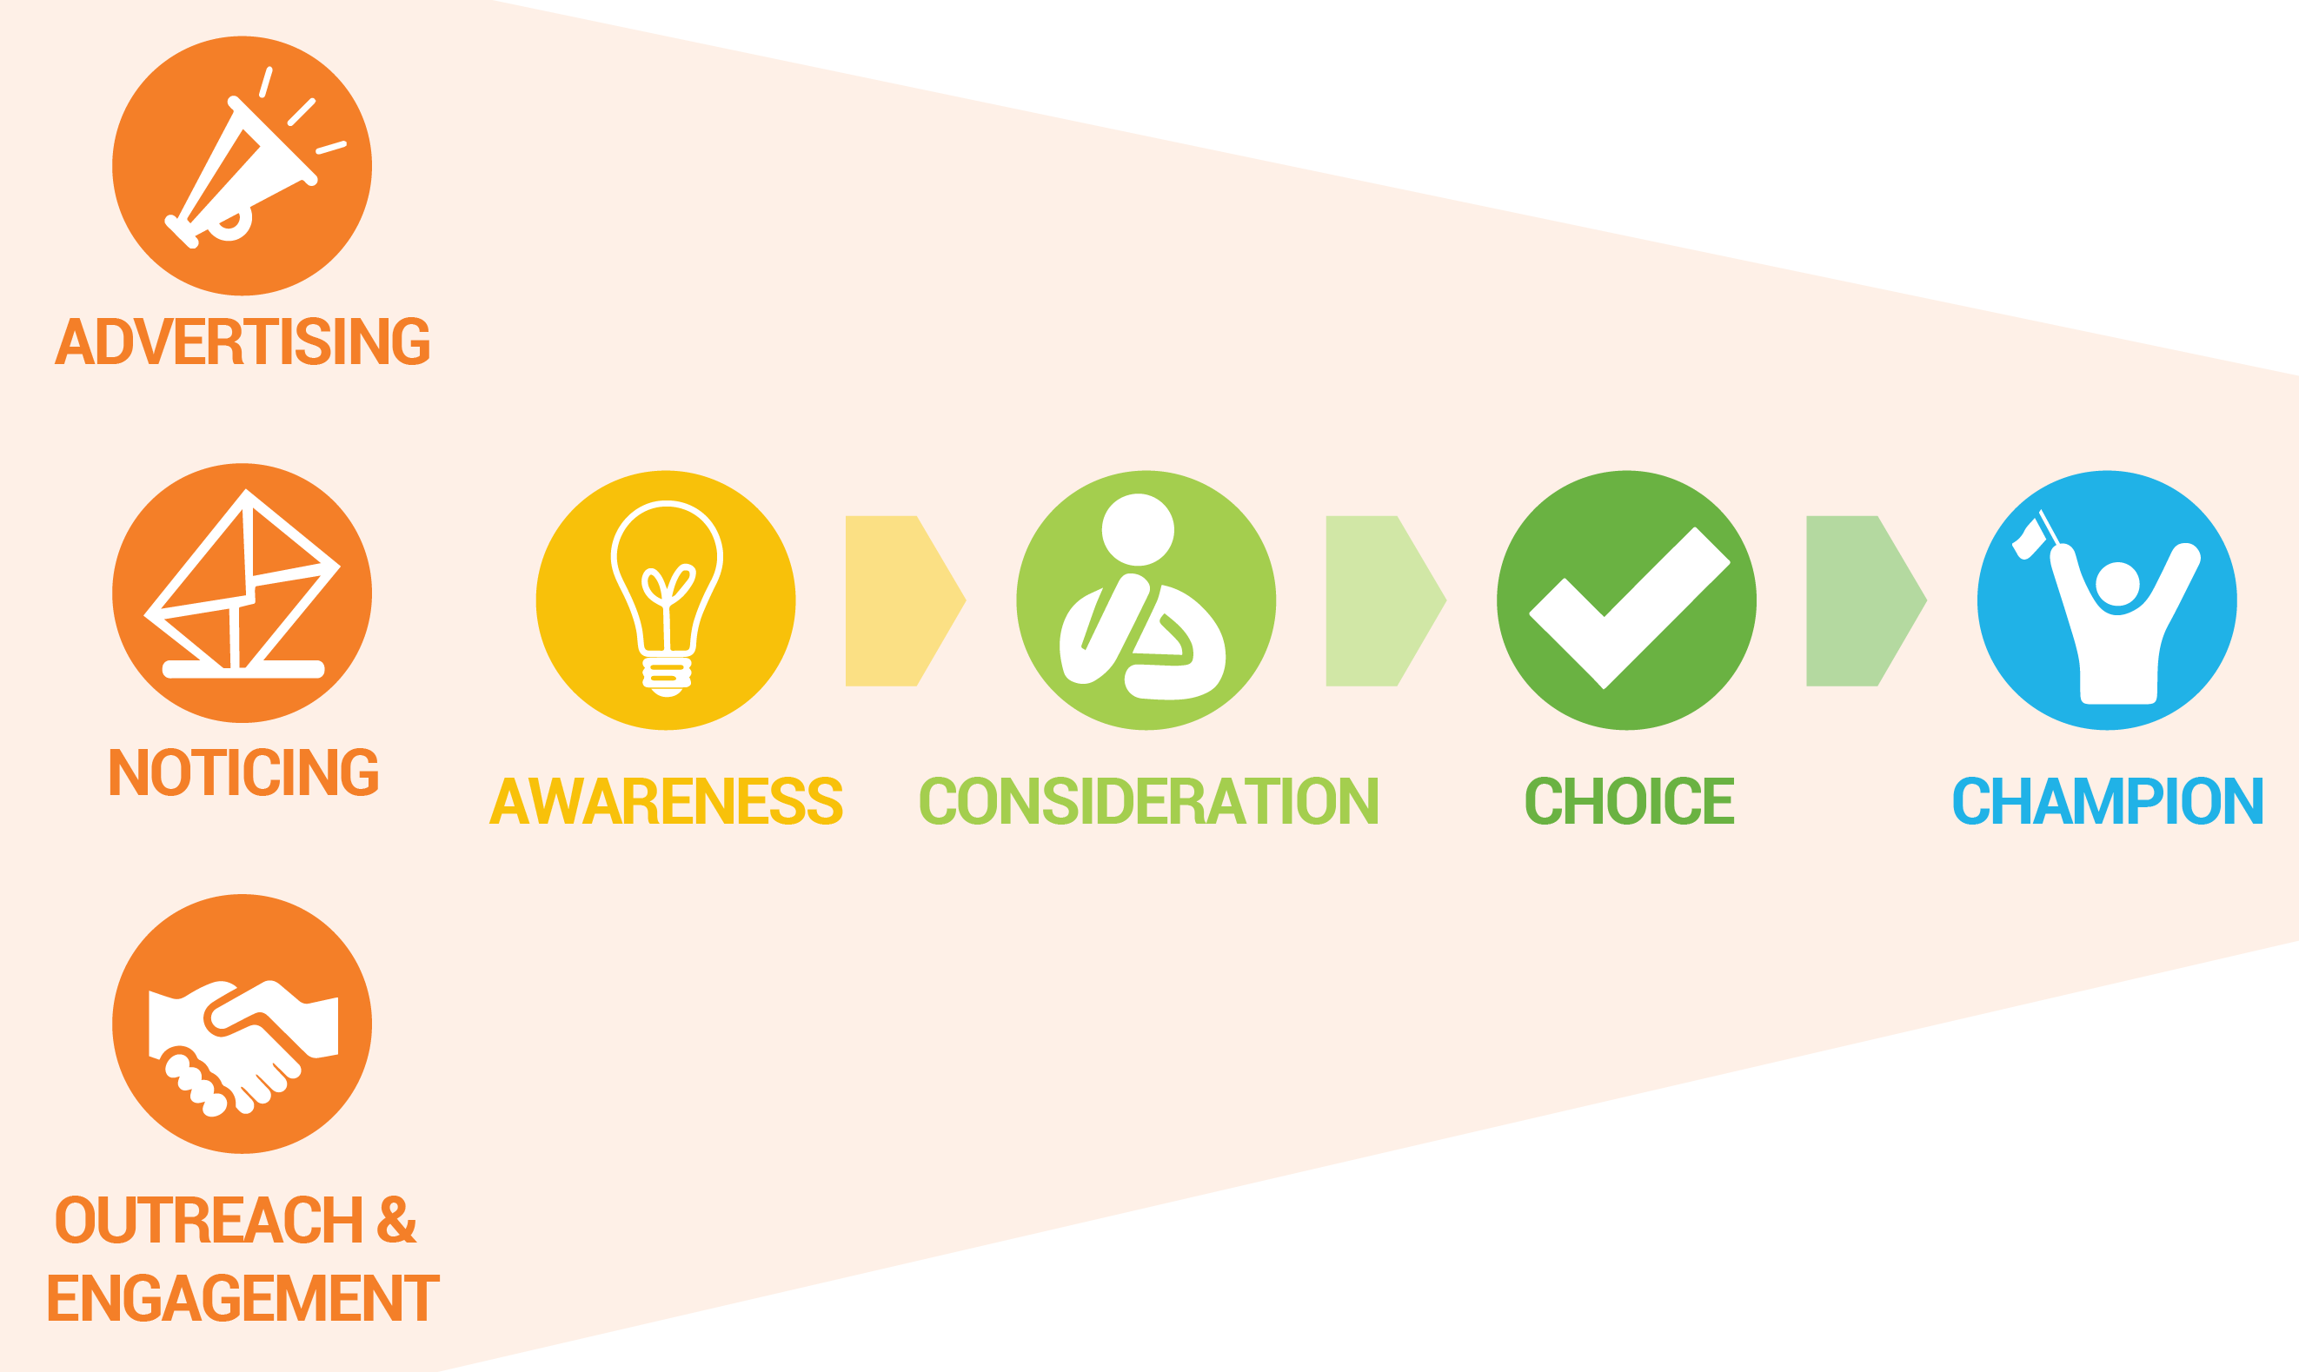
Communications Channels
Enhanced website
Print collateral
Social media
Email marketing
In-person events and outreach
Earned media
Advertising
Call center
Notes:
We see the board being involved with community meetings and events – meeting with local elected officials especially, helping us to create brand champions

Slide 8






Media Plan
Leverage a rich mix of media to reach a wide range of audiences
through their preferred channels*:
  Print
  Digital
  Social
  Outdoor/Transit
  Radio/Streaming music service
*Will include multi-lingual ads and outlets

Slide 9

Success Measurements
Residential opt-out rate
Business opt-out rate
Residential and business opt-up rate
Social media followers, conversations, engagement, and viral spread
Website traffic, usage, and patterns
Email sign-ups and engagement
Attendance at meetings and events
Advertising reach, impressions, and effectiveness

Slide 10
Upcoming Timeline
May
  Strategic marketing & communications plan
  Multicultural audiences plan
  Media plan
  Website audit and transfer
June
  Branding guidelines
  Sub-product names
  Website enhancements
  Collateral development
July
  Website additions
  Start community outreach and stakeholder engagement
  Develop pre-launch advertising campaign
  Establish social media presence

Slide 11
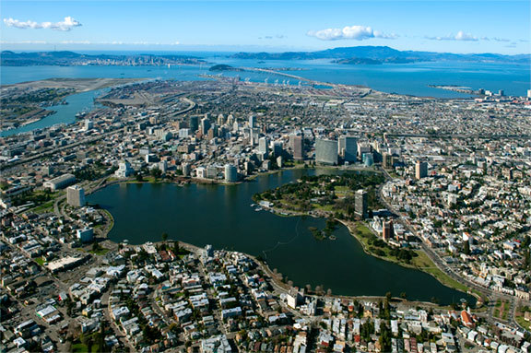
  Thank you!

