Slide 1

Communications Update
  Focus Groups
    Who:
      Members of the CAC, public, and key stakeholders
      Members of the Board or their City staff surrogates
    Why:
      Review draft energy product logo options
      Gather Board and CAC member opinions and insights
      Use input to inform final design selections
    When: Week of October 9, 2017
    Where: Alameda County offices

Slide 2
Communications Update
  Completed Activities
    Communications & Outreach Plan
    Branding Guidelines
    Draft messaging framework and product branding options
  Current Activities
    Email blasts
    Website content and design enhancements
    Advertising campaign concept development
    Media planning
    Program collateral
    Customer notification planning

Slide 3
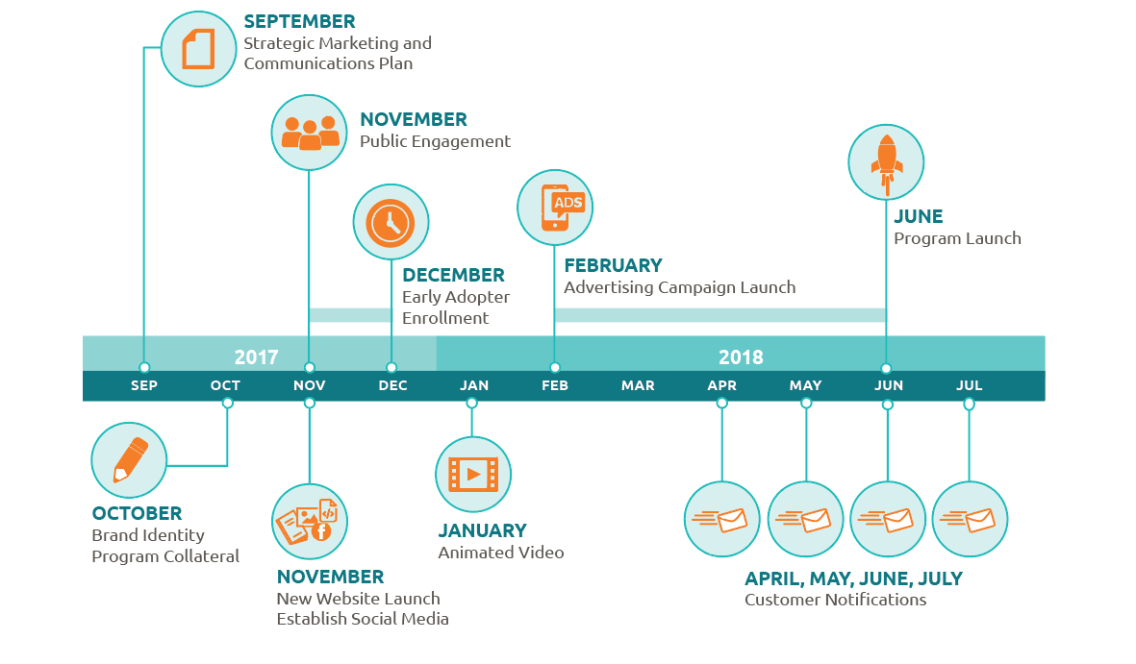
Communications Update

