Slide 1

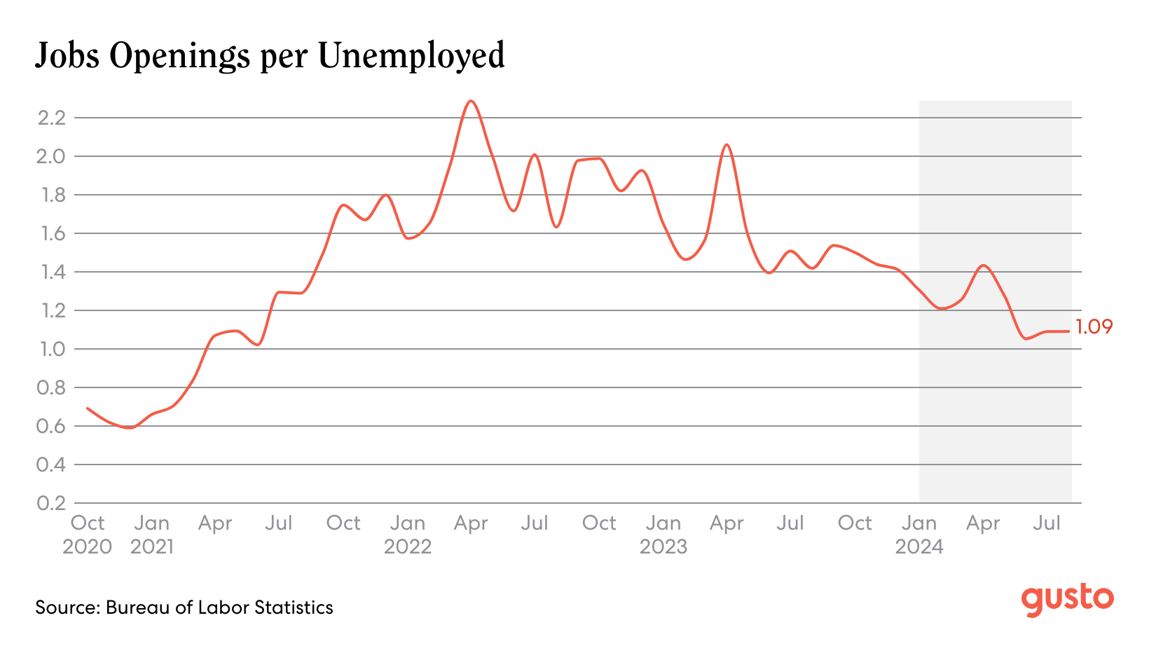
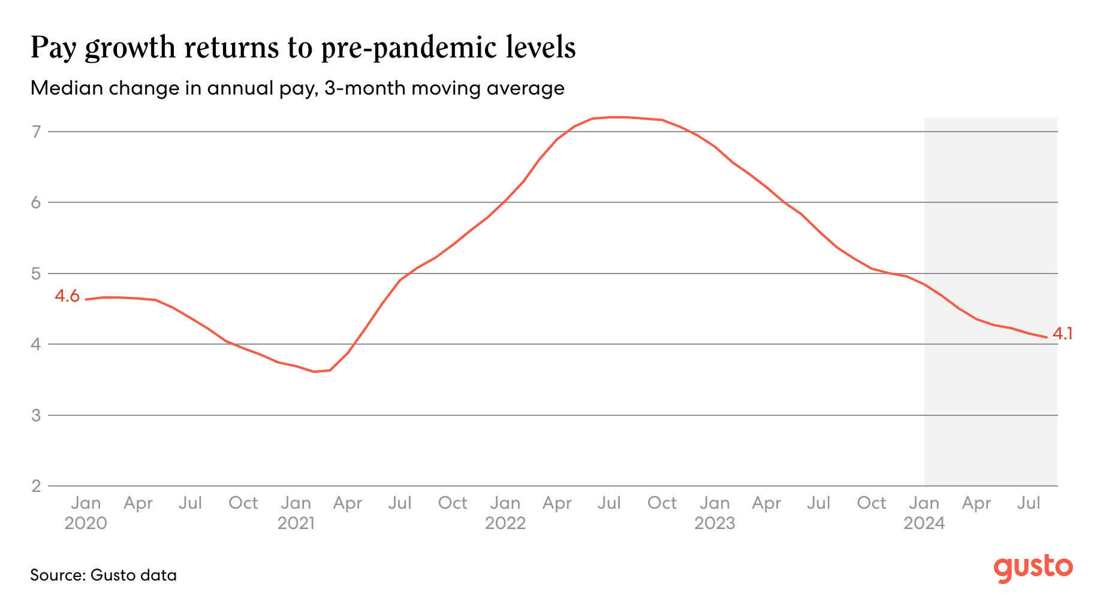

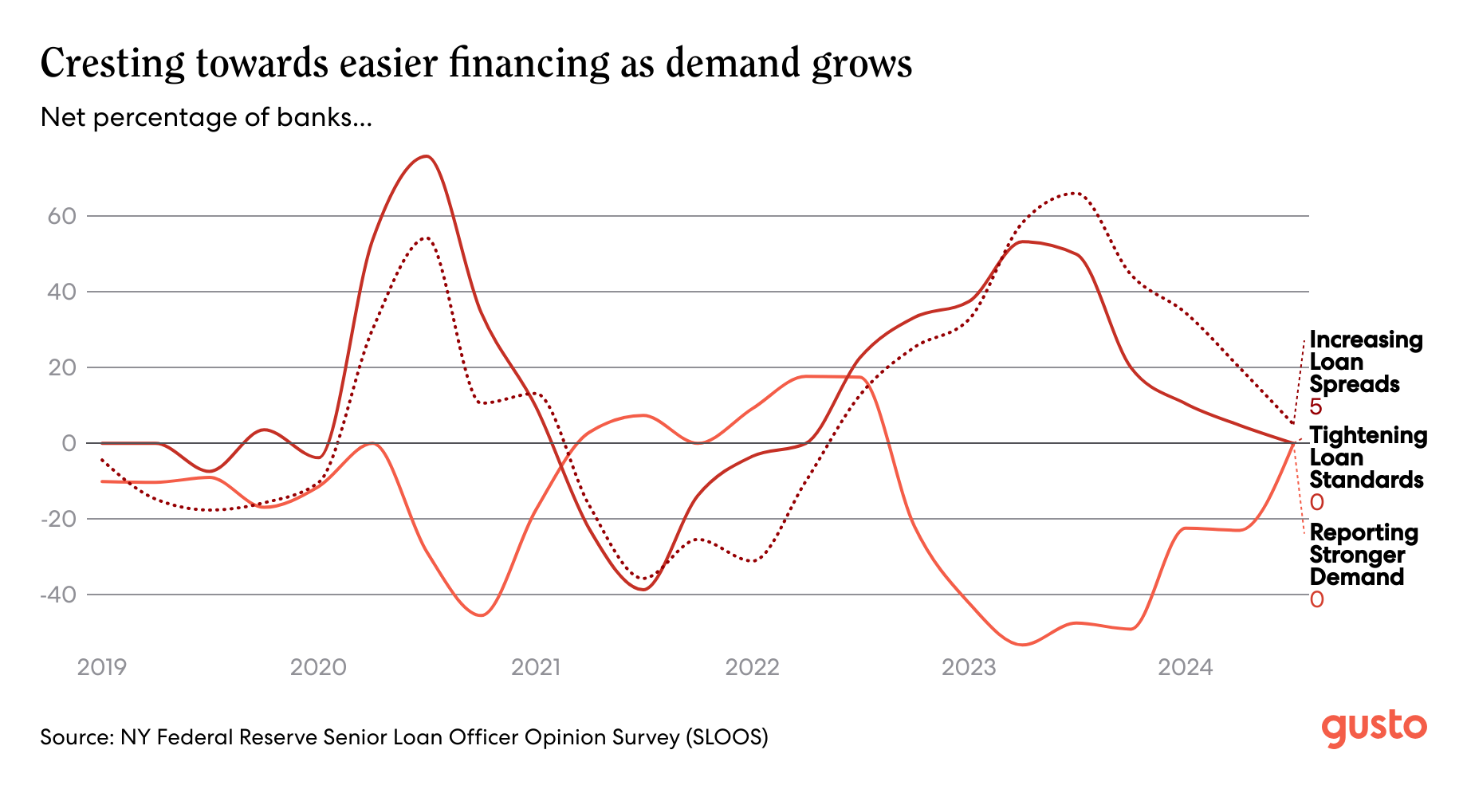
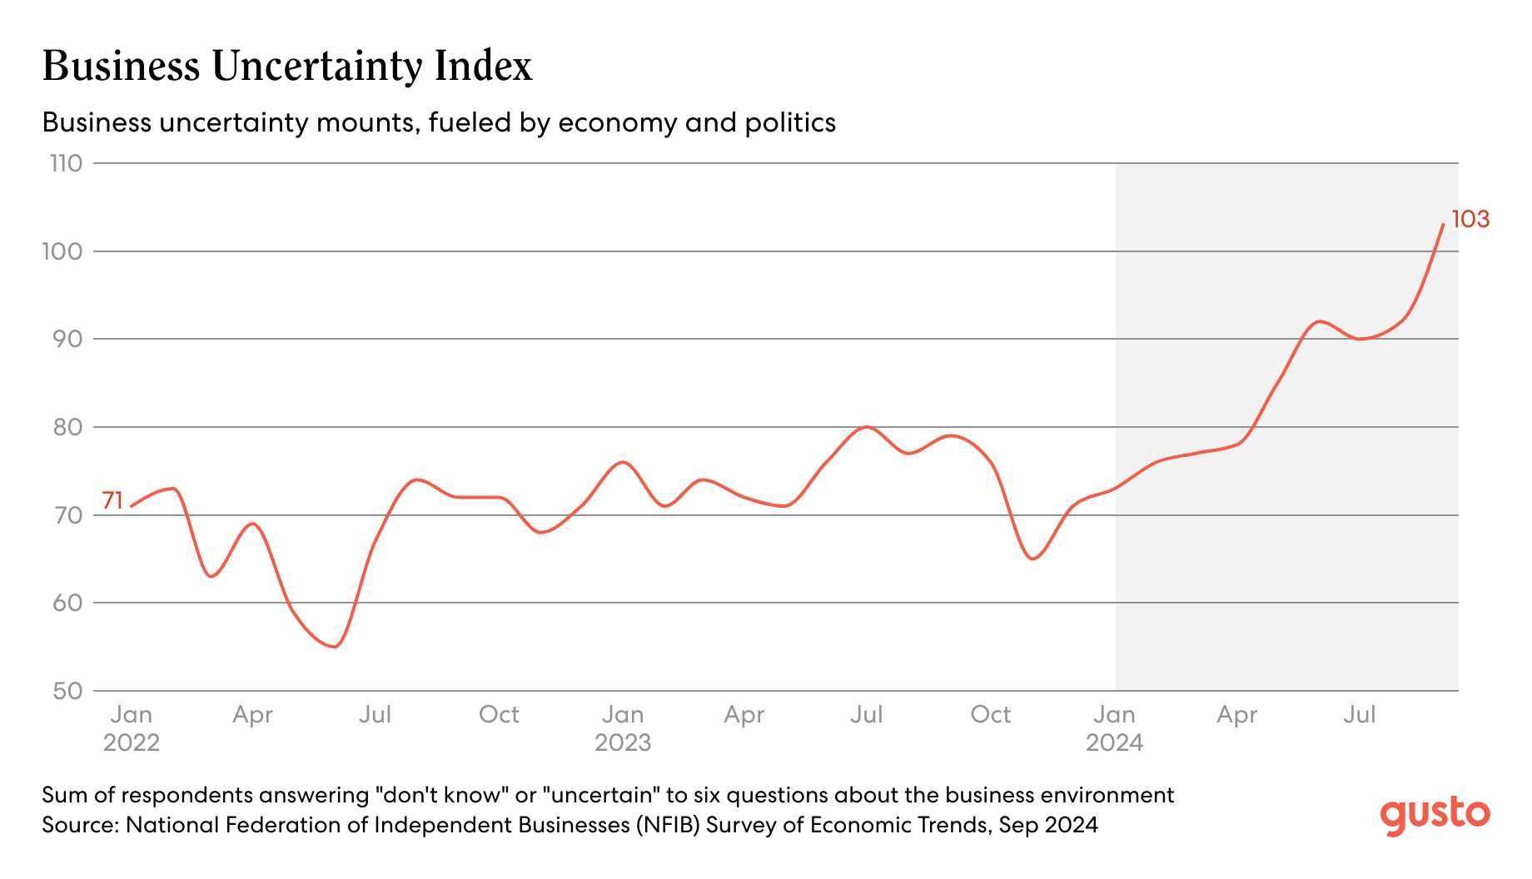
A strong economy looks to hold through year-end, with a solid labor market supporting household income and consumer spending. Despite good performance, many SMB owners have high uncertainty about the near-term future. Planning for multiple scenarios can increase the confidence to act on investments and other plans in 2025.
Labor market cooling continues, but with uneven progress
The gradual loosening of the labor market continues, as companies report finding better-quality candidates more easily in recent months. But, talent remains scarce in Midwest states as well as trades and specialized services. Moderate pay growth remains in the forecast, between 3-5% annualized.
Improving Optimism, high Uncertainty
SMB optimism has improved steadily over the last year. This should help spur a wave of SMB investments and growth in 2025 as interest rates drop. But, uncertainty has also risen, which impedes decision-making by companies nervous about what the future might hold.
Help businesses change recruiting strategies for hard-to-fill roles and areas. Recruiting widely can help fill talent pipelines. Many businesses rely solely on personal and professional networks.
Businesses will need to invest in productivity and efficiency to keep up with pay growth.
Engage in scenario-planning for multiple financial situations in the next six months to build confidence about strategic actions.
The Economy Explained, with
November 2024
Your quarterly download on the economy and what it means for your clients. Brought to you by Gusto’s team of economists.
Watch this quarter’s webinar
Headline
Trends to Watch
Metrics to Watch
Metrics to Watch
So what? Strategies for SMBs
This is not to be taken as tax, legal, financial, or HR advice. Consult an accountant, tax advisor or HR expert for specific guidance.
Have feedback? Email us at the-economy-explained@gusto.com

