Slide 1
STRATEGIC SECURITY RISK MANAGEMENT FOR PRACTITIONERS

Slide 2

“Risks are essential
elements of our culture”
“Prevention is
Better than cure”

Slide 3
CONT’D
Risk is inherent in all tasks, training, missions, operations, and in personal activities, no matter how the routine is.
Some risks are potentially dangerous to people while others can be threats to operations, procedures, systems, production and more.
The most common cause of task failure is as a result of human error, specifically the inability to consistently manage risk.

Slide 4
CONT’D
The most embarrassing moment of any core security professional or risk manager is being caught napping when an anticipated or unanticipated security breach occurs in their organization.
A security/risk professional should at times take a retrospective look at all the security measures put in place, and ask why things go wrong the way they happen.

Slide 5
CONT’D
Personnel/employees, companies and government agencies are exposed to operational risks ranging from ambushes, kidnapping to increased health issues, safety, and environmental pressures resulting from major accidents, negatively impacting the environment.
Since some of these risks are either caused by people, the processes or systems that they use, or external factors such as natural disasters, external frauds, ransomware etc., organizations need an operational security risk management program to mitigate potential risks.

Slide 6
CONT’D
So as professionals;
You are responsible for managing risk in all tasks in your organization.
While leaders at all levels are responsible for ensuring proper procedures are in place, and appropriate resources are available for personnel and employees to perform assigned tasks through the operational risk management process.
So this course will equip security practitioners with the strategic mindset, analytical competencies, leadership capabilities, and decision-making tools required to manage uncertainty proactively rather than merely reacting to crises.

Slide 7
THE FOCUS OF THE COURSE
To refresh the minds of security professionals, and to re-awake their consciousness in understanding and performing the task of mitigating risk.

Slide 8
Who is a Security Risk Management Practitioner?
A practitioner is a professional responsible for implementing security risk management policies, conducting assessments and advising management.
Examples include:
Security Managers
Corporate Security Officers
Risk Consultants
Intelligence Officers
Safety Managers
Business Continuity Officers

Slide 9
Practitioner Competencies
Every SSRM practitioner should possess:
Technical Skills
Risk Assessment
Incident Investigation
Security Auditing
Threat Analysis
Analytical Skills
Critical Thinking
Decision Making
Intelligence Analysis
Leadership Skills
Communication
Crisis Leadership
Stakeholder Engagement

Slide 10
Strategic Security Environment
Practitioners must understand:
Internal Environment
Organizational culture
Leadership
Resources
Policies
External Environment
Terrorism
Cybercrime
Political instability
Economic conditions
Climate change

Slide 11
Security Risk Management Framework
The Practitioner Framework
Establish Context
Identify Risks
Analyze Risks
Evaluate Risks
Treat Risks
Monitor Risks
Review
Communicate

Slide 12
Establishing the Context
Understand:
Organizational objectives
Risk appetite
Stakeholders
Legal requirements
Operating environment
Security Risk Identification
Sources of Risk
Terrorism
Kidnapping
Armed robbery
Insider threats
Cyber attacks
Fraud
Natural disasters

Slide 13
Risk Identification
Risk identification establishes the foundation of the entire assessment process.
The objective of a practitioner is to determine what could happen, how it could happen, and what assets may be affected.
Threat Intelligence Sources
Effective risk identification relies on credible information.
Sources include:
Security agencies
Intelligence reports
Industry advisories
Local community networks
Media monitoring
Incident databases

Slide 14

Risk Identification Techniques
Hazard Identification (HAZID)
Brainstorming
Root cause analysis
SWOT analysis
Interviews
Inspections
Observations
Evaluations
Asset data system
Each method, and the best to use will depend on the operations, mission, project and type of risks.

Slide 15
Threat Assessment
Threat Assessment answers:
Who is the threat actor?
Capability?
Intent?
Opportunity?
Target?
Threat Actors
Criminals
Terrorists
Employees
Competitors
Hackers

Slide 16
Vulnerability Assessment
Vulnerability refers to weaknesses that may be exploited.
Examples:
Physical
Broken perimeter fence
Technical
Weak passwords
Personnel
Poor staff screening
Procedural
Lack of SOPs

Slide 17
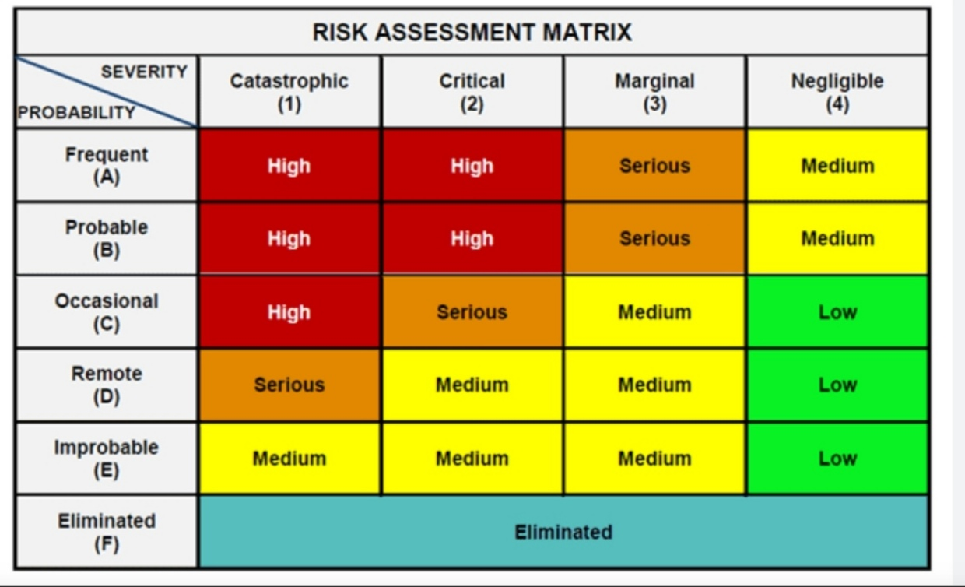
Risk Matrix
Use a Risk Matrix to prioritize risks.
High Likelihood + High Impact = Immediate action
Low Likelihood + Low Impact = Monitor
Risk Analysis
Risk = Threat × Vulnerability × Consequence
Analyze:
Likelihood
Rare
Unlikely
Possible
Likely
Almost Certain
Impact
Minor
Moderate
Major
Severe
Catastrophic

Slide 18
Risk Treatment Strategies
Following assessment, practitioners must determine appropriate treatment measures.
Risk Avoidance
Eliminating activities that generate unacceptable risk.
Risk Reduction
Implementing controls that reduce likelihood or impact.
Examples:
CCTV systems
Access control measures
Security awareness training
Security escorts

Slide 19
CONT’D
Risk Transfer
Shifting financial consequences to another party.
Examples:
Insurance
Outsourcing
Contractual arrangements
Risk Acceptance
Accepting residual risk where treatment costs exceed potential losses.
Acceptance should be formally documented and approved by management

Slide 20
Access Control
A practitioner must ensure that only authorized individuals gain entry to facilities, systems, and information.
Common measures include:
Identification cards
Visitor management systems
Biometric controls
Electronic access systems
Incident Reporting
A practitioner must know how write Incident report because facilitates timely response and organizational learning.
An effective reporting system should capture:
Nature of incident
Time and location
Persons involved
Immediate actions taken
Recommendations

Slide 21
Security Controls
Categories
Physical
Guards
CCTV
Fencing
Technical
Firewalls
Biometrics
Encryption
Administrative
Policies
SOPs
Security plan
Training
Personnel
Vetting
Awareness
Ethics

Slide 22
Intelligence in SSRM
Security intelligence supports:
Risk prediction
Threat monitoring
Early warning
Decision making
Sources:
Human Intelligence (HUMINT)
Open Source Intelligence (OSINT)
Signals Intelligence (SIGINT)
Social Media Intelligence

Slide 23
Open-Source Intelligence (OSINT)
OSINT refers to the collection and analysis of publicly available information.
Common OSINT sources include:
News platforms
Government publications
Academic research
Social media platforms
Corporate reports
Geospatial information
OSINT enhances situational awareness and supports evidence-based security decisions.

Slide 24
Developing a Security Risk Register
A security risk register serves as a central repository for identified risks and mitigation measures. Typical components include:
Risk | Threat | Vulnerability | Impact | Likelihood | Rating | Control Measures
Kidnapping | Criminal Groups | Predictable travel pattern | Severe | Likely | High | Route variation, tracking, escorts
Risk registers should be reviewed regularly to reflect emerging threats and operational changes.

Slide 25
Incident Response
The Practitioner should:
Prepare
Detect
Respond
Recover
Review
Example;
Following a ransomware attack, isolate affected systems, activate backups and investigate the breach.

Slide 26
Crisis Management
During crises practitioners should:
Coordinate teams
Communicate clearly
Protect lives
Protect assets
Restore operations
Example;
Managing a coordinated response during a terrorist attack on corporate facilities.

Slide 27
Security Performance Measurement
A practitioner must measure:
Incident reduction rate
Response time
Compliance level
Risk exposure index
Loss reduction
Recovery time
Employee security awareness

Slide 28
Conducting a Site Security Risk Assessment
A site security assessment should follow a systematic process:
Step 1: Define Scope
Identify facilities, personnel, operations, and assets under review.
Step 2: Identify Assets
Determine critical assets requiring protection.
Step 3: Identify Threats
Assess credible internal and external threats

Slide 29
CONT’D
Step 4: Identify Vulnerabilities
Evaluate weaknesses within existing security arrangements.
Step 5: Assess Risk
Determine likelihood and consequence levels.
Step 6: Recommend Controls
Develop practical mitigation measures.
Step 7: Report Findings
Present conclusions and recommendations to decision-makers.

Slide 30
Case Study
Scenario
A manufacturing company experiences repeated theft of raw materials.
Practitioner's Actions
Conduct threat assessment
Identify insider involvement
Review access controls
Install CCTV
Strengthen inventory controls
Train supervisors
Monitor implementation
Outcome:
Theft incidents reduce significantly, inventory accuracy improves, and operational losses decline.

Slide 31
Practical Case Study (Kidnapping for Ransom)
Strategic risks include:
Loss of investor confidence
Increased insurance costs
Reduced economic activities
Humanitarian concerns
National reputation damage
Strategic responses:
Intelligence sharing
Community policing
Technology deployment
Inter-agency collaboration
Local intelligence networks
Policy reforms
Socio-economic interventions

Slide 32
Conclusion
Strategic Security Risk Management is a continuous management process rather than a one-time security activity. Practitioner-level professionals bridge organizational strategy with day-to-day security operations by identifying risks early, assessing their potential impact, implementing appropriate controls, and continually monitoring the security environment.
An effective practitioner combines technical expertise, analytical thinking, leadership, communication, and ethical judgment to help organizations anticipate threats, minimize vulnerabilities, and strengthen resilience.
Ultimately, the success of SSRM is measured not only by preventing incidents but also by enabling organizations to achieve their objectives securely, sustainably, and with confidence.

Slide 33

08055999152

