Slide 1


BAGAKHANGAI–KHUSHIG VALLEY BRANCH RAILWAY PROJECT
www.mtz.mn

Slide 2

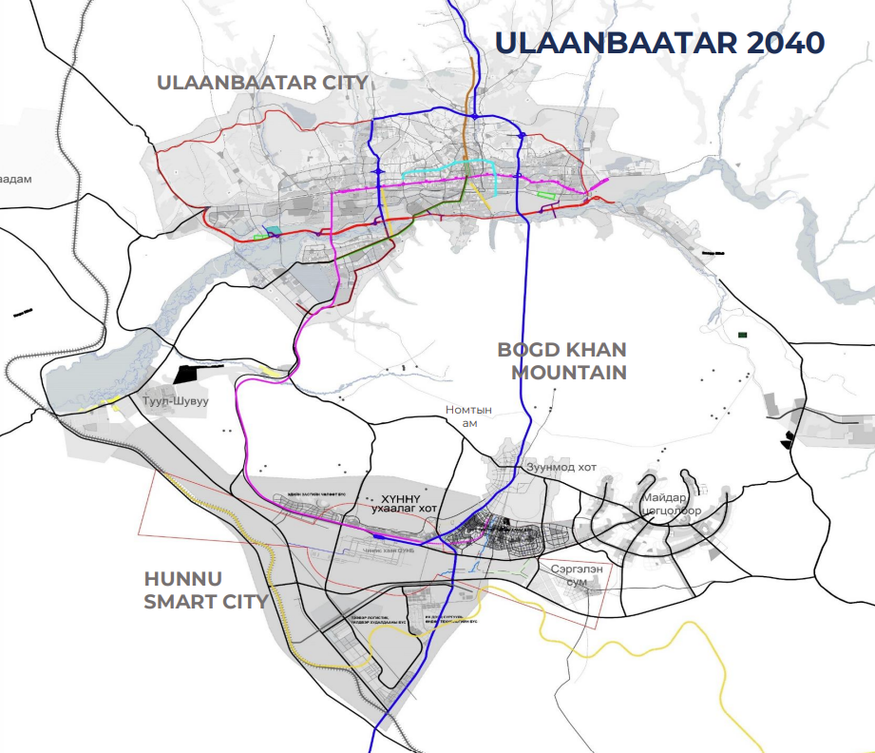
Rationale for Establishing KHUNNU City
Captial city
Population
2023
2040
1,725,000
2,086,000
Satellite city Population: 450,000
KHUSHIG VALLEY :
Planned population: 150,000 residents
Total land area: 31,501.3 hectares
Employment capacity: 80,000
Government administrative complex
Free economic zone
University campus
Integrated logistics center
International airport
Ulaanbaatar – Khunnu city expressway 62.0 km
Bagakhangai – Khushig valley branch railway 102 km
Light Rail Transit (LRT)
Mongolian railway company | BAGAKHANGAI–KHUSHIG VALLEY BRANCH RAILWAY PROJECT
2

Slide 3
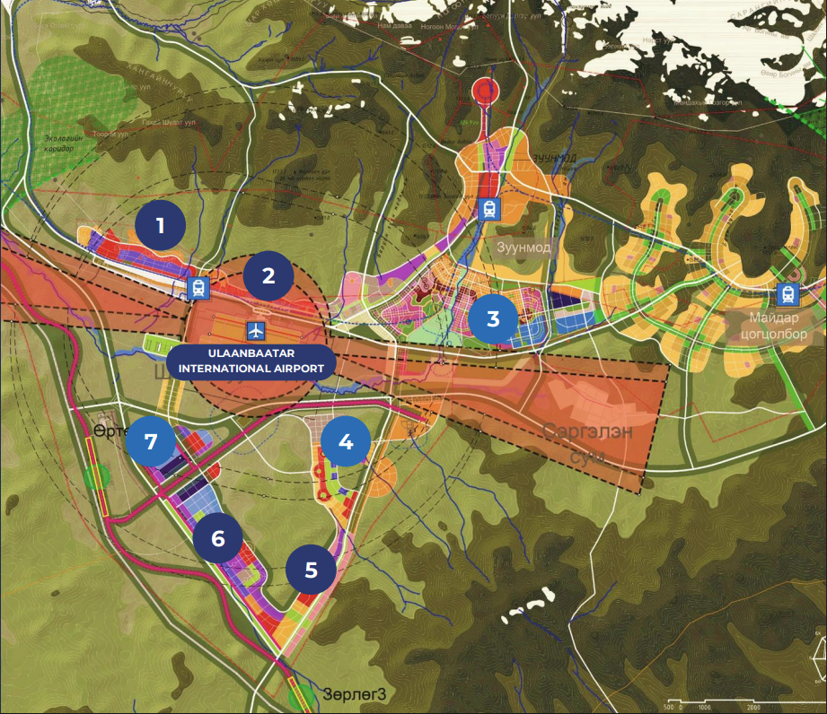
KHUNNU CITY MASTER PLAN
Mixed-Use zone: Free economic zone, Logistics hub, Business district, Residental area
Sustainable infrastructure: Green energy, Smart city system, Integrated transportation network
1. Free economic zone– 1,000 hectares
2. Business district– 700 hectares
3. Government administrative complex– 3,000 hectares
4. University campus– 506.7 hectares
5. Commercial zone – 500 hectares
6. Industrial zone – 1,019 hectares
7. Logistics zone – 1,019 hectares
Mongolian railway company | BAGAKHANGAI–KHUSHIG VALLEY BRANCH RAILWAY PROJECT
3

Slide 4
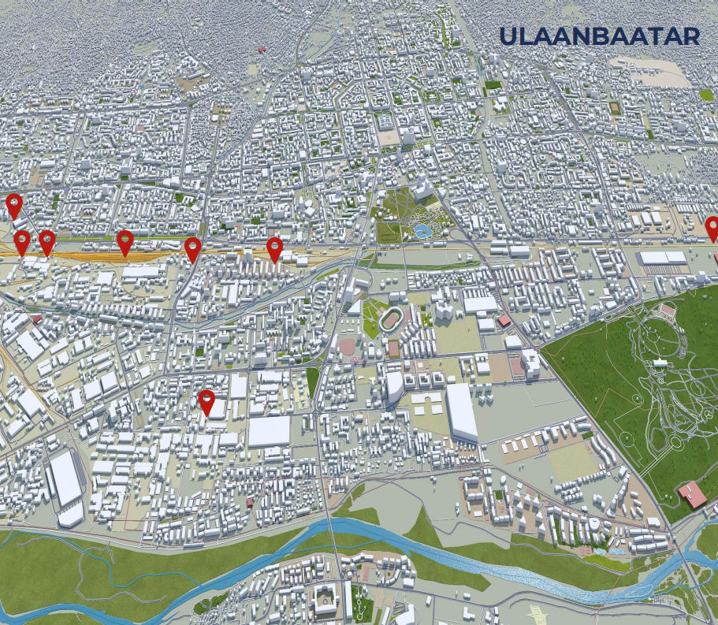
Current State of Logistics
Freight Forwarding Market: Over 300 freight forwarding companies registered, with 60 companies actively operating.
Rail Infrastructure: The Ulaanbaatar station /UBTZ/ network comprises a total of 59 different side railway lines.
Operations: 9 enterprises operate across 10 types of loading and unloading terminals at 2 main stations.
Total Railway Area 27.2 hectares (ha)
Total Railway Line Length 10.1 km
Total Terminal Area 132 hectares (ha)
Annual handling capacity 2.4 million tons per year
Wagon Capacity 186 wagons
Low efficiency and high operational costs.
Manual container sorting and limited wagon distribution lead to high unit costs.
Incomplete implementation of equipment at loading and unloading terminals.
40% of unloaded cargo is redistributed back to regional areas.
Mongolian railway company | BAGAKHANGAI–KHUSHIG VALLEY BRANCH RAILWAY PROJECT
4

Slide 5
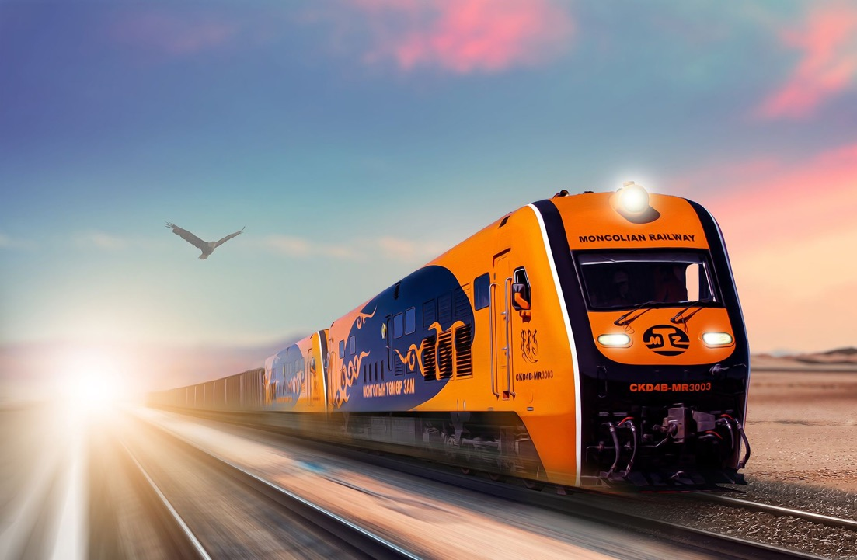
BAGAKHANGAI-KHUSHIG VALLEY BRANCH RAILWAY PROJECT
PROJECT RATIONALE
Within the framework of the goals and directions for developing the national railway transport and logistics system as outlined in the "Vision-2050" Long-term Development Policy of Mongolia and the Action Program of the Government of Mongolia for 2024-2028, the following Government Resolutions were issued: Resolution No. 229 dated December 25, 2024; Resolution No. 21 dated January 14, 2025; and Resolution No. 86 dated February 12, 2025. These resolutions mandated "Mongolian Railway" SOSC to be responsible for the construction and operational management of the Bagakhangai-Khushig Valley branch railway.
PROJECT SIGNIFICANCE
With the implementation of the project, a cumulative volume of 3.5 to 20.0 million tons of freight per year will be transported to the newly built Transport and Logistics Center in Khushig Valley. This will reduce the average daily road closure time of 144 minutes at railway and road intersections in Ulaanbaatar by 21 to 120 minutes.
PROJECT OVERVIEW
The project branches off from the Bagakhangai station and extends 102 km to the Khushig Valley. According to the MNS 6229:2021 standard for general technical requirements of railway superstructure, a 1520 mm gauge track with 25-meter jointed rails will be constructed.

Slide 6
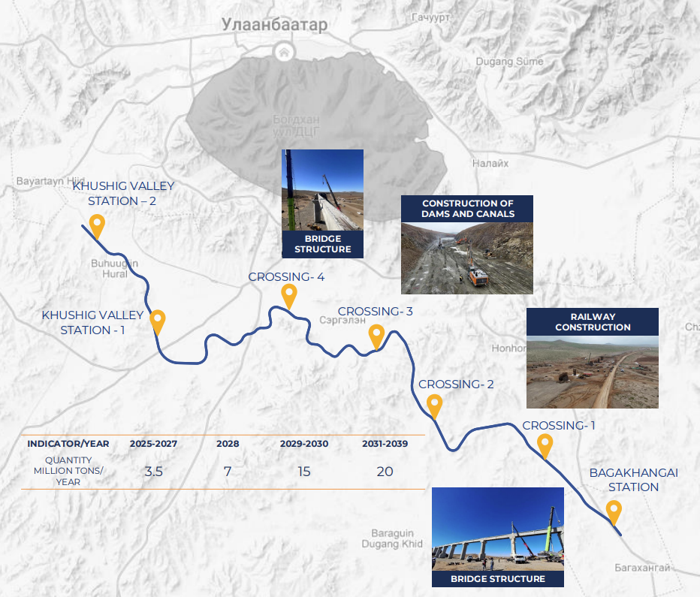

Bagakhangai-Khushig Valley branch railway
Project Phase I
Bagakhangai station and extends for a total of 87.54 km to the Khushig Valley.
Project Phase II
It extends for a total of 15.0 km from the Khushig Valley to Shuvuun Fabric.
Project plan
Total length of the railway: 102.5 km
Mongolian railway company | BAGAKHANGAI–KHUSHIG VALLEY BRANCH RAILWAY PROJECT
6

Slide 7
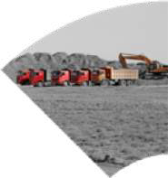
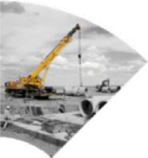


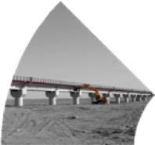

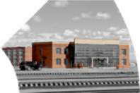
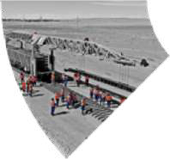
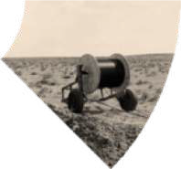

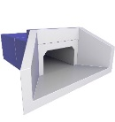
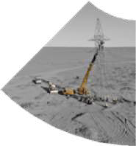
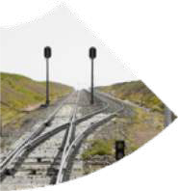
PROJECT PHASE I: WORK PROGRESS
PK 0 – 87.8 KM
EARTHWORK
REINFORCED CONCRETE PIPE
Contractors: 39 companies
Total Work Volume: 16.4 million M³
Current Progress: 96.23% /15.7 M3 /
Contractors: 33 companies
Pipe culverts – 61 units
Work progress: 88.30%
PROJECT PROGRESS
REINFORCED CONCRETE BOX CULVERTS
BRIDGE
Contractors: 15 companies
Box Culverts: 22 units
Work Progress: 75.77%
Contractors: 10 companies
5 locations, 652 meters
Work Progress: 91.6%
A total of 63 domestic enterprises, 2,748 engineering and technical personnel, and 1,453 units of machinery and equipment are engaged in the project.
Overall Project Progress
89.39%
Mongolian railway company | BAGAKHANGAI–KHUSHIG VALLEY BRANCH RAILWAY PROJECT
12

