Slide 1
Global Climate Models
Week 6 – July 27th, 2020

Slide 2
Announcements
Lab #4 Due Sunday, August 2nd to Canvas
  Due date is always flexible, just let me know if you need more time and I’ll happily grant any extensions! ☺

Slide 3
Lecture Readings
Chp. 7 in textbook – dense; check out the note on the next slide about readings for this Chapter in your textbook!
Climate Rage Naomi Klein (2009) – PDF on Canvas
What the Queer Community Brings to the Fight for Climate Justice Aletta Brady, Anthony Torres, and Phillip Brown (2019) (https://grist.org/article/what-the-queer-community-brings-to-the-fight-for-climate-justice/)
Climate Justice is Racial Justice Abeer Almahdi (2019) (http://www.mcgilltribune.com/climate-justice-is-racial-justice/)
The non-textbook readings for this week are meant to give you head start on the topics of next week. Please complete them this week, but we will engage with them fully in the discussion for Week #7

Slide 4
A quick word about Chp. 7
This is a dense chapter and we do not cover all materials presented in the textbook here in lecture. I will go over the main points discussed in Chp. 7 as listed in the Lecture Outline in the next slide.
This week focus heavily on the readings assigned to you, and read over the parts in the textbook that I also go over here – but don’t spend too much time on the nitty gritty details in Chp. 7. These sets of slides will be light given the increase in reading and the amount of different activities you need to complete for Lab #4.
Alright….let’s go!

Slide 5
Lecture Outline
Intro to Global Climate Models (the basics)
  Momentums and prognostic variables
  Time steps and forward modelling
  Errors and temporal scale
  Construction and Evaluation – we will skip these sections from the textbook (these are the details referred to on the previous slide)
Applications
  Paleoclimate studies – you’re experts on those now! ☺
  Detection and attribution – HUGE when it comes to anthropogenic climate change

Slide 6
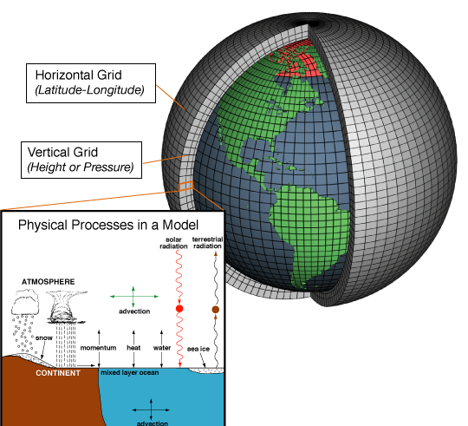
Global Climate Models
So what is a GCM? They’re models that track the exchange of energy momentum and matter between boxes
You need a few things in the model – specifically, prognostic variables (e.g. temp), and 3 momentums are calculated per box (zonal, meridional, and vertical)
  Think of these momentums as the rate of change from those three different axes (zonal is latitude, meridional is longitude, and vertical would be the Z axis)
Flux between the boxes at each time step updates the prognostic variables (forward modelling) without observations – i.e. temperature is modeled across the boxes based on the momentums and the starting condition

Slide 7
Global Climate Models
Top and bottom boundary conditions are important when modeling (you need to know what’s going on at the surface and what’s going on in the atmosphere aloft)
Bias and error lead to discrepancies in model predictions and observations
Model variables must be of similar/compatible scales (both spatially and temporally)
Hyper-fine time series data often leads to model errors, but hard to exclude (e.g. clouds)

Slide 8
And that is literally as deep as I can go for this class in fine detail about GCMs – I would love to spend more time in exactly how the calculations are constructed and which variables matter most, and when/where, etc. However, we just don’t have time in 10 weeks to go that deep. If you’re interested in learning more about specifically how climate models are used or how they vary (e.g. how does one model differ from the next?), I encourage you to check out the upper level course on weather and climate that I teach (GEOG 314 – alternating winter terms, may increase in frequency based on enrollments).

Slide 9
Applications
Paleoclimate studies are often a big part of global climate modeling
Reconstructed climates are great ways to evaluate (don’t worry this is as deep as we’ll go!) the skill with which the GCMs are predicting unknown climates.
IF the GCMs recreate similar climate models as those created via paleoclimate reconstructions, then climate scientists can have confidence their GCMs have been constructed well
Additionally, when combined with GCMs, these two types of climate modeling can provide information both into the past and forward into the future

Slide 10
Applications – Paleoclimate Studies
Comprehension Check!
Go back over Week 3 lecture slides and find a paleoclimate proxy we learned about. If I was a climate modeler interested in comparing my GCM with reconstructed climate of the past 10K years, which kinds of proxies would I hope to have in that reconstruction? What type of radiometric dating might I be expected to use given that time frame?

Slide 11
Detection and Attribution
This approach to research global climates first looks for something unusual in the system (the detection)
  This can be anything – anomalously high global temps, for example
The second step in the process is to determine which climate forcing agents are responsible for that detection.
  Solar radiation spikes?
  Increased greenhouse gas concentrations?
  Aerosol release?
  Etc….
It’s not hard to see why these types of studies are hot right now – it’s harder and harder to ignore or deny the existence of the detections nowadays (e.g. each year we break a top 10 global temp record). Now, we’re all extremely interested in determining why we see the changes we’re seeing.

Slide 12
Detection and Attribution
Check out this study, which produced these key figures in the most recent IPCC report
The primary thing to focus on are the series of three global maps stack on the right hand side.
  Notice how much warming you would expect under natural (non-human caused) forcing, versus what we’re seeing from the observed trend.
  It’s quite clear the forcing agents involved are anthropogenic and we can attribute the detections to human origins.

Slide 13
Ok! That’s all for now! Interest piqued on GCMs? Email me with more questions if you have them!
Check out the next few slides for more info and an exercise on plotting climate data from NOAA/NCEI if you’d like to explore more!

Slide 14
NOAA Climate Models
https://www.climate.gov/maps-data/primer/climate-models
Check this link out and the data plotting exercise on the next slide for deeper learning!
Most importantly read up on what GCMs are and refresh what you’ve read in Chp. 7 of your textbook. BUT, don’t worry about grasping all of this in fine detail – it’s complicated and you can get entire PhDs in this material! It’s most important you get the basics, which is what I’ve covered here in this set of lecture slides. If you want to dig deeper, I encourage you to explore the links I provide here and from the textbook. Or…reach out via email, I’m always ready to talk climate change!

Slide 15
NCEI (remember, this is the “new” NCDC)
https://www.ncdc.noaa.gov/cag/national/time-series
Plot avg temperature, precipitation, and PDSI for July in the US for the entirety of NOAAs available record (for each parameter) using trend lines. Notice patterns for each parameter on a national scale. Pick the one with the strongest climate change signal, and report on it in detail.
Here’s an example plot for Sept temp…

Slide 16
Links to Check Out!
The Open Science Climate Lab Book by Ed Hawkins
  http://www.climate-lab-book.ac.uk/
The Nature Conservancy – all around awesome organization. I’ve been lucky enough to work with some folks from the Florida branch while working on my PhD. This is a great bookmark for your browser on all things environmental!
  https://www.nature.org/en-us/
Inland Northwest Land Conservancy – a new group for me! I’m not from this area and I’ve recently discovered this organization. It’s orgs like these that facilitate the connection between the research on the front lines and the community that experiences it all.
  https://www.inlandnwland.org/

Slide 17
Looking Ahead…
Next week we delve into the specific impacts of climate change we have already experienced across the Earth
We’ll begin to explore Chp. 8 in our textbook and circle back to the readings you are completing for this week

