Slide 1
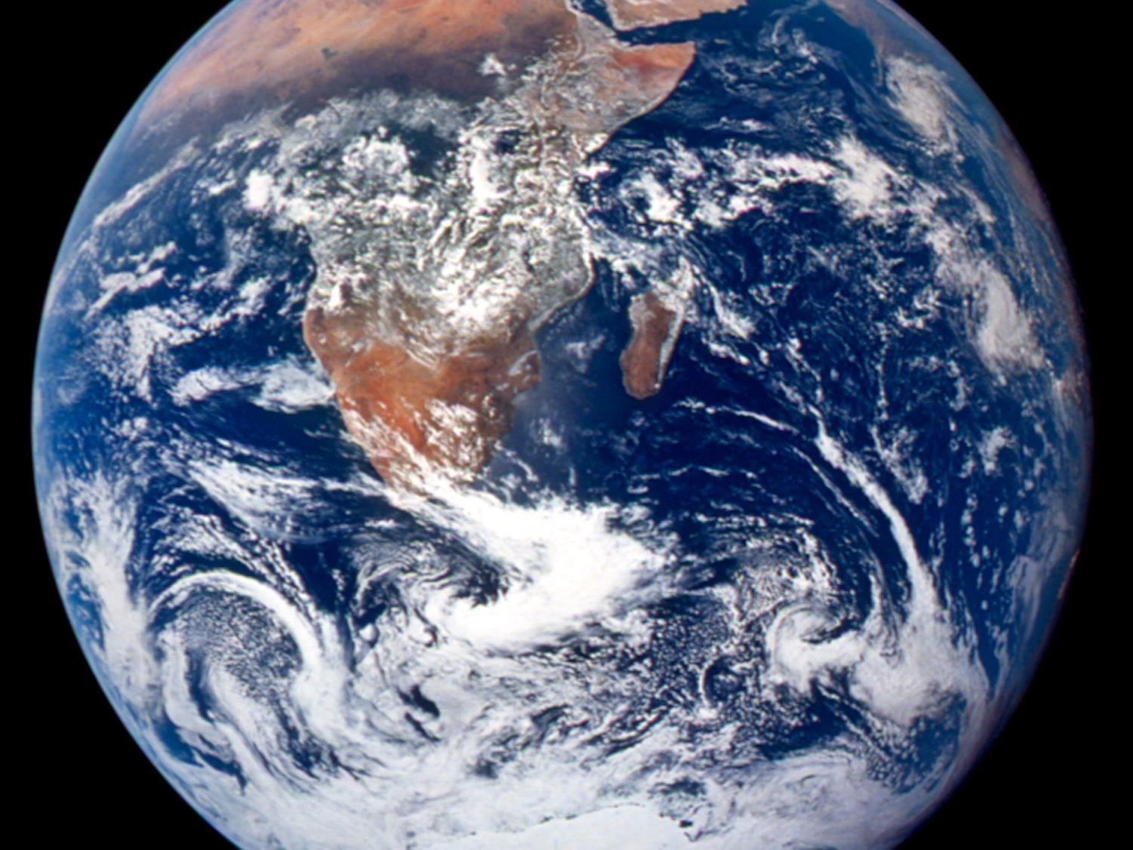
PROCESSES
Week 5 – July 20th, 2020

Slide 2
Announcements
Lab #3 is due Sunday, July 26th by midnight

Slide 3
Lecture Outline
Introduction to the atmosphere (atm)
Basics of energy
Heat and Controls on Temps
Atmospheric (atm) pressure
Forces Controlling Global Winds
Atmospheric Circulation
This lecture slide is dense. It’s best to review these slides in tandem with Chp. 6 in your textbook.

Slide 4
Readings With Lecture
Week 5 Readings Include:
  Chp. 6 in textbook

Slide 5
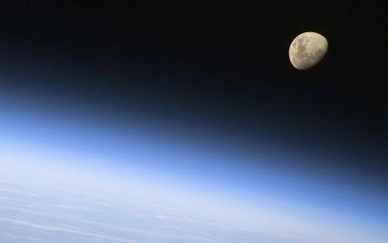
Atmospheric Profile
Earth’s atmosphere is composed of “shells” held to the planet by gravity.
Classified by:
  Composition
  Temperature
  Function

Slide 6
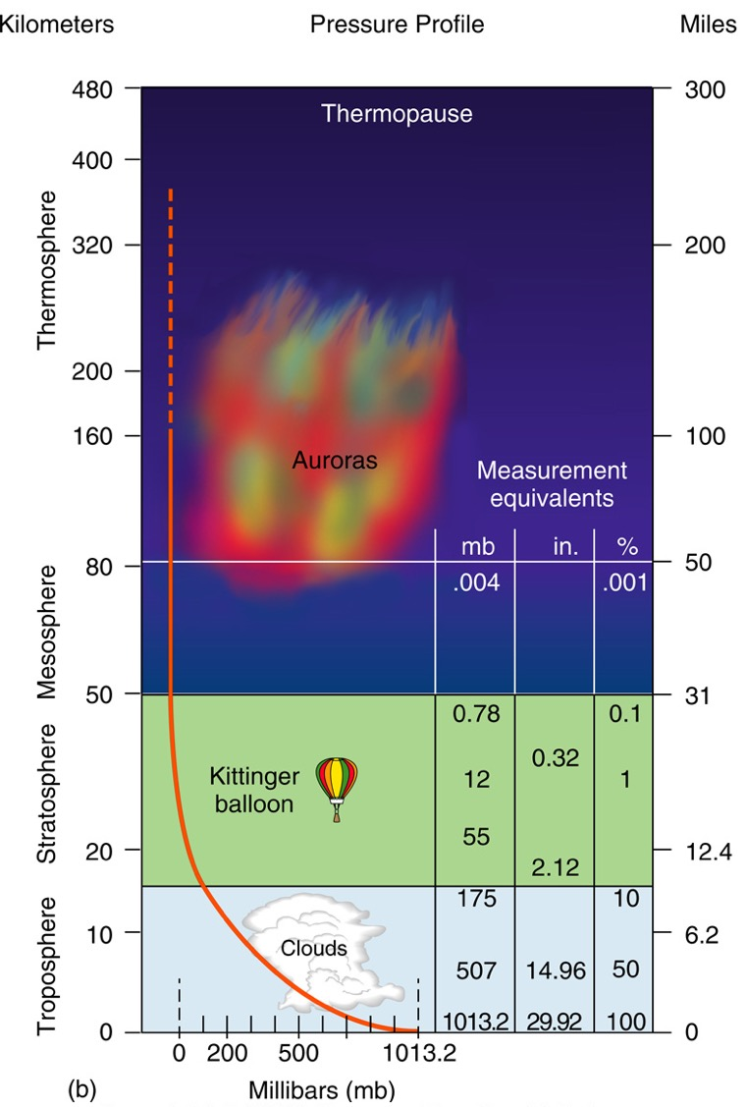
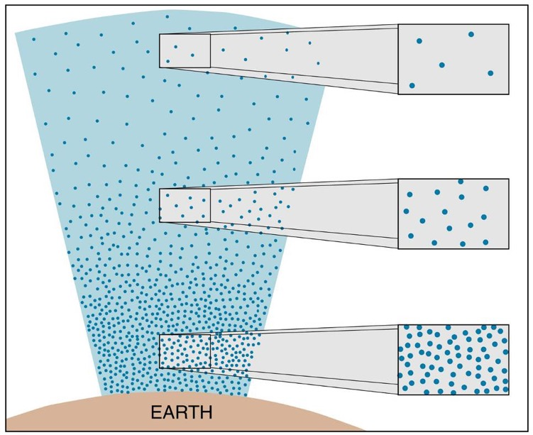

Slide 7
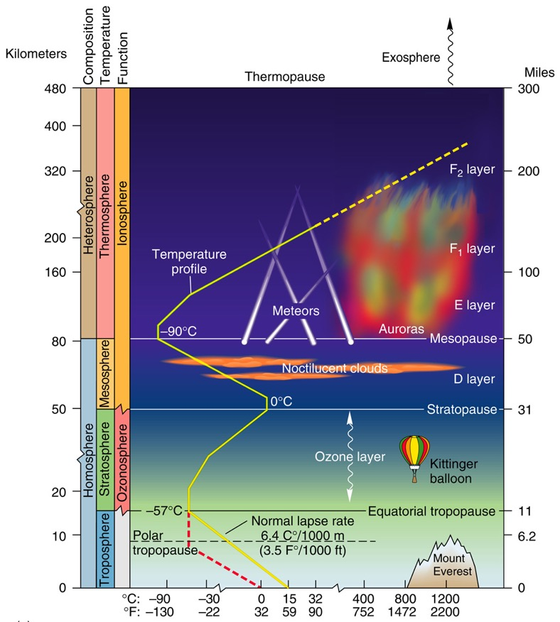
Atmospheric Temperature Criterion
Four distinct temperature zones
  Thermosphere
  Mesosphere
  Stratosphere
    Ozone here!
  Troposphere
    Weather here!
    Most mass in atm here!

Slide 8
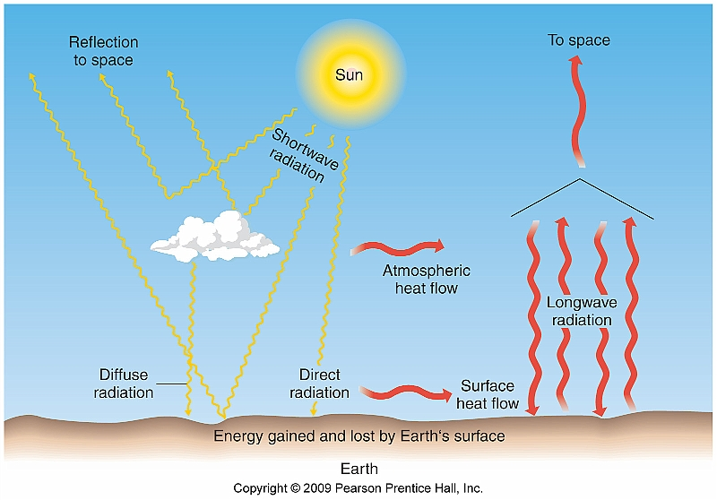
Energy Pathways and Insolation
Passage of shortwave and longwave energy through either the atmosphere or water is transmission

Slide 9
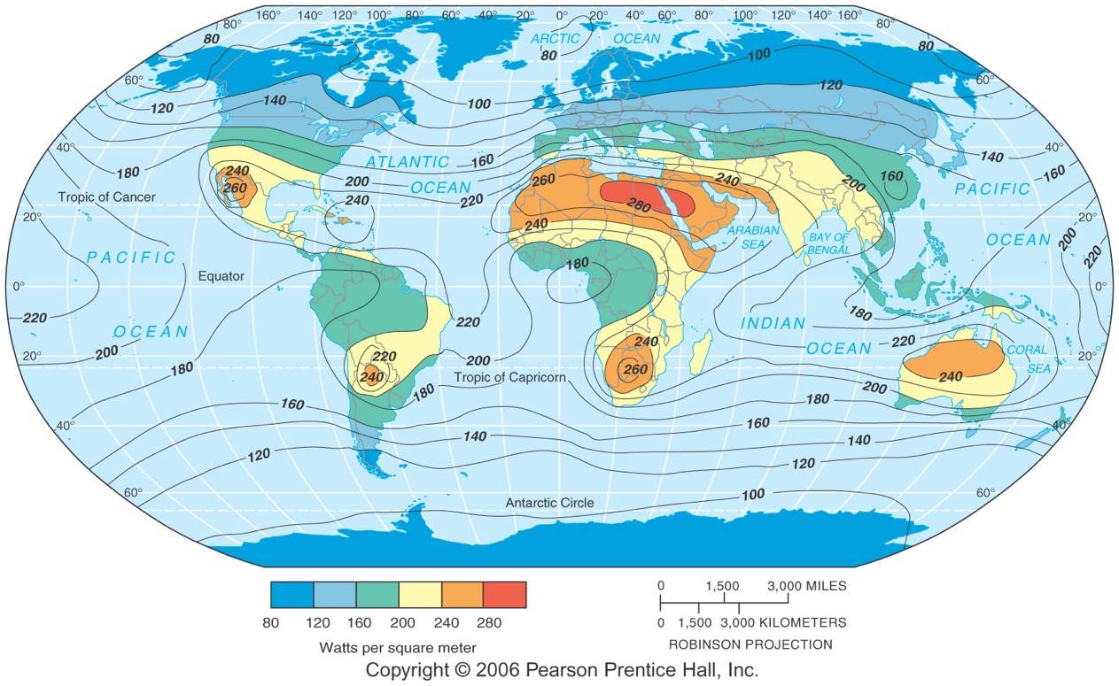
Insolation at Earth’s Surface
Notice the highest locations are about 30°N and S. These are often also places of intense aridity.

Slide 10
Insolation Input
Four ways incoming energy is transmitted:
  Scattering
  Refraction
  Reflection
  Absorption

Slide 11
Scattering (Diffuse Radiation)
Scattering - The molecules change the direction of the insolation without changing the wavelength.
Diffuse radiation is the downward component of scattered light

Slide 12


Rayleigh Scattering
The shorter the wavelength, the greater the scattering
On the visible light spectrum, which color is the shortest wavelength? The longest?

Slide 13
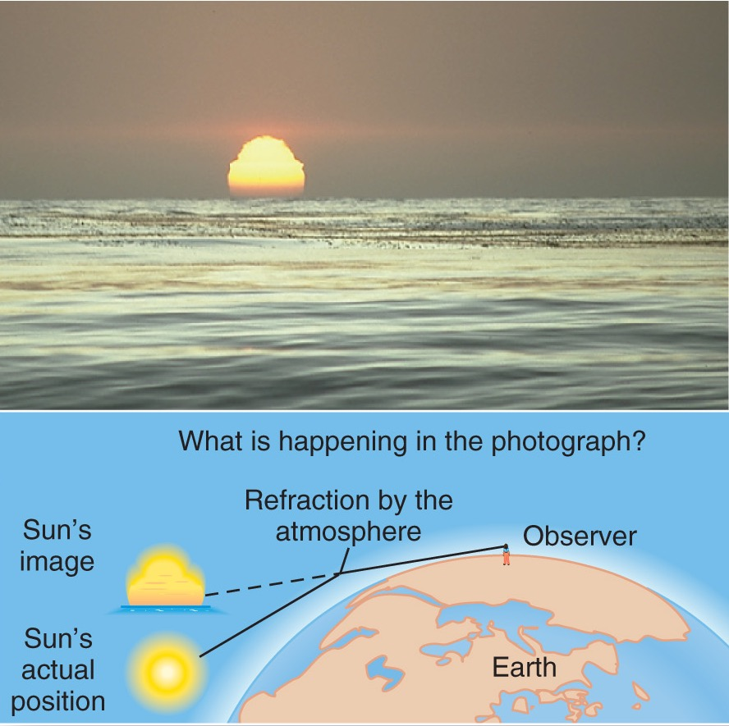
Refraction
Changes in density through which insolation passes causes a change in its direction and speed
  Light is bent
  (refraction)

Slide 14
Reflection
Reflection – energy hitting Earth and bouncing back into space, without being absorbed or performing work
Albedo – the reflective quality of a surface measured in percent
  Controls the amount of absorption for a surface

Slide 15
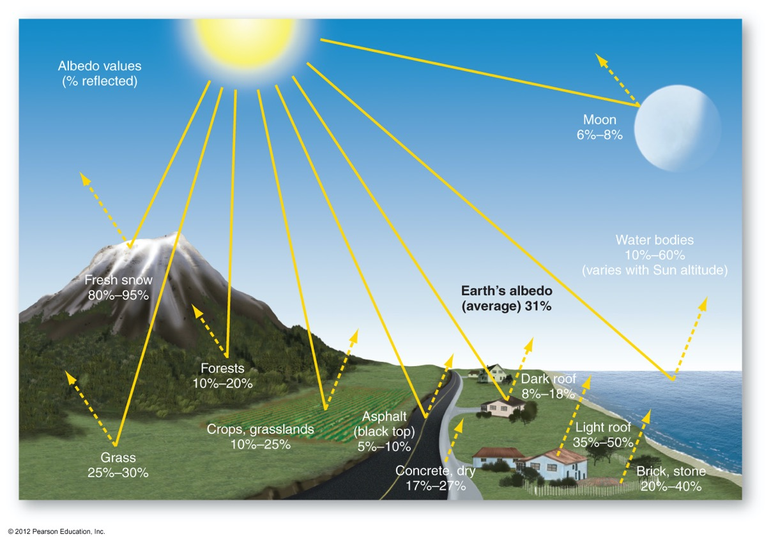
Albedo
What do you think would happen if Earth’s albedo increased?

Slide 16
Absorption
Absorption – assimilation (take in) of radiation by molecules of matter and its conversion from one form of energy to another
  Plants absorb energy for photosynthesis
  Converted to longwave radiation

Slide 17
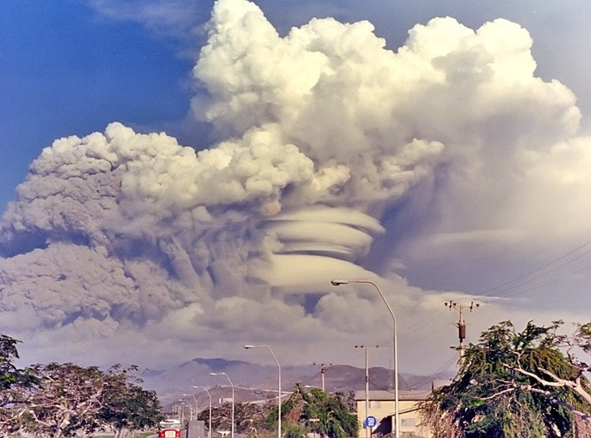
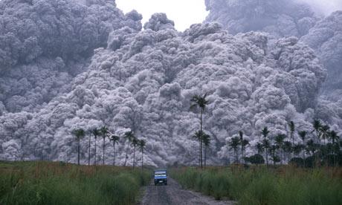
Atmospheric Disruption
Mt. Pinatubo eruption in 1991
  Massive amounts of sulfur dioxide droplets were shot into the stratosphere
  The globe experienced a temporary cooling of 0.5°C

Slide 18
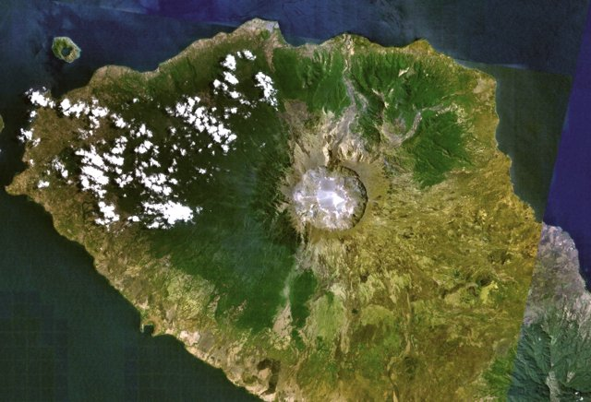
Atmospheric Disruption
Mt. Tambora eruption in 1815
  Stratovolcano eruption shot ash and aerosol ejecta into the stratosphere
  Created the Year Without A Summer in 1816

Slide 19
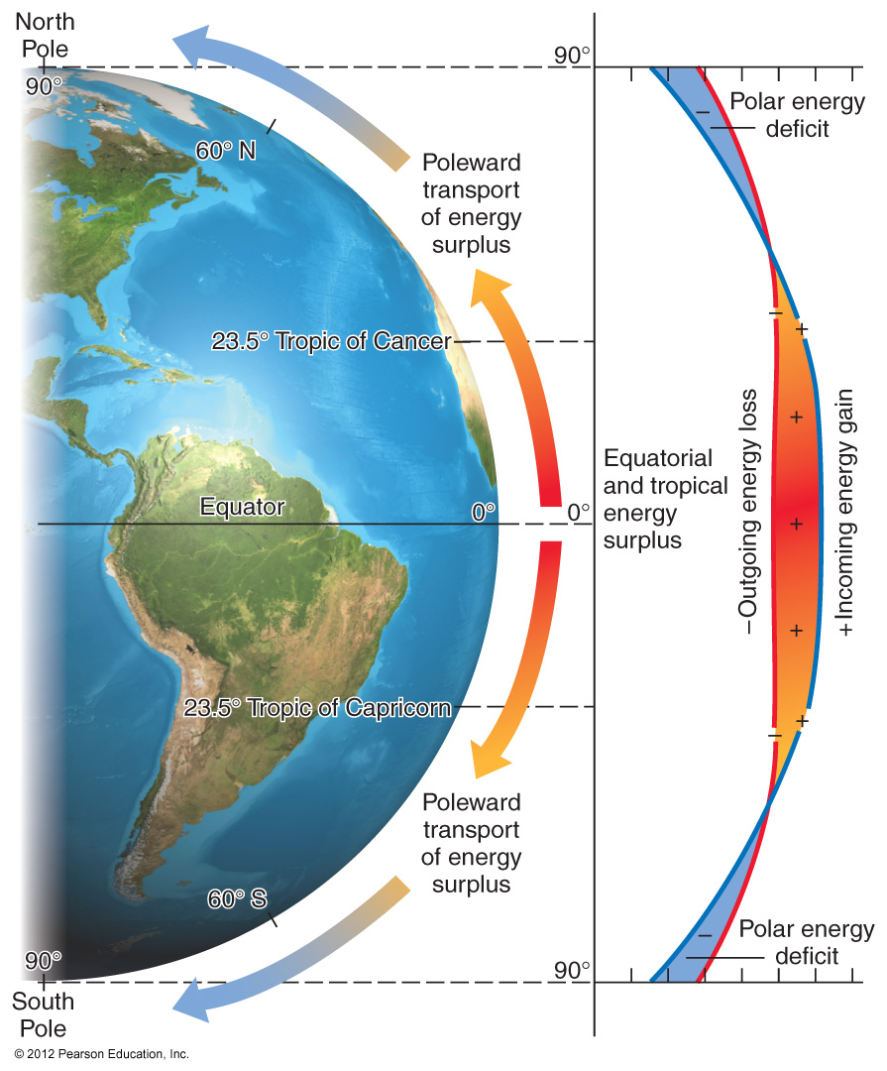
Tropical surpluses and polar deficits drive global circulation!

Slide 20
Introduction to Heat
Four modes of heat transfer on Earth:
  Conduction – molecule-to-molecule
  Convection – physical mixing of gas or liquid in a vertical motion
  Advection – physical mixing of gas or liquid in a horizontal motion
  Radiation – transfer using electromagnetic waves

Slide 21
Introduction to Heat
Latent heat of evaporation – the energy stored in water vapor as water evaporates
  Water absorbs energy to change from liquid to gas
Sensible Heat – back-and-forth transfer through convection and conduction

Slide 22
Principal Temperature Controls
Temperature is not uniform across the globe
Influences upon temperature include:
  Latitude
  Altitude/Elevation
  Cloud Cover
  Land-Water Heating Differences

Slide 23
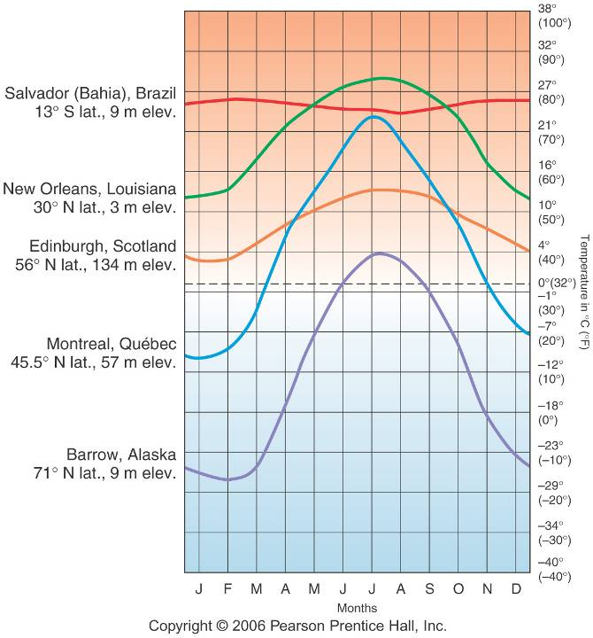
Latitude
Remember, latitude affects insolation, sun angles, and daylength

Slide 24
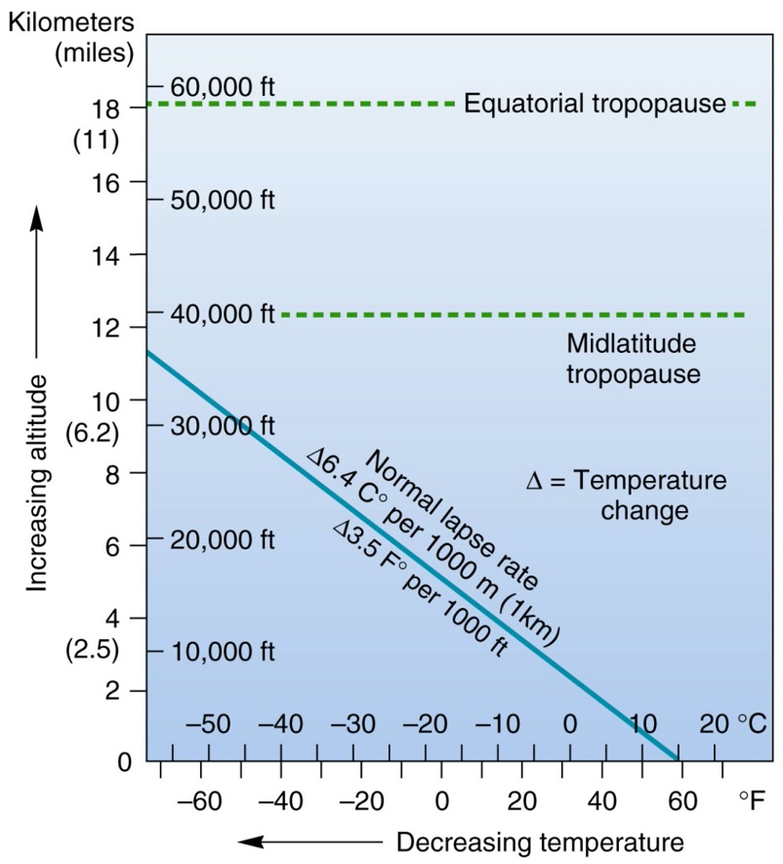
Altitude/Elevation
Temperatures decreases higher up
Thin atmosphere means less sensible heat
Check out this graph which tracks the normal lapse rate with elevation

Slide 25
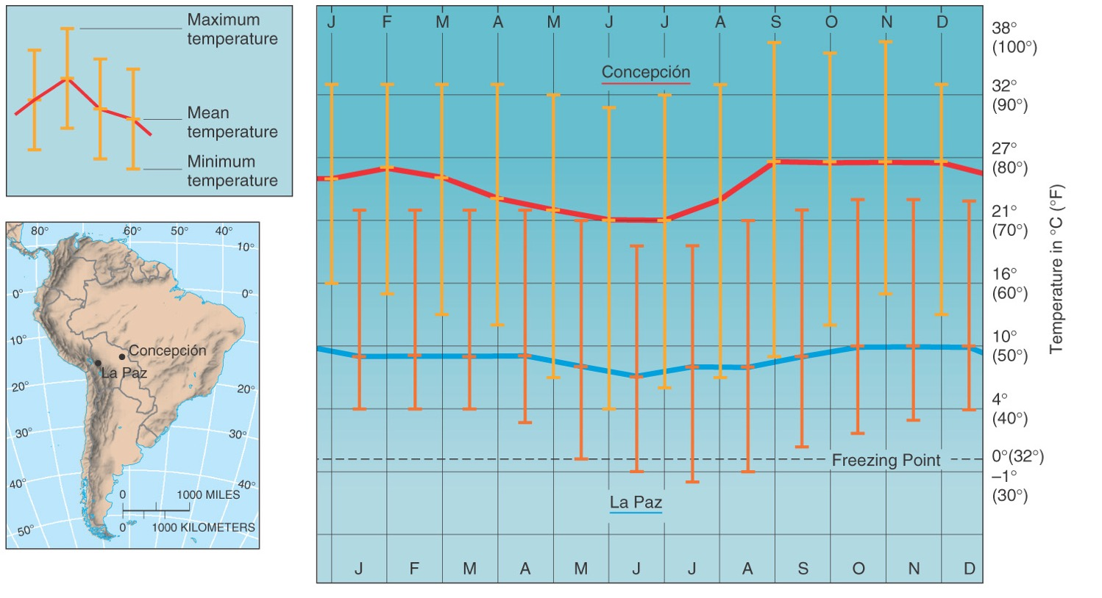
High Elevation

Slide 26
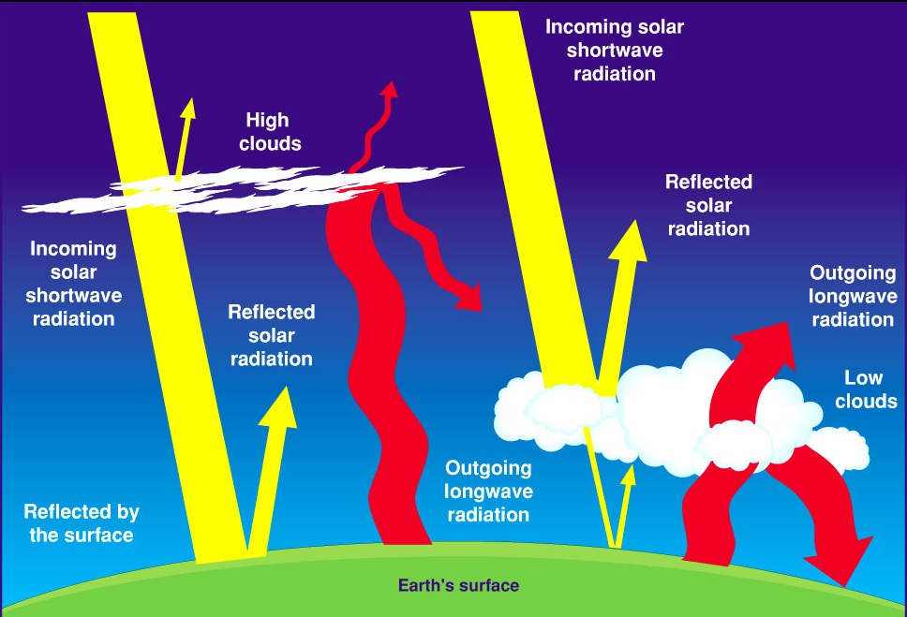
Cloud Cover

Slide 27
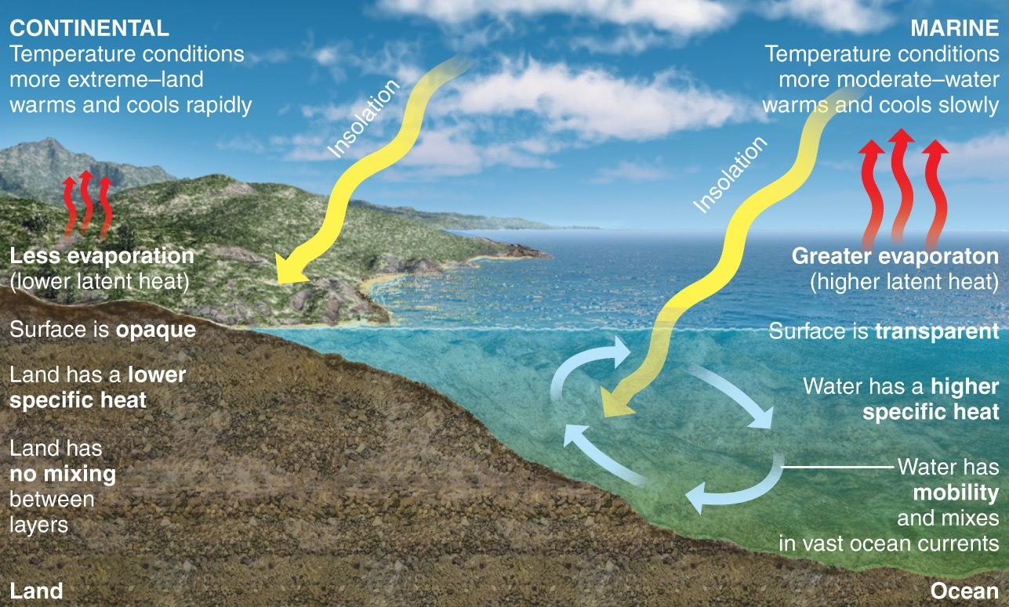
Land-Water Heating Differences
Continents and oceans are physically different

Slide 28
Land-Water Differences
Evaporation
  Energy is stored as latent heat, resulting in lower temperatures
  Happens more in marine locations than over land
Transparency
  Land is opaque, water is transparent
  Energy can penetrate deeper into water than soil, creating a larger heat reservoir

Slide 29
Land-Water Differences
Specific Heat – the heat capacity of a substance
  Water heats slower, but retains heat longer
Movement
  Oceans flow and mix/redistribute heat energy over a greater volume than land
  Horizontal and vertical mixing

Slide 30
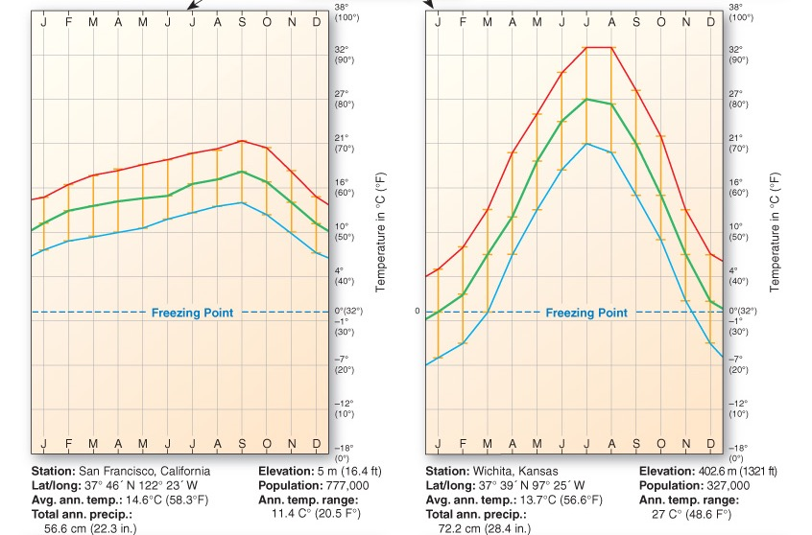
Marine Effect vs. Continentality
The only difference between these two locations is the left is closer to water. This demonstrates the marine effect, or essentially the buffering impact of water on local climate.

Slide 31
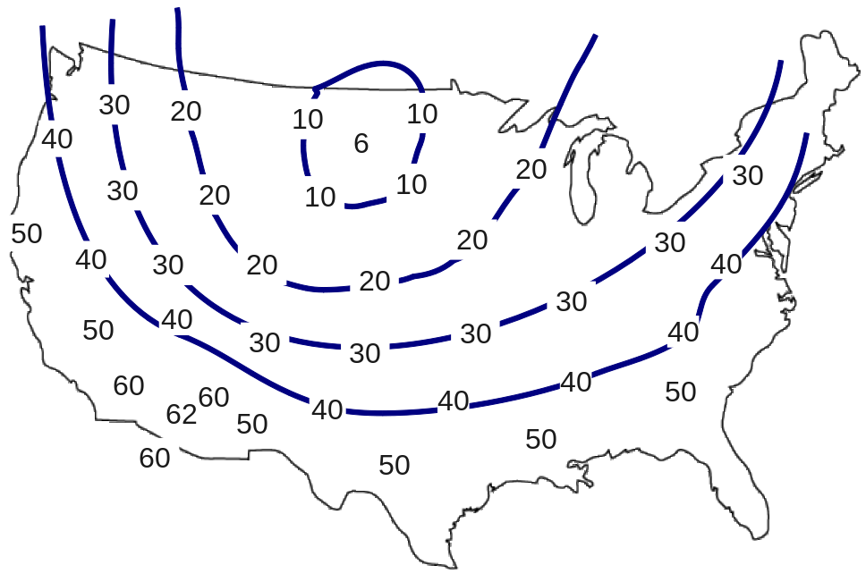
Earth’s Temperature Patterns
Isotherm – a line on a temperature map that connects points of equal temperature
Thermal equator – isotherm connecting all points of highest mean temperature
  Shifts with seasons

Slide 32
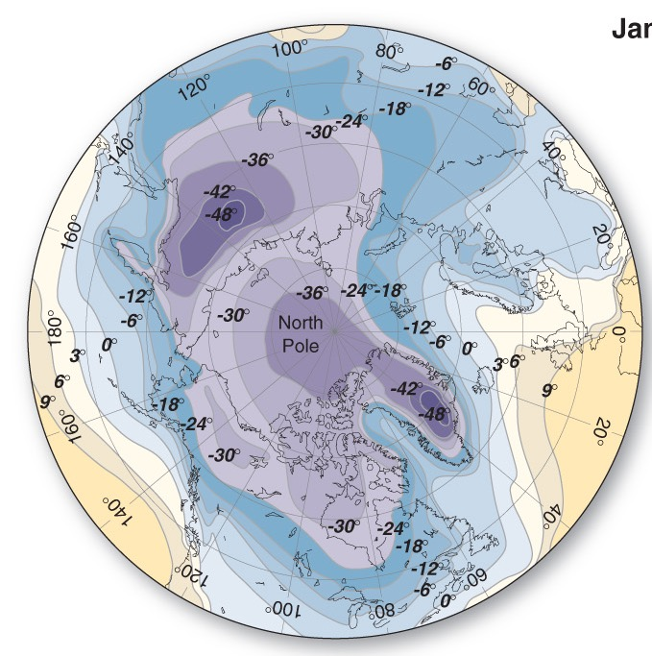
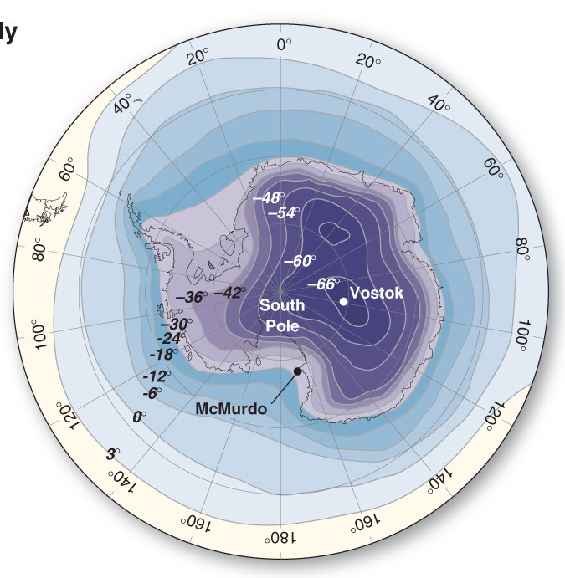
North Pole vs. South Pole
North Pole Winter
South Pole Winter

Slide 33
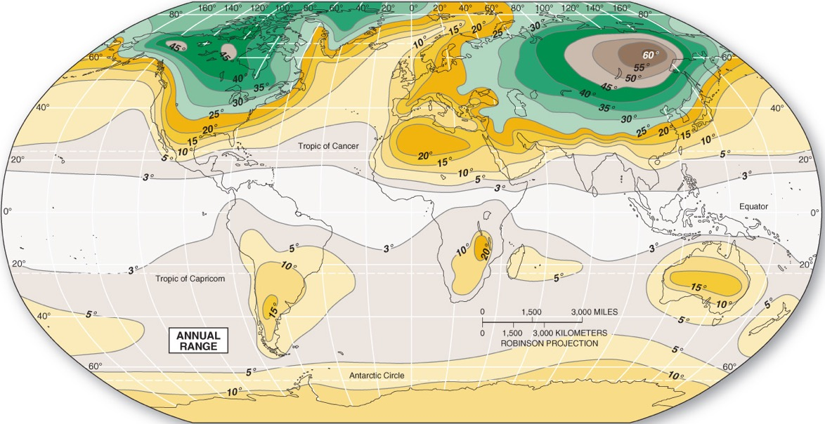
Annual Temp Range Maps
Highlights areas of high to low temp range (difference between hottest summer temp and coldest winter temp).
Why are areas of greatest difference mainly in the North?

Slide 34
Ok, break! This first part of the lecture was focused primarily on energy and temperature.
The next half of lecture focuses on pressure and wind. Go back and review core topics on principal controls on temperature before moving on!

Slide 35
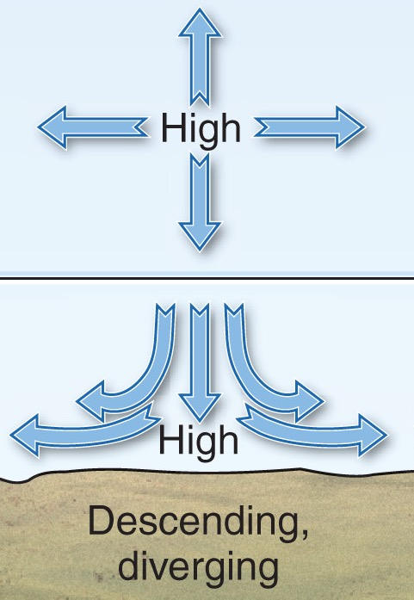
Essentials of High Pressure
Descending air from above, OR
Air that is colder, and heavier that stays at the surface
Prevents convection because air can’t rise and mix
Air is diverging at the surface
Stable weather

Slide 36
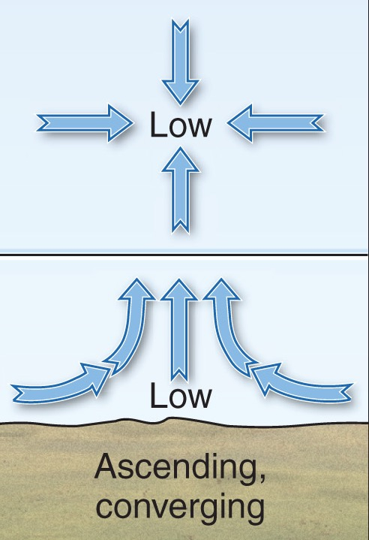
Essentials of Low Pressure
Ascending/Rising air from below, OR
Air that is warmer and rising above the surface
Promotes convection because air can rise and mix
Air converging at the surface
Weather events

Slide 37
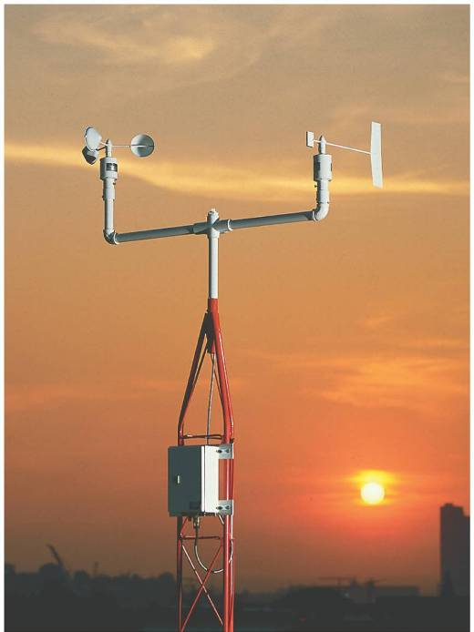
Wind Basics
Wind – Horizontal movement of air across Earth’s surface
Produced by differences in pressure between one location and another
Anemometer
Vane

Slide 38
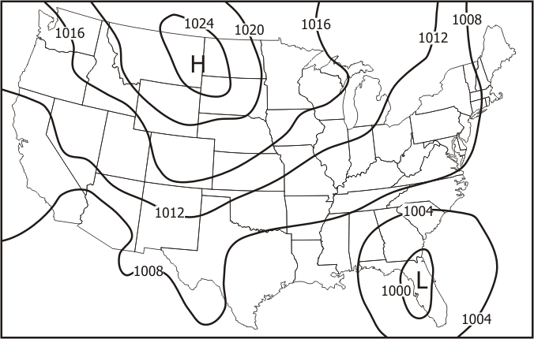
Wind Maps
Isobar- line connecting points of equal air pressure
Contour intervals

Slide 39
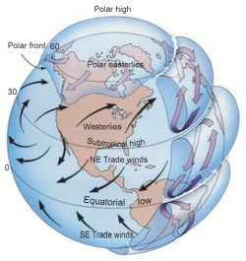
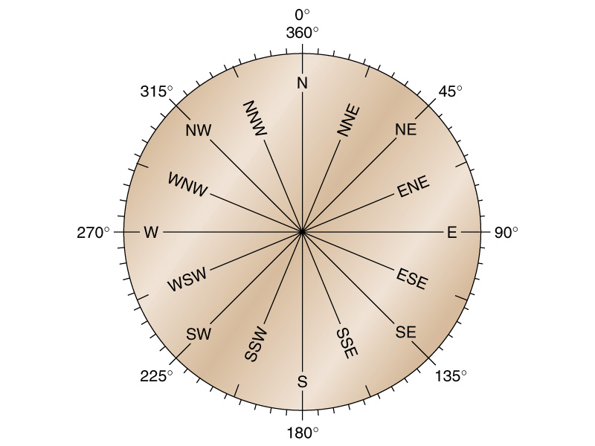
Wind Direction
Winds are always named after the direction from which they are blowing.

Slide 40
Driving Forces of Global Wind
Several Factors influence the patterns of wind on a global scale:
  Gravity
  Pressure Gradient Force
  Friction Force
  Coriolis Force

Slide 41
Pressure Gradient Force
Differences in pressure across Earth’s surface encourages air flow
The stronger the difference, the stronger the wind
Closeness of isobars determines the strength of the difference or gradient between high and low.

Slide 42
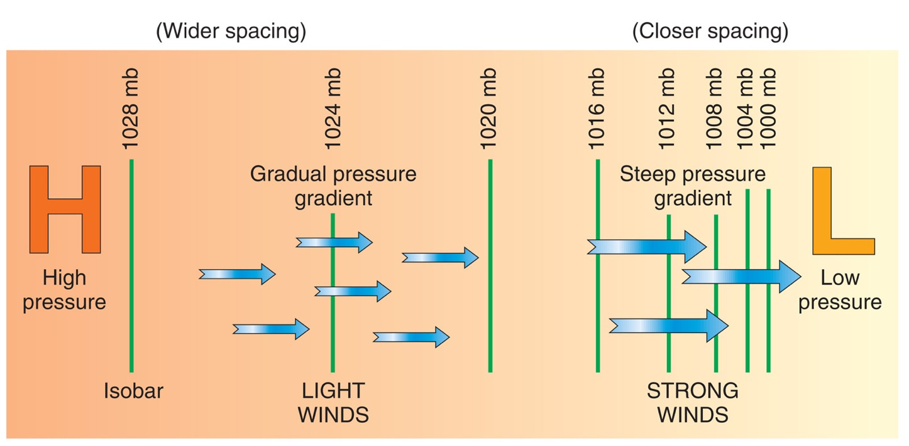
Pressure Gradient and Isobars

Slide 43
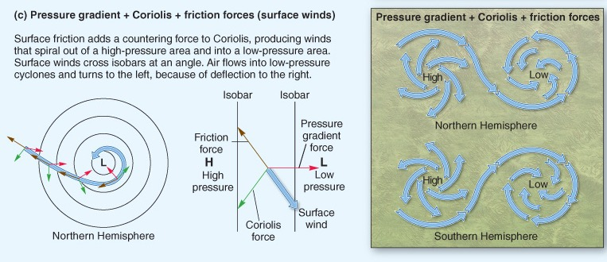
Pressure + Coriolis + Friction

Slide 44
Global Circulation System
Dynamic Pressure Area –pressure area stimulated primarily by movement or mechanical factors
Thermal Pressure Area– pressure area stimulated primarily by temperature or thermal factors

Slide 45
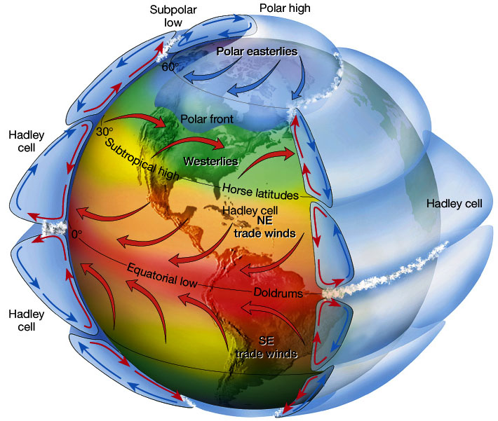

Slide 46
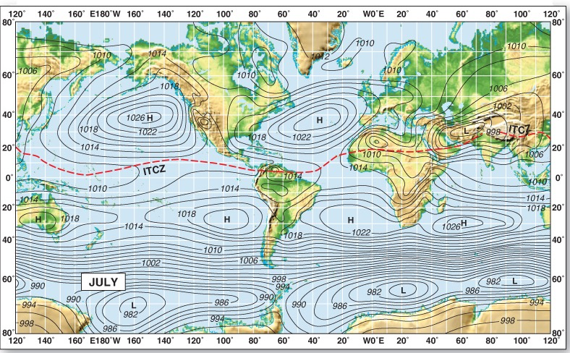
Equatorial Low Pressure trough
Thermal low pressure area
  High sun angles, consistent daylength
  Warm, less dense air, rises consistently

Slide 47
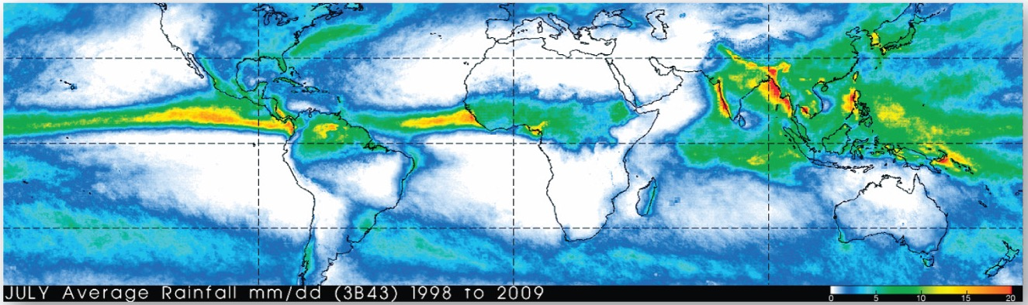
Equatorial Low Pressure Trough
Intertropical Convergence Zone (ITCZ)
Area of extreme low pressure
Calm winds under the ITCZ because of low pressure gradient and vertically rising air

Slide 48
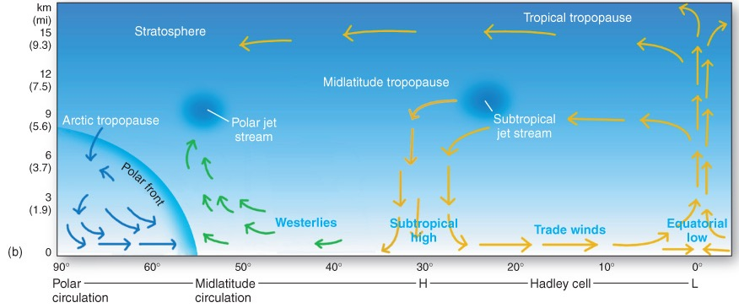
Equatorial Low Pressure Trough
Zone of convergence by rising air being replaced by air moving in from the north and south

Slide 49
Equatorial Low Pressure Trough
Hadley Cells – the circuit completed by winds rising along the ITCZ
Trade winds – prevailing winds caused by Hadley circulation cell
  N.H. = northeast
  S.H. = southeast

Slide 50
Sub-Tropical High Pressure Cell
Dynamic descending air from the Hadley cell creates areas of high pressure (about 20-35° N and S)
Air is heated by compression as it is forced downward creating hot/dry conditions

Slide 51
Sub-Tropical High Pressure Cell
Westerlies – dominant surface winds from the subtropics to high latitudes resulting from divergence at the Hadley cell

Slide 52
Sub-Polar Low Pressure Cell
Dynamic low pressure area from ascending air at about 60° N and S
Cold air from higher latitudes and warm air from lower latitudes converge causing rising air
Spreading air masses from the poles form the polar front

Slide 53
Polar High Pressure Cells
Thermal high pressure area from frigid descending air at the poles
Descending air diverges at the surface and form the weak, variable polar easterlies
  Coriolis deflects wind from a straight southward path

Slide 54
Rossby Waves
Polar front – the line of conflict between colder air from the north and warmer air from the south
Dynamically active area creates disturbances in the upper air circulation and jet stream

Slide 55
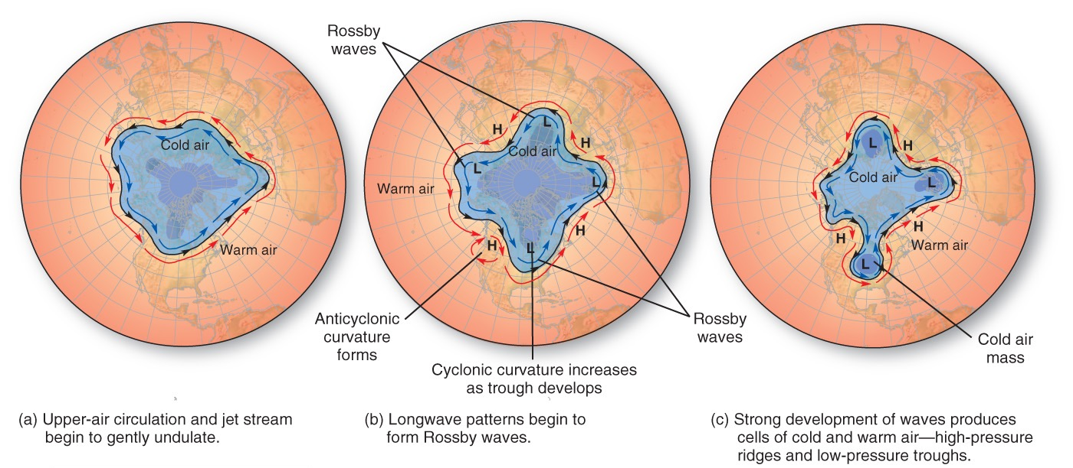
Rossby Waves
Wave-and-eddy formations occur and create lobes of cold air that flow away from poles.

Slide 56
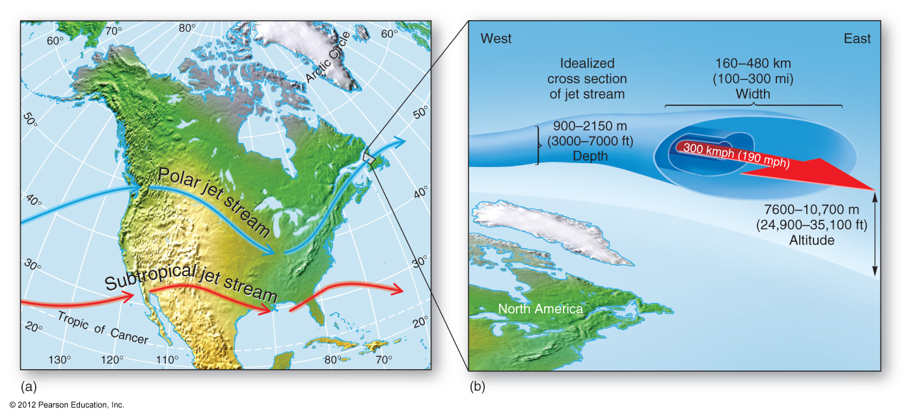
Jet Streams
Jet streams – irregular and concentrated upper level westerly winds (2 per hemisphere)

Slide 57
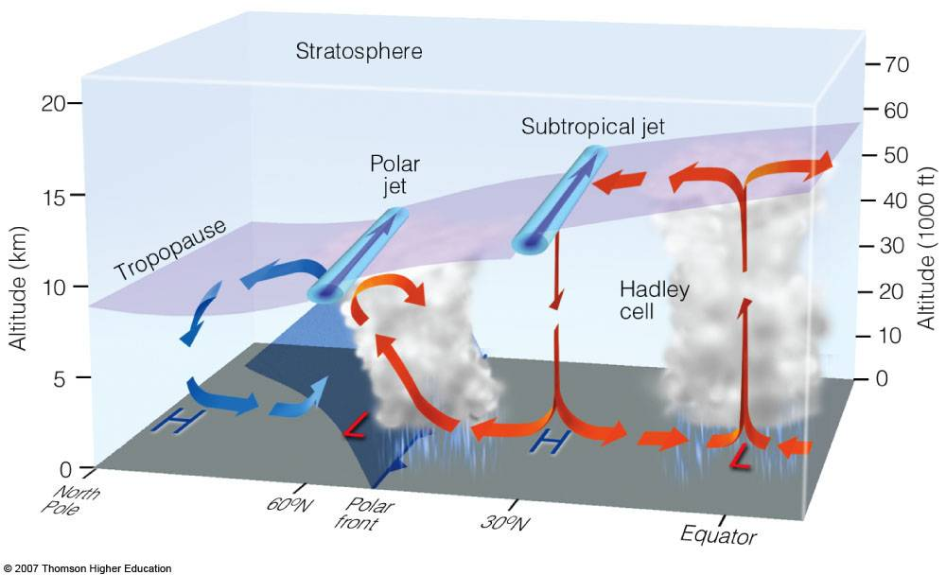
Jet Streams

Slide 58
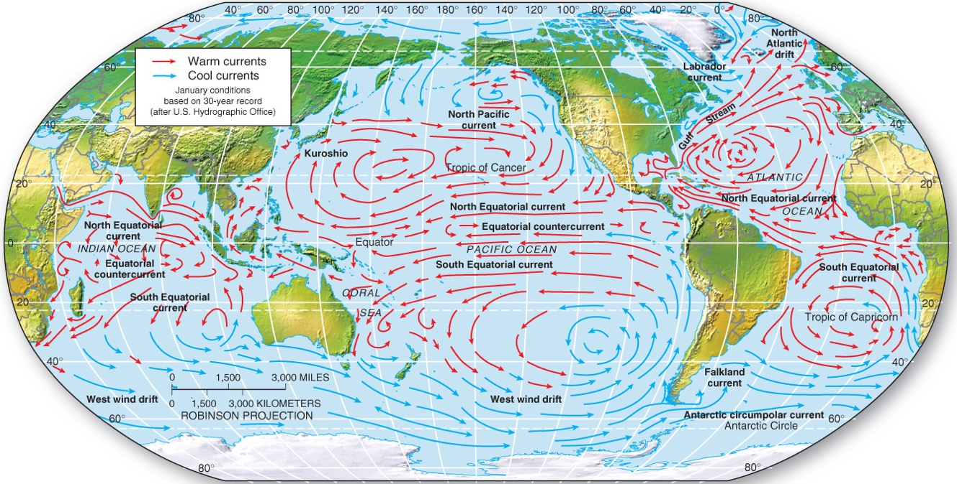
Ocean Currents
Surface Currents AND Deep Currents form the Thermohaline Circulation

Slide 59
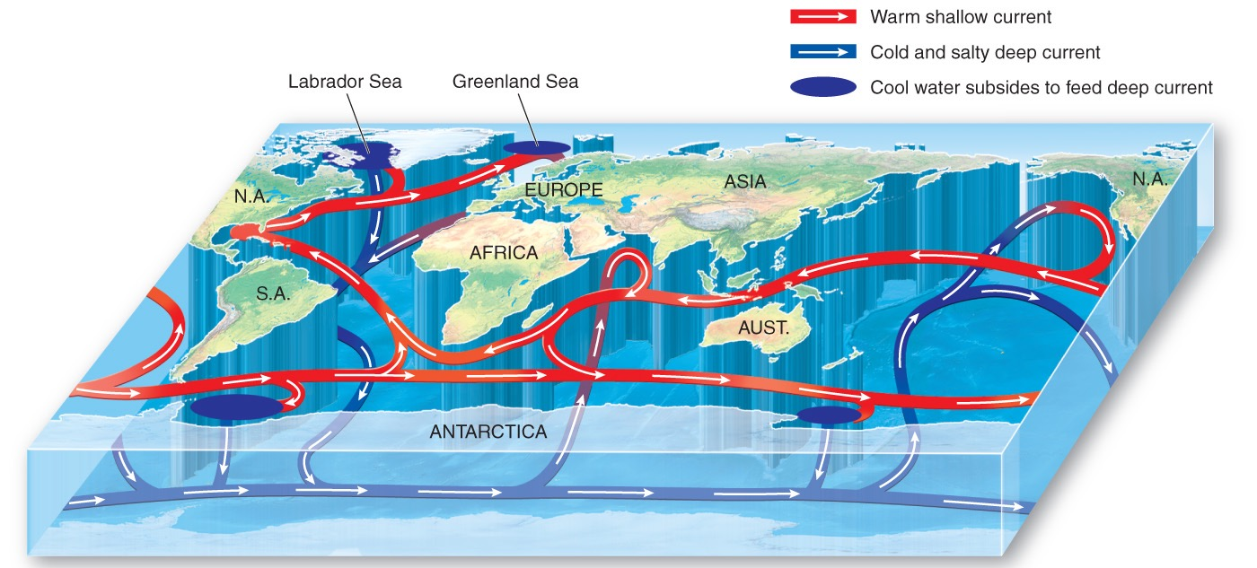
Thermohaline Circulation

Slide 60
Ocean Currents
Driving force for ocean currents is the wind!
  Frictional drag along the surface
  Creates vital link between atmospheric and oceanic circulation systems
Coriolis force, density differences (temperature and salinity), placement of the continents, tides…

Slide 61
Whew! I think that’s enough for now.
There’s always more to learn about earth surface and atmospheric processes, so if you’re interested in these materials, reach out! I teach upper level courses in weather and climate and biogeography! ☺

Slide 62
Looking Ahead…
Next week we delve into climate modeling!
Please be sure that you’re confident with this week’s course materials before we move on to Week 6!
As always, don’t hesitate to reach out with questions!

