Slide 1
BUS 2003: BUSINESS LAW
  Weeks 5 & 6
  UAE Contract Law
  SLO2: Apply basic principles of UAE contract and tort law, to business and commercial transactions in the UAE

Slide 2

UAE CONTRACT LAW
Agenda:
The basic requirements for a contract:
  Offer
  Acceptance
  Consideration
The necessary requirements for a VALID contract:
  Intention (duress and misrepresentation)
  Capacity (age and mental disability)
  Legality
  Possibility of performance
Breach of Contract
  Remedies for Breach of Contract

Slide 3
UAE CONTRACT LAW
UAE Contract Law can be found in FEDERAL GOVERNMENT LEGISLATION (CODE) called the UAE Civil Code Federal Law No.(5) of 1985 (the “UAE Civil Code”)

Slide 4

  DEFINITION OF A CONTRACT
A contract is:
  an agreement
  between two (or more) persons
  that results in obligations or duties (things that both parties must do)
The parties to a contract may be:
  natural persons (people) or
  artificial persons (companies) (eg: an employment contract is between a company and an employee)

Slide 5
VERBAL / WRITTEN CONTRACTS
A contract may be verbal OR written
However, the UAE law requires that certain types of contracts must be written
These include:
  contracts of marriage
  contracts for the sale of fixed / immovable property (such as a house or apartment or land)
  an employment contract between a UAE employer and a foreign national
ALL other contracts may be verbal: although it may sometimes be difficult to prove the terms of the contract if it is verbal, so it is preferable to have a written contract

Slide 6
3 BASIC REQUIREMENTS OF A CONTRACT
The 3 basic requirements for a contract are:
An OFFER : one party must make an offer
ACCEPTANCE : the other party must accept the offer
CONSIDERATION : BOTH parties must receive something of value from the contract ie: there must be a mutual promise to exchange something of value in the future (value includes money, services or property)
If the 3 basic requirements are present, then there is a contract between the parties
When there is a contract between two parties then this means that both parties must do what they promised to do in the contract (provided that it’s a *valid contract)
*NOTE: for a contract to be VALID: that is, a contract that the Court will recognize and enforce, certain necessary elements must be present If any of these necessary elements is missing then the contract is not valid and will not be enforced by the courts (necessary elements will be discussed in 2nd class on contract)

Slide 7
OFFER AND ACCEPTANCE
EXAMPLE: Ali offers to sell his car to Budour for AED 70 000. Budour accepts the offer.
Are the 3 basic requirements of a contract present?
The 3 basic requirements of a contract are:
  Offer: one party must make an offer
  Acceptance: the other party must accept the offer
  Consideration: both parties must receive something of value
So the 3 basic requirements of a contract are present:
  Offer: Ali makes an offer to sell his car to Budour
  Acceptance: Budour accepts Ali’s offer
  Consideration: both Budour and Ali will receive something of value: Ali will receive AED 70 000 and Budour will receive a car (there is a mutual exchange of value)

Slide 8
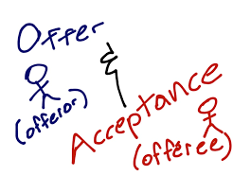
OFFER AND ACCEPTANCE
  Offeror: the person who makes the offer is the offeror - Ali is the offeror because he offers to sell his car to Budour
  Offeree: the person who receives the offer is the offeree - Budour is the offeree because she receives Ali’s offer (Ali makes the offer to her)

Slide 9
NECESSARY REQUIREMENTS
There are 3 basic requirements for a contract: offer, acceptance and consideration
However the contract will only be VALID if the following necessary requirements are present
A contract is valid if the court will recognize and enforce it
Necessary requirements of a contract are:
Intention : both parties must have the intention to enter into the contract
Capacity: both parties must have the capacity to enter into the contract
Legality: the contract must be lawful
Possibility of performance: it must be possible to perform under the contract ie: both parties must agree to do something that is possible

Slide 10
INTENTION
BOTH parties to the contract must have the intention to enter into (to make) the contract
If one of the parties entered into the contract as a result of:
  Duress
  OR
  Misrepresentation
THEN that party DOES NOT HAVE INTENTION and the contract is either void or voidable

Slide 11
DURESS
Duress is forcing or threatening a person to do something against his or her will
Duress can be:
  Forcible
  Non-forcible
Forcible duress: if is it an immediate threat of serious physical harm
Non-forcible duress: if it is a lesser threat (not immediate or serious physical harm)
If the duress is forcible: the contract is void (completely invalid)
If the duress is non-forcible: the contract is voidable, (ie: the party who was threatened can choose whether or not to continue with the contract)

Slide 12
Duress
EXAMPLES:
Forcible duress: Tariq threatens Ali with a knife and says that Ali must sign a contract agreeing to sell Tariq his house in RAK for AED 1000 000. Ali signs the contract. This contract is VOID because Tariq used forcible duress ie: he threatened Ali with a knife – to get Ali to sign the contract
Non-forcible duress: Tariq, who is Ali’s boss, threatens Ali that it “will not be good for his job” if Ali doesn’t sign a contract agreeing to sell Tariq his house. This is non-forcible duress as it is a lesser threat. The contract is VOIDABLE ie: Ali can choose whether or not to continue with the contract of sale

Slide 13
MISREPRESENTATION
A misrepresentation is when one of the parties to the contract deceives the other party which leads the deceived party to make a contract that he may not have made if he’d known the truth
The misrepresentation may be made by:
  Word
  Deliberate silence
The law requires that the parties to a contract:
  must act honestly (in “good faith”) and
  have a duty to disclose any known defect in a thing being sold
If a party enters into a contract as a result of a misrepresentation, then the contract is voidable (ie: deceived party can choose whether or not to continue with the contract)

Slide 14
MISREPRESENTATION
Examples:
Misrepresentation by word:
Salama offers to sell her car to Maha for AED 50 000. Maha accepts the offer. Salama knows that the car has faulty brakes but tells Maha that the car is in excellent condition. Salama has made a misrepresentation by word. Salama has a duty to act honestly (in “good faith”) and to disclose the fact that the car has faulty brakes to Maha
Misrepresentation by deliberate silence:
Salama offers to sell her car to Maha for AED 50 000. Maha accepts the offer. Salama knows that the brakes are faulty but says nothing to Maha. Salama has made a misrepresentation by deliberate silence. Salama has a duty to act honestly (in “good faith”) and to disclose the fact that the car has faulty brakes to Maha
In both cases, there is a misrepresentation and so the contract is voidable (Maha can choose whether or not to continue with the contract)

Slide 15
CAPACITY
One of the necessary element of a contract is that both of the parties to the contract must have capacity
This means that they must be capable of understanding the terms of the contract
The following persons do NOT have FULL capacity to enter into a contract:
  A minor (person under the age of 21)
  A mentally disabled person

Slide 16
CAPACITY: AGE
According to the UAE law on capacity:
  A person aged 21 and above with full mental capacity has full capacity to enter into a contract
  A person under the age of 21 years (age 20 and below), is a minor and does NOT have full capacity to enter into a contract
The law distinguishes between a minor:
  Aged 0 – 6 years (no capacity)
  Aged 7 – 20 years (limited or restricted capacity)

Slide 17
MINORS: 0 – 6 years (no capacity)
According to UAE law
  a minor under the age of 7 years old (under the “age of discretion”) has no capacity to enter into a contract
Therefore a contract entered into by a minor who is under 7 years old) will only be valid if the guardian consents to the contract
If the guardian does not consent then the contract is void (invalid)

Slide 18
MINORS: 7-20 years (limited / restricted capacity)
According to UAE law:
a minor between the age of 7 and 20 has limited (restricted) capacity
The following rules apply to a contract entered into by a minor of limited (restricted) capacity:
  if the contract is purely for the benefit of the minor then it will be valid
  If the contract is only to the detriment of the minor (has NO benefit), then it is void (invalid)
  If the contract has both benefits and detriments, then the contract will only be valid if the guardian of the minor (usually the father) consents to the contract OR if the minor ratifies (confirms) the contract after he or she reaches the age of 21 years

Slide 19
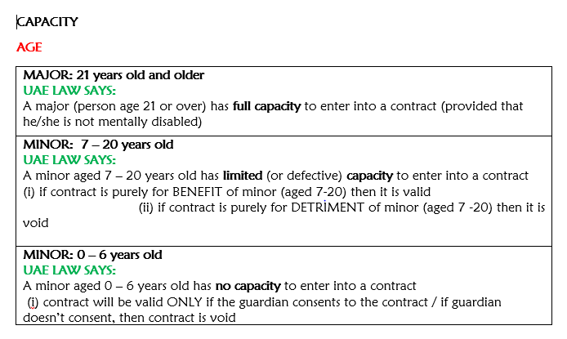
CAPACITY
Summary below:

Slide 20
CAPACITY: MENTAL DISABILITY
MENTALLY DISABLED PERSON: UNDER RESTRICTING ORDER
The family of the mentally disabled person may apply to court for a restricting order appointing a legal guardian to assist the mentally disabled person
According to UAE law, if a mentally disabled person is under a restricting order and a guardian has been appointed, then:
  The mentally disabled person has no capacity to enter into a contract on his own a contract
And any contract entered into by the mentally disabled person is:
  valid if the legal guardian consents to the contract
  and
  void if the legal guardian does not consent to the contract

Slide 21
MENTALLY DISABLED PERSON: NO RESTRICTING ORDER
According to UAE law, if a mentally disabled person is NOT under a restricting order and no legal guardian has been appointed, then:
  The mentally disabled person has limited capacity to enter into a contract on his own a contract
And any contract entered into by the mentally disabled person (no restricting order) is:
  valid if the contract benefits him (is not unfair to him)
  and
  void if the contract does NOT benefit him (is unfair to him)

Slide 22
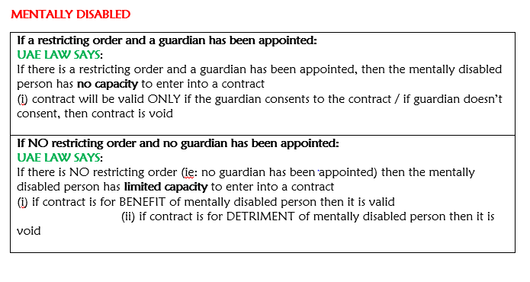
CAPACITY
Summary below:

Slide 23
LEGALITY
The 3rd necessary requirement is legality
According to UAE law, a contract will only be valid if the purpose of the contract is LEGAL
If the purpose of the contract is not legal, then the contract is void
Example: Moham offers Khalifa AED 5000 to break into Noura’s house and to steal her laptop. Khalifa accepts the offer. Khalifa breaks into Noura’s house, steals her laptop and gives it to Moham. Moham refuses to pay Khalifa the AED 5000. The contract between Moham and Khalifa is for an unlawful purpose and is therefore void. The court will not enforce the contract between Khalifa and Moham because the contract is void (invalid)

Slide 24
POSSIBILITY of PERFORMANCE
The 4th necessary requirement is possibility of performance
According to UAE law, it must be possible to perform under the contract (ie: both parties must be able to do what they promised to do) otherwise the contract is void
Example:
Saif offers to build Mouza a house on her land in the desert for AED 2 000 000. Mouza accepts the offer. A land surveyor then assesses the land and says that it is not possible to build the house as the land has too much sand. The contract between Saif and Mouza would therefore be VOID because of impossibility of performance (it is not possible for Saif to perform under the contract and to do what he promised to do)

Slide 25

BREACH OF CONTRACT
If one of the parties fails or refuses to comply with his or her obligations (does not do what he/she promised to do in the contract), or does not perform them exactly as the contract states, then this is a breach of contract
To breach = to violate, not comply with
If a contract is breached by one party then the other party (the non-breaching party) has certain legal remedies (remedies in law) against the party who is in breach of the contract

Slide 26
BREACH OF CONTRACT
EXAMPLE: Ali and Salwa enter into a valid contract of sale in terms of which Ali will sell his car to Salwa and Salwa will pay AED 40 000 for the car. As the contract is valid, both Ali and Salwa must do what they promised to do in the contract. Therefore:
  Ali must deliver the car to Salwa AND
  Salwa must pay Ali the AED 40 000
if Ali complies with the contract and delivers the car to Salwa but Salwa does not pay Ali the AED 40 000, then Salwa is in breach of contract
OR if Salwa pays Ali the AED 40 000 but Ali does not deliver the car to Salwa, then Ali is in breach of contract
the non-breaching party will then has certain LEGAL REMEDIES available against the party who breached the contract

Slide 27
LEGAL REMEDIES FOR BREACH OF CONTRACT
The legal remedies for breach of contract are:
The non- breaching party can send a written notice (called a letter of demand) to the party in breach and claim / ask for:
•SPECIFIC PERFORMANCE: ie ask the party in breach to perform under the contract (to do what he promised to do)
OR
•CANCELLATION and RESTITUTION: ie: cancel the contract and claim back any monies paid or property given BEFORE the breach
PLUS
  claim DAMAGES (financial compensation) if the non- breaching party has suffered a financial loss as a result of (because of) the breach of contract
(NOTE: If the party in breach does not comply with the letter of demand, then the non-breaching party can institute legal proceedings against the party in breach and the court can make an order for any of the above ie: can order: specific performance OR cancellation and restitution and/or damages if there are any)

Slide 28
SPECIFIC PERFORMANCE
If the non -breaching party wants the party in breach to fulfil his/her obligations under the contract ie: to do what he/she promised to do, then the non- breaching party may ask (or the court can order) the party in breach for specific performance
The non breaching party will usually only ask for (or the court will only order) specific performance if it is a suitable remedy in the circumstances
For example in the contract of sale between Salwa and Ali: if Salwa pays Ali the AED 40 000 but Ali does not deliver the car to Salwa, then Ali is in breach of contract and Salwa can ask for specific performance ie: ask Ali to deliver the car. Specific performance would be a suitable remedy in the circumstances.

Slide 29
CANCELLATION AND RESTITUTION
Alternatively, the non- breaching party can ask for cancellation of the contract and restitution
NOTE: the non- breaching party must ask for cancellation AND restitution (the contract MUST be cancelled in order for the non -breaching party to get restitution)
Cancellation of the contract: means that the contract will be void / there is no longer a contract between the parties
Restitution means:
  that the non -breaching party is put back in the position he/she was in before the breach.
  So the non- breaching party can claim back any money paid or property given BEFORE the breach
For example in the contract of sale between Salwa and Ali: if Salwa pays Ali the AED 40 000 but Ali does not deliver the car to Salwa, then Ali is in breach of contract and Salwa can ask for cancellation and restitution which means that Salwa can ask for the contract to be cancelled and for the AED 40 000 to be returned

Slide 30
DAMAGES
Damages is money paid by the party in breach to compensate the other party for any loss caused by the breach of contract ie: any loss which occurs (takes place) as a result of the breach
Therefore if the party in breach had not breached the contract then the loss would NOT have occurred
The primary purpose of damages for breach of contract is to place the non- breaching party in the same position he/she would have been in had the party in breach complied with the contract (had not breached the contract/had done what he promised to do under the contract)
Damages might include compensation for loss of profits

Slide 31


