Slide 1
CIPS Advanced Practitioner Programme
Module: Advanced Category Management

Slide 2
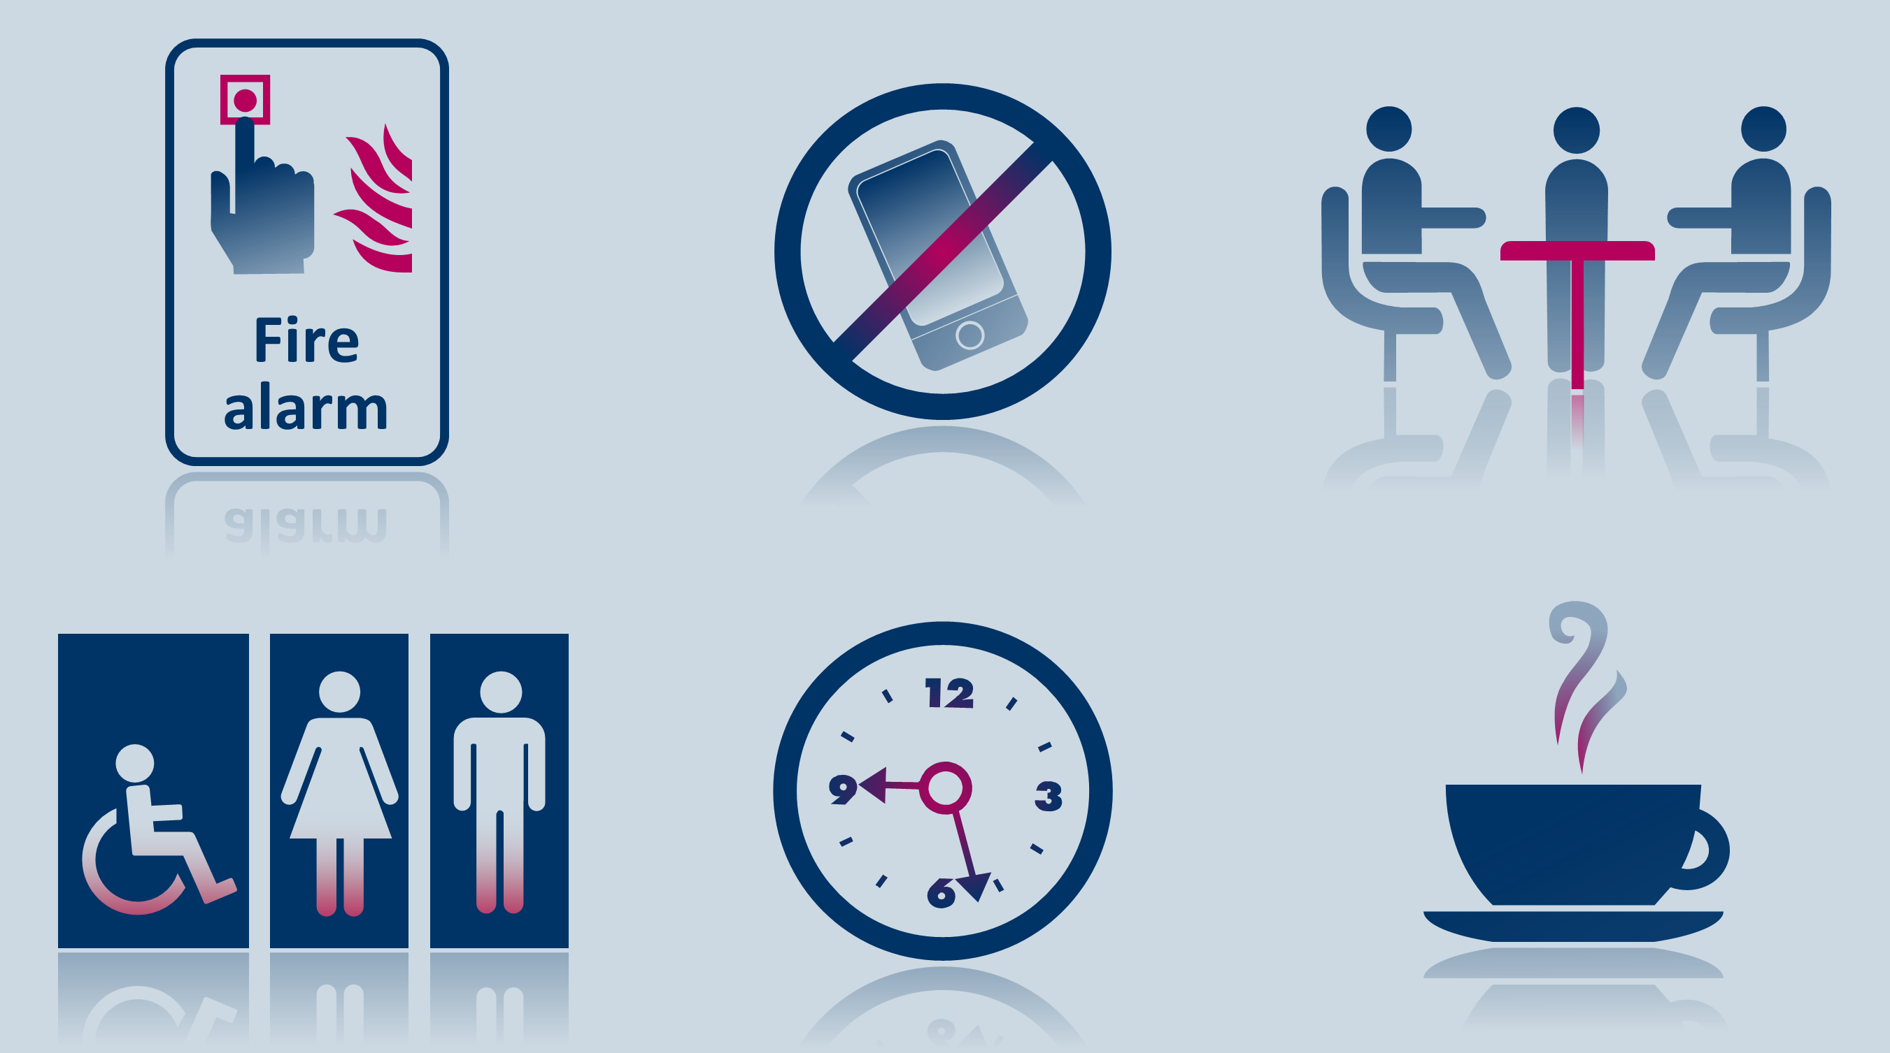
Important Issues

Slide 3
The Advanced Practitioner Modules and Units
Advanced Practitioner Level Modules and Units
Induction
Module: Strategic Supply Chain Management Supply Chain Management Corporate Strategy and Procurement and Supply Chain Management The Impact of Globalisation on Supply Chains | Module: Developing People in Procurement and SCM Developing Individuals and Teams in Procurement and Supply Developing Leadership Capabilities to Improve Procurement and Supply
Module: Advanced Category Management in Procurement and SCM Developing Systems for Procurement and Supply Chain Management Category Management Supply Chain Improvement | Module: Implementing Change in Procurement and SCM Effective Procurement and Supply Chain Management Leading Stakeholders to Achieve Change
Module: Contracting Excellence in Procurement and SCM Legal Aspects of Commercial Contracts Managing Risks in Contracting | Project in Procurement and Supply Chain Management

Slide 4
Advanced Category Management in Procurement and SCM module
There are 3 units to this module
Category Management
Supply Chain Improvement
Developing Systems for Procurement and Supply Chain Management

Slide 5
Advanced Category Management in Procurement and SCM module
There are 3 units to this module
Category Management
Supply Chain Improvement
Developing Systems for Procurement and Supply Chain Management

Slide 6
Category Management
In this Unit, we will be focusing on:
Understanding the Category Management Approach
Categorising Expenditure
The CIPS model
Category Management Governance
Behavioural and technical skills

Slide 7
Category Management
In this Unit, we will be focusing on:
Understanding the Category Management Approach
Categorising Expenditure
The CIPS model
Category Management Governance
Behavioural and technical skills

Slide 8
Conventional Purchasing
In groups discuss the following questions and be prepared to feedback:
What are the differences between traditional/transactional purchasing and strategic sourcing
What is your understanding of category management?

Slide 9
Purchasing: the traditional view
Purchasers are not involved until an actual, real need is presented to them by the user. They remain involved only until the need has been fulfilled and paid for
Purchasers have little contact with or involvement in user functions’ planning and scheduling, and play a service role to them, perhaps as a sub-function of finance
Purchasers have very little influence
Purchasers’ freedom to make
decisions is very limited, and
tends to be focused on
individual transactions
Source: Adapted from CIPS Study Materials

Slide 10
Transactional and Strategic Procurement
Traditionally procurement has been based around transactional activities
Reactive – responding not leading
Short term – insufficient focus on long term value
Adversarial – one off - little long term value for the supplier
Uncoordinated – each purchase stands on its own
Vulnerable – the market conditions are what they are
Thus the likelihood is that supply is what is available rather than meeting an organisations precise needs resulting in poor quality outcomes
Source: Adapted from CIPS Study Materials

Slide 11
Transactional purchasing/strategic sourcing
TRANSACTIONAL PURCHASING | STRATEGIC SOURCING
Operates at departmental level | Operates at the organisational level
Not represented on the senior team | Represented on the senior team
Short term focus | Longer term focus
Reactive | Proactive
Administrative skills needed | Commercial skills needed
Processing data | Turning data into information and making decisions
One-size fits all | Prioritises and adapts, setting appropriate objectives and taking relevant approach
Respond to internal customers | Align to external customer
Suppliers are antagonists | Suppliers are resources and value creators
Source: Adapted from CIPS Study Materials

Slide 12
Transactional Purchasing
Value added
Level of effort
PROCESS STAGE
Initiate project
Identify needs and analyse the market
Specify requirements
Plan approach to market and evaluation
Approach market and select supplier
Negotiate and award contract
Manage contract and relationship
Review
Source: New Zealand Government Procurement Reform Programme

Slide 13
The strategic approach to sourcing
Value added
Level of effort
PROCESS STAGE
Initiate project
Identify needs and analyse the market
Specify requirements
Plan approach to market and evaluation
Approach market and select supplier
Negotiate and award contract
Manage contract and relationship
Review
Source: New Zealand Government Procurement Reform Programme

Slide 14
Category management and strategic sourcing
Category management is an organisational philosophy that permeates and organises its activities and attitudes. It aims to link and align customer requirements, corporate strategy and supply market capability. It includes:
Strategic sourcing which is a focused, technical, tool-driven supply chain activity occurring within the strategic decision frame
What is meant by this?
Examples of the tools?
Notes:
Strategic process based approach
Practice of segmenting the main areas of spend into discrete groups to mirror how individual market places are organised
Cross functional
Actively challenge what has gone on before
Seek breakthrough improvement
Opportunity to drive value for the organisation – such as reductions in purchase price / reduction in TCO / reduction in risk . Innovation / sustainabiluty / process change

Slide 15
Aims of Category Management
Tailor the procurement process to the different types of organisational inputs
Enable deep understanding of the needs of the category
Create depth of knowledge and expertise in the ‘technology’, including anticipating and planning for changes
Makes the procurement process outwards facing
Development of a range of strategic options and selection based on agreed rational criteria
Good communications and co-working internally and across the value chain

Slide 16
Strategic Sourcing
Group Discussion:
Define ‘strategy’ (recall from Module 1?)
What category strategies are available to us?
Notes:
Tutor: The direction and scope of an organization over the long-term which achieves advantage in a changing environment through its configuration of resources and competencies, with the aim of fulfilling stakeholders expectations”
Make/buy
Outsource / insource
LCC, Gloabal, local
SME
Ethical
Sole, single, dual, multiple
Partnerships, JVs, integratiion ( forward/backward)

Slide 17
Category Management
The process of Category Management encompasses:
Profiling of the Categories
Understanding the business needs and value levers
Carrying out internal and external analysis
Developing a category strategy
Implementing the strategy which may include:
  Identification of potential suppliers
  Evaluation of suppliers
  Negotiation and award of contracts
  Implementation of the contract (including transition where appropriate)
  Contract management and SRM
Continuous improvement and increasing value for both buyer and supplier
Benefits tracking and reporting

Slide 18
Value Levers
Discussion
In what ways can the function add value in terms of supporting the achievement of the organisations strategic goals?

Slide 19
Value Levers
In what ways can the function add value in terms of supporting the achievement of the organisations strategic goals:
Areas of opportunity include:
Specifying
Efficiency
Competition
Supply Chain
Demand Management
Relationship Management
TCO
Any others?
What interventions are required to drive value in each of these areas?

Slide 20
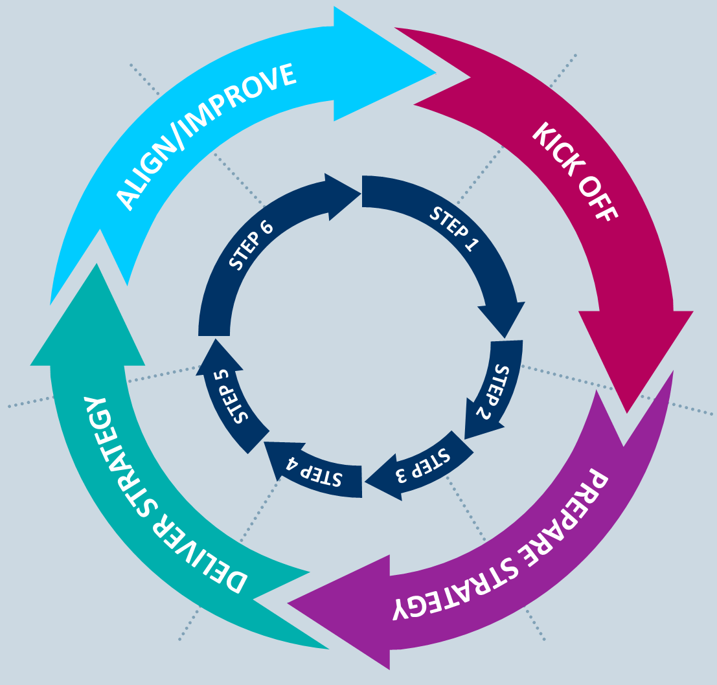
The CIPS category management model
STEP 6
Improve and enhance
STEP 1
Initiate/prepare
STEP 5
Maintain
STEP 2A/2B
Identifying opportunities
Prioritising opportunities
STEP 4
Implementing changes
STEP 3
Prepare/present strategy

Slide 21
Category Management
In this Unit, we will be focusing on:
Understanding the Category Management Approach
Categorising Expenditure
The CIPS model
Category Management Governance
Behavioural and technical skills

Slide 22
Task
In groups carry out the following task and present back in 10 minutes:
What is the purpose of categorising?
Give examples of possible ways of categorising purchases from you own organisation
What would be the benefits of categorising in this way?
Are there any challenges of categorising in these ways?

Slide 23
Categorising
The purpose of categorising:
To create groups of goods or services that can be managed together in a coherent way to bring greater cost and outcome improvement
A means by which you organise your procurement function
Enables the team to build up knowledge of the supply market
Enables the alignment to and delivery of corporate goals
Allows relationships to develop with internal and external stakeholders and facilitates cross functional working

Slide 24
Categorising Expenditures
Key Tasks
Spend analysis
  Historical , committed and planned spend
  aggregate total purchases across all organisational divisions
  Frequency and pattern of spend / volumes
  identify purpose and performance of spend
  Identify spend profile by supplier
Categorising spend by
  Customer
  Supplier
  technology
  supply market
  direct versus indirect
  geography
What are the pros and cons of each of these?
What would be the best approach for your organisation?

Slide 25






CCS Category Focus
Technology
Buildings
People
Corporate
Solutions
Network Services
Cloud & Digital
Tech Products & Tech Services
Software Licensing
Property
Facilities Management
Energy
  Professional Services
  Consultancy & Contingent Labour
Travel
Fleet
Communications
Financial Services
Office Solutions
Accelerating savings through taking a more strategic approach
Listening to customers and suppliers
Notes:
The next 6 slides are taken from the “Canada Presentation 091115” in the contextualisation file. This a 20 slide presentation covering Crown Commercial Service approach to Category Management

Slide 26
A section of a sourcing tree
CATEGORY
SERVICES
€Xbn
SUB-CATEGORY
FAMILY
SOURCING GROUP
Professional services
€750m
Risk management
€200m
Personal insurance
€Xm
Product liability
€Xm
Property insurance
€Xm
Employee health insurance
€Xm
Workers’ compensation
€Xm
Other
€Xm
Market research/data
€50m
Market research/data
€Xm
Advertising/PR
€500m
Advertising media placement
€Xm
Advertising (radio/TV)
€Xm
Event marketing
€Xm
Promotional materials
€Xm
Video duplication, localisation and translation services
€Xm
….
€Xbn
Public relations
€Xm
….
€Xbn
Other
€Xm

Slide 27
Categorising using Portfolio Analysis
The Kraljic Model
In what ways does this tool help in the categorisation process?
For each quadrant:
  What are the procurement objectives?
  How can we add value?
  What would be the contract strategy?
  What type of relationship would you need from the supplier?
  What tools and techniques might you use?

Slide 28
The Kraljic Matrix
Low
Complexity of the supply market
High
High
Procurement focus
Leverage items
Key performance criteria
Cost/price and materials flow management
Typical sources
Multiple suppliers, chiefly local
Time horizon
Varied, typically 12-24 months
Items purchased
Mix of commodities and specified materials
Supply
Abundant
Procurement focus
Strategic items
Key performance criteria
Long-term availability
Typical sources
Established global suppliers
Time horizon
Up to 10 years, governed by long-term strategic impact (risk & contract mix)
Items purchased
Scarce and/or high-value materials
Supply
Natural scarcity
Importance of the item
Procurement focus
Non-critical items
Key performance criteria
Functional efficiency
Typical sources
Establish local suppliers
Time horizon
Limited: normally 12 months or less
Items purchased
Commodities, some specified materials
Supply
Abundant
Procurement focus
Bottleneck items
Key performance criteria
Cost management and reliable short-term sourcing
Typical sources
Global, predominantly new suppliers with new technology
Time horizon
Variable, depending on availability vs short-term flexibility trade-offs
Items purchased
Mainly specified materials
Supply
Production-based scarcity
Low

Slide 29
Massin’s sourcing groups with six criteria
They come from a similar supplier source
They have similar production processes
They have a similar use or purpose
They have similar material content
They have similar specifications
They employ similar
technology

Slide 30
Challenges of Implementing Category Management?
Many organisations find that Category Management is a failure
One survey suggests that as few as 10% of organisations achieve their objectives (Eric Evans & Associates Ltd - 2011)
Is this because Category Management is flawed?
Or is it that organisations see Category Management as an easy fix for procurement issues and a way to drive cost savings and often one which can be quickly implemented
So what is needed for effective Category Management?

Slide 31
Overcoming those Challenges
Category Management is a Strategic concept, it requires
Careful and detailed planning with clear strategic aims and objectives
Strong executive sponsorship and support
A standard category management process
A cross functional team approach
Rational decision making based on facts and data
Suitable change management approaches
Training – the skills necessary to go beyond traditional procurement competencies

Slide 32
Category Management
In this Unit, we will be focusing on:
Understanding the Category Management Approach
Categorising Expenditure
The CIPS model
Category Management Governance
Behavioural and technical skills
Outsourcing and offshoring
Supplier relationship management

Slide 33
The CIPS category management model
STEP 6
Improve and enhance
STEP 1
Initiate/prepare
STEP 5
Maintain
STEP 2A/2B
Identifying opportunities
Prioritising opportunities
STEP 4
Implementing changes
STEP 3
Prepare/present strategy

Slide 34

Step 1 Initiate/Prepare
Key Questions
What is the scope of the category?
Who are the key stakeholders?
What key issues or problems need to be addressed, are you aware of the key business objectives you need to consider?
Do you have support for this work?
Do you have the resources and skills to undertake the work?
Are you clear about the high level benefits and risks you might face?

Slide 35
Step 1 Initiate/Prepare
Checklist – To Do
Initiate project (if required)
Define initial scope and objectives
Engage stakeholders and gain support
Identify and secure resources and access to specialist skills
Form cross functional team and development of a project charter
Map stakeholders and create stakeholder management plan
Build a project timeline
Create communication plan
Define data/information and knowledge management requirements
Define roles and responsibilities (RACI)
Confirm initial scope, potential benefits and risks
[Formal ‘stop and think’ before proceeding e.g. gate review with senior business stakeholders]

Slide 36
Creating the Team
Cross Functional Approach:
Procurement is not simply a function – it is a competence or a collection of competencies
Need to bring together people from across the business to deliver the category management initiatives
Need to embedding category management as a business process not a procurement only activity
Likely to be a core team of 4-7 people and others on a ‘part-time’ basis
Need a sponsor and a project leader
Need to think about who is Responsible, who is Accountable, who to Consult and who to Inform (RACI)

Slide 37
The 3 Areas Of Focus For Effective Teams
For a team to be successful these three ‘interlocking needs must be understood and fulfilled
Task
The need of the group to accomplish something e.g. solve a problem, plan a conference. Tension will remain so long as this task is undone
Group
The need to develop and maintain relationships among the members so that the group task can be accomplished
Individual
The needs of individuals, fulfilment of various needs. Membership of a group provides fulfilment
From John Adair, Effective Teambuilding 1986

Slide 38
Preparing a Team Charter
Purpose of a team charter
To gain common understanding and agreement of the project scope, aims and process, as well as the roles of the team members
To use as a communication tool with sponsors and other stakeholders
To provide a definitive document that summarises the project; its aims, people and targets
To gain the commitment of the team to the project
To identify and highlight any major challenges and how these may be dealt with
Source: Adapted from CIPS Study Materials
Notes:
Guidance on completing the Draft Project Brief and Charter
Purpose Statement – When completing, please outline the current situation, think about the problem that needs to be solved e.g. poor service, inefficient processes, supply market issues etc. Also include any critical information e.g. key timescales incl. current contract termination dates, budget restraints.
Deliverables – the Deliverables should give your project stakeholders and sponsor a clear idea of what they can expect at the end of the project. Define what is ‘in scope’ as well as what is ‘out of scope’. Deliverables can be anything from a physical item (e.g. documentation) to a service (training and support), just be specific. Link deliverables to key milestones & target implementation dates.
Risks – Give a summary of the risks that may be encountered during the project as well as how these risks may be minimised. Risk mitigation and action steps can be listed under Contingency Plans.

Slide 39
Indicative Project Brief or Charter
Project Title ( Category and/or Specific Change)
Purpose Statement:
Scope: Excludes…Includes..
Deliverables: | Key Milestones and Target Implementation Dates:
Project Team / Roles and Responsibilities / RACI: | Sponsors/Sponsor Duties:
Major Assumptions / Constraints / Linkages:
Risks: | Contingency Plans:

Slide 40
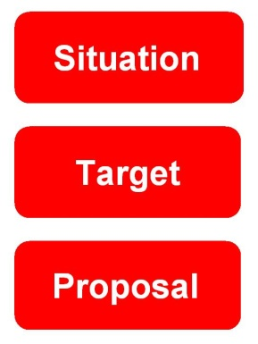
Using an STP
Situation: | Spend is £2.5 million High inventories 70+ suppliers High purchasing process costs Poor internal customer service
Target: | 8% cost saving Inventory managed and owned by supplier No lead time 1 Core Supplier Improved internal service image
Proposal: | Analyse supply market Detailed tendering process Evaluate options Contract negotiation Implementation plan Performance management

Slide 41
Purpose of Stakeholder Management
Influence ‘the need’ and the specification
Evaluate and agree business needs
Discuss and agree strategic direction
Make the best commercial decisions for our business
To identify and reduce maverick behaviour
Drive value / Reduce non-value adding processes
To understand sources and use of Power and Influence
To gauge and then positively influence levels of interest and support
To develop communication plans

Slide 42
Stakeholder analysis
Identify | Use individual or team brainstorming and consultation to identify who your stakeholders are Who is or will be affected by strategies? Who might have power or influence over strategic decisions? Who might have an interest in their success or failure?
Prioritise | Map and classify stakeholders Which stakeholders will need to be the focus of management attention? What engagement and management strategies are indicated by the priority and classification of each stakeholder group?
Understand | Analyse key stakeholder awareness, positions, interests and responses How they are likely to feel about the proposed strategy? How are they likely to respond and react? How can they best be communicated with, engaged, influenced?
Source: Adapted from CIPS Study Materials

Slide 43
Identifying and mapping stakeholders
Internal stakeholders
Other functions / departments / divisions / management / other categories
Connected stakeholders
Customers / suppliers / shareholders / banks
External stakeholders
Society / media

Slide 44
Understand and Prioritise
C
Keep satisfied
D
Key players
High
Sources of Power:
Legitimate
Expert
Reward
Referent
Coercive
A
Minimal effort
B
Keep Informed
POWER
Low
High
INTEREST
Source: Mendelow / French and Raven
Positive / Negative/Neutral
Active / Passive / Neutral

Slide 45
Stakeholder Map and Communication Plan
Stakeholder Map for (name) Category
Stakeholder | Nature of involvement | Business Needs | Power/Influence (HML) | Interest (HML) | Interest: Positive Negative Neutral | Activity: Active Passive Neutral | Action Required | Communication required

Slide 46
Step 2A Identifying Opportunities
Key Questions
Do we understanding our business needs and issues (now and into the future as far as possible)?
Do we have a deep understanding of the external market place, its trends and dynamics and an appreciation of our organisations position within this?
What opportunity for improvement can be gained by commercial and economic insight and an appreciation of best practice?
Are the any quick win opportunities that emerge through our immediate research & analysis? Can we implement these before developing a final strategy?

Slide 47
Step 2A Identifying Opportunities
Research
Analysis
Define scope & purpose and source(s) of research. Agree roles & responsibilities.
Conduct product research & data gathering
Conduct portfolio research & data gathering
Conduct supply market research & data gathering. Undertake RFI if needed.
Conduct relationship history research & data gathering
Conduct internal stakeholder needs analysis and determine strategic business priorities
Derive competitive insight – Porters 5 Forces / Capacity & Demand Analysis/Switching costs/ SWOT analysis/ Pricing Behaviour/ Industry Competitiveness
Derive economic insight – value chain mapping/costs structures/cost modelling/margin analysis. Life cycle costing.
Understand supplier capability & preferencing
Determine category sourcing characteristics

Slide 48
Simplified Opportunity analysis
HIGH
LOW
HIGH
This is an on-going analysis to identify and prioritise opportunities for action.
Typical prioritisation criteria includes:
  Scale of benefits
  Ease/Difficulty
Difficulty could be internal or related to the supply marke
Top Priority
Put Extra Effort in!
LOW
Benefits
Just do it
Avoid
Difficulty
Notes:
Tutor: Later we will discuss Suitability / feasibility / Acceptability

Slide 49
Business Needs
REQUIREMENT | CONCERNED WITH…
Regulatory | Complying with laws and regulations
Assurance of supply | The availability and accessibility of products and services when they are needed
Quality | Consistency and fitness for purpose of products and services
Service | The way in which products and services are supplied; support activities
Cost | Costs and prices, including terms and mechanisms
Innovation | Continuous improvement for the organisation e.g. to reduce costs, increase value, or create competitive advantages

Slide 50
Business Requirements – Hierarchy of Needs
What is the Hierarchy of Needs?
Business Requirements need to be prioritised based on their importance to stakeholders
There is a need to form an objective assessment and evaluation of strategic options
The options we are faced with need to be evaluated against what the organisation actually needs and wants
Of course this is likely to be an areas for conflict – why? And what solutions would you suggest?
Notes:
Diversity of need
Hierarchy of Needs addresses this by ranking requirements in order of importance and criticality to the category
Cost versus Lead Time
Service versus Quality
Quality versus Innovation
Service versus Cost
Cost versus Quality

Slide 51
Hierarchy of Needs
Hierarchy of Needs reviews all Business Requirements and establishes a weighted representation for decision making
This approach allows for conflicting views from different departments in the organisation, for example…
The Quality Department will have different priorities to the Purchasing Department, who in turn will have different priorities to the Warehouse, who in turn will have different priorities to Operations and so on….
Low
Relative importance
of weighted criteria to
stakeholders
High
Go/No Go Criteria

Slide 52
Acquiring Data
Critical to Category management is gaining a clear understanding your current position
Frequently access to such data is complicated by the limitations of IT systems
This is a problem which can be overcome through the use of specialist data mining specialists
Understanding future demand is also critical

Slide 53
Acquiring Data
Customer and business requirements
What do our customers need and how is that / might that change?
What does the organisation need in the short, medium and long term?
Spend analysis
Historical usage analysis of goods and services; supplier positioning; supplier historical analysis; transaction cost analysis; criticality of products and services
Cost and Price analysis
Purchase price cost analyis / should cost
Pricing strategies
Contractual commitment analysis
What contracts do we have, for what, how are they performing, scope for change and/or exit
Cont../

Slide 54
Acquiring Data
Future spend analysis
Forward/expected usage of goods and services; trends in the market
Technology
What is on your / your customers’ / your suppliers’/ the supply market’s technology roadmap?
Are there similarities and/or differences and gaps?
Market analysis
Assessment of market capability; analysis of power dependency in supply chains; analysis of individual marketplaces; supplier preferencing; relative positioning of your organisation; supply chain cost analysis; the nature of the market and appropriate sourcing strategy; potential and actual size of the supply base

Slide 55
Developing a Purchase Price Cost Analysis
Determine the direct and indirect costs that sit behind a product or service
List all indirect costs associated with the running of the organisation behind these products or services
For both the direct and indirect costs, identify cost estimates for as many items as you can
For those areas that cannot be estimated, agree actions as to how to assess these costs
Once your research is complete, review it and interpret what it is telling you
What might you find out?

Slide 56
“Should” costing
56
Develop a strategic intent to manage suppliers through intensive cost knowledge
Move focus of buyers and significant stakeholders from price to costs
  Cost analysis part of the training
  ‘Should costing’ part of the thinking and the process
Move suppliers thinking to working with you on cost
  Cost down cost out approach
Always seek cost breakdowns
  Make it a condition of participation for new suppliers, more important than a tactical gain achieved by introducing a new player
Notes:
56

Slide 57
“Should” costing
57
Develop a data collection plan
  Competitive tendering
  Internet
  Estimating department
  Market research agency
  Network
  Consultants
Start to collect data as essential part of the purchase process
  Set up a group responsible for this type of work
  Widen the net – more suppliers, different locations
  Put in place a data collection process that can be audited and searched
    Membership of journals and internet sites
Notes:
57

Slide 58
“Should” costing
58
Model the supply chain
  Where do the cost sit?
  Who has most influence over them
  What are the trends?
Identify cost drivers
  Labour, materials, overheads, profit margin
  What proportion of each goes to make the finished cost / price
  Where do these costs accrue in the supply chain?
  To what extent can the supplier influence the cost drivers
    Energy?, Intel, Microsoft?
Notes:
58

Slide 59
“Should” costing
59
Understand the costing methods used in different parts of the supply chain
  Breakeven
  Absorption
  ABC
Model the cost of item
  Look at spread of competitive pricing
  Parametric estimates
  Market studies
  Price Listing
Collect historic cost data of cost drivers and previous purchases
  Compare this with your model cost(s)
Notes:
59

Slide 60
Gathering Data on Markets
DATA POTENTIALLY WORTH COLLECTING | POTENTIAL DATA SOURCES
Market conditions and the factors driving them Trends Suppliers operating in the market now Potential entrants to the supply market Market competitiveness Technology trends and emerging technologies Market segments and niches Potential opportunities Potential threats Our power and share of spend in the market | Industry publications Interviews and discussions with suppliers Interviews and discussions with experts Financial reports Media reports Consultants Public indices (e.g. commodity prices) Trade shows
Source: Adapted from CIPS Study Materials

Slide 61


Porter’s five forces model
Threats from new entrants
Competitive rivalry within the industry
Supplier’s bargaining power
Buyer’s
bargaining power
Threats from substitutes

Slide 62
Market Position
The number of suppliers and the extent of global competition
The market shares of the suppliers in the market – market leader, market challenger (number 2), market followers (number 3 onwards)
The extent and success of product differentiation/branding (e.g. Apple - will they always be the market leader or will they be overtaken by Samsung in the different consumer markets they both serve?)
The number and size of other purchasers in the market which will affect your influence with suppliers
The turnover of customers from one supplier to another (market churn which can be very high in consumer markets)

Slide 63
Market Position
Task
Identify examples of organisations whose market positions are
Nicher
Leader
Challenger
Follower
Are there generalisations that can be made about their behaviours?

Slide 64

The Levels of Industry Competition
Depends on the level of competition in any supply market
Perfect Competition
Imperfect Competition
Oligopoly
Monopoly
Source: Adapted from CIPS Study Materials

Slide 65
The Levels of Industry Competition
PERFECT COMPETITION | IMPERFECT COMPETITION | OLIGOPOLY | MONOPOLY
Very many small suppliers | Many slightly larger suppliers | Few large suppliers | One supplier
No market power | Little market power | High market power | Absolute market power
Homogeneous goods: suppliers’ products are interchangeable | Differentiated goods: suppliers’ products are close substitutes | Differentiated goods: degree of substitution variable | No substitutes
One market price: suppliers are ‘price takers’ | Price competition | Seeking of price stability by price leadership or collusion | Price set by one ‘price maker’: potential for price discrimination
Normal profits | Small abnormal profits, short term | Abnormal profits, depending on competition | Abnormal profits
No advertising or branding (everyone knows all goods identical) | Heavy advertising and branding > differentiation | Much advertising and branding > non-price competition | Not much advertising or branding required (no competition)
No barriers to entry | No barriers to entry in the long run | Barriers to entry | Barriers to entry
Source: Adapted from CIPS Study Materials

Slide 66
The Levels of Industry Competition
Task
Analyse 2 or 3 supply markets that you deal with and identify the level of competition in these markets
Identify the impact the level of competition has on:
  Pricing (Stability, Competitiveness)
  Availability
  Power

Slide 67

The Industry Lifecycle
Market size
Development
Growth
Shake-out
Maturity
Decline
Typical five forces
Low rivalry
High differentiation
Innovation key
Low rivalry
High growth and weak buyers, but low entry barriers
Growth ability key
Increasing rivalry
Slower growth and some exits
Managerial and financial strength key
Stronger buyers
Low growth and standard products, but higher entry barriers
Market share and cost key
Extreme rivalry
Typically many exits and price competition
Cost and commitment key
Source: Adapted from Johnson. Scholes and Whittington

Slide 68
STEEPLE Analysis
FACTOR | ANALYSIS
Socio-Cultural | How might changes in attitudes, fashions or other trends impact on the expectations of customers, suppliers and other stakeholders
Technological | The impact of technology in the form of materials, innovations or working methods that can impact on the organisations operations
Economic | The underlying changes in the macro (inflation, unemployment, interest rates, currency value) and micro (changes in costs and supply factor) economy
Environmental | The impact on waste and the environment and the need to comply with environmental standards
Political | The likely implications of a change in government or governmental policies in the countries that can affect the organisation’s operations
Legal | Changes in legislation, quality or environmental standards that can affect the organisation’s supply of products or services
Ethical | The areas of the organisation’s supply chain that can be impacted by adverse publicity through any perceived breach of ethical standards such as the use of modern slavery or human rights
Notes:
Note for Tutors – TTIP and Brexit are obvious examples of Political factors but not stated here as potentially controversial and distracting.

Slide 69
Steps in Environmental Analysis
Audit environmental influences
Identify environmental factors that are affecting or might affect the organisation and its market
1
Assess nature of the environment
Identify whether the environment is stable or changing (dynamic), and what the changes and trends are
2
Identify key environmental forces
Identify which factors are having or will have the greatest impact on the organisation
3
Identify opportunities and threats
Identify opportunities or threats posed by these factors: analyse risk and possible response
4
Formulate strategies
Make plans that will minimise threats, capitalise on opportunities, and therefore ‘fit’ the organisation to its environment
5

Slide 70
The Boston matrix
High
Low
High
Low
Product movement (A to B to C, representing the product lifecycle)
Stars
Question marks
B
A
x
y
Relative market growth
Cash cows
Dogs
Cash movement (from product z to products x and y)
C
z
Relative market share

Slide 71
Supplier Preferencing Matrix
HIGH
There are other matrices that can be applied to profile expenditures such as:
LOW
HIGH
Development
Core
LOW
Attractiveness of
buying organisation
Nuisance
Exploitable
Source: PMMS
Value of buyer’s business

Slide 72
Bringing it all together into a SWOT
Weaknesses
HELPFUL
To your objective
HARMFUL
To your objective
Strengths
INTERNAL
(Within organisation)
Opportunities
Threats
EXTERNAL
(outside organisation)

Slide 73
Step 2B Prioritising Opportunities
Key Questions
What are the changes and opportunities that will drive improved performance?
What risks need to be addressed?
What priorities make sense for the business?

Slide 74
Step 2B Prioritising Opportunities
Checklist – To Do
1.Screen & prioritise opportunities
2.Identify potential suppliers
3.Determine desired relationship type & segmentation approach
4.Qualify suppliers
5.Conduct impact assessment (include corporate responsibility & CSR/sustainability factors i.e. Social, Economic and Environmental impacts)
6.Assess the capability of the internal procurement process to deliver suggested changes
7.Socialise proposed opportunities with significant stakeholders

Slide 75
Category options
Outsource / Insource Make / Buy / Lease Local / International / local sourcing Partnership / Joint ventures Integration upstream, downstream, horizontally Product Development Innovation Single sourcing/ Dual Soucing / Multiple Sourcing Co-ordinated single-sourcing or parallel sourcing Systems / Systems Integration No Change Stop Others?

Slide 76
The product/market growth matrix – Ansof
Diversification
On existing competencies
With new competencies
Market penetration
Withdrawal
Consolidation
Market penetration
Product development
On existing competencies
With new competencies
Existing product
New Product
Market development
New segments
New territories
New users
New Market
Existing Market

Slide 77
Integration options
Machinery manufacture
Components manufacture
Raw materials production
BACKWARDS INTEGRATION
Machinery supply
Components supply
Raw materials supply
Research and design
Transport
Finance
Complementary products
Complementary capabilities
HORIZONTAL INTEGRATION
THE ORGANISATION
Competitive products
By-products
FORWARD INTEGRATION
Distribution channels
Transport
Marketing
Repairs and servicing

Slide 78
Intregration options
Horizontal integration
Development into activities which are competitive with, or directly complementary to, the organisation’s present activities
Backward vertical integration
An organisation becomes its own supplier of raw materials, components or services: in other words, it controls the inputs to its business
Forward vertical integration
An organisation enters areas concerned with the outputs of its business

Slide 79
The make or buy decision
‘Buy’ advantages | ‘Buy’ disadvantages
Allows downsizing Allows focused investments on people and other resources in core competencies Leverages the specialist expertise, technologies, resources and economies of scale of suppliers Enables synergy through collaborative supply relationships | Costs of services and relationship/contract management Loss of control and difficulties ensuring service standards Potential reputational damage if service or ethical issues arise Loss of in-house knowledge and competencies (for future needs) Loss of control over confidential information/intellectual property Ethical and employee relations issues of downsizing
Source: Adapted from CIPS Study Materials

Slide 80
Make or buy
Internal sourcing (the make option) is excluded for any item which cannot be made on available equipment or using existing resources subject to capacity constraints.
External sourcing (the buy option) should be excluded for items which can be made economically with in-house capacity.
Tactical decisions involve procuring equipment, personnel or other resources without changing the fundamental nature of the organisation’s asset base.
Strategic decisions take place on issues around the vertical integration wherein entire business units are acquired or outsourced. This results in either developing or closing down part of the capabilities of the organisation.
Source: Baily et al

Slide 81
Determining strategic outsourcing suitability
High
In house
Collaboration
Core importance
Develop contracting
Outsource
Low
High
Competence of contractors

Slide 82
Outsourcing
ADVANTAGES/OPPORTUNITIES | DISADVANTAGES/RISKS
Supports rationalisation and downsizing Allows focused investment of managerial, staff and other resources on core activities Accesses and leverages the specialist expertise, technology and resources of contractors Access to economies of scale Adds competitive performance incentives Leverages collaborative supply relationships Cost certainty for activities where demand and costs are uncertain or fluctuating | Potentially higher cost of services Difficulty of ensuring service quality and consistency and corporate social responsibility Potential loss of in-house expertise, knowledge, contacts or technologies Potential loss of control over key areas of performance and risk Added distance from the customer or end-user Risks of ‘lock in’ to an incompatible or under-performing relationship Risks of loss of control over confidential data and intellectual property Ethical and employee relations issues of transfer or cessation of activities Potential risks, costs and difficulties of in-sourcing if the outsource arrangement fails
Source: Adapted from CIPS Study Materials

Slide 83
Market Approaches – Features
COMPETITION | DIRECT NEGOTIATION
More supply options at any one time A distant relationship with the supplier is more likely Suitable for more generic or specified products or services Formal, recorded, regulated process Rigorous assessment and structured evaluation with transparent scoring Time consuming High preparation costs, but no guarantee of success Requires substantial data gathering and analysis | Fewer supply options at any one time Direct face-to-face engagement highly dependent on personal interactions Influenced by negotiators’ choices and experiences Suitable for complex environments or specialist needs Process responds to tactical moves and power plays
Source: Adapted from CIPS Study Materials

Slide 84
Market Approaches – Advantages
COMPETITION | DIRECT NEGOTIATION
Provides leverage in the market place Forces suppliers to work against each other Forces organisations to be more specific about what they want before going to market Needs audit trail which will demonstrate unbiased decision making Notionally open, transparent and fair for suppliers All potential suppliers work off the same information and criteria Little scope for change or adaptation unless specifically requested by a supplier | Permits closer relationships More collaborative – only seriously rated suppliers involved Flexible to in-process changes Terms of reference more open More responsive to individual skill and initiative Reflects less programmable factors e.g. supply market competition, geography, power, risk, complexity, relationships, and people More likely to need a back-up plan; greater chance of failure
Source: Adapted from CIPS Study Materials

Slide 85
Market Approaches – Drawbacks
COMPETITION | DIRECT NEGOTIATION
Prohibits close relationships with suppliers during process Sets requirements for organisational behaviours High cost and time impacts Organisation cannot choose preferred suppliers Less flexible decision making; constrained by pre-programmed criteria and process | More difficult audit trail More subjective and biased Less transparent Negotiation is an open-ended process rather than a carefully defined event; not clear where it starts and finishes
Source: Adapted from CIPS Study Materials

Slide 86
Risk and Risk Management
ISO31000 define risk as “the effect of uncertainty on objectives – can be negative, positive or a deviation from the expected. It should be measured against stakeholders expectations”
Institute of Risk Management define risk management as “ the systematic process of identifying, analysing and addressing risk in order to deliver objectives”
Questions relating to category strategy risks
Why do we need a systematic process? And what does that mean?
How do we identify and analyse risks in relation to our proposals?
What means do we have of addressing them?

Slide 87
Types of Risks
87
Operational
Distribution/ logistics
Suppliers
Product/ service quality
Employee issues
Fraud
Projects
Natural events
IT
Fire
Strategic
Markets
Competitors
Technology
The economy
Consumer needs
Legal: contracts, litigation and IPR
Merger
Acquisition
Business
Risk Management
Compliance
Stock exchange rules
Taxation requirements
Environmental legislation
Accounting standards
Internal controls
Ethics
Financial
Exchange rates
Interest rates
Liquidity
Profitability
Credit
Costs
  Source: Sadgrove, The Complete Guide to Business Risk Management, 2nd Edition (2005)

Slide 88
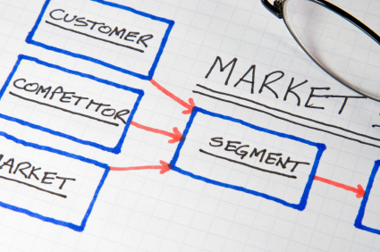




Consequences of not managing risk…..
88
Losing
Competitive
Advantage
Losing Market
Disrupting
Supply
Creating
Bad Press
Increasing Costs
5 fundamental ways to damage an organisation

Slide 89
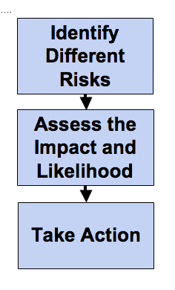
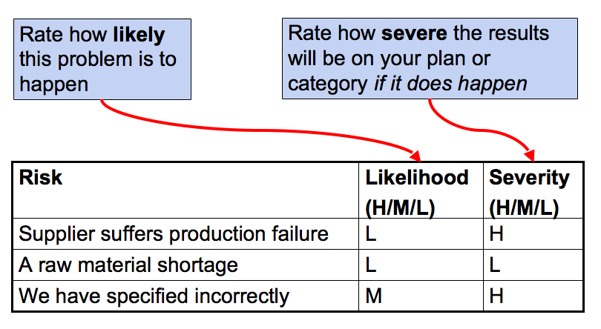
Risk Management Process
89
A 3 step approach to Risk Management:
1
2
3
Notes:
89

Slide 90
Red / Amber / Green (RAG)
90
Probability
Impact
Notes:
90

Slide 91
Dealing with Risk
The 4 Approaches
Tolerate
  Low risk / low impact
  Cost of mitigating prohibitive
  No suitable mitigation available
  High risk appetitie
Treat
  Take action yourself
  Reduce likelihood and/or impact
Transfer
  To suppliers, customers, insurers
Terminate
  Risk too great / impact to high
  Low risk appetite
  No suitable mitigations

Slide 92
Strategic Analysis, Choice and Implementation
Expectations
Power
The
Environment
Resources
Strategic
Analysis
Generation
of Options
Resource
Planning
Strategic
Choice
Strategy
Implementation
Evaluation
of Options
Organisation
Structure
Selection
of Strategy
People and
Systems
Source: Johnson, Scholes and Whittington

Slide 93

Strategic Choice
Each option developed for a change in category strategy should be evaluated-
They can be profiled in terms of their suitability, feasibility and acceptability
The costs of implementation or switching costs versus their potential benefits can also be evaluated
This option evaluation should be included in the business case.

Slide 94
Indicative Opportunity Analysis Template
Category | Opportunity / proposed action | Scale of benefit (HML) | Cost of change / implementation | Measure of benefit | Difficulty level | Priority (RAG) | Risk (RAG) | Timescale for Action | Responsible for Action

Slide 95
Step 3 Prepare/Present Category Strategy
Key Questions
Is the strategy grounded and are the recommendations supported by the research and analysis?
What is the payback (benefit) how will it be measured and is it realistic and tangible?
Does the expected benefit stack up in relation to the anticipated risks and the resources required to deliver them?
Does the strategy address the business issues and objectives identified at the outset?

Slide 96
Step 3 Prepare/Present Category Strategy
Checklist – To Do
Develop sourcing strategy/route to market and other recommended changes
Quantify expected benefits define resource and costs implications
Quantify risk & develop mitigation plans
Prepare detailed implementation plan
Define relationship management & governance structures
Confirm segmentation approach, relationship profiles and roles Confirm transaction process
[Formal ‘stop and think’ before proceeding e.g. gate review with senior business stakeholders]

Slide 97
Sections in a category strategic sourcing plan
Current situation
Business requirements
Strategic analysis and insight
Options for change
Recommended sourcing option
Risk and contingency plan
High-level implementation plan
Cost-benefit analysis
Next steps
Appendices (as needed)

Slide 98
Pointers about the plan
Key gate review stage and sign off is critical!
It will vary in depth and complexity depending upon the nature of the improvement exercise and the category change programme
Its purpose is to get organisational and stakeholder sign-off, and ultimate agreement to the recommended course of action
It also provides documentary evidence of the journey through the category that can serve as an audit, support future change in the management of the category, and provide a baseline against which to track the programme
It will provide an excellent communication vehicle to internal stakeholders but should not be shared externally
Cont../
Source: Adapted from CIPS Study Materials

Slide 99
Determining how to pitch the plan to stakeholders
Detailed source plan, focus on securing widescale buy-in
Typically lengthy document
Simple source plan to secure go-ahead
Typically short document, maybe only a few pages
Focus on how the change will be implemented
Typically medium-length document
Many /
varied
Focus on why the
change is necessary
Typically medium-length document
Number and variety of stakeholders
Few
Simple
Degree of change
Complex

Slide 100
Step 4 Implement Category Strategy
Key Questions
Is the implementation and change program being communicated effectively?
Is implementation proceeding as outlined in the strategy?
Are relationships and supporting structures in place?
Are performance measurement/reporting systems established?
Are benefits secured and captured?
Are transition risks being effectively managed?
Are stakeholder’s satisfied?

Slide 101
Step 4 Implement Category Strategy
Checklist – To Do
Create service/specification & requirements
Conduct market enquiry (RFI/RFQ/Pitch)
Analyse responses
Select preferred suppliers
Negotiate
Select Supplier
Contract with supplier
Mobilise other strategy change initiatives
Measure & communicate progress
Manage transition risk
Initiate relationship management process
Deliver training for new/changed resources/systems/processes
Apply supplier segmentation rules

Slide 102
Compliance monitoring
Price monitoring
Making sure invoiced prices match with contract prices, and that any discrepancies are justifiable
CSR and sustainability monitoring
Are suppliers complying with the organisation’s policies? If not, is the organisation protected from e.g. reputational risk and can it move on to alternative suppliers?
Contract users
Make sure all internal personnel are using
the installed contracts; identify and
address off-contract spend

Slide 103
Continuous improvement
Specification improvement
That is, to keep track of changes, identify refinements and communicate and implement these as necessary, including reviews of needs and the supply markets, trend tracking, options for substitution and aggregation, CSR developments
Cont../

Slide 104
Continuous improvement cont../
Process improvement
Eliminate non-value-adding processes through modifications to current processes and systems, facilitating best practice amongst contract users and suppliers,
supplier forums and workshops,
focusing high value-adding suppliers
Knowledge sharing
With procurement in general and
other category managers in particular

Slide 105
Category manager duties
Ensure that contracts are implemented according to the agreed terms
Ensure all users keep to established agreements
Act as the main point of contact with suppliers and internal stakeholders
Resolve operational issues raised by contract users and suppliers
Communicate operational procedures to contract users and stakeholders
Cont../

Slide 106
Category manager duties cont../
Report on supplier performance, transaction data, savings and continuous improvement initiatives to stakeholders
Ensure all goods and /or services are provided in accordance with the contractual requirements
Progress the continuous improvement opportunities identified during strategic sourcing
Maximise opportunities to improve the corporate social responsibility of the organisation and its suppliers

Slide 107
Step 5 Maintain
Key Questions
Are we managing supplier relationships effectively?
Are we managing internal stakeholder relationships effectively?
Are risks identified and managed?
Is the strategy delivering the expected benefits?
Is performance monitored and are issues effectively managed and resolved?

Slide 108
Step 5 Maintain
Checklist – To Do
Manage and evaluate supplier relationships
Manage and evaluate internal relationships
Manage performance; non-conformance events, problem resolution, learning
Manage supplier contract
Manage supplier contract variation & changes
Manage supplier contract termination
Measure & review performance
Communicate with stakeholders & suppliers
Manage ongoing risk and continuity planning
Manage transactions (fulfilment); demand notification, aggregation, forward demand planning, supplier allocation & payment
Apply audit & controls

Slide 109
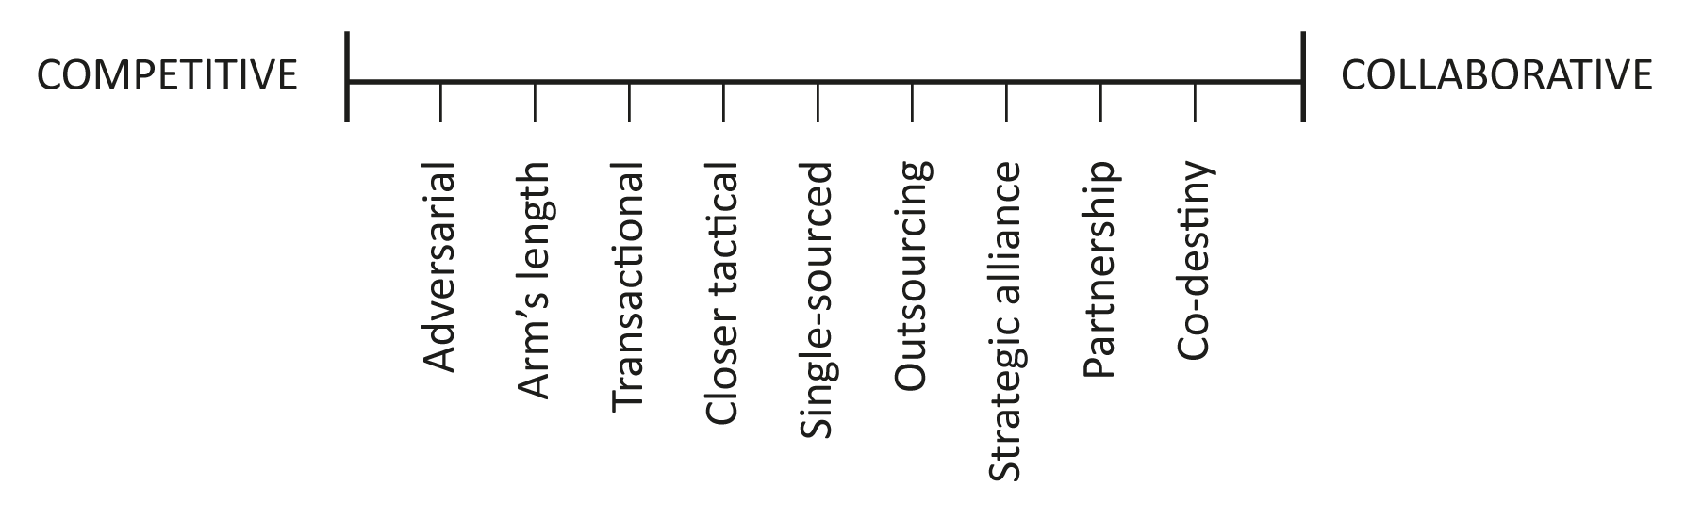
The relationship spectrum
  Traditionally the supplier/ buyer relationship is based on win/lose principles with each party seeking to Win.
  Inevitable this leads to an Adversarial relationship whereby one party gains ascendancy and the other seeks to limit its “losses”
  By limiting its losses, it restricts inputs and thereby overall value diminishes
Source: Adapted from CIPS Study Materials
Notes:
Cox talks of a step ladder of relationships from adversarial, preferred, single source through to strategic. Each step defines increasing inter dependency

Slide 110
Shortcomings of the traditional adversarial model
  The emphasis on competition, rather than co-operation, means that each party fails to derive the full benefits of the other party’s expertise
  More waste arises from the breadth and lack of development of the supply base
  Suppliers are unlikely to be focused or motivated by short-term contracts
  There is little potential for improved quality and reduced costs arising from integration and co-operation or for a continuous improvement orientation
Source: Adapted from CIPS Study Materials

Slide 111
Supply chain collaboration drivers
Competitive advantage cannot be sustained purely through win/lose strategies
Organisations are increasingly outsourcing non-core activities to external contractors hence longer term relationships and need to maximise value
ICT developments have enabled and supported inter-organisational networking and relationships
There is pressure for companies to protect and leverage their intellectual property, knowledge, relationship networks and brand values
A focus on arms’ length, opportunistic transactions fails to leverage the competitive and value-adding potential in supply chain relationships
There are costs of adversarial relationships
With competitive pressures towards ‘lean’ supply, closer relationships and integration help to reduce waste in supply chains
‘Best practice’ supply techniques, such as total quality management and just in time supply, reduce tolerance for delays and errors in the supply process
Source: Adapted from CIPS Study Materials
Notes:
Gaining competitive advantage through traditional adversarial approaches is limiting. Value has to be created through mutual advantage
Martin Christopher 4 ‘R’s, 2005.

Slide 112

Relationship Development
‘Sharing both profits and risk’
‘Risk sharing and shared milestones’
Integration
‘Reduced price fee for service’
Alliance
Partnering
‘Fee for service’
Preferred
Transactional
ATTRIBUTES | Price dominates | Assured standards | Performance improvement | Business objectives | Core competence
FEATURES | Tenders Tactical negotiation | Preconditions Prequalifications | Mutual development | Joint ventures | Mergers and acquisitions
INCREASING CLOSENESS OF RELATIONSHIP
Source: Adapted from CIPS Study Materials

Slide 113
The PADI buyer value framework
Integration
Core buyer value:
‘understand me’
Caring; interaction; teamwork; participation; partnership; joint development; loyal/long term; lower price sensitivity
Development/Divergence
Core buyer value:
‘Surprise me’
Innovative, creative, entrepreneurial; flexible; what’s new/different?; ideas; new technology; individualistic; better ways of doing things; lower price sensitivity
Administration
Core buyer value:
‘Be consistent’
Accuracy; no frills; reliable/consistent; predictable/ routine; regular/planned; account administration; very price sensitive; discounts/reduce costs; efficiency/ savings; no surprises
Production/Pragmatic
Core buyer value:
‘Respond’
Demanding; urgency; time sensitive; want one person to solve problems quickly; VFM/price sensitive; not loyal (shop around); results-driven, not procedures-driven; competitive

Slide 114
Contract Management and SRM
According to the UK Government:
“Contract management is the process which ensures that both parties to a contract fully meet their respective obligations as efficiently and effectively as possible, in order to deliver the business and operational objectives required from the contract and in particular to provide value for money”
“Supplier Relationship Management can be defined as the proactive management of an ongoing business relationship to secure a competitive advantage for your own organisation. The focus of SRM is on the overall relationships between the supplier and the buying organisation rather than a focus on a specific contract”

Slide 115

Contract Management and SRM
There are a variety of processes to establish supplier relationship management - one that combines contract management and SRM was published
by the UK Government’s Office of
Government Commerce as relationship
management can be seen as an
element of approaches to
contract management

Slide 116
Contract Management and SRM
Structure and Resources
Delivery
Development
Strategy
Governance
Transition from tendering process
Clear ownership
High level visibility
People
Appropriate staff resource
Training and development
Job descriptions and objectives
Wider contract community
Administration
Storage and records
Reporting
Key trigger points
Relationship
Supplier continuity
Supplier liaison
User feedback
Problem resolution process
Performance
Service management
Service level agreements and performance metrics
Performance reviews
Payment
Invoice checks
Incentives/penalties
Forward budgetary management
Risk
Joint risk assessment and actions
Contract Development
Negotiation of changes/ new terms
New services
VFM testing
Supplier Development
Development plans
Joint improvement teams
Shared training
Innovation
Supplier Relationship
Management
Structured relationship management programme
Senior relationship governance
Market Management
Market intelligence
Market capacity and capability issues
Re-competition
Adapted from OGC ‘Good Practice Contract Management Framework (2008)

Slide 117
Step 6 Improve and Enhance
Key Questions
Do we have mechanisms which identify and seek to deliver continuous improvements?
Do we have the right internal and external behaviours and structures to generate and deliver change and innovation?
Are we aware of internal and external changes and routinely assess how they might present risk or opportunity?
Is the category strategy still aligned to the needs and priorities of the organisation?

Slide 118
Step 6 Improve and Enhance
Checklist – To Do
Identify improvement opportunities
Deliver continuous improvement actions; benchmarking, problem analysis, competitor analysis, supplier networking & development
Capture/share learning & knowledge
Consider internal/external events which change, challenge, provide opportunity or risk procurement deliverables
Continue to align strategy & business needs (e.g. through the planning process)
Communicate progress in delivering strategy & benefits
Formal ‘stop and think’ to re-affirm strategy effectiveness or as a result of a major internal or external trigger event.

Slide 119
Benefits Tracking
Objectives
Assess what has been achieved compared to the agreed objectives
Provides rational information to deal with emotional evaluations
Identify root causes of underachievement and modify the approach through corrective actions
Enables continuous improvement
Helps (re)prioritise resources
Share experiences with others / learning from experience
Escalate blockages or conflic to seek support
Anticipate change and respond appropriately
Raise the profile of the procurement function

Slide 120
Category Management
In this Unit, we will be focusing on:
Understanding the Category Management Approach
Categorising Expenditure
The CIPS model
Category Management Governance
Behavioural and technical skills

Slide 121
Typical governance structure for category management
Executive team
People development
Programme steering group
(including chairman and programme manager)
Programme communications
Benefits tracking
Programme plan
Category team 1
Category team 2
Category team 3
Category team 4
Category team 5
Category teams include a category manager/team leader

Slide 122
Governance
Purpose:
Signs off the Project Charter
Ensures strategic alignment
Provides direction, guidance, coaching and support
Ensures that the right resources are allocated
Enables interfaces with other functions, projects, teams
Helps manage the project timelines
Helps ensure projects managed to budget
Reviews benefits gained versus expectations and costs
Help resolve disputes and/or contraints

Slide 123
Category Management
In this Unit, we will be focusing on:
Understanding the Category Management Approach
Categorising Expenditure
The CIPS model
Category Management Governance
Behavioural and technical skills

Slide 124
Snell’s Category Management Skill Set
Change management Commercial awareness Communication Creativity Flexibility | Leadership Market knowledge Persuasion Procurement skills Tenacity Vision
Notes:
see handout

Slide 125
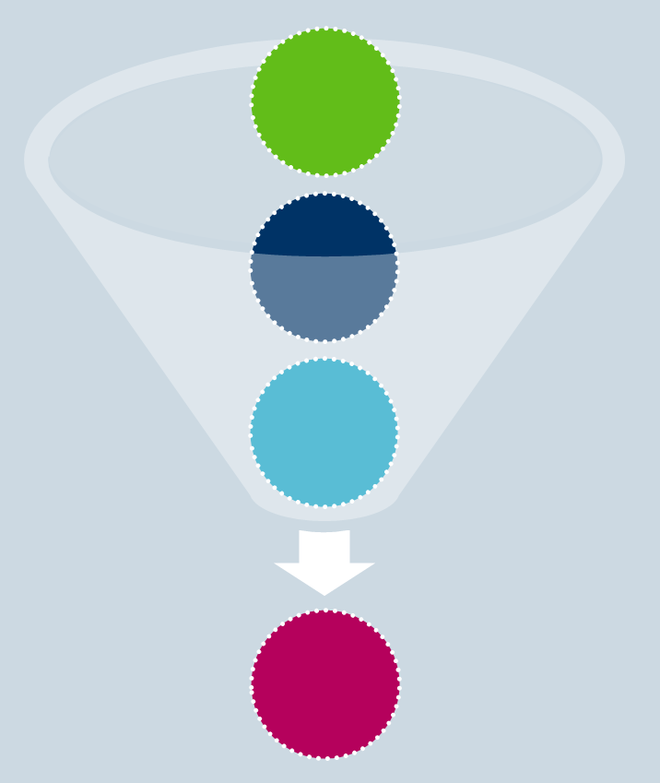
Interpersonal Skills
Influencing and Persuasion
Applying pressure to
change attitudes through
authority and power
Persuading through logical
argument or appeal
a
awareness
i
interest
d
desire
a
action

Slide 126
Leading in four directions
Own boss
Senior
decision-makers
Supply chain
Manager/leader
Colleagues in purchasing and
other functions
Subordinates/team members
(Boddy and Buchanan (1992)
Notes:
Particularly relevant for the idea of “informal leadership”

Slide 127
Pedler’s Challenges Approach
7 CORE PRACTICES | 14 KEY CHALLENGES
‘Leading yourself’ | Developing direction and strategy
 | Creating a ‘learning organisation’
‘On purpose’ | New, flexible and continually changing organisational structures
 | Working effectively with complex, self-managing and ‘virtual’ teams
‘Power’ | Creating and maintaining cultures of innovation and creativity
 | Fostering diversity and inclusion
‘Living with risk’ | Promoting collaborative, negotiated partnerships
 | Improving the quality and efficiency of work processes
Notes:
A collective functional model based on what we do when facing challenges – recognising, mobilising and taking action
3 domains of their model:
Challenges – tasks, problems and issues to be faced by all involved
Characteristics – qualities, competencies and skills of those involved
Context – the immediate conditions of the challenging situation
Involves developing effectiveness in core practices

Slide 128
Pedler’s Challenges Approach
7 CORE PRACTICES | 14 KEY CHALLENGES
‘Challenging questions’ | Streamlining
 | Encouraging social responsibility
‘Facilitation’ | Mobilising knowledge
 | Leading in networks
‘Networking’ | Managing mergers for added value
 | Making major change
(Pedler, Burgoyne and Boydell, 2004)
Notes:
A collective functional model based on what we do when facing challenges – recognising, mobilising and taking action
3 domains of their model:
Challenges – tasks, problems and issues to be faced by all involved
Characteristics – qualities, competencies and skills of those involved
Context – the immediate conditions of the challenging situation
Involves developing effectiveness in core practices

Slide 129
Ashridge Approach
Tells (autocratic)
The leader makes decisions and issues instructions which must be obeyed without question
Sells (persuasive)
The leader still makes decisions, but believes that team members must be motivated to accept them in order to carry them out properly
Consults (participative)
The leader confers with team members and takes their views into account, although he retains the final say
Joins (democratic)
Leader and team members make the decision together on the basis of consensus
Source: Ashridge Management College
Notes:
UK Industry Study showed clear preference by subordinates for Consults
Managers often perceived as telling or selling
Least favourable was where there was no consistency
Subordinates are unsettled by a boss who changes style

Slide 130

Facilitative Communication Skills
The use of questions and answers to support information exchange
Presenting complex arguments in manageable segments
Summarising each section of a discussion or argument to reinforce understanding
Asking for feedback to check
understanding
Sensitivity and flexibility to
respond to verbal and
non-verbal signals of
where the other party is ‘up to’
Source: Adapted from CIPS Study Materials
Notes:
Persuasion is exerting influence over people by means other than using authority or power – pull influencing
Logical argument
Involves rapport, positive body language, pacing and leading, speaking with appropriate appeal and interest
YUKL 1998:
Impression management
Political influence
Proactive influence

Slide 131
Techniques for Building Rapport
Subtly matching or mirroring the other person’s posture, body language and/or volume, speed and tone of voice
Picking up on the other person’s use of technical words, colloquialisms and metaphors
Picking up on the other person’s dominant way of experiencing and expressing things
Listening attentively and actively to what the other person is saying
Finding topics of common interest, and emphasising areas of agreement or common ground where possible
Remembering and using people’s names
Source: Adapted from CIPS Study Materials

Slide 132
Push and Pull Influencing
A PUSH APPROACH | A PULL APPROACH
Telling (very hard push!) Proposing Suggesting Information sharing Developing the idea further……. “so from what you are saying we could also…..” | Clarifying Asking Seeking information Asking Testing understanding Summarising
Research by Huthwaite reveals people with higher developed
interpersonal skills are able to use pull approaches to influence others
Notes:
Push – own agenda, directive, prescriptive, demands, statements, “should”, “ought”
Pull – others agenda, questioning, probing, reflecting, clarifying

Slide 133
Influencing Tactics
TACTIC | APPROACH
Rational persuasion | Logical argument and evidence
Inspirational appeal | Appeal to the influencee’s ideals, values and aspirations
Consultation | Asking the influencee to participate in planning, or demonstrating willingness to take the influencee’s ideas and concerns into account
Ingratiation | Getting the influencee to think well of you, or to be in a co-operative frame of mind, before a request is made
Exchange | Offering a reciprocal exchange of favours or promising a share of the benefits
Personal appeal | Appealing to personal friendship and loyalty
Coalition | Seeking the help of others to persuade the influencee, or using the fact of their support as a reason for the influencee to agree as well
Legitimating | Establishing the objective legitimacy of a request
Pressure | Threatening sanctions, or using assertiveness bordering on aggression, to demand compliance
(Yukl and Falbe, 1990)
Notes:
Different tactics depending on 4 directions
Choice of influencing tactic depends on
Leaders power and resources
Likely response
Potential costs (eg loss of cradibility)
How ethical it is
Prevailing culture (acceptability)

Slide 134
Resolving Conflict (Thomas and Kilmann 1974)
Importance of relationship
Assertive
Forcing/competing
Collaborating
Attempt to satisfy own concerns
Compromising
Importance
of the issue/ outcome
Avoiding
Accommodating
Unassertive
Uncooperative
Attempt to satisfy others’ concerns
Cooperative

Slide 135
Advanced Category Management in Procurement and SCM module
There are 3 units to this module
Category Management
Supply Chain Improvement
Developing Systems for Procurement and Supply Chain Management

Slide 136
Supply Chain Improvement
In this Unit, we will be focusing on:
The collaborative model of SCM
Value chain analysis
Total quality approaches
Using statistical analysis to develop supplies
JIT and lean thinking
Benchmarking
BPR

Slide 137
The shift to supply chain management
Rate your supply chains against each of these. What is the conclusion?
TRADITIONAL WAYS | NEW WAYS
Key feature: Independence | Key feature: Integration
Independent of next link | Dependency
Links are protective | End-to-end visibility
Uncertainty | More certainty
Unresponsive to change | Quicker response
High cost, low service | High service, lower cost
Fragmented internally | ‘Joined up’ structures
‘Blame’ (adversarial) culture | ‘Gain’ (collaborative value-adding) culture
Competing companies | Competing supply chains

Slide 138
The shift to supply chain management
Why the change?
Cost pressures
Time pressures
Reliability pressures
Response pressures
Transparency pressures
Globalisation pressures
What else is driving the change?
But are there any pressures to reverse the process?

Slide 139
Benefits of a SCM approach
Reduced total costs
Improved responsiveness to customers’ requirements
Access to complementary resources and capabilities
Enhanced product and service quality
Improved supply chain communication
Improved inventory management
Reduced cycle times
Greater transparency for cost and risk management
Greater supply chain visibility
Optimising the balance of service levels and costs

Slide 140
Supply Chain Management Discussion
What are the implications of this change for the buyer
Think about:
Nature of relationships?
Technologies?
Commercial Risks / exposures?
Number of suppliers
Who owns the relationship?
Links internally with others?
Role of Procurement?

Slide 141
The Relationship Spectrum
COMPETITIVE
COLLABORATIVE
Adversarial
Arm’s length
Transactional
Closer tactical
Single-sourced
Outsourcing
Strategic alliance
Partnership
Co-destiny
Source: Adapted from CIPS Study Materials

Slide 142
Supply Partnership
A joint and mutual search for greater efficiency and competitiveness
Joint planning for the future by the customer and the supplier
Agreed shared objectives
Understanding between the customer and the supplier that there should be a joint effort to eliminate waste from the supply chain
Openness and transparency between the organisations
Each party understands the expectations of the other and seeks to meet or exceed them
The relationship is one of equal partners
They recognise that the relationship might not last for ever and have a prepared and agreed exit strategy
Source: Adapted from CIPS Study Materials

Slide 143
Supply Partnership - Characteristics
Cultural compatibility between the partners
A high level of trust, knowledge sharing and openness between customer and supplier
Mutual acceptance of the concept of win-win within the supply chain
Relevant expertise, resources or competencies in complementary areas
Clear joint objectives and meaningful performance measures for assessing supply chain performance
The use of cross-functional teams to enhance co-ordination, process focus and continuous improvement
A total quality management philosophy, focused on co-operative efforts to maximise quality and secure continuous improvement
A high degree of systems integration
Source: Adapted from CIPS Study Materials

Slide 144
Supply Partnership - Characteristics
ADVANTAGES FOR THE BUYER | DISADVANTAGES FOR THE BUYER
Greater stability of supply and supply prices | Risk of complacency regarding cost and quality
Sharing of risk and investment | Less flexibility to change suppliers at need
Better supplier motivation and responsiveness | Possible risk to confidentiality, intellectual property
Cost savings from reduced supplier base, collaborative cost reduction | May be locked into relationship with an incompatible or inflexible supplier
Access to supplier’s technology and expertise | Restricted in EU public sector procurement directives
Joint planning and information sharing, supporting capacity planning and efficiency | May be locked into relationship, despite supply market changes and opportunities
Ability to plan long-term improvements | Costs of relationship management
More attention to relationship management | Mutual dependency may create loss of flexibility and control
Source: Adapted from CIPS Study Materials

Slide 145
Adversarial Relationships - Characteristics
Lack of trust and therefore little information sharing
A one-off or short-term transaction focus
The use of power and negotiation to seek the best possible deal
Rigorously enforced compliance with contract terms
Little co-operation or recognition of mutual interests
Source: Adapted from CIPS Study Materials

Slide 146
Supply Chain Improvement
In this Unit, we will be focusing on:
The collaborative model of SCM
Value chain analysis
Total quality approaches
Using statistical analysis to develop supplies
JIT and lean thinking
Benchmarking
BPR

Slide 147
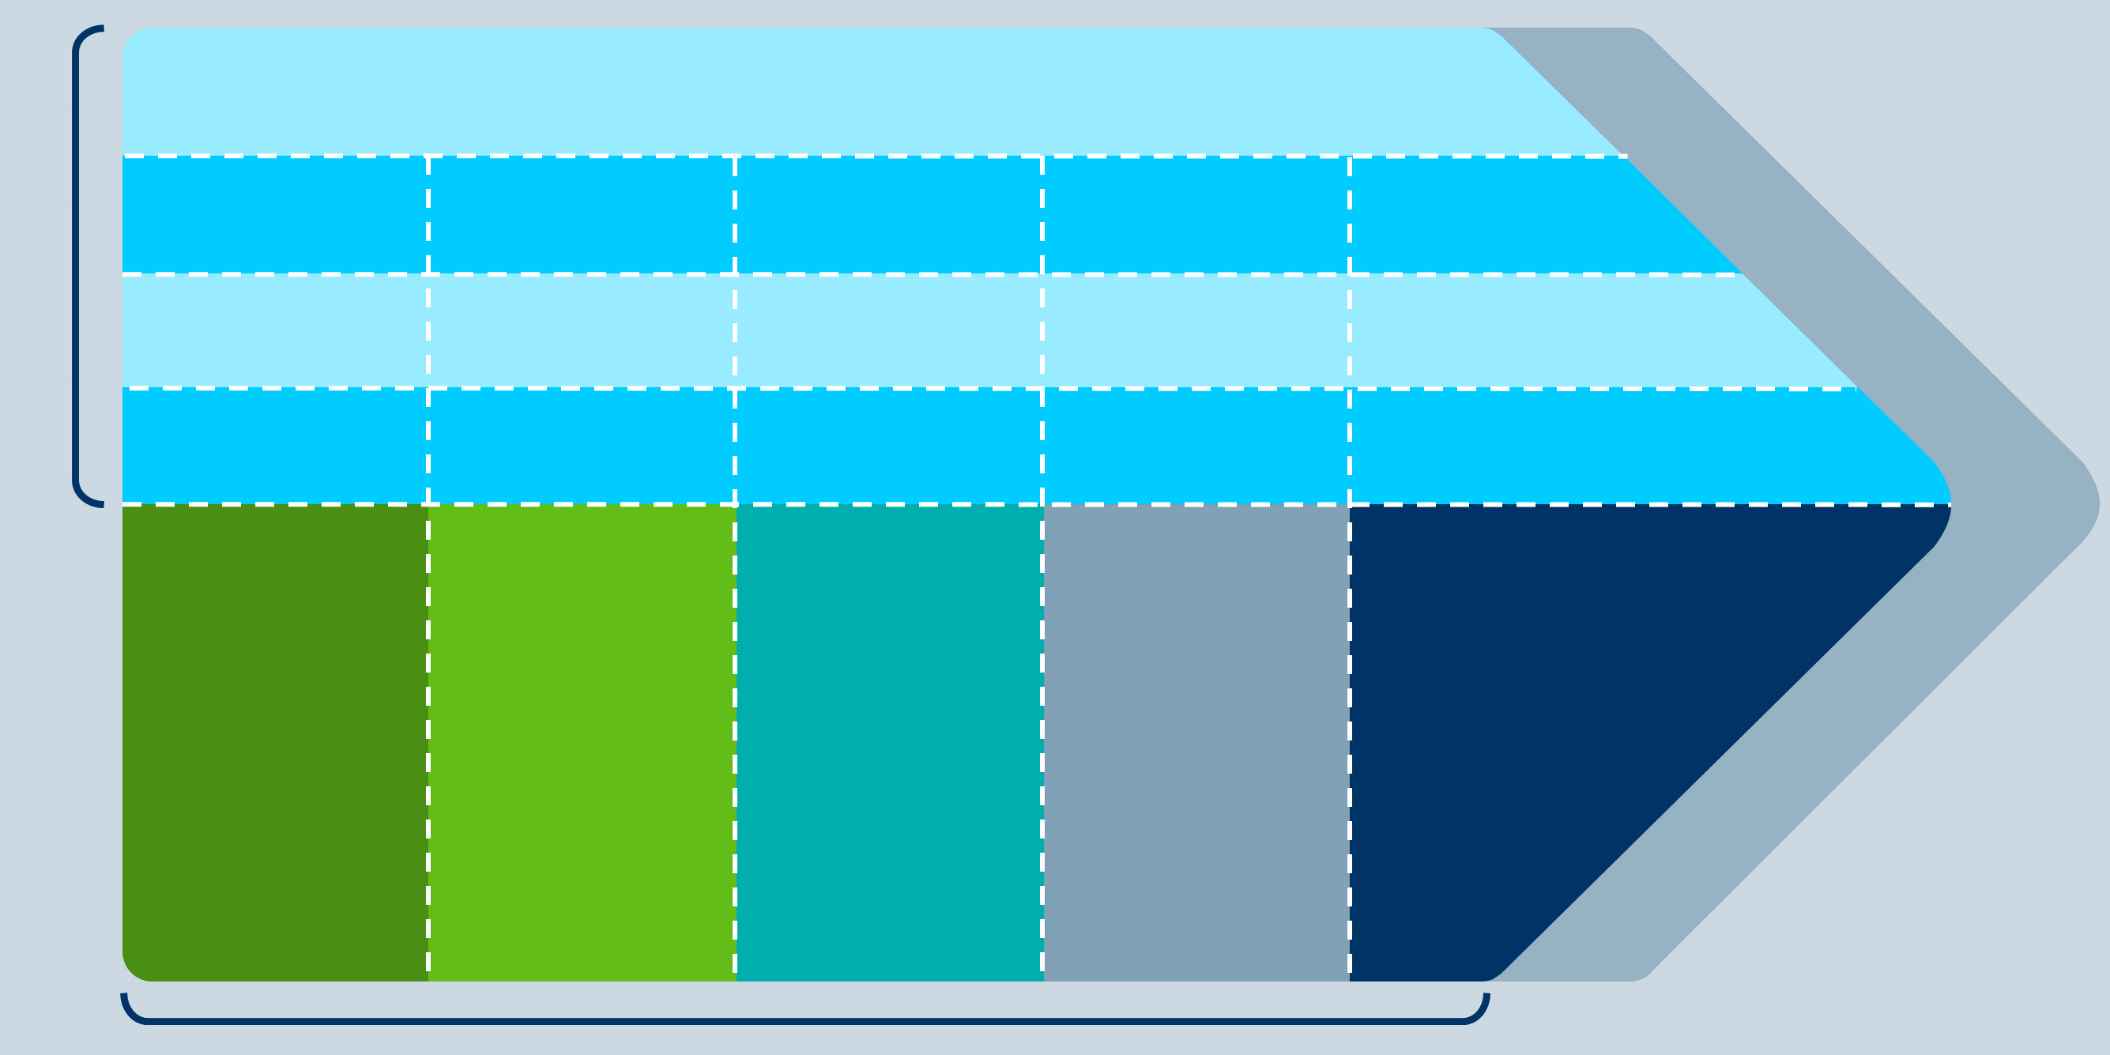
Porter’s Value Chain
FIRMS INFRASTRUCTURE
Support Activities
HUMAN RESOURCES MANAGEMENT
MARGIN
TECHNOLOGY DEVELOPMENT
PROCUREMENT
INBOUND
LOGISTICS
OPERATIONS
OUTBOUND
LOGISTICS
MARKETING
AND SALES
SERVICE
MARGIN
Primary Activities
Source: adapted from Porters, 1985

Slide 148
Value Chains
Supplier
value chains
Firm’s
value chains
Channel
value chains
Customer
value chains
Competitor
value chains

Slide 149
Process Mapping
Evaluating process flows and the sequence of process activities, enables the identification of:
Sources of process inefficiency and non-value-adding activity
Sources of process ineffectiveness
Points of process complexity
Points of risk
Points of cost
Points of profit and opportunity

Slide 150
Flowchart symbols
Beginning or end point
Activity
Delay
Process flow
Preparation
Decision
Document

Slide 151
Process Map Example
Cut out Shapes
Yes
Fit templates
No
Cut out Shapes
Yes
Make surface
decoration
e.g. tie dye
Re-attempt technique for surface decoration
No
Yes
Appliqué onto
Material
Unpick and sew again
No
Notes:
Focus is on eliminating non essential steps and adding value

Slide 152
Value-Added Flowchart
List all steps in a process and create a simple flowchart with the steps in a sequence of boxes
Add to each box the time currently required to complete each step
Identify steps that do not add value
Move the boxes representing non-value-added processes to the right of the boxes representing value-added processes
Total the times in the value-added column to derive a value-added cycle time, and the times in the non-value-added column to derive a non-value-added cycle time
Calculate the percentage of the total cycle time that results from non-value-added operations

Slide 153
Supply Chain Improvement
In this Unit, we will be focusing on:
The collaborative model of SCM
Value chain analysis
Total quality approaches
Using statistical analysis to develop supplies
JIT and lean thinking
Benchmarking
BPR

Slide 154

Defining Quality
"Quality is a predictable degree of uniformity and dependability, at low cost and suited to the market“
Dr Edwards Deming

Slide 155

The Costs of Quality
Total Quality
Prevention
Appraisal
Increase Prevention
Failure
Increase Appraisal
Prevention
Decrease Failure
Appraisal
Failure
Before TQ

Slide 156
Deming’s 14 Points for Management
Create constancy of purpose toward improvement of product and service
Adopt a new philosophy. “Western management must awaken to their challenge, must learn their responsibilities and take on leadership for change”
Cease dependence on inspection to achieve quality
End the practice of awarding business on the basis of price tag. Instead, minimise total cost. Move towards a single supplier for any one item, on a long-term relationship of loyalty and trust
Improve constantly and forever the system of production and service, to improve quality and productivity, and thus constantly decrease costs
Cont../

Slide 157
Deming’s 14 Points for Management
Institute training on the job
Institute leadership - the aim of leadership should be to help people and machines and gadgets to do a better job
Drive out fear, so that everyone may work effectively for the company
Break down barriers between departments
Eliminate slogans, exhortations and targets for the workforce asking for zero defects and new levels of productivity
Eliminate arbitrary numbers and numerical goals
Cont../

Slide 158
Deming’s 14 Points for Management
Remove barriers that rob the workers of their right
to pride of workmanship. This means abolishment
of the annual or merit rating and of management
by objectives and numbers
Institute a vigorous programme of education and self improvement
Put everybody in the company to work to accomplish the transformation. The transformation is everybody’s job

Slide 159
Quality Tools
Pareto charts: used to identify the principal causes of risks
Ishikawa/fishbone diagrams: charts of cause and effect in processes
Stratification: layer charts which place each set of data successively on top of the previous one
Check sheets: to provide a record of quality
Histograms: graphs used to display frequency of various ranges of values of a quantity
Scatter graphs: used to help determine whether there is a correlation between two factors
Control Charts: used as a device in SPC

Slide 160
Total Quality Approaches
Ishikawa’s Methodology Enables us to Identify
the Root Causes of any Desired Outcome
Notes:
The fishbone diagram identifies many possible causes for an effect or problem. It can be used to structure a brainstorming session. It immediately sorts ideas into useful categories

Slide 161
Using Ishikawa – Cause and Effect
How to create a fishbone diagram:
Create a head, which lists the problem or issue to be studied.
Create a backbone for the fish (straight line which leads to the head).
Identify at least four “causes” that contribute to the problem. Connect these four causes with arrows to the spine. These will create the first bones of the fish.
Brainstorm around each “cause” to document those things that contributed to the cause. Use the 5 Whys or another questioning process such as the 4P’s (Policies, Procedures, People and Plant) to keep the conversation focused.
Continue breaking down each cause until the root causes have been identified

Slide 162
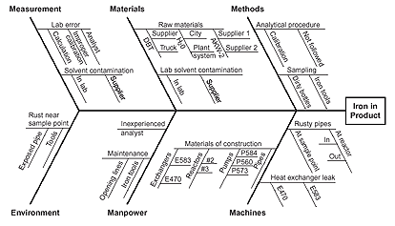
Ishikawa Example
This fishbone diagram was drawn to try to understand the source of periodic iron contamination in materials. Six generic headings were used to prompt ideas. Layers of branches show thorough thinking about the causes of the problem

Slide 163

Deming’s PDCA Cycle
Plan
  Plan ahead for change, and
  analyse and predict the results
Do
  Implement the solution,
  taking small steps in
  controlled circumstances
Check
  Measure the performance
  of the solution or impact
  of the change
Act
  Develop further action
  plans to standardise or
  improve the process
Continuous Improvement
Act
Plan
Check
Do
Act
Plan
Quality Improvement
Check
Do
Standard
Standard
Consolidation through standardisation
Time

Slide 164
Crosby’s Quality Management Maturity Grid
Stage 1: Uncertainty
‘We don’t know why we have problems with quality’
Stage 2: Awakening
‘Is it absolutely necessary to always have problems with quality?’
Stage 3: Enlightenment
‘Through management commitment and quality improvement, we are identifying and resolving our problems’
Stage 4: Wisdom
‘Defect prevention is a routine part of our operation’
Stage 5: Certainty
‘We know why we do not have problems with quality’

Slide 165
Supply Chain Improvement
In this Unit, we will be focusing on:
The collaborative model of SCM
Value chain analysis
Total quality approaches
Using statistical analysis to develop supplies
JIT and lean thinking
Benchmarking
BPR

Slide 166
Statistical Sampling
Simple random sampling
The sampler uses a random number generator to select items from the population
Systematic sampling
We select every nth item from the total population
Stratified sampling
The population is broken down into various categories, using any classification relevant to the object of the investigation
Cluster sampling
Clusters of items are sampled instead of individual items
Multistage sampling
Sub-divisions are progressively created for sampling

Slide 167
Statistics
The arithmetic mean (denoted by x)
Defined as the total value of the items divided by the total number of the items in a data set
The median
Calculated as the middle term in a data set, once all the items have been arranged in order of magnitude
The mode
The value that occurs most frequently among all the items in the data set
The range
The difference between the extreme values of the distribution
The standard deviation
Calculating the average distance or range of items from their mean

Slide 168
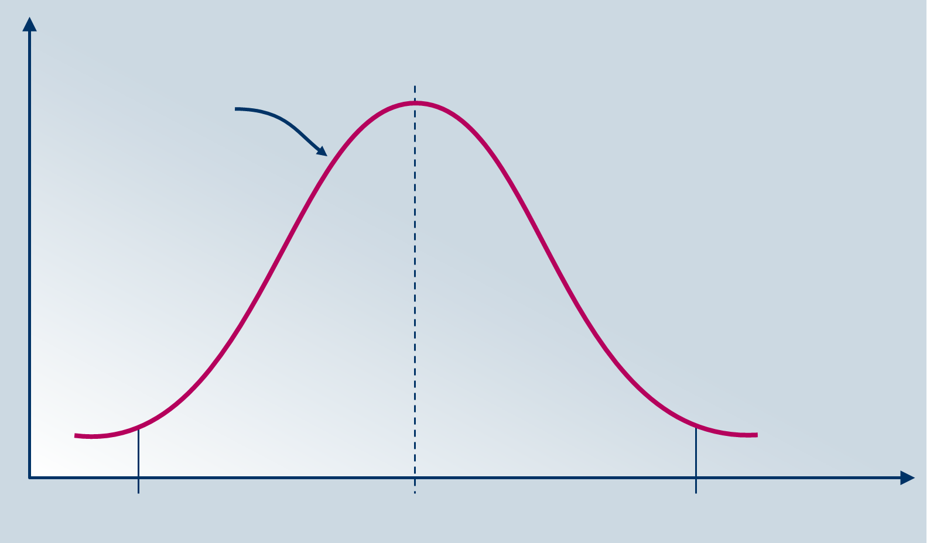
The Normal Distribution
Relative frequency
Process distribution
63.4
(-3 process SDs)
69
Process mean
74.6
(+3 process SDs)
x

Slide 169
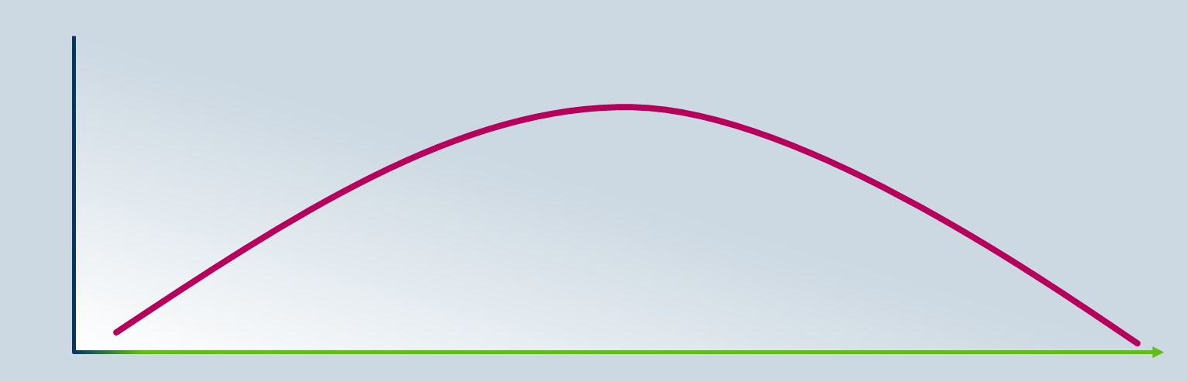
The Normal Distribution
Is characterised by a probability distribution having a bell shaped curve
The area represented by the curve provides the probability
The mean of the probability distribution is the peak
The standard deviation measures the variation or spread of the data so the more the data is spread out, the higher is the value of the standard deviation
p
1.0
measure

Slide 170
Normal Distribution
There are many things, such as intelligence, height, and blood pressure, that naturally follow a normal distribution.
Most of the data values in a normal distribution tend to cluster around the mean
The measure of how spread out numbers are is referred to as Standard Deviation
For example, if you took the height of one hundred 22-year-old women and created a histogram you would get a normal distribution
A normal distribution is a bell-shaped frequency distribution curve where normally 68% of values are within 1 standard deviation of the mean, 95% of values are within 2 standard deviations of the mean and 99.7% of values are within 3 standard deviations of the mean
The further a data point is from the mean, the less likely it is to occur.

Slide 171
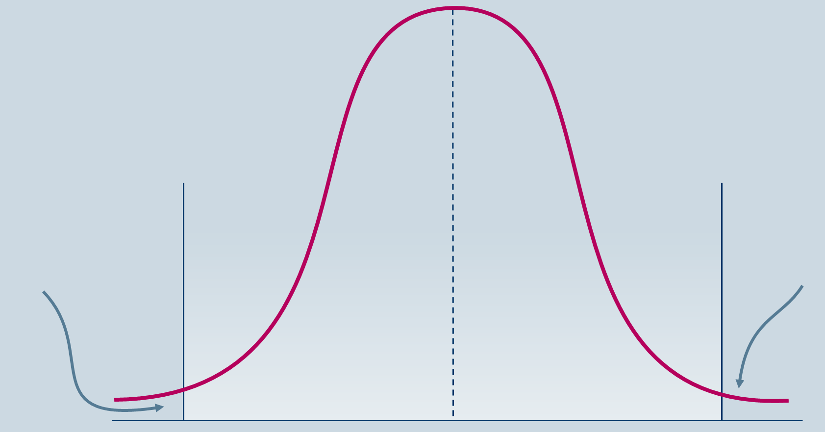
The Normal Distribution
Approaches to quality management will seek to calculate tolerances
Below Lower
Specification
Tolerance
(Unacceptable)
Above Upper
Specification
Tolerance
(Unacceptable)
505
510
515

Slide 172
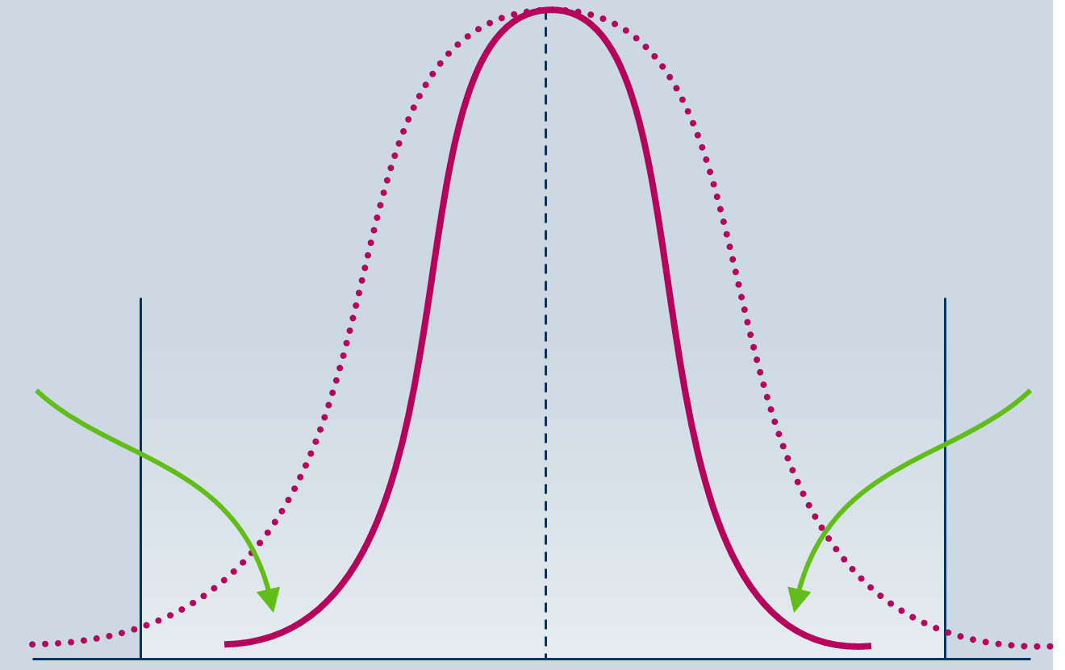
The Normal Distribution
Approaches to quality management will seek to reduce the degree of variance (the standard deviation)
The Impact
of a Continuous
Improvement
Programme
The Impact
of a Continuous
Improvement
Programme
505
510
515

Slide 173
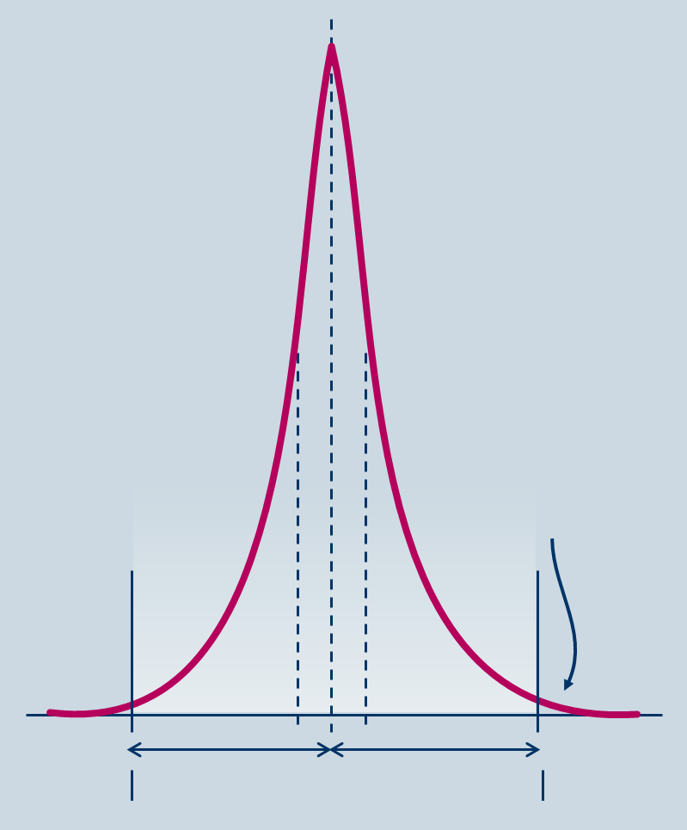
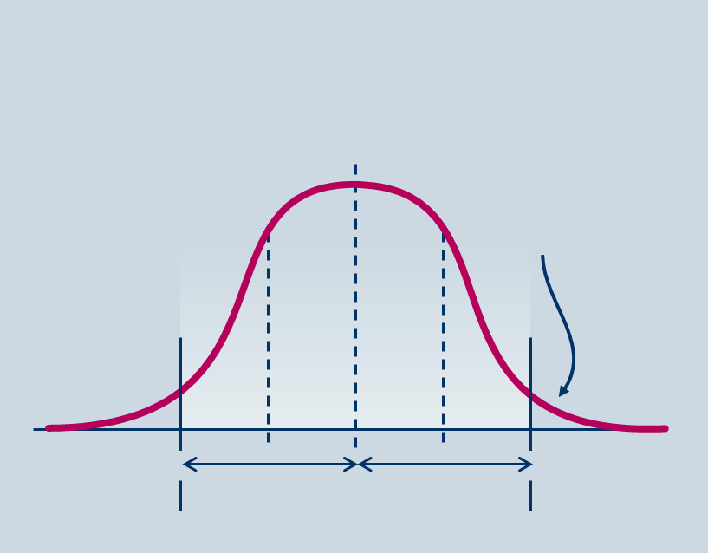
Two Sigma and Six Sigma Processes
Mean
Mean
4.56% probability of defect
0.00034% probability of defect
2σ
2σ
6σ
6σ
Lower specification limit
Upper specification limit
Lower specification limit
Upper specification limit

Slide 174
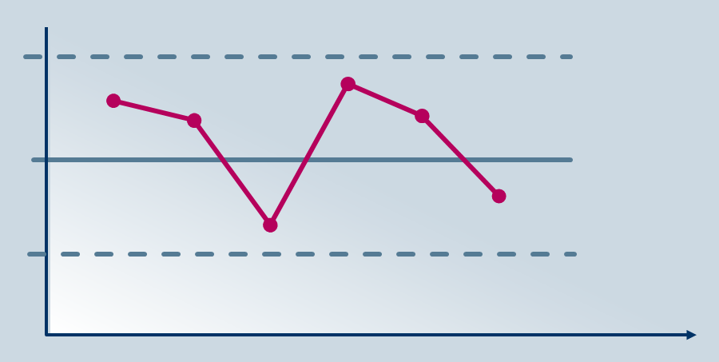
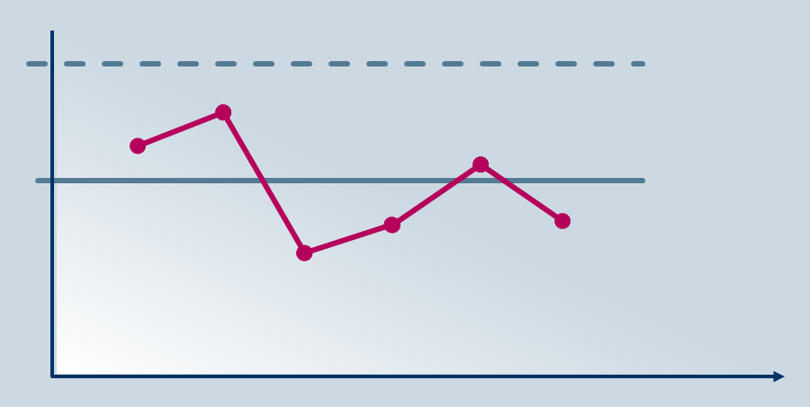
SPC charts
X-CHART
Sample average
Upper control limit
Predetermined expectation
Lower control limit
Time
R CHART
Sample average
Upper control limit
Predetermined expectation
Time

Slide 175
Probability Distributions
 | FOCUS | APPLICATIONS
Binomial distribution | The occurrence of discrete events with only two either/or outcomes | Probability of a batch containing defects or non-defects; x or more/fewer-than-x defects Customers buying or not buying a brand Success or failure of a project; delivery on time or late
Poisson distribution | The occurrence of discrete events occurring within a continuous medium | Quality control and risk assessment e.g. Defects in a pipeline (or other continuous medium) Supplier failures over a time period Machine breakdown over a time period Problems occurring within a given time period
Normal distribution | Ranges of possibilities and how likely they are to occur | Statistical process control: If defects are normally distributed, calculate the probability that defects are between 3 and 7 (tolerance level) per delivery

Slide 176
Supply Chain Improvement
In this Unit, we will be focusing on:
The collaborative model of SCM
Value chain analysis
Total quality approaches
Using statistical analysis to develop supplies
JIT and lean thinking
Benchmarking
BPR

Slide 177
What is lean?
Lean is a set of tools that assist the identification and steady elimination of waste ( muda)
As waste is eliminated quality improves whilst production time and costs are reduced
Examples of such tools include:
  Value stream mapping
  Five S
  Kanban /pull systems
  Poka-Yoke ( error-proofing)

Slide 178
How do we define waste
Lean is not the tools but the reduction of three types of waste:
Muda - non-value adding work
Muri – overburden
Mura - unevenness

Slide 179
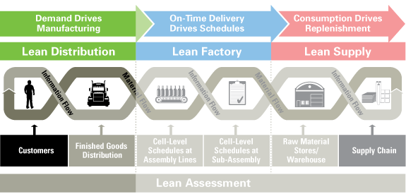
What is Lean?
The need for Lean is driven by the Customer

Slide 180
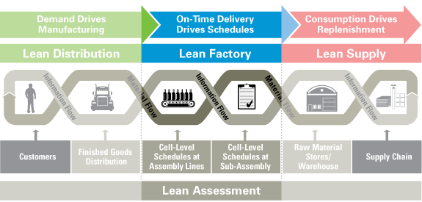
What is Lean?
Lean is about planning and doing things on time

Slide 181
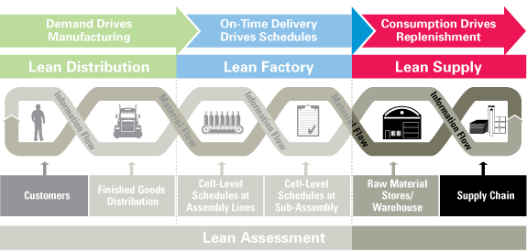
What is Lean?
Lean is about linking Supply with Demand

Slide 182
JIT –Performance Objectives
Quality
All tiers of suppliers must share the commitment to quality, as there is no slack for inspection, rework or rejection
Speed
Little work in progress is held, with most of the work effectively being made on a make-to-order basis
Flexibility
JIT is designed to react flexibly to customers changing requirements
Dependability
Pursuing quality, speed and flexibility leads to the exposure and rectification of inefficiencies and process variability, which can be addressed

Slide 183
Traditional versus JIT supply
TRADITIONAL PROCUREMENT | JIT PROCUREMENT
Production runs are long and standardised Delivery timings are not critical, and long lead times are built into calculation of order quantities | Production runs are short and frequently switched Delivery dates and times are carefully defined by the buyer’s production schedule
Inventory buffers are held as a safety net, to protect service levels | ‘Inventory is evil’: reduced or eliminated
A certain level of quality defects is expected Quality management is based on inspection of incoming goods | Zero-defect targets are set Inspections are replaced by supplier quality assurance
Contracts are awarded on lowest price | Long-term relational contracts are awarded on quality and delivery performance, flexibility and willingness to pursue JIT
Wide supplier base and competitive orientation support opportunistic switching | Narrow supplier base allows focus on relationship and supplier development
Administrative bureaucracy and formal communication interfaces to control supply | Internal flexibility and communication
Source: Adapted from CIPS Study Materials

Slide 184
Limitations and Risks of JIT
The gains of JIT are offset by some reduction in capacity utilisation, loss of economies of scale, and additional transport costs
The gains of JIT come at a risk: there are no time or stock buffers, if the supplier or the system fails
There may be additional costs associated with the evaluation, development and management of high-quality, long-term supply partners
‘What might look like a cost saving to one firm could mean increased costs to the supply chain as a whole’ (Christopher)
Buyers may pay a higher unit price to compensate for the supplier’s costs in supplying on a JIT basis
Source: Adapted from CIPS Study Materials

Slide 185

Lean Thinking
Identify the Value Stream
Enable Flow
Pull Requirements
Seek Perfection
“Lean Thinking” James Womack & Dan Jones (1996)

Slide 186
Lean Supply
The Value Stream of a Can of Cola
 | Incoming Storage | Processing Time | Finished Storage | Process Rate | Cumulative Days
Mine | 0 | 20min | 2 wks | 1000t/hr | 319
Reduction Mill | 2 wks | 30min | 2 wks |  | 305
Smelter | 3 mths | 2hours | 2 wks |  | 277
Hot Rolling Mill | 2 wks | 1min | 4 wks | 10ft/min | 173
Cold Rolling Mill | 2 wks | 1min | 4 wks | 2000ft/m | 131
Can Maker | 2 wks | 1min | 4 wks | 2000/min | 89
Bottler | 4 days | 1min | 5 wks | 1500/min | 47
Tesco RDC | 0 | 0 | 3 days |  | 8
Tesco Store | 0 | 0 | 2 days |  | 5
Home | 3 days | 5min
Total | 5 months | 3 hours | 6 months |  | 319
Lean Thinking: James Womack & Dan Jones (1996)

Slide 187

Lean Supply-Ohno
Waste needs to be eliminated in order to maximise the benefits in Supply Chain Management
The 7 major types of waste are:
Over production
Correction
Over processing
Unnecessary motion
Unnecessary Conveyance
Waiting
Excess inventory
Elimination of Waste is
a key principle of
LEAN thinking

Slide 188

Principles of Lean Thinking
Specify what creates value as seen from the customer’s perspective
Identify all steps across the value stream
Make actions that create value ‘flow’
Only make what is pulled by customer demand, just in time
Strive for perfection by continually
removing successive layers of waste

Slide 189

The 5-S methodology
Shitsuke – or Self-discipline
A foundational value of the framework, and of Kaizen in general
Seiri – or Straighten
Valuing tidiness
Seiton – or Sort
Establishing a state of orderliness
Seizo – or Sweep
Valuing cleanliness
Seiketsu – or Standardise
Specifically, standardising clean-up processes

Slide 190
Agile - Martin Christopher’s 4 R’s
190
“As we move into the era of supply chain competition a number of principles emerge to guide the supply chain manager”
Responsiveness
  The ability to respond to customers’ requirements
  Flexibility
  Customised solutions
Resilience
  Today’s markets are turbulent and volatile
  Ability to deal with unexpected disturbances
  Need to assess risks in supply chains
Reliability
  Traditionally achieved by holding high inventories
  Need for reliability in logistics
Relationships
  Organisations now seeing the benefits of long term contracts
  “The more processes are linked between suppliers and their customers the more mutual dependencies increase and hence more difficult for competitors to break in”
    Source: Martin Christopher ‘Logistics and Supply Chain Management’ (2005)
Notes:
190
Now into Agile

Slide 191
Agility
191
Responsive Short lead-times Flexibility Increased customisation Pull not push (demand driven) | Reliable Re-engineer process Enhance pipeline visibility Reduce stocks Focus on process not inspection
Resilience Cope with the unexpected Strategic inventory Second sourcing Manage Risk ( probability of disruption x impact) Design for agility Transferable manufacturing processes Supply chain visibility Monitoring the risk environment | Relationships Partnership win/win Mutually beneficial long term Creates barriers to entry and mutual dependencies
Notes:
191
191
p120

Slide 192
Starting with a Blank Sheet
If you were designing a brand new supply chain:
What steps would you take?
What characteristics would it have?
How would it be managed?
What would be it’s outputs?
Use a blank sheet of paper to create a mind
map of your ideas

Slide 193
Supply Chain Design
We need to focus on:
The role and positioning (or repositioning) of an organisation within the total supply chain
The configuration of the chain or network, and the competitive or collaborative nature of the relationships within it
The selection of strategic supply chain partners
Internal and trans-organisational processes for materials and information flow
Collaborative and integrative arrangements, where appropriate

Slide 194
Designed to:
Reducing non-value-adding (waste) activities
Reducing total costs throughout the supply chain
Reducing cycle times
Improving responsiveness to customer requirements
Giving access to complementary resources and capabilities
Enhancing quality and service
Improving supply chain communication
Optimising the balance of service levels and costs
Greater transparency for cost and risk management
Greater supply chain visibility

Slide 195
Value Add – Cost Reduction
Collaboration on cost reduction programmes utilising supply chain expertise and resources
Increasing the visibility of supply chain processes, enabling areas of waste to be identified
Supporting the optimising of end-to-end supply chain costs
Supporting better information-sharing, activity co-ordination and collaborative planning
Supporting proactive quality assurance and management
Encouraging buyer-side and supplier-side systems integration, offering reduced transaction costs
Creating long-term, stable and mutually beneficial commercial relationships
Supporting whole-life contracts, which can lower the whole life costs of assets

Slide 196
Adding Value - Improving quality
Selecting suppliers with third party approved or accredited quality management systems
Appraising the quality management systems and ‘track record’ of suppliers
Preparing preferred or approved supplier lists
Influencing the quality of product design
Translating design requirements into clear, accurate materials and service specifications
Developing goods inwards procedures for quality inspection and testing
Managing relationships with suppliers
Monitoring and controlling suppliers’ quality performance over time
Working with suppliers to resolve quality disputes, solve quality problems and/or make ongoing quality improvements

Slide 197
Value Add - Reducing time-to-market
Creating a pool of trusted expert suppliers, and a collaborative approach, enabling early supplier involvement in product design and development
Encouraging end-to-end proactive management of supply chain processes, so that downstream channels are prepared to adopt and distribute new products
Encouraging demand chain management and data-sharing, enabling sensitivity to changing and emerging customer demands
Developing supply chain ‘agility’ or responsiveness – supporting short product lifecycles and frequent adaptations and customisation

Slide 198
Adding Value - Supporting innovation
Enhanced access to market intelligence
Faster and more effective product design and development processes
Tapping into synergies and opportunities available from pooling information, ideas and expertise
Creating incentives for supply chain partners to innovate
The intentional selection of long-term strategic supply chain partners
Supporting the use of collaborative techniques
Supporting the ongoing development of supplier innovation capability
Supporting supply chain management techniques which are themselves regarded as ‘innovative’ in traditional procurement settings
Supporting continuous supply chain improvement and development

Slide 199
Value Add – Non-replicable Competencies
Identify and develop unknown suppliers, which competitors are unlikely to be able to access
‘Enclose’ a supplier in order to secure sole access to its resources
Apply procurement strategies which are hard for competitors to imitate

Slide 200
Value Add – International Sourcing
Access to required materials, facilities and/or skills
Availability of culturally distinctive goods
Access to a wider supplier base
Opportunities for cost savings
Exchange rate advantages
Competitive quality
Reduced regulatory and compliance burden
Leveraging available ICT developments for virtual organisation, e-sourcing and e-procurement, contract management and supplier relationship management and communication
Support for supply chain agility and the establishment of a ‘local’ supply presence in global markets
Ability to compete with competitors who are benefiting from any or all of the above advantages

Slide 201
Supply Chain Improvement
In this Unit, we will be focusing on:
The collaborative model of SCM
Value chain analysis
Total quality approaches
Using statistical analysis to develop supplies
JIT and lean thinking
Benchmarking
BPR

Slide 202
Benchmarking
Internal benchmarking
Comparison with high-performing units in the same organisation
Competitor benchmarking
Comparison with high-performing competitors in key areas which give them their competitive advantage
Functional benchmarking
Comparison with another, high-performing organisation
Generic benchmarking
Comparison of business processes across functional and industry boundaries

Slide 203


Benchmarking
Supplier position with group
Average position with group
Supplier delivery
Group performance range
Group performance
Poor
(0-2)
Moderate
(2-4)
Adequate
(4-6)
Good
(6-8)
Excellent
(8-10)

Slide 204
Supply Chain Improvement
In this Unit, we will be focusing on:
The collaborative model of SCM
Value chain analysis
Total quality approaches
Using statistical analysis to develop supplies
JIT and lean thinking
Benchmarking
BPR

Slide 205
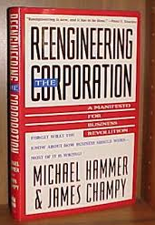
BPR
‘Business Process Re-engineering’
The fundamental rethinking and radical redesign
of business processes. To achieve dramatic
improvements in critical, contemporary
measures of performance such as cost, quality,
service and speed
Key concepts:
Radical redesign of process can result in dramatic performance improvements
At least some existing processes are unsound and need to be replaced (‘breakthroughs’)
BPR is concerned with fundamental change
Notes:
205

Slide 206
BPR
Benefits | Reasons for failure
Revolutionary thinking Breakthrough improvement More effective organisational structures Organisational renewal Corporate culture Job redesign | High risk of changing what is proven to work Focus on process may ignore the people Inappropriate change management methods High cost of IT projects Difficulties in project management such as in participation and leadership Inadequate training
Source: Adapted from CIPS Study Materials

Slide 207
Advanced Category Management in Procurement and SCM module
There are 3 units to this module
Category Management
Supply Chain Improvement
Developing Systems for Procurement and Supply Chain Management

Slide 208
Developing Systems
In this Unit, we will be focusing on:
The use of systems, ERP and databases
The development of P2P systems
Data integrity
Integration tools
Developments in IT

Slide 209
Developing Systems
In this Unit, we will be focusing on:
The use of systems, ERP and databases
The development of P2P systems
Data integrity
Integration tools
Developments in IT

Slide 210
The Use of Systems
Independence
Procurement operates within its own guidelines, with a focus on functional efficiencies and improvements
Dependence
Procurement dovetails with other functions via consultation and reporting, but still uses a standalone information system
Business integration
Procurement systematically integrates with other functions in the internal supply chain
Chain integration
Procurement has a key role in securing systematic co-operation and information-sharing across the supply chain

Slide 211
Use of Systems
Enterprise Resource Planning
Provides an integrated view of the core business processes
ERPI
  Accounting
  Human Resource
  Corporate Performance and Governance
  Sales
ERP II
  Customer Services
  Production
  Distribution
  Procurement (SRM)

Slide 212

Use of Systems
Enterprise Resource Systems
What do we want the system to do for us?
  Collect Data
  Store Data
  Manage Data
  Interpret Data
What does that mean for us?
  What do we know?
  What can we do?
Notes:
E-commerce – Focussing on external strategies
Business Intelligence – Analysing data and converting to information
Enterprise Asset management – managing asset lifecycles improving useage and managing costs

Slide 213
Enterprise Resource Planning Systems (ERP)
ERP software is a business software solution aimed at the integration of all business processes into a single unified system aimed at supporting the achievement of the business goals of an organization. Benefits include:-
Standardised environment with shared databases independent of applications and integrated applications
All processes and sub-processes are linked and unified into a single system
Smooth and seamless flow of information across organisational boundaries
Improved productivity, efficiency and consequent achievement of business objectives.
Reduced response times by allowing access and effective usage of business critical information
The streamlining of numerous functions performed by the organisation as a whole
Aids decision making and control within organisations

Slide 214
E-Procurement
What do we need from an e-procurement system
Efficient implementation
Spend visibility across the supply chain
Financial performance
Functionality
Ease of use and end user adoption
Collaboration between internal and external stakeholders
End to end visibility
Advanced procurement analytics and flexible data models (Big Data analytics)
Ability to manage strategic procurement not just operational procurement i.e. savings tracking, supplier value management, spend analysis, contract management
Source: BravoSolution, CIPS Knowledge Partner http://more.bravosolution.com/hubfs/0_Global_BravoSolution/1_CIPS/Content/CIPS_Whitepaper_10-Reasons-Why-ERP-Fails-Procurement.pdf
Notes:
Bravo Solution cite these as all the things an ERP system does not do and why they fail for Procurement. CIPS have given a caveat in the paper shown in the link and in training I think we should not be as bold in to say ERP systems fail because of this but the list is very relevant.

Slide 215
Developing Systems
In this Unit, we will be focusing on:
The use of systems, ERP and databases
The development of P2P systems
Data integrity
Integration tools
Developments in IT

Slide 216
Purchase to Pay (P2P)
E-PROCUREMENT
E-SOURCING
Payment
Knowledge
Receive
Specification
Business Case
Legal
Security
CSR
Order
RFQ/tender
Authorise
Negotiation and evaluation
Select and requisition
Contract
Source: Adapted from CIPS Study Materials

Slide 217
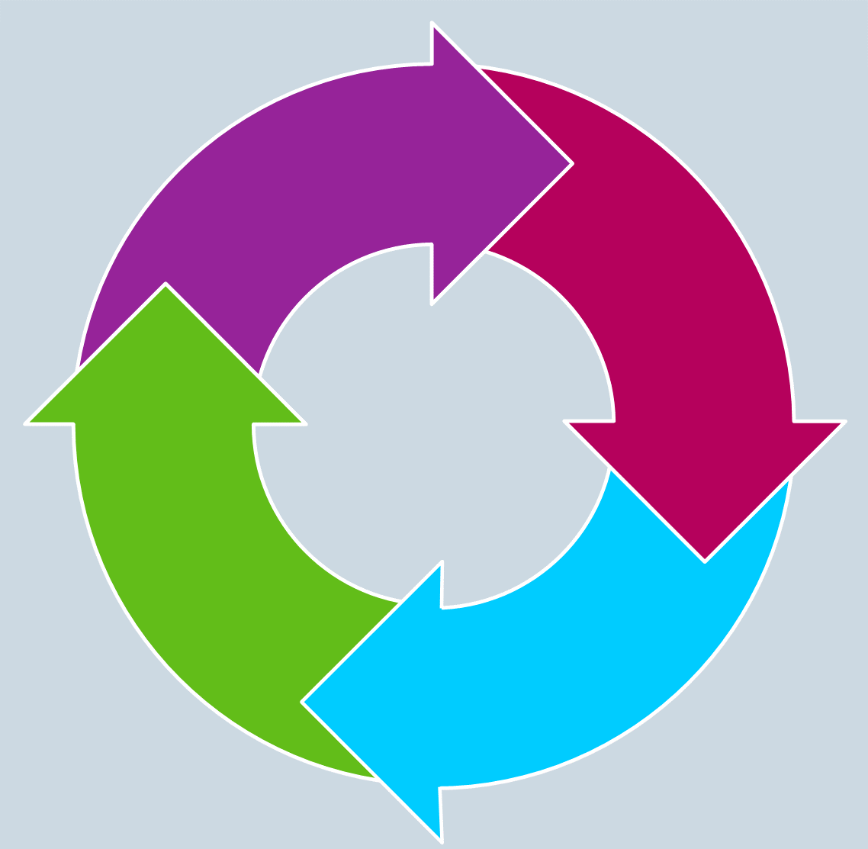
Purchase to Pay (P2P)
Information provided by eProcurement
Enables benefits management and
on-going strategic sourcing
Improved supplier
management
Spend analysis and aggregation
Standardises specifications
Supplier rationalisation
Track
Savings
Identify
Savings
E-Procurement enables compliance to contracts
Content management
Purchase 2 Pay Process
Reduces maverick spend
Strategic sourcing
E-auctions and E-tendering
Deliver
Savings
Secure
Savings
Source: Adapted from CIPS Study Materials

Slide 218
E-sourcing
E-catalogues
Suppliers exhibit their products in electronic catalogues, which can be viewed online or downloaded by potential purchasers
Supplier portals and market exchanges
    Sites where multiple buyers and sellers access and share information about requirements and offerings
  Online supplier evaluation data
    Third party reports, customer feedback, approved or accredited supplier registers and directories, benchmarking reports, market intelligence tools

Slide 219
E-sourcing
E-auctions
Conducted online using the buyer’s or seller’s website, or third party auction sites
E-tendering
    Using e-RFQs (electronic requests for quotation) and specifications posted online or emailed to potential suppliers

Slide 220
E-auctions
Benefits | Criticisms
Efficient administration and reduction in acquisition lead time Savings for buyers, as a result of competition Improved value for buyers Access for buyers to a wider range of potential suppliers Less time ‘wasted’ on interpersonal interaction Opportunities for suppliers to enter previously closed markets or accounts Opportunities for suppliers to gather competitor and market pricing data | Based on a zero-sum, adversarial or ‘win-lose’ approach and suppliers more vulnerable There may be long-term adverse effects on both the supplier and purchaser Promised savings may not materialise- suppliers may seize opportunities to increase prices The indication is that pricing will be the key award criteria The process leaves little scope to take adequate account of non-price criteria and other sources of value add
Source: Adapted from CIPS Study Materials

Slide 221
Types of Auction
Single Variable reverse auction ( price only)
Weighted Multi-Variable or Parametric Auction
Bundled ( seller has to bid for it all)
Cherry pick ( seller selects which elements to bid on)
Dutch (buyer raises price. First to accept wins)
Japanese ( buyer lowers price until only one supplier remaining)

Slide 222
E-auctions
Tasks:
Assess the categories of procurement that Reverse Auctions are an appropriate buying tool for
Develop conclusions on their impact on Supplier Relationships

Slide 223
E-tendering
The invitation to tender (ITT) is published on the buyer’s e-tender web portal, for potential suppliers to view
Suppliers respond to the ITT by sending their bids using secure email to the e-tendering system’s ‘electronic vault’, and are registered as bidders
Buyers can often observe and manage the tendering process through a ‘front end’ web function
In-built security features prohibit access to any of the tender responses until a specified time
The system may include an automatic scoring particularly for PQQs and pricing details included in the tenders
Successful and unsuccessful bidders can be automatically notified of debrief/award

Slide 224
Developing Systems
In this Unit, we will be focusing on:
The use of systems, ERP and databases
The development of P2P systems
Data integrity
Integration tools
Developments in IT

Slide 225

Data Security
Unauthorised access to confidential or commercially sensitive data
Industrial espionage, data fraud and data theft
Data corruption
Input or transcription errors
Lack of controlled data management, protocols and ‘housekeeping’ disciplines

Slide 226

Data Security
Systems failure, and associated data loss
Lack of systems integration and compatibility
Compliance risk in regard to law and contractual provisions
Risks to the organisation’s intellectual property
Risks to the confidentiality of the organisation’s sensitive commercial data
Turnover of key personnel and/or the
outsourcing of organisational activities

Slide 227

Information Assurance
Information assurance refers to the use of IRM (Information Risk Management) which controls the access of information to authorised users reducing access to unauthorised personnel. It also links in with information security and business continuity planning. In addition to defending against malicious hackers and code through viruses, IA considers corporate governance issues such as privacy, regulatory and standards compliance, auditing, as well as business continuity and disaster recovery planning

Slide 228
A Study of the Impact of Data Breaches
By The Ponemon Institute (2013):
For the sixth consecutive year, the cost per lost or stolen record has increased with the average cost to organisations being £2.04 million
Abnormal churn of customers often arises as a result of the data breach incident with financial services, pharmaceutical companies and service organisations more susceptible to customer churn
Data breaches caused by or occurring at a third-party organisation such as a supplier or business partner increased the per capita cost
Lost business costs increased from £779 thousand in 2011 to £921 thousand in 2012
Notes:
Ponemon Institute conducts independent research in the USA on privacy, data protection and information security policy

Slide 229
A Study of the Impact of Data Breaches
By the Ponemon Institute (2013):
These costs refer to abnormal turnover of customers (a higher than average loss of customers for the industry or organisation), increased customer acquisition activities, reputation losses and diminished goodwill. If the organisation has a formal incident response plan in place prior to the incident, the average cost of a data breach was reduced
Negligence is the main cause of data breach, but malicious or criminal attacks are the most costly. Thirty-seven percent of data breaches involved negligent employees or contractors. Malicious or criminal attacks have increased slightly from 31 percent to 34 percent of data breaches

Slide 230
A Study Published by Quocirca (2012)
“The majority of software is still installed in-house, either as specially developed bespoke applications or commercially acquired packages. However, the proportion of software procured as a service is on the rise, as is the use of mobile apps and open source components. In addition, more and more in-house applications are being web-enabled and exposed to the outside world
The vast majority of software will contain flaws which can constitute a security risk, especially for those applications that are web-enabled. The cost of fixing a flaw increases the later that they are found in the development, acquisition and deployment life-cycle. Static code scanning involves taking the source code, in whatever language it is written, and scanning every line seeking potential coding flaws appears to be the best method of mitigating such risks”

Slide 231
Data Protection
Under UK law, the Data Protection Act 1998 lays down 8 principles for managing data. The 1st principle states that organisations must:
Have legitimate grounds for collecting and using the personal data
Not use the data in ways that have unjustified adverse effects on
the individuals concerned
Be transparent about how to use the data, and give
individuals appropriate privacy notices when
collecting their personal data
Handle people’s personal data only in ways they would
reasonably expect; and
Make sure they do not do anything unlawful with the data

Slide 232
Data Protection
Individuals should generally be able to choose whether or not their personal data is disclosed to another organisation. The organisation’s intention to disclose information should be made clear at the start of their dealings
If, despite security measures being taken to protect the personal data, a breach of security occurs, it is important to deal with the breach effectively. The breach may arise from a theft, a deliberate attack on systems, the unauthorised use of personal data by a member of staff, accidental loss, or equipment failure. The organisation will need a strategy for dealing with the breach, including:
    a recovery plan, including damage limitation
    assessing the risks associated with the breach
    informing the appropriate people and organisations
    that the breach has occurred and
    Reviewing and updating information security

Slide 233
Security in Data
…. Throughout the contractual process consideration should be given to ensuring security is appropriate and considers;
Physical risks e.g. controlling who has access to your buildings and how much of the building they can access, when and where deliveries are made
Personnel risks (ensuring people are who they say they are, contractors manage sub-contractors effectively and identify possible motives to compromise your information)
Cyber risks (do suppliers hold official information on secure networks, are those networks regularly patched and do they control who can see that data within their organisation)
Notes:
This is now a part of the UK Governments Commercial skills and Competency Framework for developing.

Slide 234
10 Steps to Cyber Security
Define and communicate your organisations ‘Information Risk management regime’
Network Security
Malware Protection
Monitoring
Incident Management
Managing User Privileges
Removable Media Controls
Secure Configuration
Home and Mobile Working
User Education and Awareness
Source: 10 Steps to Cyber Security from CESG
Notes:
Protect your network against attack by managing the network perimeter. Filter out unauthorised access and malicious content. Monitor and test security controls.
Produce relevant policy and establish appropriate antimalware. Regular scanning for malware across the business
Establish monitoring strategy and policy. Make someone responsible to monitr ICT Systems and networks. Analyse logs for unusual activity.
Establish an incident response and disaster recovery capability. Produce and test incident management plans. Provide training.
Adopt account management processes and limit the number of privileged accounts. Limit user privileges and monitor accounts. Audit logs regualarly.
Produce policy to control all access to removable media and limit types and useage. Scan all media before importing onto systems.
Apply security patches regularly Create a system inventory and design a baseline build for systems
Develop a mobile working policy and train staff. Apply secure baseline
Produce user security policies covering acceptable and secure use of systems. Establish staff training programme for cyber security.

Slide 235
Developing Systems
In this Unit, we will be focusing on:
The use of systems, ERP and databases
The development of P2P systems
Data integrity
Integration tools
Developments in IT
Notes:
Companies A and B use different forms for purchase orders etc.
They may well use different terms for the same thing e.g. Size vs. Dimensions
and their computer systems will likely be using different applications that, to add to the incompatibility, store things in a different order etc. To a computer ‘colour’ and ‘color’ are as different as [choose your cliché!].
They are effectively incompatible. To integrate would require expensive programming to be done that would probably need to be repeated as new partners had to be connected. i.e. Company A would need to program it’s systems with not only Co. B’s descriptions to enable translations with it’s own but would have to repeat the exercise for Companies C, D, E etc. etc.
XML enables integration with new partners with only incremental effort and this is made even simpler if there is an appropriate ‘standard’ for example cXML (Commerce XML).
An XML ‘standard’ should contain a set of ‘tags’ which are agreed between the participants of an industry or sector as the standard computer description of a piece of data.
Therefore using cXML all participants in an Exchange would transmit data using the same description and in the same format - SEE NEXT SLIDE

Slide 236
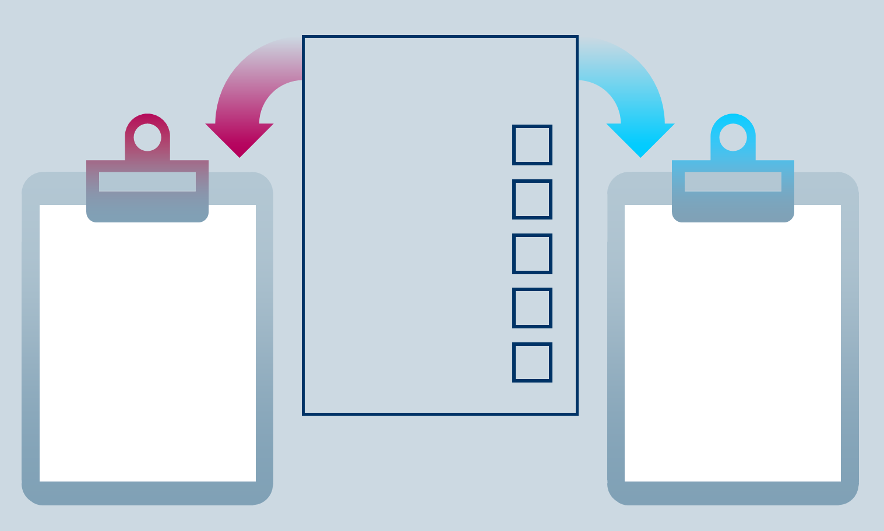
Data Integration
Different organisations though have different data formats
making the sharing of data difficult across a supply chain
Purchase Order
Size
Part ID
Quantity
Colour
Delivery
Company A
<dimension>
<part number>
<order quantity>
<colour>
<del date>
Company B
<diameter>
<catalogue no.>
<quantity>
<colour>
<date required>
Notes:
Companies A and B use different forms for purchase orders etc.
They may well use different terms for the same thing e.g. Size vs. Dimensions
and their computer systems will likely be using different applications that, to add to the incompatibility, store things in a different order etc. To a computer ‘colour’ and ‘color’ are as different as [choose your cliché!].
They are effectively incompatible. To integrate would require expensive programming to be done that would probably need to be repeated as new partners had to be connected. i.e. Company A would need to program it’s systems with not only Co. B’s descriptions to enable translations with it’s own but would have to repeat the exercise for Companies C, D, E etc. etc.
XML enables integration with new partners with only incremental effort and this is made even simpler if there is an appropriate ‘standard’ for example cXML (Commerce XML).
An XML ‘standard’ should contain a set of ‘tags’ which are agreed between the participants of an industry or sector as the standard computer description of a piece of data.
Therefore using cXML all participants in an Exchange would transmit data using the same description and in the same format - SEE NEXT SLIDE

Slide 237
Integration Tools: XML
eXtensible Markup Language
A protocol capable of use on internet based documents that can support links between multiple documents
XML is a means of standardising on data description and eases the path of integration between different systems used by the organisations in a supply chain
It allows designers to create their own customised tags, enabling the definition, transmission, validation, and interpretation of data between applications and between organisations

Slide 238
Sample XML
<ItemOut quantity="2" lineNumber="1"
RequestedDeliveryDate=”2001-02-21">
<ItemID>
<SupplierPartID>1233244</SupplierPartID>
<SupplierPartAuxiliaryID>ABC</SupplierPartAuxiliaryID>
</ItemID>
<ItemDetail>
<UnitPrice>
<Money currency="USD">1.34</Money>
</UnitPrice>
<Description xml:lang="en">hello</Description>
<UnitOfMeasure>EA</UnitOfMeasure>
<Classification domain="SPSC">12345</Classification>
<ManufacturerPartID>234</ManufacturerPartID>
<ManufacturerName xml:lang="en">foobar</ManufacturerName>
<URL>www.bar.com</URL>
</ItemDetail>
Database files
need to be
recoded into
XML format

Slide 239
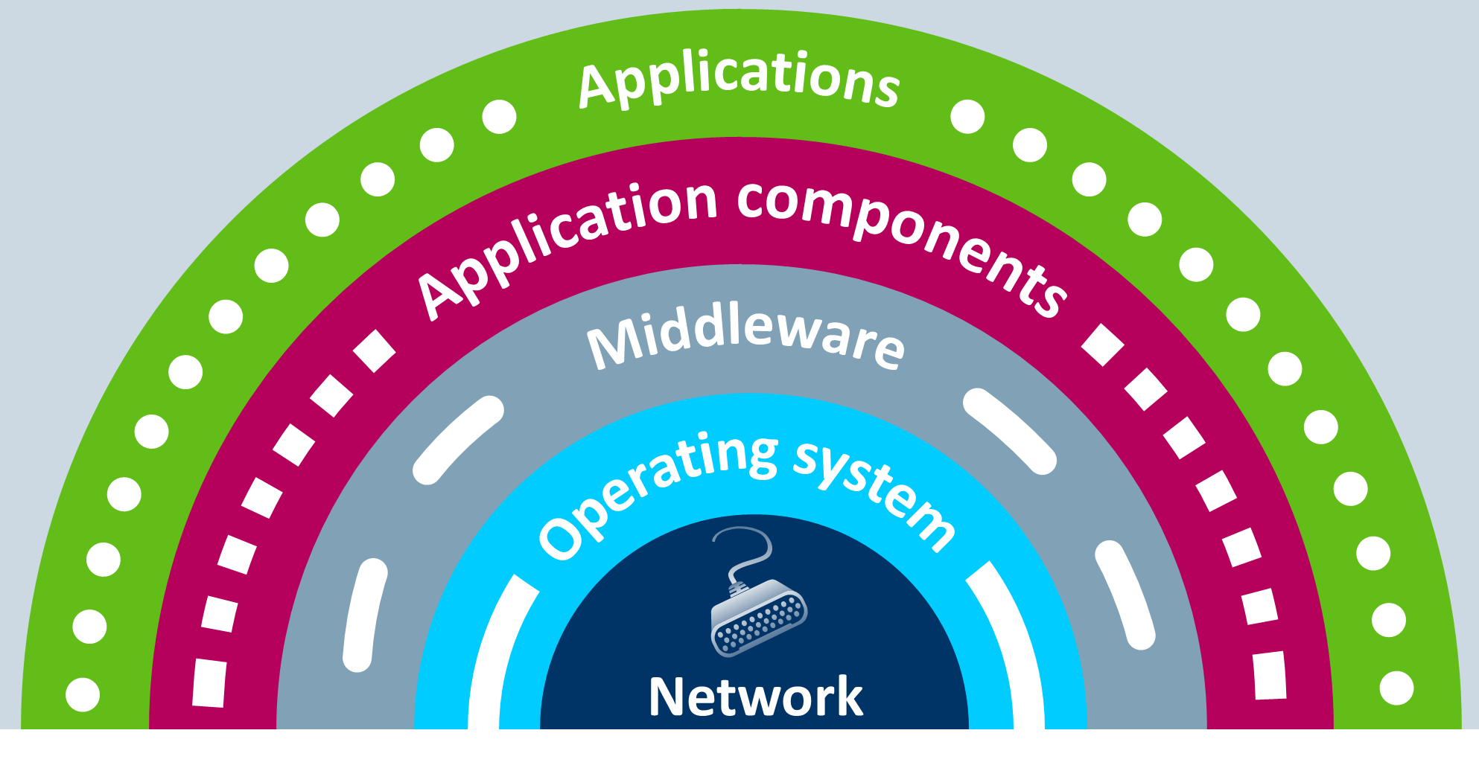
Data Integration
An IT infrastructure will generally consist of different layers

Slide 240
Integration Tools - MOM
Message-Oriented Middleware (MOM)
Previously non-MOM systems required:
Network connectivity
Senders and receivers running at the same time
Connections from senders to specific receivers
Message-Oriented Middleware is suitable for connecting systems across unreliable networks such as the Internet or internally and so systems do not need to be connected continuously

Slide 241
Integration Tools
Simple Object Application Protocol (SOAP) messages can be sent to a web service enabled web site (for example, a house price database) with the parameters needed for a search. The site would then return an XML-formatted document with the resulting data (prices, location, features, etc). Because the data is returned in a standardised format, it can then be integrated directly into a third-party site
The SOAP architecture consists of several layers of specifications for message format, message exchange patterns (MEP), underlying transport protocol bindings, message processing models, and protocol extensibility

Slide 242
Developing Systems
In this Unit, we will be focusing on:
The use of systems, ERP and databases
The development of P2P systems
Data integrity
Integration tools
Developments in IT

Slide 243
Cloud Computing
Cloud computing is a metaphor for the Internet but organisations software, platforms and infrastructure can be sold as a service remotely, through the Internet. Typically, the supplier has actual energy-consuming servers which host products and services from a remote location, so end-users don't have to; they can simply log on to the network without installing anything
Software, platforms or infrastructure are offered in a public, private or hybrid networks by leading companies such as Google, Oracle, Access2MyPC and Microsoft

Slide 244
Open Source Software
Refers to computer software with its source code made available and its licence that allows the holder to change and distribute the software to a third party for any purpose. Its use generally leads to reductions in life cycle costs for the development of software
Its main disadvantage is that open source may allow hackers to know about the weaknesses or loopholes of the software more easily than closed-source software
The more prominent organisations involved in OSS development include the Apache Software Foundation and the Linux Foundation

Slide 245
Convergence of Technology
Technological convergence is the tendency for different technological systems to evolve toward performing similar tasks. Digital convergence refers to previously separate technologies such as voice (and telephony features), data (and productivity applications), and video that now share resources and interact with each other simultaneously
The downside of convergence is that converged devices are often less functional and reliable than their component parts - a mobile phone's web browser may not render some web pages correctly, due to not supporting certain technologies. As the number of functions in a single device escalates, the ability of that device to serve its original function can decrease

Slide 246
The Advanced Practitioner Modules and Units
Advanced Practitioner Level Modules and Units
Induction
Module: Strategic Supply Chain Management Supply Chain Management Corporate Strategy and Procurement and Supply Chain Management The Impact of Globalisation on Supply Chains | Module: Developing People in Procurement and SCM Developing Individuals and Teams in Procurement and Supply Developing Leadership Capabilities to Improve Procurement and Supply
Module: Advanced Category Management in Procurement and SCM Developing Systems for Procurement and Supply Chain Management Category Management Supply Chain Improvement | Module: Implementing Change in Procurement and SCM Effective Procurement and Supply Chain Management Leading Stakeholders to Achieve Change
Module: Contracting Excellence in Procurement and SCM Legal Aspects of Commercial Contracts Managing Risks in Contracting | Project in Procurement and Supply Chain Management

