Slide 1
Strategies and Instruments

Slide 2
Strategies
A strategy is a broad-based statement that enables you to accomplish an objectives
  use the national media to defend a client
  use the student newspaper to deliver a particular theme
Notes:
This PowerPoint is meant to help you discern between strategies and instruments. For your assignment you have the option of creating either or.

Slide 3

Old but good Strategy Examples
Starbucks wants to get away from the reputation as being too expensive particularly in today’s economic climate
So they start selling in Costco (marketing)
Have their CEO give an interview for Costco’s customer magazine (PR)

Slide 4
Instruments
A tactic (or an instrument as I call them) is the specific activity, event or channel that you propose to implement
  press release
  Pitch letter
  Report
  Media event

Slide 5



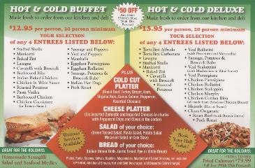
Instrument Examples
Reports
Flyers
Flyers

