Slide 1
Role of Development for the Practical Nurse
PNR 300NIM

Slide 3
Essay Requirements

Slide 4
PROCESS
The ethical essay is to be written individually using American Psychological Association (APA) format.
Select ONE of the topics posted for your essay. Be sure to choose the topic that you have a strong interest and a strong background of information or a strong personal belief in.
Read widely about your topic by researching literature study to familiarize yourself with the different perspectives that exist about your topic.
Formulate a clear and concise thesis/argument. The aim of your paper is to support your position through ethical reasoning with valid literature references.
Make sure that you use a MINIMUM of five references that are NOT part of the required course readings
Notes:
Includes Presentation, Essay

Slide 5
Expectations and FORMAT
NOTE: Only the approved listed of topics posted should be used for your Ethical Dilemma paper. Essays submitted with a topic that is not on the list will not be accepted and mark of your paper will be automatically zero.
APA format with a clear and well-developed introduction, thesis, content, and conclusion
Microsoft Word-processed (not (PDF) adobe format, not Mac format).
Double space- type/word processed with 12-point font, Times New Roman
Complete 6 pages individual essay paper excluding title page and reference page. No marks will be awarded for essays over the page limit***
Submit an electronic copy to the instructor through SAFE ASSIGNMENT by midnight of the due date and only single attempt.
NOTE: Please make sure to double check that it is the right paper that you are submitting. (Student had submitted wrong paper in the past).
If requested by your professor, a hard copy of the paper must be submitted on the due date or late penalties will apply.
Notes:
Includes Presentation, Essay

Slide 6
Expectations and FORMAT
Resources:
Minimum of five scholarly resources as references – should not include our course textbooks
Refer to Publication Manual of the APA for paper format
Retrieved from nursing journals or any journals from the library like CNA journals
Other scholarly articles may be utilized, library resources like Seneca can be used. Internet/Google/Edge searches for news/articles/journal are not an academic resource
Safe Assign: Faculty will use discretion to deduct marks based on safe-assign matches. Your paper must be submitted through safe assign in the Assignment folder Safe Assign title Essay.
Note: Safe Assign is a sensitive system that captures and detects papers from the past or years and years ago including your own paper or copied from another student, or information copied from journals and other pertinent resources. It will result to having a high percentage of plagiarize paper if not reference properly.
Do not use or/recycle your own paper that you have written from your other course. Please ensure that your paper is not plagiarize and reference properly.
Notes:
Includes Presentation, Essay

Slide 7
Grading
Missed paper: An automatic grade of zero will be given to students who missed to submit their paper. Should extenuating circumstances arise, appropriate supporting documentation must be provided within one week of the due date. Failure to produce documentation within the timeframe will result to having a grade of zero.
Upon acceptance of the documentation and confirmed it is valid, your essay will be extended – instructor will confirm the extension date.
Note: E-mail your Faculty Instructor immediately once you are unable to submit your paper on time due to illness or extenuating circumstances. Computer problem is not a reason for an extension. Power outage is not an acceptable excuse.
Late paper: The faculty instructor will deduct 10% per day and will not be accepted beyond two weeks after the assignments due date.
Cheating and Plagiarism: Read Academic Policy. It is strictly enforced.
Notes:
Includes Presentation, Essay

Slide 8
Tips
Be analytical and provide effective argument.
Be sure to explain your agreement and disagreement with the nursing practice identified.
Your position should be through the utilization of relevant ethical theories, principles, nursing standards and codes and current relevant research to formulate your argument, this must include the applicable/appropriate legislation.
Make sure that your paper contains a reflection on what personal values you have in relation to the issue. A good argument always presents both sides but justifies why one side is more compelling than the other.
Additional tips:
Background information and significance of the topic chosen should be included
Good case scenario that reflects your argument (i.e., journal case study from the library not internet searches)
Well-focused essay showing your understanding of the topic, clear, readable, good flow with correct grammar and spelling.
Strong argument and avoid repeated ideas and information
Discuss the implications of this topic for nursing practice.
Conclusion; summarizes your ideas/argument/stand on the chosen theory and principle/s.
Notes:
Includes Presentation, Essay

Slide 9
Additional marks will be deducted:
Wrong spelling/grammars, punctuations, sentence structure are not clear.
Narrative essay (e.g., describing history of your chosen topic from beginning to end). Shows that the paper wasn't researched well.
For the use of different theme fonts (e.g., using design of ARIAL font BUT rest of the paper shows design of TIMES NEW ROMAN) and spacing/alignment is off.
It is considered exceeded pages if it’s 7 pages and considered too short if it’s 4 pages (excluding cover page & reference page) only. No marks will be awarded for essays over the page limit***
Not referencing properly. References taken from the internet like www.wikipedia.org, online dictionaries are not academic online references and are not acceptable.
Each paragraph doesn’t address one main idea.
Faculty Instructor will use discretion for students not following the format and expectations (e.g., submitted paper in PDF format- deductions can be minus 5%)
If all the key elements in the paper are not covered in a substantive way.
Notes:
Includes Presentation, Essay

Slide 10
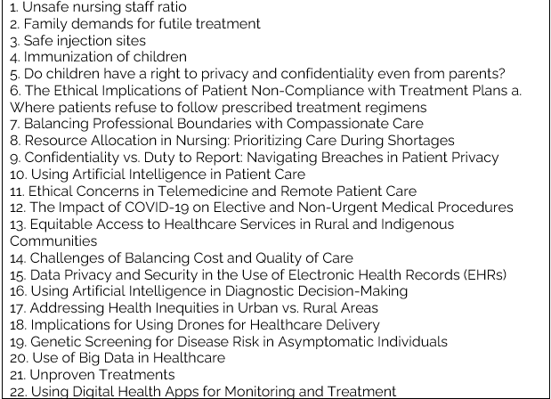
TOPICS- select only one topic. Please note: Students will not be allowed to discuss MAID/End of Life or Abortion
Notes:
Includes Presentation, Essay

Slide 11
Paper Overview
Note: Decide on a position that you will take regarding the identified issue.
State if you personally agree or disagree with the practice identified based on a reflection of your personal values.
  Cover page – follow APA format, first page. Include title of your essay (1 page)
  Introduction/Thesis (can be ½ page) – first paragraph that engages the reader’s attention and gives an overview, background, significance, and ethical dilemma of your topic.
          Introduction “grabs” the reader and very effectively tells the reader where the paper is headed.
          Identify your thesis statement using your case scenario relating to your topic.
          Your argument and justification of your position should be included including APA format reference.
.
Notes:
Includes Presentation, Essay

Slide 12
Essay Format:
    c. Identify how 1 ethical theory would view the ethical dilemma. Identify how 2 different Ethical theories/principles would have the opposing views with your topic. (i.e., can be 1 page or more)
          Use the assumptions of two ethical theories; (deontology, utilitarianism, etc.) to explicate the ethical concerns within the contemporary issue. This is the concern you introduced in your introduction.
          Then choose one ethical theory including your rationale to justify your argument
          Use the assumptions of two or three ethical principles (veracity, beneficence etc.) to explicate the ethical concerns of this issues.
          Then choose two or three ethical principles including your rationale to justify your argument.
  .
Notes:
Includes Presentation, Essay

Slide 13
Essay Format:
  d. How is the nursing profession involved in this issue? Identify relevant nursing standards or codes (CNO) ( can be 1 page)
          Use the CNO, CNA, RPNAO to demonstrate how the nursing profession and/or standards/ guidelines are engaged in addressing the ethical concerns arising from your issue.
          Identify legal considerations (RHPA, Nursing Act, Criminal Code, Human Rights, etc.)
          e. How is your issue connected to social justice. (can be 1 page)
Provide one sentence to define social justice (use a resource to support). Then explain how the ethical issue you described above specifically links to social justice.
Explain any existing laws and how that affects your ethical concern/issue
  f. State your point of view based on a reflection of your personal values on the ethical issue/dilemma presented. (can be ½ page)
  Explain how your values/beliefs/culture, media and/or religion play a role in your ethical concern/issue
Notes:
Includes Presentation, Essay

Slide 14
Essay Format:
          Integrate how your values/beliefs/culture, media, and/or religion support or do not support your ethical issue/concern
  g. Ethical Action: Identify and Describe the ethical framework that best fits with your ethical concern/issue. (can be ½ page)
          Use your ethical decision framework to describe how you would work through the ethical concern/issue.
          h. . Conclusion – last paragraph, provides a summary of the most salient points. (i.e., can be ½)
          Conclusion is persuasive, insightful, and clearly expressed. Does not raise any new points.
          Conclusion draws on research data as well as substantial information and ideas already presented throughout
          Summarization of Remember**A good argument always presents both sides but justifies why one side is more compelling than the other.
          i. APA References- last page
Notes:
Includes Presentation, Essay

Slide 15
Essay
NOTE: Please proofread your paper as much as you can and read your paper repeatedly before submission. Access Seneca resource for support. Inquire with the continuing education coordinator for staff that assist with writing an essay paper.
By the end of your paper, you will have a better understanding of ethical situations and how these issues can affect your nursing practice.

Slide 16
Evaluation Mode

Slide 17
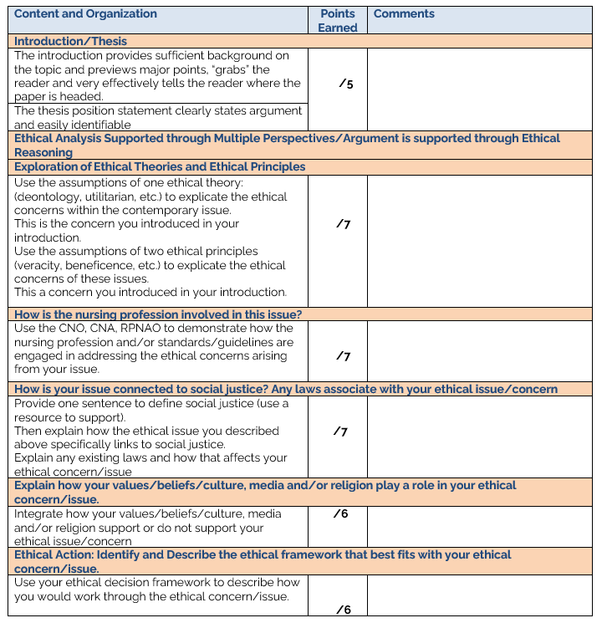

Slide 18
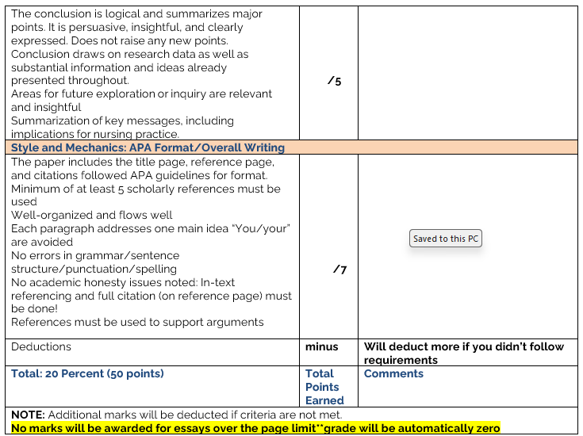

Slide 19
Modes of Evaluation
NOTE: Additional marks will be deducted if criteria are not met.
No marks will be awarded for essays over the page limit**grade will be automatically zero
If an essay, exam, and/or other requirements is missed due to extenuating circumstances, please NOTIFY the course faculty and Academic Coordinator
Instructor must be notified via SENECA email within 48 hours
Any absences or missed submissions of any of the requirements due to medical or other reasons must be supported by medical or other appropriate documentation within one (1) week of the due date.
Failure to produce documentation within the timeframe will result in a grade of zero in the missed evaluation
High percentage of plagiarism will be reported

Slide 20
Copyright Statement
A majority of the course lectures and materials provided in class and posted in BlackBoard are protected by copyright. Use of these materials must comply with the College’s Copyright Policy, Fair Dealing Policy, Intellectual Property Policy and Student Code of Conduct.
Students may use, copy and share these materials for learning and/or research purposes provided that the use complies with fair dealing or an exception in the Copyright Act. Permission from the rights holder would be necessary otherwise.
Please note that it is prohibited to reproduce and/or post a work that is not your own on third-party commercial websites including but not limited to Course Hero, OneNote or StudyBlue.
It is also prohibited to reproduce and/or post a work that is not your own or your own work with the intent to assist others in cheating on third-party commercial websites including but not limited to Course Hero, OneNote or StudyBlue.
https://seneca.libguides.com/c.php?g=588668&p=4986403

Slide 21


