Slide 1


CMH COVID-19 Training
Oregon OSHA Training Requirement
Introduction
1
2
3
4
5
6
7
8
9
10

Slide 2

Why do I have to do this training?
To help reduce worker exposure to COVID-19, Oregon OSHA developed a rule called “Addressing COVID-19 Workplace Risks”
Part of this rule is the requirement for employers to train their employees on 10 training elements
Note: All material contained in this training is based on the latest information provided by
Oregon OSHA
Oregon Health Authority (OHA)
Centers for Disease Control and Prevention (CDC)
Introduction
1
2
3
4
5
6
7
8
9
10

Slide 3

Required Elements included in this training per OAR 437-001-0744
Characteristics and methods of transmission of the SARS-CoV-2 virus
Symptoms of the COVID-19 disease;
The ability of pre-symptomatic and asymptomatic COVID-19 persons to transmit the SARS-CoV-2 virus
Safe and healthy work practices and control measures
Physical distancing requirements as they apply to the employee’s workplace and job function(s)
Mask, face covering, or face shield requirements as they apply to the employee’s workplace and job function(s)
COVID-19 sanitation requirements as they apply to the employee’s workplace and job function(s)
COVID-19 signs and symptom reporting procedures that apply to the employee’s workplace
COVID-19 infection notification process
Medical removal as required by the rule.
Introduction
1
2
3
4
5
6
7
8
9
10

Slide 4

This training is intended to give you a Solid foundation to understand the hazards of COVID 19 and the solutions available to keep you safe
Introduction
1
2
3
4
5
6
7
8
9
10

Slide 5

Like other diseases, COVID-19 is contagious and will spread rapidly if control measures are not established
Transmission
1
2
3
4
5
6
7
8
9
10

Slide 6

Transmission
1
2
3
4
5
6
7
8
9
10

Slide 7

How is COVID spread?
It is believed that COVID-19 spreads through the droplets and airborne particles formed when a person who has COVID-19 coughs, sneezes, sings, talks, and breathes.
There is growing evidence that particles can remain suspended in the air and be breathed in by others, and travel distances beyond 6 feet.
Transmission
1
2
3
4
5
6
7
8
9
10

Slide 8

Transmission
1
2
3
4
5
6
7
8
9
10

Slide 9

Droplets
A respiratory droplet is a small liquid drop produced by exhalation, consisting of saliva or mucus.
Droplets are 5 to 10 micrometers in size and drop to surfaces quickly.
Aerosols
Aerosolized particles are infinitesimal - meaning that they are extremely small.
Aerosols can travel on air currents potentially for hours.
This is why proper ventilation and masking are very important.
Transmission
1
2
3
4
5
6
7
8
9
10

Slide 10

Droplets that land on surfaces and objects can be transferred by touch.
Research shows that COVID-19 can stay alive on some surfaces for up to a few days if left un-sanitized
To reduce the spread of COVID-19, it is important to properly sanitize and disinfect all high-touch surfaces and wash your hands often especially before touching your face
High-touch areas are equipment or surfaces that are handled frequently throughout the day by multiple individuals. A few examples include countertops, credit card terminals, doorknobs, digital kiosks, touch-screen enabled devices, light switches, handrails, elevator control panels, and steering wheels.
Please refer to the CDC guidance for more information
Transmission
1
2
3
4
5
6
7
8
9
10

Slide 11

COVID-19 affects people in different ways.
Infected people have had a wide range of symptoms reported – from mild symptoms to severe illness.
Most people infected with COVID-19 will experience mild to moderate respiratory illness and recover without requiring special treatment.
Older people and those with underlying medical conditions such as cardiovascular disease, diabetes, chronic respiratory disease, and cancer are more likely to develop serious illness.
People of all ages who experience fever and/or cough associated with difficulty breathing or shortness of breath, chest pain or pressure, or loss of speech or movement should seek medical care immediately.
Symptoms
1
2
3
4
5
6
7
8
9
10

Slide 12
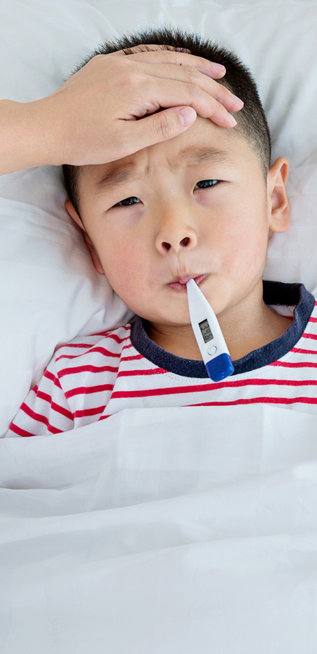
Symptoms may appear 2-14 days after exposure to the virus. People with these symptoms may have COVID-19:
Fever or chills
Cough
Shortness of breath or difficulty breathing
Fatigue
Muscle or body aches
Headache
New loss of taste or smell
Sore throat
Congestion or runny nose
Nausea or vomiting
Diarrhea
Symptoms
1
2
3
4
5
6
7
8
9
10

Slide 13

Pre-symptomatic
Infected people who have not yet developed symptoms but will go on to develop symptoms later.
Asymptomatic
asymptomatic refers to those who are infected but never develop any symptoms,
Pre-symptomatic
& Asymptomatic
1
2
3
4
5
6
7
8
9
10

Slide 14

Viral Shedding
Viral Shedding occurs when a virus is released from an infected host.
This means that both asymptomatic and pre-symptomatic individuals, who may not yet have any of the symptoms, are shedding viral particles while they talk, exhale, eat, and perform other normal daily activities.
Pre-symptomatic
& Asymptomatic
1
2
3
4
5
6
7
8
9
10

Slide 15

Pre-symptomatic
& Asymptomatic
1
2
3
4
5
6
7
8
9
10

Slide 16

Infection Prevention
The number one thing we can do to prevent the spread of COVID-19 is to treat everyone as if they are infected and contagious, even if they are feeling well.
This is important because people can spread the virus without showing any symptoms or even knowing that they are sick.
Healthy Work
1
2
3
4
5
6
7
8
9
10

Slide 17

Physical Distancing
Physical distancing means keeping at least 6 feet between yourself and other people who are not from your household.
Your employer is required to ensure that both work activities and workflows are designed to keep employees at least 6 feet from other people, unless they can demonstrate that such physical distancing is not feasible for certain activities.
Healthy Work
1
2
3
4
5
6
7
8
9
10

Slide 18

Examples of modifying a workplace to meet distancing requirements
Modify seats, furniture, workstations, etc. to maintain at least 6 feet of separation
Stagger shifts, start times, and break times where possible to reduce the number of team members in common areas
Provide visual cues to ensure proper spacing of 6 feet in areas where team members congregate. Examples include signs, tape, floor markings etc.
Install physical barriers in areas where 6 feet of separation cannot be maintained
Use video conferencing to avoid “in-person” meetings where possible.
Healthy Work
1
2
3
4
5
6
7
8
9
10

Slide 19

Source Control
Source control is reducing disease transmission by blocking respiratory droplets.
Masks, face shields, goggles, gloves and plexi-glass are all example of source control
These barriers block infectious droplets from spreading to others nearby.
Healthy Work
1
2
3
4
5
6
7
8
9
10

Slide 20

Source Control
Oregon OSHA requires everyone at the workplace to wear a mask, face covering, or face shield.
These source control items are required to be provided by the employer to workers at no cost.
CMH policy requires employees to use hospital provided mask and/or face shield
Healthy Work
1
2
3
4
5
6
7
8
9
10

Slide 21
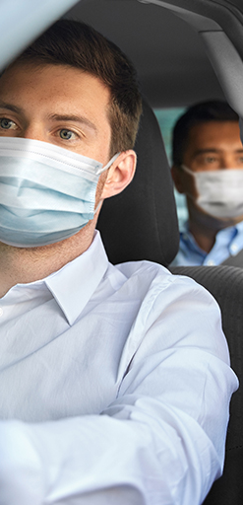
Transportation
When employees are transported in a vehicle for work purposes, regardless of the travel distance or duration involved, everyone in the vehicle must wear a mask.
This rule doesn’t apply when everyone in the vehicle are members of the same household.
Healthy Work
1
2
3
4
5
6
7
8
9
10

Slide 22

Employers are required to make sure that all common areas, shared equipment, and high-touch surfaces are cleaned regularly.
Healthy Work
1
2
3
4
5
6
7
8
9
10

Slide 23
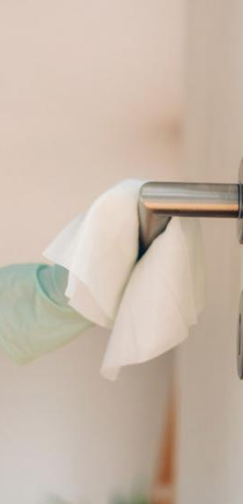
Cleaning
OSHA requires employers to make sure that all common areas, shared equipment, and high-touch surfaces are cleaned regularly.
At least once every 24 hours if the workplace is occupied less than 12 hours a day
At least every 8 hours if the workplace is occupied more than 12 hours a day
For workplaces not continually occupied or used for drop in purposes only, the employee should sanitize the area when done doing work in this area.
Healthy Work
1
2
3
4
5
6
7
8
9
10

Slide 24

Hand Hygiene
Washing or sanitizing hands regularly throughout your day is extremely important in reducing the spread of COVID-19
The CDC recommends washing for at least 20 seconds or using hand sanitizer with at least 60% alcohol
Avoid touching your face with unwashed hands
Introduction
1
2
3
4
5
6
7
8
9
10

Slide 25

Healthy Work
1
2
3
4
5
6
7
8
9
10

Slide 26

Healthy Work
1
2
3
4
5
6
7
8
9
10

Slide 27
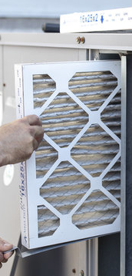
Ventilation at CMH
Columbia Memorial Hospital reviews annually in compliance with American Society of Heating and Refrigeration and Air Conditioning Engineers (ASHRAE) to ensure optimal air exchanges within patient care areas
These reports are reviewed by the Infection Preventionist for compliance.
All air filters are replaced quarterly to ensure proper function and ventilation
The air handler units are cleaned, maintained, and cleared of debris every 6 months to ensure proper function and performance
Healthy Work
1
2
3
4
5
6
7
8
9
10

Slide 28

Physical Distancing at CMH
All departments work flows and activities have or will be assessed and adjusted to maintain 6 feet from other individuals
There may be job duties and work flows in which 6 feet is not feasible
Your manager will inform you if there are exceptions to physical distancing requirements in your work area
Direct care departments will evaluate for reduction in shared surfaces and tools, ventilation, and potential staggering of shifts
Physical Distance
1
2
3
4
5
6
7
8
9
10

Slide 29
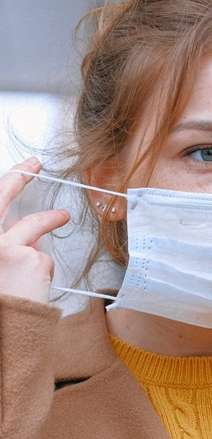
PPE Guidelines for CMH Employees
All employees, contractors, and volunteers are required to wear a hospital provided mask in any CMH workplace, including hallways, bathrooms, elevators, conference rooms, lobbies, breakrooms, shared vehicle, etc.
Employees in a private, non-shared, workspace do not have to wear a mask while alone in the private space
Employees are required to wear a personal mask into the facility until they are given a hospital provided mask
Review the PPE algorithm for guidelines for when to use certain PPE
Your manager will inform you if there are exceptions or additions to these guidelines for your work area
1
2
3
4
5
6
7
8
9
10
Masking

Slide 30
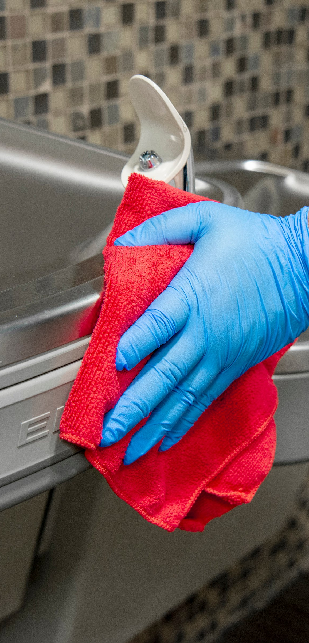
Sanitation Guidelines at CMH
  CMH Environmental Services provides, a thorough wipe down of all CMH departments using a hospital approved disinfectant:
    Three times (every 8 hours) daily for 24 hour departments
    Once daily for all departments open for less than 12 hours per day.
  Focus will be placed on common areas, shared equipment and high touch areas.
Sanitation
1
2
3
4
5
6
7
8
9
10

Slide 31
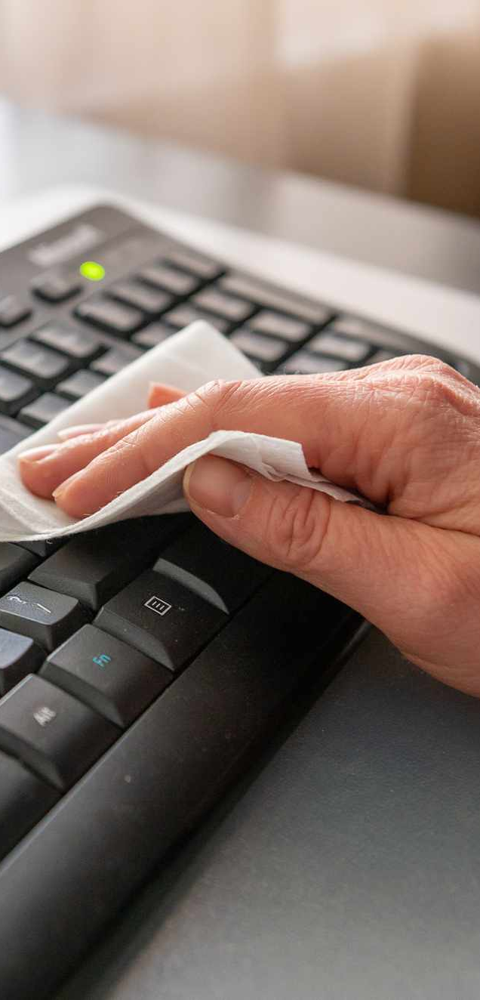
Sanitation Guidelines at CMH
  Only hospital approved disinfectants will be utilized in the cleaning of all surfaces and environments, utilizing manufacturer guidelines
  It is an expectation that each hospital department will implement practices to ensure that all shared equipment is wiped down between users including but not limited to end of shift wipe down of computers, phones, etc.
  All staff are expected to follow CMH Hand Hygiene policy 8727-001.
Sanitation
1
2
3
4
5
6
7
8
9
10

Slide 32
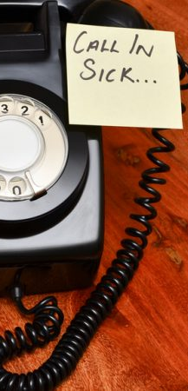
What if I am exposed or have symptoms?
Inform your supervisor of symptoms or known exposure
Contact CMH Employee Health RN, Betsy Brenden
Employee Health RN may refer the employee for testing
Work restriction or furlough may be required according to the CMH return to work algorithm for COVID related symptomology
Employees screened out upon arrival to work will be given a notification letter and sent home.
Symptom Reporting
1
2
3
4
5
6
7
8
9
10

Slide 33

Will I be notified if a patient I care for develops symptoms?
Out Patient department managers will be notified if a COVID positive patient has been seen in the department
The department manager is expected to identify staff who may have had contact with the patient
The manager, will use the COVID+ Manager Follow-Up form to assess caregivers for risk
This form will be sent to Infection Prevention who will review based on CMH Criteria for Staff Exposure
If it is determined that you meet exposure criteria, you will be contacted by Employee Health.
Infection Prevention and Employee Health will collaborate with Clatsop County Health Department for all exposure cases.
It is not required to provide contact tracing for staff that provide care on a unit in which patients are admitted to the organization.
Notification
1
2
3
4
5
6
7
8
9
10

Slide 34
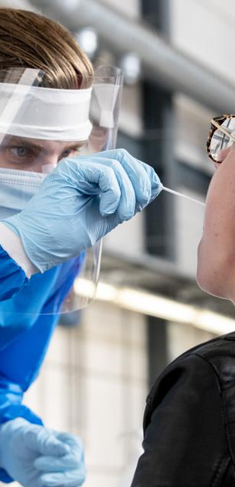
If I get COVID, how do I know if I got it at work?
All Employee COVID 19 positive cases will be evaluated by CMH Employee Health with consultation from Infection Prevention as needed to identify the following:
  Potential work-related exposure versus community exposure
  Potential exposures to other CMH employees
  Necessity for work restriction and/or return to work guidelines
  Necessity for OSHA Recordkeeping requirements
  Necessity for source tracing within the organization
Notification
1
2
3
4
5
6
7
8
9
10

Slide 35

What happens if I cannot work because of COVID?
Work Restriction or Medical Removal may be implemented according to CMH return to work guidelines
CMH Human Resources will make final decisions related to work related furlough
Variation to these practices may occur based on Oregon Health Authority guidelines addressing staffing emergencies
Medical Removal
1
2
3
4
5
6
7
8
9
10

Slide 36

What happens if I cannot work because of COVID?
OSHA Rule for missing work related to COVID
  Employees restricted from work due to medical removal must be allowed to work from home if suitable work is available and they feel well enough to do so.
  An employee participating in quarantine or isolation is entitled to return to their previous job duties.
  No adverse action can occur as a result of participation in quarantine or isolation activities.
Medical Removal
1
2
3
4
5
6
7
8
9
10

Slide 37

Congratulations!
You did it! You are not CMH OSHA trained on COVID-19
If you loved this training and cannot get enough, check out the CMHTV COVID-19 page for resources and more information
Medical Removal
1
2
3
4
5
6
7
8
9
10

