Slide 1
Cultural Competency and Patient Engagement

Slide 2
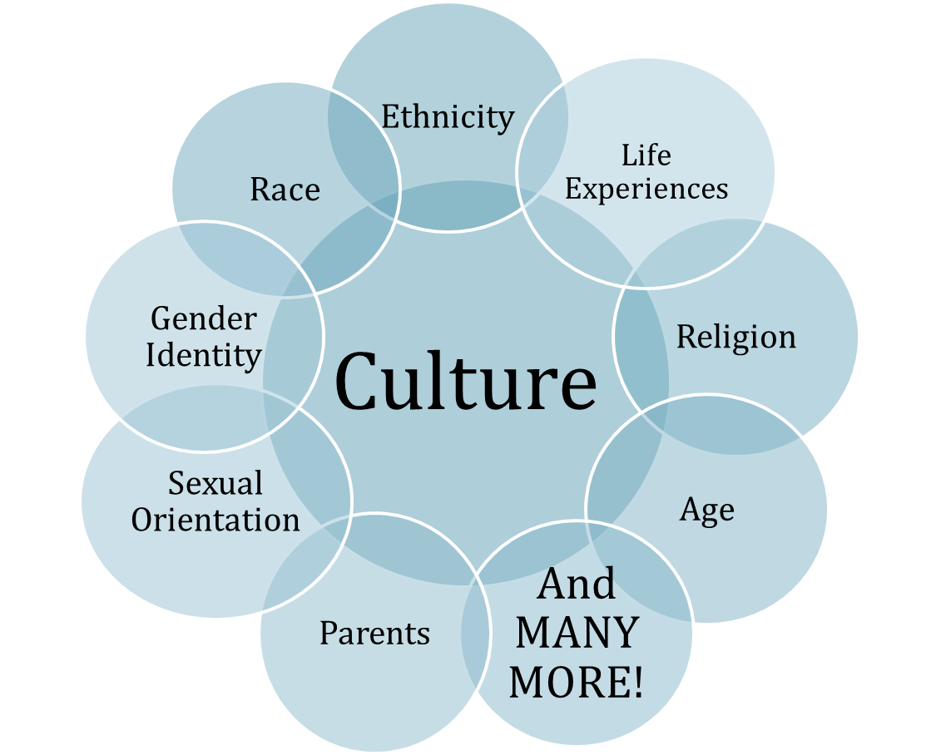
What is Culture?
Culture refers to integrated patterns of human behavior that includes language, thoughts, actions, customs, beliefs, values, and institutions that unite a group of people.¹
We use it to create standards for how we act and behave socially.
"Culture hides much more than it reveals, and strangely enough what it hides, it hides most effectively from its own participants.” E.T. Hall
⁻ ¹Source from http://minorityhealth.hhs.gov and The Cross Cultural Health Care Program
Notes:
Culture is in us and outside of us
We have a shared way of viewing the natural world, the spiritual world, our family structure
We are comfortable that we know what to expect in behaviors from others around us
We all agree that waiting your turn is the standard
We all share that injured should be helped
Growing up we become enculturated to the standards of the culture we were born into.
As we grow, we may be in a position to need to acculturate, or adapt to another culture.
Some people never have this experience and other people have the experience many times in their life.

Slide 3
“Building Cultural Engagement With Patients Is A Process!”
Awareness of how culture shapes who you are.
Knowledge of how culture shapes the decisions that each one of us will make.
Skills to build on cultural similarities and bridge cultural gaps.

Slide 4
Culture is not only learned but it is shared, adaptive, and is constantly changing.
Notes:
Remember (Slide)
Therefore, the more exposure you have to different culture the more likely you are to be able to relate or understand patients from those cultures

Slide 5
Individual Culture
Each individual’s culture is
a unique representation of the variation that exists in larger culture
learned as you grow up
shaped by the power relations within your social context
changes over the lifetime of the individual
Because each individual is a unique cultural package, cross cultural encounters need strategies to open the door to discover the individual’s cultural preferences and frame of reference.
Notes:
changes over the lifetime of the individual based on experiences and social interactions
While there is always individual variation,
There are limits, there are some cultural options that a single individual can not adopt without being ostracized by the group
Example: The American standard for cleanliness.

Slide 6
An Individual’s Culture is Present in Every Health Care Encounter
Our view of illness and what causes it
Our attitudes toward doctors, dentists, and other health care providers
When we decide to seek our health care provider
Our attitudes about seniors and persons with disabilities
The role of caregivers in our society
Notes:
Cultural perspectives directly create what one considers to be illness and what one should do about it
Are you treating an infection or an ancestor’s warning?
Research has demonstrated that there is a decision making hierarchy in societies that use both biomedicine and alternative health care practices.
Attitudes can be expressed in a very subtle manner- the seating arrangement- by placing seating in rows, the office has allowed for the natural addition of wheel chairs into the seating of the waiting room. If all of the chairs were lining the walls someone in a wheel chair would be in the center of the room standing out from the others seated.
Subtle differences like the use of color, position of chairs and use of decorative elements convey cultural inclusion or exclusion.
In some areas the door jambs and window casings would be red. Or there would be a mirror directly in front of you when you walked in.

Slide 7
The Health Care Encounter
Because each individual brings their cultural background with them. There are many cultures at work in each health care visit:
Culture of Bio-Medicine
Provider’s Culture
Patient’s Culture
Interpreter’s Culture
Culture of Health Care Institution
Health Care Encounter

Slide 8
Cultural Competency Continuum
For each row, CIRCLE where you are now
Area of Competency | Stage 1 Culturally Unaware | Stage 2 Culturally Resistant | Stage 3 Culturally Conscious | Stage 4 Culturally Insightful | Stage 5 Culturally Versatile
Knowledge of Patients | Doesn't notice cultural differences in patients' attitudes or needs. | Denigrates differences encountered in racial/ethnic patients. | Difficulty understanding the meanings of attitudes/ beliefs of patients different from self. | Acknowledges strengths of other cultures and legitimacy of beliefs whether medically correct or not. | Pursues understanding of patient cultures. Learns from other cultures.
Attitude Towards Diversity | Lacks interest in other cultures. | Holds as superior the values, beliefs and orientations of own cultural group | Ethnocentric in acceptance of other cultures. | Enjoys learning about culturally different healthcare beliefs of patients. | Holds diversity in high-esteem. Perceives as valuable contributions to healthcare, medicine, patient well-being from many cultures.
Practice Related Behaviors | Speaks in a paternalistic manner to patient. Doesn't elicit patient's perspectives. | Doesn't recognize own inability to relate to differences. Tends to blame patient for communication or cultural barriers. | May overestimate own level of competent communication across linguistic or cultural boundaries. | Able to shift frame of reference to other culture. Can uncover culturally based resistance, obstacles to education & treatment | Flexibly adapts communication, inter-actions to different cultural situations. Can negotiate culture-based conflicts in beliefs and perspectives.
Practice Perspective | Believes one approach fits all patients. No "special treatment." | Has lower expectations for compliance of patients from other cultural groups. | Recognizes limitations in ability to serve cultures different from own. Feels helpless to do much about it. | Incorporates cultural insights into practice where appropriate. | Incorporates cultural insights into practice where appropriate.
Source: J. L. Mason, M. P. Benjamin, & S. A. Lewis (1993). The cultural competence model: Implications for child and family mental health services.
Notes:
Health Professionals Self-Assessment Tool
As we go through the strategies for becoming culturally aware and sensitive, we can use this tool to help guide where you began and where you would like to be in the continuum.
Think about the practice perspective to see where your comfort areas are.

Slide 9
Section 2 Clear Communication: The Foundation of Culturally Competent Care
Notes:
Module 1
Diana

Slide 10
Training Goals
Define “Clear Communication” in patient/provider encounter.
Describe actions to improve communication in health care setting.
Define “Health Literacy” in a health care setting.
.
10
Notes:
Create new goals for each module
Diana
During the training we will go over how to achieve cultural engagement with Seniors that have special needs including refugees, LGBT , homeless, disabled and cognitive impairment.

Slide 11
Did you know?
California is one of the most diverse states in the nation
1 in 6 people living in the US are Hispanic (almost 57 million). By 2035, this could be nearly 1 in 4. (CDC, 2015)
Average physician interrupts a patient within the first 12 seconds. (Family Medicine, 2001)
20% of people living in the U.S. speak a language other than English at home. (CIS, 2014)
Latino population in the U.S. has grown by 43% between 2000 and 2010. (Census, 2011)
17% of the foreign born population in the U.S. are classified as newly arrived (arriving in 2005 or later). (Census, 2011)
Notes:
First Bullet Point: http://www.cdc.gov/vitalsigns/hispanic-health/
Second Bullet Point: https://www.ncbi.nlm.nih.gov/pubmed/11456245
Third Bullet Point: http://cis.org/record-one-in-five-us-residents-speaks-language-other-than-english-at-home
Fourth Bullet Point: http://www.census.gov/prod/cen2010/briefs/c2010br-04.pdf
Fifth Bullet Point: https://www.census.gov/prod/2011pubs/acsbr10-16.pdf
MODULE 1
Health literacy is another issue that impacts all patients, but has a much larger impact on seniors and person’s with disabilities.
Health literacy impacts all English speakers
Means ability to read, understand and ACT on health information.
Even professionals can be stumped by the simple direction: take two a day.
When health literacy is coupled with learning English as a second language, communication during an office visit can be greatly impacted.
Fast and clear communication relies on a common vocabulary

Slide 12
Barriers to Communication
Linguistic Barriers
Speech patterns, accents or different languages may be used
Limited Experience (Health Care Concepts & Procedures)
Many people are getting health care coverage for the first time
Cultural Barriers
Each person brings their own cultural background and frame of reference to the conversation
Systematic Barriers
Health system have specialized vocabulary and jargon
Our personal culture includes what we find meaningful--beliefs, values, perceptions, assumptions and explanatory framework about reality. These are present in every communication.
Notes:
MODULE 1

Slide 13
Benefits of Clear Communication
Safety & Adherence
Physician & Patient Satisfaction
Office Process
Saves Time & Money
Malpractice Risk
Medical Error
Reduces Cost
13
Notes:
MODULE 1
Diana:
Clear communication is an important part of cultural engagement.
Use plain language or every day words.
Patient engagement is based on clear communication that the patient will understand the first time they hear it.
Research indicates that clear communication, patient satisfaction, trust and confidence are all linked.
Successful patient engagement leads to equity in health outcomes .
To help support clear communication and equity in health outcomes, HN uses evidence based guidelines

Slide 14
Clear Communication
Here’s What Patients Wish Their Health Care Team Knew…
Here’s What Your
Team Can Do…
I tell you I forgot my glasses because I am ashamed to admit I don’t read very well
I don’t know what to ask and hesitant to ask you
When I leave your office I often don’t know what I should do next
I’m very good at concealing my limited reading skills
Use a variety of instruction methods
Encourage open-ended questions and use Ask Me 3
Use Teach Back Method or “Show Me” method
Use symbols, color on large print direction or instructional signs
Create a shame free environment by offering assistance with materials
- Image Source: Robert Wood Johnson
Notes:
MODULE 1
With each patient it’s important to look for hints of low health literacy. Health literacy impacts everyone, but some groups are at higher risk for poor health literacy.
Low health literacy is a sensitive subject and most patients do a very good job of hiding the fact that they don’t understand or cannot read.
The slide shows some statements that may help identify health literacy.
Asking
1. Would you prefer to read health information on your own or have me discuss it with you first.
2. What do they enjoy reading
may help identify what vocabulary level to use or if health literacy is an issue for your client.
Another clue could be Repeat phone calls with the same question to your office
Pictures/images are great memory prompts. Using a simple body outline to describe the way a treatment works or how a chronic condition effects the body is a great memory prompt.
The Ask Me 3® is a great way to focus on the information you need from your patients. The Ask Me 3® model uses the following questions:
What is my main problem?
What do I need to do about it?
Why is this important for me?
Instead you could use the teach back method by asking
“I want to make sure I explained this clearly. When you go home today, what will you tell your [friend or family member] about [key point just discussed]?”

Slide 15
Clear Communication
Here’s What Patients Wish Their Health Care Team Knew…
Here’s What Your
Team Can Do...
I put medication into my ear instead of my mouth to treat an ear infection because the instructions said "For Oral Use Only".
I am confused about risk and information given in numbers like % or ratios. How do I decide what I should do?
Explain how to use the medications that are being prescribed.
Use specific, clear & plain language on prescriptions
Use plain language to describe risks and benefits, avoid using just numbers.
Notes:
MODULE 1
Facilitator:
Does ‘For Oral Use Only’ mean ear, mouth or other parts?
Don’t assume the patient knows. Drawing it out on the line drawing of a body can be very helpful and again a good memory support.
Numeracy skills are challenging for most patients. This one area had the lowest scores in the National Adult Literacy Survey.
Dose tables by weight, increasing dosage, even dosage throughout the day. Most people, even those well educated, did not get it right.

Slide 16
Clear Communication
Here’s What Patients Wish Their Health Care Team Knew…
Here’s What Your
Team Can Do…
I am more comfortable waiting to make a health care decision until I can talk with my family.
I am some times more comfortable with a doctor of my same gender.
Its important for me to have a relationship with my doctor.
I use alternative and complementary medicine and home remedies but don’t think to tell you.
Confirm decision-making preferences
Office staff should confirm preferences during scheduling
Spend a few minutes building rapport at each visit
Ask about the use of complementary medicine and home remedies
Notes:
MODULE 1
Facilitator:
Health literacy coupled with cultural background can really impact understanding, retention and follow through.
Asking a few questions can help build your understanding of your patient’s cultural background or their linguistic needs.

Slide 17
Clear Communication: Effective Use of An Interpreter
Speak directly to the patient, not the interpreter
Speak in the first person
Speak in a normal voice, try not to speak fast or too loudly
Speak in concise sentences
Interpreters are trained in medical terminology; however, interpretation will be more smooth if you avoid acronyms, medical jargon and technical terms
Be aware of the cultural context of your body language
Use the Teach Back Method even during an interpreted visit. It will give you confidence that your patient understood your message.
17
Notes:
Source:
MODULE 1
Facilitator:
If an interpreter is used here are a few simple tips to support the rapport that you worked hard to build.
Face the patient and talk to the patient directly, not the interpreter.
Don’t ask or say anything that you don’t want the patient to hear. Interpreters should say Everything that you said.
Speak in the first person to your patient, not the interpreter.
Speak in a normal voice,
give information in small chunks and pause for the interpreter
You will not need to adjust your vocabulary as much if you use a professional interpreter. If not, keep in mind the age and background of the person that is interpreting.
Your body language is all that the patient is understanding when you speak. They read your body language in their cultural context.
Watch the patient’s eyes, facial expression and body language when you speak and when the interpreter speaks. Look for signs of comprehension, confusion, agreement or disagreement.

Slide 18
Clear Communication: Limited English Proficiency
Here’s What Patients Wish Their Health Care Team Knew…
Here’s What Your
Team Can Do…
My English is pretty good but at times I need an interpreter
Some days it's harder for me to speak English
When I don’t seem to understand, talking louder in English intimidates me
If I look surprised, confused or upset I may have misinterpreted your nonverbal cues
Office staff should confirm language preferences during scheduling
Consider offering an interpreter for every visit.
Match the volume and speed of the patient’s speech
Mirror body language, position, eye contact
Ask the patient if they're unsure
Notes:
MODULE 1
Facilitator: for limited English Proficient seniors----
Don’t assume always ask. It is not the patient’s responsibility to ask for an interpreter, it’s yours. Could result in a Civil Rights violation.
Even someone whose English is pretty good may need an interpreter when they are sick or dealing with complex information.
Offer an interpreter every time an appointment is made.
Document the patient’s preferred language AND when they refuse an interpreter in the medical record.
To help identify if your patient needs an interpreter
Display a poster of common languages spoken by patients; ask patients to point to their language of preference
Health Net offers sign language and interpreters for each clinical visit.
If you elect to not use an interpreter, here are some things to help the conversation:
When in doubt or you feel there is some confusion, speak slowly and try not to raise your voice
Tolerate gaps between questions and answers. It may take limited English proficient patients a little longer to process information or to answer questions.
clear enunciate words so that patients have an easier time understanding you. Many words sound similar.
If you notice discomfort, ask- I am sensing something is bothering you, can you explain? ….)

Slide 19
Language Assistance Services
Language assistance is available at no cost to
Members & Providers:
Interpreter support at a medical point of contact
Sign language interpreters
Speech to text interpretation for hearing loss in patients who do not sign
Member informing materials in alternative formats (i.e., large print, audio, and Braille)
Contact the health plan for assistance with language services.
19
Notes:
MODULE 1
All providers are eligible for this support-
From an ADA perspective it is the facilities responsible to provide the service
HN makes it available to you at no cost, but it is the facility that can be fined from OCR not HN
CBAS, LTSS, clinics and physician offices

Slide 20
Use Professionally Trained Interpreters
When patients are stressed by illness, communication in their preferred language can improve understanding. Being prepared to use an interpreter
when needed will keep the office flow moving smoothly.
Hold a brief introductory discussion with the interpreter
Introduce yourself and give a brief nature of the call/visit
Reassure the patient about your confidentiality practices
Be prepared to pace your discussion with the patient to allow time for interpretation
Avoid interrupting during interpretation
In some languages, it may take longer to explain a word or a concept.
20
Notes:
MODULE 1 - Add 711 – add content on alternative formats
One of my colleagues, a PhD, recently supported her father through cancer treatment, hospice care and his final days. One of the ways that she was able to provide loving and attentive support for her father as well as deal with the emotional trauma herself was to not act as an interpreter.
When language is a barrier to effective communication a professional trained interpreter can provide many advantages over using office staff or the family of the patient.
Taking a minute to brief the interpreter before stepping into the exam room can help keep the appointment moving smoothly.
Avoid interrupting during interpretation.
In some languages, it may take longer to explain a word or concept

Slide 21
Alternate Formats Are Required!
Under Title II of the Americans with Disabilities Act and Section 504 of the Rehabilitation Act of 1973, federally conducted and assisted programs along with programs of state and local government are required to make their programs accessible to people with disabilities as well as provide effective communication.
Effective communication means to communicate with people with disabilities as effectively as communicating with others. Alternative communications that support a patient encounter include Sign Language interpreters, Tactile interpreters, captioning and assisted listening devices.
- Source National Center on Accessibility | IU Research Park, 501 North Morton Street, Suite 109, Bloomington, IN 47404-3732
21
Notes:
MODULE 4
The ADA requires that communication with person’s with disabilities be as effective as communicating with others.
Sign language interpreters are required.
Speech to text interpreting is also available.
Hospitals to provide their own.

Slide 22
References
Culture and Cultural Competency
U.S. Department of Health and Human Services (n.d.). The Office of Minority Health. Retrieved from http://minorityhealth.hhs.gov/
Clear Communication: The Foundation of Culturally Competent Care
Health Industry Collaboration Effort , Inc. (2010, July). Better communication, better care: Provider tools to care for diverse populations. Retrieved from http://www.iceforhealth.org/library/documents/ICE_C&L_Provider_Tool_Kit.10-06.pdf
U.S. Department of Health and Human Services, Office of Minority Health (n.d.). Handouts: Theme 1: BATHE Model (1.3). In The facilitator's guide: Companion to: A physician's practical guide to culturally competent care (pp. 145-145). Retrieved from https://cccm.thinkculturalhealth.hhs.gov/PDF_Docs/Physicians_QIO_Facilitator_GuideMEDQIC.pdf
Weiss, B. D. (2007). Health literacy and patient safety: Help patients understand; Manual for clinicians (2nd ed.). Chicago, IL: American Medical Association Foundation. Retrieved from http://med.fsu.edu/userFiles/file/ahec_health_clinicians_manual.pdf
National Patient Safety Foundation: Ask Me 3 materials for providers. Retrieved from http://www.npsf.org/?page=askme3
22
Notes:
NOTE (JC: changes have been made)
Do you want to keep the original format of the references? Example; Culture and Cultural Competency as the topic, then bullet the references pertaining to that topic?
References match the original ICE Trainings, but two of the five hyperlinks won’t open. 3 and 4th.
Third Bullet: Hyperlink does not open the source. Here is the link I believe pertains to the resource title. PLEASE DOUBLE CHECK! https://cccm.thinkculturalhealth.hhs.gov/PDF_Docs/Physicians_QIO_Facilitator_GuideMEDQIC.pdf
Fourth Bullet: Hyperlink does not open the source. Here is a link to the same source material: http://med.fsu.edu/userFiles/file/ahec_health_clinicians_manual.pdf

Slide 23
Developed in collaboration with Health Industry Collaboration Effort
Notes:
Update the ICE Logo
*the logo on the slide is from there website (Fix logo)

