Slide 1
Provider Access and Availability
of Language Services

Slide 2
Language Assistance
Kern Health Systems (KHS) is committed to providing quality health care to our culturally and linguistically diverse member population. To assist providers in providing the best possible service to our members, KHS:
Shares member preferred language with each provider.
Provides telephone, in-person and video remote interpreting services.
Shares Kern County and our members’ language profile with all providers, annually.
Provides a language assistance resource to all providers.
Offers providers training on the provision of KHS’s language services.

Slide 3
Telephone interpreting, in-person and video remote interpreting services
Telephone interpreting is available 24 hours a day, 7 days a week. In-person and video remote interpreting services must be scheduled at least 5-7 days in advance of an appointment through KHS’ Member Services Department.
During KHS Office Hours: Contact KHS’ Member Services Department at 1-800-391-2000. A Member Services Representative will connect you with one of our interpreting services.
After KHS Office Hours:
1. Call 1-800-391-2000
2. Select option 2 for the Advice Nurse Line
3. Select option 3 to access an interpreter
4. Inform the Advice Nurse Line of the need for an interpreter and you will be connected to an interpreter

Slide 4
Tips for Effective Interpretation
Speak Slowly
Use Simple words and avoid jargon
Repeat important information
Avoid technical language (if possible)
Give information in small chunks
Ask patients to repeat back to you important information
Be aware and attentive
Ask one questions at a time
Don’t make assumptions

Slide 5
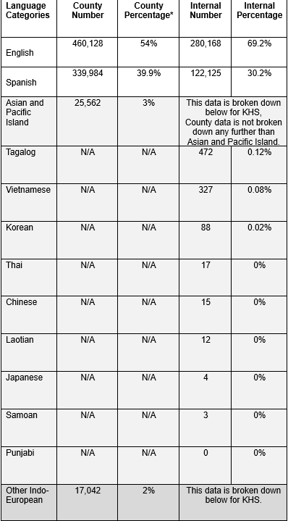
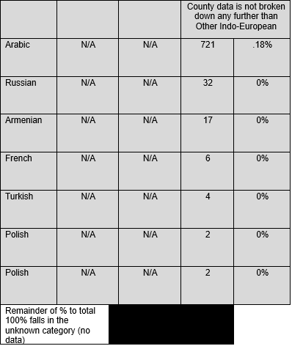
Kern County and KHS Member Language Profile
The table below shows Kern County and KFHC member language profile as of February 2024.

Slide 6
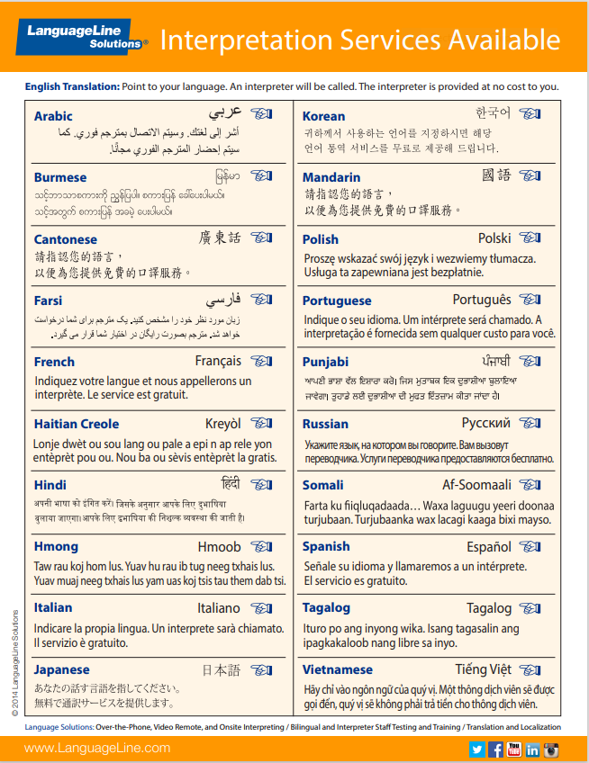
Language Assistance Resource
KHS provides Point to language ID card to all providers. This card is accessible at the link below.
[lls-desktop-display-to-e-mail-2.pdf (cloudinary.com) Point to Language ID Card]
If you need a printed copy of the Point to Language ID Card, please contact your Provider Relations Representative at 1-800-391-2000, silent prompt 5.

Slide 7
Provider Training on the Provisions of
KHS’s Language Services
Additional training and resources are available under the KHS Provider Resources webpage:
https://www.kernfamilyhealthcare.com/providers/provider-resources/cultural-and-linguistic-services/
KHS posts all bulletins on the KHS website, www.kernfamilyhealthcare.com, choose Provider, then Bulletins.

Slide 8
Members Preferred Language
Providers can access an individual member’s profile, including their preferred language, via the KHS Provider Portal at the link below. Please follow the outlined steps to access this information for each member.
Kern Provider Portal (kernfamilyhealthcare.com)

Slide 9
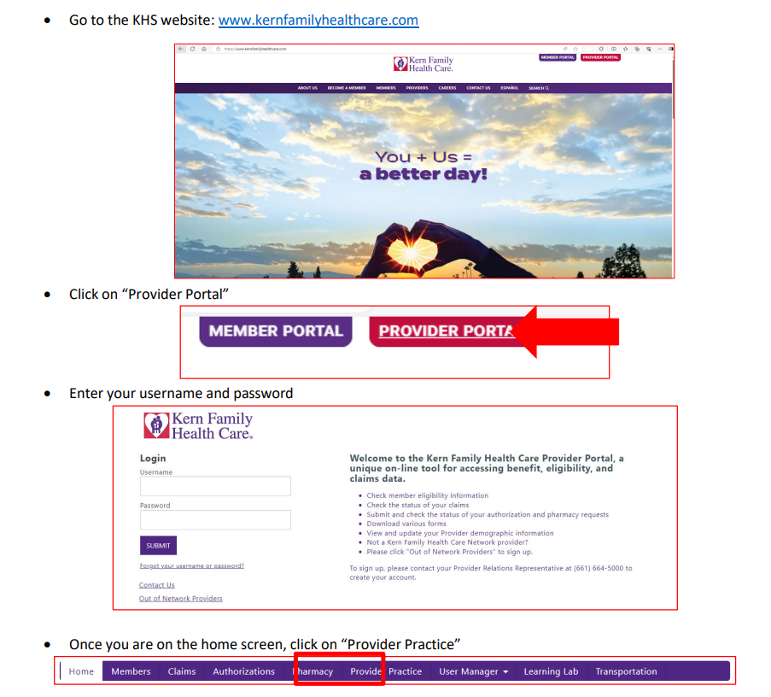
Provider Practice – Member Profile – Preferred Language
Member Profile Tab

Slide 10
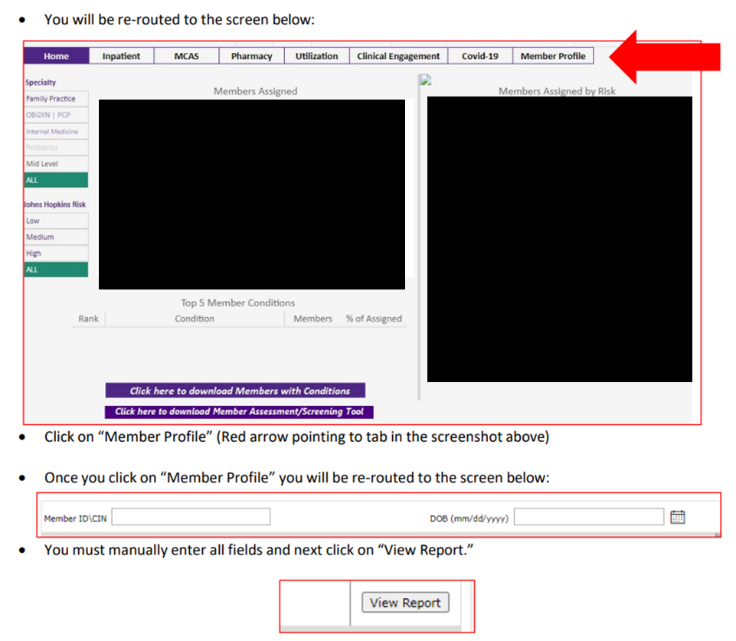
Provider Practice – Member Profile – Preferred Language
Member Profile Tab

Slide 11
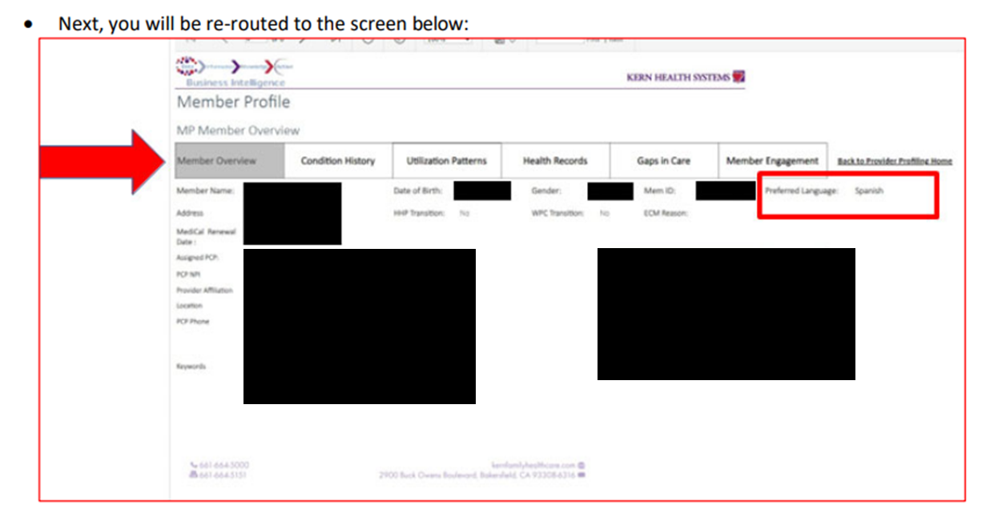
Provider Practice – Member Profile – Preferred Language
Member Profile Tab

Slide 12
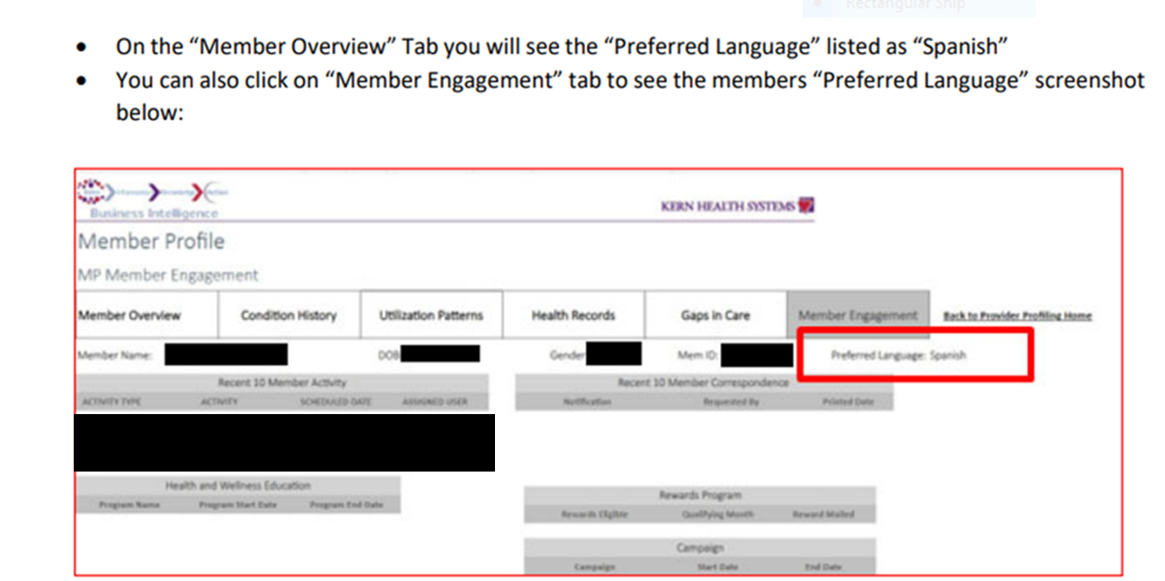
Provider Practice – Member Profile – Preferred Language
Member Profile Tab

Slide 13
THANK YOU.!
Questions?
If you have any questions, please contact your Provider Relations Representative at (661)-632-1590 or (800)-391-2000 and select silent prompt 5

