Slide 1
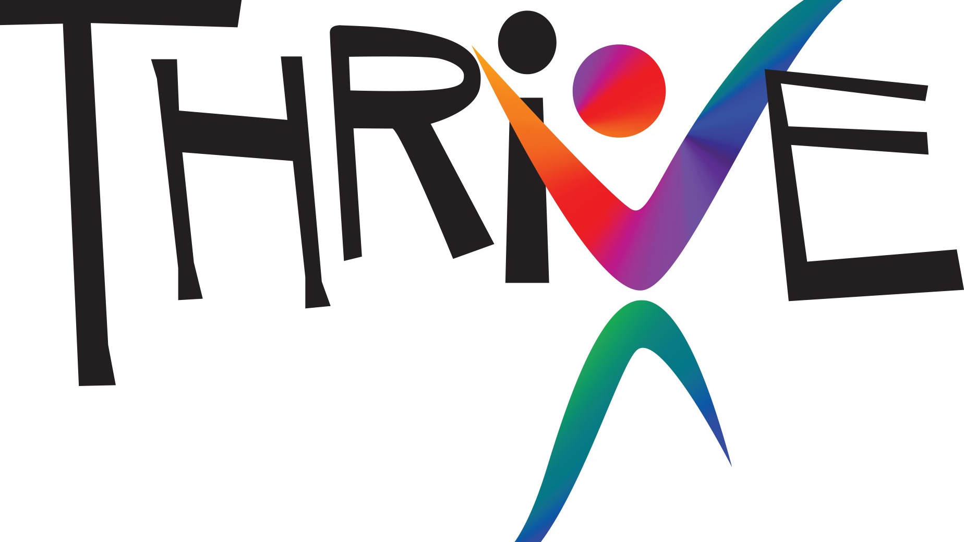
Random Acts of Kindness
Practice #2
Notes:
As you recall, our workplace is participating in The People Project with the goal of creating a flourishing workplace, a flourishing community. Last month you practiced Gratitude thank you! This month we are practicing Kindness.

Slide 2
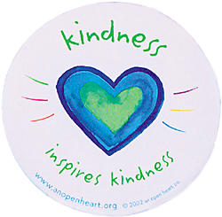
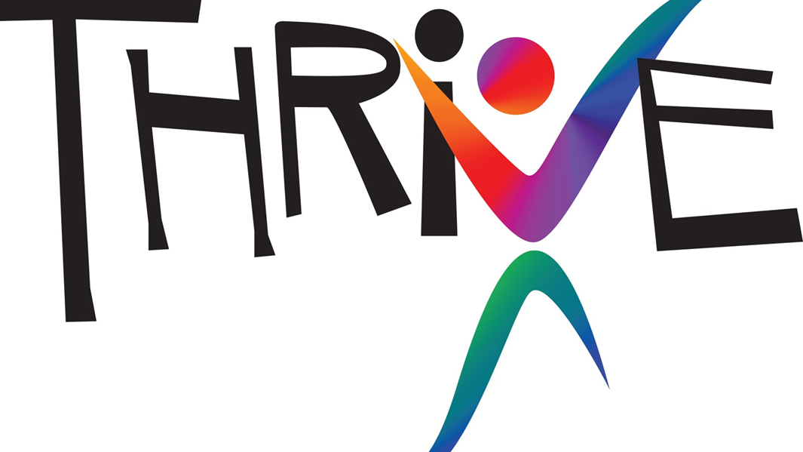
Kindness
kindness (/ˈkīn(d)nəs/) noun:
The quality of being friendly, generous, and considerate.
Synonyms:
affection, warmth, gentleness, concern, care; consideration, helpfulness, thoughtfulness, unselfishness, selflessness, altruism, and compassion.
Notes:
The old adage is true: it is better to give than it is to receive. We all love being on the receiving end of kindness, but it turns out that offering kindness to others actually benefits us more in the long run. Let’s keep kindness flowing by both giving and receiving acts of kindness.

Slide 3
Random Acts of kindness
Doing an act of kindness produces the single most reliable momentary increase in well-being of any exercise that has been tested.
Dr. Martin Seligman
University of Pennsylvania
Notes:
Through Dr. Seligman’s work he has found that doing an act of kindness produces the single most reliable momentary increase in well-being of any strategy that has been tested.

Slide 4
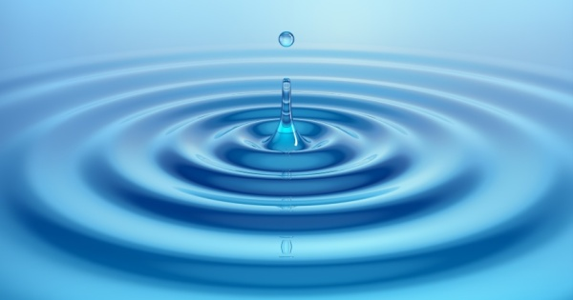
Kindness Benefits everyone
Acts of kindness can result in a “helpers high” that lead to more health benefits than from exercise or quitting smoking
People who receive acts of kindness frequently “pay it forward” that causes a ripple effect of kind acts
Those who spend money on others report much greater happiness than those who spend it on themselves.
Do you need a quick mood boost? Perform random acts of kindness to others for a boost in your short term happiness.
Do you want a longer happiness fix? Five acts of kindness in a week will increase your happiness for up to three months.
Notes:
Helping a neighbor, volunteering, or donating goods and services results in a ‘helper’s high,’ and you get more health benefits than you would from exercise or quitting smoking.
When people benefit from kindness they “pay it forward” by helping others who were not originally involved, and this creates a cascade of cooperation that influences dozens more in a social network. Those who spend money on others report much greater happiness than those who spend it on themselves.
The most powerful way to increase your short-term feelings of happiness is to perform random acts of kindness to others.
Five acts of kindness in a week will increase your happiness for up to three months.
Sources: 20 Surprising Facts About Happiness By David Weedmark
10 Things Science Says Will Make You Happy
By Jen Angel – October 31, 2008

Slide 5
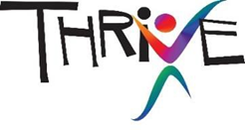
Kindness Increases
Oxytocin – the love hormone
Energy – half of people reported feeling stronger and more energetic after helping others
Happiness – altruistic people are happiest of all
Lifespan – People 55 and older who volunteer at two or more organizations have a 44% lower likelihood of dying early;
Pleasure – when you are kind to others, your brain reacts as though you were the one receiving the kindness
Serotonin – kindness increases serotonin, the same chemical in many antidepressant medications.
Notes:
Oxytocin: which aids in lowering blood pressure and improving our overall heart-health. Oxytocin also increases our self-esteem and optimism, which is extra helpful when we’re in anxious or shy in a social situation.
Energy: About half of participants in one study reported that they feel stronger and more energetic after helping others; many also reported feeling calmer and less depressed, with increased feelings of self-worth” Christine Carter, UC Berkeley, Greater Good Science Center
Happiness: 2010 Harvard Business School survey of happiness in 136 countries found that people who are altruistic—in this case, people who were generous financially, such as with charitable donations—were happiest overall.
Lifespan: People who volunteer tend to experience fewer aches and pains. Giving help to others protects overall health twice as much as aspirin protects against heart disease. People 55 and older who volunteer for two or more organizations have an impressive 44% lower likelihood of dying early, and that’s after sifting out every other contributing factor, including physical health, exercise, gender, habits like smoking, marital status and many more. This is a stronger effect than exercising four times a week or going to church.” Christine Carter, Author, “Raising Happiness; In Pursuit of Joyful Kids and Happier Parents”
Pleasure: According to research from Emory University, when you are kind to another person, your brain’s pleasure and reward centers light up, as if you were the recipient of the good deed—not the giver. This phenomenon is called the “helper’s high.”
Serotonin: Like most medical antidepressants, kindness stimulates the production of serotonin. This feel-good chemical heals your wounds, calms you down, and makes you happy!

Slide 6
Kindness Decreases
Pain – endorphins are nature’s painkiller
Stress – Kind People have 23% less cortisol (stress hormone) than the average population
Anxiety – doing at least 6 kind acts a week benefited people with social anxiety
Depression – life satisfaction and physical health increase, mortality and depression are reduced
Blood Pressure – engaging in kindness releases oxytocin and produces nitric oxide, which dilates the blood vessels and lowers blood pressure.
Notes:
PAIN
Engaging in acts of kindness produces endorphins—the brain’s natural painkiller!
STRESS
Perpetually kind people have 23% less cortisol (the stress hormone) and age slower than the average population!
ANXIETY
A group of highly anxious individuals performed at least six acts of kindness a week. After one month, there was a significant increase in positive moods, relationship satisfaction and a decrease in social avoidance in socially anxious individuals. University of British Columbia Study
DEPRESSION
Stephen Post of Case Western Reserve University School of Medicine found that when we give of ourselves, everything from life satisfaction to self- realization and physical health is significantly improved. Mortality is delayed, depression is reduced and well-being and good fortune are increased.
BLOOD PRESSURE
Committing acts of kindness lowers blood pressure. According to Dr. David R. Hamilton, acts of kindness create emotional warmth, which releases a hormone known as oxytocin. Oxytocin causes the release of a chemical called nitric oxide, which dilates the blood vessels. This reduces blood pressure and, therefore, oxytocin is known as a “cardioprotective” hormone. It protects the heart by lowering blood pressure.

Slide 7
The Science of Kindness
https://youtu.be/O9UByLyOjBM
Notes:
The positive effects of kindness are experienced in the brain of everyone who witnessed the act, improving their mood and making them significantly more likely to “pay it forward.” This means one good deed in a crowded area can create a domino effect and improve the day of dozens of people! It’s kind of like weight training, we found that people can actually build up their compassion ‘muscle’ and respond to others’ suffering with care and a desire to help.

Slide 8
Practical application
Individual
What is one way you can express kindness to a friend or significant other this week?
Family
What is one way you can express kindness as a family to each other and others in the community?
School
As students what are some ways you can demonstrate kindness in the classroom or around school?
Organization
What’s one way you can express kindness with co-workers at the office?
What’s one way as an organization you can express gratitude in the community or with other business partners?
Notes:
Through Dr. Seligman’s work he has found that doing an act of kindness produces the single most reliable momentary increase in well-being of any strategy that has been tested.

Slide 9
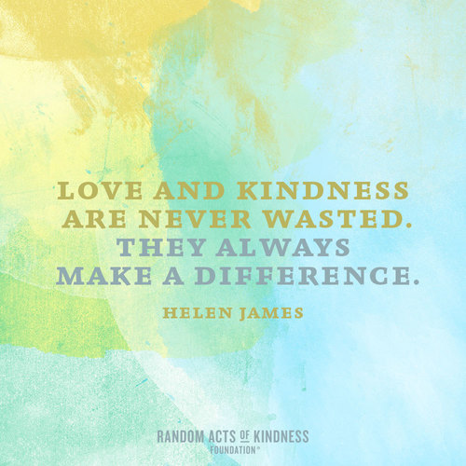
Simple Acts of Kindness
Practice courtesy: Holding the door and saying “please” and “thank you” are easy ways to practice kindness.
Offer to return a supermarket cart to its rack for a busy parent or a senior.
Put a coin in an expired or expiring meter for a stranger.
Write a gratitude letter to someone who has been a positive force in your life. Or just tell someone how much you appreciated something he or she did.
Notes:
Start Simple. Give Freely. The smallest gestures can mean the most. Here are ideas to inspire you.
https://www.psychologytoday.com/us/blog/changepower/201711/16-easy-random-acts-kindness-practice-today

Slide 10
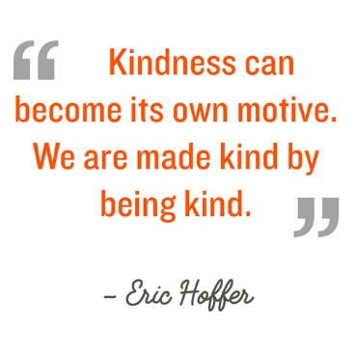
Simple Acts of Kindness
Call a relative or friend to see how they're doing.
Offer to pick up groceries or medications for someone who is ill.
Buy a cup of coffee for a stranger.
Write a check to a worthwhile charity.
Notes:
Start Simple. Give Freely. The smallest gestures can mean the most. Here are ideas to inspire you.

Slide 11
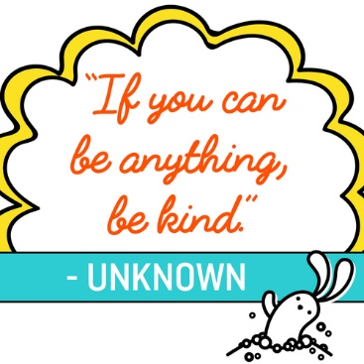
Simple Acts of Kindness
For five minutes, listen to someone without interrupting.
Slow down. Research tells us you are more likely to be kind to others when you are not in a hurry.
Give someone you love a hug. Say, "I love you."
If you can afford it, contribute a few dollars when someone comes up short in the check-out line.
Notes:
Start Simple. Give Freely. The smallest gestures can mean the most. Here are ideas to inspire you.
https://www.psychologytoday.com/us/blog/changepower/201711/16-easy-random-acts-kindness-practice-today

Slide 12
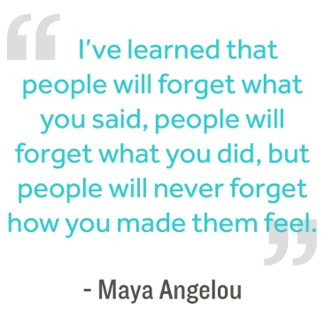
Simple Acts of Kindness
Donate blood.
Give a ride to someone who doesn’t have a car.
Babysit for a friend or relative who needs some “me time.”
Make soup and share it with neighbors.
Notes:
Start Simple. Give Freely. The smallest gestures can mean the most. Here are ideas to inspire you.

Slide 13
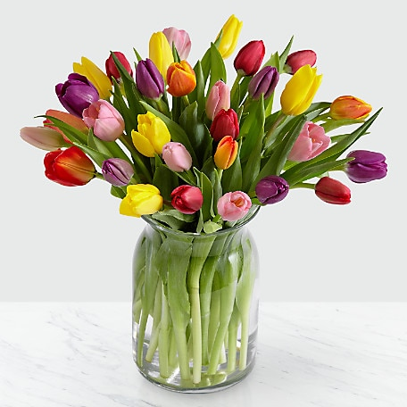
Lake Region Healthcare
Used May Day to hand out flowers to employees
Notes:
Here’s one simple example of spreading kindness within an organization. (200 flowers dispersed in an hour to employees) (administration encouraged employees to pick up a flower and pass it to somebody )
Lake Region Healthcare sponsored a May Day event where they gave away single tulips in a vase as an act of kindness to share with co-workers. The project cost $100 for 100 tulips, simple yet effective.

