Slide 1
ER Provider Stroke Education

Slide 2
Acute Stroke Ready Hospital (ASRH)
In 2019, TJ Samson Hospital in Glasgow became an Acute Stroke Ready Hospital (ASRH).
Joint Commission-certified ASRHs and organizations are required to adopt a set of standardized performance measures. Organizations collect monthly data for each measure in the set. The data is then submitted quarterly to The Joint Commission.

Slide 3
Code Stroke/Stroke Alert
“Code Stroke” indicates a patient has signs and symptoms of an ischemic or hemorrhagic stroke developing within 4.5 hours of last known well.
“Stroke Alert” indicates a patient has signs and symptoms of an ischemic or hemorrhagic stroke developing within 4.5-24 hours of last known well.
“Last known well” indicates the time at which the patient was last known to be without the signs and symptoms of the current stroke or at his or her prior baseline.”

Slide 4
Code Stroke
Initiating Code Stroke: Code Stroke is called by a Licensed Provider or Nurse when a patient presents with clinical signs and/or symptoms of an acute stroke in the Emergency Department or by the Licensed Provider or Primary Nurse if such signs develop in an inpatient within 4.5 hours of last known well.
Clinical Criteria for Code Stroke: The criteria include but is not limited to the sudden onset of one or more of the following signs and/or symptoms:
a) Facial droop
b) Numbness or weakness to the face, arm or leg (unilaterally or bilaterally)
c) Speech difficulty
d) Vision changes such as blurred, loss, or double vision
e) Difficulty walking or loss of balance
f) Severe headache with no known cause
g) Difficulty or loss of swallow function
h) Hearing loss
i) Sudden Confusion

Slide 5
Code Stroke continued
Code Stroke Activation: The Code Stroke will be activated by the switchboard as
follows:
a) Switchboard to page “Code Stroke” and location overhead three times.
b) Switchboard to contact ICU and give notification of the Code Stroke.
c) Switchboard to contact Air Methods for standby. Air Methods will launch and standby on hospital helipad per their request. (1-888-729-9111)
d) If Air Methods is unavailable contact Air Evac for standby. (1-800-247-3822)
e) Switchboard to contact EMS for standby. (270-651-5121)
f) Switchboard to contact Transfer Center and find out patient’s name and age and update concerning transportation method.
g) Switchboard to take all unnecessary methods of transport off standby as soon as possible. Switchboard to contact the involved department(s) at 1 hour intervals to check status of standby.
h) Switchboard to log all information in the “Code Stroke” call log.
i) Switchboard to notify the Stroke Coordinator.

Slide 6
Code Stroke Responders
Code Stroke Responders: The following personnel should respond to location of Code Stroke:
a) Licensed Provider
b) Emergency Department RN
c) Primary Care RN
d) House Supervisor
e) Phlebotomist

Slide 7
Stroke Alert
Stroke Alert Initiation: Stroke Alert is called by a Licensed Provider or Nurse when a patient presents with clinical signs and/or symptoms of an acute stroke within 4.5-24 hours of last known well. Treatment is determined by the provider. No other activation is required.
The patient will not be a candidate for Thrombolytic Infusion, but continues to have the possibility of treatment intervention up to 24 hours after onset of signs/symptoms.

Slide 8
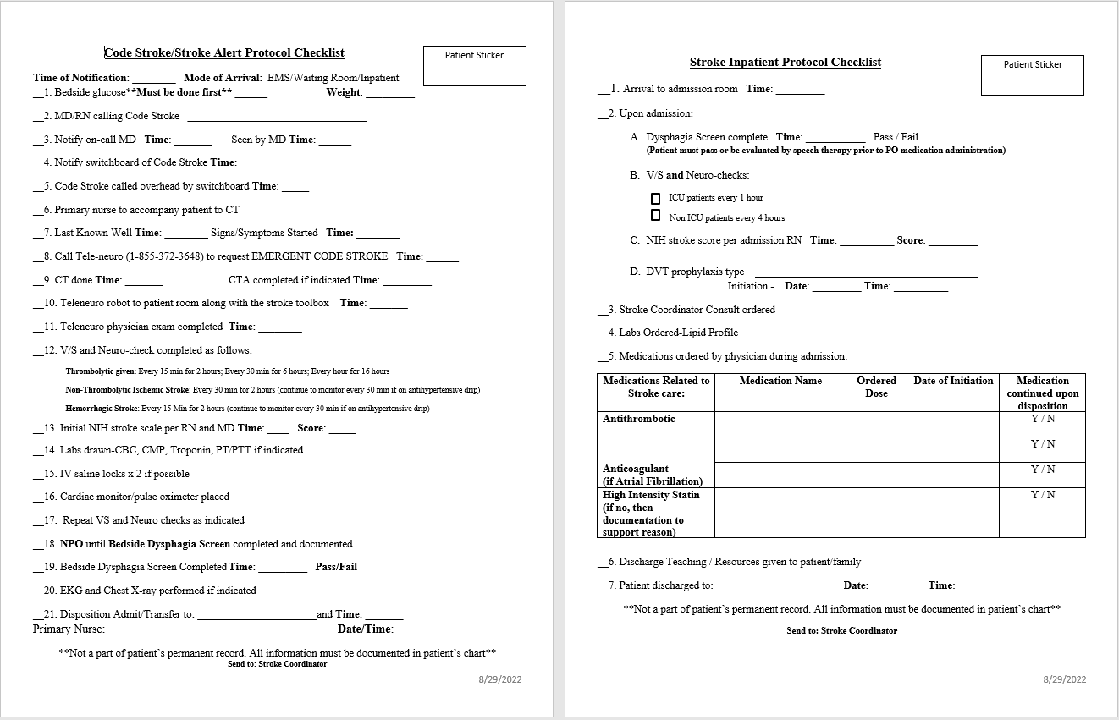

Slide 9
Required Documentation
Last Known Well
Time that Signs/Symptoms started
NIHSS (should be completed by each provider at the initial evaluation and PRN)
Was a CT completed at this facility? Results? CTA?
Was tPA considered? If not, then why?
If tPA was administered and it was >60 minutes, then why?
Communication information (if completed) with teleneuro regarding recommendations.

Slide 10
Was patient screened for dysphagia prior to any oral intake including water or medications?
Stroke patients should be screened for dysphagia before being given any oral intake including food, fluids, or medications.
For inpatient stroke, assess dysphagia screen prior to oral intake from the date/time of discovery of stroke symptoms.
If the patient arrives to the hospital with transient symptoms that resolve and was screened for dysphagia (prior to oral intake) but later in the hospital stay has new onset stroke symptoms and meets criteria to be entered as an inpatient stroke, a new dysphagia screen should be performed and dysphagia screen prior to oral intake should be assessed from the date/time stroke symptom discovery.
Documentation in the record should indicate that an assessment of the patient's ability to swallow was completed by a health care professional prior to oral intake of food, fluid, or medications. A screening test need not be a formal evaluation of swallowing by a speech and language pathologist, but can be a bedside swallow evaluation performed by nursing staff.
Reasons for not performing a dysphagia screen must be explicitly documented by a physician, advance practice nurse, or physician assistant.

Slide 11
Required documentation for patients who transfer and/or failed the dysphagia screening.
If a patient arrives to the floor, and has failed a dysphagia screening, then indicate if the patient was NPO (nothing by mouth), including food, water, or medications, for the entire hospital stay. This includes any medications delivered in the Emergency Room phase of care.
If a patient exhibits stroke like symptoms while inpatient and requires a transfer to another facility, then indicate if the patient was NPO (nothing by mouth), including food, water, or medications, for the entire hospital stay.

Slide 12
If transferred:
Transfer time goal is <120 minutes from door to transfer.
Please document reason for delay if >120 minutes (ex. Weather, bed availability, medical complications, etc.)

Slide 13
Does the patient have a new diagnosis of diabetes?
If yes, then was an anti-hyperglycemic medication prescribed at discharge? If no, then a documented reason should be listed.
If yes, then documentation of a follow up appointment for diabetes management.

