Slide 1
LECTURE # 01
SUBJECT: APPLIED PHYSICS
Prepared by
Dr. Fareesa Tahir
UNIVERSITY OF AGRICULTURE PESHAWAR

Slide 2

LECTURE # 01
SEMESTER: 1st
SUBJECT: APPLIED PHYSICS
Prepared By
Dr. Fareesa Tahir
UNIVERSITY OF AGRICULTURE PESHAWAR

Slide 3

Electrostatic (Electric Charge)
What is an Electric Charge?
Types of Electric Charges
How to Measure an Electric Charge?
Unit of Electric Charge
Is Electric Charge a Vector Quantity?
Properties of Electric Charge

Slide 4
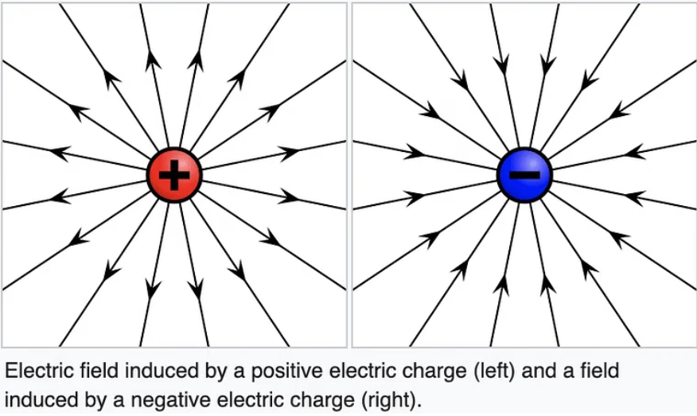
What is an Electric Charge?
Electric charge is a fundamental property of matter that determines how it interacts with other charged matter and electric fields. This property is carried by subatomic particles, with protons carrying a positive charge, electrons a negative charge, and neutral particles having no charge.
The word "electricity" comes from the Greek word "elektron," which means amber. This word refers to the ancient observation of static electric charges generated by rubbing amber.

Slide 5
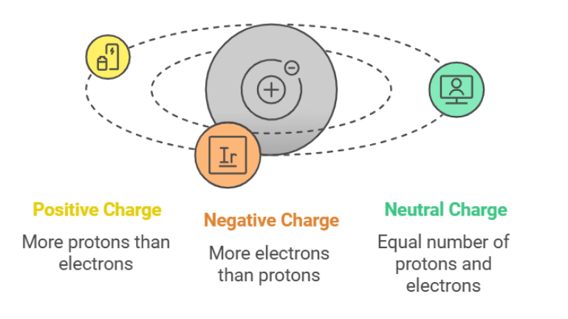
Types of Electric Charges
Two kinds of electric charges exist:
Positive(+) charge
Negative(-) charge
Positive Charge: When an object has a positive charge, it means that it has more protons than electrons.
Negative Charge: When an object has a negative charge, it means that it has more electrons than protons. When there is an identical number of positive and negative charges, the negative and positive charges would cancel out each other and the object would become neutral.
How to Measure an Electric Charge?
The electric charge is measured using a coulomb. “One coulomb is the quantity of charge transferred in one second.”
Mathematically, the definition of a coulomb is represented as:
Q = I.t
In the equation, Q is the electric charge, I is the electric current and t is the time.

Slide 6
Unit of Electric Charge:
A charge is a derived physical quantity. The charge is measured in coulomb in the S.I. unit.
Is Electric Charge a Vector Quantity?
No, electric charge is a scalar quantity. Apart from having a 'magnitude' and 'direction', for a quantity to be termed a vector (which we will study in detail later) it should also obey the laws of vector addition such as triangle law of vector addition and parallelogram law of vector addition, only then the quantity is said to be a vector quantity.
Imagine you have two charges:
Charge 𝑄 1 = + 4 C (4 coulombs of positive charge)
Charge 𝑄 2 = − 2 C (2 coulombs of negative charge)
When we combine these two charges, we can simply add them algebraically:
Q total = Q1 + Q2
Substituting the values:
Q total = +4C + (−2C) = +4C−2C=+2C
The total charge Q total= +2C
indicates that after combining both charges, you end up with a net positive charge.
Notice that we only considered the numerical values and their signs (positive or negative) when adding. There was no need to consider any direction associated with the charges.
This illustrates that charge is a scalar quantity:
it only has magnitude (how much charge) and sign (positive or negative), but no direction.

Slide 7
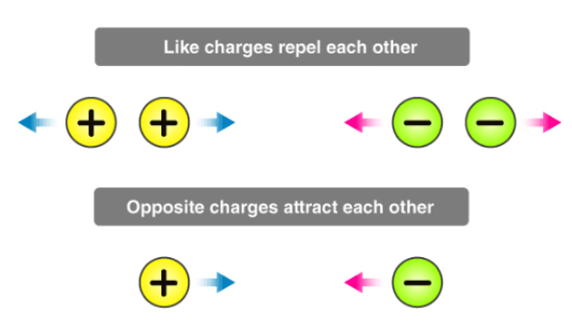
Properties of Electric Charge
Like charges repel each other and unlike charges attract each other. (As Electric Charge comes in two varieties, which are called “plus” and “minus”.)
2. Electric Charge is a scalar quantity:
It follows scalar laws of operations, i.e. it adds algebraically and represents the excess of electrons in a negatively charged atom or a deficiency of electrons in a positively charged atom.
3. A charge is transferable: Electric charge can be transferred from one body to another, but there is a restriction to the charge transfer. Only electrons are transferred from one body to another because protons are tightly bound to the nucleus of every atom.
Hence, the body which loses electrons in the transfer becomes positively charged, and the body which receives electrons becomes negatively charged.
A neutral body has a number of electrons = number of protons
A positively charged body has a number of electrons < number of protons
A negatively charged body has a number of electrons > number of protons.

Slide 8
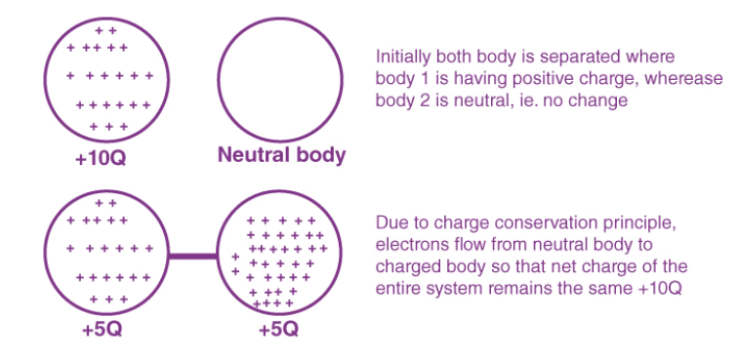
4. Charge is always conserved:
In an isolated system, the total charge (sum of positive and negative) remains constant whatever charge transfer takes place in the system internally. During this internal charge transfer, charges flow until they are evenly distributed, reaching a state of electrostatic equilibrium where no further charge movement occurs without external influence. This is known as the principle of charge conservation.
5. Charge is quantized:
Charge on anybody always exists in integral multiples of a fundamental unit of electric charge. This unit is equal to the magnitude of the charge on one electron (1e = 1.6 × 10-19 C). So charge on anybody Q = ± ne, where n is an integer and e is the charge on a single electron. This was proved by Millikan's oil drop experiment.
Recently, the existence of particles of charge +(2/3) e and -(1/3) e has been postulated. These particles are called quarks, but still, this is not considered as the quantum of charge because these are unstable (They have a very short span of life.)
6. Charge is always associated with mass: Yes! Electrons, Protons and Neutrons also have masses.
Their value is determined, experimentally, to be following:
Mass of an electron = 9.109 × 10-31 Kg = 5.49 × 10-4 amu
Mass of a proton = 1.6726 × 10-27 Kg = 1.007 amu
Mass of a neutron = 1.6749 × 10-27 Kg = 1.008 amu

Slide 9
H.W: 10 Numerical's

