Slide 1
Sales
Training Webinar
Welcome
Selling Financing
November 13th 2019

Slide 2
When and how to introduce Financing
# 1 Advantages of Asking Early
#2 Present Financing during your presentation of your product
#3 Offer it as an alternative to a credit card

Slide 3
Advantages to selling Financing
#1 Helps to increase your closing Ratio
#2 Increase your average ticket and sell more ESP
#3 Promotes Guest Loyalty
#4 Forgives sin

Slide 4
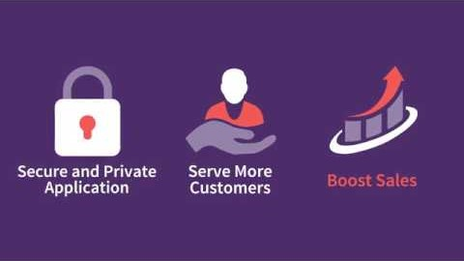

Slide 5


Slide 6
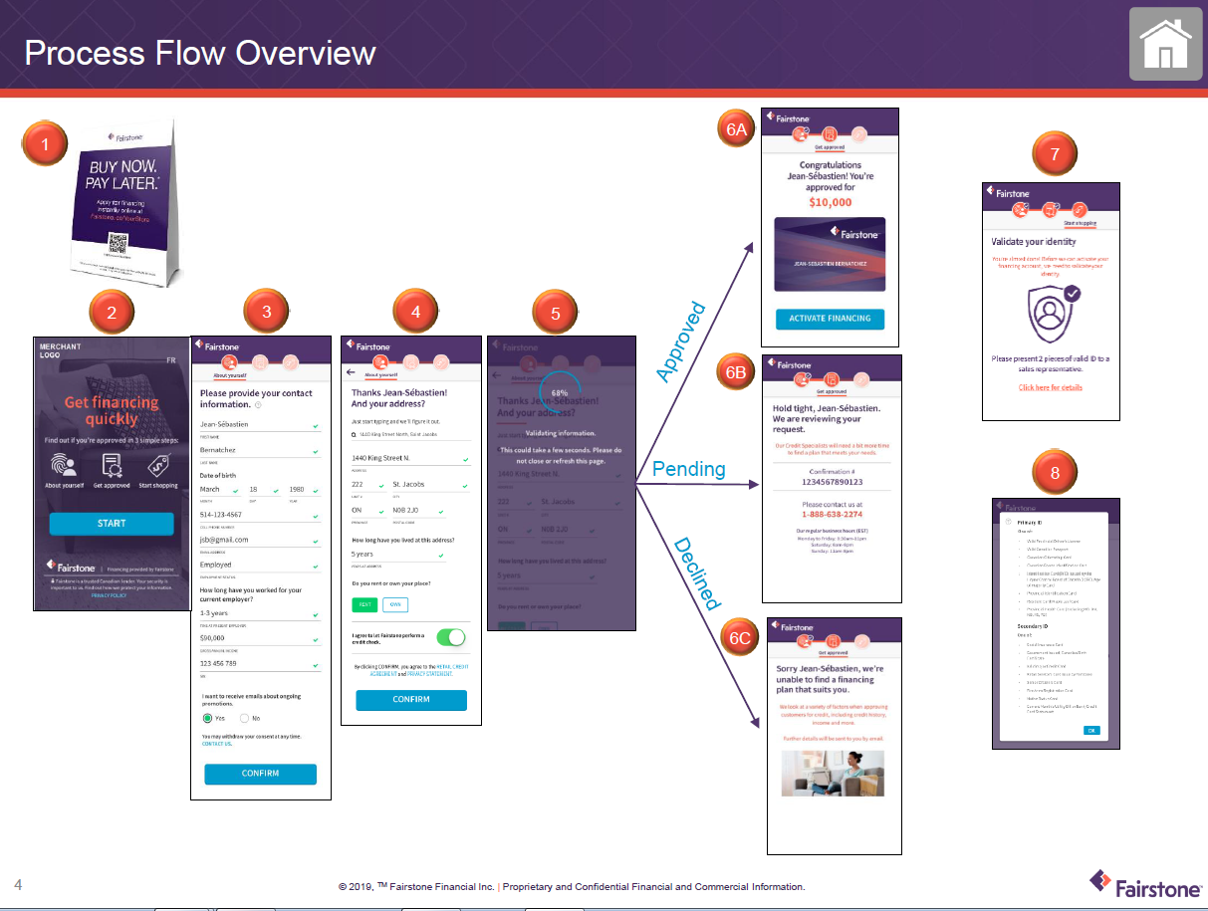

Slide 7
Question time
I promise myself and my company that I will strive to be better today than I was yesterday

