Slide 1


BAHRIA UNIVERSITY
VID-AI
SUPERVISED BY:
WHERE TRADITION MEETS TECHNOLOGY
DR. KASHIF SULTAN
GROUP MEMBERS:
Faiza Alam Warraich (01-131222-016)
Syed Asad E Bukhari (01-131222-045)
HTTPS://WWW.VIDAI.LIVE/
05 MAY 2026

Slide 2
BAHRIA UNIVERSITY
PROBLEM STATEMENT
Event coordination is essential for a flawless wedding, yet traditional planning methods remain surprisingly disjointed, manual, and time-consuming. Families spend countless hours relying on word-of-mouth recommendations, negotiating with vendors, and struggling with basic spreadsheets, which frequently results in logistical blind spots and unnecessary financial stress. As the desire for unique, seamless celebrations grows, there is an urgent need for smarter and more transparent planning solutions. By leveraging AI-driven recommendations and automated budgeting tools, we can streamline vendor management, eliminate the manual workload, and ultimately ensure a more personalized and joyful planning experience.
HTTPS://WWW.VIDAI.LIVE/
PAGE 01

Slide 3
BAHRIA UNIVERSITY
INTRODUCTION
VidAI is a comprehensive, AI-powered wedding planning platform designed to transform how families and vendors collaborate. By replacing scattered spreadsheets and unreliable word-of-mouth with a unified digital ecosystem, VidAI provides a seamless, end-to-end planning experience. The platform leverages a robust microservices architecture, integrating a privacy-first, locally hosted LLM to deliver intelligent vendor recommendations, and context-aware guidance. Accessible via both a web interface and a mobile application, VidAI eliminates logistical blind spots and manual workloads, bridging the gap between couples and service providers to ensure a transparent, personalized, and joyful celebration.
HTTPS://WWW.VIDAI.LIVE/
PAGE 02

Slide 4
BAHRIA UNIVERSITY
USER ROLES
Customer
01
Budget Tracking, Wedding Planning, Booking Management
Vendor
02
Booking Management, Portfolio Management, Sales Analytics
Admin
03
Manager Users, View System Logs, Manage System Reports, Check System Health
HTTPS://WWW.VIDAI.LIVE/
PAGE 03

Slide 5
BAHRIA UNIVERSITY
CUSTOMER FEATURES
Booking Management
Digital Invitation Generation
01
Measure annual income changes to evaluate consistent financial business performance.
04
Measure annual income changes to evaluate consistent financial business performance.
Multi-Event Planning
In-App Chat
02
Measure annual income changes to evaluate consistent financial business performance.
05
Measure annual income changes to evaluate consistent financial business performance.
AI Vendor Recommendations
Automated Budget Tracking
03
Measure annual income changes to evaluate consistent financial business performance.
06
Measure annual income changes to evaluate consistent financial business performance.
HTTPS://WWW.VIDAI.LIVE/
PAGE 05

Slide 6
BAHRIA UNIVERSITY
VENDOR FEATURES
Booking Management
View Sales Analytics
01
Accept/Reject/Cancel bookings.
04
View sales analytics and download PDFs (Monthly and Annual).
Portfolio Management
In-App Chat
02
Create/Update porfolio (images & videos).
05
Talk with customer one-on-one within the app.
Profile Management
Modify/Create Service Packages
03
Update business details in profile.
06
Create/Update service packages and mark them active/inactive
HTTPS://WWW.VIDAI.LIVE/
PAGE 06

Slide 7

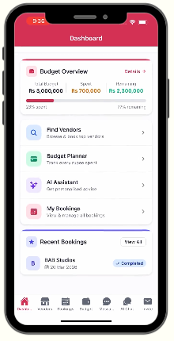
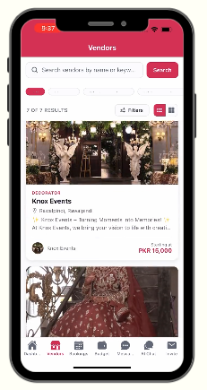
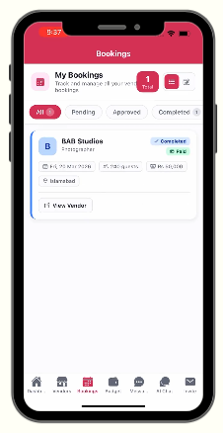
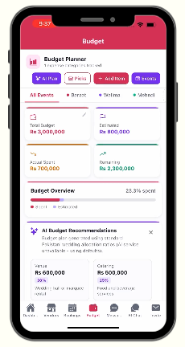
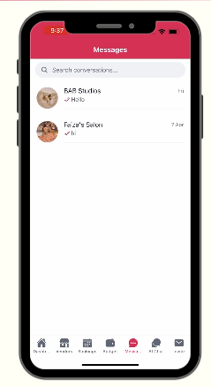
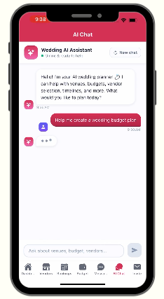
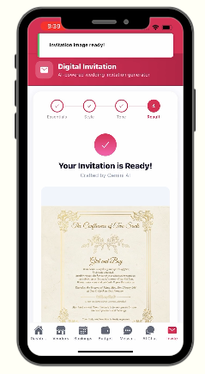
BAHRIA UNIVERSITY
MOBILE APP
HTTPS://WWW.VIDAI.LIVE/
PAGE 11

Slide 8
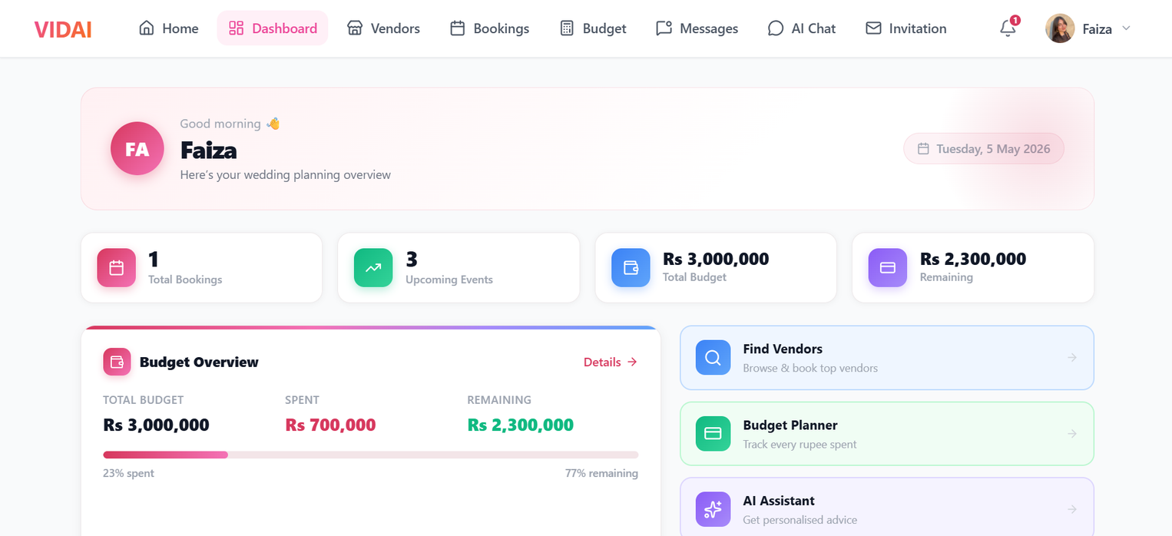
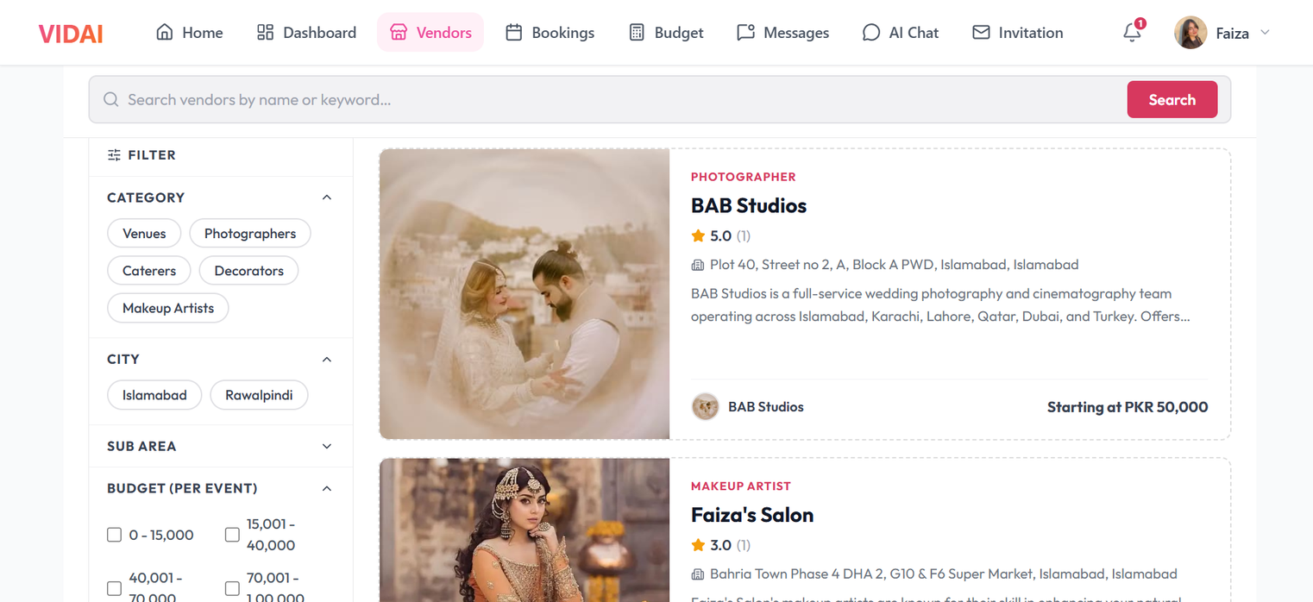
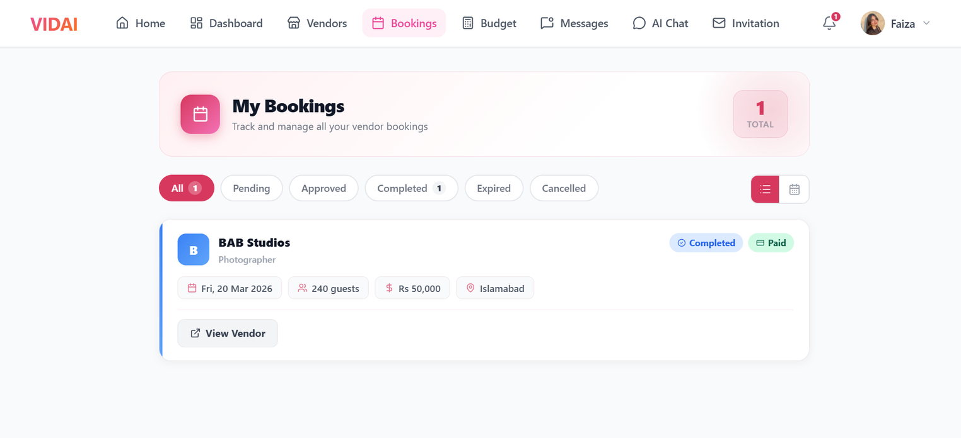
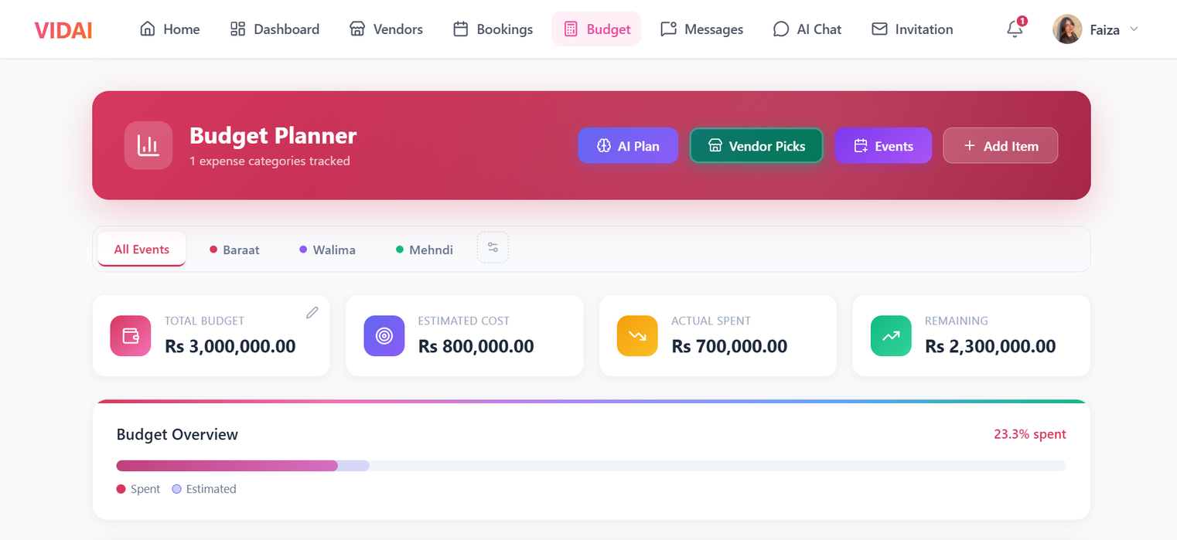
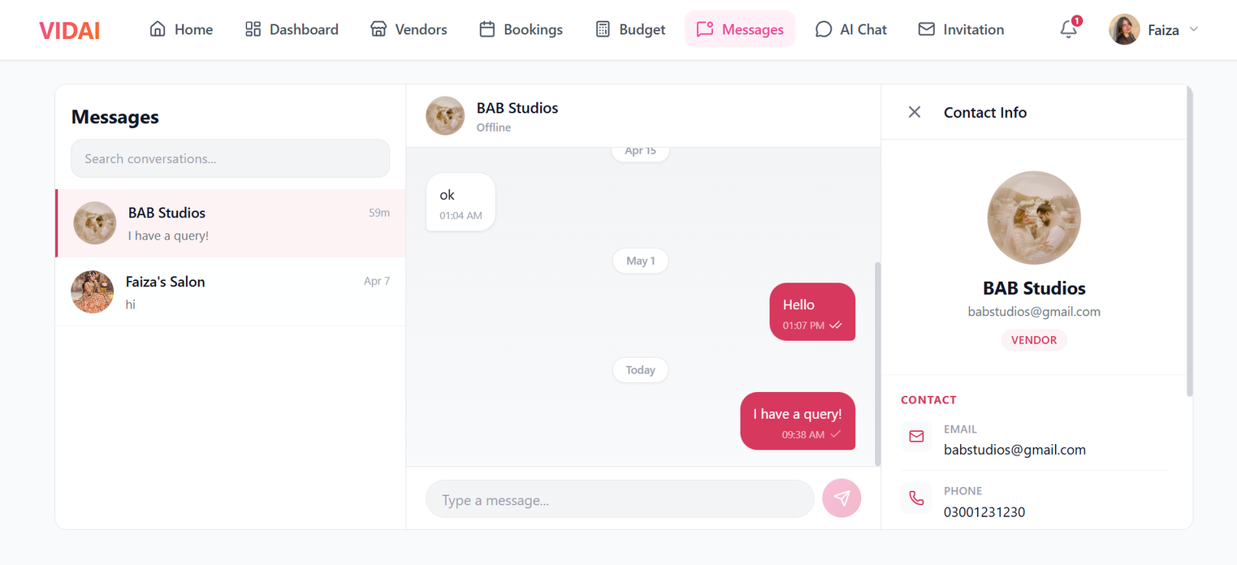
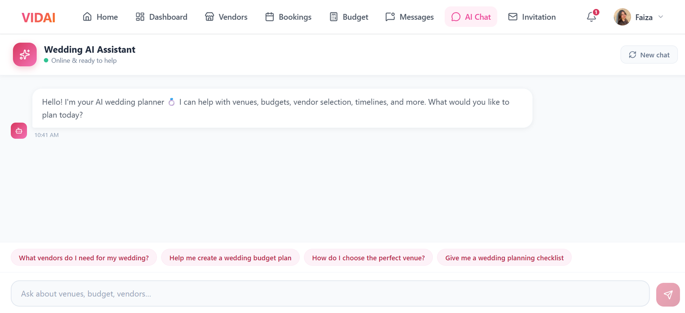
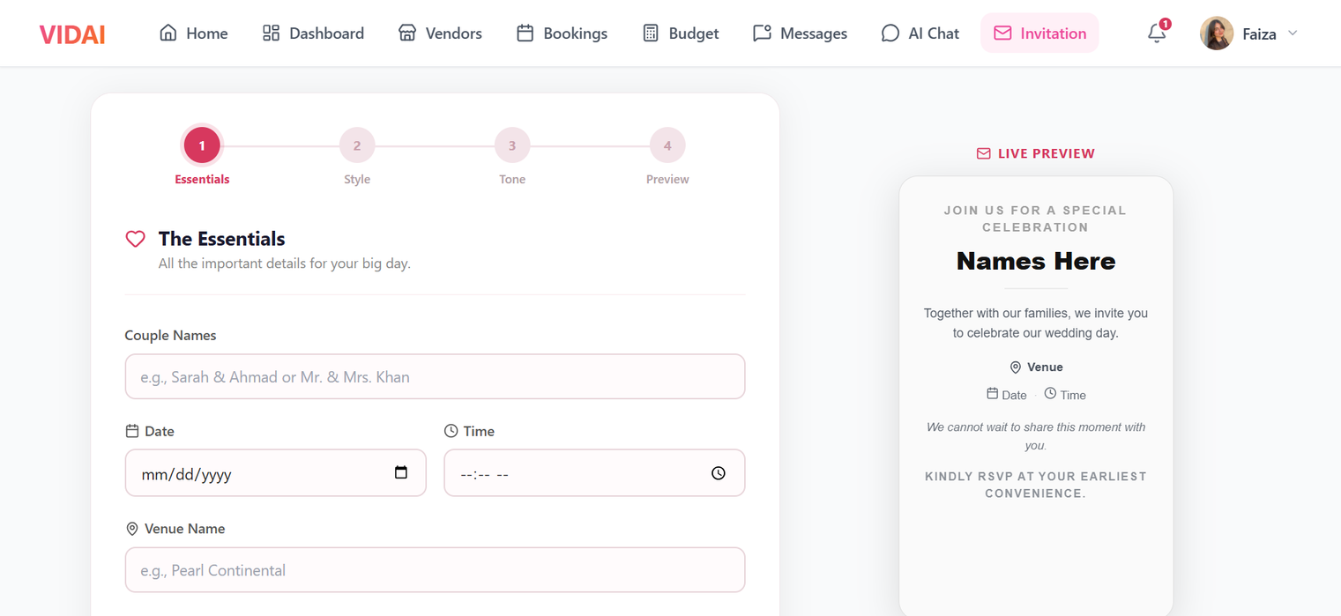
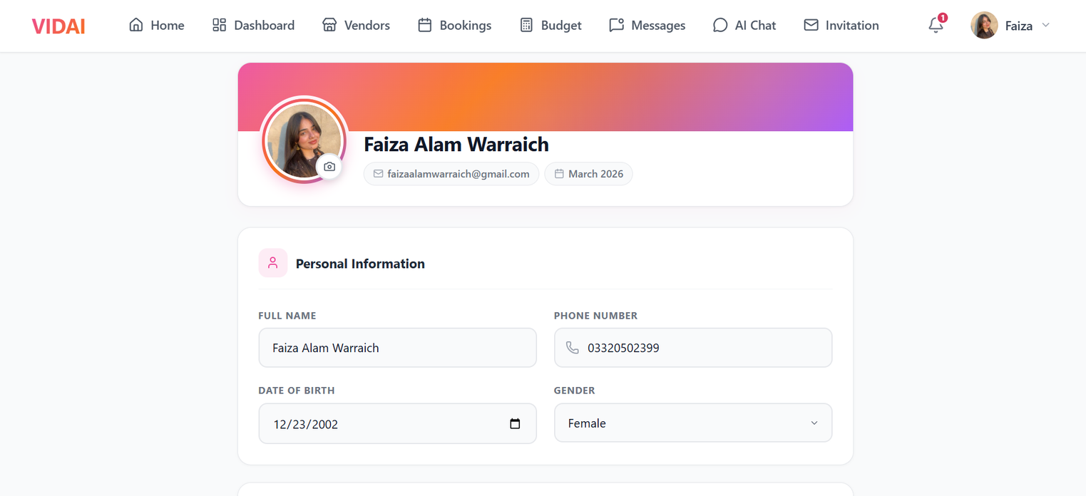
BAHRIA UNIVERSITY
WEB APP
HTTPS://WWW.VIDAI.LIVE/
PAGE 11

Slide 9
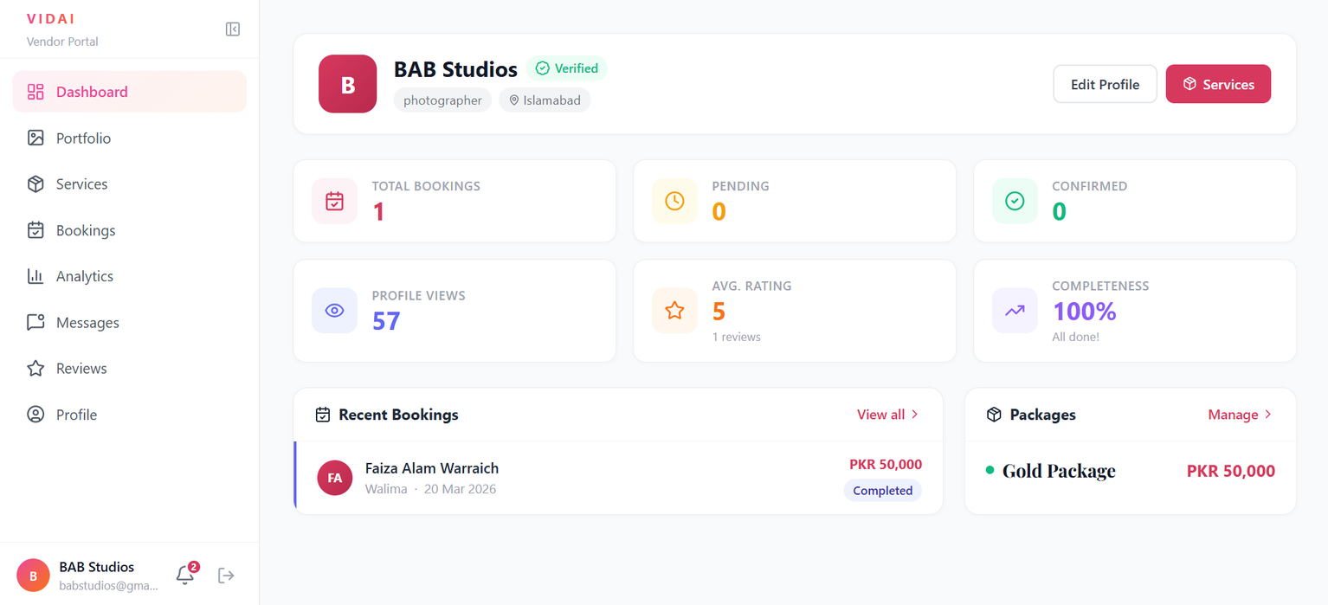
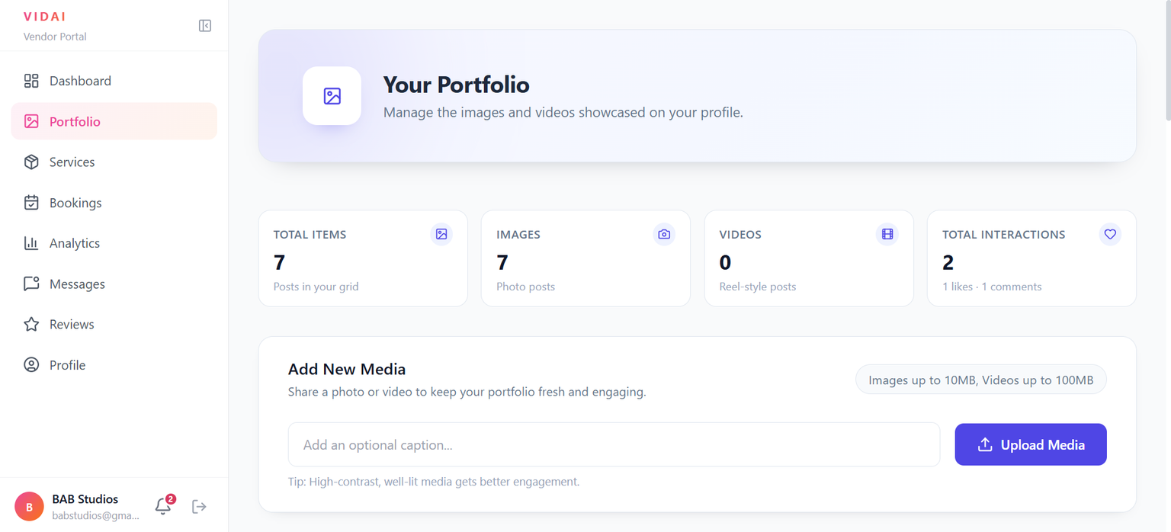
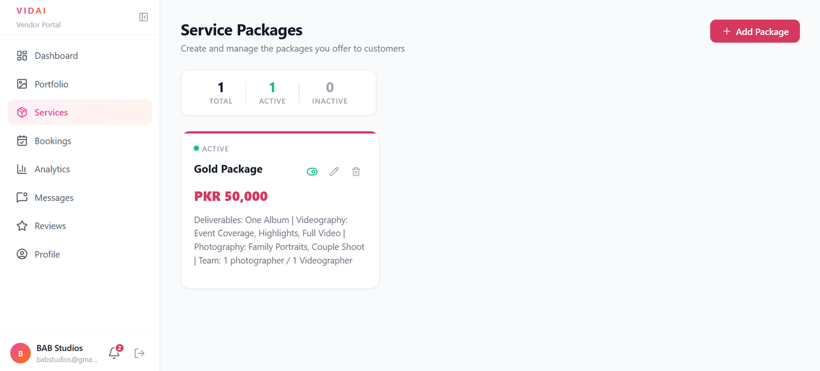
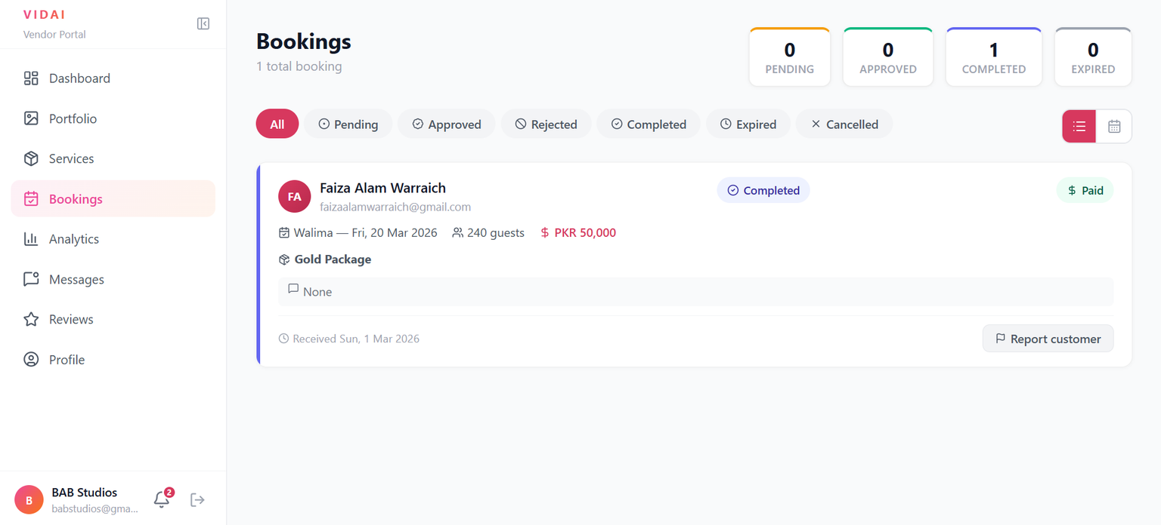
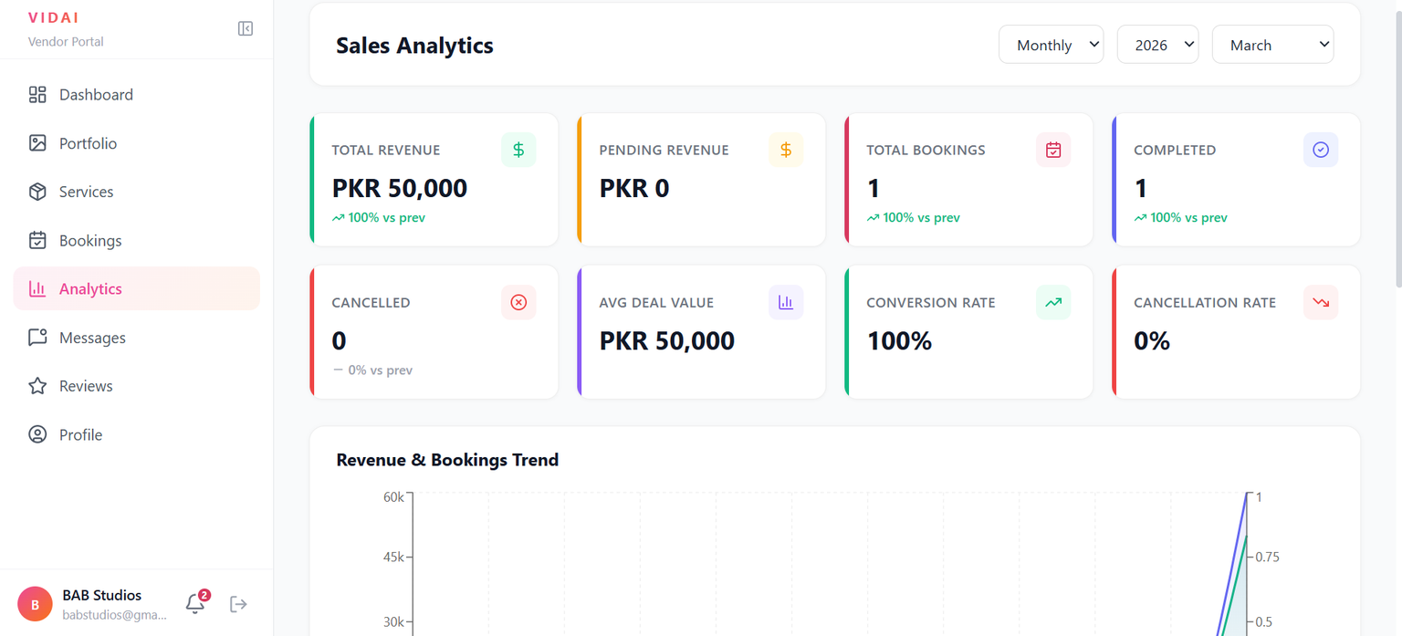
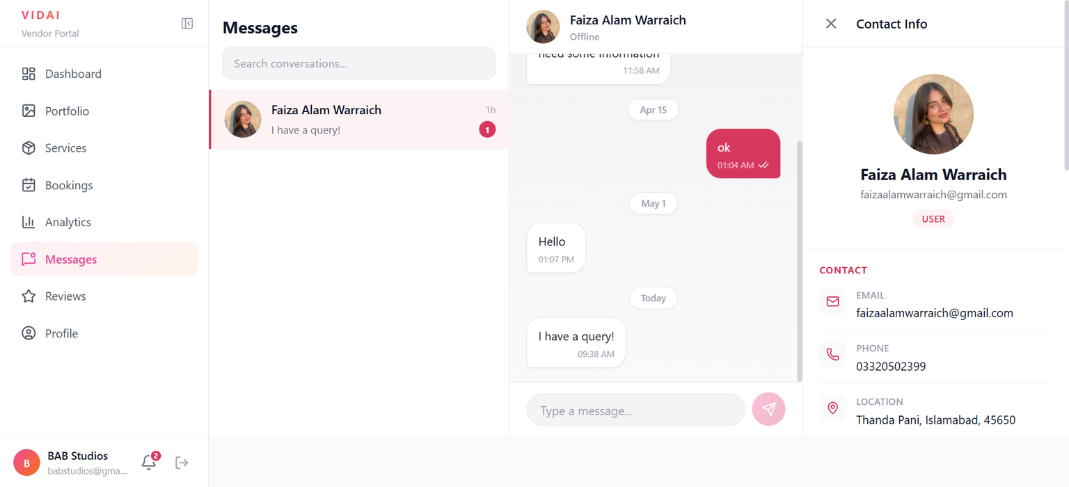
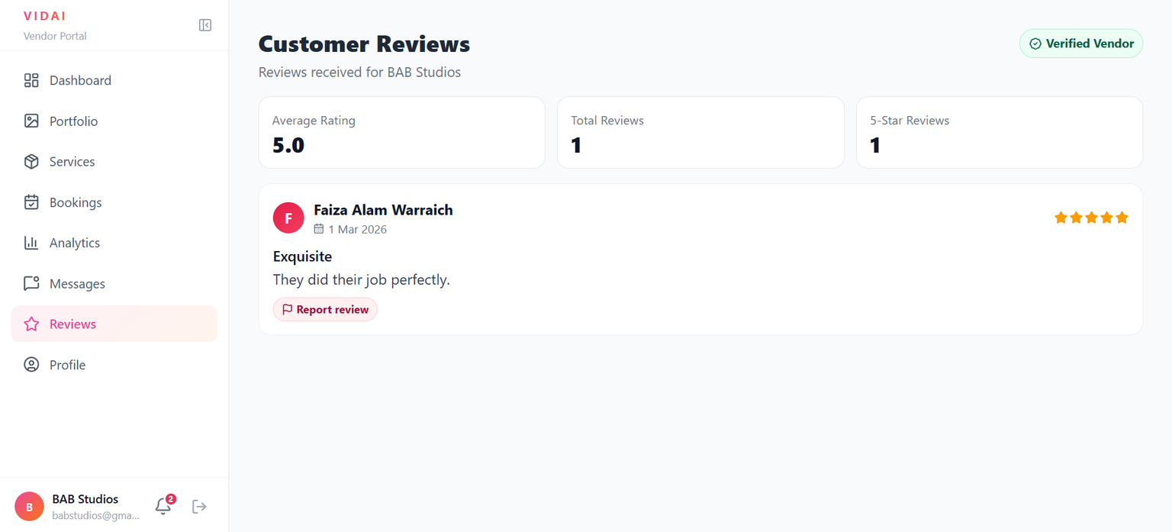
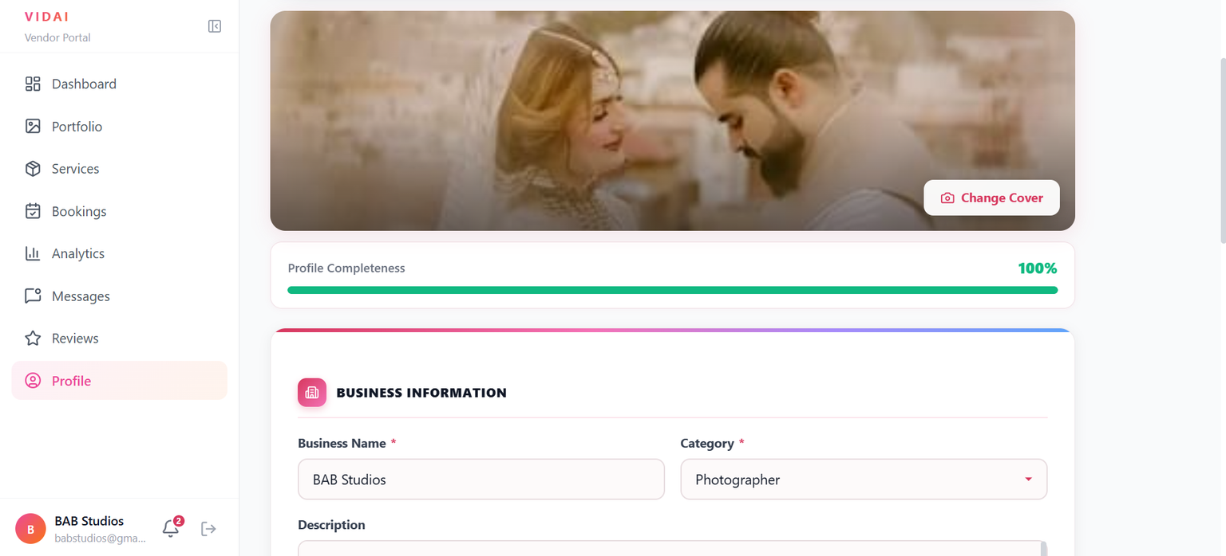
BAHRIA UNIVERSITY
VENDOR DASHBOARD
HTTPS://WWW.VIDAI.LIVE/
PAGE 15

Slide 10
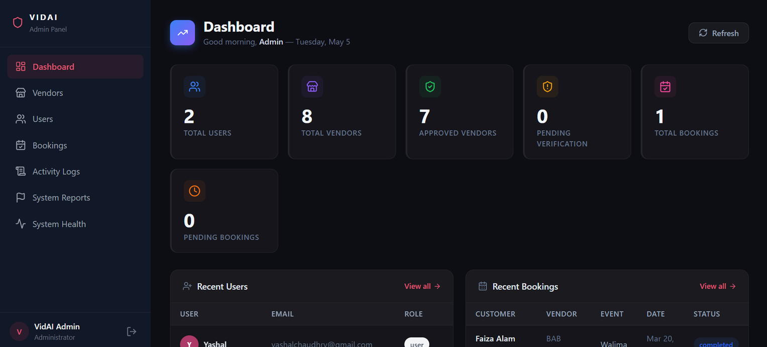
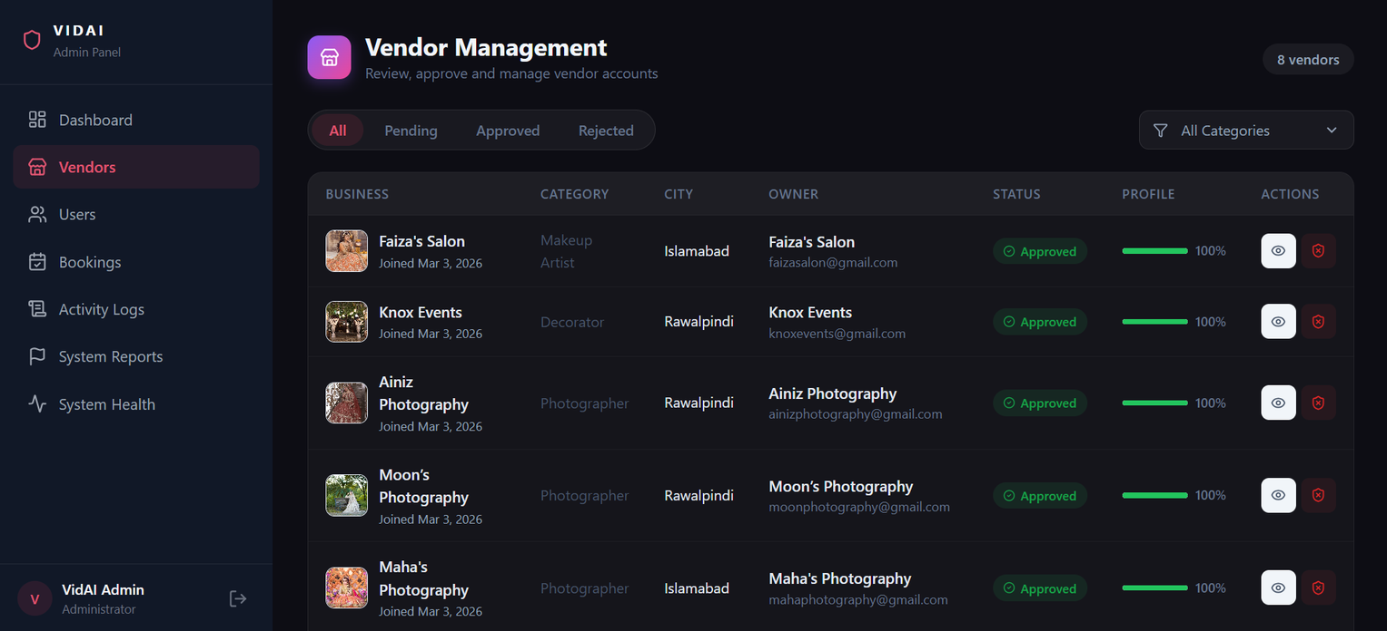
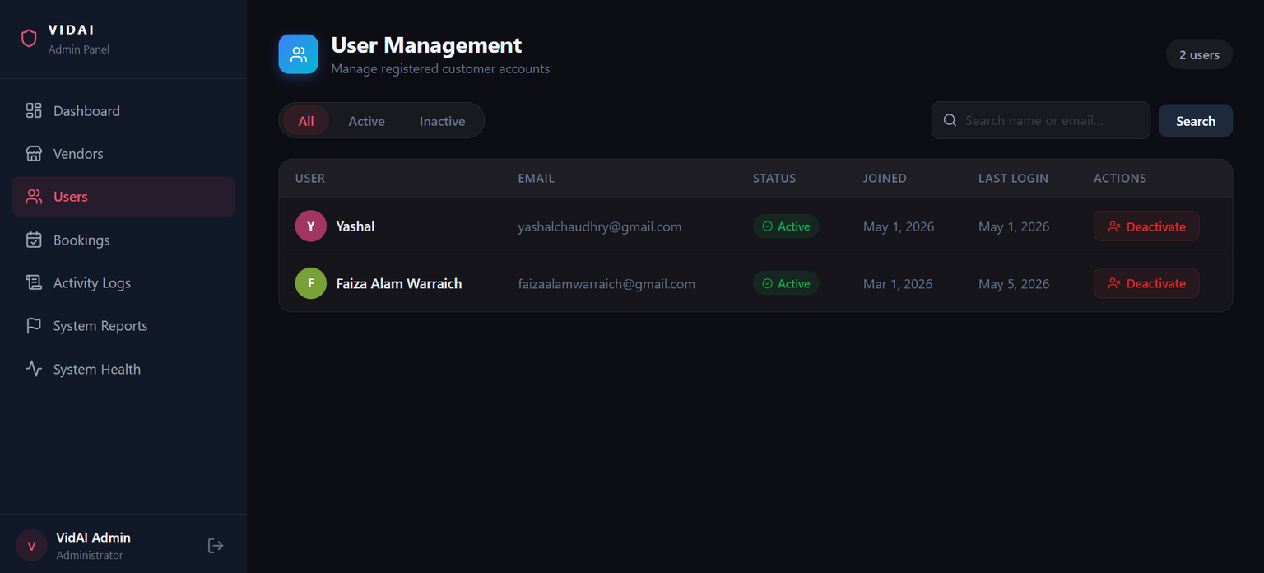
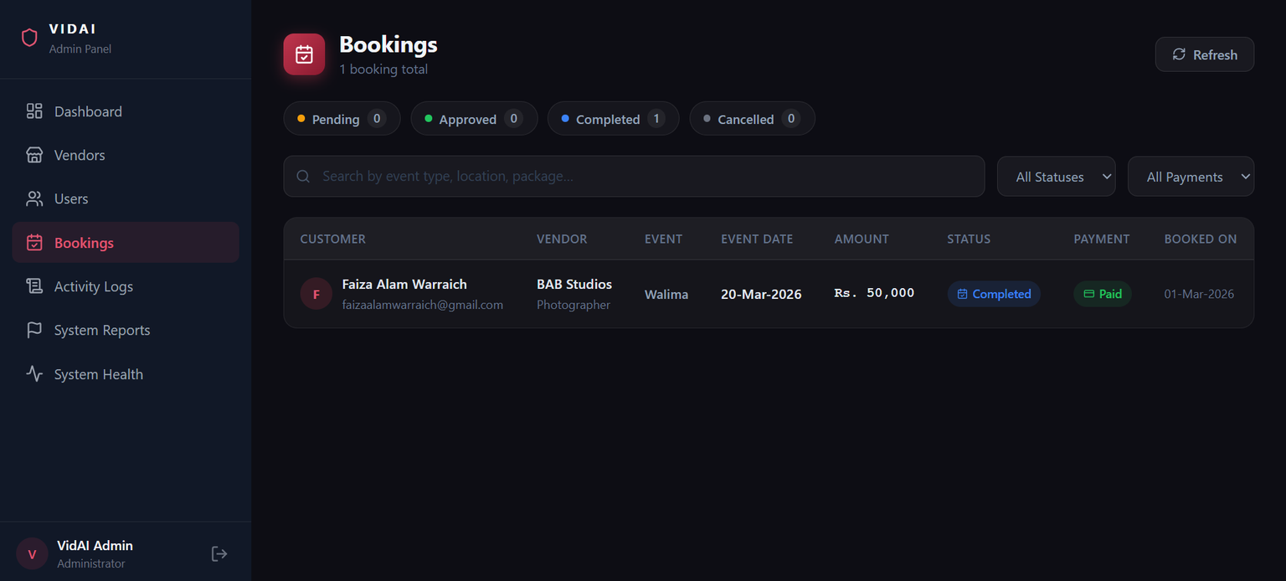
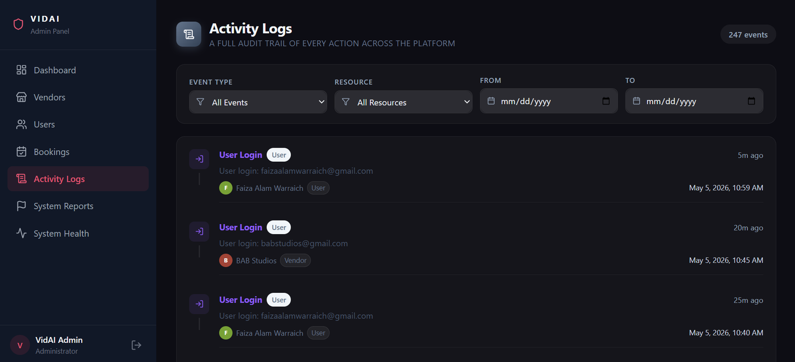
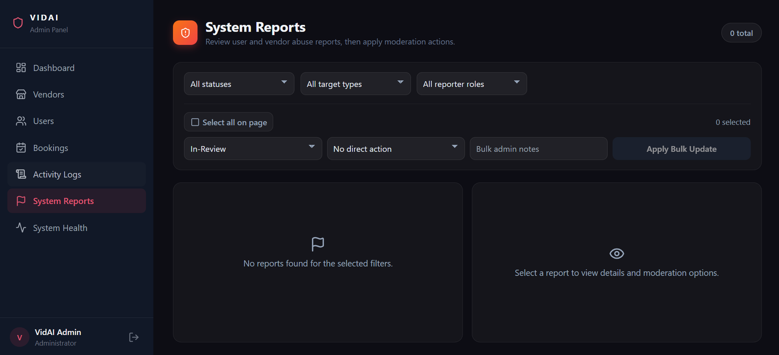
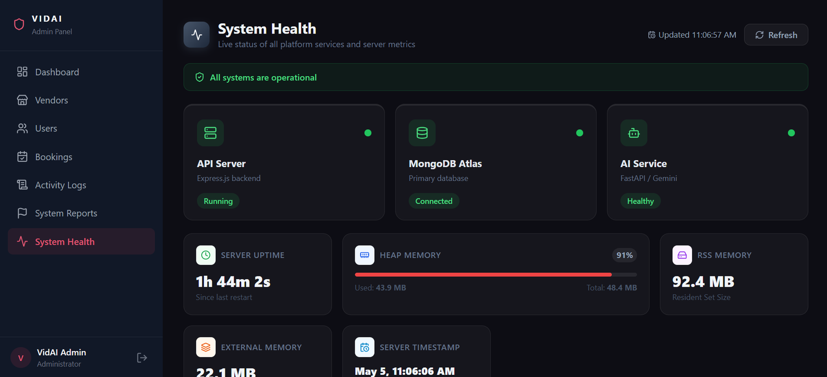
BAHRIA UNIVERSITY
ADMIN DASHBOARD
HTTPS://WWW.VIDAI.LIVE/
PAGE 20

Slide 11
BAHRIA UNIVERSITY
FUTURE WORK
Geographic and Market Expansion
Introducing Multilingual Support
01
In future developments, the system can expand its vendor network to include more cities in Pakistan
03
Future upgrades may involve providing support for multiple interfaces and interaction in different languages with the AI component.
Enhancement of Event Planning
Side-by-side Vendor Comparison
02
Incorporation of Guest list management, creation of checklists, scheduling, reminders, and ceremony-based planning.
04
Visually cross-analysing two or more vendors side-by-side for better decision-making, cost evaluation, and value assessment.
HTTPS://WWW.VIDAI.LIVE/
PAGE 25

Slide 12
BAHRIA UNIVERSITY
THANK YOU
HTTPS://WWW.VIDAI.LIVE/
PAGE 28

