Slide 1

VOICE FEST 1.0
Artificial Intelligence:
The Power of Communication
Learning, Influence, and the Future of Media
Presented By: Dist. Sen. Ibrahim Sobur Bamidele
FESSU National Senator | Federal University Dutse

Slide 2





Quick Show of Hands
The Big Question:
Used ChatGPT?
Used Meta AI?
Do you think AI will replace humans?
Used Gemini?
Weekly AI User?

Slide 3




What is Artificial Intelligence?
Technology that enables computers to perform tasks that normally require human intelligence.
Language
Creation
Answering questions
Generating content
Vision
Logic
Recognizing images
Recommendations

Slide 4





Why AI Matters Today
Education
Social Media
Business
Communication
Learning support and research assistance.
Content creation and audience engagement.
Marketing automation and customer support.
Writing, speeches, and public speaking.
AI is no longer the future. AI is the present.

Slide 5

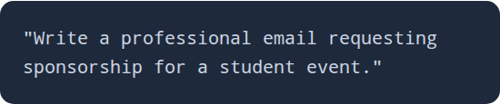
Empowering Communication
Write Smarter
The Prompt Secret
Draft speeches and reports
Organize complex ideas
Improve grammar and tone
Result: Faster, clearer, and more impactful communication.
Generate social media posts

Slide 6


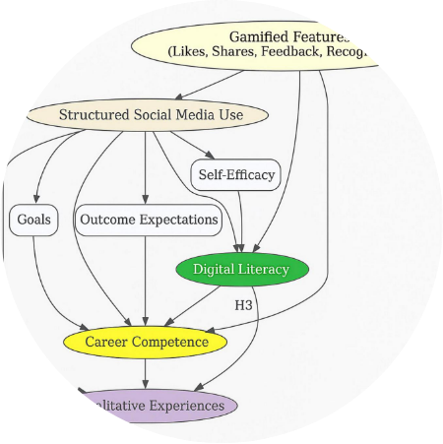
AI in Media & Content
Content Creators: Scripting & Captions
Journalists: Story drafting & Research
Student Leaders: Proposals & Speeches
Influence grows when communication improves.

Slide 7


Academic Excellence with AI
Research Support
Assignment Support
Note Summarization
Brainstorming Ideas
Study Plans
Exam Preparation
Student Prompt Example:
"Summarize this chapter into 10 key points for my upcoming test."

Slide 8

Live Demonstration
Ex. 1
Ex. 2
"Explain photosynthesis like I'm an SS2 student."
"Create a 2-week study timetable for a 200-level CS student."
Better prompts = Better results.

Slide 9
The Student's AI Toolkit
Tool | Core Strength
ChatGPT | General writing, brainstorming, and creative learning
Gemini | Research, live data, and Google Ecosystem integration
Meta AI | Instant assistance within WhatsApp & Instagram
Canva AI | Graphic design, presentations, and visual storytelling
Gamma AI | Automatic professional slide and document creation

Slide 10

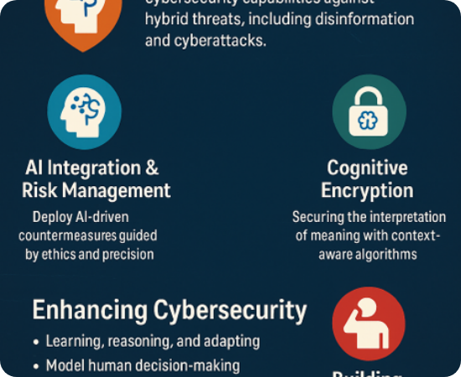



Understanding the Risks
Misinformation: AI can hallucinate facts.
Privacy: Be careful with sensitive data.
Plagiarism: Academic integrity still matters.

Slide 11


The Responsible Path
"AI should be used as an assistant to support your thinking,
not a replacement for it."
Verify Information
Think Critically
Cite Your Sources

Slide 12



The Future of AI
New Jobs
Careers that don't exist today are emerging.
Leadership
Data-driven decision making for smart leaders.
"People who use AI effectively may replace
people who don't."

Slide 13





Summary Checklist
AI is a tool, not a replacement.
AI significantly increases productivity.
AI improves communication & influence.
Responsible use is non-negotiable.

Slide 14
This Week's Challenge
LEARN
SOLVE
CREATE
TEACH
One new AI tool today.
A real academic problem.
Something of high value.
Share knowledge with a peer.
Your voice becomes stronger when technology supports your purpose.

Slide 15
Thank You!
Any Questions or Contributions?
Dist. Sen. Ibrahim Sobur Bamidele
FESSU Senator Representing Federal University Dutse

Slide 16




Image Sources
https://images.presentationgo.com/2025/06/futuristic-ai-robot-concept.jpg
Source: www.presentationgo.com
https://www.frontiersin.org/files/Articles/1700213/xml-images/fpsyg-16-1700213-g001.webp
Source: www.frontiersin.org
https://tdhj.org/wp-content/uploads/2025/11/Marsh_01.png
Source: tdhj.org
https://www.talentlms.com/blog/wp-content/uploads/2023/07/TLMS_20230606_1200x628-1.png
Source: www.talentlms.com

