Slide 1



Smoke Free GAA Clubs:
Going Smoke Free (including E Cigarettes)
A New Opportunity for GAA Clubs
The GAA Smoke Free initiative is supported by Irish Life, Healthy Ireland, the Public Health Agency (PHA) and the Tomar Trust

Slide 2
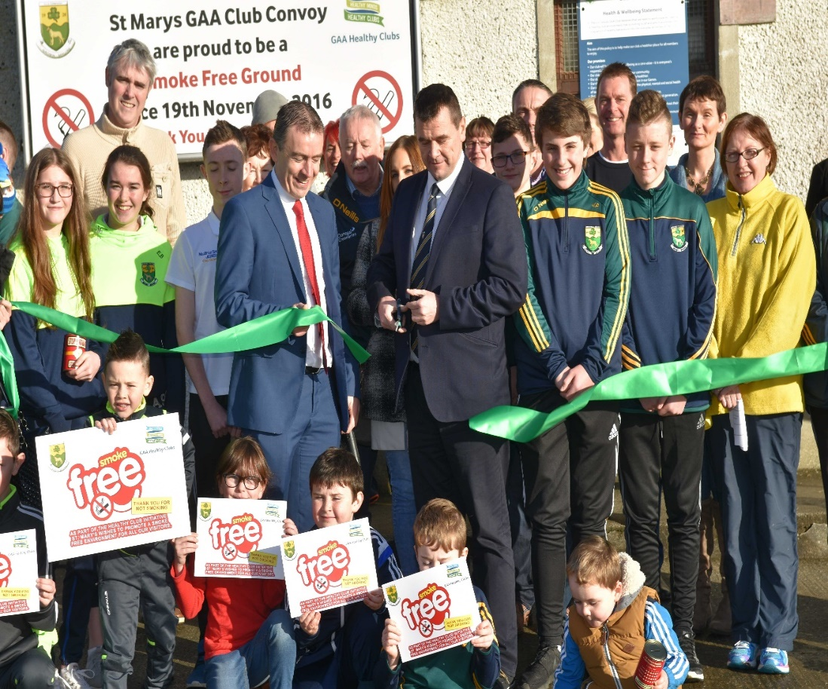
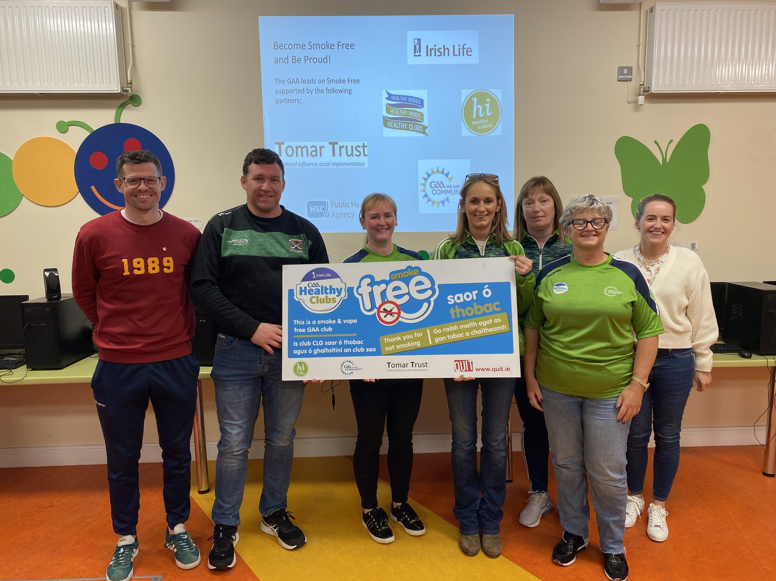
Key Message
Work towards achieving smoke and vapour free unity for all persons attending, working in, visiting and using the GAA facilities
Protecting our members, volunteers & visitors from the dangers of first and second-hand smoke exposure
The Advocacy of all stakeholders is vital if this is to be successful

Slide 3
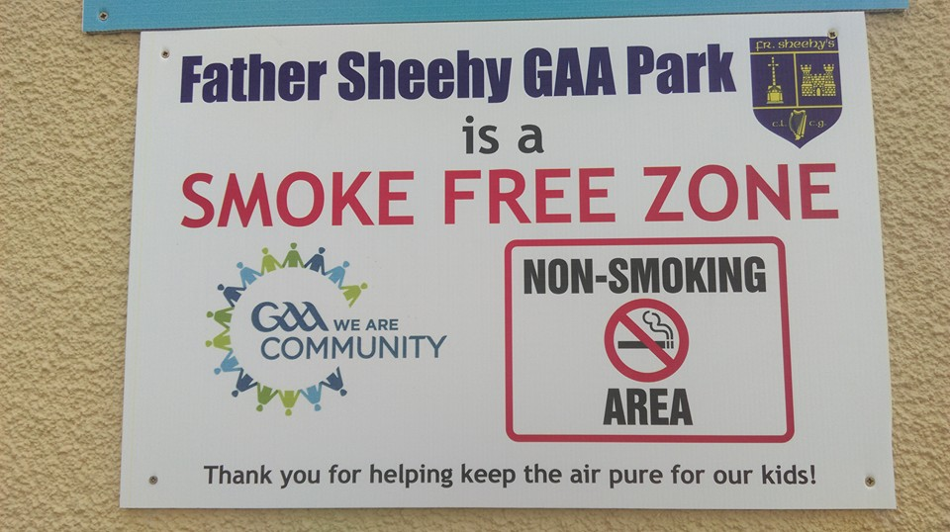
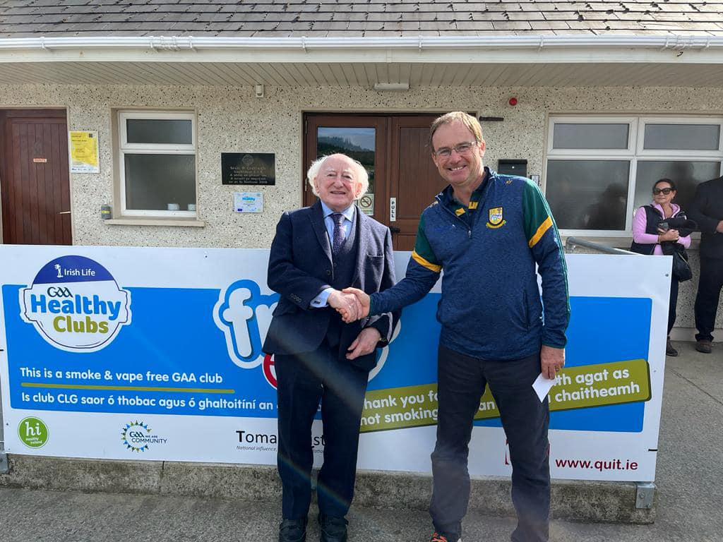
Why?
Set a positive example
Make it clear to children what the GAA's stance is on tobacco and electronic cigarettes
Eradicate any association between the GAA & tobacco and electronic cigarettes
Break the cycle of children learning the habit through adults/role models
Reduce the initiation of smoking tobacco and electronic cigarettes amongst young people
Protect our members, volunteers & visitors from the dangers of first and second-hand smoke exposure
Reduce the impact of tobacco, vape and other harmful chemicals on sports performance
Create a safer GAA grounds atmosphere for everyone involved, especially children
Minimise tobacco and electronic cigarette related litter

Slide 4
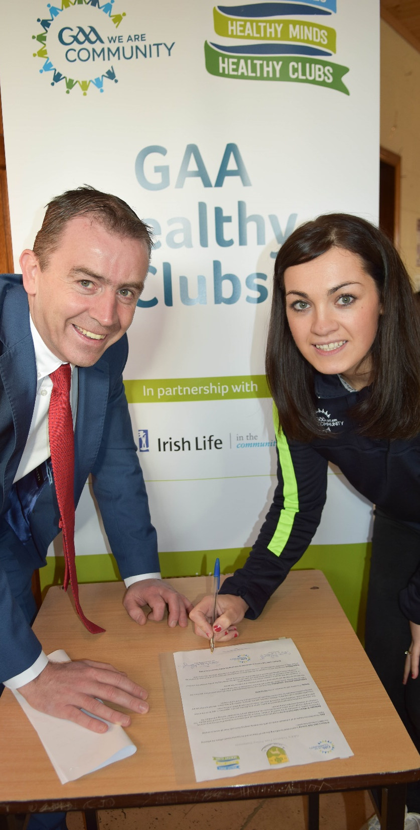
Planning and Policy
The best outcomes emerge from a zero- tolerance policy both in regard to going smoke-free and staying smoke-free
Consider banning smoking tobacco and electronic cigarettes in the entire club, including pitches and facilities
Check with Club Executive about the best way for your club to progress
Gold standard: complete smoke free club grounds
Download the GAA’s Smoke Free policy at https://www.gaa.ie/my-gaa/community-and-health/
The Smoke Free should promote a sense of “we are smoke-free and very proud of this”.

Slide 5
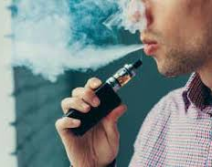
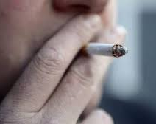
Smoke Free GAA Clubs:
Why is smoking tobacco a problem?
Smoking tobacco is one of the world’s biggest public health threats, killing over 7 million people per year. Approximately 890,000 of these deaths are caused by exposure to second-hand smoke. (WHO, 2019)
In Ireland, there are approximately 5,500 tobacco related deaths each year. Over 50% of long-term tobacco users will die from a tobacco related disease (HSE, 2019)
There is no safe level of exposure to second hand smoke!

Slide 6
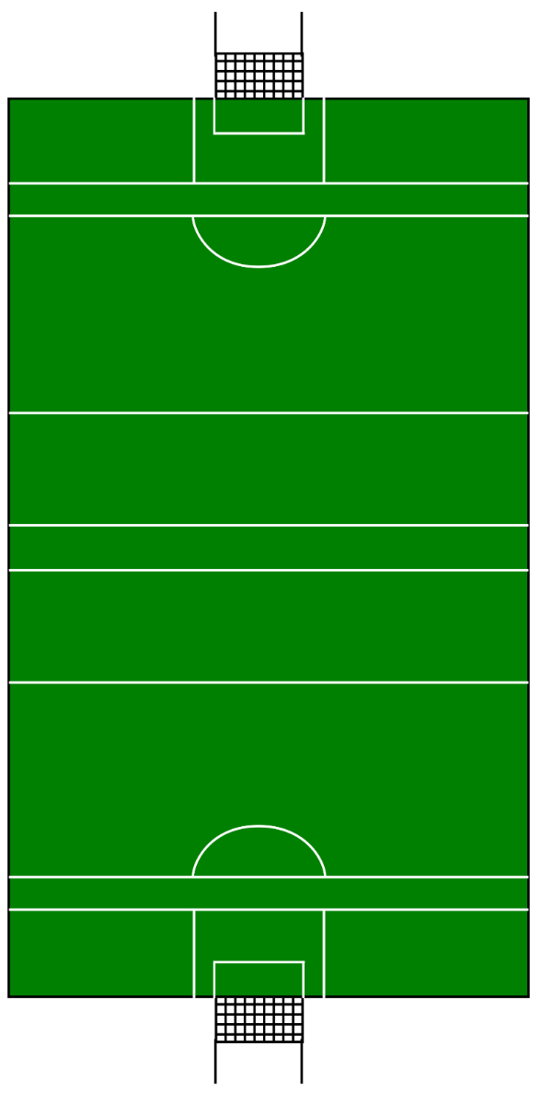





How healthy is your membership?

Slide 7
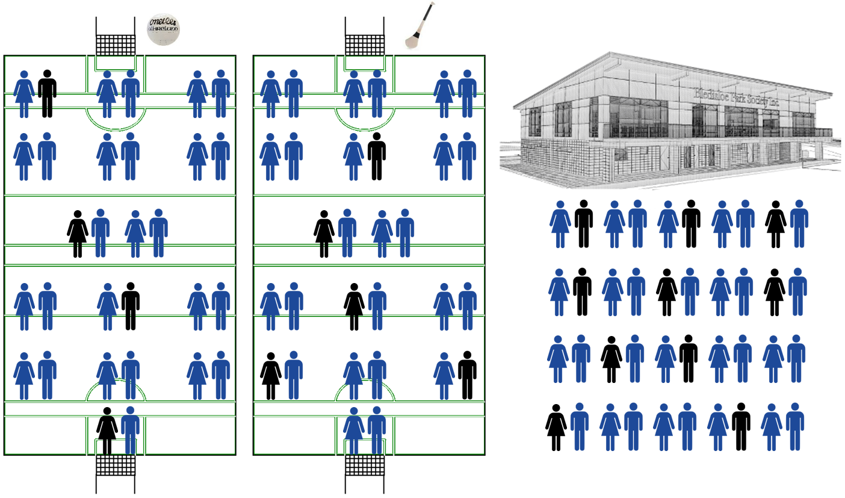

Statistic:
In a 100 member club, 17 are tobacco users .

Slide 8
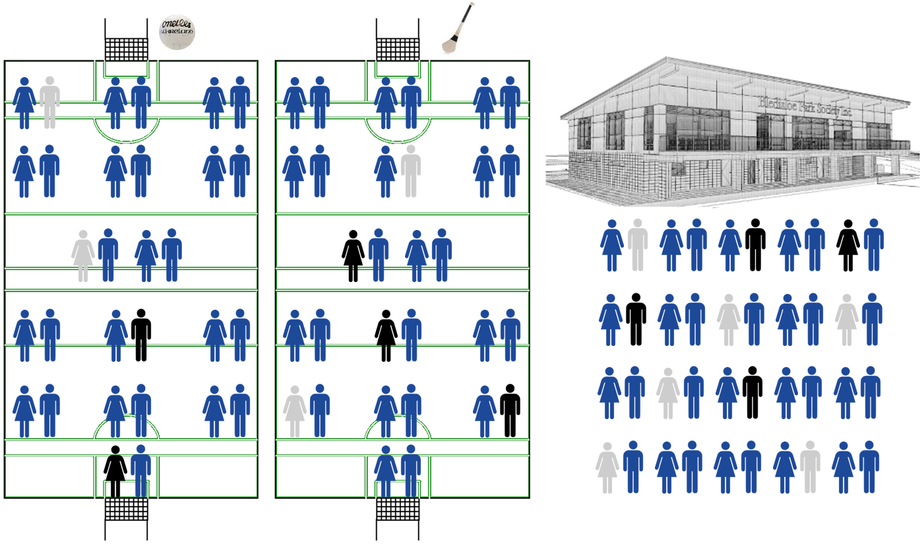
Statistic:
50% of those tobacco users will die from a tobacco related disease!

Slide 9
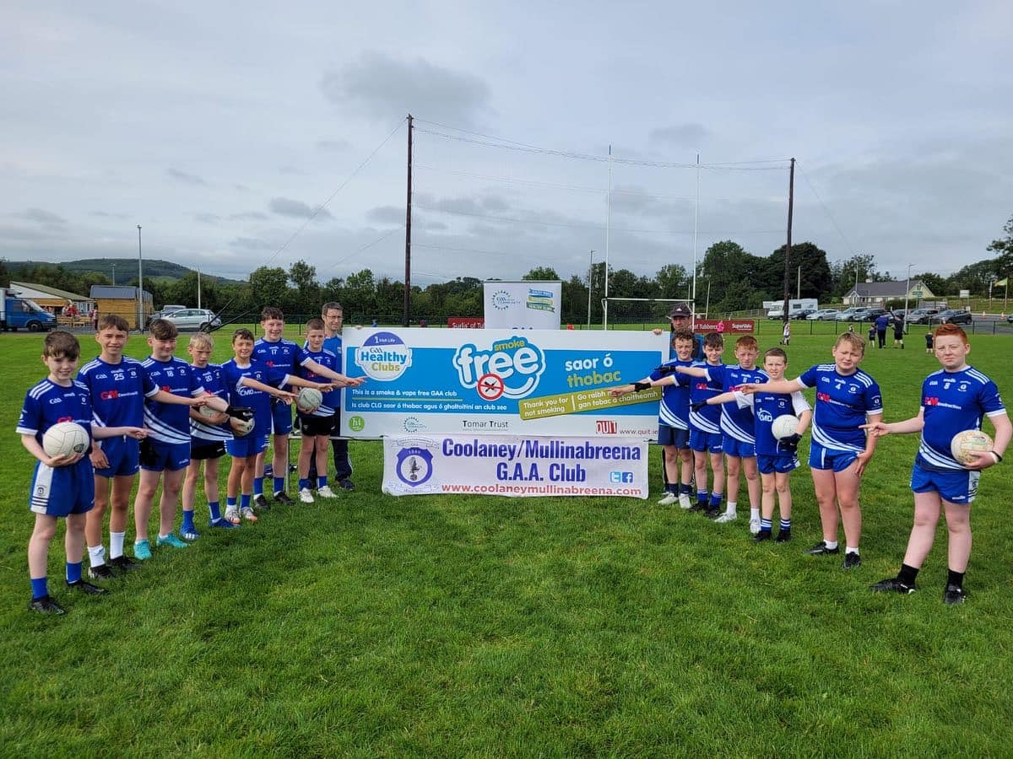
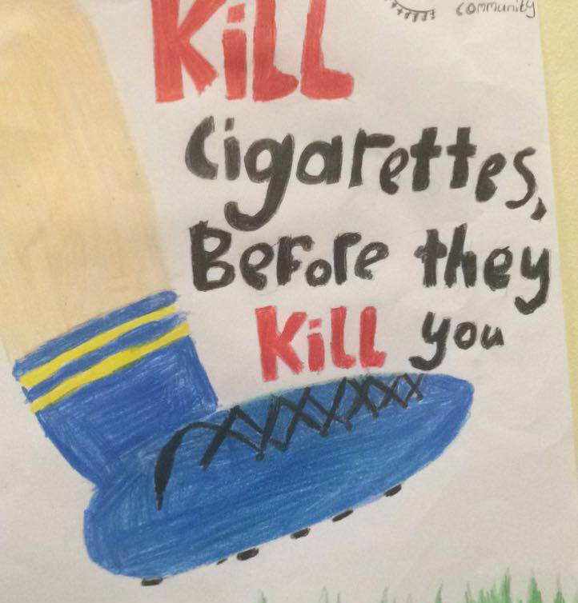
Partnerships & Collaborations
Seek ambassadors within the club & community who will support the initiative (club/county players etc.)
Build relationship with other Healthy Clubs who have successfully implemented a Smoke Free Policy
Stop Smoking Specialists/Health Promotion & Improvement Officers/ Health & Social Wellbeing Improvement Officers
Local pharmacist, nurse, GP etc.
Local schools – smoke free poster competition

Slide 10
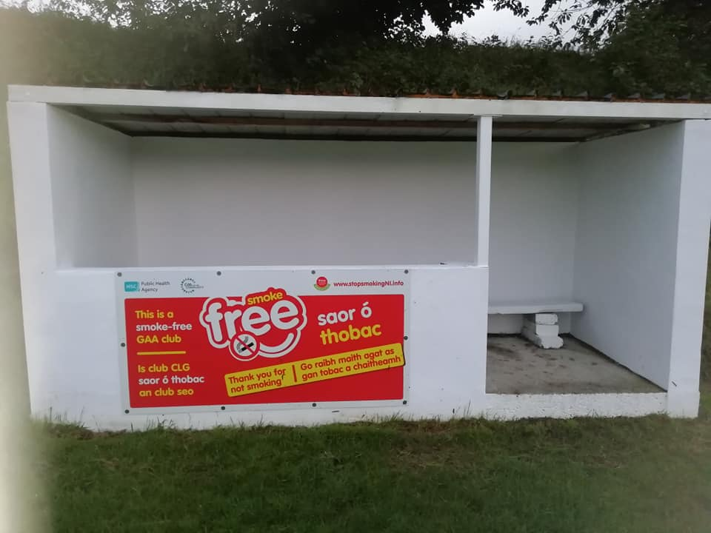
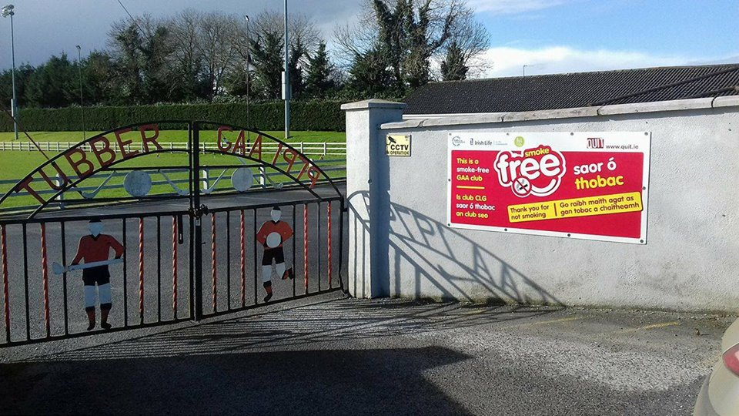
Activities
Set a date for the Smoke-Free Club launch
Communicate and Promote: count down to becoming a Smoke Free Club works well on social media
Get committee members, players, coaches and children to do a short video in support of the Smoke-Free Club launch
Obtain clear-cut and easily visible ‘Smoke Free’ signage
Visit https://www.gaa.ie/my-gaa/community-and-health/ to access & download templates
Inform all members, volunteers, parents, coaches, players, etc.

Slide 11
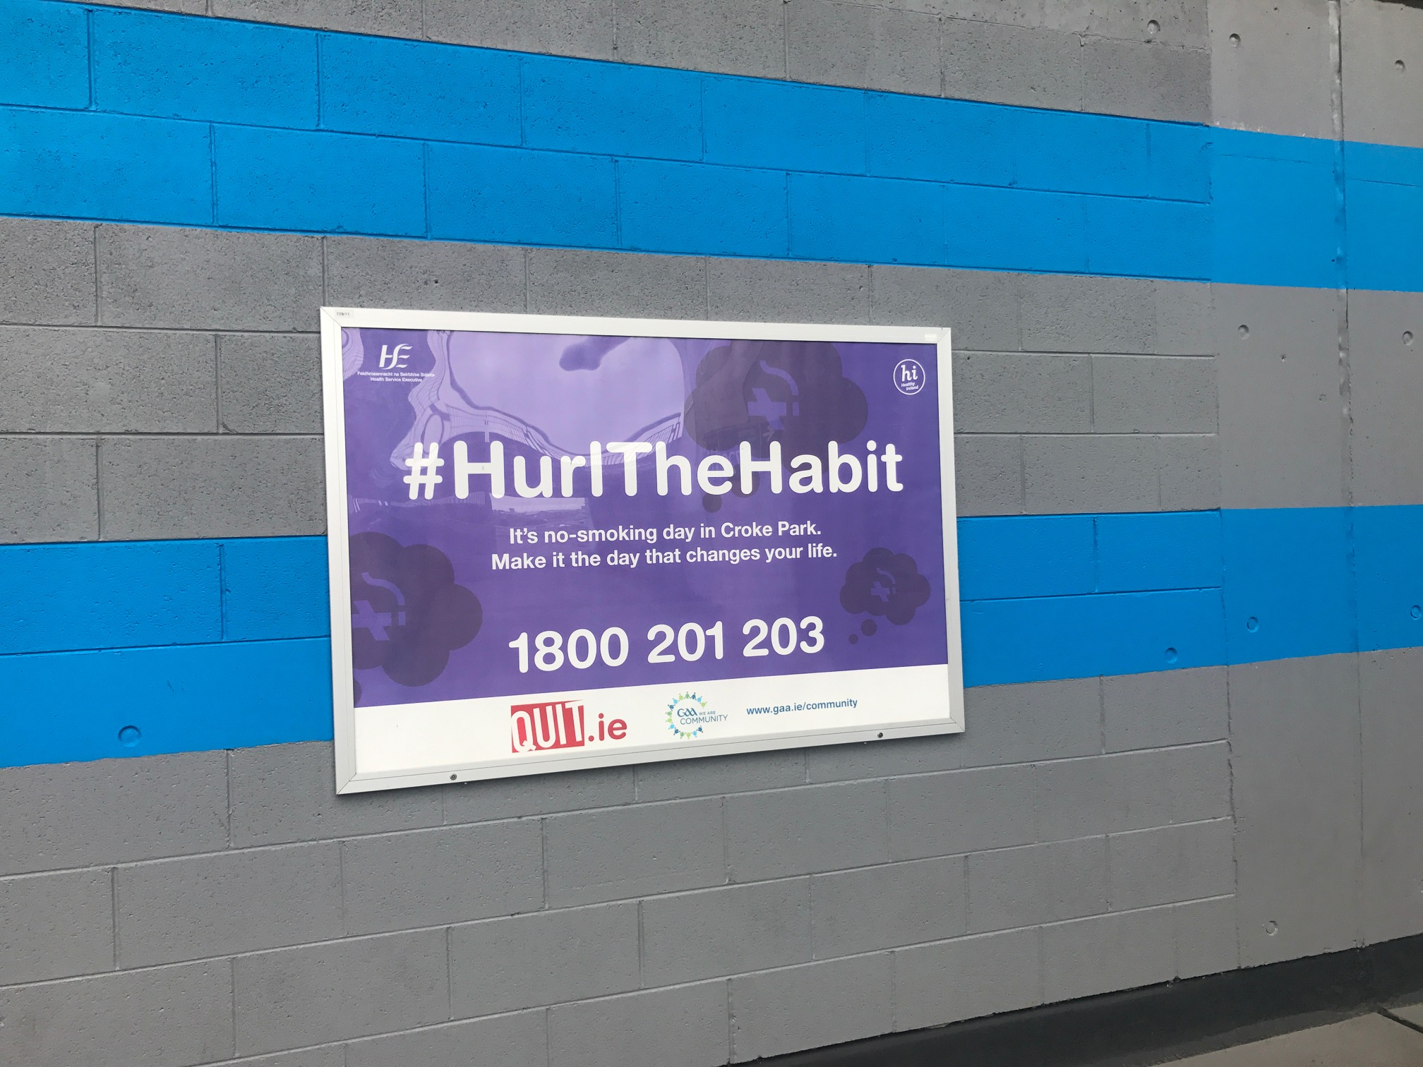
Organise a smoke free poster competition with local school(s)
Choose a number from each school and vote online for the winner(s)
Link in with local partners to see if Stop Smoking Services are available
Signpost individuals who want to quit to relevant resources
Sign and circulate the Smoke Free Policy
Monitor compliance - all breaches must be addressed promptly and firmly

Slide 12
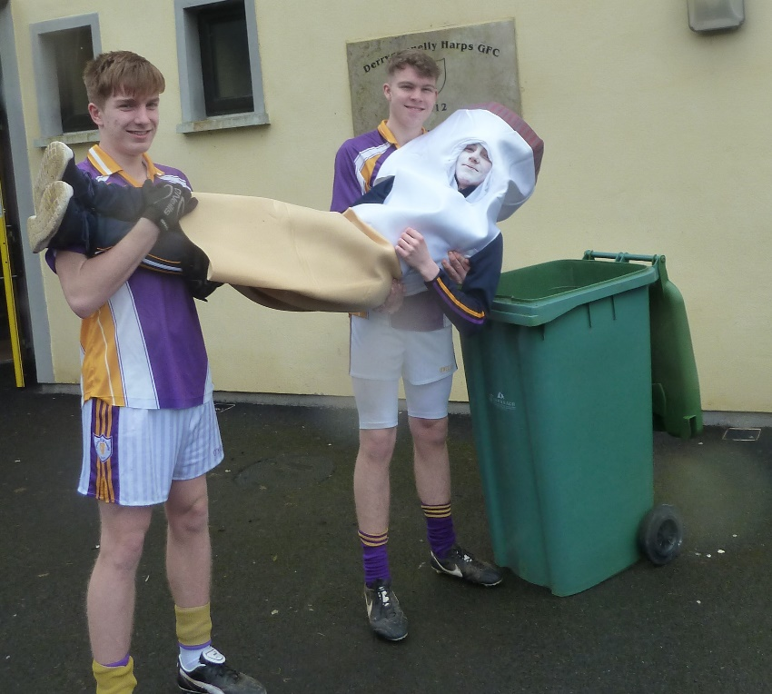
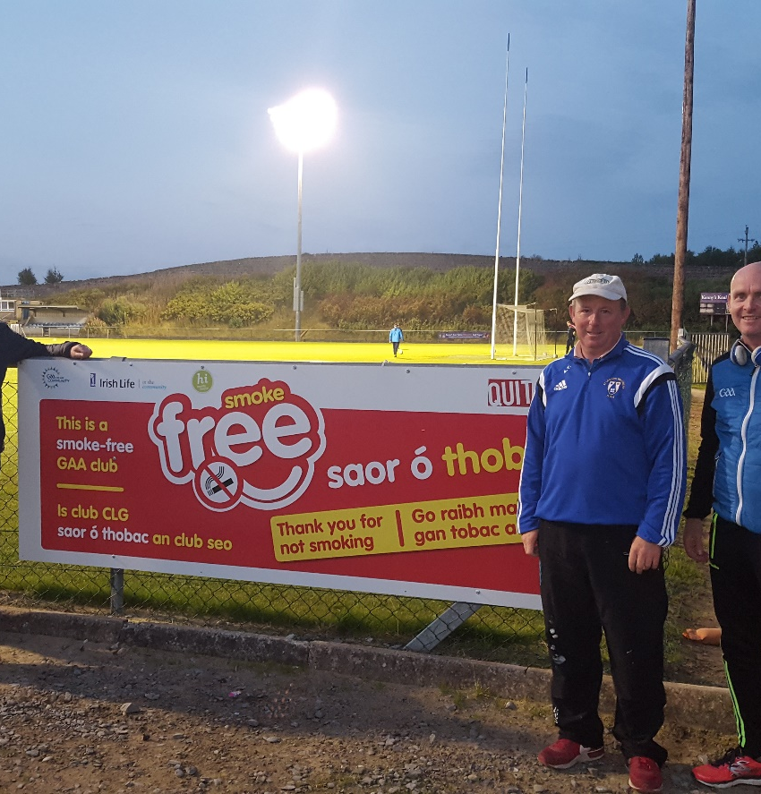
Supervision
Designated supervisors can be useful in the initial stages
If a leader in the GAA is seen smoking tobacco at training or at a game - this will undermine the policy
The main challenges tend to emerge in the congregation areas such as entrances to pitch, bar, car park, pitch side etc.
Breaches tend to be made when people are not be aware of the policy
Don’t allow a small number of individuals who refuse to cooperate undermine what is a major health initiative.

Slide 13
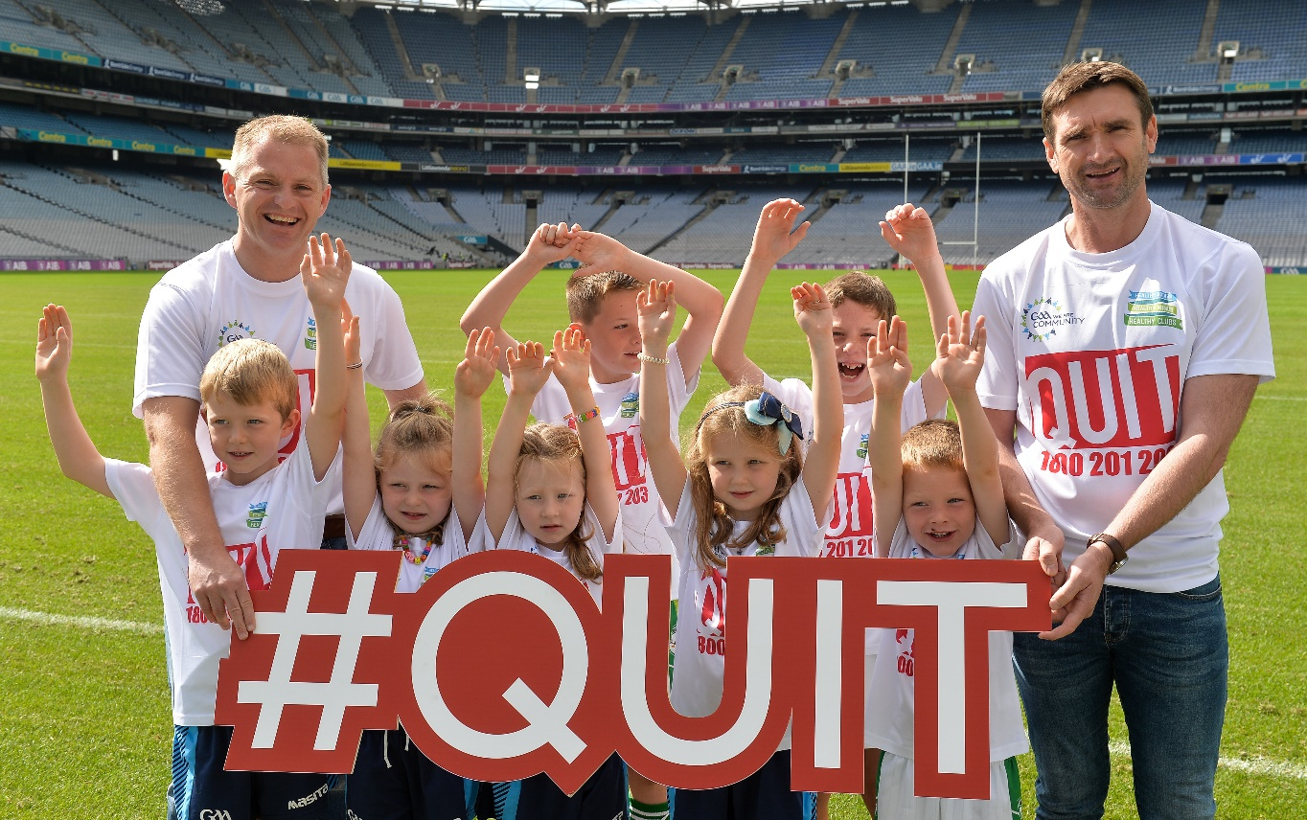
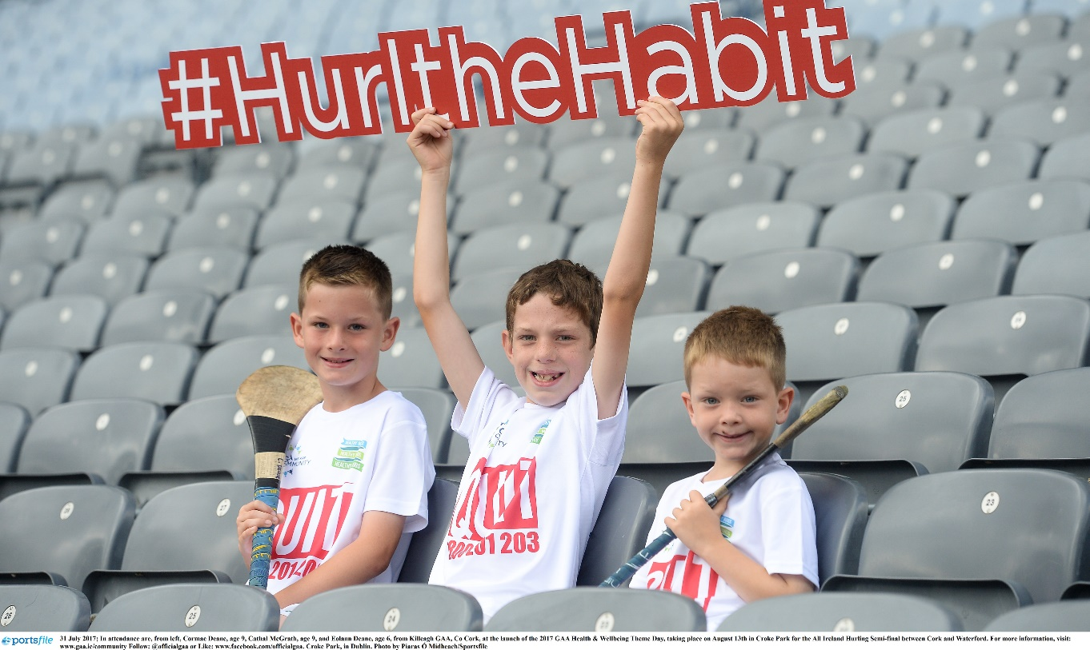
  Don’t allow mini failures undermine the bigger picture!

Slide 14





Become Smoke Free and Be Proud!
The GAA leads on Smoke Free supported by the following partners;

