Slide 1

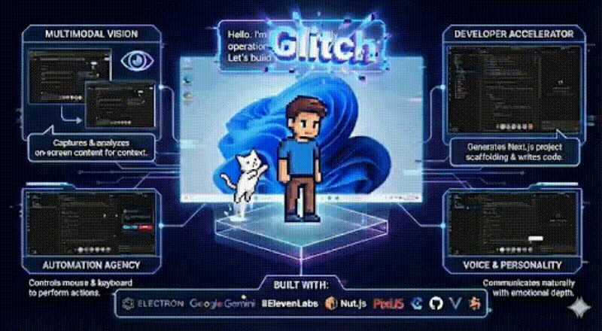
Hackathon Submission
Glitch
AI Desktop Companion
The AI that lives on your desktop — sees, thinks, and acts
Vision
Voice
Automation
Kirthan NB & Rohith M
Developer & Creator
January 2026

Slide 2
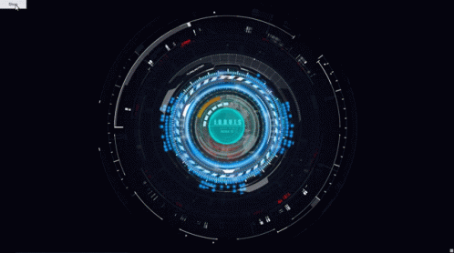
The Challenge
Disconnected from Workflow
AI Assistants Trapped in
Browser Tabs
Traditional AI assistants exist in separate windows, requiring constant context switching and breaking creative flow.
"We grew up dreaming of companions that don't just listen, but act."
Passive, Not Active
Current solutions only respond to queries. They can't see your screen or control your system.
Fragmented Experience
What users actually need:
Voice, vision, and automation are separate tools. No unified companion that combines all modalities.
Desktop-native integration
Autonomous action capabilities
Transactional, Not Relational
Multimodal interaction (voice + vision)
AI feels robotic and cold. Users dream of companions like JARVIS — agents that feel alive.
Personality that makes AI feel alive

Slide 3
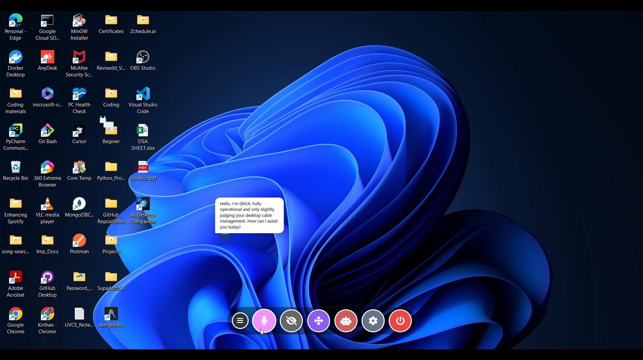
The Solution
Glitch Breaks the
Fourth Wall
A fully multimodal, autonomous desktop agent that lives on your desktop
Desktop-Native
Transparent, click-through overlay that shares your workspace instead of hiding in a window.
Interactive Character
Playful pixel-style companion. Drag, click, interact — inspired by classic desktop pets, powered by modern AI.
Meet Glitch
Multimodal by Design
Status
Online
Voice, vision, and automation seamlessly integrated. No switching apps. No broken context.
Mode
Multimodal Agent
Autonomous Agent
Controls mouse, keyboard, opens apps, executes multi-step workflows — all from voice commands.
Personality
Witty & Helpful
Personality-Driven
Glitch isn't robotic. He reacts. He feels present. Working with AI finally feels alive.

Slide 4
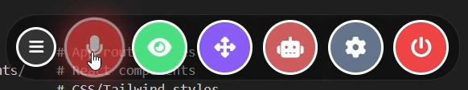
Features
All Modes, One Companion
Everything is built in. No switching apps. No broken context.
Glitch's control panel — all modes accessible
Voice Mode
Vision Mode
Natural conversation powered by ElevenLabs TTS. Speak naturally — Glitch listens, understands, and responds with realistic voice synthesis.
Screen understanding via Gemini 2.0 Flash. Ask "What's on my screen?" and Glitch analyzes the current window content in real-time.
Speech-to-Text
Low Latency
Screenshot Analysis
UI Detection
Agent Mode
Settings
Autonomous automation controlling mouse, keyboard, and system. Opens apps, types code, clicks UI elements — executes complex workflows.
Full customization. Change character appearance, voice, personality, and behavior. Make Glitch truly yours.
System Control
Workflows
Character
Voice ID

Slide 5
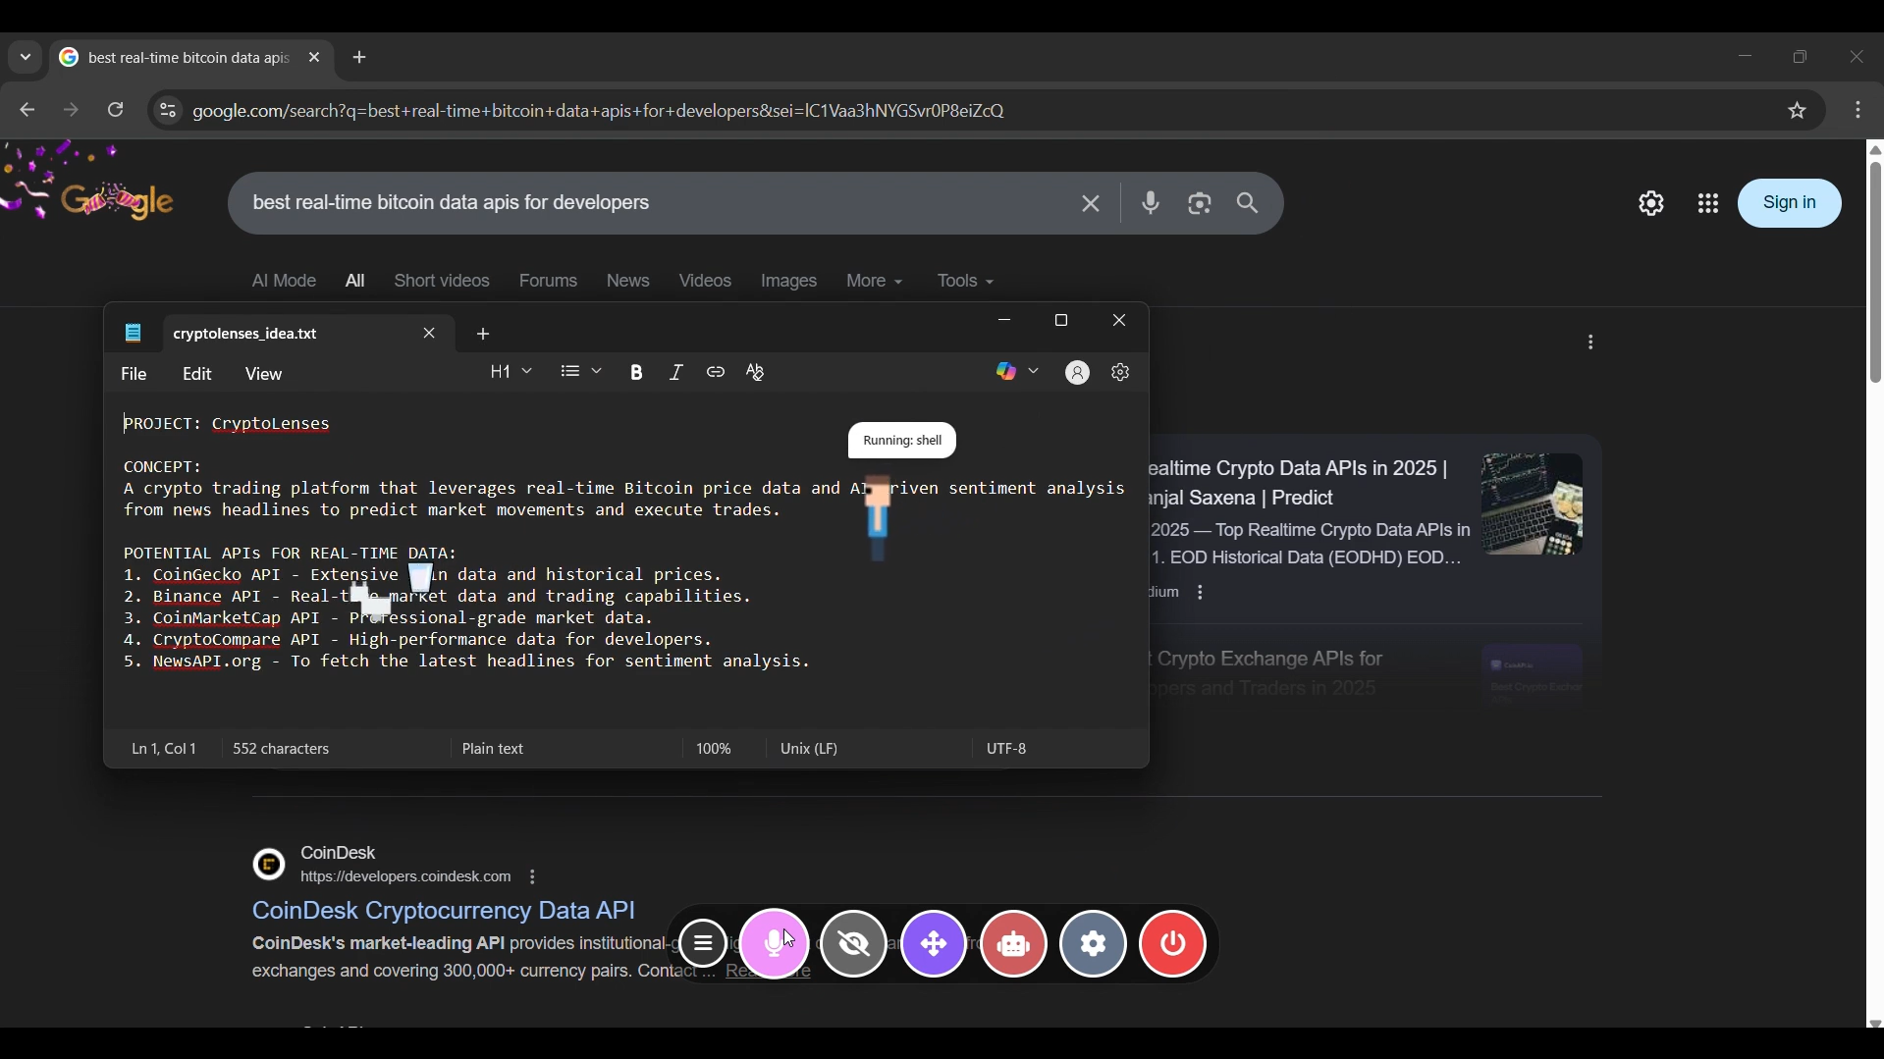
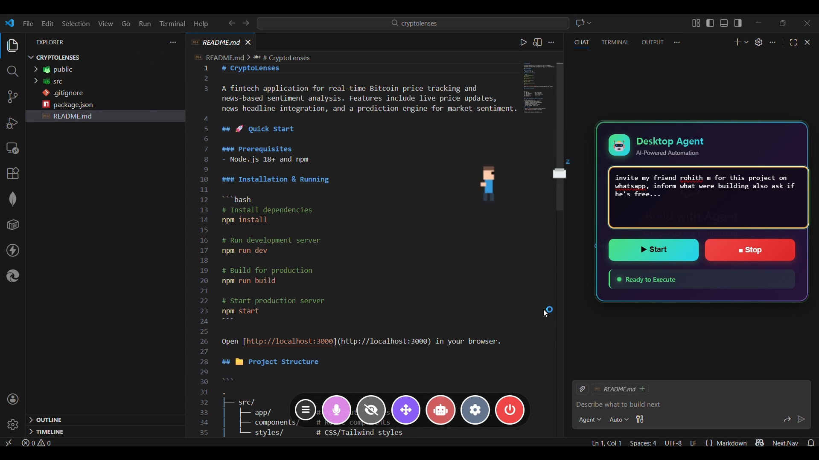
Agent Mode
Agent Mode executing a multi-step task
Real Automation in Action
This is not just another chatbot
Launch Applications
"Open VS Code" → Instantly launches editor
Type & Write
"Type Python for fibonacci" → Generates & types code
Creating a Next.js project from voice command
Visual Interaction
"Click the Send button" → AI sees UI & clicks
Web Automation
"Search Google for AI trends" → Opens, searches, extracts
Developer Accelerator
Creates complete project structures from voice commands — Next.js, React, Python projects ready in seconds

Slide 6
Architecture
Hybrid Multimodal Design
A carefully orchestrated system where each component plays a vital role
Brain
Eyes
Data Flow
Google Gemini 2.0 Flash — Multimodal reasoning for chat + vision intelligence
ScreenObserver — Captures and compresses screenshots for real-time analysis
1
User speaks → Renderer captures audio
LLM
Vision
Vision
Compression
2
Main process forwards to GameAgent
Voice
Hands
3
GameAgent captures screen + sends to Gemini
ElevenLabs TTS — Low-latency, natural voice synthesis for realistic responses
nut.js — Mouse, keyboard, and OS control for true system automation
4
Gemini analyzes → Returns action commands
TTS
Natural
Input
System
5
Action executed → User sees result
Soul
Electron + PixiJS — Desktop overlay and character animation that brings Glitch to life
Continuous Loop

Slide 7
Technology
Technical Stack & Implementation
Frontend
Backend
Electron
Node.js
Key Technical Achievements
Transparent overlay window, cross-platform desktop app
Main process, system integration, file operations
PixiJS
IPC Communication
Real-Time Screen Analysis
Character animation, particle effects, smooth rendering
Secure message passing between renderer & main
Captures, compresses, and analyzes screenshots in <500ms
Web Audio API
Child Process
Microphone capture, audio visualization
Shell command execution, workflow automation
Low-Latency Voice Pipeline
End-to-end voice response in <2 seconds
Hybrid Command Execution
Smart routing between system commands and visual interaction
AI / ML
Automation
Google Gemini 2.0 Flash
nut.js
Secure API Key Storage
Multimodal reasoning, chat, vision analysis
Mouse control, keyboard input, screen capture
electron-store with protected user data directory
ElevenLabs API
Playwright
Low-latency text-to-speech synthesis
Browser automation, web scraping
Safety First: Always a Stop Button
Speech-to-Text
Shell Integration
Real-time voice transcription
System commands, app launching

Slide 8
Use Cases
Real-World Impact
Compelling scenarios demonstrating Glitch's value
The Automated Coder
The DJ
"Open VS Code and write a Python script for fibonacci"
"Open Spotify and search for lofi beats"
Launches VS Code
Launches Spotify
Generates Python code
Clicks search bar
Types it into editor
Types query & clicks play
Result: Working script written before your eyes
Result: Music playing, hands-free
The Knowledge Keeper
The Researcher
"Summarize this article and save to Notepad"
"Search Google for latest AI trends"
Captures screen content
Opens browser
Extracts key points
Searches & parses results
Writes to Notepad
Presents findings via voice
Result: AI remembers for you
Result: Research done hands-free

Slide 9
Market Analysis
Market Opportunity &
Competitive Position
Glitch's Competitive Advantage
AI Agents Market Growth
Desktop-First Architecture
Unlike browser-based competitors, Glitch lives in your workspace
$5.9B
$37.88B
2024
2029
True Autonomy
46.2% CAGR
Controls system directly vs simple chatbot responses
Exponential growth driven by enterprise automation demand
Multimodal Integration
Key Trends
Market Gap
Voice + Vision + Action in one seamless experience
Multimodal agents
Cloud-based chatbots dominate
Desktop automation
Lack desktop integration
Screen understanding
Limited autonomy
Personality-Driven UX
Autonomous workflows
Single-modal tools
AI that feels alive, not transactional
Pioneer in Desktop-Native AI Agent Category

Slide 10

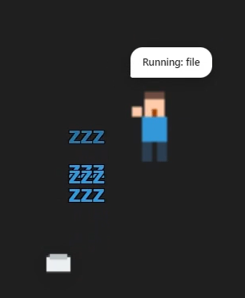
The Future is Here
The Future of
Human-AI Collaboration
Working with AI should feel like working with a partner, not using a tool. Glitch makes that future real today.
First Truly Multimodal
Breaks the Browser Barrier
Autonomous Capabilities
Personality-Driven
Desktop AI agent combining voice, vision, and automation
Lives in your workspace, not a separate tab
Sees, thinks, and acts on your behalf
AI that feels alive, not robotic
Live Demo
Open Source
https://ai-desktop-companion-glitch.vercel.app
https://github.com/KirthanNB/AI-Companion
Built for developers who dream of JARVIS

