Slide 1
Rauhuia | Leadership
Shaping the future together
February 2021
Notes:
This PowerPoint, its associated images and text, has been shared with you in the hope that you will join with us in developing Rauhuia – the Leadership space for the teaching profession of Aotearoa New Zealand. We look forward to hearing from you and your colleagues.
This presentation is supported by the Leadership Strategy for the teaching profession | Te Rautaki Kaihautū mō te Umanga Whakaakoranga (https://teachingcouncil.nz/assets/Files/Leadership-Strategy/Leadership_Strategy.pdf)
If you are intending to use this presentation and you would like support from us to do that, please contact us at Rauhuia@teachingcouncil.nz

Slide 2
“Matatū. Tū Mataora.”
Lesley Hoskin, Chief Executive, Teaching Council of Aotearoa

Slide 3
What do we want to achieve?
Our aspiration is for a fair, just, equitable and inspirational education system that honours Te Tiriti in practice and enables our tamariki and their whānau to flourish.
All teachers to:
have the opportunity to grow their leadership capability and to lead through values
build new knowledge about effective leadership through partnerships
easily find and participate in a range of networks relevant to their learning goals
be engaged in work to address significant issues, advocating and participating in problem solving, at local and national levels

Slide 4
Mana Tangata
“The mana tangata of our teachers is precious. Without it, they cannot teach.”
Mana is the principle of power, authority, influence, and prestige. Mana tangata refers to that mana which is derived from the actions and abilities of the holder. All teachers have mana tangata because of their professional skills, relationships, influence over ākonga, and essential role in their communities. If we reflect on the most influential teachers in our lives, they are usually those teachers whose mana tangata is abundant and unquestionable.
It is our duty to protect and grow teachers’ mana
We consider this mana-enhancing responsibility key to achieving safe, high-quality leadership, teaching, and learning for all ākonga in Aotearoa New Zealand.
The Teaching Council is working to ensure that Rauhuia, our Leadership Space, will grow the mana of teachers so they can, in turn, support the growth of mana of their ākonga, whānau, and communities.

Slide 5
How will we get there?
Establish the kawa – these are the non-negotiable things that will need to be common across the system to get the changes we aspire to
Understand and apply the kawa in practice – support you to engage with local knowledge holders and lead in your local communities and differing contexts (tikanga)
Deliver the priorities and focus areas of the Leadership Strategy | Te Rautaki Kaihautū (kaupapa)

Slide 6
Te mahere: the plan
Kawa
Te Tiriti o Waitangi
Values: Whakamana, Manaakitanga, Pono, Whanaungatanga
Wellbeing
Tikanga
Discussion groups
e.g. how to give effect to Te Tiriti o Waitangi at place
Modules
e.g. how to grow mana
Creating a network
e.g. connect to work on a capability - strategic thinking and planning
Acknowledging leadership capability
e.g. ERO leaders programme
Kaupapa
The Strategy’s focus areas:
1. Stewardship
2. Capability frameworks
3. Personalised professional learning
4. Partnerships, Communities & Networks
Code and Standards
The Strategy & Capability framework
Notes:
KAWA – non negotiable enduring principles that ensure connection at a system level
Te Tiriti o Waitangi needs to be embedded in the approach to governance and stewardship of Rauhuia
Any significant decisions about the establishment of the Leadership Space need to reflect the teaching profession and the Council’s commitment to honouring Te Tiriti o Waitangi, through processes and structures that actively promote an authentic and equitable relationship between the partners. This commitment is laid out in the Council’s own Te Tiriti policy and in the Standard/Paerewa “Te Tiriti o Waitangi partnership”. This Standard/Paerewa notes that teachers in Aotearoa New Zealand must show their understanding and recognition of the unique status of tangata whenua in Aotearoa New Zealand; understand and acknowledge the histories, heritages, languages and cultures of partners to Te Tiriti o Waitangi; and practise and develop the use of te reo and tikanga Māori. A Tiriti-based approach to planning and decision-making for the Leadership Centre, in the any structures that are created for governance, stewardship or advice, means being explicit in thinking about the distribution of power between tangata whenua and tangata Tiriti, and about engagement and participation from all parts of the profession and our communities.
TIKANGA – what this looks like will be different in different communities; locally driven mana motuhake
Uniquely for Aotearoa: We want to create educational leadership that is uniquely crafted for Aotearoa and our future
Wellbeing: Caring for the wellbeing of all needs to be central to this work
Cultural Competence: Demonstrating cultural competence in our work and being agents of change for equity, inclusion and better outcomes for Māori and Pasifika learners – which aligns to the vision of the Leadership Strategy that through principled and inspirational leadership, a culturally capable, competent and connected teaching profession achieves educational equity and excellence for all children and young people in Aotearoa New Zealand
Wall of identity: Connecting mana whenua to bi-cultural, multi Pacifica, multi cultural identity and affirmation (see next slide)
Local place-based: connections and solutions that are designed locally and respond to local issues, and representing local manuwhenua perspectives
KAUPAPA
The focus areas of the leadership strategy are the starting point, drawing on other valued work that has gone before or other initiatives and strategies you may want to bring to the table (e.g. Tu Rangatira, Leadership Capabiltiies framework, Professional Growth Cycle)

Slide 7
Kawa
Notes:
Kawa– these are the non negotiable enduring principles that ensure connection at a system level

Slide 8
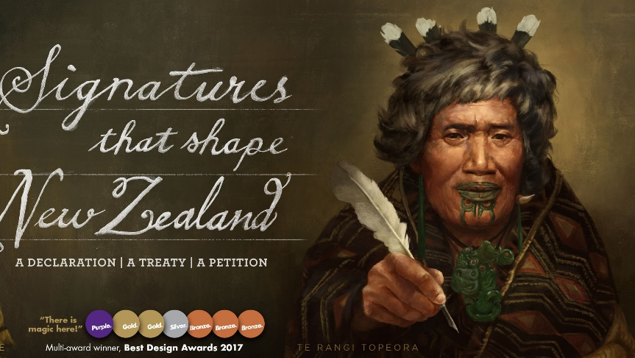
Notes:
Rauhuia is the overarching framework we are using to show how leadership will grow and be supported in a uniquely New Zealand way for education.
The feathers from the huia bird were a prized possession throughout Te Ao Māori, as it symbolised leadership.
Rauhuia is centralised around the concept of wearing of the huia feather by our esteemed leaders.
Māori Hapū and hapori (communities) defined significant attributes that formed leadership, from a Māori perspective.
The central organising idea is best described with the image of this well-known female Rangatira, Te Rangi Topeora, shown above from Ngāti Toa. She wore the feathers of the huia as a sign of her mana and the agreement by her people that she was their leader; that she had the right skills and attributes to lead this mahi, hence her role in the signing of Te Tiriti o Waitangi in 1840.
Image from the National Library of NZ

Slide 9

Teaching Council’s Te Whare Tiriti
Pou Whakamana
empowering all learners to reach their highest potential by providing high-quality teaching and leadership.
Pou Manaakitanga
creating a welcoming, caring and creative learning environment that treats everyone with respect and dignity.
Pou Whanaungatanga
engaging in positive and collaborative relationships with our learners, their families and whānau, our colleagues and the wider community.
Pou Pono
showing integrity by acting in ways that are fair, honest, ethical and just.
Tekoteko
Ako, Kaiako, Pouako
Te Koruru/The Vision
Maihi tangata whenua
Maihi tangata tiriti
Amo Tikanga
Amo Tikanga
Te
Whāriki
Notes:
Te Tiriti led and values-based Teaching Council
Maihi Tangata Whenua (Māori) and Maihi Tangata Tiriti All non-Māori Citizens of Aotearoa. Maihi (the two gables and forward-facing boards of the house of equal dimensions and standing)
Tekoteko the main carved figure on the gable of a meeting house, Representing the main ancestor or binding agent in our case, it is Learning, the learner and the Teacher.
As part of the Code of Professional Responsibility and Standards for the Teaching Profession ‘Our Code, Our Standards: Ngā Tikanga Matatika Ngā Paerewa,’ an expectation is placed on the teaching profession to understand the unique status of tangata whenua, understand and acknowledge the histories, heritages, languages and cultures of partners to Te Tiriti o Waitangi, and to practise and develop the use of te reo and tikanga Māori.
As this expectation applies to the teaching profession, we know that the same expectation applies to us.
This commitment to honouring Te Tiriti has implications on the work that we carry out – including in the leadership space.
To date, the Council has engaged Taura Kaihautū in a genuine, authentic partnership between Tangata whenua and Tangata Te Tiriti in conceptualising a leadership space for Māori medium.

Slide 10




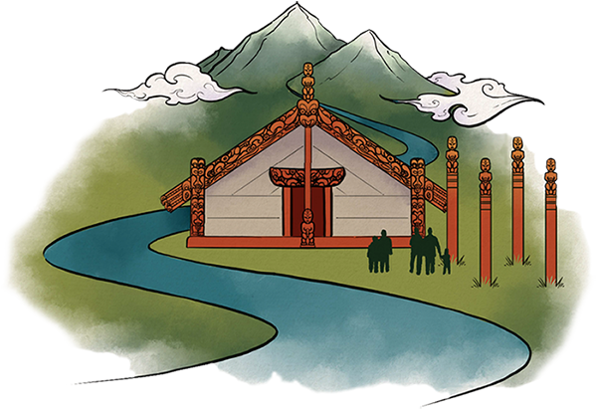
Te Pātū o te Whare - Wall of Identity
The Wall of Identity in our Tiriti-led and Values Based Council
Kawa – Our ways of being driven by our non-negotiables
The Teaching Council and all its strands of work are led by Te Tiriti o Waitangi, our values and the wall of identity demonstrated by our tukutuku patterns and its narrative. Each of these tukutuku patterns are bound to each other by Te Tiriti o Waitangi and our values and in doing so amplify individual and collective wellbeing.
Hauora / Wellness
The panel of individual and collective Hauora.
Tinana
(Physical)
Taiao
(Environmental)
Wairua
Spiritual/Wellness
Hinengaro
( mental and emotional wellbeing )
Whānau
(Family)
Nga Tangata Katoa
Societal
MANA WHENUA / TANGATA WHENUA
BI-CULTURAL
MULTI PACIFICA
MULTI CULTURAL
Notes:
The walls of te whare reflect that this is a space for all – all who meet here are bound by Te Tiriti o Waitangi, and in this space we are able to include, and acknowledge the diverse cultural heritages present in Aotearoa NZ. The communities and families we work with and lead are all represented here- and this is a reminder that effective leadership must reflect an authentic individual and collective identity.
Wellbeing/Oranga
Early conversations have indicated that Oranga isn’t currently visible within either the Profession/Council’s values or the strategy – in Aotearoa New Zealand today, wellbeing and care is critical, as it will be for priorities around leadership development. We see it as essential for the partnerships with communities and networks that we form. We will ensure this is built into Rauhuia as part of the next stage.
The image of Te Whare draws a strong link for New Zealand teachers to the concept of Te Whare Tapa wha – where Hauora is treasured and enhanced. We know the importance of ‘well-being/oranga’ to each individual, and the need for each leader to be able to build and sustain individual and collective well-being.

Slide 11
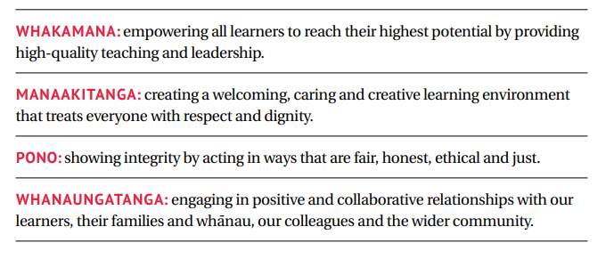
Uara | Values
Notes:
Mana is at the heart of leadership, supported by values
The uara/values and values-based leadership underpin all of the Council’s work.
Our Code Our Standards Ngā Tikanga Matatika Ngā Paerewa and their uara/values are the backbone of the system put in place to build coherence and promote notions of building partnerships and strengthening the teaching profession. They are integral and complementary to professional practice and growth of kaiako, with a sharper focus and expectation on quality learner outcomes across the sector.
As the Leadership space takes shape, the values embedded in Our Code Our Standards Ngā Tikanga Matatika Ngā Paerewa, should be visible in the four focus areas, both in how decisions are made about the establishment of this space, and in identifying priorities under each focus area. Using the values to explicitly guide future work also assists the Leadership space in maintaining an authentic Tiriti-based approach. This is because the values capture and reflect the importance of inclusivity, diversity, care for people, and the broad-based engagement that are fundamental to these relationships.

Slide 12

Rauhuia
Tangi wairua ana te Huia Kaimanawa
Waiho anō ia kia arahi ana
Huia
Huia
Tangi ana te Tui
Waiho anō, kia korihi ana
Tuia ki runga
Tuia ki raro
Tangi ana te Pipiwharauaroa
Waiho anō kia korihirihi ana
Whiti, whiti ora
Tangi ana te Kawekawea
Waiho anō kia tangi ana, kia korihi ana
Kia aroaro ki te mahana
Ka taka mai te ahuru
Tihei Mauri ora
The spiritual call of the treasured Huia
Let it guide us
To unite above
To unite below
The Tui calls
Let it sing its melody
To stitch above
To stitch below
The Pipiwharauroa calls
Let it sing its melody
That wellness shines upon us
The Kawekawea calls
Let it sing its melody
To front the comfort of the warmer months
Descending upon us.
Let there be life!
Notes:
Rauhuia acknowledges the many ways leadership can be expressed – whether within iwi and Māori communities (tangata whenua) or non-Māori (tangata Tiriti) communities.
Rauhuia acknowledges that every region utilises and connects to the symbols and imagery of significant birds, specific to their environment. This demonstrates that regions have their own unique ways of growing and nurturing what leadership means for them. Rauhuia is a locally driven approach, being careful as to what things need to be in common for a system design.
Rauhuia acknowledges the mana regarding the roles and responsibilities of leaders, including Principals to lead in our communities. Rauhuia is not role-based, but identifies all teachers and education leaders as having leadership responsibilities.
And acknowledges the saying:
Waiho mā ngā Tui, ngā Tui e tiaki
Waiho mā ngā Tumuaki, ngā Tumuaki e tiaki
Waiho mā ngā Kaihautū, ngā Kaihautū e tiaki
Leave it to the Tui to take care of the Tui
Leave it to Principals to take care of Principals
Leave it to the leaders to care of the leaders
Rauhuia and its principles are guided by the articles of Te Tiriti o Waitangi and the values of the teaching profession.
This means being explicit in thinking about the distribution of power between tangata whenua and tangata tiriti, with any decisions needing to reflect the teaching profession and the Council’s commitment to honouring te Tiriti o Waitangi, through processes and structures that actively promote an authentic and equitable relationship between the partners.
Using the values to explicitly guide future work will also assist us in maintaining an authentic tiriti-based approach. This is because the values capture and reflect the importance of inclusivity, diversity, care for people, and broad-based engagement that are fundamental to these relationships.
Te Rauhuia framework acknowledges all Iwi, Māori communities and non-Māori communities approaches to leadership. There is the space and ability to weave these in to the framework within each region.

Slide 13
What do you think?
What else do you think belongs in the kawa (non-negotiables) which would ensure we have a common approach to leadership?
Do you think well-being/oranga should be added to the strategy? Is it best placed in kawa or as tikanga? How could Rauhuia support or enhance ‘oranga’?
In what ways does the symbolism of Rauhuia resonate with you as an educator in NZ?

Slide 14
Tikanga
Notes:
There are certain kawa for pōwhiri, but how that kawa looks will be different in different places depending on the iwi - how it is done, the tikanga, is determined by mana whenua.
Tikanga is a local response determined by those at place, who are best placed to make decisions.

Slide 15
Who is a leader?
Rauhuia is a leadership space for all: Principals, professional leaders, middle leaders, team leaders, curriculum leaders, mentor teachers, senior teachers, developing leaders, beginning leaders….
Every teacher is a leader and will be supported to grow leadership capabilities when they are ready.
‘I’d like to help my deputy principals to connect with other networks’
‘How do I get support as a principal to meet the needs of my community?”
‘For those that live in isolated communities, and some of our smaller schools- leadership support can be a real challenge.’
‘I have some amazing groups I access but it can be hard to sustain some of our thinking and initiatives’
Notes:
The vision of the Leadership Strategy ; enabling every teacher to develop their leadership capability

Slide 16
Ako
The development of Rauhuia will be an on-going iterative process where we learn with and from others, including:
Teachers in all settings
Centre/school leaders
Leadership groups
Innovative practitioners
Researchers and academics
Local iwi and communities
Students and their whanau

Slide 17
What do you think?
Tikanga will look different in each community, and it is determined by those ‘at place’.
Do you have or who would you build relationships with to understand your local tikanga?
What are the things in your community environment, and who are the people that influence and/or inspire you?
What are the characteristics of leadership you value in your place?
‘ It takes a village to raise a child’ : who else should you lead with?

Slide 18
Kaupapa
Notes:
The focus of Rauhuia is growing educational leaders and leadership, starting with the Leadership Strategy for the teaching profession

Slide 20
Growing Leadership
We want to partner with and build on the profession’s work to develop the leadership strategy, and sustain other valued leadership work (e.g. Tū Rangatira).
What we have heard so far is we need to start with
  Relationships –from the Capability Framework # 1
  Personalised Professional Learning – Leadership Strategy, Focus Area 3
  Partnerships, networks and community – Leadership Strategy, Focus Area 4
Ruahuia will work with others to provide access to local Māori knowledge, and expertise to guide and form partnerships.
Teaching Council is partnering with peak bodies and groups of teachers to create pathways of development across the system (e.g. a Principal’s strand)
Notes:
The work the Teaching Council is doing to partner with a wide range of right-holders, and to connect educators within and across the profession, supports the development of Focus Area 4 of the Leadership Strategy | Te Rautaki Kaihautū. We know the value of engaging in communities and networks.
The Professional Growth Cycle is an excellent example of how all teachers can access a ‘learning pathway that support[s] their growth and development (Focus Area 3).

Slide 21
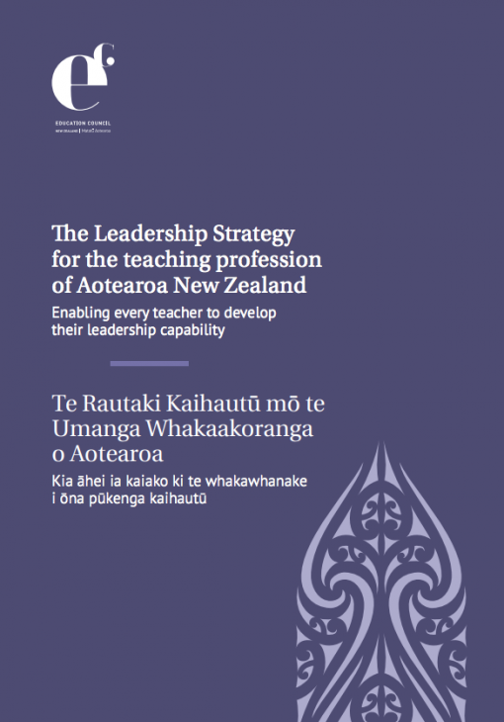
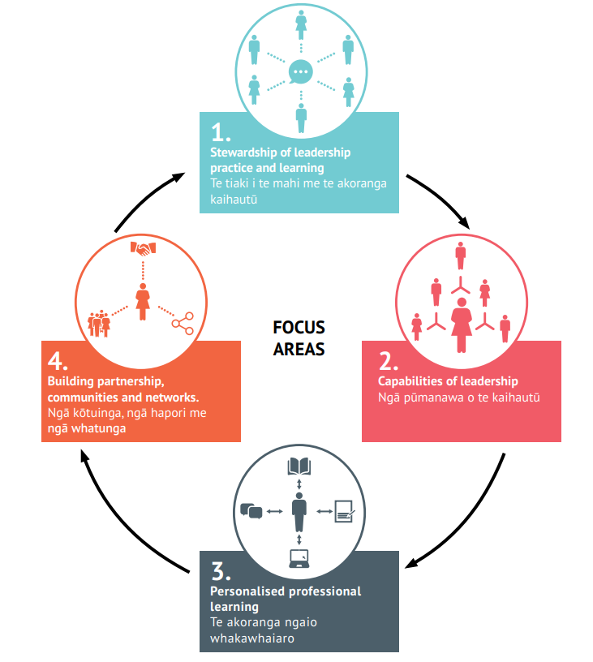
Notes:
The four focus areas are underpinned by the Leadership Strategy vision:
Stewardship of leadership practice and learning – Kaiako should be involved in decisions affecting their profession. This focus area is about the profession having ownership and input into decisions that will grow and support leadership now and into the future and ensuring that leadership learning opportunities are increasingly accessible to all Kaiako.
Capabilities of leadership - this focus area is about establishing a common language for effective educational leadership across different settings, contexts and spheres of influence. The leadership capability framework includes and encapsulates distinctive mātauranga Māori contexts and supports Kaiako to determine their current expertise and build an understanding of what their development needs might be within their current areas of responsibilities and the leadership pathway/s they might pursue.
Personalised professional learning - is about ensuring equity of access to leadership development for all kaiako and learning pathways that support their growth and development. This is important because in our diverse Aotearoa New Zealand context educational leaders have an important role to play and we need all Kaiako to understand they are leaders and seek to develop and exercise effective leadership.
Partnerships, communities and networks - is about leadership within and across learning environments, ensuring leaders are well-connected to leadership opportunities and networks and encouraging them ato act increasingly as community leaders. This is important because to be successful leaders of change, and to improve the ways in which learning organisations meet the needs of learners, leaders must work through others and with others. This focus area has particular relevance for educational leaders who have a responsibility under Te Tiriti o Waitangi to establish culturally responsive conditions for learning, enabling Māori learners to enjoy and achieve educational success as Māori. It is critical that teaching professionals can build meaningful relationships with Māori communities, engage with them about their aspirations, and work alongside communities beyond the kura or centre gate.

Slide 22


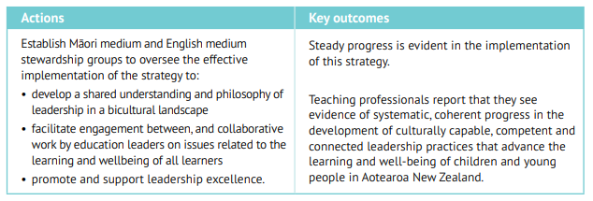
Notes:
The Teaching Council currently has two groups of critical friends working with us to help us develop what this looks like: an English Medium Group and Taura Kaihautū.

Slide 23
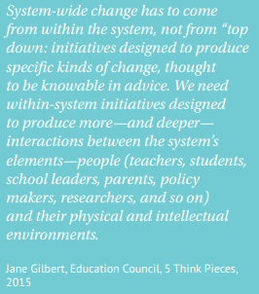
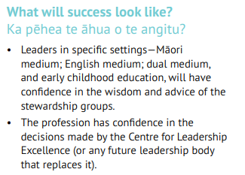
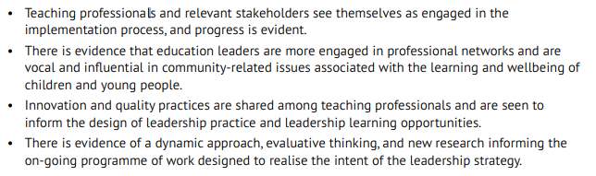


Slide 24

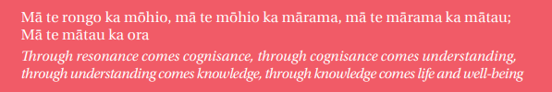
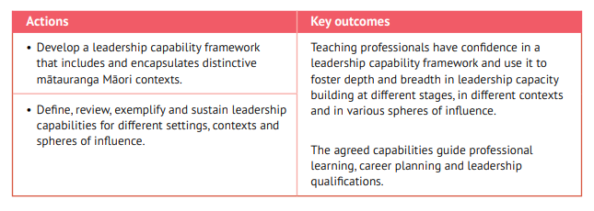
Notes:
Capabilities Framework
https://teachingcouncilnz-uat.cwp.govt.nz/assets/Files/Leadership-Strategy/Leadership_Capability_Framework.pdf
Tu Rangatira
English (https://www.educationalleaders.govt.nz/Leadership-development/Key-leadership-documents/Tu-rangatira-English)
Te Reo (https://www.educationalleaders.govt.nz/Leadership-development/Key-leadership-documents/Tu-rangatira-Maori)
ERO leadership indicators
https://www.ero.govt.nz/publications/school-evaluation-indicators/process-indicators/#domain-2-leadership-for-equity-and-excellence
Are there other frameworks that you value?

Slide 25
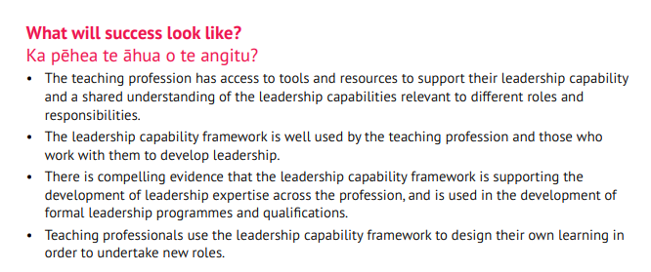


Slide 26
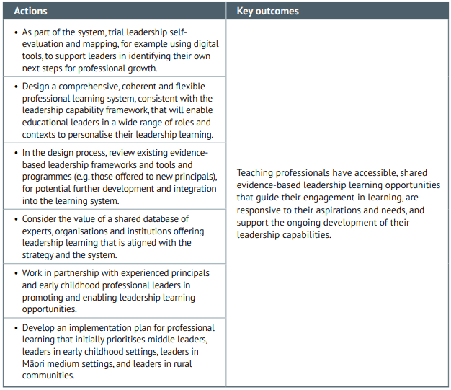

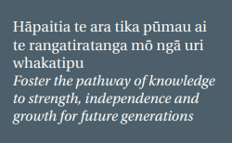
Notes:
The professional growth cycle that became effective 1 Feb 2021 creates an opportunity for every teacher to actively participate in their own personalised professional growth.
The elements of a professional growth cycle can be found here:
https://teachingcouncil.nz/professional-practice/professional-growth-cycle/
A similar professional growth cycle for leaders is currently being consulted on.

Slide 27
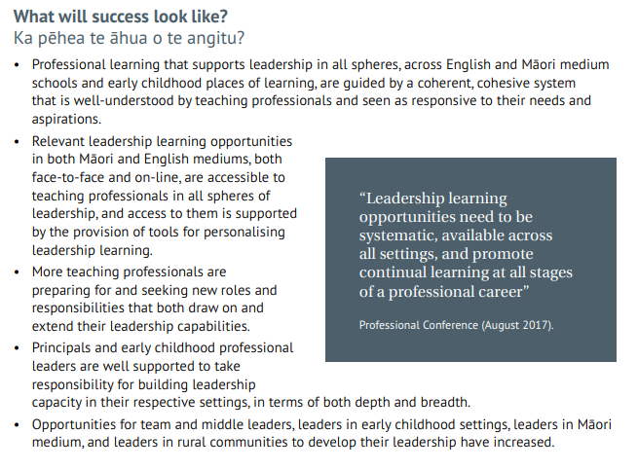


Slide 28


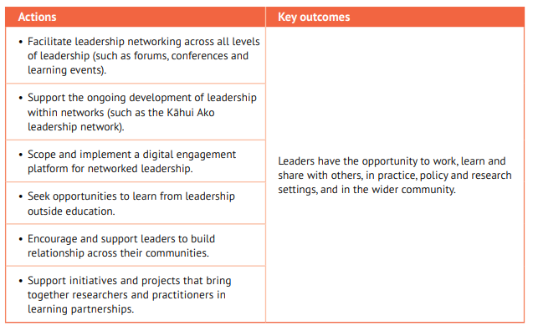
Notes:
This is an area to explore and shape for Rauhuia.
What would this look like for you?

Slide 29
Notes:
This is an area to explore and shape for Rauhuia.
What would this look like for you?

Slide 30
What do you think?
Thinking about Partnerships, Communities and Networks (The Leadership Strategy, Focus Area 4) where will you and your team start?
To enable leadership development to be part of your Personalised Professional Learning ( Focus Area 3) are there resources or supports that you need?
What aspects of the Capabilities of Leadership (Capabilities Framework, Focus Area 2) will you focus on first?
What are the challenges to your current leadership development and who or what can help?
Do you need help to tap into the expertise of others? E.g. mana whenua, local community leaders, other centres or schools, academics, disability sector leaders, youth leaders etc?

Slide 31
Shaping the future

Slide 32
Come and shape Rauhuia with us, for you…
Discuss the kawa, tikanga and kaupapa model at your place, in your networks and on Hapori Matatū.
Let us know what you need to see in each.
Tell us what your priorities are for growing leadership.
What could Rauhuia offer to support your professional growth?
Who else should you be working with to lead learning at your place?
Who else, in your wider community, has a vested interest in the success of your learners? How can they support leadership at your place?

Slide 33
How to connect and shape Rauhuia
Connect with the conversations on Hapori Matatū
Give us feedback to Rauhuia@teachingcouncil.nz
Share the information: send a postcard to a colleague
Join a local conversation – details to come
Invite us to join your discussions at Rauhuia@teachingcouncil.nz

Slide 34
“Mā te huruhuru, ka rere te manu.”
With feathers, a bird will take flight.

