Slide 1
Activities you can do with your staff to unpack the Elements of a PGC
Element A

Slide 2
Considering the purpose of Element A
Element A of the PGC requires settings to come to a common understanding of what the Standards look like in their setting.
As with any activity, it's a good idea to consider what the purpose of coming to a common understanding of the Standards is. Further to that, how will you use that common understanding for the benefit of your professional growth cycle.
You might like to ask that question of your staff. The following slide has the questions on it that we asked our focus group.

Slide 3
ACTIVITY SLIDE:
The Elements of a Professional Growth Cycle
A – Each setting agrees on a shared understanding of Standards/Paerewa
B – Each setting designs an annual cycle of professional growth
Looking at the PGC as a whole, and all of the times you have to recognize the Standards.
What do you think the purpose of element A is?
How do you use it? How could you be using it more? .
C – Teachers engage in professional learning and discuss in relation to the Standards and outcomes for learners
D – Teachers have opportunities to discuss their practice and receive feedback, including observation
E - Teacher confirmed as participating in PGC and as meeting Standards
F- Teacher judged to not meet Standards

Slide 4
Coming to a common understanding of the standards with your staff.
When the PGC was first created, it was suggested that a quality practice document could provide an assurance of what meeting the Standards looks like in practice. However, quality practice documents are not the only way to come to a common understanding of the standards.
This is not something that you do every year. You create your common understanding and then review it when you feel the time is right to make this process valuable for you/your setting.
We didn't suggest a way of coming to a common understanding with our group of leaders. But we did do this exercise to get them to start thinking about how the Standards operate in practice.
We'll put it on the next few slides. Their ideas of how they thought they would facilitate a common understanding with their staff is back on our webpage under Element A.

Slide 5
ACTIVITY SLIDE:
Puzzles of Practice – one of the ways into Element A
Consider an aspect of your practice that you have been focussing on over the last couple of months.
What told you that there was something you needed to change?
What professional learning did you do? Activated pedagogy from a reading. Talked to and observed another teacher and enacted something from that? Had an observation and activated advice etc)
What was the outcome?

Slide 6
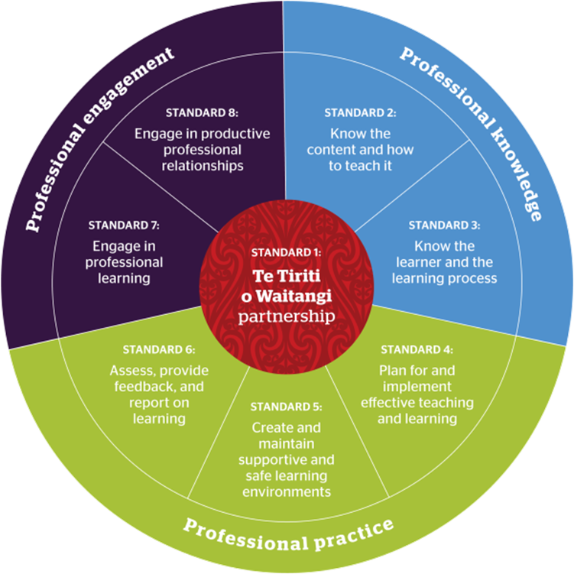
ACTIVITY SLIDE:
Linking your puzzle to a Standard.
Often a puzzle like this will link to multiple Standards.
Have a look at the titles of the Standards; which ones relate to your work in solving the puzzle?
Now pick the one that REALLY sat at the heart of what you were exploring (try to go for one other than Standard 7, which will always relate)

Slide 7
ACTIVITY SLIDE:
Using the language of the focus areas to recognise growth; both achieved and future
Next, have a look at the focus areas within that Standard.
Pick the one that reasonates with you as being at the heart of what you did.
Use the language in the focus area to start unpacking your puzzle. There will be a mix of the wording of the focus area, mixed in with a desciption of what you did.
As you talk, you might find yourself acknowledging there are still some areas for growth. Talk about them too.
The next slide uses focus area 5.2 as an example to help you.

Slide 8
ACTIVITY SLIDE: an example using Focus area 5.2
Establish workable routines and learning environments that support different physical, social and intellectual development needs to ensure access to learning for all.
I established some new routines with my learners in that I .....
The physical needs I was supporting were..
The social needs were ..
The intellectual development needs were...
I’ve noticed still that Billy Jean needs some further support to... I intend to ....

Slide 9
ACTIVITY SLIDE:
How could you use that activity...
To explore new quality practice statements for Element A?
Could unpack it to explore all of the naturally occuring evidence that was also part of the puzzle?
To consider next steps for growth?
As a way to unpack a lesson observation?
As a way to consider next steps and goals?
In a staff meeting as a PGC ‘check in’?
With a PCT to build collaborative conversation?
With a teacher under going some kind of competence process – how to get buy in and build collaborative conversations?

Slide 10
Naturally Occurring Evidence
An important aspect of recognising the Standards is being able to do so, through naturally occurring evidence.
The Council have spoken about natually occurring evidence since the Standards | Ngā Paerewa first came out.
You could ask your staff to consider the questions we gave to our leaders in the focus group.

Slide 11
ACTIVITY SLIDE:
What comes to mind when you hear ‘naturally occurring evidence’?

Slide 12
ACTIVITY SLIDE:
How would we describe naturally occurring evidence in our own words
What makes it valuable or trustworthy?

Slide 13
ACTIVITY SLIDE:
Draw a diagram that shows the following:
Start with the teacher in the middle; what are all of the different ways their teaching practice is visible to others? Write down each of them as a new ‘stem’ on the diagram ie specific planning, specific assessment, activities, discussions, informal observations, formal observations.
For each of the examples, write down who directly experiences each of those practices?
How and when do conversations about these practices and how they meet the Standards occur?
What is the easiest way to communicate that the teacher does/does not meet the Standards to the endorser?
teacher

Slide 14
ACTIVITY SLIDE:
What’s one idea you’re taking away about using naturally occurring evidence in endorsement?”

Slide 15
Coming to a common understanding of the standards
At the conclusion of those activities, here are some questions you might like to consider as a senior leadership team.
What process of creating a ‘common understanding’ of the Standards are you thinking you will go through with your staff?
What could Element A look like (if not a quality practice template?)
How can you ‘bring your quality practice documents to life’ so they become useful?
3. How can we recognise naturally occurring evidence in teacher practice:
  For growth (rather than compliance)
  In ways that gives us confidence in endorsement decisions

Slide 16
Documenting the common understanding of the standards
In the past we have shared what has become known as the Quality Practice Template, but your 'common understanding' of the Standards can be shared with your staff in a number of different ways.​
You can see some of the ideas that the leaders in our focus group came up with, back on our website.

