Slide 1
Activities you can do with your staff to unpack the Elements of a PGC
Element F

Slide 2
Element F: If in the Principal or professional leader’s judgment the teacher does not currently meet the Standards or Paerewa, they will discuss that with the teacher and provide support to enable improvement and if sufficient progress is not made, they may commence formal performance management processes outlined in employment agreements.

Slide 3
On the next slide, you will see a diagram the council refer to often with regards to considering support for teachers.
Firstly, it helps to consider the big wheel as representing a cycle of growth for a teacher whose practice meets the Standards,and the smaller wheel as someone who needs support to develop their practice.
As cycles occur, the teacher whose practice meets the Standards will require fewer touch points. However the teacher who needs support will need support more often. The smaller wheel could also be seen as a reminder that their cycles will need to be more focussed and specific.

Slide 4
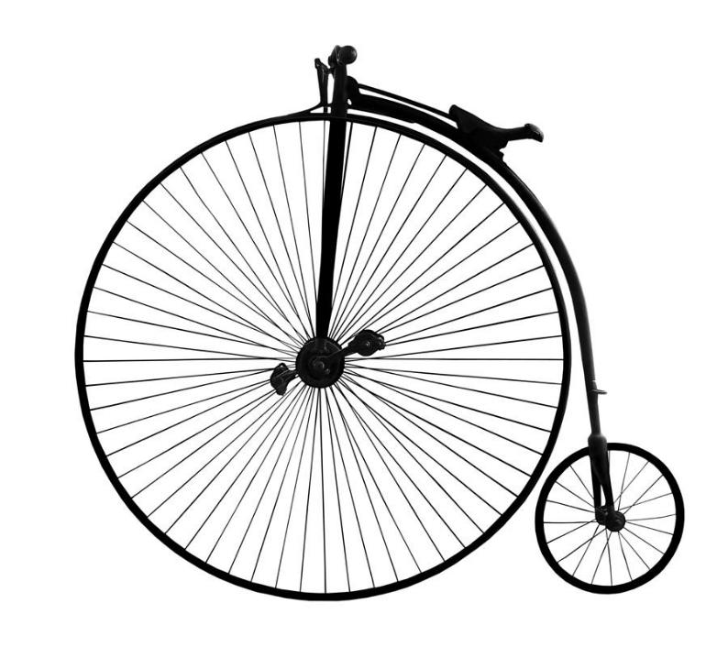
Supporting Practice Based on the metaphor we just unpacked and the image here, what do you already know is important about supporting the practice of a teacher who needs support? Unpack the metaphor a bit more and consider the following: touchpoints balance momentum early course correction

Slide 5
Element F: the early stages
Purpose: Focus on proactive support and partnership when concerns arise about meeting the standards or paerewa.
Consider what indicators you often get that a teacher needs support with their practice.
If you are in a large setting, how can you inform your senior and middle leaders about what steps they need to take when these indicators arise?
How do you ‘support the supporters’ so that they are empowered to have challenging conversations in a way that engages and empowers the teacher?
What are the policies/procedures and communication tools you need in place so that:
The isues are noticed and response happens early (not just at the time of the annual summary statement)
All staff are aware of the process and know what to expect, if and when it needs to be enacted,
:

Slide 6
What does a supportive support plan require?
How do you:
communicate the issues clearly?
set clear expectations
decide on support that will be offered ie:
Professional development
Mentoring
Observation and feedback
document the process
In a way that is growth focussed and is done WITH the teacher?

