Slide 1
Annual Summary Statements
As considered by the leaders in our focus group

Slide 2

Michela
What should be included in an annual summary statement
Confirmation that the kaiako has engaged meaningfully in a PGC over the year.
Confirmation that the kaiako has engaged in PLD that has improved outcomes for learners over the year.
Confirmation that the Kaiako has continued to develop their competency in te reo Māori.
Confirmation that the Kaiako meets the Standards for the Teaching Profession in their practice. If not, what is required to happen.
Opportunity to celebrate the learning and impact over the year and opportunity to develop next steps.
​How do annual summary statements support endorsement?
When the Standards for the Teaching Profession haven’t been met and this is highlighted through the annual summary statements. It also gives assurance a professional leader can endorse if the Kaiako hasn’t been with them for the full three years.
What happens if a teacher moves (to or from your setting) or hasn’t completed a full cycle?
They take the annual summary statements with them to share with their new professional leader. We look for this when someone starts with us.

Slide 3
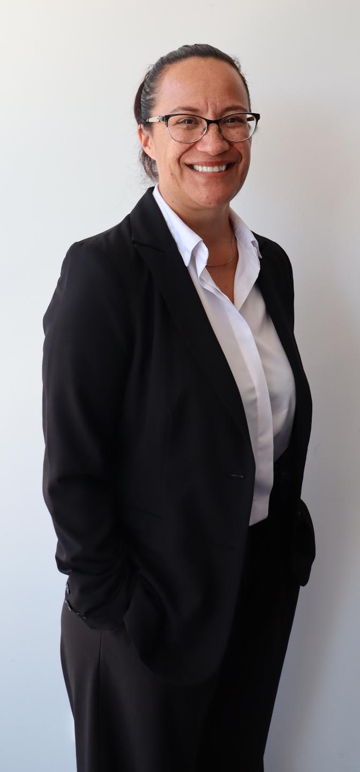
Lysandra
What should be included in an annual summary statement? At Glenbrook School, the Annual Summary Statement provides professional assurance that each kaiako and leader continues to meet the Standards for the Teaching Profession through authentic engagement in our Strengthening Learner Practice (SLP) model.
This statement reflects the outcomes of our Professional Growth Cycle (PGC), which is grounded in collaboration, inquiry, and continuous improvement for all ākonga. The PGC–SLP process includes participation in professional learning and development (PLD), the Spiral of Inquiry, professional learning groups (PLGs), and the gathering of naturally occurring evidence. Through these processes, teachers and leaders demonstrate ongoing competence and growth across all six Standards for the Teaching Profession.
At the end of each year, the Professional Leader (Principal or delegated appraiser) meets with each kaiako to review their Professional Growth Cycle and confirm that:
“Based on professional conversations, inquiry evidence, and participation in the Strengthening Learner Practice process, I confirm that [Name] meets and continues to meet the Standards for the Teaching Profession in their everyday practice.”
The Annual Summary Statement is then recorded, signed, and securely stored as part of the teacher’s professional record.
​

Slide 4
Lysandra
How do annual summary statements support endorsement? At Glenbrook School, the Annual Summary Statement plays a key role in supporting endorsement. It provides a concise, evidence-informed reflection of each teacher’s professional growth, impact on learning, and alignment to Ngā Paerewa | Standards for the Teaching Profession. This summary draws together naturally occurring evidence gathered throughout the year — including inquiry outcomes, observations, feedback, and professional learning reflections — to show how practice meets and strengthens the Standards. It enables the professional leader to make a confident, transparent endorsement judgement, ensuring the process is authentic, growth-focused, and consistent across the school.
What happens if a teacher moves (to or from your setting) or hasn’t completed a full cycle? When a teacher leaves Glenbrook School, the professional leader provides an interim summary outlining their progress, inquiry focus, and strengths to support a smooth transition for the receiving school.
If a teacher has not completed a full cycle, endorsement is deferred until sufficient evidence is available to make a sound professional judgement against Ngā Paerewa | Standards for the Teaching Profession.
Where a teacher has already met the endorsement criteria, the professional leader may endorse them up to two years after leaving, recognising their professional capability and contribution.
This ensures a credible, continuous, and portable Professional Growth Cycle that honours teacher professionalism.

Slide 5
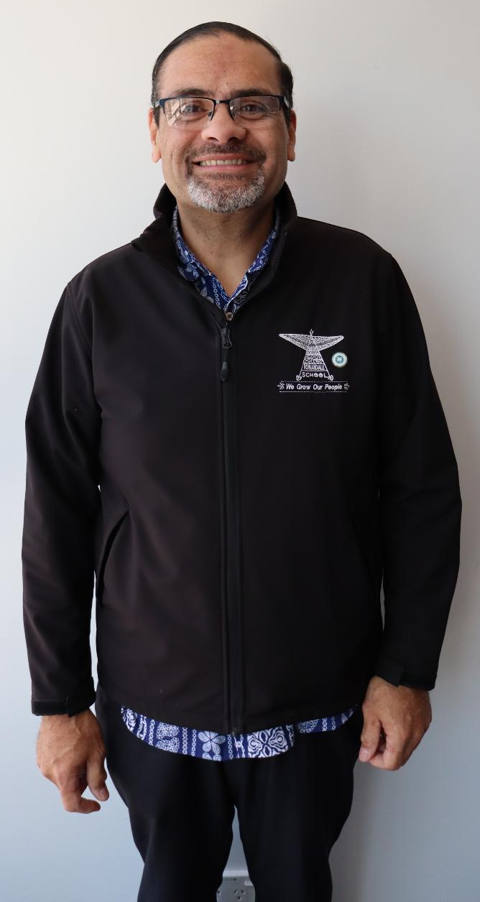
Karl
What should be included in an annual summary statement?
Participated in a PGC
Confirm participation in PLD
Evidence of practice/observations/ planning
checks/Talanoa
State if the teacher meets the Standards for the Teaching Profession
Reflections and Advice and Guidance evidence
Stipulate life span of the form.
​How do annual summary statements support endorsement?
Evidence and information to back up professional judgements.
What happens if a teacher moves (to or from your setting) or hasn’t completed a full cycle?
We used current documentation, recent evidence, even includes a discussion with teachers.

Slide 6

Helen
What should be included in an annual summary statement?
Goals for the year:
school wide or department
personal
Link to evidence of practice:
Lesson observation
Professional learning group inquiry
Student feedback
Reflection on Standards:
How they meet
Work ons for the following year
Summary statement from HOD/TIC
Endorser signature
​How do annual summary statements support endorsement?
In a large school they are the documentation that signals endorsement
What happens if a teacher moves (to or from your setting) or hasn’t completed a full cycle?
When a teacher moves they are expected to take/bring documentation with them.
If they haven’t completed a full cycle it would be a principal meeting.

Slide 7

Glenda
What should be included in an annual summary statement
Conversations with PGC mentor/coach
PLD engaged in for the current year
Observations
Continuing to develop and practise te reo me ngā tikanga Māori
Hard copy: to go in the HR file
Treat this as an opportunity for a celebration
​How do annual summary statements support endorsement?
Provision of a framework of evidence to justify endorsement.
What happens if a teacher moves (to or from your setting) or hasn’t completed a full cycle?
Teachers’ responsibility to take information and evidence with them.

Slide 8
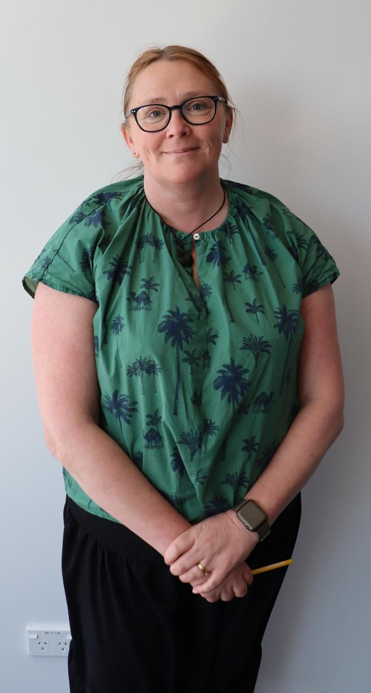
Jo
What should be included in an annual summary statement?
At our kura we include our purpose as a teacher, 3 core values, our qualities and the strengths we bring.
Conversations are summarised around growth from inquiry/GROW/ARA goal setting conversations and PD over the year in relation to the Standards and the impact of these actions on learners.
We also summarise the conversation around their growth of usage of Te Reo/tikanga – (reflected in observation) if not, it becomes a key area of growth.
Summary of evidence of other Standards from the conversations about the year.
​How do annual summary statements support endorsement?
They provide evidence and assurance each year towards the teacher being endorsed.
What happens if a teacher moves (to or from your setting) or hasn’t completed a full cycle?
They complete the annual summary chat with the principal or deputy principal before leaving. Teachers have their own folder and take all their documents with them including the annual summary and observation.

Slide 9
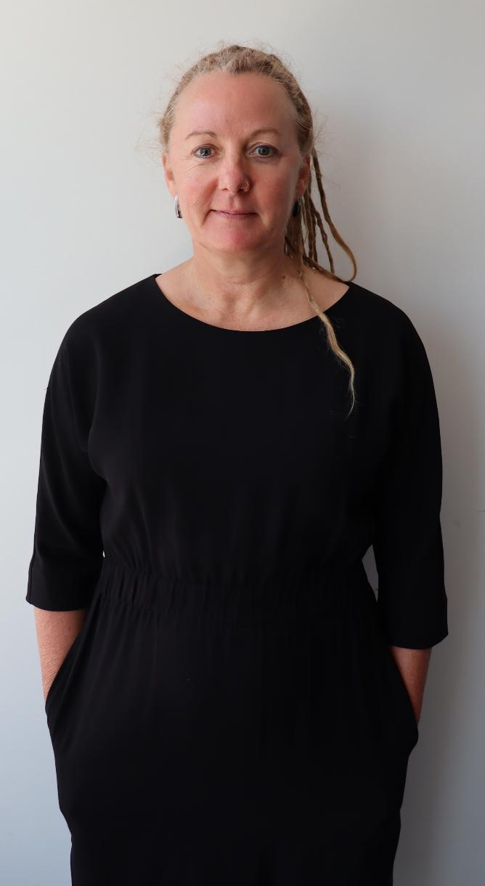
Liz
What should be included in an annual summary statement
Participation in two professional conversations and reflection on professional practice
Lesson observation participation
Participation in PLD
Development and practice of te reo and tikanga Māori
Meets the Standards for the Teaching Profession
Signature of delegated endorser
Signature of teacher
PD agreed for next year: reflection on growth
​How do annual summary statements support endorsement?
Enable endorser to have confidence in the endorsement process.
What happens if a teacher moves (to or from your setting) or hasn’t completed a full cycle?
It is the teacher's responsibility to take their annual statements with them; they own their professional registration process. They can then provide evidence of participation in PGC, so that a full 3-year cycle can be seen.

Slide 10
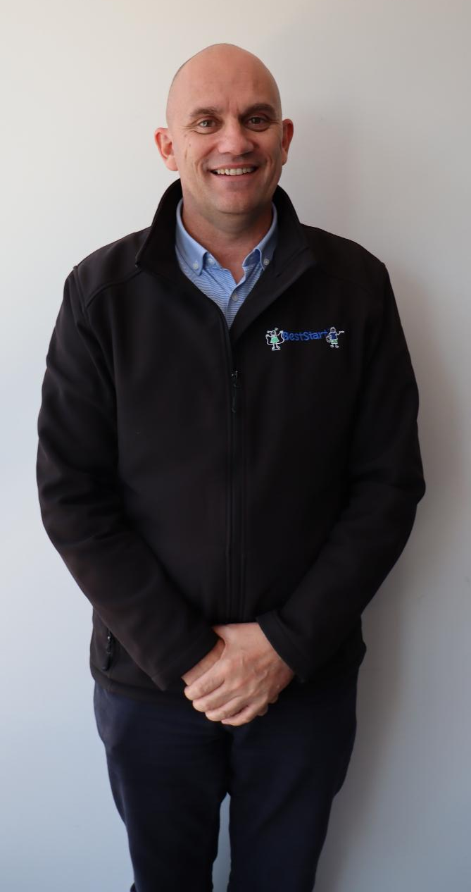
Ken
What should be included in an annual summary statement
All elements of your PGC cycle from your mentor/coach/manager.
1:1 hui and observations
PLD - Outcomes for learners
Reflection /Future development
Meeting the Standards for the Teaching Profession Summary
Signed by manager annually.
How do annual summary statements support endorsement?
They build a picture of how a teacher meets the Standards for the Teaching Profession over time and demonstrate progress.
What happens if a teacher moves (to or from your setting) or hasn’t completed a full cycle?
We send a copy of the annual summary statement with the teacher.
If they don’t complete a full cycle, this is documented.

