Slide 1
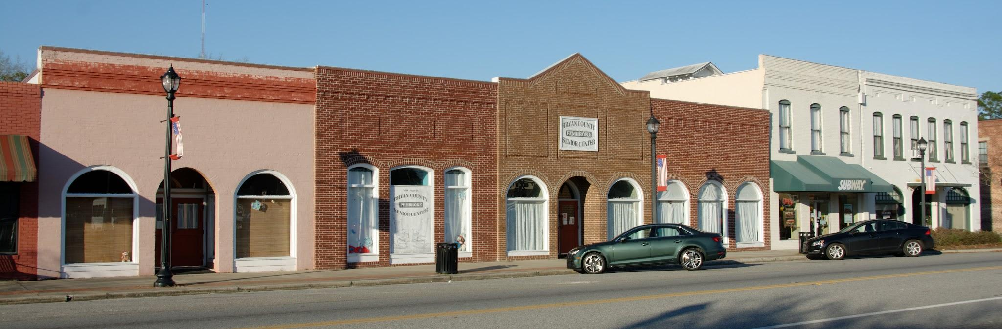

Using Your Local History
Fernanda Camacho Hauser

Slide 2
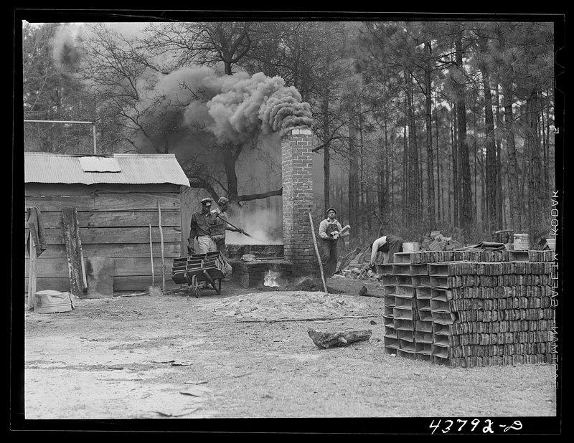
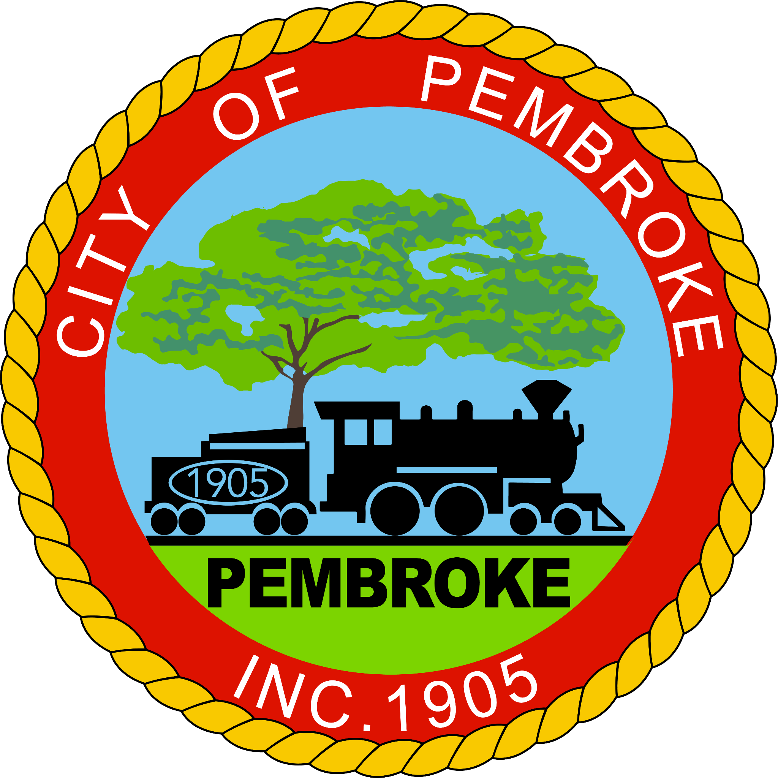
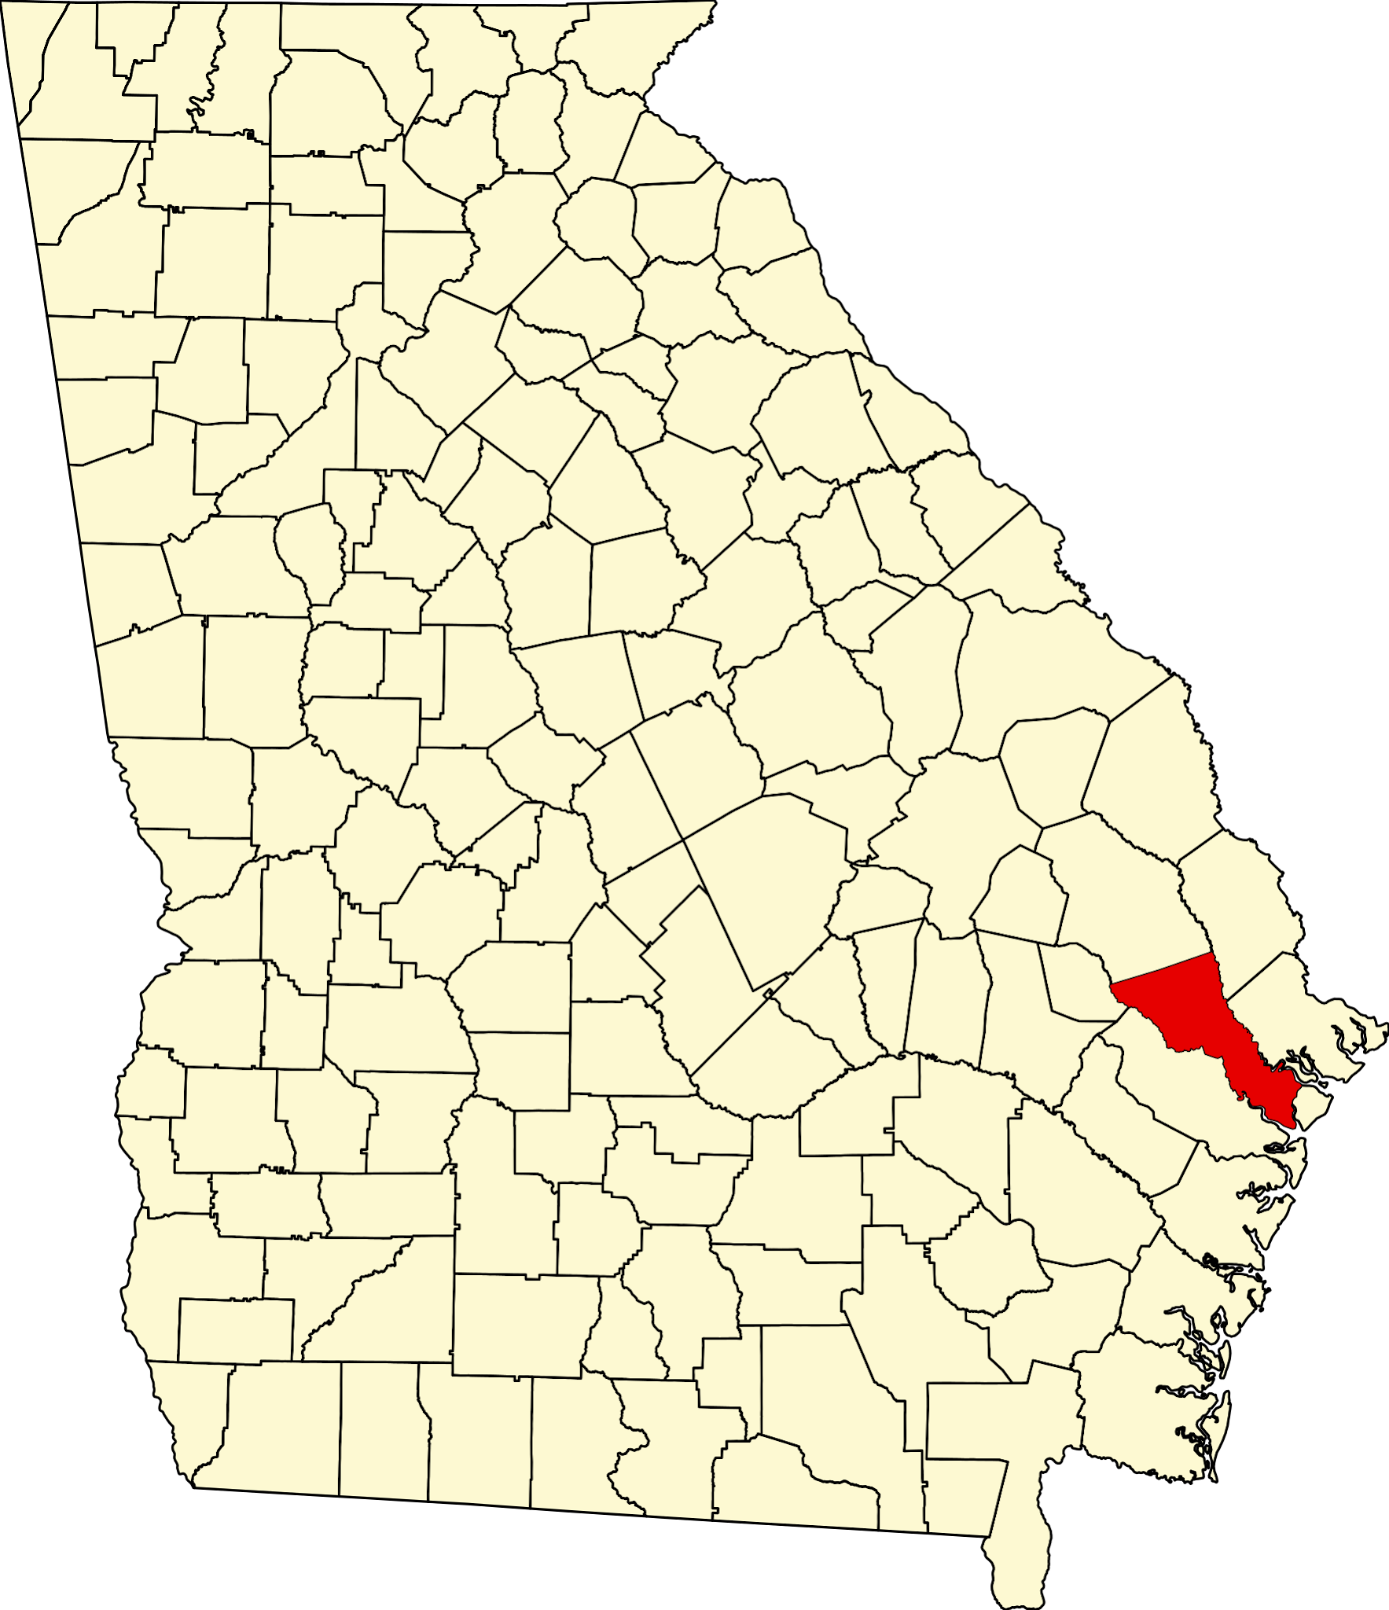
About Pembroke
City located in North Bryan County created in 1889 incorporated in 1905 and made county seat a few years prior to the original county seat of Clyde having been absorbed into what is now Ft. Stewart.
Photo is from one of Jack Delano’s photo collection during the 1940s as part of the Farm Security Administration

Slide 3
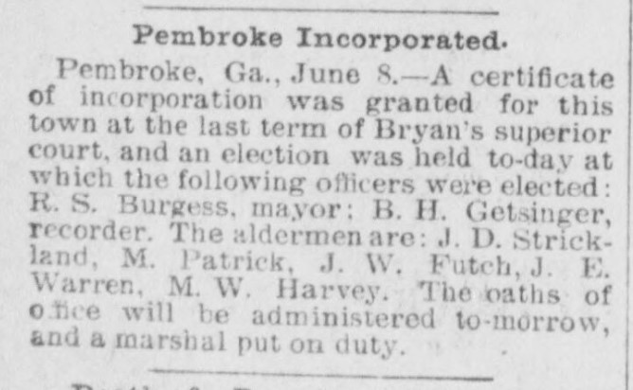
The morning news. (Savannah, Ga.) 1887-1900 (June 9, 1894)
Savannah announcement of city in corporation

Slide 4
Your Turn!
When was your city created or incorporated?
How was your city named?
Why was your city created?
Bonus: What are some ways your community incorporates your local history?
The morning news. (Savannah, Ga.) 1887-1900 (June 9, 1894)
Savannah announcement of city in corporation

Slide 5
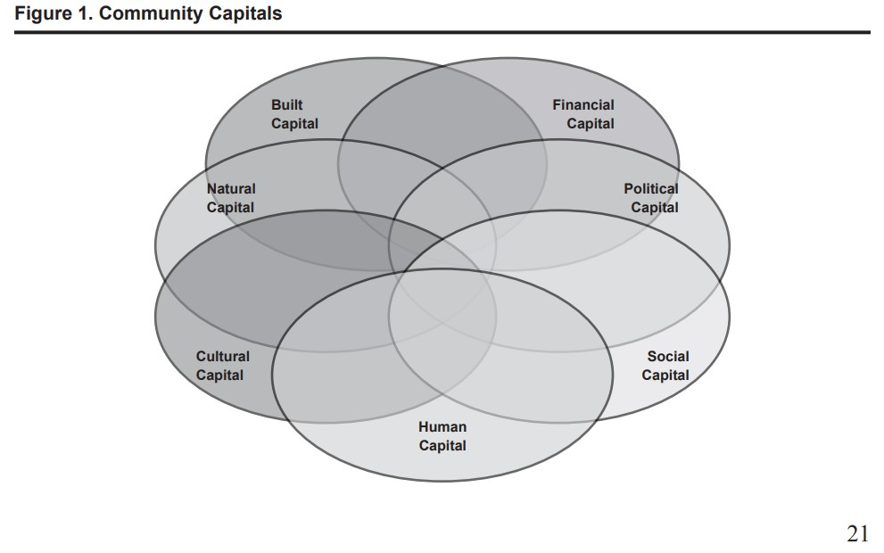
Community Capital
Seven Forms of Community Capital:
Natural
Built
Financial
Political
Social
Human
Cultural
Emery & Flora (2006) Spiraling-Up: Mapping Community Transformation with Community Capitals Framework

Slide 6
In action!
Swamp Gravy

Slide 7
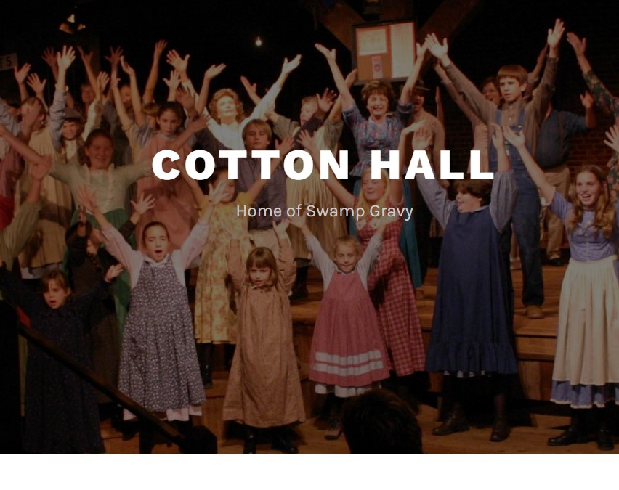
In action!
Swamp Gravy
Colquitt County

Slide 8
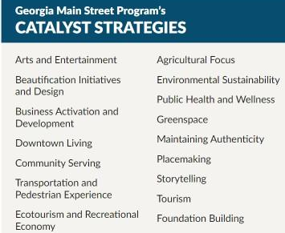
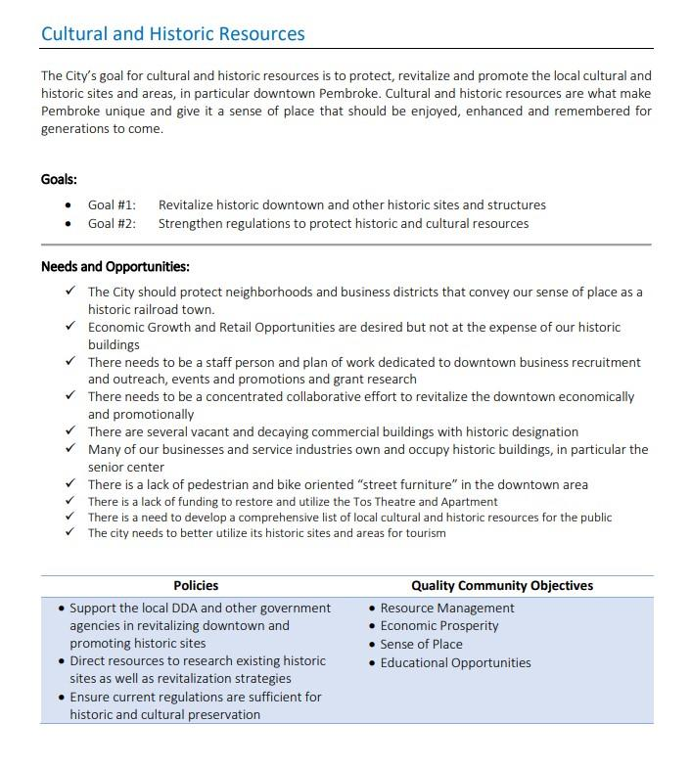

Slide 9
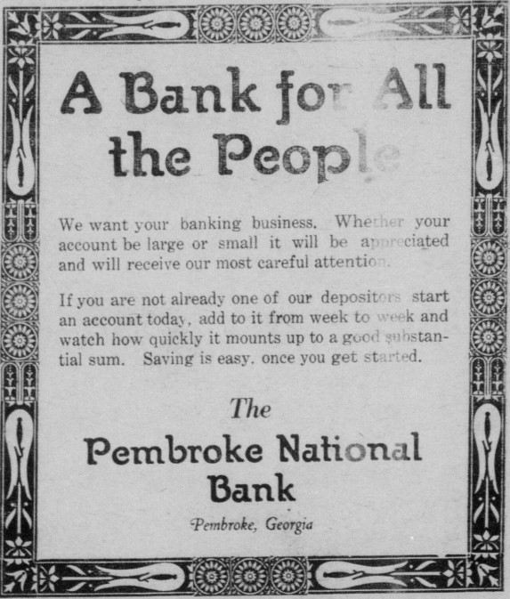
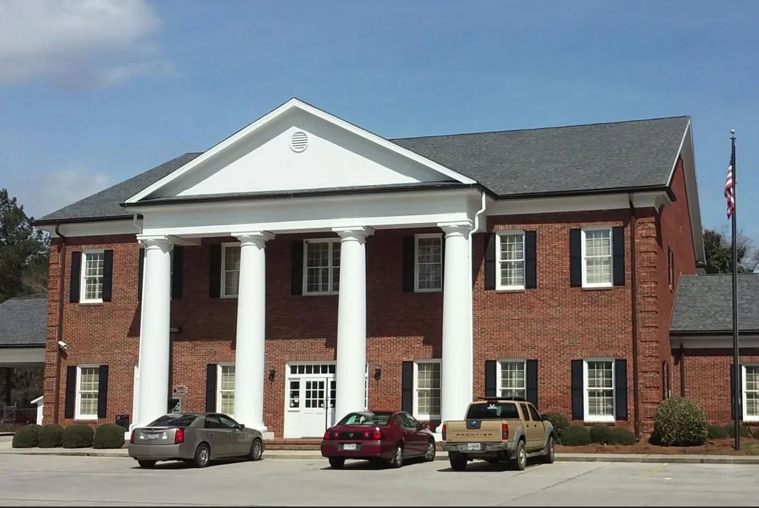
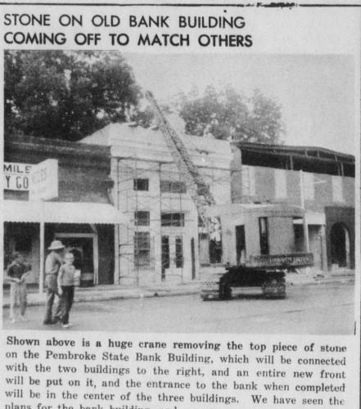
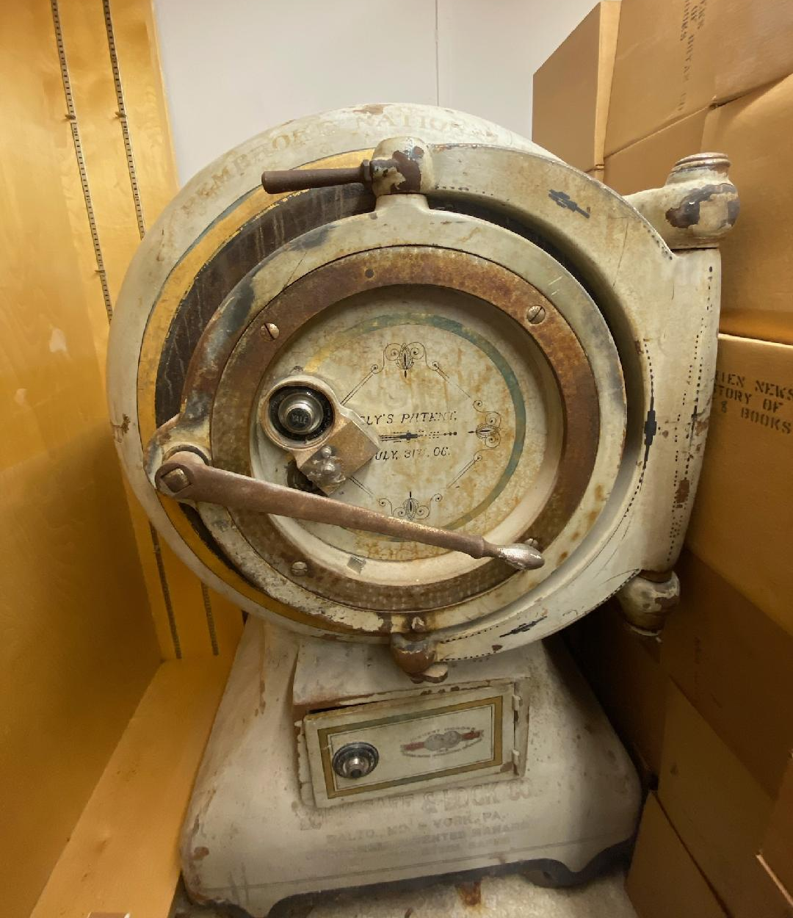
Your Turn!
What are your newest downtown business and building?
What is your oldest downtown business?
What is your oldest downtown building?
1928 Ad
Georgia Historic Newspapers

Slide 10
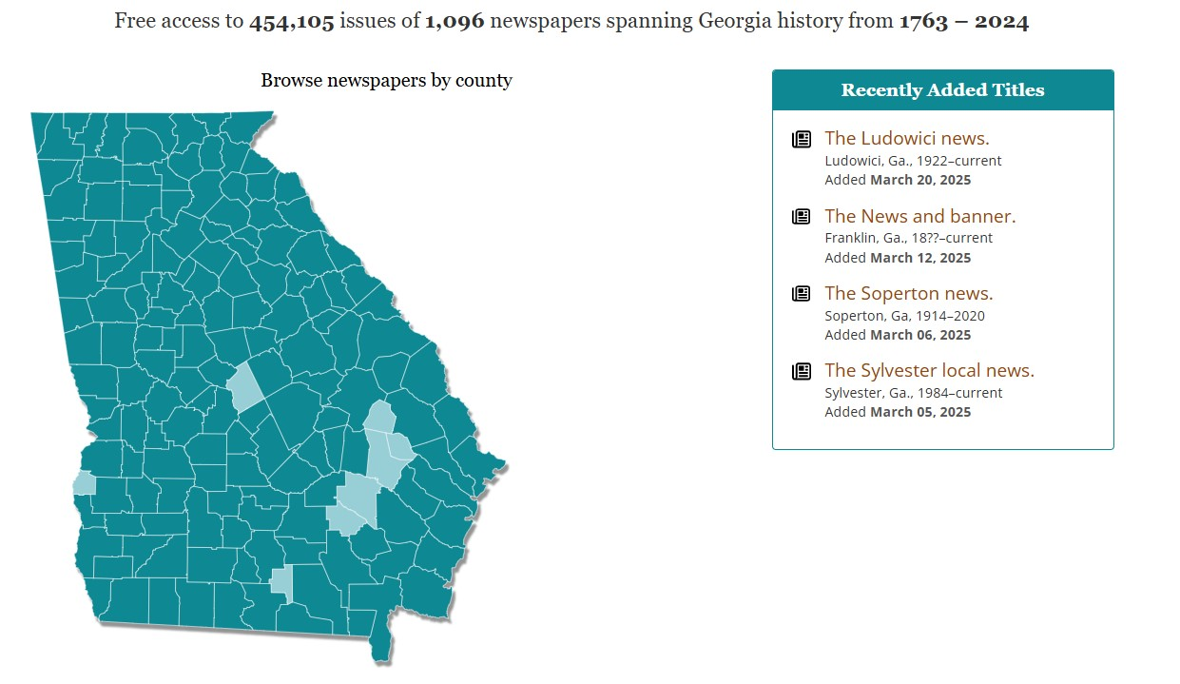

Pembroke Historic District Walking Tour
Pre-Grant Application
Grant Application
Research
Launch
01
02
03
04

Slide 11
Community Partnerships
Previous Projects
What can we bring now?
How do we increase community participation?
Inventory
Established Connections
Expanding Resources
What had already been done? Who had participated?
Who do we know or what new resources are available now?

Slide 12
Who was the first Barber in Pembroke?

Slide 13
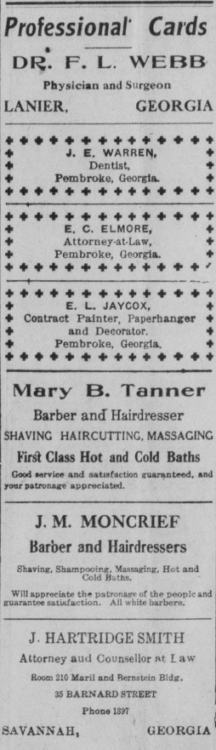
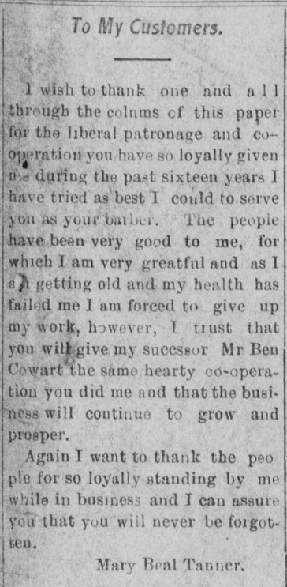
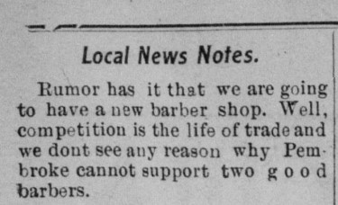
Who was the first Barber in Pembroke?
Pembroke Journal 1915-1916

Slide 14
Your turn!
What are the resources you know of?
Who are your neighbors?
Who might have shared history?

Slide 15
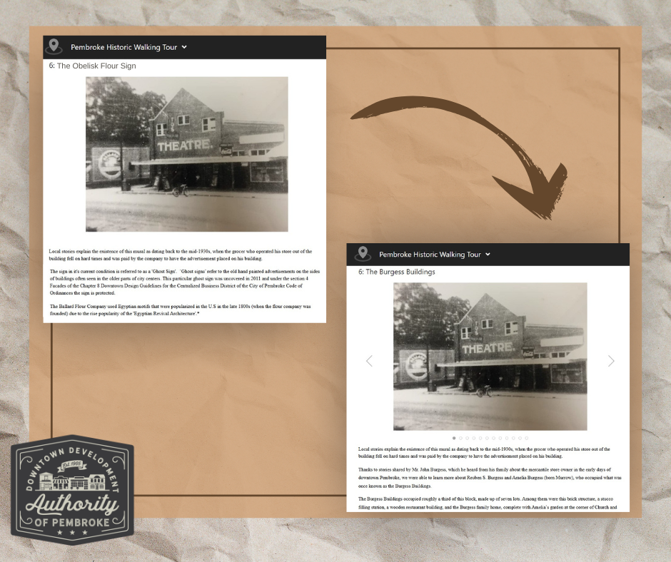
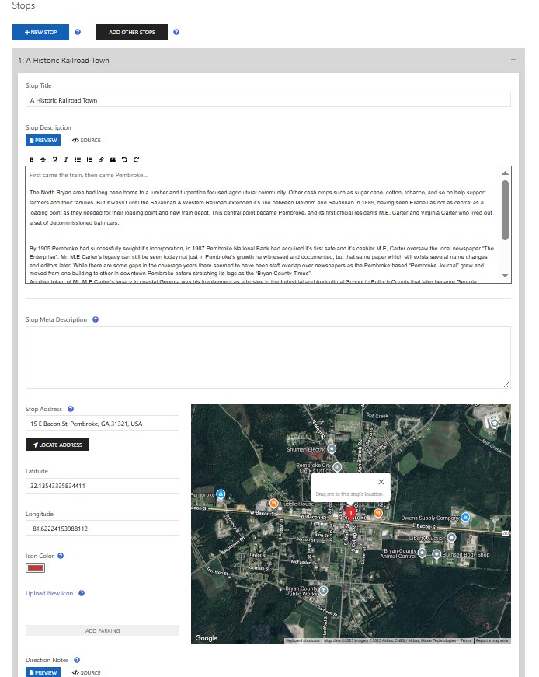
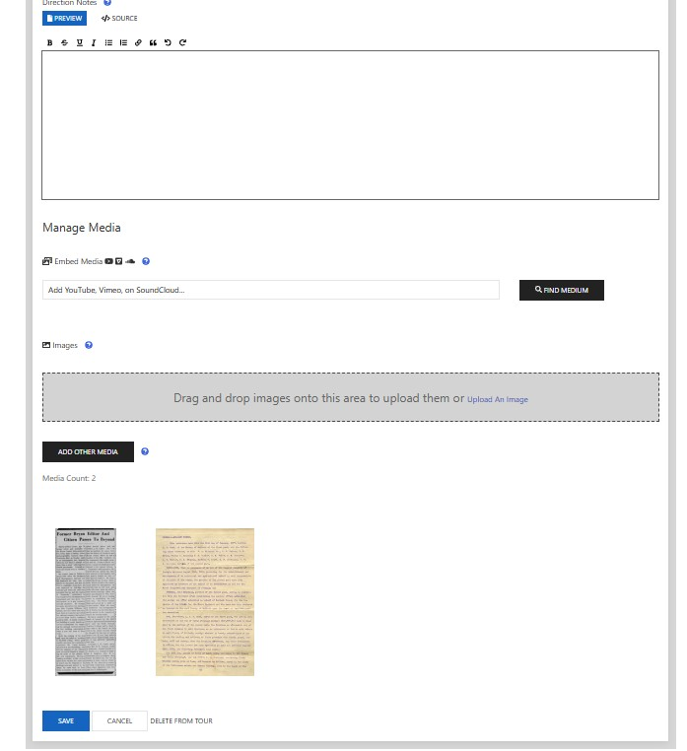
Walking Tours
https://georgia-humanities.opentour.site/pembroke-historic-walking-tour

Slide 16
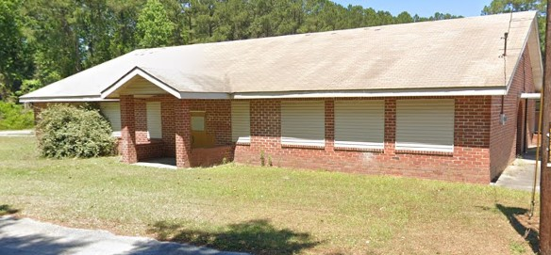
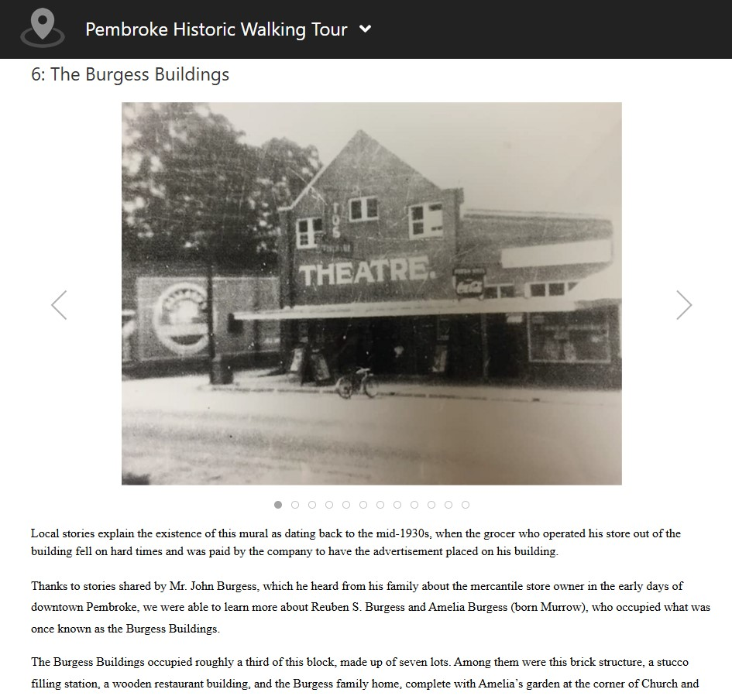
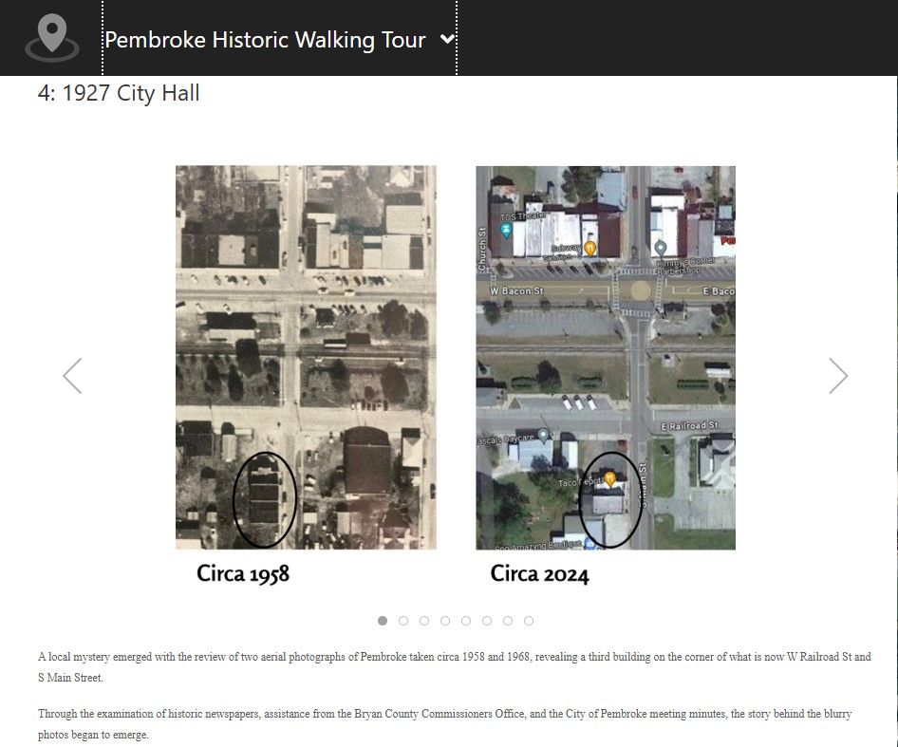
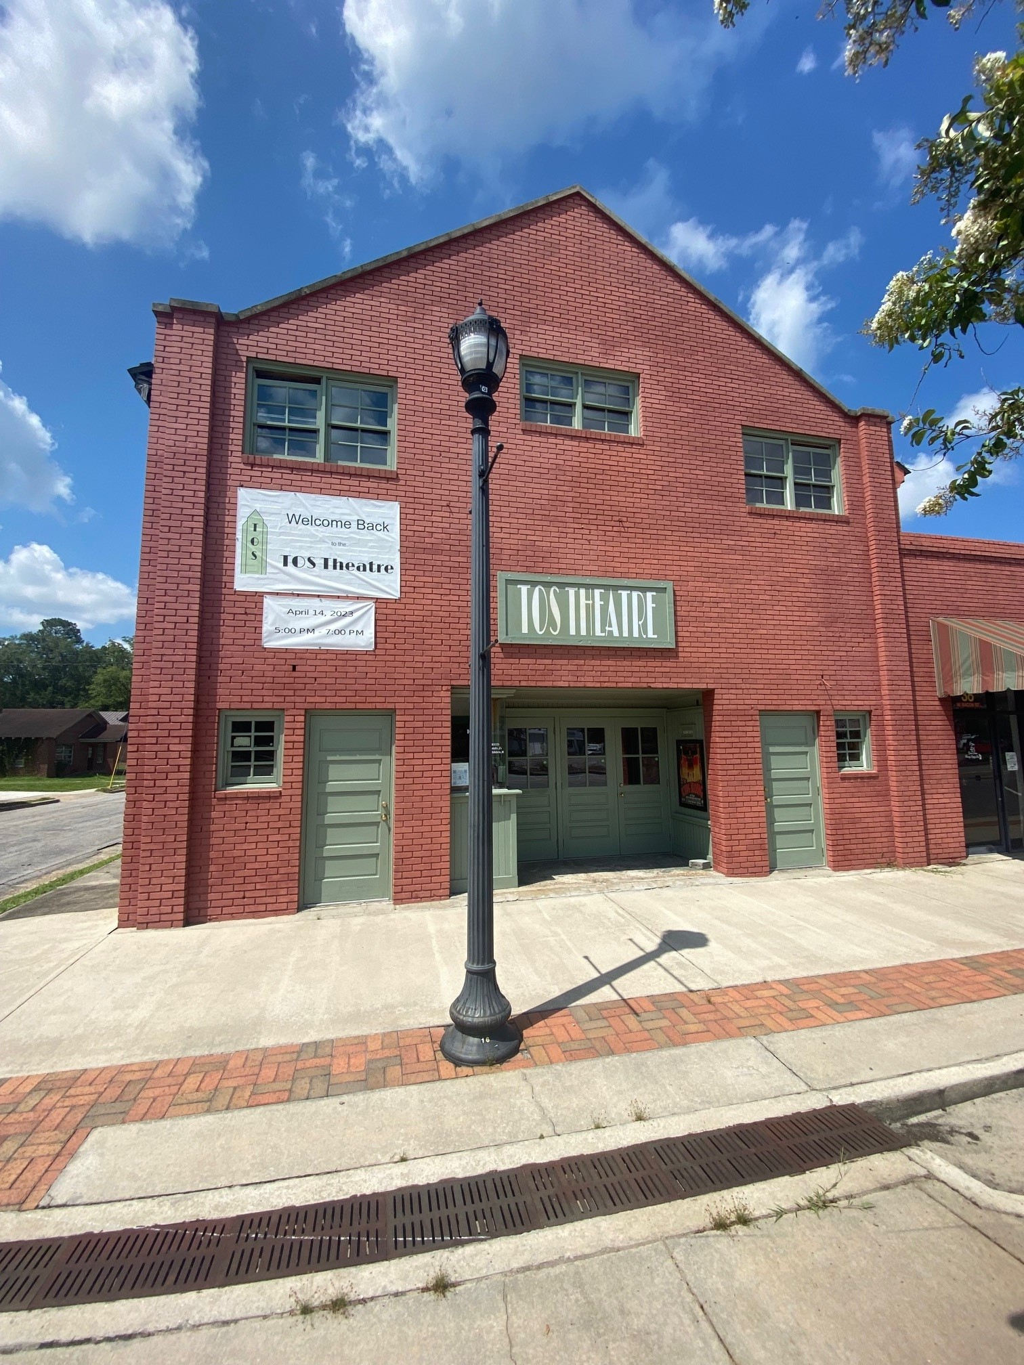
What’s next for us?
A.)Preserve
B.)Revitalize
C.)Share
What other resources of information can we still look through and find?

Slide 17
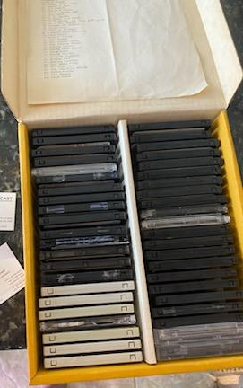
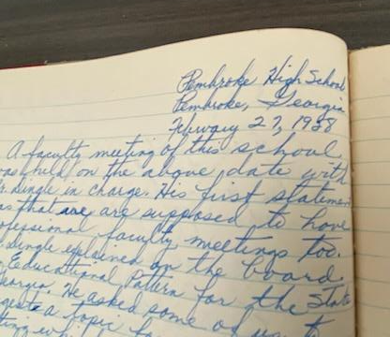
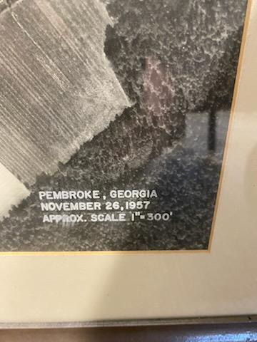
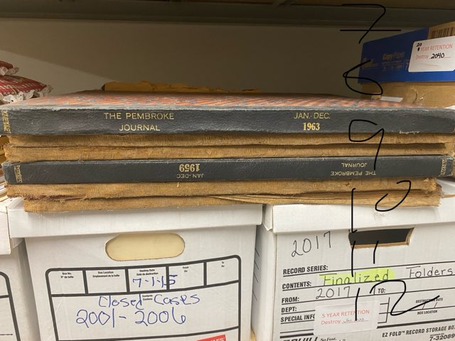
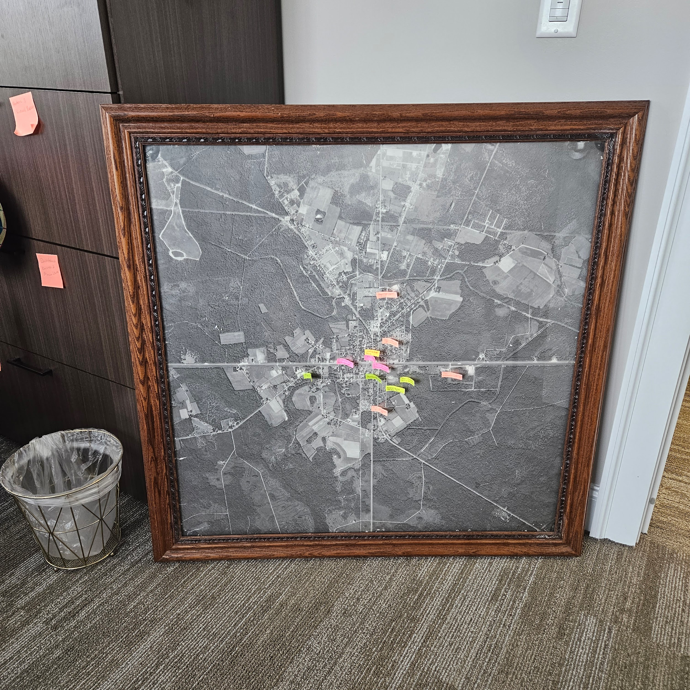
Check the shelves
Might not just be decorational
The ‘old stuff’ in the attic

Slide 18
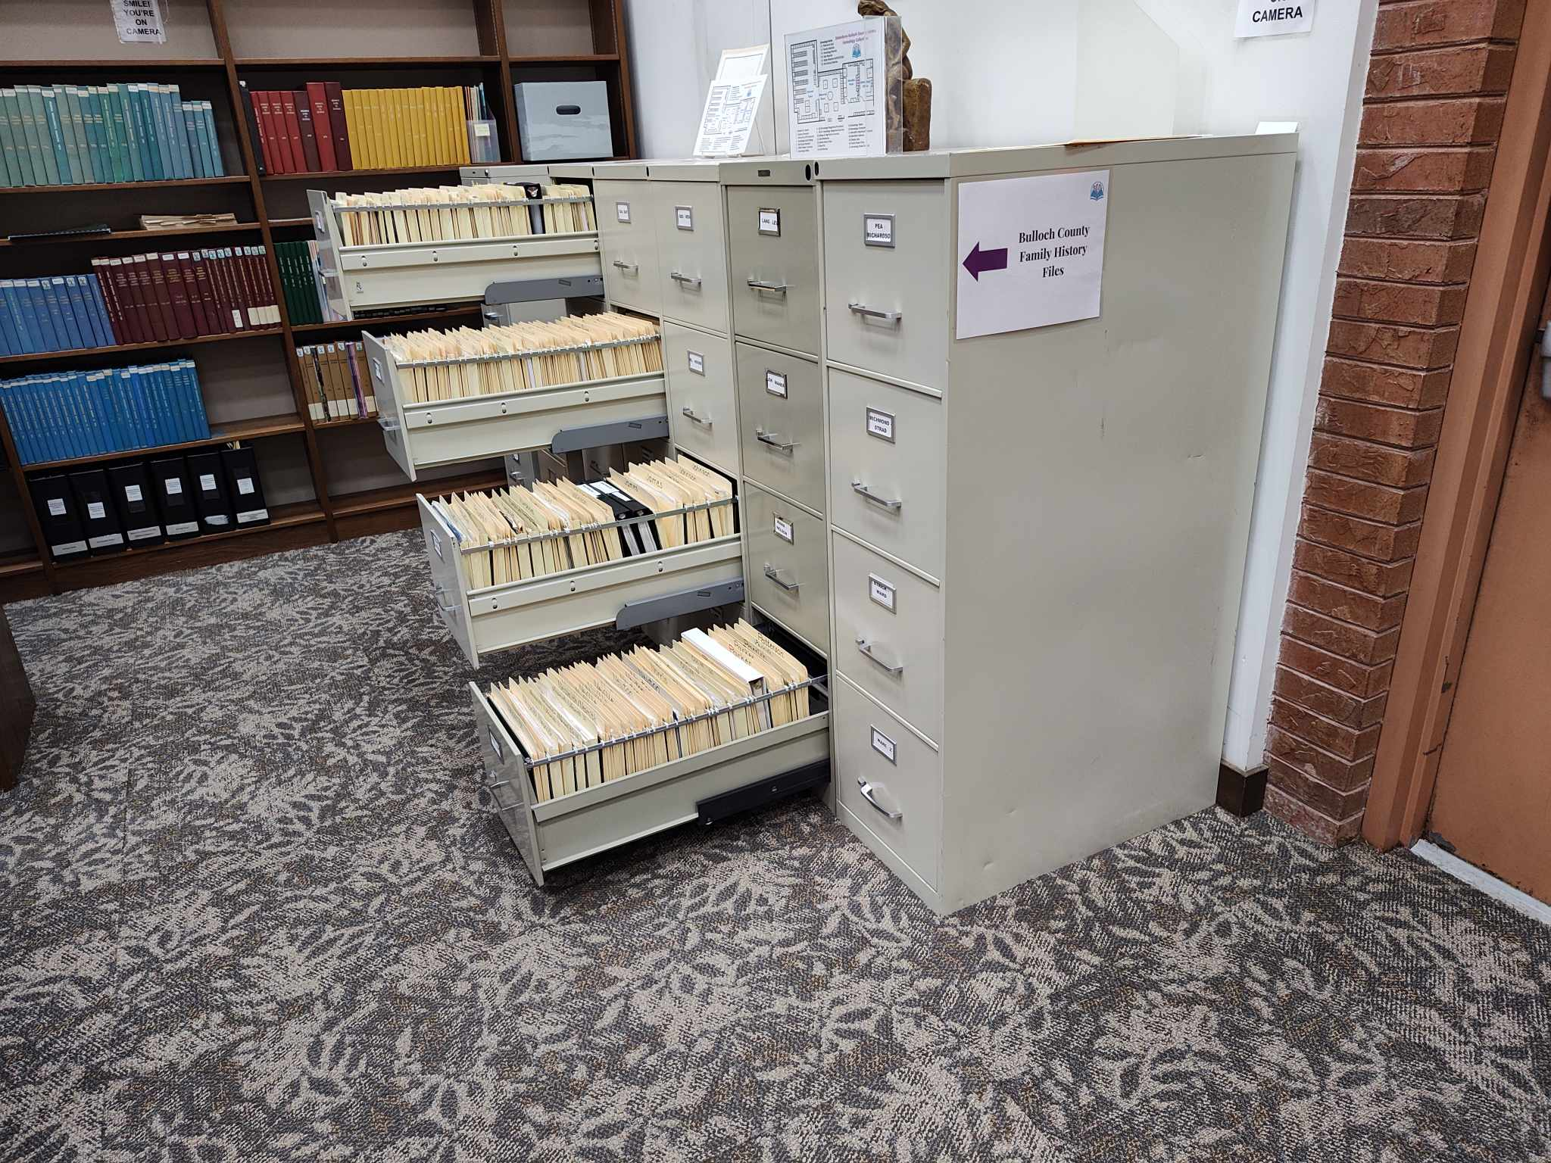
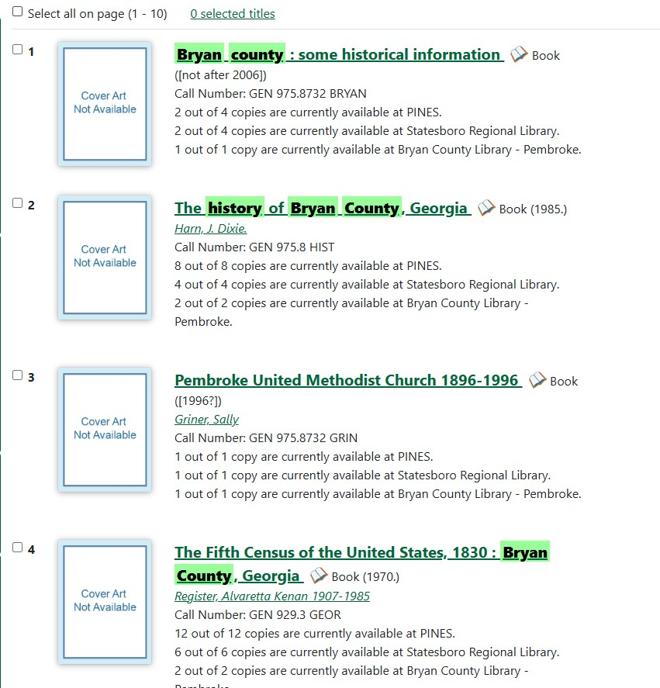
Historic Societies
Cities, Counties, Regional
Active or inactive
Books or family folders
Georgia Historical Society

Slide 19
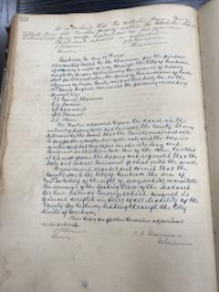
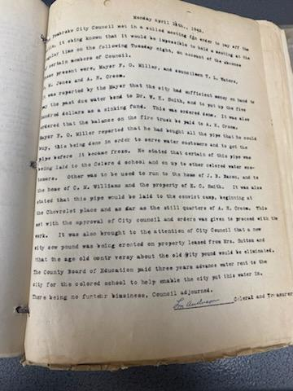
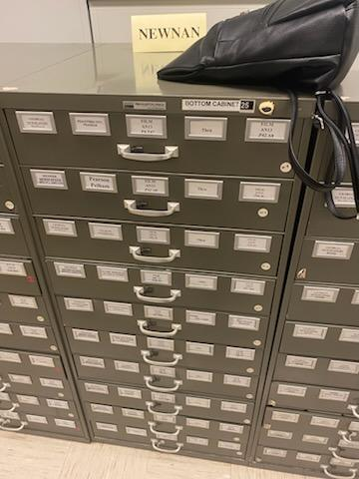
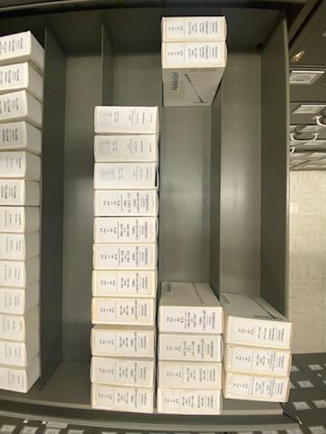
Archival Resources
City, County, Regional
Georgia State Archives

Slide 20
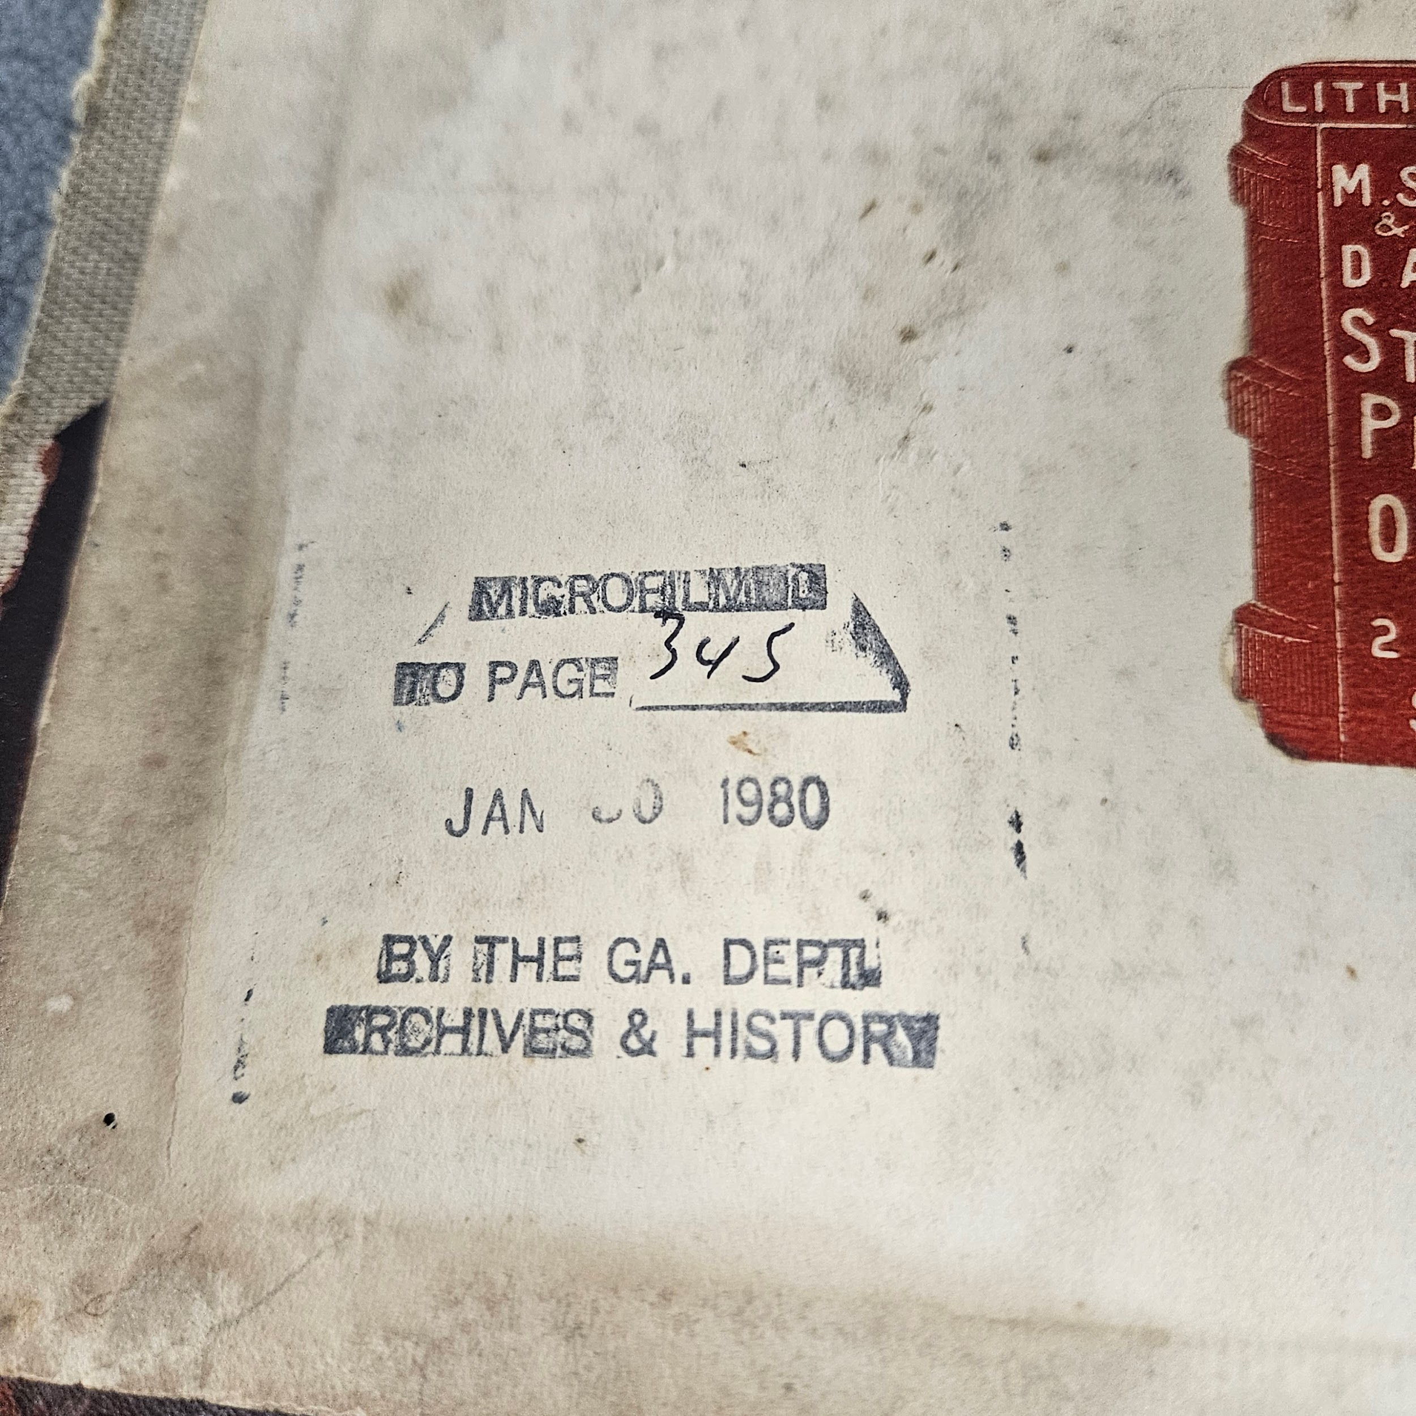
A note from the Georgia State Archives:
Research Hours:
Tuesday - Saturday 9 am to 4 pm
Closed for USG Holidays
For Original Records:
Best to request ahead of time so they’ll be ready to go when you arrive
Research Help
Things to Know Before You Visit

Slide 21
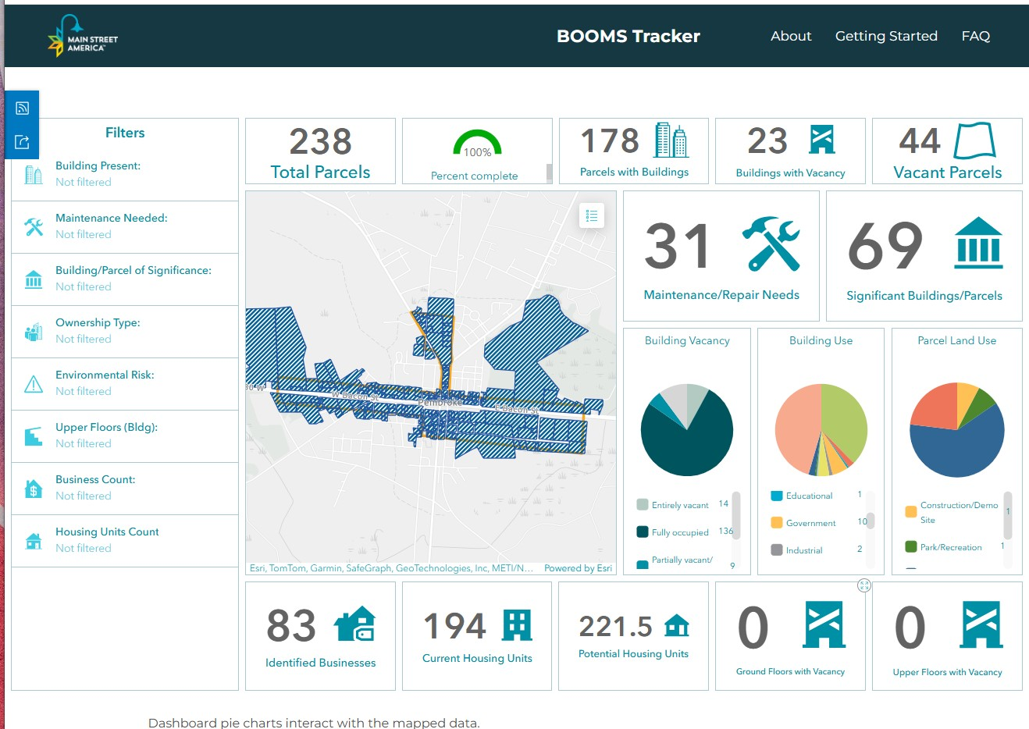
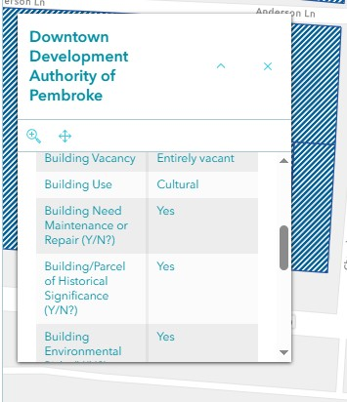
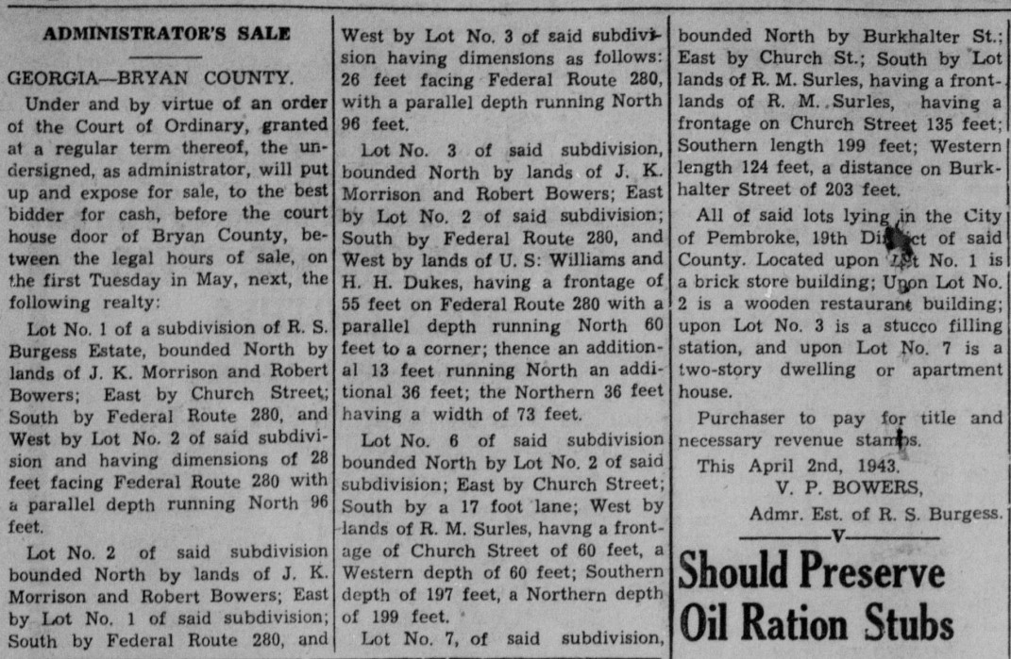
Digital Resources
Georgia State Archives
Digital Libraries of Georgia
Georgia Historic Newspaper Project
National Archives
National Register of Historic Places
Main Street America BOOMS Tracker
Genealogical Websites

Slide 22
A note from the Georgia Historic Newspaper Project:
List of Unrepresented Counties in GHN:
Appling County
Bacon County
Candler County
Catoosa County
Colquitt County
Echols County
Emanuel County
Evans County
Lanier County
Liberty County
Quitman County
Tattnall County
Telfair County
Towns County
Twiggs County
Union County
Donnie Summerlin
University of Georgia Libraries | Digital Projects Archivist
donsum@uga.edu

Slide 23
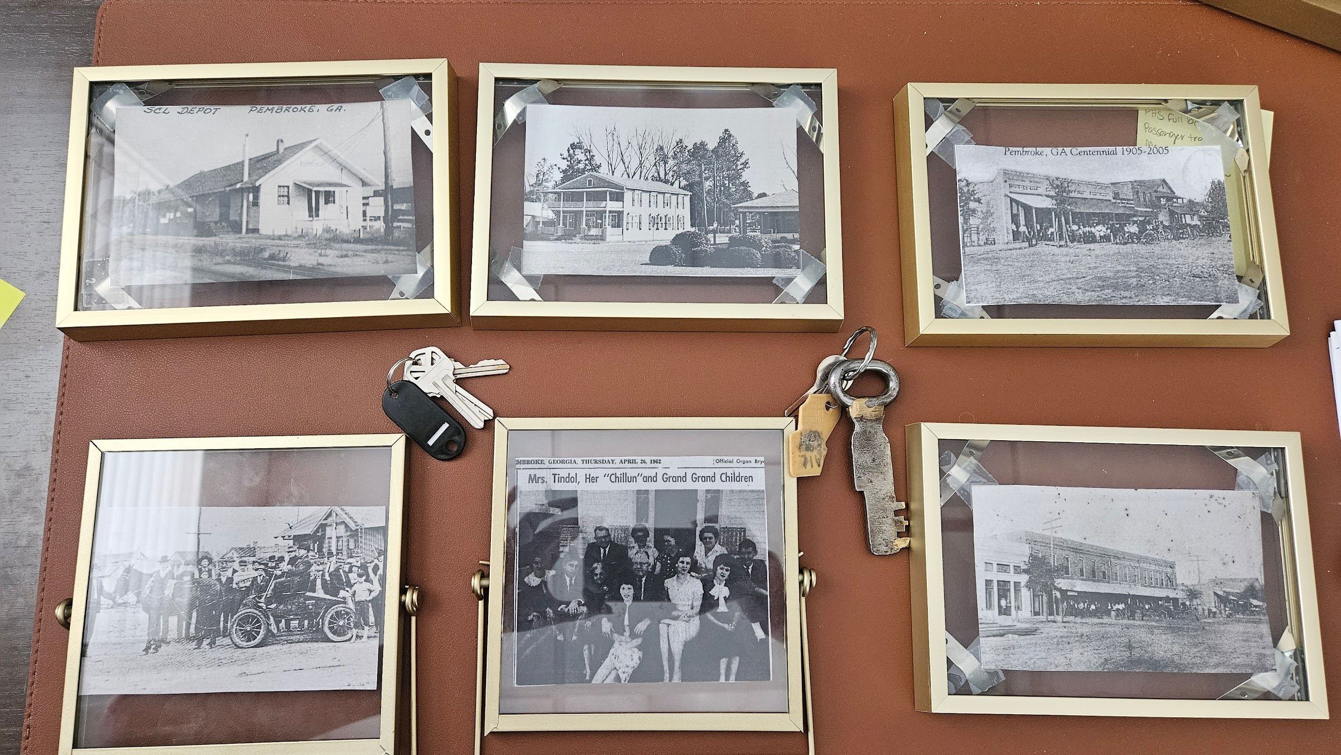
What could be next for you?
How are you already doing some of this?
How could you incorporate some of these ideas into your existing schedule?
How can this shape future programs/events?

Slide 24
Thank You
Any Questions?
fhauser@pembrokega.net

